Slide 1

Homophily and degree correlations
Introduction to Network Science
Carlos Castillo
Topic 06

Slide 2
Sources
Albert László Barabási: Network Science. Cambridge University Press, 2016. Ch 07
Networks, Crowds, and Markets Ch 03 and 04
Nicola Barbieri’s tutorial on homophily and influence in social networks, 2016

Slide 3
Triangle closure
If two nodes in a network …
  are not connected,
  but have connections in common,
… there is a larger probability that they will form a connection in the future

Slide 4
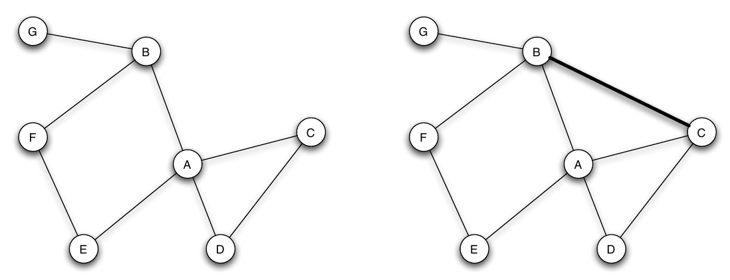
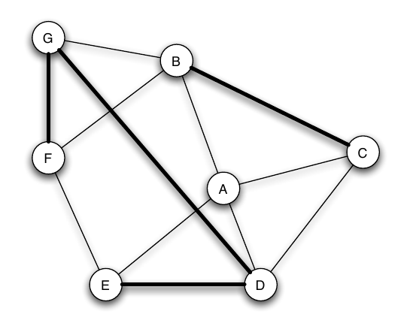
Triadic closure example
Which edges are triadic closures?

Slide 5
Possible mechanisms for triadic closure
Opportunity: A meets B and C often, eventually B and C will meet
Trust: A trusts B, A trusts C, B can trust C
Incentive: if A is friend with B and C, but B and C are not friends, there is tension/stress
  Teenage girls with low clustering coefficient more likely to contemplate suicide
Peter Bearman and James Moody. Suicide and friendships among American adolescents. American Journal of Public Health, 94(1):89–95, 2004.

Slide 6
Strong/Weak Triadic Closure
Triadic closure can be seen in weighted graphs
If A-B and A-C have a strong connection, then strong triadic closure is violated if B-C have a weak connection or no connection at all

Slide 7
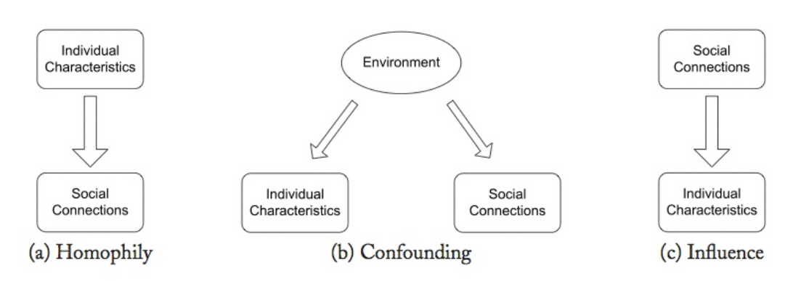
Three models of social correlation

Slide 8
Three models (cont.)
Homophily: tendency of agents to connect to similar agents
Confounding: correlation between agent actions can be explained by external factors
Influence: agent actions influence the actions of their connections

Slide 9
Homophily
Your friends are not a random sample
  Similar age, affluence, interests, beliefs, … to you
  (most of them)
Long-standing observation
  Plato (“similarity begets friendship”)
  Aristotle (people “love those who are like themselves”)

Slide 10
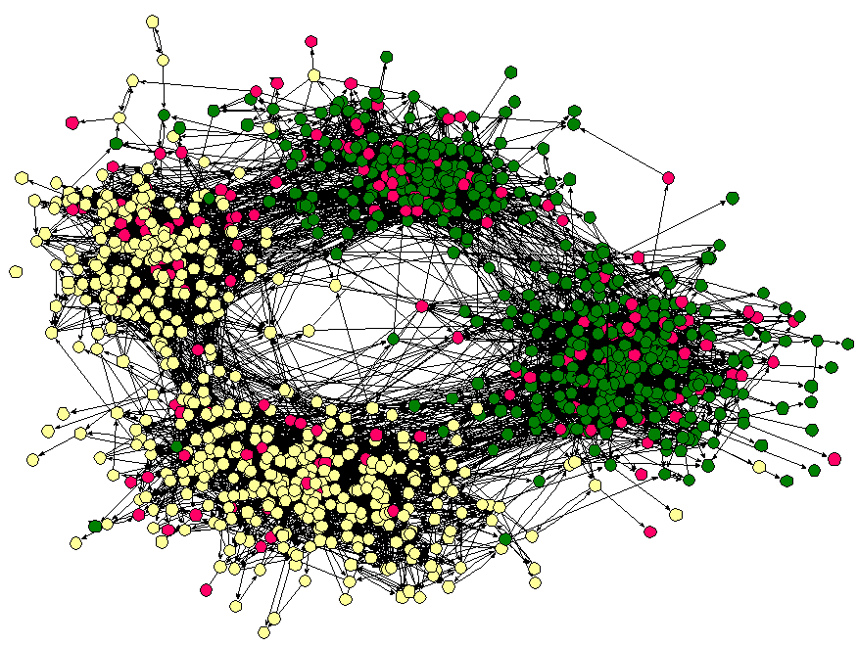
Friendships by race
(Middle school in the US, ca 2001)
Moody, J. (2001). Race, school integration, and friendship segregation in America. American journal of Sociology, 107(3), 679-716.

Slide 12
Two simple variants
No preference
  Nodes receiving inlinks are picked uniformly at random
No growth
  The network starts with N nodes
  No new nodes are created

Slide 13
No preference model
Write the process on paper
Write
Noting that obtain

