Slide 1

Complex Networks
Social Networks Analysis and Graph Algorithms
Prof. Carlos Castillo — https://chato.cl/teach

Slide 2
Sources
A. L. Barabási (2016). Network Science - Chapter 01 and Chapter 02
F. Menczer, S. Fortunato, C. A. Davis (2020). A First Course in Network Science - Chapter 00
URLs cited in the footer of slides

Slide 3
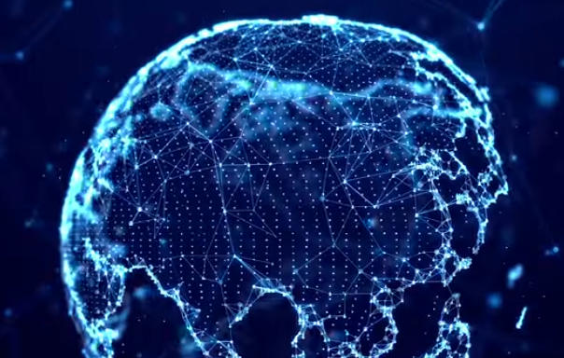

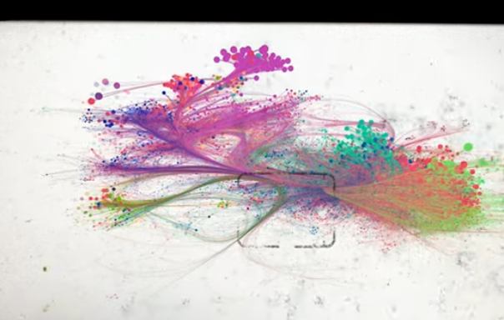
Introductory video (00:00-01:20) by Albert-László Barabási,
https://www.youtube.com/watch?v=RfgjHoVCZwU

Slide 4
What is networks science?
Network science studies complex networks:
  Social networks, telecommunication networks, computer networks, biological networks, cognitive and semantic networks
A network is an interconnected object with:
  elements or actors represented by nodes
  connections between them represented as links

Slide 5
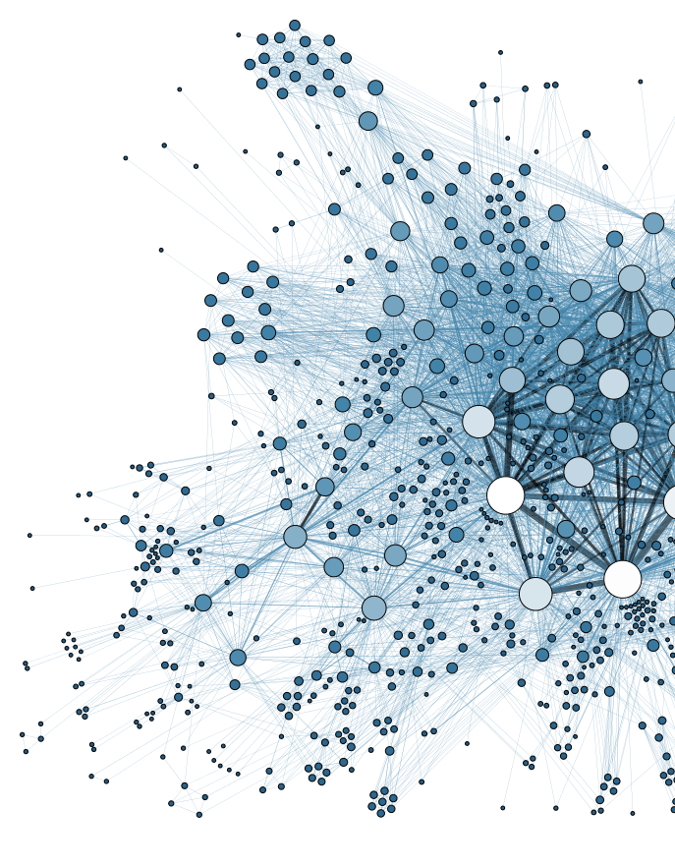
Complex systems
Many interconnected parts
Intrincate arrangement
of connections
Emerging properties

Slide 6
Behind every complex system there is a complex network
Connections between neurons in the brain
Interactions between genes and proteins
Family/friendship links in human and non-human animals
Infrastructure of telecommunications, electricity
Commerce/trade networks

Slide 7
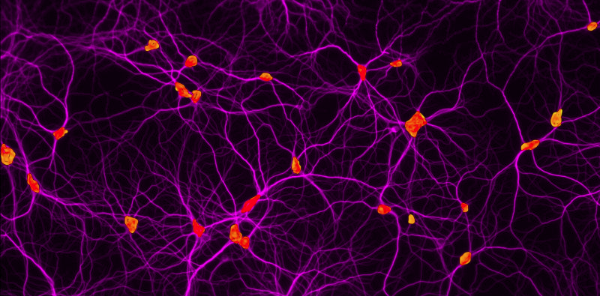
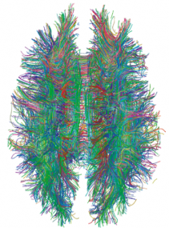
Human brain: |V| ≃ 90 x 10⁹
https://health.uconn.edu/cell-analysis-modeling/microscopy-facility-2/
https://dx.doi.org/10.1371%2Fjournal.pone.0004006

Slide 8
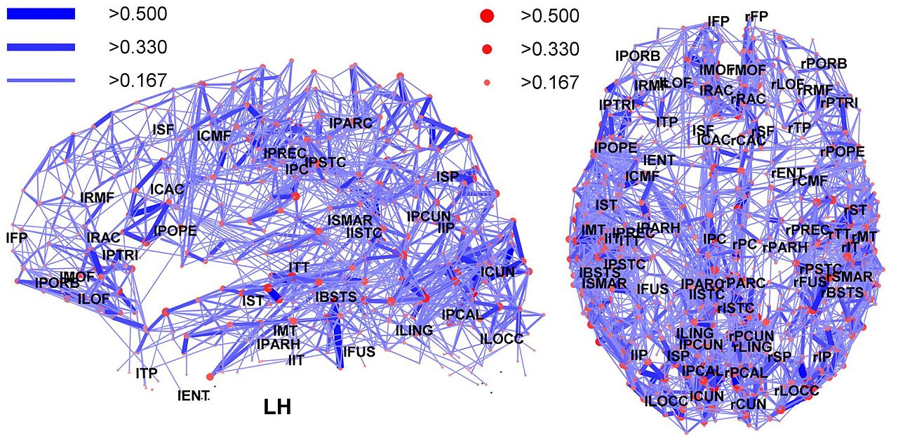
Regions in the human brain
https://en.m.wikipedia.org/wiki/File:Network_representation_of_brain_connectivity.JPG

Slide 9
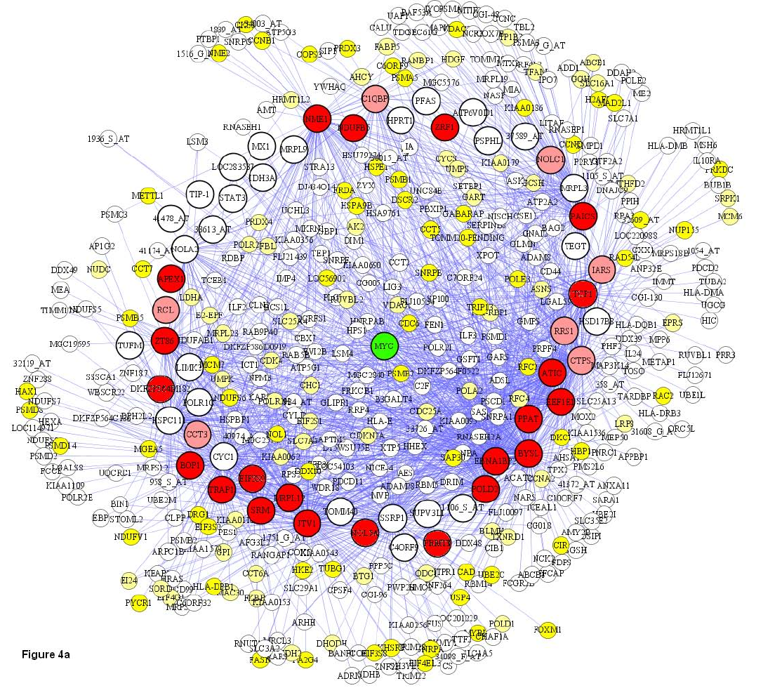
Genes
|V|=500 in this plot
Basso, K., Margolin, A. A., Stolovitzky, G., Klein, U., Dalla-Favera, R., & Califano, A. (2005). Reverse engineering of regulatory networks in human B cells. Nature genetics, 37(4), 382.

Slide 10
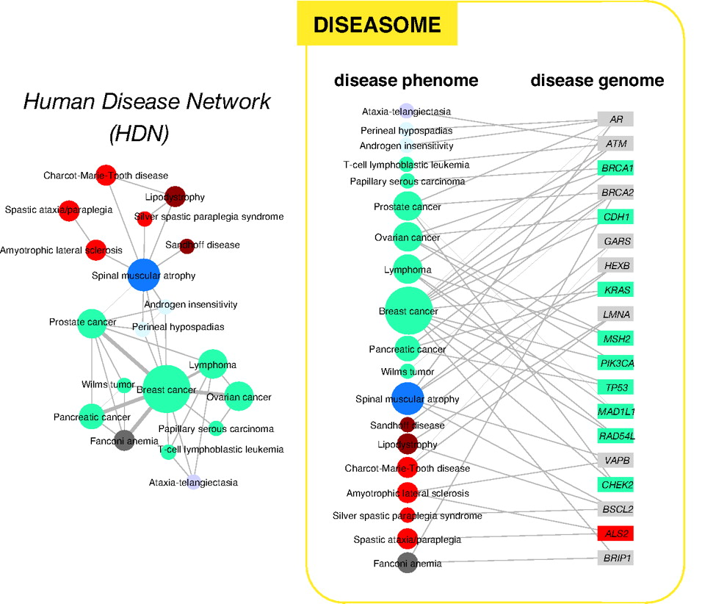
Human disease network
http://www.pnas.org/content/104/21/8685

Slide 11
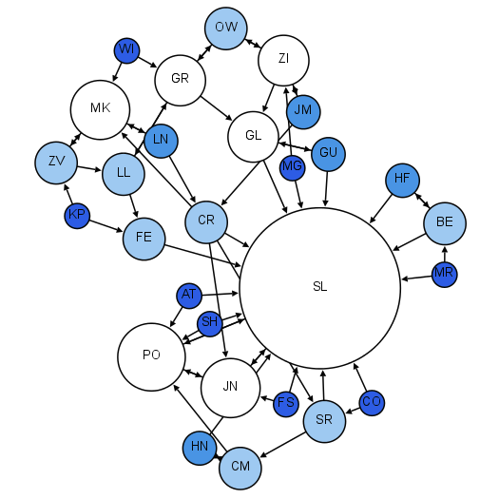
Moreno’s sociograms
Colors and sizes:
indegree
Early 1930s
Children in 2nd grade
Who would you like to sit with?
http://www.martingrandjean.ch/social-network-analysis-visualization-morenos-sociograms-revisited/

Slide 12
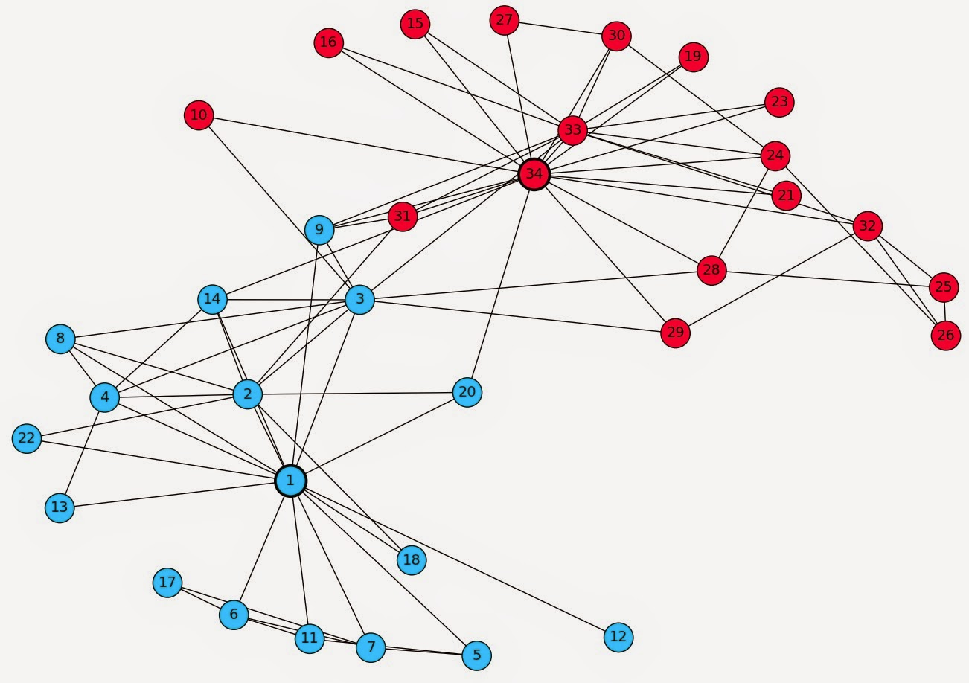
Zachary’s Karate Club
Karate club that split into two clubs
(led by 1 and 34)

Slide 13
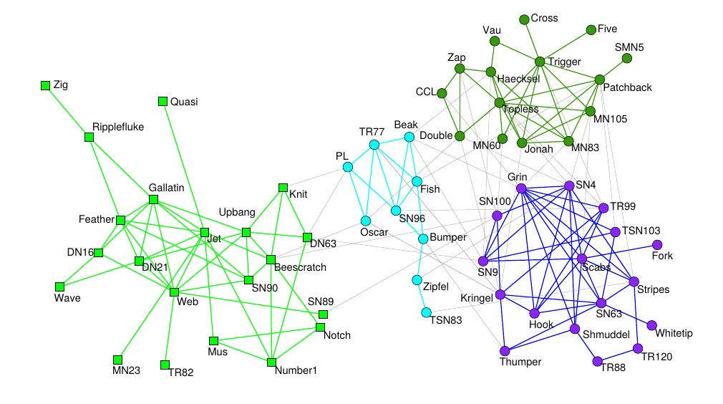

Dolphins in a fjord in New Zealand
Research following a school of dolphins in the wild (2003)
Look for dolphins swimming together
Found long-lasting associations; research has been repeated with other non-human animals (e.g., sheep)
https://doi.org/10.1007/s00265-003-0651-y
I really like dolphins

Slide 14
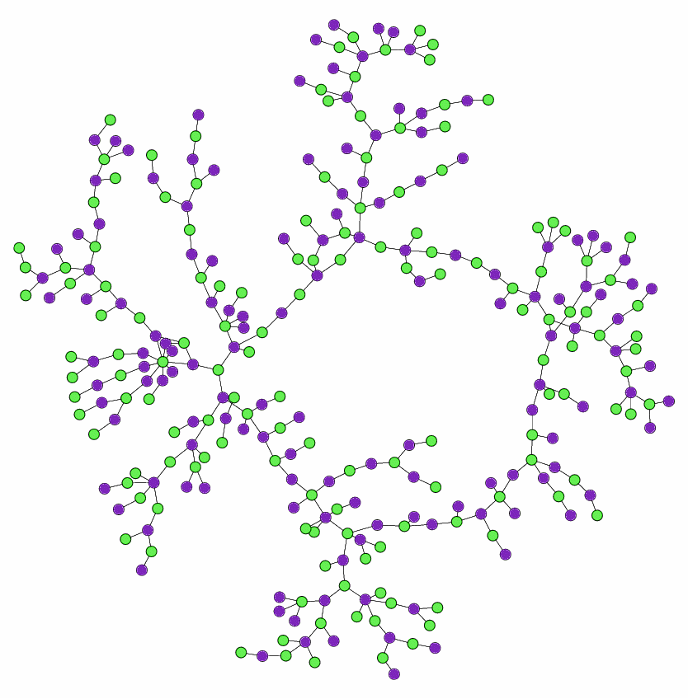
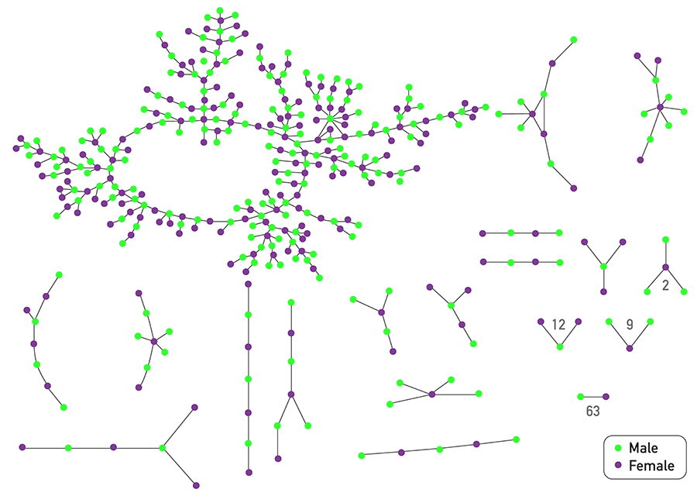
Chains of affection
Early 2000s
Adolescents in high school
A “special romantic relationship” or a “nonromantic sexual relationship” in the past 18 months
Bearman, P. S., Moody, J., & Stovel, K. (2004). Chains of affection: The structure of adolescent romantic and sexual networks. American journal of sociology, 110(1), 44-91.

Slide 16
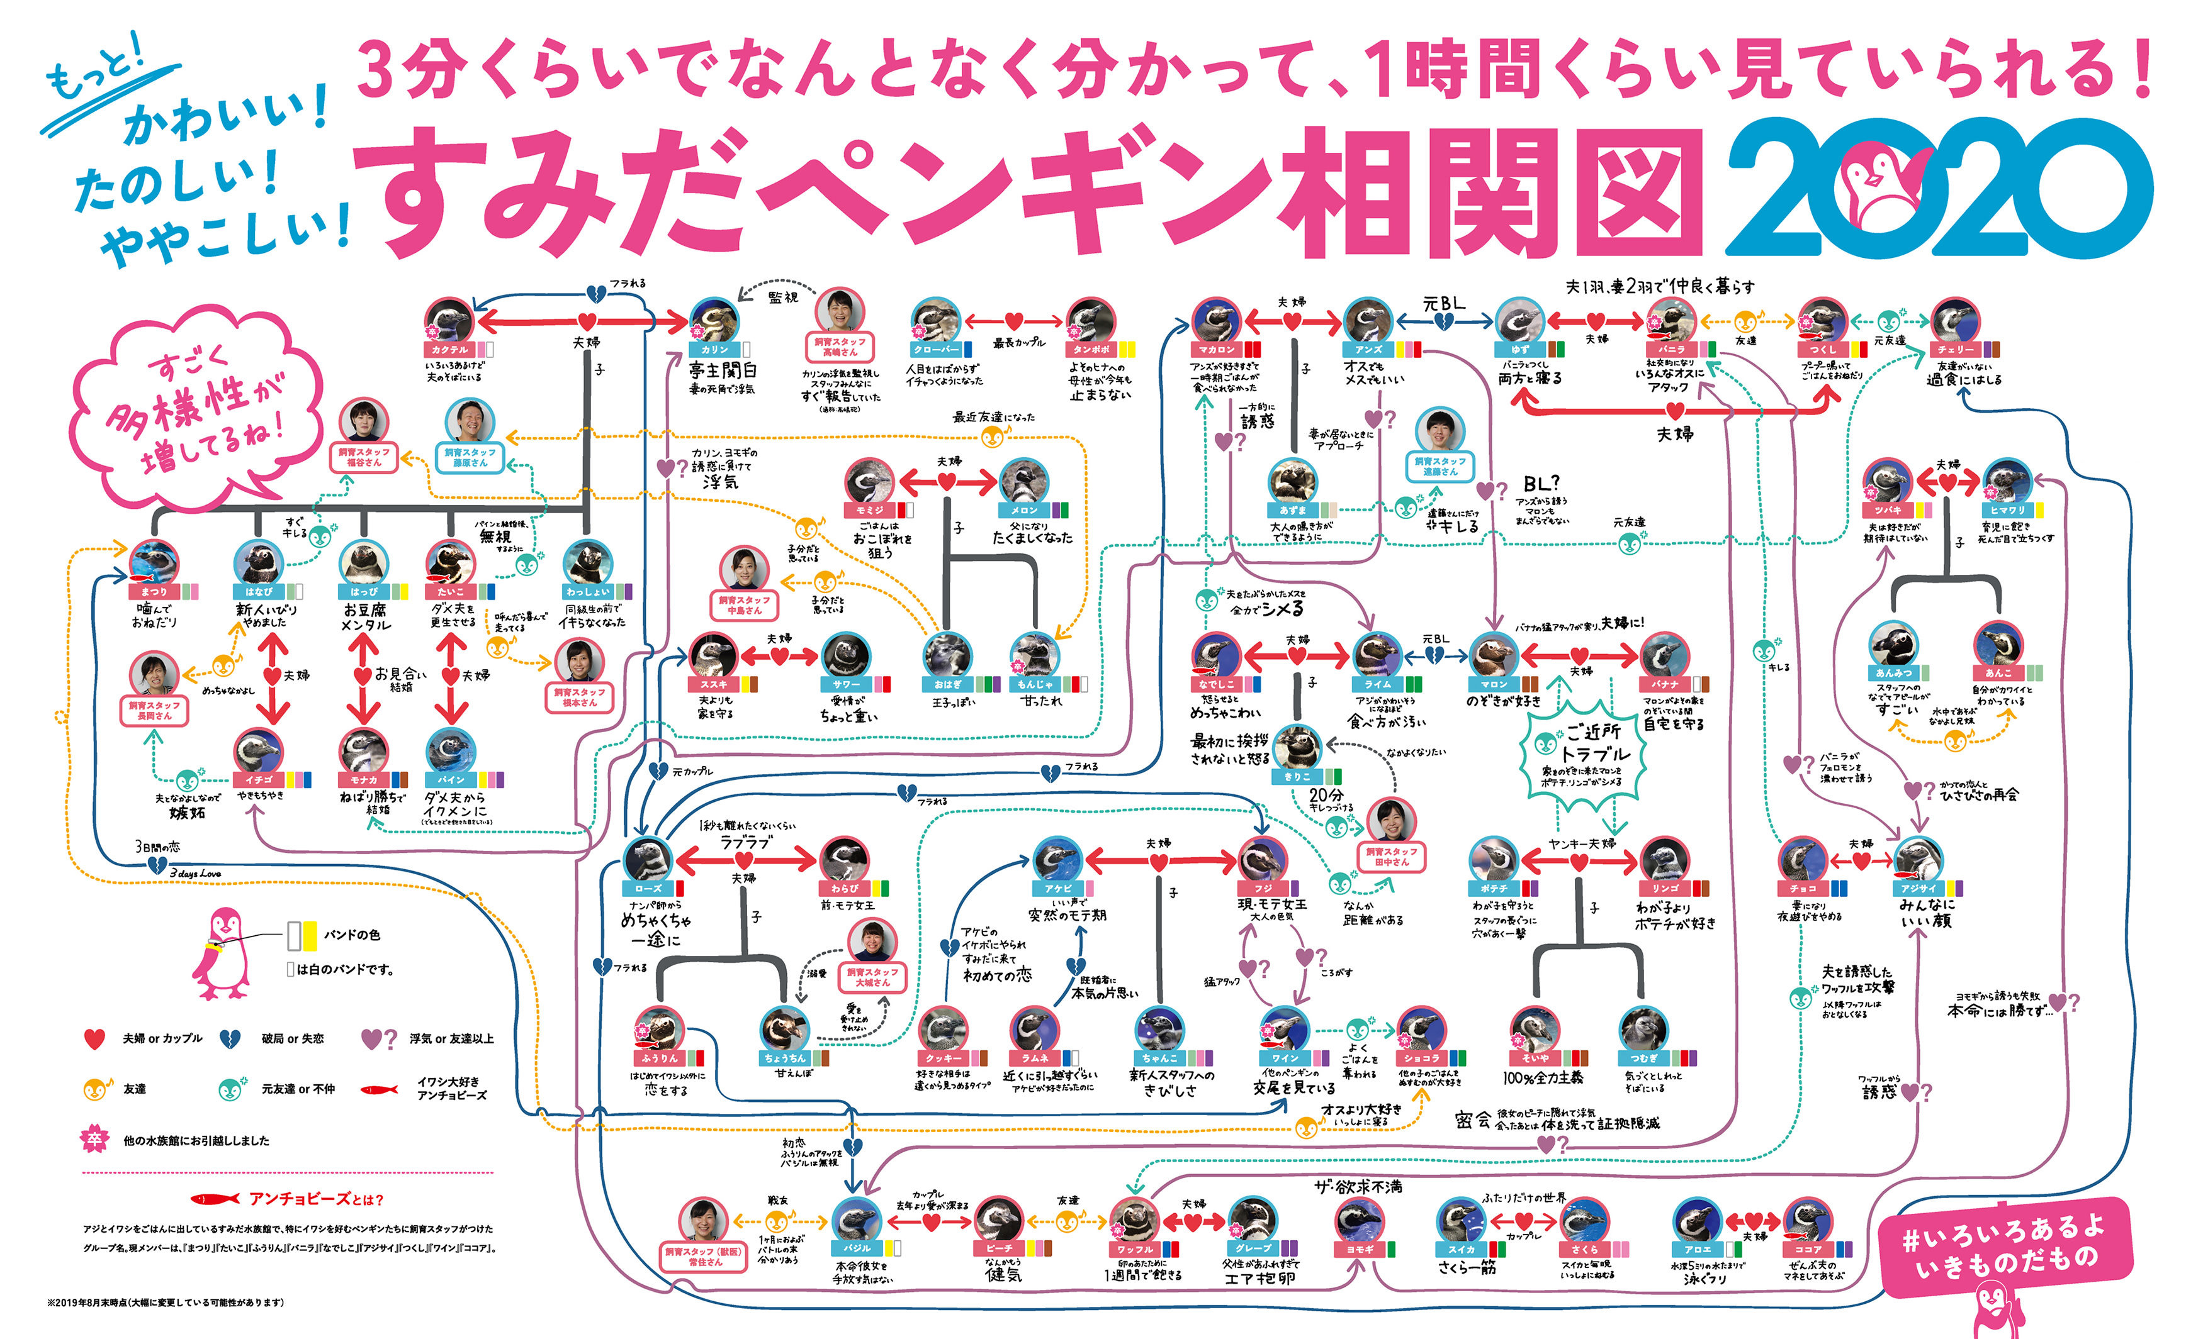
Complex relationships between penguins
Image: https://www.sumida-aquarium.com/

Slide 17
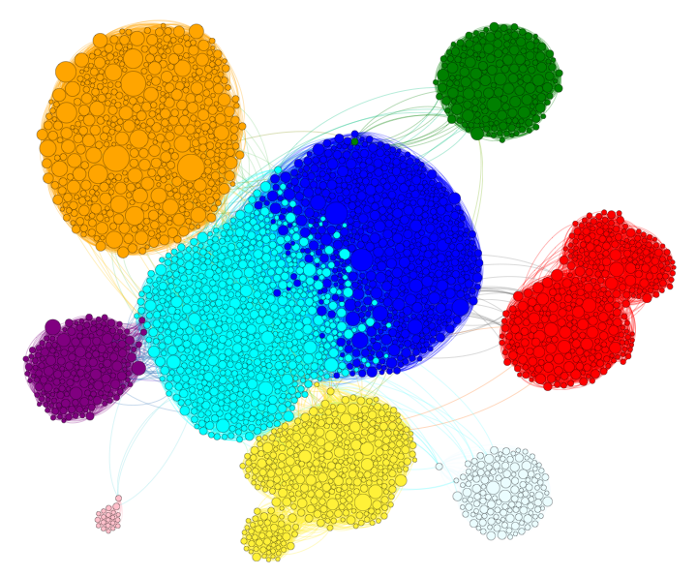
Movie stars in international cinema
East. Europe
Filipino
Hollywood
Indian
Western
Mexican
Chinese
Node = actor/actress
Link = appear in the same movie
🌽
Greek
Source: Menczer, Fortunato, Davis: A First Course on Networks Science. Cambridge, 2020.

Slide 18

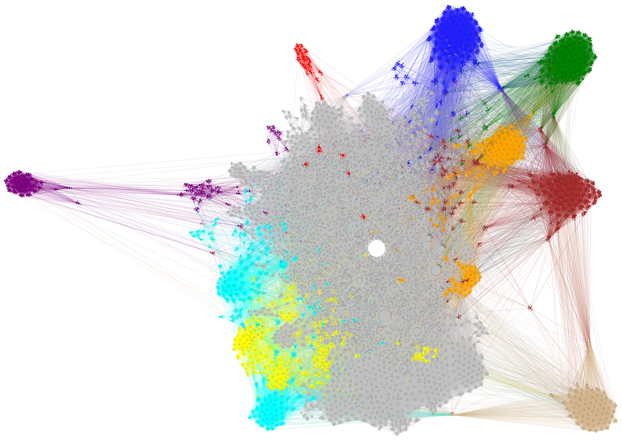
Articles about mathematics
Greek
Arab
Teaching math
Math
& Art
Math software
Indian
Statistics
Game theory
Node = article
Link = link
Contemp.
Indian
Source: Menczer, Fortunato, Davis: A First Course on Networks Science. Cambridge, 2020.

Slide 19
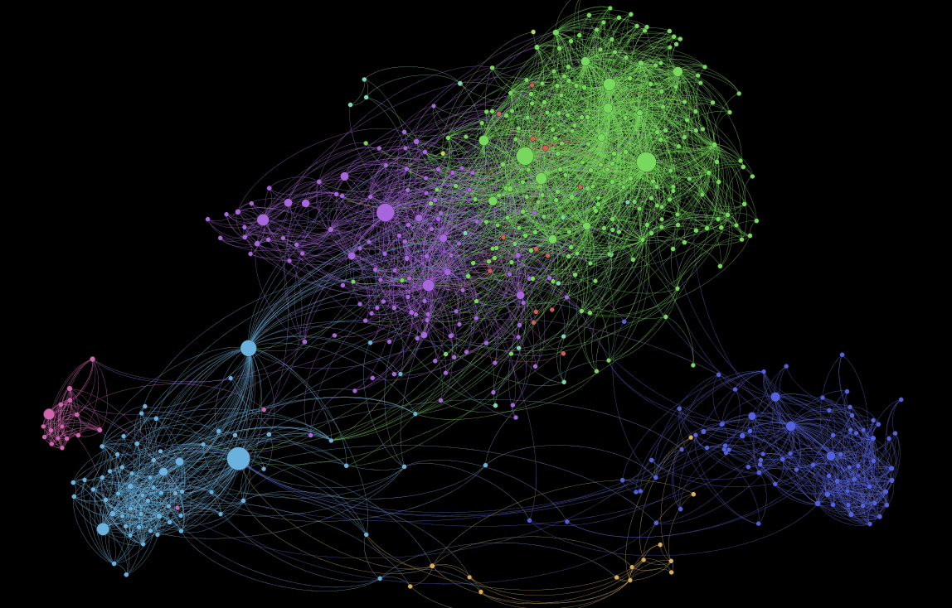
1,000 Somali Users of Facebook
https://kimoquaintance.com/2011/08/22/what-can-we-learn-about-somalis-from-their-facebook-networks/

Slide 20
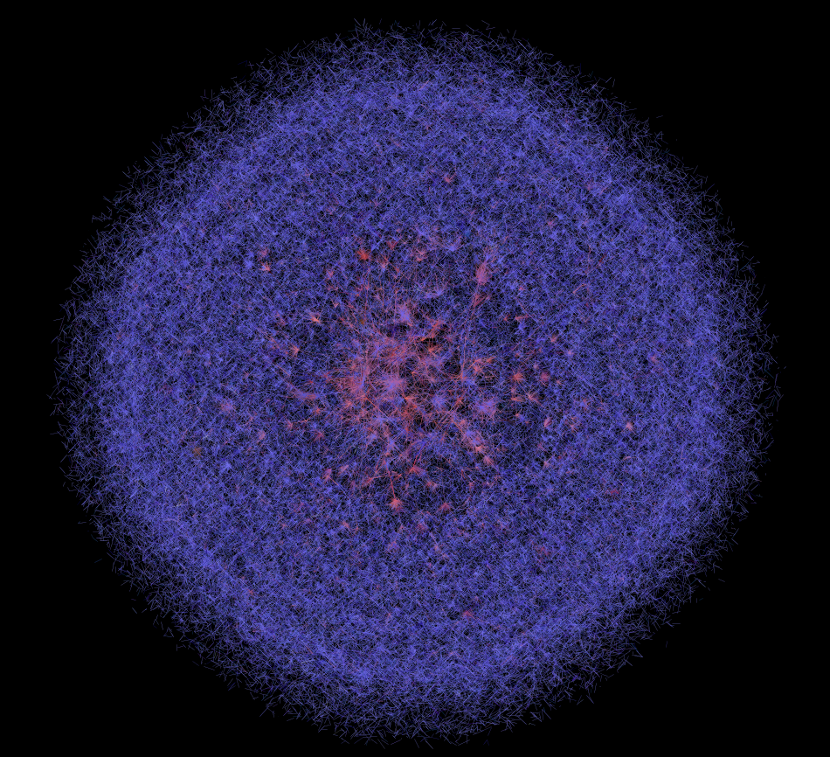
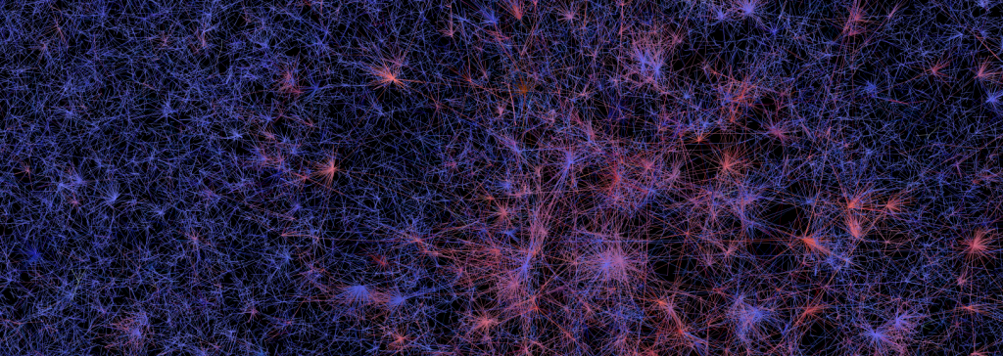
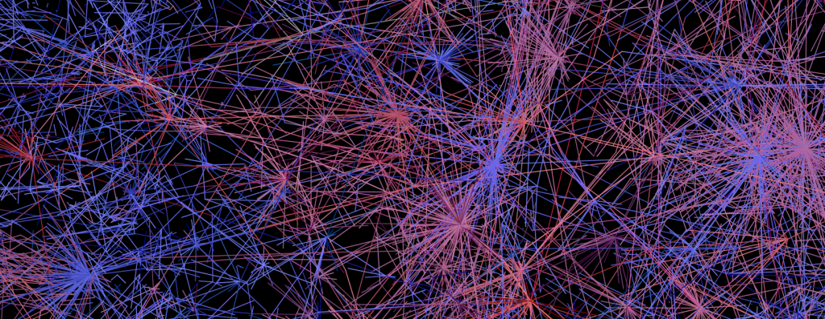
400,000 Twitter Users
https://dhs.stanford.edu/gephi-workshop/twitter-network-gallery/

Slide 21
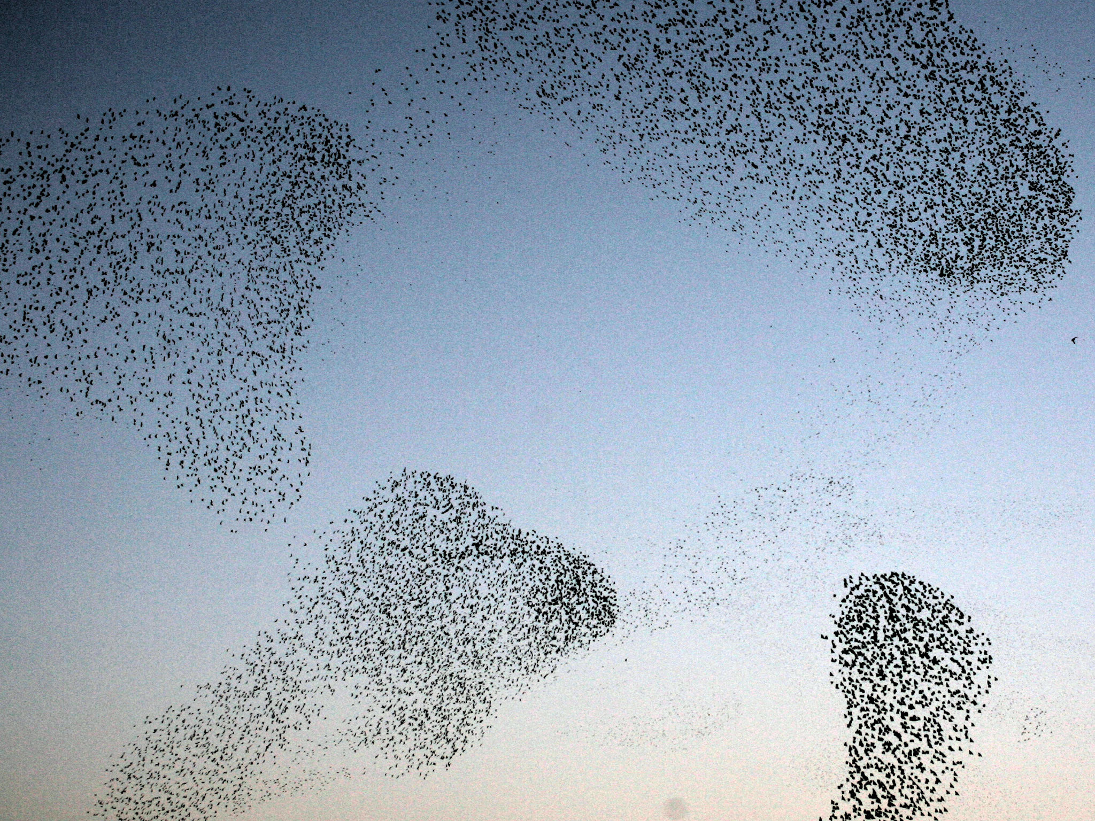
Emergent characteristics
Birds → Flocks
Ants → Colonies
People → Cities
Neurons → Consciousness
https://www.science.org/content/article/how-bird-flocks-are-liquid-helium

Slide 22
What could complex networks have in common? Why those regularities could be relevant? How would you find out what they are?

Slide 23
Universality of complex networks
“A key discovery of network science is that the architectures of networks emerging in various domains of science, nature and technology are similar to each other, a consequence of being governed by the same organizing principles.” (Barabási 2016)

Slide 24

Exercise
Find examples of networks
Find examples of networks, just indicating:
  Name
  Number of nodes (approximately)
  Number of edges (approximately)
Pin board: https://upfbarcelona.padlet.org/chato/xr8sktik56mnftuj

Slide 25
Things to remember
Definitions
  complex system, complex network, emergent property
Examples of complex networks

