Slide 1

Spreading Phenomena
Social Networks Analysis and Graph Algorithms
Prof. Carlos Castillo — https://chato.cl/teach

Slide 2
Sources
D. Easley and J. Kleinberg (2010). Networks, Crowds, and Markets — Chapter 19
C. Castillo, W. Chen, L. V. S. Lakshmanan (2012). Information and Influence Spread in Social Networks, KDD Tutorial.
F.Menczer, S. Fortunato, and C. A. Davis. A First Course in Network Science. Cambridge University Press, 2020 — Chapter 7.
URLs cited in the footer of slides

Slide 3
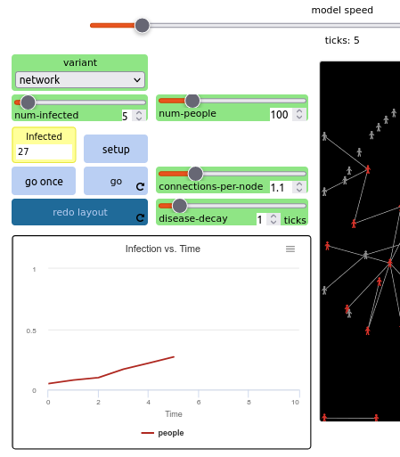
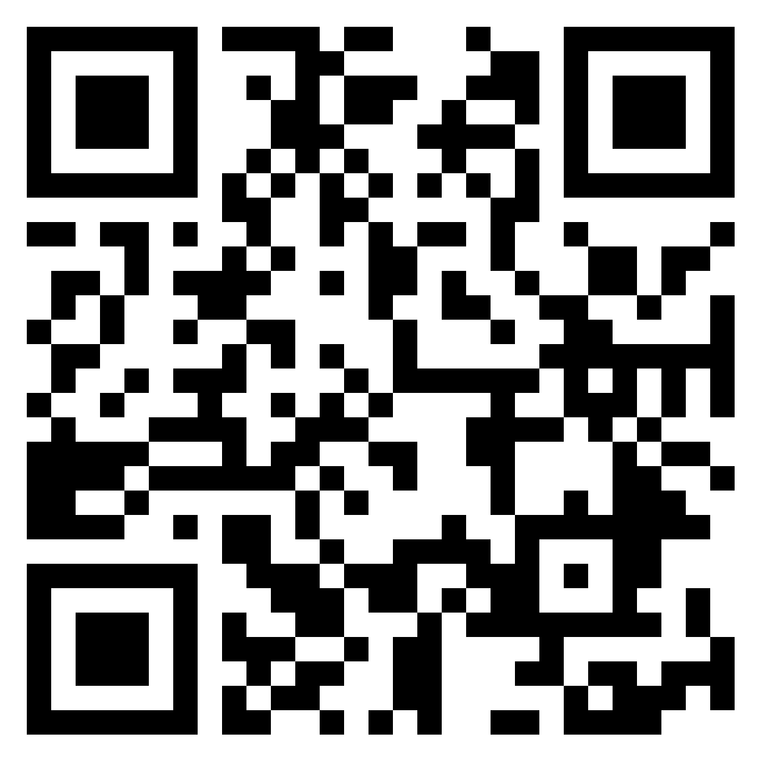
Exercise
Spread of Disease
Go to netlogoweb.org/launch and select:
“IABM Textbook / chapter 6 / Spread of Disease”
Execute the “Spread of Disease” program in Netlogo Web
  Slow down model speed
  Choose one variant
  Select num-people 100
  Click “set-up”
  Click “go”
  Play with “connections-per-node” in the “network” variant
  Note that “disease-decay” only affects the “environmental” variant
Indicate what the three variants do (network, mobile, environmental)
Pin board: https://upfbarcelona.padlet.org/chato/k5zn9l4itg3axw3s

Slide 4
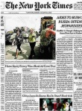


Social influence on a network
nice read
indeed!
09:00
09:30
People are connected and perform actions
friends, fans,
followers, ...
comment, link, like, share, stitch, duet, ...
People are connected and perform actions
People are connected and perform actions

Slide 5
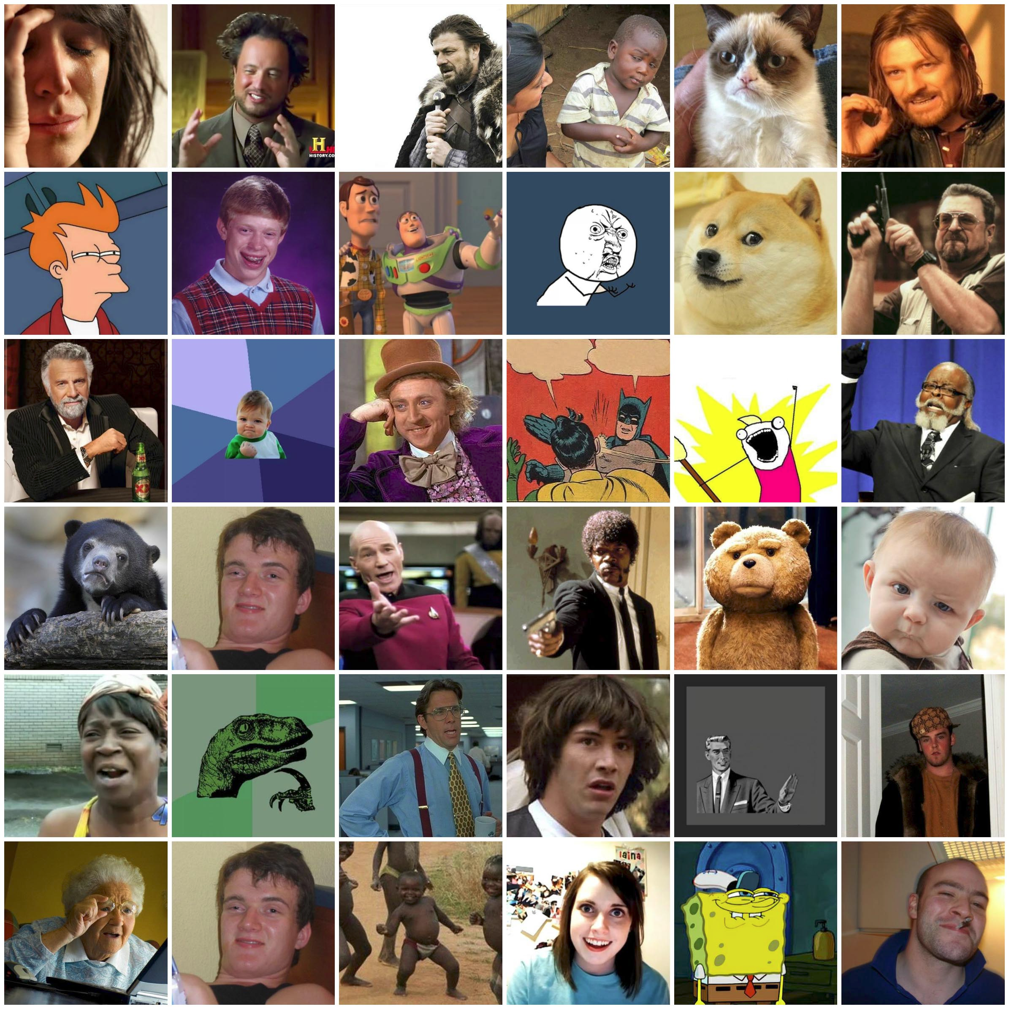
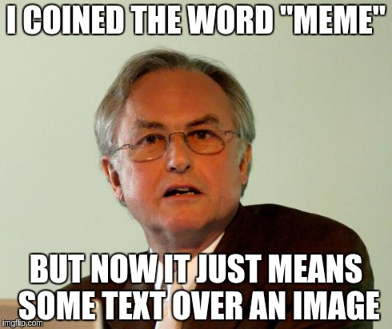
“The Selfish Gene” by Richard Dawkins (1976)
Chapter 11: “Memes: the new replicators”

Slide 6
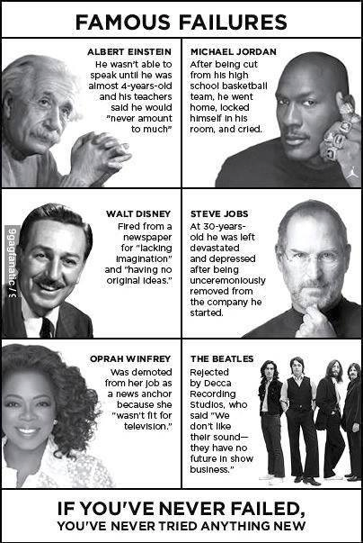
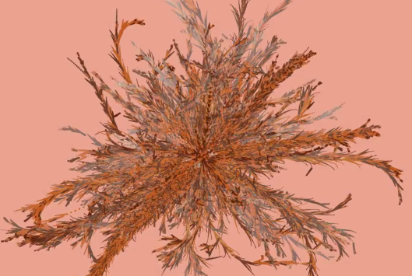
Spread of a Meme
(“Famous Failures”)
https://vimeo.com/50730795

Slide 7
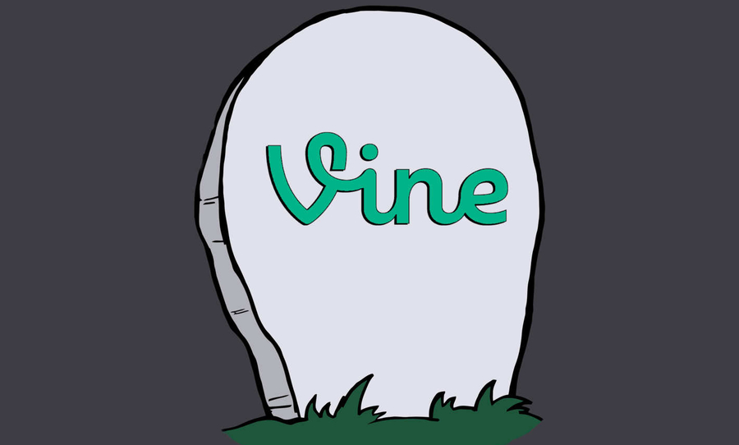


Slide 8

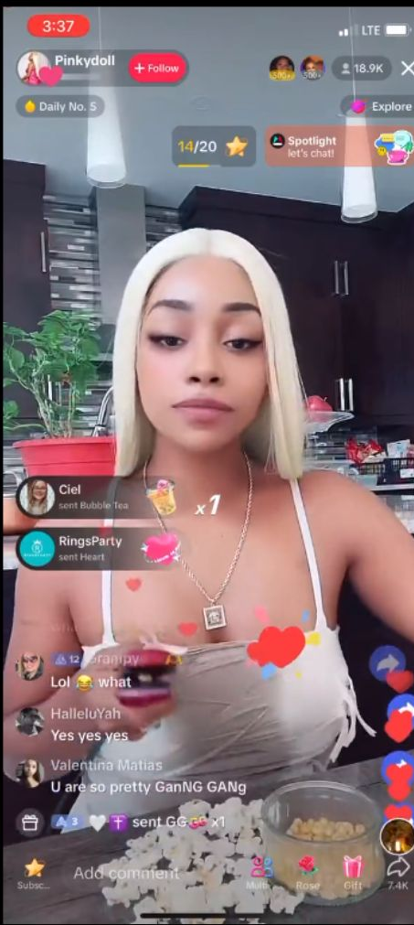
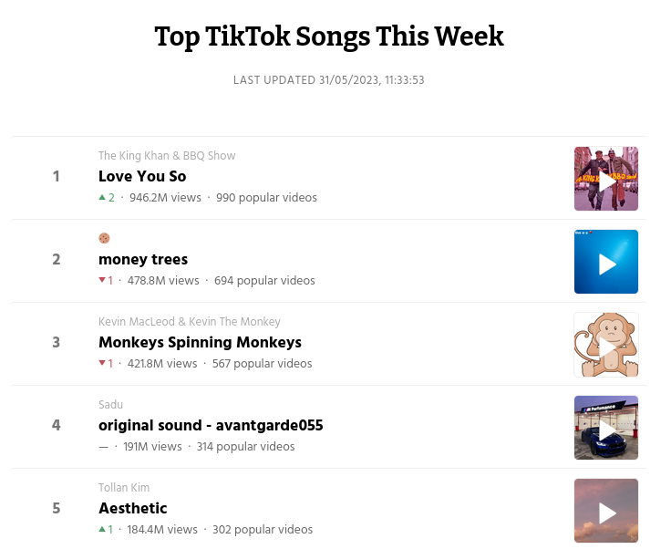
Various forms of “trend”: music/audio that is re-used, stitches, side-by-side “duets”, actions/challenges, etc.
https://tokboard.com/

Slide 9
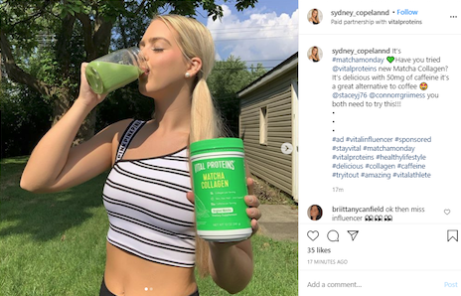
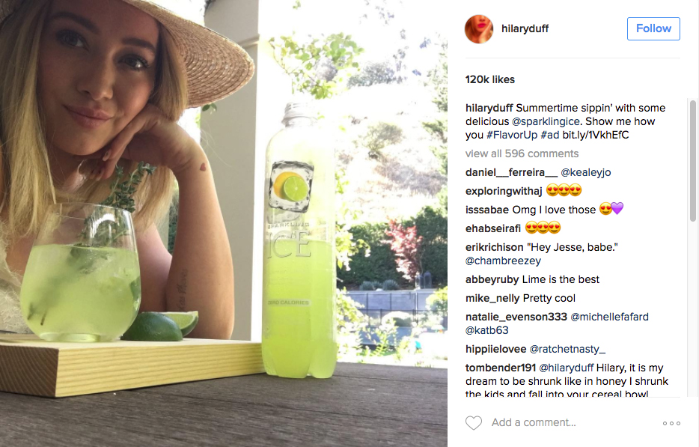
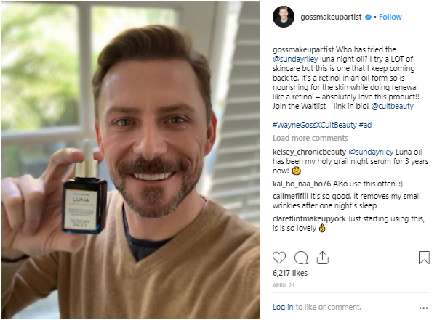
“Influencers” and their sponsored posts

Slide 10
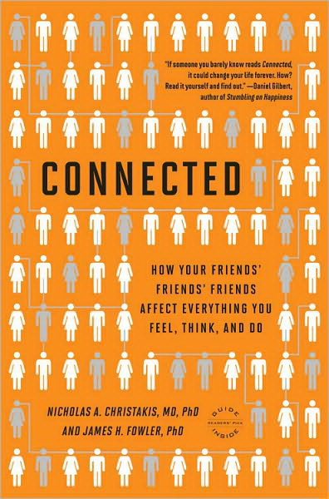
Non-trivial examples
Back pain: spread from West to East in Germany after fall of Berlin Wall
Suicide: well known to spread throughout communities on occasion
Sexual “scripts”: expected sequences of behaviors during intimate situations
Politics: the denser your connections, the more intense your convictions

Slide 11
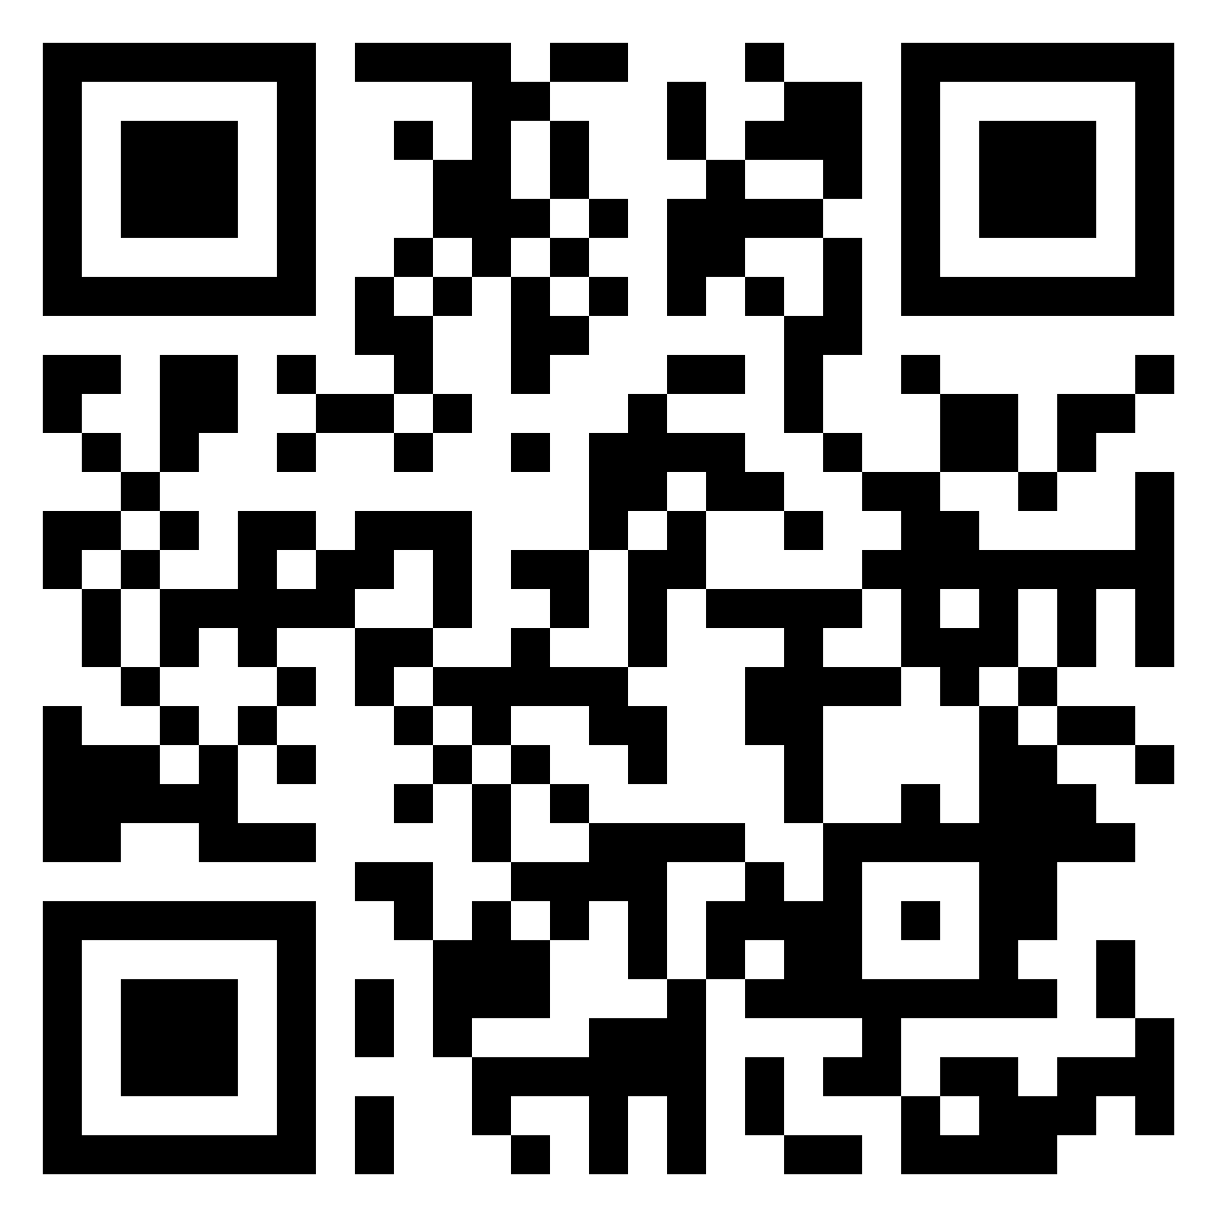
Exercise
Find examples of spreading phenomena
What else propagates in a contagion-like manner?
Pin board: https://upfbarcelona.padlet.org/chato/a0xnaoohsfc117nl

Slide 12
News, misinformation, and collective action

Slide 13
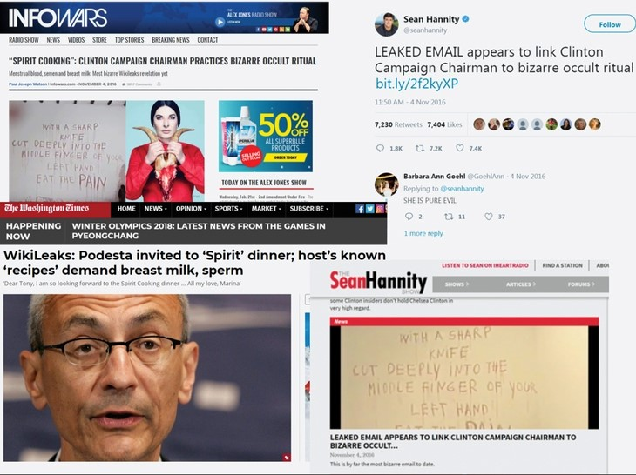
Fake news
Fake news about an occult ritual to which the campaign chairman of US presidential candidate Hillary Clinton was invited.
This was posted four days before the 2016 election, which was won by her opponent, Donald Trump.
Chapter 7, The Propaganda Pipeline: Hacking the Core from the Periphery in Network Propaganda: Manipulation, Disinformation, and Radicalization in American Politics (2018), https://doi.org/10.1093/oso/9780190923624.003.0007

Slide 14
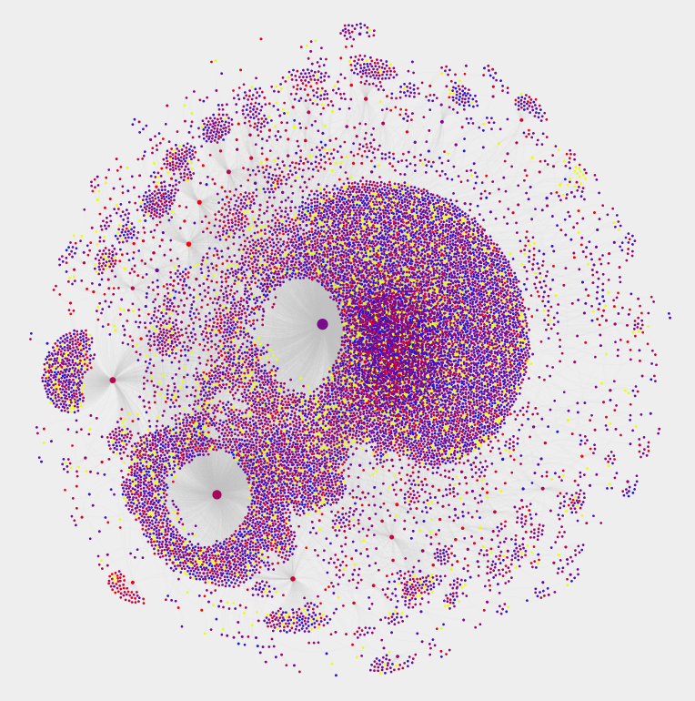
Fake news spread
A combination of authentic (blue) and inauthentic (red) accounts, also known as bots. Yellow nodes were removed by Twitter and are probably also bots.
Interactive version:
https://iunetsci.github.io/HoaxyBots/

Slide 15
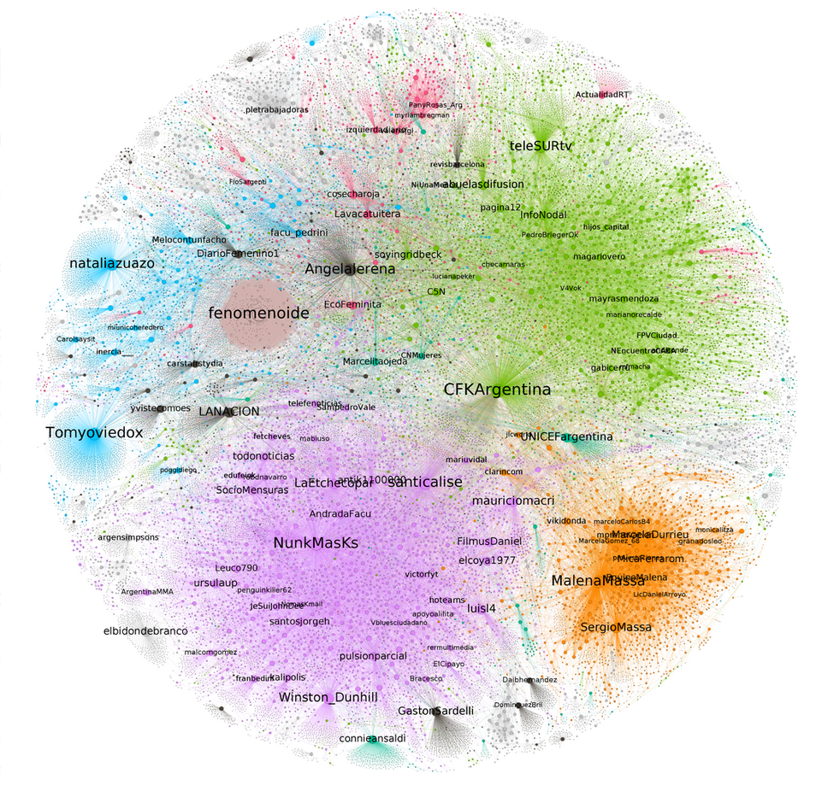


Collective action
Spread of the #NiUnaMenos hashtag: a movement against gender-based violence and femicide started in Argentina in 2015
Colors based on communities detected through modularization optimization
https://medium.com/@rusosnith/analizando-el-niunamenos-en-las-redes-1c49bd9c5781

Slide 16
Summary

Slide 17
Things to remember
Direct social influence is observed online when connected people perform an action in sequence
A wide array of phenomena spread through networks, not only viruses and information

Slide 18

Additional contents

Slide 19
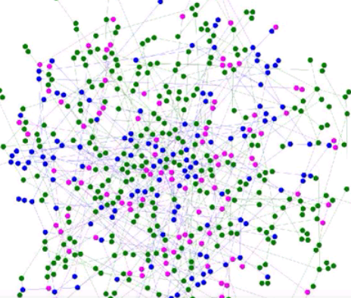
Simulated contagion in graph
https://www.youtube.com/watch?v=WWTmRlDsydA

