Slide 1

Epidemics
Social Networks Analysis and Graph Algorithms
Prof. Carlos Castillo — https://chato.cl/teach

Slide 2
Sources
A. L. Barabási (2016). Network Science – Chapter 10
D. Easley and J. Kleinberg (2010). Networks, Crowds, and Markets — Chapter 21
URLs cited in the footer of slides

Slide 3
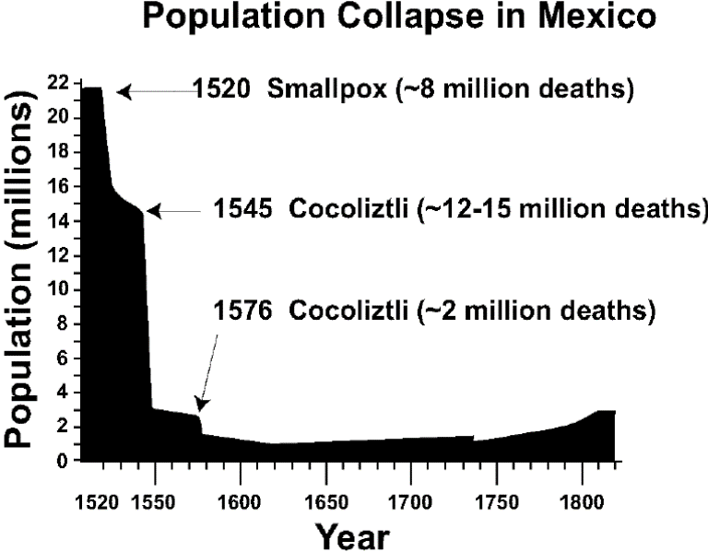
Examples: human epidemics
Influenza, measles, STIs, ...
Smallpox and other diseases brought by Europeans to America since early 1500s
The “Black Death” (next slide)
https://en.wikipedia.org/wiki/Cocoliztli_Epidemic_of_1545-1548

Slide 4
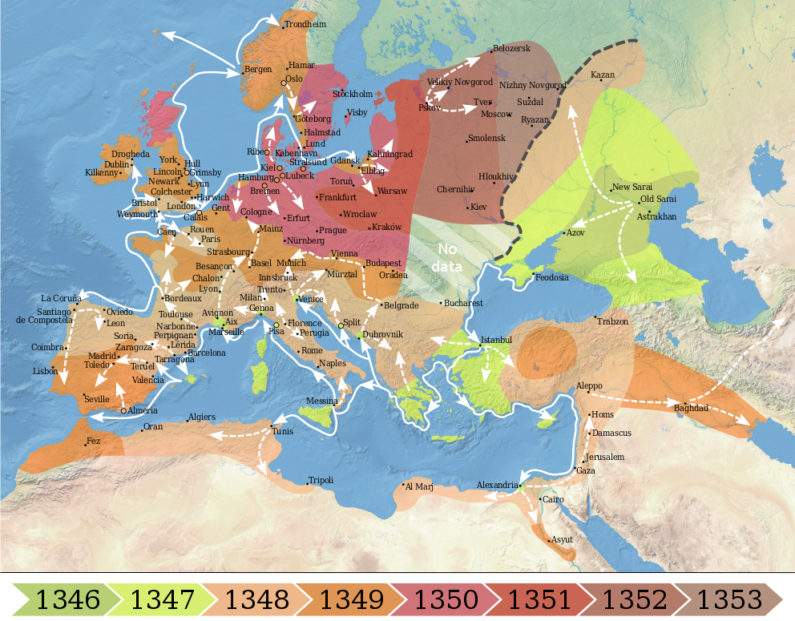
The “Black Death” (Bubonic plague)
1300s
Killed 30%-60% of the total population of Europe
https://commons.wikimedia.org/wiki/File:1346-1353_spread_of_the_Black_Death_in_Europe_map.svg

Slide 5
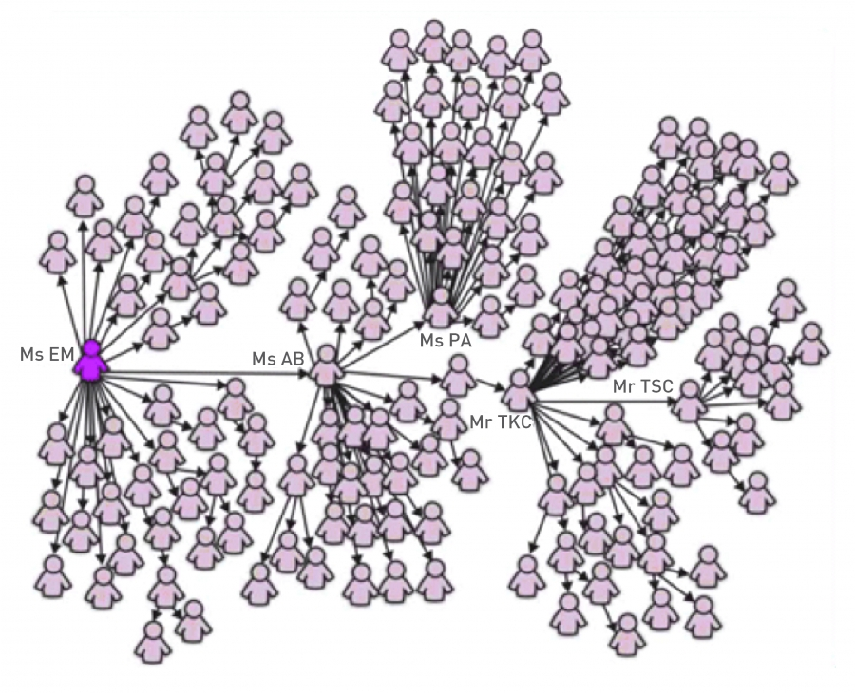
SARS Outbreak (2003)
February 21st: Chinese doctor who have been several treating “atypical pneumonia” cases check-ins into hotel in Hong Kong
  Hospitalized on Feb 22nd
  Died on March 4th
March 1st: “Ms. E. M.” returns to Singapore after visiting Hong Kong
  Graph depicts 144 out of the first 206 SARS patients in Singapore
  Ms. E. M. lived, various of her family members died
https://en.wikipedia.org/wiki/Timeline_of_the_SARS_outbreak

Slide 6
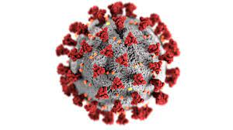
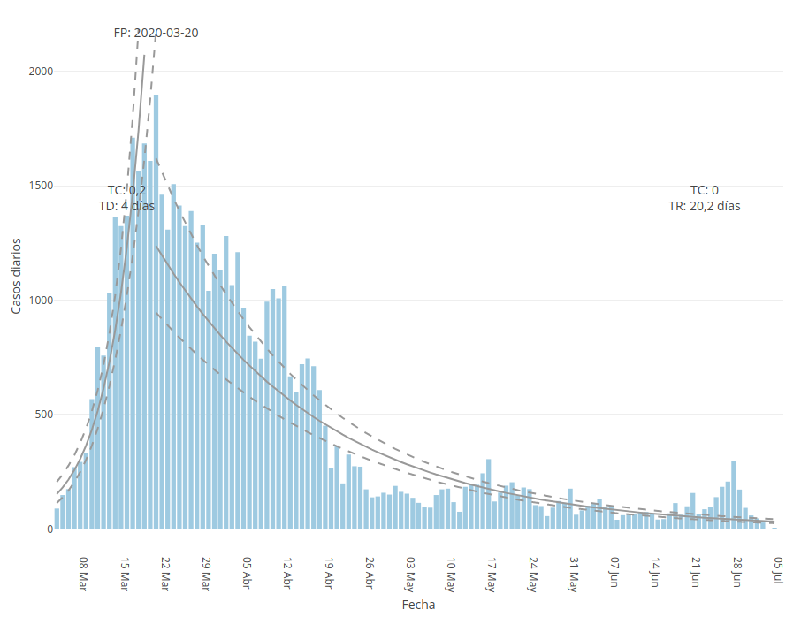
COVID-19
Why this curve?
How can one make this kind of forecast?
COVID-19 cases in Catalonia as of July 2020 - https://cnecovid.isciii.es/covid19/#ccaa

Slide 7
Diffusion of ideas vs diseases
Adopting a new idea, behavior, fashion, product, taste, may also spread from person to person: “social contagion”
There is a certain agency of the receiver
In diffusion of diseases, we assume there is no agency: each contagion is random

Slide 8
Simple model: branching process

Slide 9
Modeling epidemics
There are many factors:
  Contagiousness
  Length of infectious period,
  Severity
  ...
Structure of contacts in a population

Slide 10
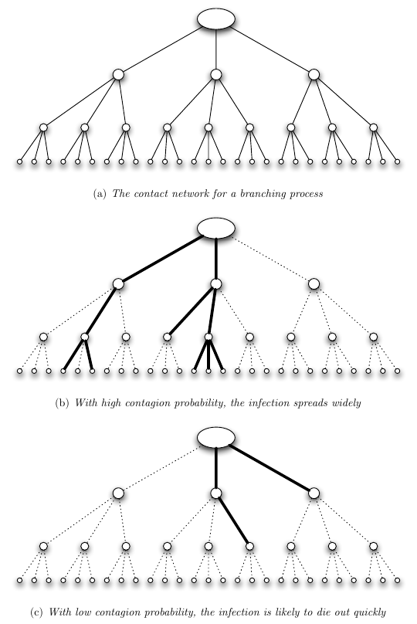
Simple model: branching process
Each person interacts with other k people
Each interaction ends in infection with probability β
Example: k=3

Slide 11
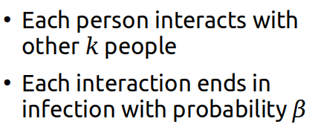
Transmission rate or “Basic reproductive number” R₀
What is the expected number of cases caused by a single individual, R₀?
What do you think happens if R₀ < 1?
What do you think happens if R₀ > 1?

Slide 12
Answers
What is the expected number of cases caused by a single individual? R₀ = βk
What do you think happens if R₀ < 1?
  The infection dies out
What do you think happens if R₀ > 1?
  The infection persists
Details: sec. 21.8 of EK’16

Slide 13
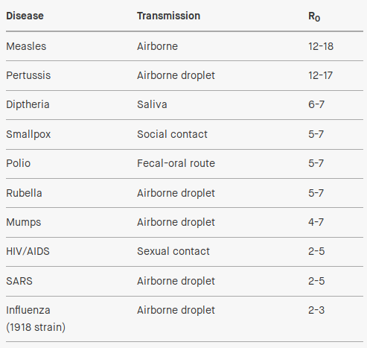
Changing R₀ = βk
Sanitary practices (to reduce what?)
Quarantine
(to reduce what?)

Slide 14
Changing R₀ = βk
Sanitary practices reduce β
Quarantine
reduces k

Slide 15
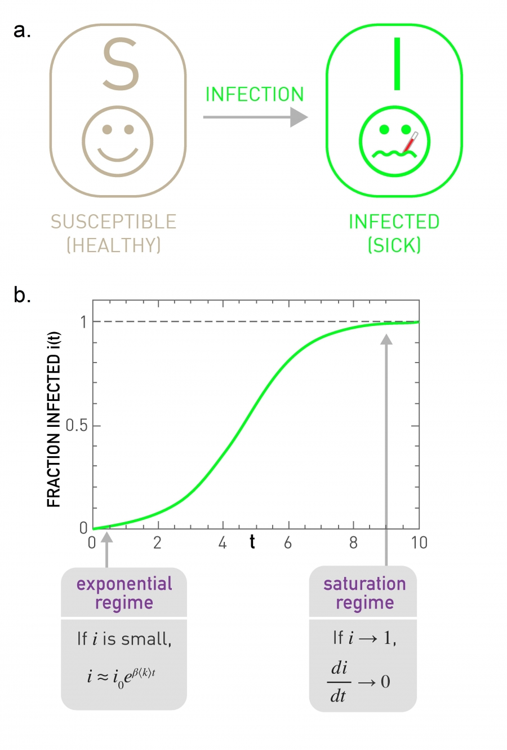
The SI model

Slide 16
The SI model
Susceptible:
  The node can catch the disease
Infected:
  The node has the disease and can spread it
  It will stay sick forever

Slide 17
Notation
Number of susceptible S(t)
  Fraction of susceptible s(t) = S(t) / N
Number of infected I(t)
  Fraction of infected i(t) = I(t) / N
s(t) + i(t) = 1

Slide 18
How many susceptible neighbors a node has?
How many new infections are produced?
(for every infected, iterate through its susceptible neighbors, infect with probability β)
infected
susceptible neighbors
infection probability

Slide 19
Prove that
Begin from:

Slide 20
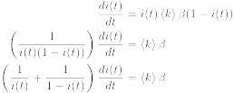
Infected per period of time
Now, integrate on both sides from t=0 to t=t ...

Slide 21
Infected per period of time

Slide 22

Infected per period of time
Now, exponentiate (apply e^{x}) in both sides

Slide 23
Infected per period of time

Slide 24
Behavior in the limit t → ∞
What is the limit of
when t→∞ ?
Hint: similar to

Slide 25
Infected as a function of time (SI)
Characteristic time
(to infect 1/e ≃ 36% of people):

Slide 26
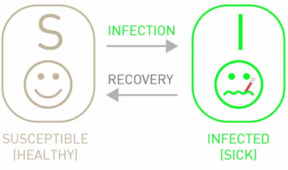
The SIS model

Slide 27
The SIS model
Susceptible:
  The node can catch the disease
Infected:
  The node has the disease and can spread it
  After some time, it recovers … but it becomes susceptible again

Slide 28
Infection dynamics
is the recovery rate, i.e., the probability of becoming susceptible again in an unit of time
C is a constant that depends on i₀

Slide 29
Behavior in the limit t → ∞
What is the limit of
when t→∞ ?
Hint: similar to

Slide 30
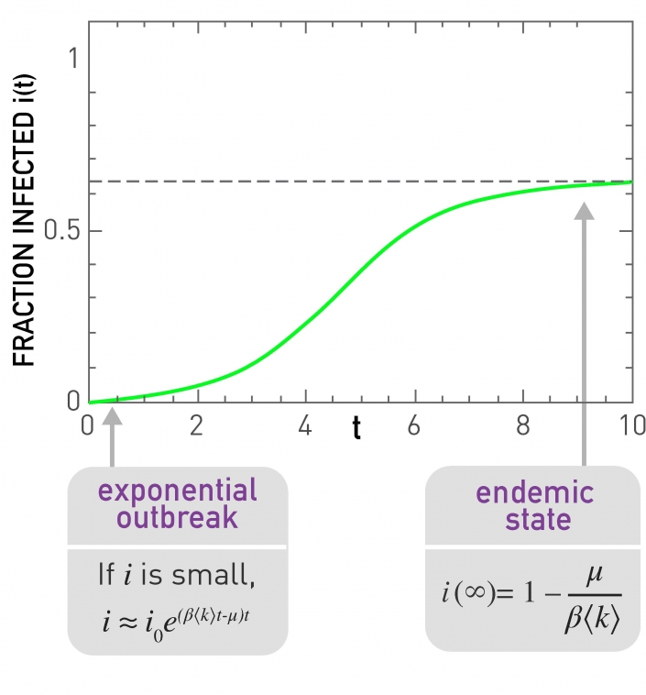
Infected as a function of time
(SIS)
This is in the case

Slide 31
What happens if ?
Remember:

Slide 32
What happens if ?
Remember:
The infection dies out
negative
negative

Slide 33
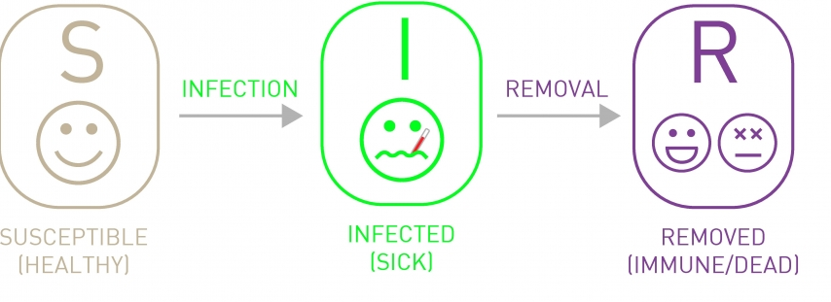
The SIR model

Slide 34
The SIR model
Susceptible:
  The node can catch the disease
Infected:
  The node has the disease and can spread it
Removed:
  The node no longer has the disease, and cannot catch it or propagate it again (permanent immunity -or- death)

Slide 35
Infection dynamics in SIR
No closed form solution

Slide 36
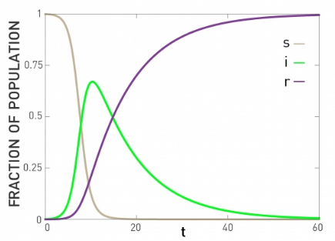
Infection dynamics (SIR)

Slide 37
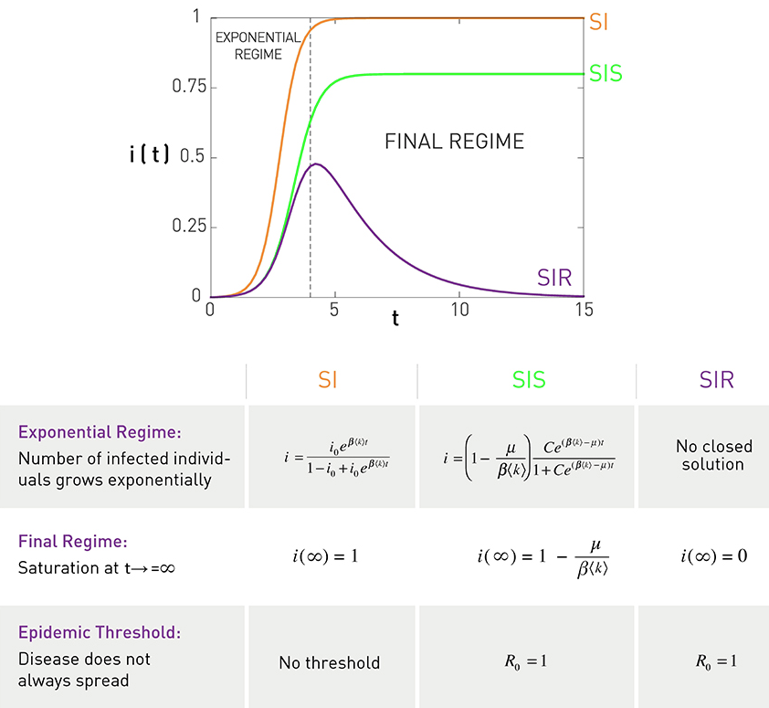
Comparison of i(t)

Slide 38
Things to remember
SI, SIS, SIR models
Which are the states in each process and which are the possible transitions
Equations for number of nodes in each state
Regimes under different parameters
Practice executing by hand and write code if it helps you remember better each process

Slide 39
Practice on your own
Under the SIS model,
When what is the limit of ?
How is this state called?
What happens when ?
What conditions lead to large values of ?

Slide 40
Practice on your own (cont.)
In the SIRS epidemic model, there are three possible states for a node: susceptible, infected, and recovered. Susceptible nodes can become infected, infected nodes can become recovered, and recovered nodes can become susceptible again.
During one unit of time, with probability β an infected node can infect one of its contacts, with probability μ, an infected node can recover, and with probability σ, a recovered node can become susceptible again.
Let s(t) be the fraction of susceptible nodes, i(t) be the fraction of infected nodes, r(t) the fraction of recovered nodes, and <k> the average degree of the graph. Write the equations, simplifying them appropriately, for:
4. Is σ > μ sufficient to say that the recovered will tend to zero in the long run?

