Slide 1

Dense sub-graphs
Introduction to Network Science
Carlos Castillo
Topic 13

Slide 2
Sources
Barabási 2016 Chapter 9
Networks, Crowds, and Markets Ch 3
C. Castillo (2017) Dense Sub-Graphs
Tutorial by A. Beutel, L. Akoglu, C. Faloutsos [Link]
Frieze, Gionis, Tsourakakis: “Algorithmic techniques for modeling and mining large graphs (AMAzING)” [Tutorial]
A survey of algorithms for dense sub-graph discovery [link]

Slide 3
Communities
2 communities [previous topic]
1 community [this topic]
3+ communities [next topic/course]

Slide 4
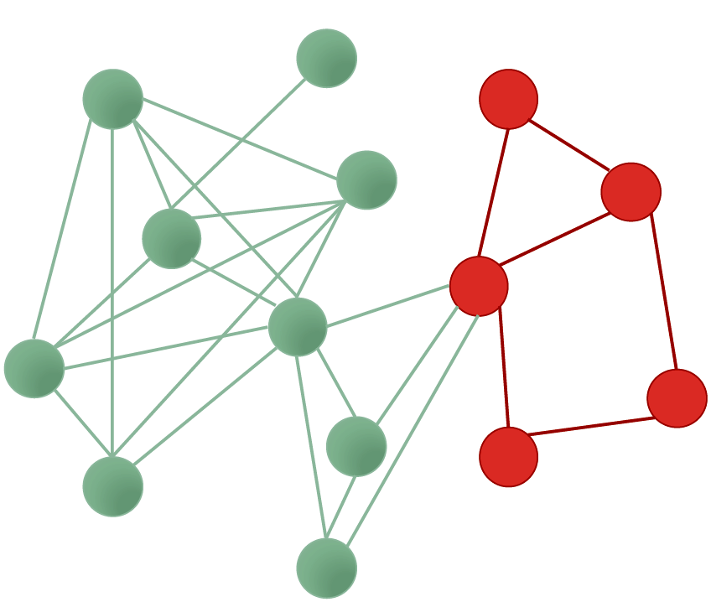
What is a sub-graph?
Subset of nodes, and edges among those nodes

Slide 5
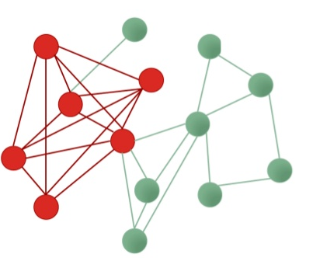
Densest sub-graph
Sub-graph having the maximum density

Slide 6
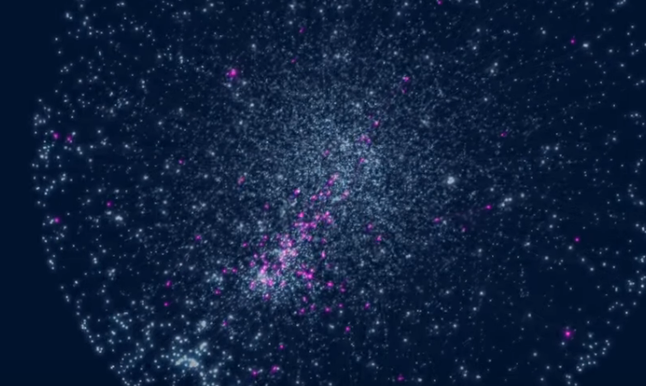
Asthma-related genes
https://www.youtube.com/watch?v=VU_7FHAKMgA

Slide 7
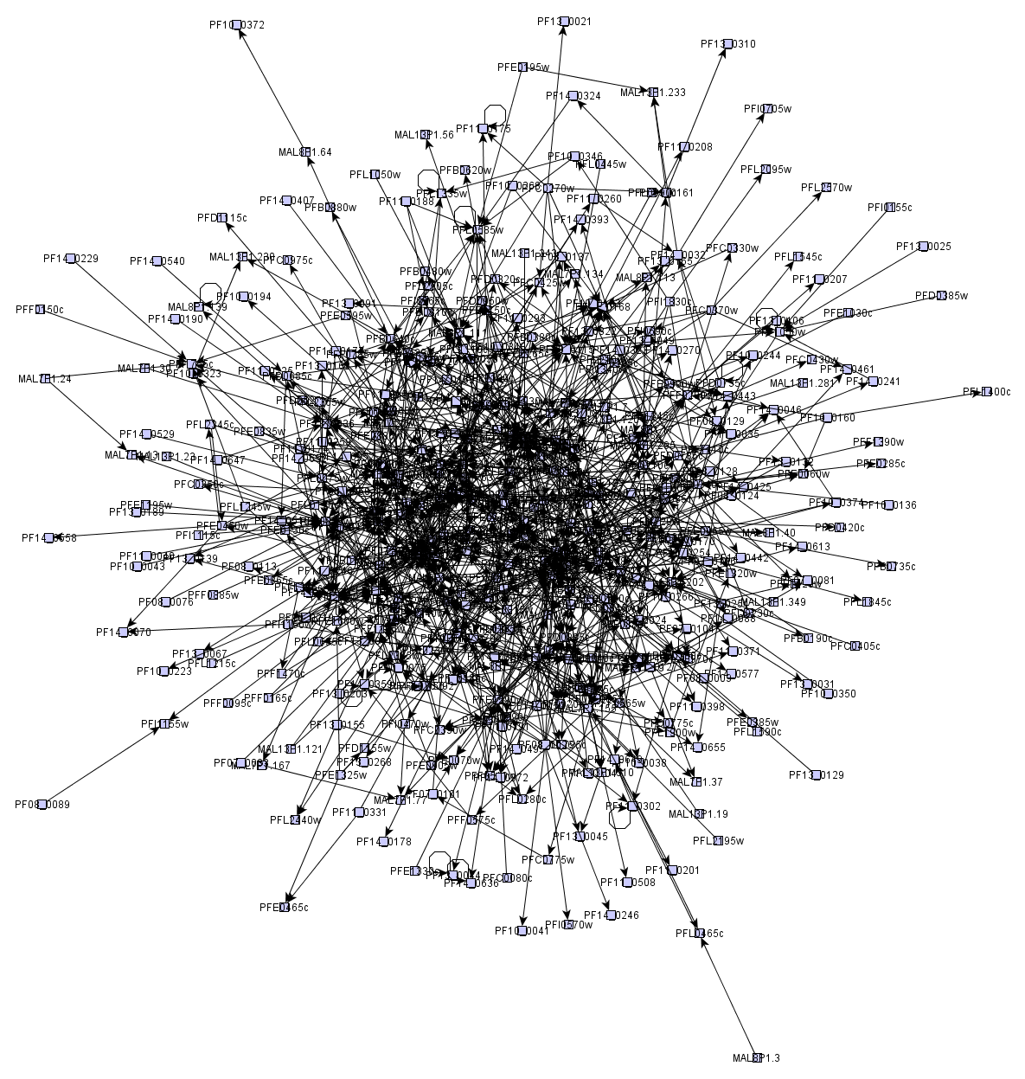
Many graphs look like “hairballs”
Sometimes, at the center these graphs may have an interesting dense sub-graph

Slide 8
k-core decomposition

Slide 9
k-core decomposition
Remove all nodes having degree 1
  Those are in the 1-core
Remove all nodes having degree 2 in the remaining graph
  Those nodes are in the 2-core
Remove all nodes having degree 3 in the remaining graph
  Those nodes are in the 3-core
Etc.

Slide 10
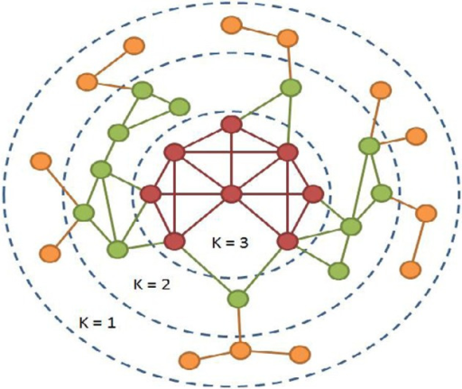
Example
https://openi.nlm.nih.gov/detailedresult.php?img=3368241_fnagi-04-00013-g0001&req=4

Slide 11
Try it!
How many nodes are there in each core of this graph?
http://www.cpt.univ-mrs.fr/~barrat/NHM.pdf

Slide 12
How many nodes are there in each core of this graph?
Core 1:

Slide 13
How many nodes are there in each core of this graph?
Core 1: 3 nodes

Slide 14
How many nodes are there in each core of this graph?
Core 1: 3 nodes

Slide 15
How many nodes are there in each core of this graph?
Core 1: 3 nodes
Core 2: 3 nodes

Slide 16
How many nodes are there in each core of this graph?
Core 1: 3 nodes
Core 2: 3 nodes

Slide 17
How many nodes are there in each core of this graph?
Core 1: 3 nodes
Core 2: 3 nodes
Core 3: 4 nodes

Slide 18
Density-based methods

Slide 19
Density measures
Density = Average degree =
  Sometimes just
Edge ratio =
What is ?

Slide 20
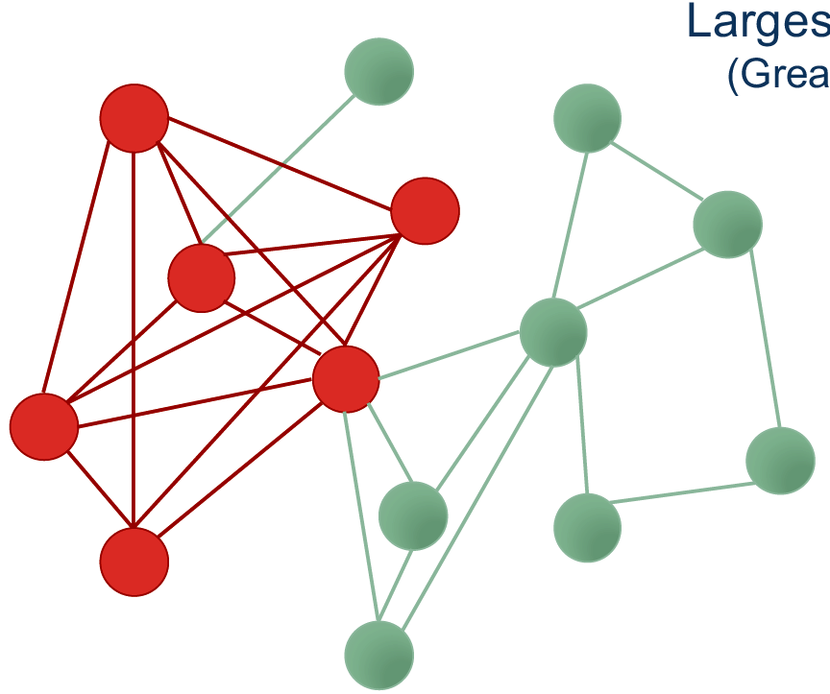
Densest sub-graph

Slide 21
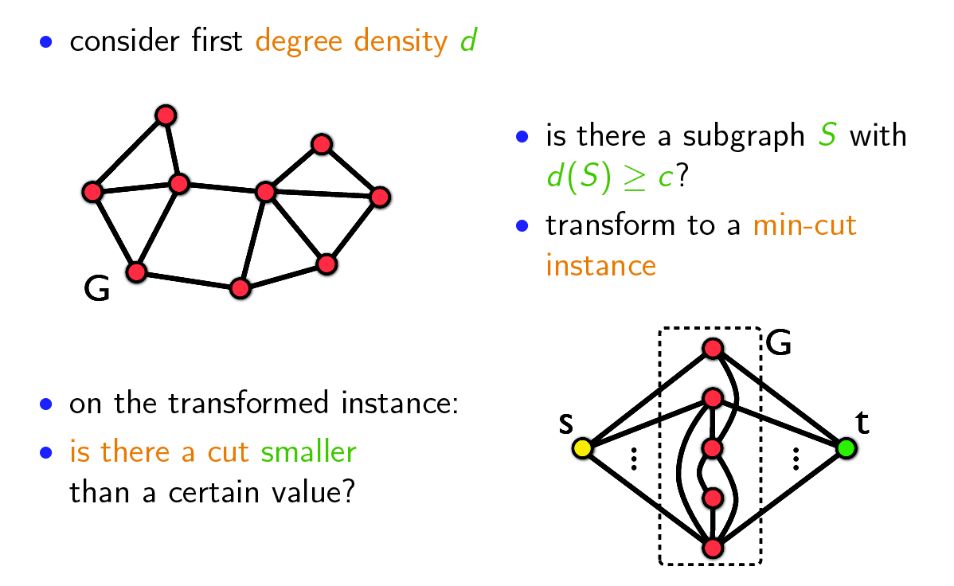
Goldberg's algorithm (1)
Slides on this section from: http://www.math.cmu.edu/~ctsourak/amazing.html

Slide 22
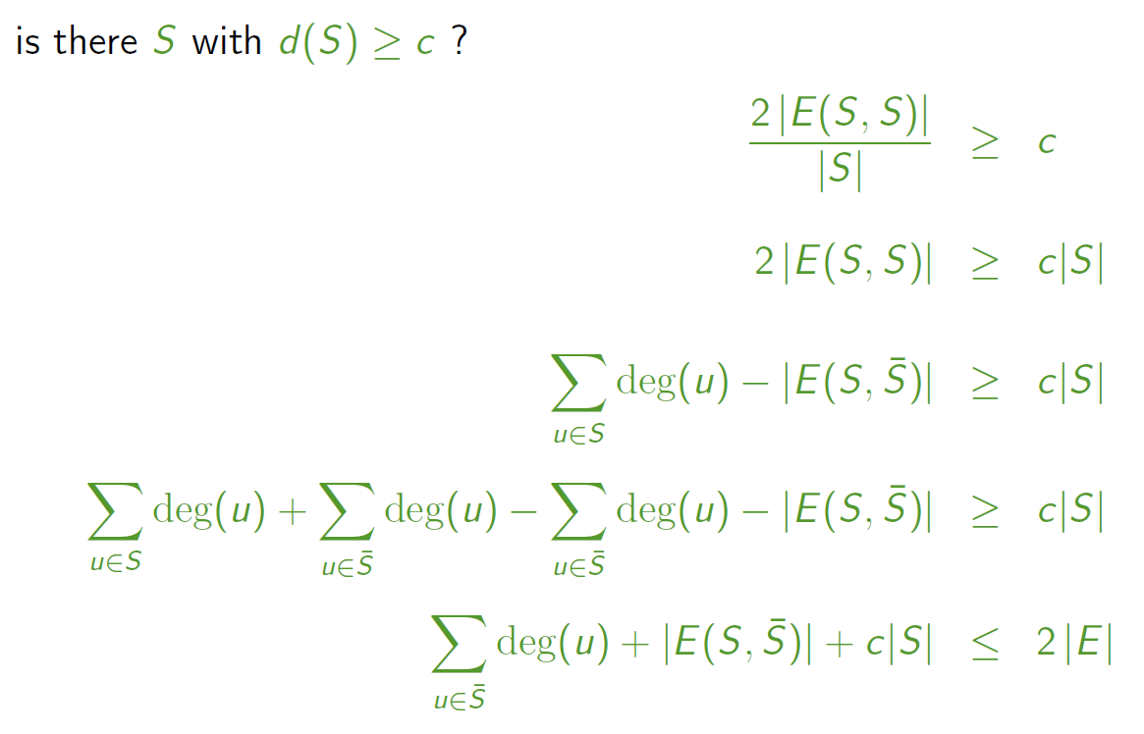
Goldberg's algorithm (2)

Slide 23
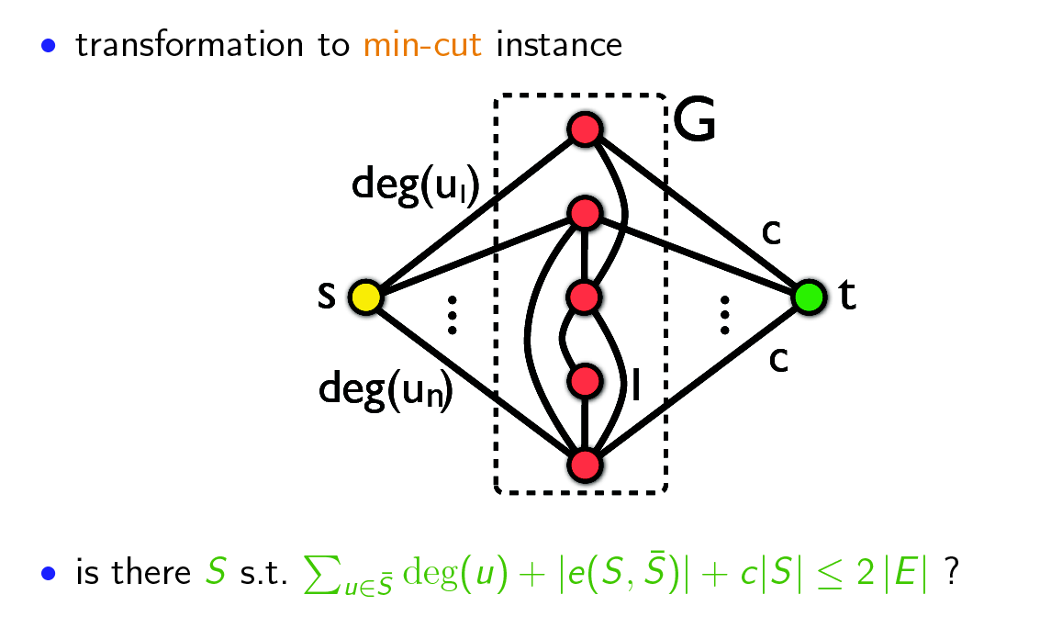
Goldberg's algorithm (3)

Slide 24
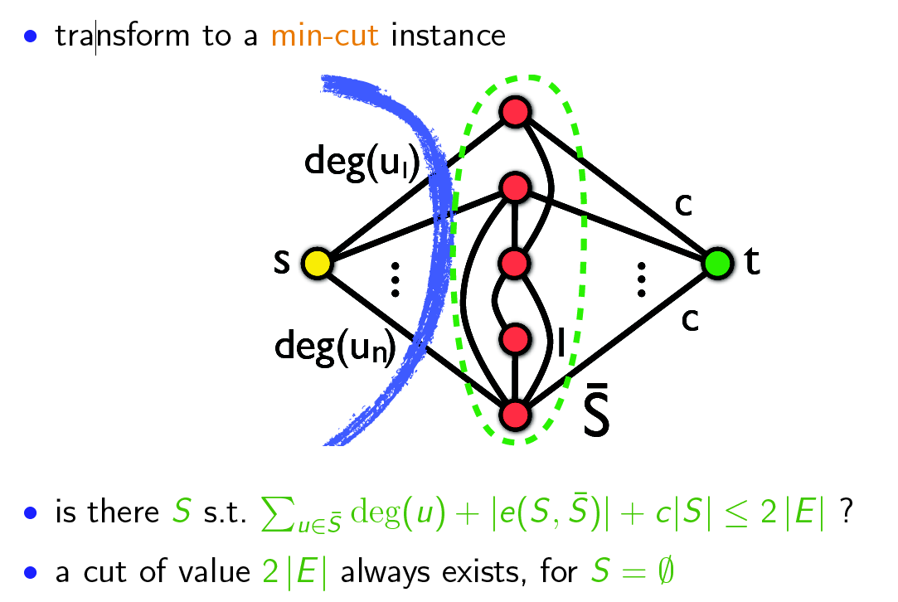
Goldberg's algorithm (4)

Slide 25
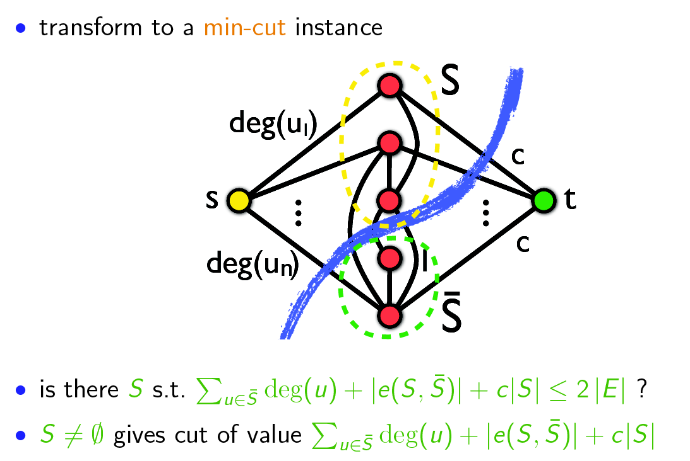
Goldberg's algorithm (5)
If this exists for non-empty S, then S is a sub-graph of density c

Slide 26
Goldberg's algorithm (6)
to find the densest subgraph perform binary search on c
  logarithmic number of min-cut calls
  each min-cut call requires O(|V||E|) time
problem can also be solved with one min-cut call using the parametric max-flow algorithm

Slide 27
A faster algorithm
Charikar, M. (2000). Greedy approximation algorithms for nding dense components in a graph. In APPROX.
Approximate algorithm (by a factor of 2)

Slide 28
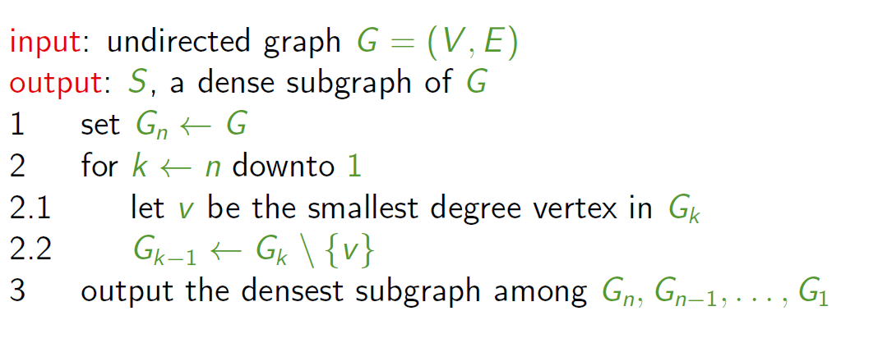
Greedy algorithm
Compute density as |V|/|E|

Slide 29
Try it!
Density = |E|/|V|

Slide 30
Greedy Algorithm
Done!

Slide 31
Greedy Algorithm
15/11=1.36
14/10=1.40
13/9=1.44
12/8=1.50
11/7=1.57
9/6=1.50
8/5=1.60
6/4=1.50
Density computed
as |E|/|V|
3/3=1.00
1/2=0.50
0/1=0.00

Slide 32
Greedy Algorithm
15/11=1.36
14/10=1.40
13/9=1.44
12/8=1.50
11/7=1.57
9/6=1.50
8/5=1.60
6/4=1.50
Done!
3/3=1.00
1/2=0.50
0/1=0.00

Slide 33
Advanced materials
(not included in the exam)

Slide 34
Approximation guarantee
S* = optimal sub-graph (highest density)
density(S*) = λ = |e(S*)| / |S*|
For all v in S*, deg(v) >= λ, because
Because of optimality of S*
https://people.cs.umass.edu/~barna/paper/dense-subgraph-full.pdf

Slide 35
Approximation guarantee (cont)
Hence,

Slide 36
Approximation guarantee (cont.)
Now, let's consider when greedy removes the first vertex of the optimal solution
At that point, all the vertices of the remaining subgraph (S) have degree >= λ, because v has degree >= λ
Hence, this subgraph has more than edges, and density more than
Hence this is a 2-approximate algorithm

