Slide 1

Betweenness
Social Networks Analysis and Graph Algorithms
Prof. Carlos Castillo — https://chato.cl/teach

Slide 2
Sources
D. Easly and J. Kleinberg (2010). Networks, Crowds, and Markets – Section 3.6B
A. L. Barabási (2016). Network Science – Section 9.3
P. Boldi and S. Vigna (2014). Axioms for Centrality in Internet Mathematics
Esposito and Pesce: Survey of Centrality 2015.
URLs cited in the footer of slides

Slide 3
Types of centrality measure
Non-spectral
  Degree
  Closeness and harmonic closeness
  Betweenness
Spectral
  HITS
  PageRank

Slide 4
Betweenness

Slide 5
Definitions
The betweenness of a node is the number of shortest paths that cross that node
The betweenness of an edge is the number of shortest paths that cross that edge

Slide 6
Node Betweenness

Slide 7
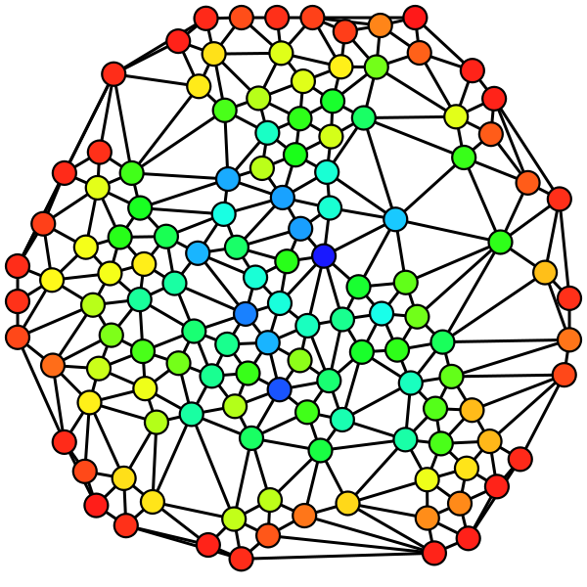
Graph with nodes colored according to node betweenness
red=low, blue=high
[Wikipedia: Betweenness centrality]

Slide 8
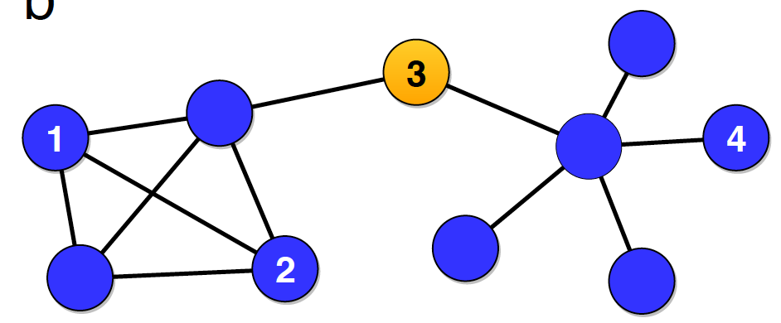
Example 1
There are 20 shortest paths that cross through the orange node. Why?
Y
Z
X
The shortest path between nodes X and Y does not cross the orange node, but the shortest path between nodes X and Z does cross the orange node.
Source: Menczer, Fortunato, Davis: A First Course on Networks Science. Cambridge, 2020.

Slide 9
Example 1
There are 20 shortest paths that cross through the orange node. Why?
Answer: there are 4 nodes to the left of the orange node, and 5 nodes to its right, and 4 x 5 = 20
Source: Menczer, Fortunato, Davis: A First Course on Networks Science. Cambridge, 2020.

Slide 10
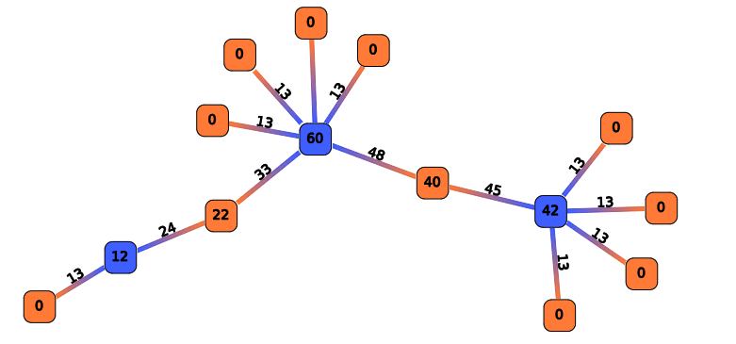
Example 2
Here, nodes and edges are labeled with their betweenness.
http://rnav.labri.fr/rNAV2.0_public_version/online_doc/_images/ComputeBetweennessCentrality.png

Slide 11

Exercise
Compute the node betweenness of the nodes marked with letters.
A
B
C
D
Pin board: https://upfbarcelona.padlet.org/chato/asfs154waxnnkhgo

Slide 12
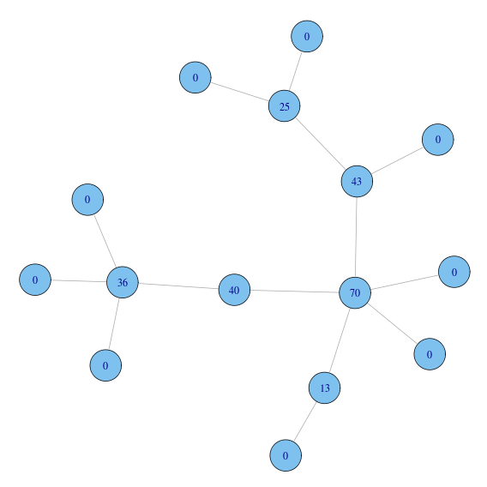
Answer
Compute
node betweenness
A
Betweenness of …
A = 25
B = 36
C = 70
D = 13
B
C
D
[Massimo Franceschet]

Slide 13
Exercise (cont.)
What is a good algorithm to compute node betweenness of all nodes?
What limitations does your algorithm have?
A
B
C
D

Slide 14
Answer
For trees, a exact algorithm could be to label each edge with the size of its sub-tree, compute product of these labels [only works for trees]

Slide 15
Edge Betweenness

Slide 16
Edge Betweenness
An edge has high betweenness if it is part of many shortest-paths.
http://rnav.labri.fr/rNAV2.0_public_version/online_doc/_images/ComputeBetweennessCentrality.png

Slide 17
Approximate method [sampling]
Label all edges e with b(e) = 0
Repeat K times:
  Pick a random pair of nodes (u,v)
  Compute shortest path between u and v
  b(e) ← b(e) + 1 for all edges e along the path
b(e) is a lower bound for betweenness (e)
Useful if we only care about finding the edge with the highest betweenness, or finding the top-k edges with the highest betweenness → an early stopping criterion is possible
Riondato, M., & Kornaropoulos, E. M. (2014, February). Fast approximation of betweenness centrality through sampling. In Proceedings of the 7th ACM international conference on Web search and data mining (pp. 413-422).

Slide 18
Exact algorithm [Brandes, Newman]
For every node u in V
  Layer the graph performing a BFS from u
  For every node v in V, v≠u, sorted by layer
    Assign to v a number s(v) indicating how many shortest paths from u arrive to v
  For every node v in V, v≠u, sorted by reverse layer
    Score to distribute = 1 + score from children
    Add score to parent edges in proportion to s(v)
In the end divide all edge scores by two
Ulrich Brandes. A faster algorithm for betweenness centrality. Journal of Mathematical Sociology, 25:163–177, 2001.
Mark E. J. Newman. Scientific collaboration networks: II. Shortest paths, weighted networks, and centrality. Physical Review E, 64:016132, 2001.

Slide 19
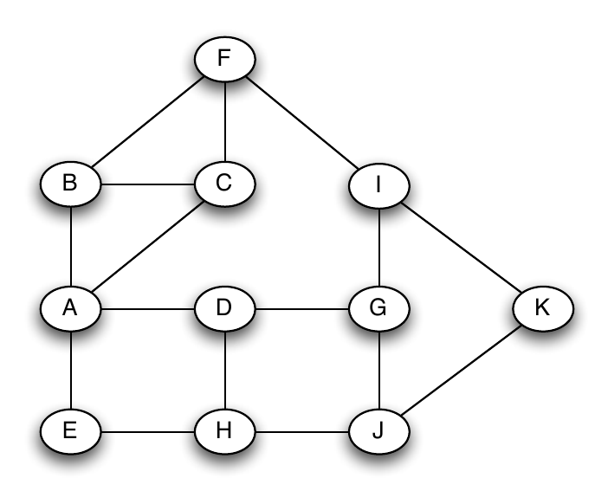
Example
For every node u in V
Layer the graph performing a BFS from u
For every node v in V, v≠u, sorted by layer
  Assign to v a number s(v) indicating how many shortest paths from u arrive to v
For every node v in V, v≠u, sorted by reverse layer
  Score to distribute = 1 + score from children
  Add score to distribute to parent edges in proportion to s(v)
In the end divide all edge scores by two

Slide 20
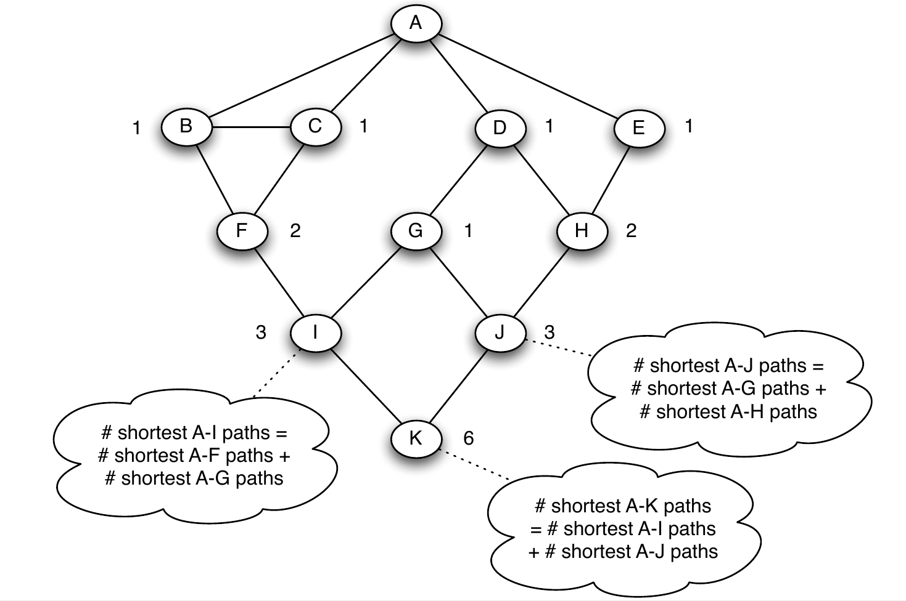
Example
For every node u in V
Layer the graph performing a BFS from u
For every node v in V, v≠u, sorted by layer
  Assign to v a number s(v) indicating how many shortest paths from u arrive to v
For every node v in V, v≠u, sorted by reverse layer
  Score to distribute = 1 + score from children
  Add score to distribute to parent edges in proportion to s(v)
In the end divide all edge scores by two
All nodes in layer 1 get s(v)=1
Remaining nodes: simply add s(.) of their parents

Slide 21
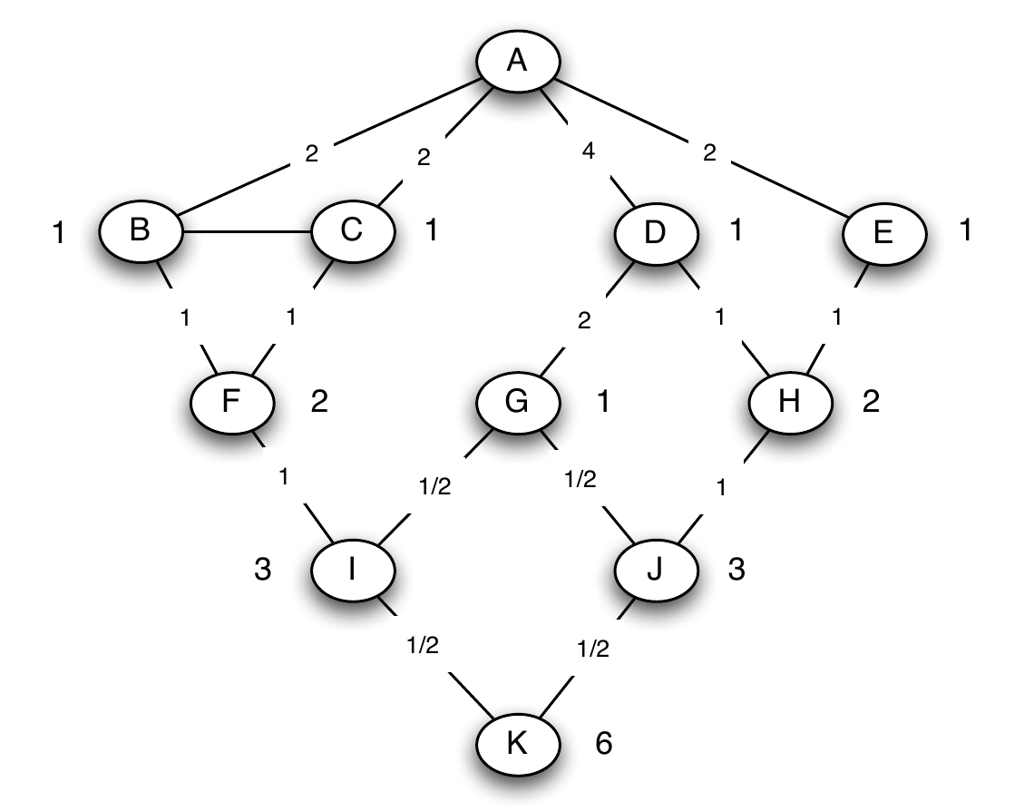
Example
For every node u in V
Layer the graph performing a BFS from u
For every node v in V, v≠u, sorted by layer
  Assign to v a number s(v) indicating how many shortest paths from u arrive to v
For every node v in V, v≠u, sorted by rev. layer
  Score to distribute = 1 + score from children
  Add score to distribute to parent edges in proportion to s(v)
In the end divide all edge scores by two
Nodes without children distribute a score of 1
Other nodes distribute 1 + whatever they receive from their children

Slide 22
Result
For every node u in V
Layer the graph performing a BFS from u
For every node v in V, v≠u, sorted by layer
  Assign to v a number s(v) indicating how many shortest paths from u arrive to v
For every node v in V, v≠u, sorted by reverse layer
  Score to distribute = 1 + score from children
  Add score to distribute to parent edges in proportion to s(v)
In the end divide all edge scores by two
6.19
6.19
1.00
Computed using NetworkX
(edge betweenness)
7.39
7.39
8.52
7.38
10.75
8.88
8.02
6.50
6.11
6.71
7.35
8.75

Slide 23
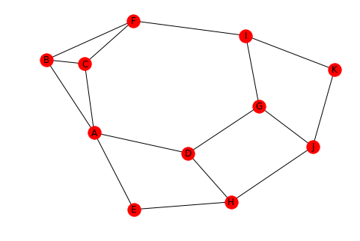
NetworkX code
import networkx as nx
g = nx.Graph()
g.add_edge("A", "B")
g.add_edge("A", "C")
g.add_edge("A", "D")
g.add_edge("A", "E")
g.add_edge("B", "C")
g.add_edge("B", "F")
g.add_edge("C", "F")
g.add_edge("D", "G")
g.add_edge("D", "H")
g.add_edge("E", "H")
g.add_edge("F", "I")
g.add_edge("G", "I")
g.add_edge("G", "J")
g.add_edge("H", "J")
g.add_edge("I", "K")
g.add_edge("J", "K")
nx.edge_betweenness(g, normalized=False)
nx.draw_spring(g, with_labels=True)

Slide 24
Exercise
For every node u in V
Layer the graph performing a BFS from u
For every node v in V, v≠u, sorted by layer
  Assign to v a number s(v) indicating how many shortest paths from u arrive to v
For every node v in V, v≠u, sorted by reverse layer
  Score to distribute = 1 + score from children
  Add score to distribute to parent edges in proportion to s(v)
In the end divide all edge scores by two
Try to compute edge betweenness by inspection first
Then use the Brandes-Newman algorithm;
you should get the same results
a
b
c
d
e

Slide 25
Solution
For every node u in V
Layer the graph performing a BFS from u
For every node v in V, v≠u, sorted by layer
  Assign to v a number s(v) indicating how many shortest paths from u arrive to v
For every node v in V, v≠u, sorted by reverse layer
  Score to distribute = 1 + score from children
  Add score to distribute to parent edges in proportion to s(v)
In the end divide all edge scores by two
Computed by inspection, by hand using the algorithm, and using NetworkX
a
4
b
6
c
3
3
d
e
1

Slide 26
Fractional values?
In a graph with cycles, you may get fractional values of the edge betweenness for an edge
Conceptually, this is because in a graph with cycles there might be s>1 shortest paths between two nodes, each of them counts 1/s

Slide 27
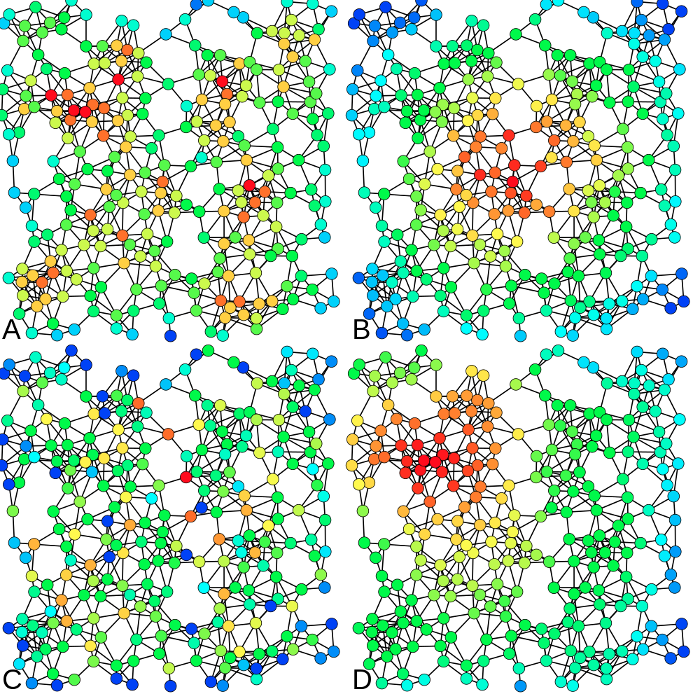
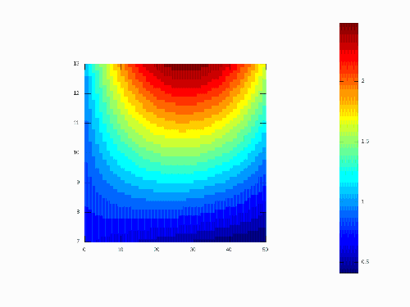
HIGH
A: Degree
B: Closeness
C: Betweenness
LOW

Slide 28
Summary

Slide 29
Things to remember
Closeness and harmonic closeness
Node and edge betweenness
Practice running the Brandes-Newman algorithm on small graphs
Write code to execute the Brandes-Newman algorithm

Slide 30
Practice on your own
Compute edge betweenness on this graph
a
b
c
d
e
f

Slide 31
Practice on your own (cont.)
a
4.00
b
4.00
c
2.67
3.67
2.67
d
4.00
e
4.00
f
If you don’t get this result, check: https://www.youtube.com/watch?v=uYjWbp8VC7c

Slide 32
Two constructive problems
Sketch a graph of N nodes in which a node, which you should mark with an asterisk (*), should have betweenness approximately equal to N and closeness approximately 1/N for large N . Explain briefly.
Sketch a graph of N nodes in which a node, which you should mark with an asterisk (*), should have betweenness approximately equal to N and closeness approximately 2/N² for large N . Explain briefly.
Do not use a concrete N . Use a general N , for instance by using the ellipsis (. . . ) to denote multiple nodes.

