Slide 1

Graph partitioning
Introduction to Network Science
Carlos Castillo
Topic 12

Slide 2
Sources
Barabási 2016 Chapter 9
Networks, Crowds, and Markets Ch 3
C. Castillo: Graph partitioning 2017

Slide 3
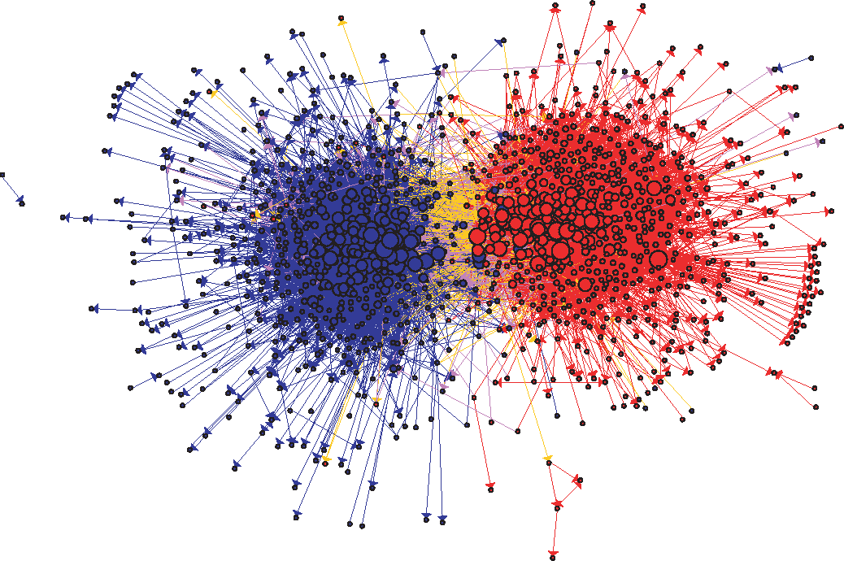
US Political Blogs (2004)
Liberal
Conservative
Adamic, L. A., & Glance, N. (2005, August). The political blogosphere and the 2004 US election: divided they blog. In Proc. LinkKDD (pp. 36-43). ACM.

Slide 4
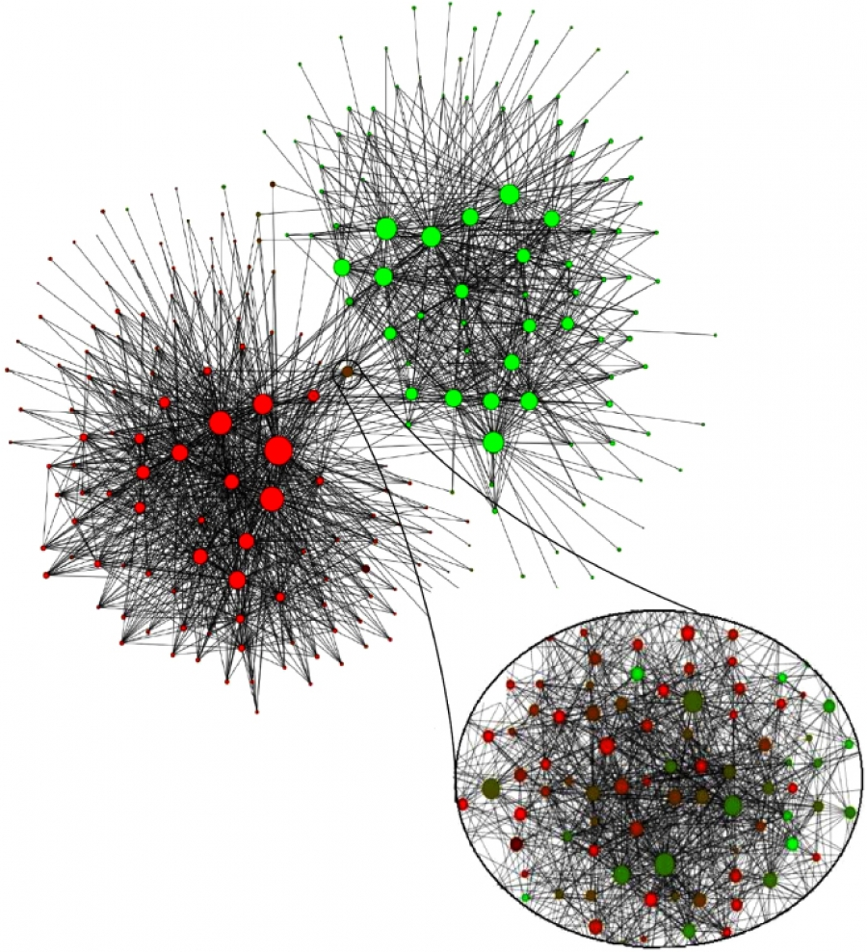
Mobile phone users in Belgium (2008)
Each node is a community of 100 mobile users or more that tend to call each other
Dutch-speaking
French-speaking
V. D. Blondel, J.-L. Guillaume, R. Lambiotte, and E. Lefebvre. Fast unfolding of communities in large networks. J. Stat. Mech., 2008.

Slide 5
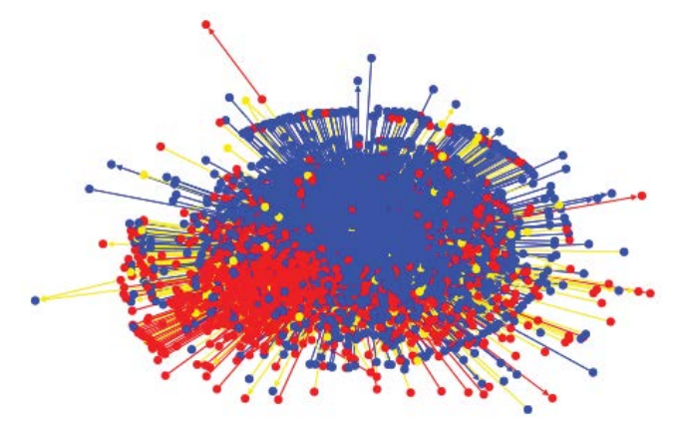
Egyptian Twitter Users (2013)
Islamist
Secularist
Weber, I., Garimella, V. R. K., & Batayneh, A. (2013, August). Secular vs. Islamist polarization in egypt on twitter. In Proc. ASONAM (pp. 290-297). ACM.

Slide 6

Wayne Zachary’s PhD Thesis (1972)
Studied 34 members of a karate club
Found 78 links between members who regularly interacted outside the club
The club splitted in two during the study
1=sensei, 34=president

Slide 7
Community hypotheses

Slide 8
Try it!
Compute closeness and harmonic closeness for all the nodes
d(u,v) = 1 if v is a neighbor of u
a
b
c
f
g
d
e

Slide 9
 | a | b | c | d | e | f | g
a | 0 | 1 | 2 | 2 | 3 | 3 | 4
b | 1 | 0 | 1 | 1 | 2 | 2 | 3
c | 2 | 1 | 0 | 2 | 2 | 1 | 2
d | 2 | 1 | 2 | 0 | 1 | 2 | 3
e | 3 | 2 | 2 | 1 | 0 | 1 | 2
f | 3 | 2 | 1 | 2 | 1 | 0 | 1
g | 4 | 3 | 2 | 3 | 2 | 1 | 0
a
b
c
f
g
d
e
Matrix is symmetric

