Slide 1

Information cascades
Introduction to Network Science
Carlos Castillo
Topic 17

Slide 2
Sources
Easley and Kleinberg (2010): Networks, Crowds, and Markets Ch 16 and Ch 19
Carlos Castillo, Wei Chen, Laks V. S. Lakshmanan (2012): Information and Influence Spread in Social Networks, KDD Tutorial.
Carlos Castillo (2017): Social influence slides

Slide 3

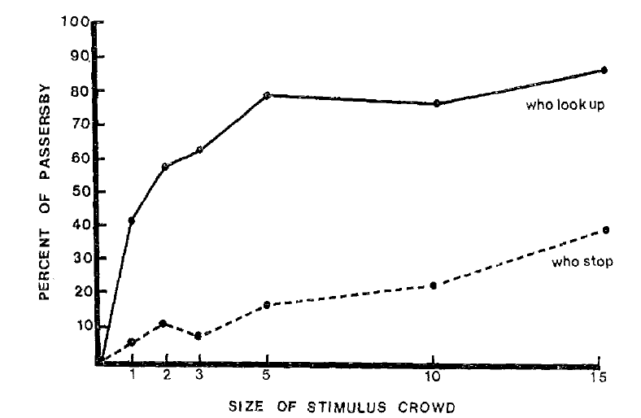
A crowd looking up on a busy street
(1969 experiment)
Milgram, S., Bickman, L., Berkowitz, L. (1969). Note on the drawing power of crowds of different sizes. Journal of Personality and Social Psychology, 13, 79-82

Slide 4
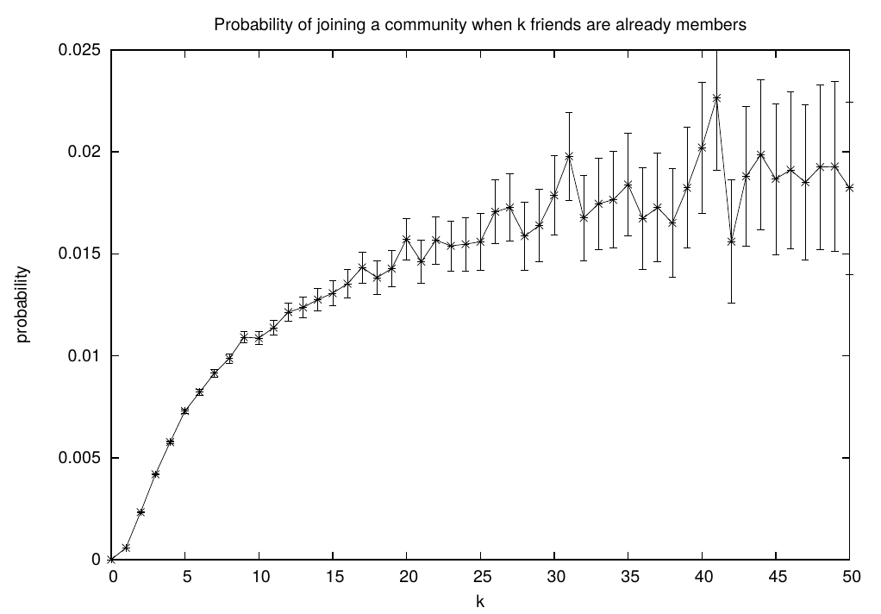
Probability of joining a community given k friends are already members
L. Backstrom, D. Huttenlocher, J. Kleinberg, and X. Lan. Group formation in large social networks. In Proc. KDD 2006.

Slide 5
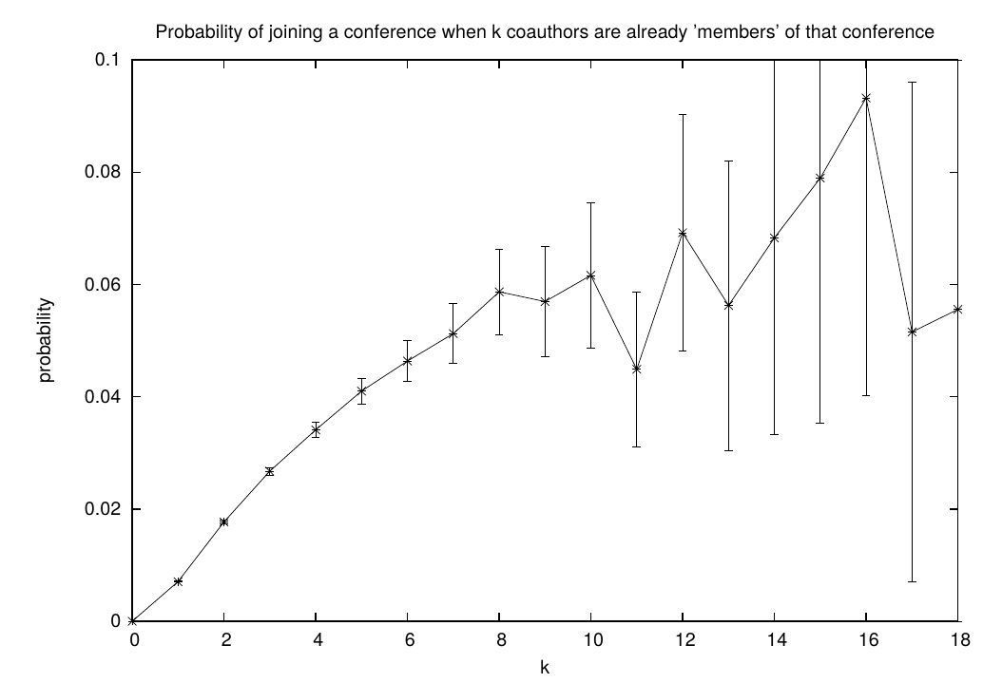
Prob. of publishing on a conference given k co-authors published there
L. Backstrom, D. Huttenlocher, J. Kleinberg, and X. Lan. Group formation in large social networks. In Proc. KDD 2006.

Slide 6
“Herding” can be rational
The actions of others ...
… tell us about what they find valuable …
… which tell us about what we might value.

Slide 7
A framework to study herding
Assume a decision must be made
Assume people make decisions in sequence, you see what others decided before you
Assume each person has some private information that helps them decide
Assume you can only observe their decisions, not their private information

Slide 8
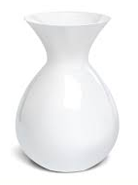
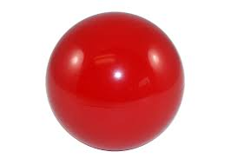
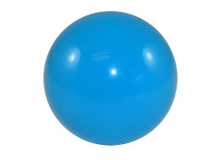
Task: guess if an urn is
“majority-blue” or “majority-red”
You can only draw one ball

Slide 9
Herding experiment
Each person from 1 … N
  Draws a ball
  Looks at the ball in secret
  Places the ball back in the urn
  Announces his/her guess publicly
People who guess correctly win € / $ / ¥ / ₤

Slide 10
Person #1
Case 1:
  Guess: majority-blue
Case 2:
  Guess: majority-red

Slide 11
Person #2
If person#1 said “majority-red” and person#2 draw
  Guess
If person#1 said “majority-blue” and person#2 draw
  Guess

Slide 12
Person #2 (cont.)
If person #1 said “majority-blue” and person #2 draw
  Guess at random
If person #1 said “majority-red” and person #2 draw
  Guess at random

Slide 13
Person #3
If the first two guessed differently (“majority-red” and “majority-blue”)
  Guess red if draw
  Guess blue if draw
If the first two people guessed red
  Guess red if draw
  Guess red if draw
Ignore your eyes, follow the herd!
Equivalently, if first two guessed blue, guess blue

Slide 14
Person #4 and following
If person#1 and person#2 guessed the same, then we know person#3 will guess the same (his/her own draw is worthless)
Hence in this case everybody will continue guessing the same
  ⇒ Information cascade

Slide 15
Information cascades
Can appear easily
  E.g., in this stylized setting
Can be broken easily
  Suppose after 49 draws, persons #50 and #51 break the protocol by showing publicly the balls they draw
  Fresh information enters the decisions, and the cascade stops (it might reappear, though)

Slide 16
Analyzing the herding experiment
Person #1
This justifies guessing majority-blue if drawing blue

Slide 17
Analyzing the herding experiment
Person #2
This justifies guessing majority-blue if drawing blue

Slide 18
Compute for person #3

Slide 19
Analyzing the herding experiment
Person #3
This justifies guessing majority-blue if drawing red, if previous two guessed majority-blue

