Slide 1

Epidemic Analysis on Graphs
Introduction to Network Science
Carlos Castillo
Topic 27

Slide 2
Sources
Barabási (2016): Network Science Ch. 10
Easley and Kleinberg (2010): Networks, Crowds, and Markets Ch 21.

Slide 3
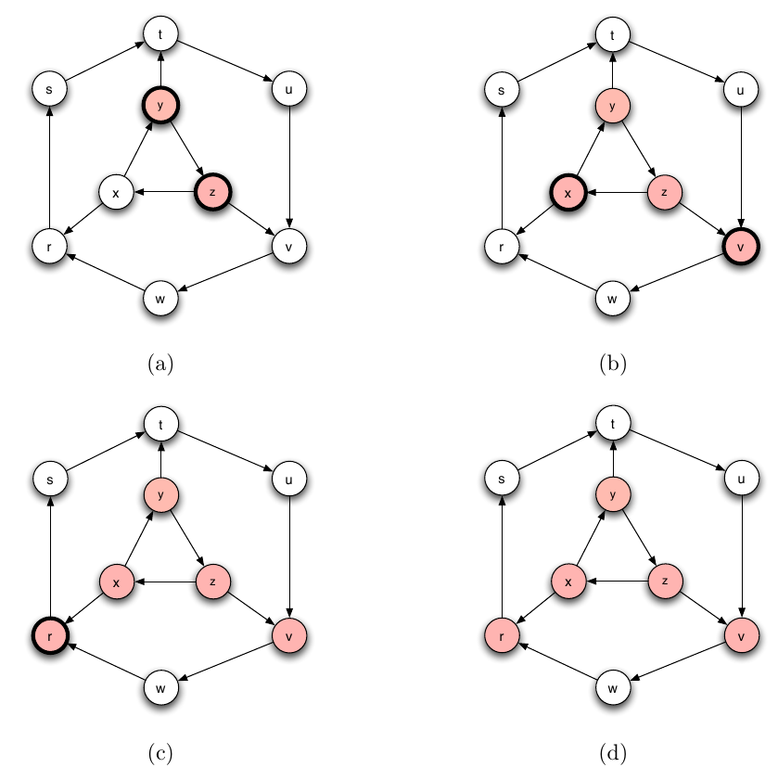
SIR on a graph
In this simulation we assume recovery takes one timestep
Infected nodes have thick borders
Recovered nodes have thin borders

Slide 4
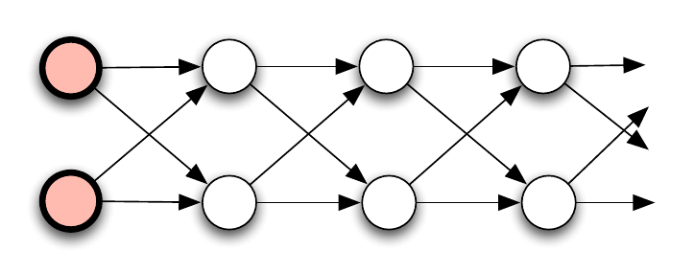
Social distancing
In this network, the epidemic is forced to pass through a narrow “channel” of nodes. In such a structure, even a highly contagious disease will tend to die out relatively quickly (fig 21.3 Easley+Kleinberg)

Slide 5
Computing infection dynamics in known graph models

Slide 6
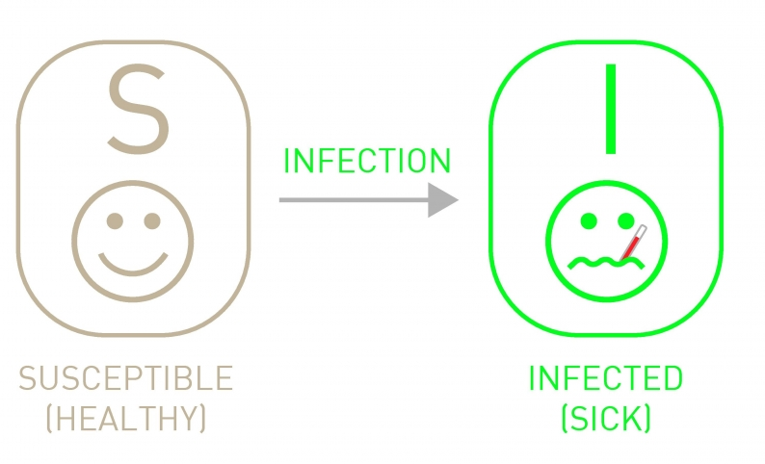
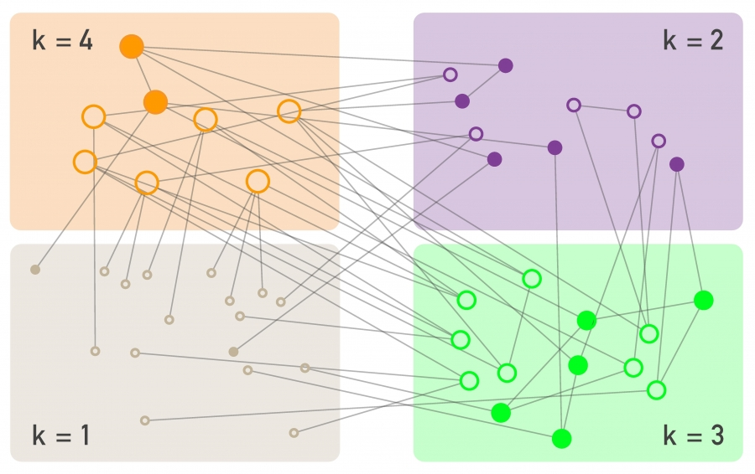
SI dynamics on a graph
Degree block approximation: all nodes with the same degree are jointly analyzed

Slide 7
SI dynamics on a graph
Degree block approximation: all nodes with the same degree are jointly analyzed
Similar to simple SI model, except:
is the fraction of infected neighbors of a susceptible node of degree k
Compare with simple SI model:

Slide 8
SI model on a graph: infected as a function of time
What can you say about ik(t)?
Characteristic time, i.e., the time to infect 1/e ≃ 36% of nodes

Slide 9
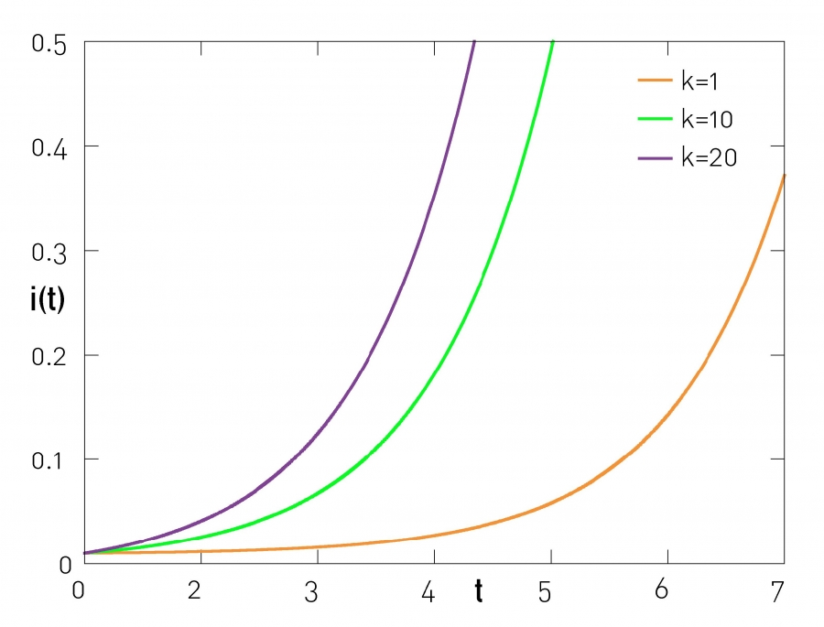
Higher degree nodes are more likely to become infected

Slide 10
Characteristic time
(time to infect 1/e ≃ 36% of nodes)
Random network
Scale-free network with γ ≥ 3
Scale-free network with γ < 3
(Do it on paper)

Slide 11
Characteristic time
(time to infect 1/e ≃ 36% of nodes)
Random network
Scale-free network with γ ≥ 3
Scale-free network with γ < 3

Slide 12
Vanishing characteristic time
If the characteristic time goes to 0
Networks with skewed degree distributions allow infections with the same β to spread faster

Slide 13
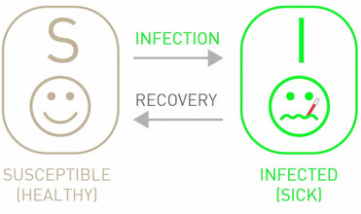
SIS dynamics on a graph
Similar to SI dynamics but allowing recovery
If people recover quickly, and the infection dies out … unless

Slide 14
Epidemic threshold
A key quantity is the spreading rate
The critical spreading rate called the epidemic threshold, is such that
Spreading rate larger than epidemic threshold:
  infection becomes endemic
Spreading rate smaller than epidemic threshold:
  Infection dies out

Slide 15
Epidemic threshold
A key quantity is the spreading rate
The critical spreading rate called the epidemic threshold, is such that
Compute the epidemic threshold for
an ER graph where
Upload to Nearpod Collaborate
https://nearpod.com/student/
Code to be given during class
Begin from:
and use that

Slide 16

Epidemic threshold in an ER graph

Slide 17
Epidemic threshold in an ER graph
If this holds, the infection becomes endemic
Any less infectious pathogen or one that has faster recovery causes the infection to die out
Epidemic threshold
in ER graph

Slide 18
Epidemic threshold in a scale-free network
Epidemic threshold
in BA graph
In a scale-free network with γ < 3

Slide 19
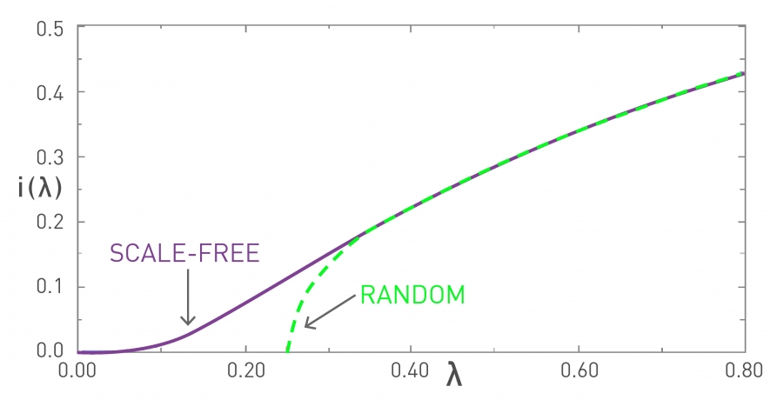
Infected (in the limit) as a function of the epidemic threshold

Slide 20
Two key results for
SI and SIS models on a BA graph
In a large scale-free network with γ < 3
An infection may reach everybody in a very short time:
An infection may become endemic even if it is not very contagious and even if people recover fast:

Slide 21
Summary

Slide 22
Things to remember
Degree block approximation
Epidemic thresholds in scale-free networks

