Slide 1

K-Core Decomposition
Social Networks Analysis and Graph Algorithms
Prof. Carlos “ChaTo” Castillo — https://chato.cl/teach

Slide 2
Sources
A. L. Barabási (2016). Network Science – Chapter 09
A. Beutel, L. Akoglu, C. Faloutsos (2015). Tutorial at KDD
A. Frieze, A. Gionis, C. Tsourakakis (2013). “Algorithmic techniques for modeling and mining large graphs (AMAzING)” Tutorial at KDD
V. E. Lee, N. Ruan, R. Jin, C. Aggarwal (2010). A survey of algorithms for dense sub-graph discovery. Chapter 10 of “Managing and Mining Graph Data”
URLs cited in the footer of slides

Slide 3
Robustness

Slide 4
Robustness to failure
A system is robust if the failure of some of its components does not affect its function
Aircrafts, for instance, have:
  Separate primary and back-up flight instruments (airspeed, altimeter, ...);
  Multiple independent hydraulic systems
  Primary and alternate/emergency landing gear;
  Multiple sources of power and priorities for energizing components

Slide 5
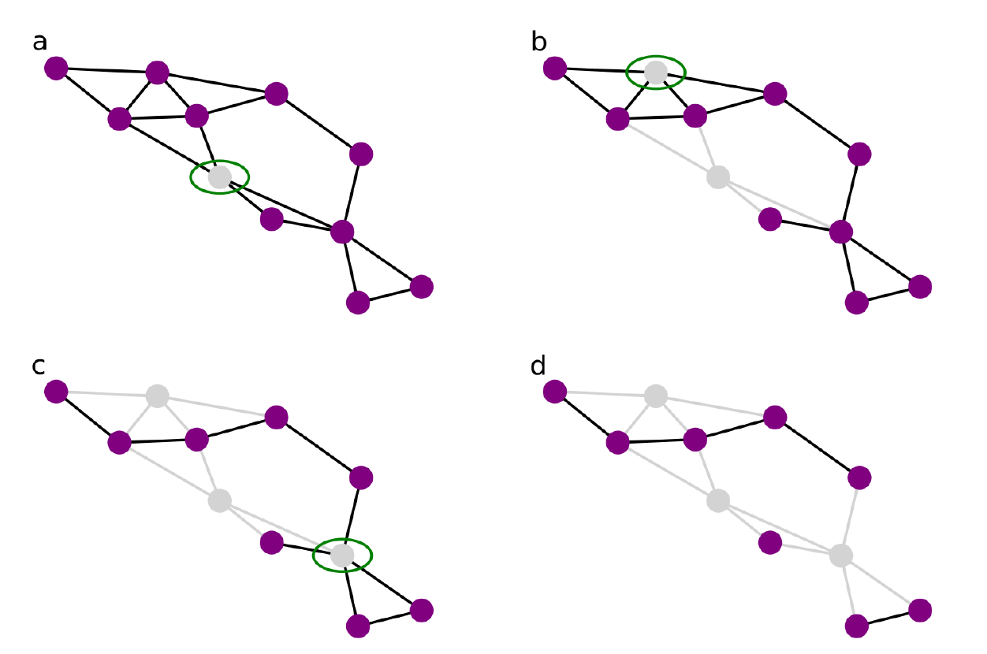
Robustness in networks
The targeted removal of 4 nodes disconnects this graph into three components
Source: Menczer, Fortunato, Davis: A First Course on Networks Science. Cambridge, 2020.

Slide 6
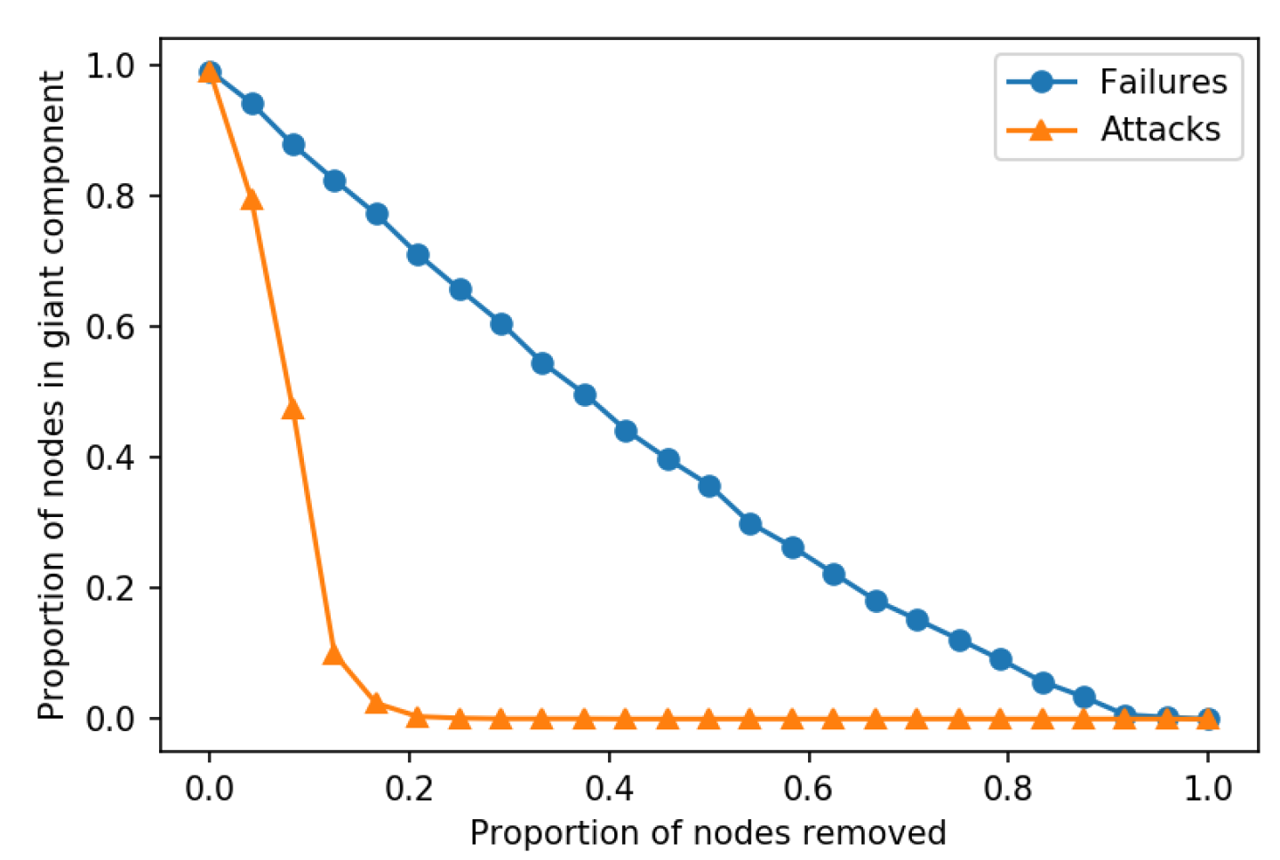
Destroying the giant connected component
The size of the giant component in this network of flights is reduced slowly by random removals (“failures”), but reduced quickly by removing high-degree edges (“attacks”)
Source: Menczer, Fortunato, Davis: A First Course on Networks Science. Cambridge, 2020.

Slide 7
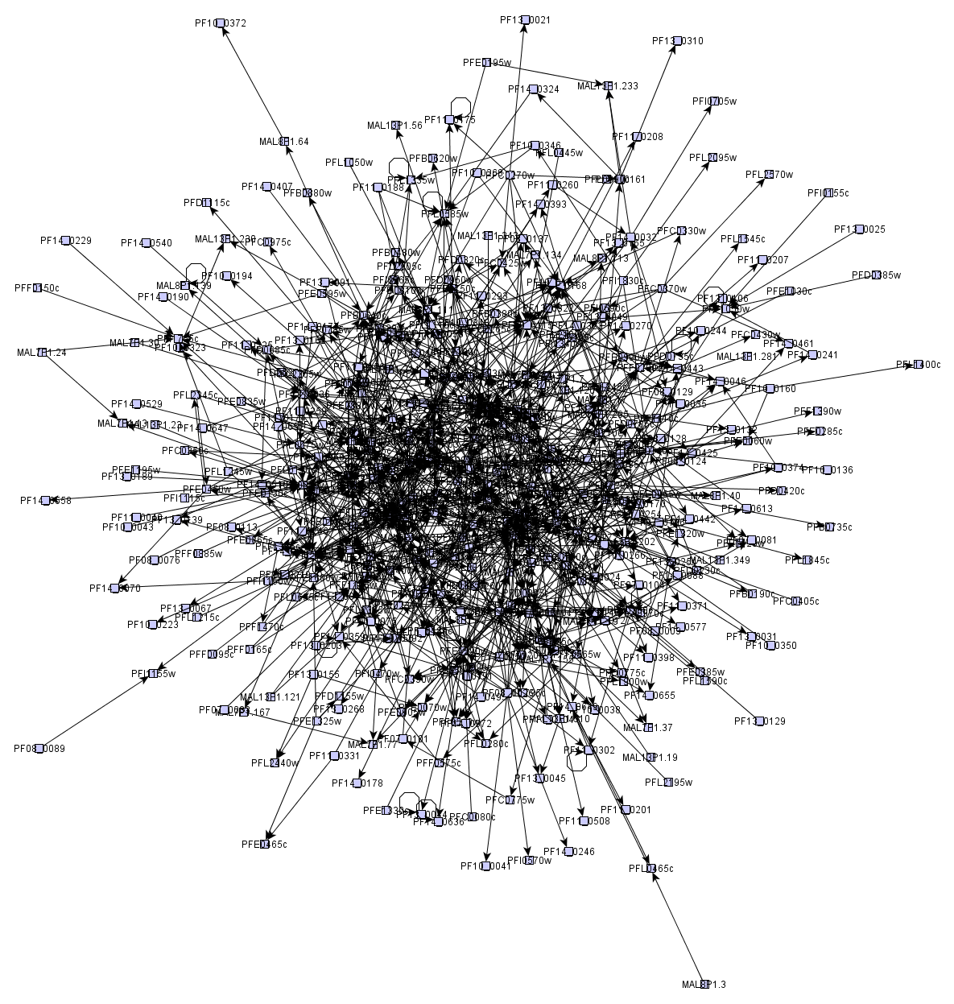
Many networks look like “hairballs”
They have a core and a periphery
How can we find the core?

Slide 8
k-core decomposition is a method to decompose a graph into layers

Slide 9
k-core decomposition
Remove all nodes having degree 1
  Those are in the 1-core
Remove all nodes having degree 2 in the remaining graph
  Those nodes are in the 2-core
Remove all nodes having degree 3 in the remaining graph
  Those nodes are in the 3-core
Etc.

Slide 10
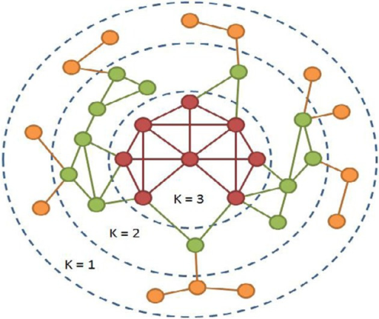
Example 1
https://openi.nlm.nih.gov/detailedresult.php?img=3368241_fnagi-04-00013-g0001&req=4

Slide 11
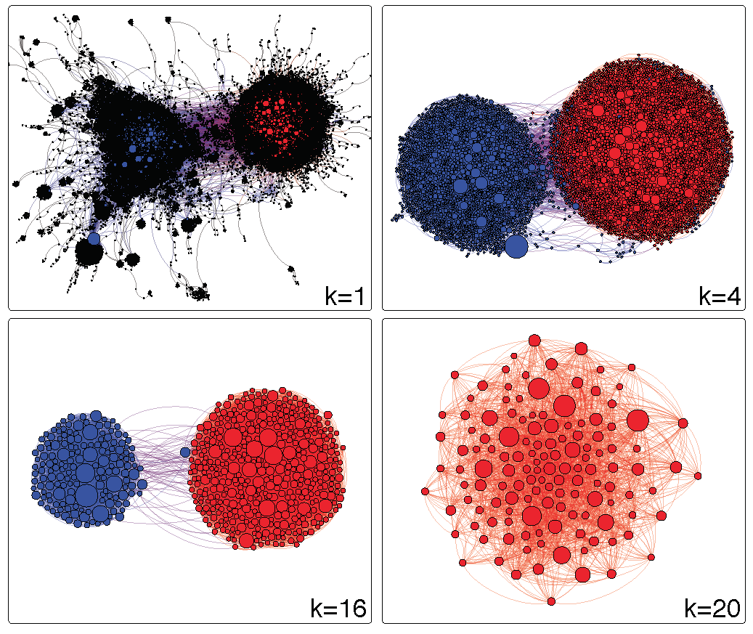
Example 2
Source: Menczer, Fortunato, Davis: A First Course on Networks Science. Cambridge, 2020.

Slide 12
Exercise
For each node in the graph, indicate the max k-core to which it belongs
Draw in Nearpod Draw-it
https://nearpod.com/student/
Code to be given during class
http://www.cpt.univ-mrs.fr/~barrat/NHM.pdf

Slide 14
How many nodes are there in each core of this graph?
Core 1:

Slide 15
How many nodes are there in each core of this graph?
Core 1: 3 nodes

Slide 16
How many nodes are there in each core of this graph?
Core 1: 3 nodes

Slide 17
How many nodes are there in each core of this graph?
Core 1: 3 nodes

Slide 18
How many nodes are there in each core of this graph?
Core 1: 3 nodes
Core 2: 3 nodes

Slide 19
How many nodes are there in each core of this graph?
Core 1: 3 nodes
Core 2: 3 nodes

Slide 20
How many nodes are there in each core of this graph?
Core 1: 3 nodes
Core 2: 3 nodes
Core 3: 4 nodes

Slide 21
Summary

Slide 22
Things to remember
What does it mean for a network to be robust?
What is the k-core decomposition
How to compute it on a graph

Slide 23
Practice on your own
a
Find the 3-core of this graph
b
d
c
g
e
f
h
Solution by Vivekanand Khyade (start at 01:23)
https://youtu.be/8sNZ5d8eNC8?t=83
m

