Slide 1

Centrality
Introduction to Network Science
Carlos Castillo
Topic 09

Slide 2
Sources
Networks, Crowds, and Markets Ch 14
Fei Li's lecture on PageRank
Evimaria Terzi's lecture on link analysis.
C. Castillo: Link-based ranking slides 2016

Slide 3
Ranking on the web is hard
Demand:
  Information needs are unclear and evolving
Supply
  From scarcity to abundance: “filter failure”

Slide 4
Purpose of Link-Based Ranking
Static (query-independent) ranking
Dynamic (query-dependent) ranking
Applications:
  Search in social networks
  Search on the web

Slide 5

Given a set of connected objects

Slide 6

Assign some weights

Slide 7

Pages for the query “newspapers”
How would you rank
these pages?

Slide 8
Counting in-links for the query “newspapers”

Slide 9

Value of a list of “newspapers”

Slide 10

Re-weighting votes by list values

Slide 11

Normalizing scores

Slide 12
The idea behind Hubs and Authorities [Kleinberg 1999]
Highly-recommended items
appear in high-value lists
High-value lists
contain highly-recommended items
Repeated improvement
  Re-calculate scores several times

Slide 13

Limit values

Slide 14
This algorithm is called “HITS”
Jon M. Kleinberg. 1999. Authoritative sources in a hyperlinked environment. J. ACM 46, 5 (September 1999), 604-632. [DOI]
Query-dependent algorithm
  Get pages matching the query
  Expand to 1-hop neighborhood
  Find pages with good out-links (“hubs”)
  Find pages with good in-links (“authorities”)

Slide 15

Root set = matches the query

Slide 16

Base set S = root set plus 1-hop neighbors
Base set S is expected to be small and topically focused.

Slide 17
Base graph S of n nodes

Slide 18
Bipartite graph of 2n nodes

Slide 19
Bipartite graph of 2n nodes
0) Initialization:
1) Iteration:
2) Normalization:

Slide 20
Try it!
Complete the table. Which one is the biggest hub? Which the biggest authority? Does it differ from ranking by degree?
H(1) | A(1) | Â(1) | H(2) | Ĥ(2) | A(2) | Â(2)
1 | 0
1 | 3
1 | 1
1 | 1
1 | 1

Slide 21
What are we computing?
Vector a is an eigenvector of A^{T}A
Conversely, vector h is an eigenvector of AA^{T}

Slide 22

Problem: tightly-knit communities
Example: a graph made of a (3,3)-clique and a (2,3)-clique
1
1
1
1
1

Slide 23
Problem: tightly-knit communities
Example: a graph made of a (3,3)-clique and a (2,3)-clique
3
3
3
2
2
2

Slide 24
Problem: tightly-knit communities
Example: a graph made of a (3,3)-clique and a (2,3)-clique
3x3
3x3
3x3
3x2
3x2

Slide 25
Problem: tightly-knit communities
Example: a graph made of a (3,3)-clique and a (2,3)-clique
3x3x3
3x3x3
3x3x3
What happens after
n iterations?
Which community
”wins”?
3x2x2
3x2x2
3x2x2

Slide 26
Problem: tightly-knit communities
HITS favors the largest dense sub-graph
After n iterations:
...
...
...

Slide 27

Hubs and authorities: not just for the web
Citations in US Supreme Court Cases
Different cases acquired authority at different speeds
(Roe v Wade legalized abortion, Brown v Board of Education declared race-segregated schools unconstitutional)
Authority score
Years after decision
Fowler, J. H., & Jeon, S. (2008). The authority of Supreme Court precedent. Social networks, 30(1), 16-30.

Slide 28
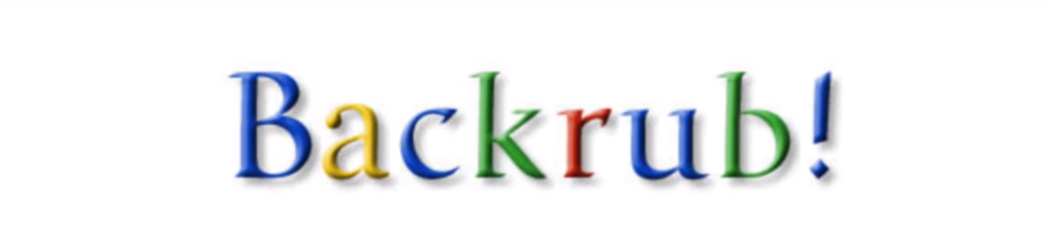
Part of a research project that started in 1995 ...

Slide 29
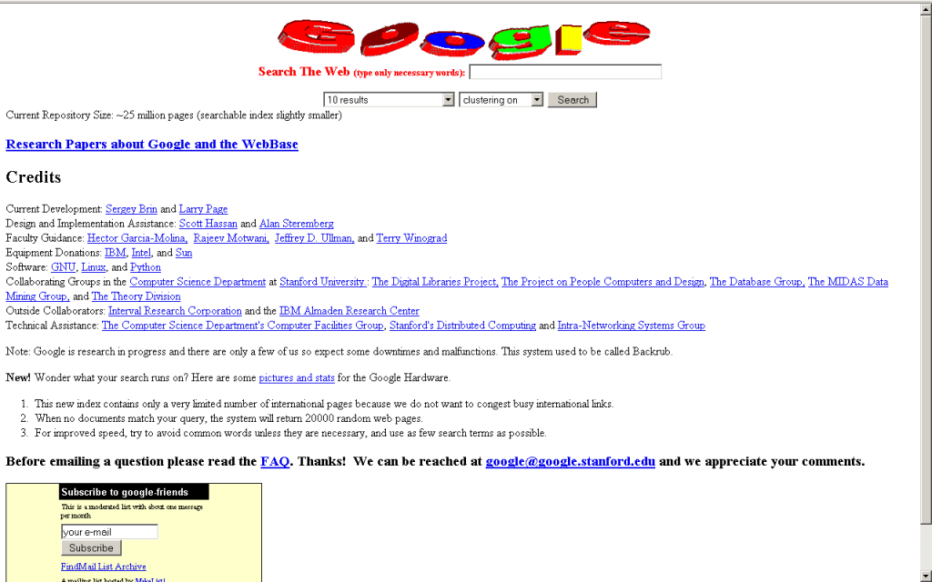

Slide 30
PageRank
The pagerank citation algorithm: bringing order to the web by L Page, S Brin, R Motwani, T Winograd - 7th World Wide Web Conference, 1998 [link].
A very good starting point, but not the end of web ranking!
  Today, it’s unlikely to be a top feature

Slide 31
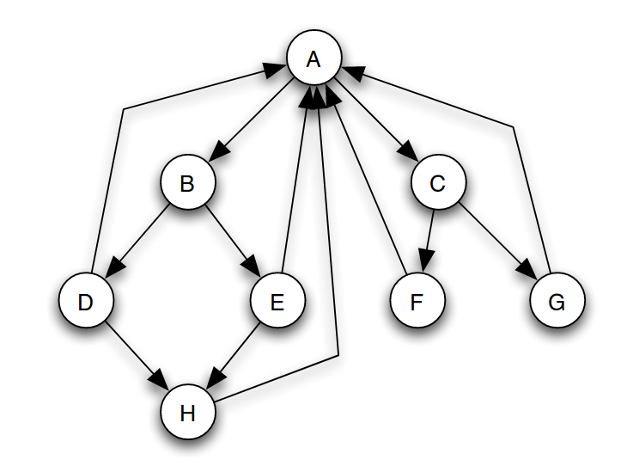
(Simplified) PageRank
All nodes start with score 1/n
Repeat k times:
  Divide equally and “send” its score to out-links
  Add received scores

Slide 32
Execute simplified PageRank:
All nodes start with
score 1/n
Repeat k times:
  Divide equally and “send”
  its score to out-links
  Add received scores
Keep intermediate values in
a table
Try to arrive to equilibrium
values

Slide 33
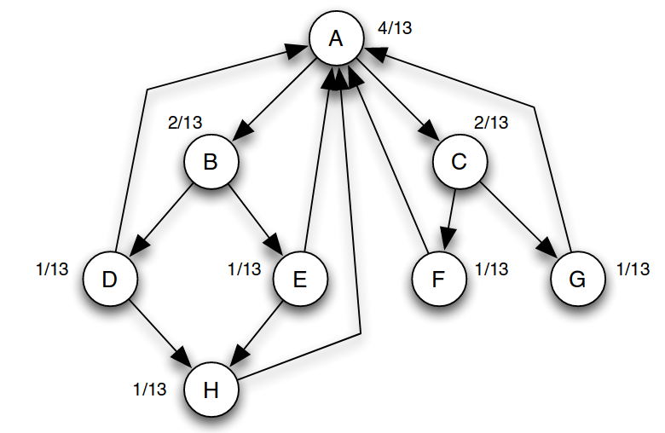
Equilibrium values

Slide 34
(Simplified) PageRank
N_{j}: the number of forward links of page j
c: normalization factor to ensure
  ||P||_{L1}= |P₁ + … + P_{n}| = 1

Slide 35
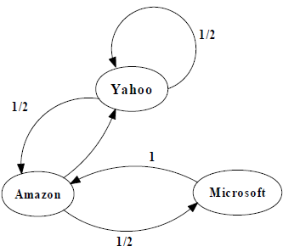
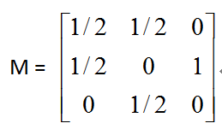
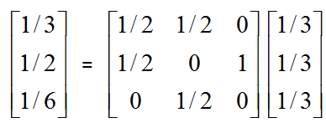
Another example of Simplified PageRank
First iteration of calculation

Slide 36
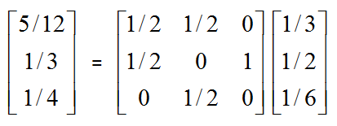
Another example of Simplified PageRank
First iteration of calculation

Slide 37
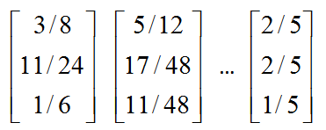
Another example of Simplified PageRank
Final score
First iteration of calculation

Slide 38
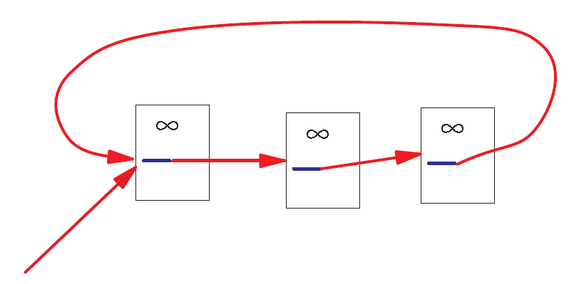
A Problem with Simplified PageRank
A loop:
During each iteration, the loop accumulates score but never distributes score to other pages!

Slide 39
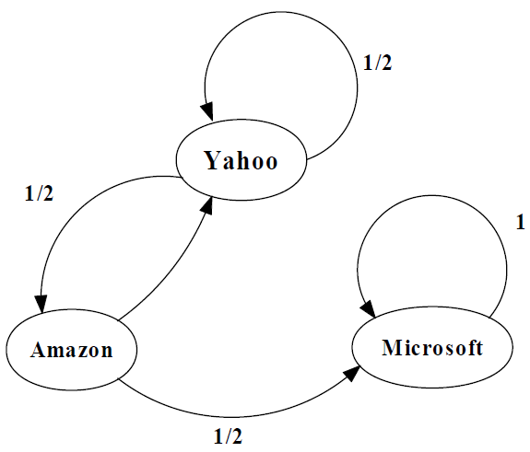
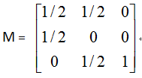
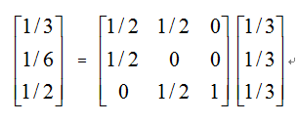
Example of the problem ...
First iteration of calculation

Slide 40
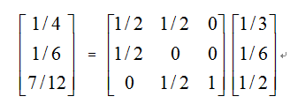
Example of the problem ...
First iteration of calculation

Slide 41
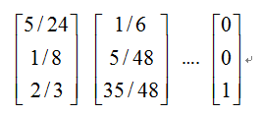
Example of the problem ...
The winner takes all!
First iteration of calculation

Slide 42
What are we computing?
What is p?
How do you call this method to compute p?

Slide 43
What are we computing?
p is an eigenvector of A with eigenvalue 1
This repeated multiplication is
the power method

Slide 44
What are we computing?
This will converge if A is:
  Stochastic (each row adds up to one)
  Irreducible (represents a strongly connected graph)
  Aperiodic (does not represent a bipartite graph)

Slide 45
Markov Chains
Discrete process over a set of states
Next state determined by current state and current state only (no memory of older states)
  Higher-order Markov chains can be defined
Stationary distribution of Markov chain is a probability distribution such that p = Ap
Intuitively, p represents “the average time spent” at each node if the process continues forever

Slide 46
Random Walks in Graphs
Random Surfer Model
  The simplified model: the standing probability distribution of a random walk on the graph of the web. simply keeps clicking successive links at random
Modified Random Surfer
  The modified model: the “random surfer” simply keeps clicking successive links at random, but periodically “gets bored” and jumps to a random page based on the distribution of E
  This guarantees irreducibility
  Pages without out-links (dangling nodes) are a row of zeros, can be replaced by E, or by a row of 1/n

Slide 47
PageRank
pref(i): web pages that “users” jump to when they “get bored”;
Uniform preferences => pref(i) = 1/n

Slide 48
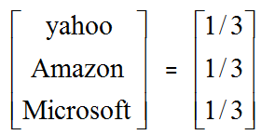
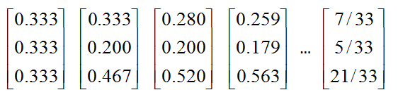
An example of PageRank

Slide 49

Variant: personalized PageRank
Modify pref(i) according to users' tastes
(e.g. user interested in sports vs politics)
http://nlp.stanford.edu/IR-book/html/htmledition/topic-specific-pagerank-1.html

Slide 50
PageRank and internal linking
A website has a maximum amount of Page Rank that is distributed between its pages by internal links [depends on internal links]
The maximum amount of Page Rank in a site increases as the number of pages in the site increases.
By linking poorly, it is possible to fail to reach the site's maximum Page Rank, but it is not possible to exceed it.
http://www.cs.sjsu.edu/faculty/pollett/masters/Semesters/Fall11/tanmayee/Deliverable3.pdf

Slide 51
Liquid democracy

Slide 52
PageRank as a form of actual voting (liquid democracy)
If alpha = 1, we can implement liquid democracy
  In liquid democracy, people chose to either vote or to delegate their vote to somebody else
If alpha < 1, we have a sort of “viscous” democracy where delegation is not total

Slide 53

PageRank as a form of liquid democracy
Boldi, P., Bonchi, F., Castillo, C., & Vigna, S. (2011). Viscous democracy for social networks. Communications of the ACM, 54(6), 129-137.

Slide 54

These two graphs have different alpha (0.2 and 0.9)
Which one is which?

Slide 55
These two graphs have different alpha (0.2 and 0.9)
Which one is which?

Slide 56
PageRank Implementation
Suppose there are n pages and m links
Trivial implementation of PageRank requires O(m+n) memory
Streaming implementation requires O(n) memory … how?
  Streaming: graph is never held on memory

Slide 57
PageRank streaming implementation
Maintain in memory
Update by reading the graph from disk

