Slide 1

Graph theory basics
Introduction to Network Science
Carlos Castillo
Topic 02

Slide 2
Sources
Albert László Barabási: Network Science. Cambridge University Press, 2016.
  Follows almost section-by-section chapter 02
URLs cited in the footer of specific slides

Slide 3

The seven bridges of Königsberg
http://networksciencebook.com/images/ch-02/video-2-1.m4v

Slide 4
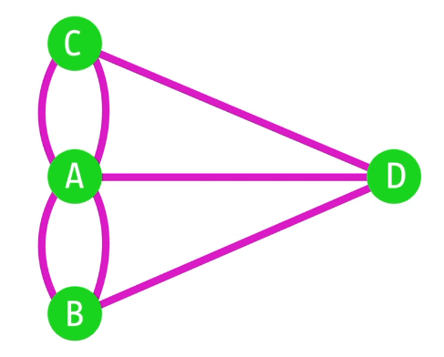
Can one walk across the 7 bridges w/o crossing the same path twice?
No
(proven by Euler, 1735)
A graph has an Eulerian circuit iff the graph is connected and all nodes have even degree
A graph has en Eulerian path iff the graph is connected and all nodes have even degree, or only 2 nodes have odd degree

Slide 5
Basic concepts

Slide 6
Notation for a graph
G = (V,E)
  V: nodes or vertices
  E: links or edges
|V| = N size of graph
|E| = L number of links

Slide 7
Typical notation variations
You may find that G is denoted by (N, A), this is typical of directed graphs
You may find that |V| is denoted by n, |E| is denoted by m

Slide 8
Directed vs undirected graphs
In a directed graph, also known as “digraph”,
E is a symmetric relation
  (u,v) ∈ E ⇒ (v,u) ∈ E
In an undirected graph, E is not symmetric

Slide 9
Example graphs we will use
Network | |V| | |E|
Zachary’s Karate Club (karate.gml) | 34 | 78
Les Misérables (lesmiserables.gml) | 77 | 254
E-mail exchanges (email-eu-core.csv) | 868 | 25K
US companies ownership | 1351 | 6721
Marvel comics (hero-network.csv) | 6K | 570K
https://github.com/chatox/networks-science-course/tree/master/practicum/data

Slide 10
Degree
Node i has degree k_{i}
  This is the number of links incident on this node
  The total number of links L is given by
Average degree

Slide 11
In directed networks
We distinguish in-degree from out-degree
  Incoming and outgoing links, respectively
Degree is the sum of both
Counting total number of links:

Slide 12
Degree distribution
If there are N_{k} nodes with degree k
The degree distribution is given by
The average degree is then

Slide 13
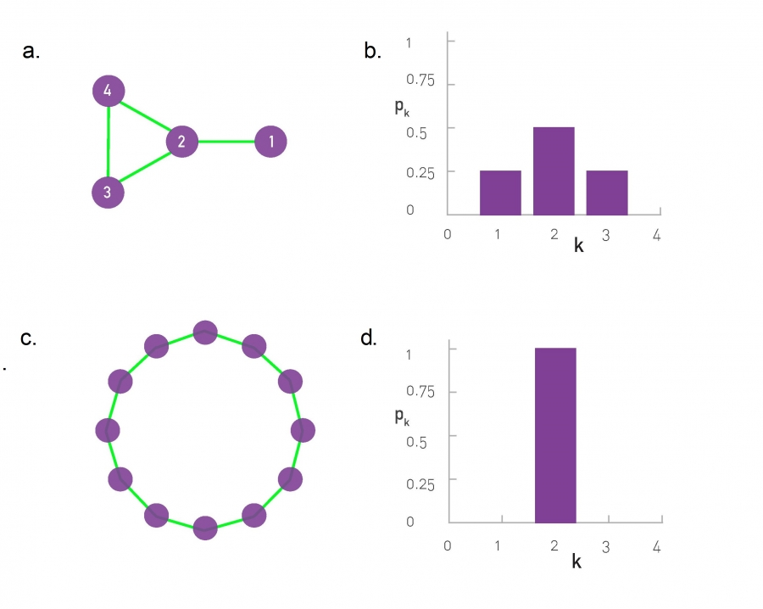
Degree distribution; two toy graphs

Slide 14
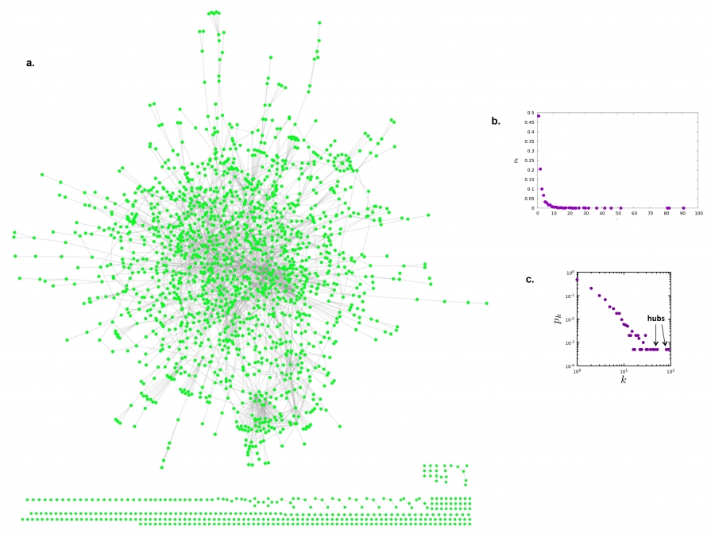
Degree distribution; real graph
Linear
scale
Log-log
scale

Slide 15
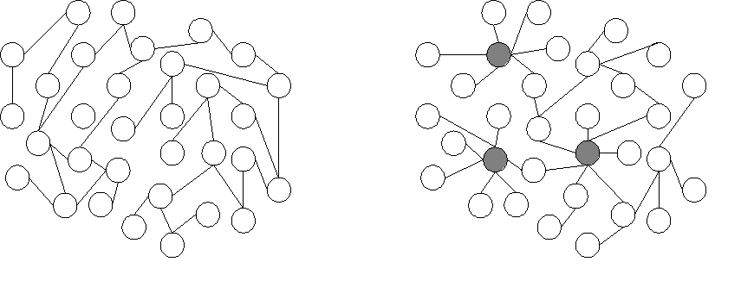
Exercise
Draw the degree distribution of these graphs

Slide 16
Adjacency matrix

Slide 17
What is an adjacency matrix
A is the adjacency matrix of G = (V, E) iff:
  A has |V| rows and |V| columns
  A_{ij} = 1 if (i,j)∈ E
  A_{ij} = 0 if (i,j)∉ E

Slide 18
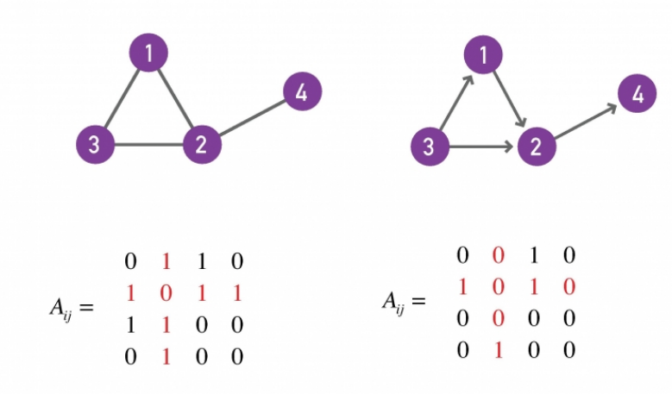
Examples
Undirected graph
Directed graph

Slide 19
Quick exercise
In terms of A, what is the expression for:

Slide 20
Quick exercise
In terms of A, what is the expression for:

Slide 21
Some “graphology” ...
G is undirected ⇔ A is symmetric
G has a self-loop
⇔ A has a non-zero element in the diagonal
G is complete ⇔ A_{ij} ≠ 0 (except if i=j)

Slide 22
Real networks are sparse
Theoretically
Most real networks are sparse, i.e.,

Slide 23
How sparse are some networks?
Network | |V| | |E| | Max |E|
Zachary’s Karate Club | 34 | 78 | 561
Les Misérables | 77 | 254 | 2962
E-mail exchanges | 868 | 25K | 376K
US companies ownership | 1351 | 6721 | 911K
Marvel comics | 6K | 570K | 17M
https://github.com/chatox/networks-science-course/tree/master/practicum/data

Slide 24

Example: protein interaction network
(N=2K, L=3K)

Slide 25
Why are networks sparse?
Different mechanisms, think about it from the node perspective:
  How many items could the node be connected to
  Would it be realistic to connect to a large fraction of them?
In social networks, Dunbar’s number (≃150)
https://en.wikipedia.org/wiki/Dunbar's_number

Slide 26
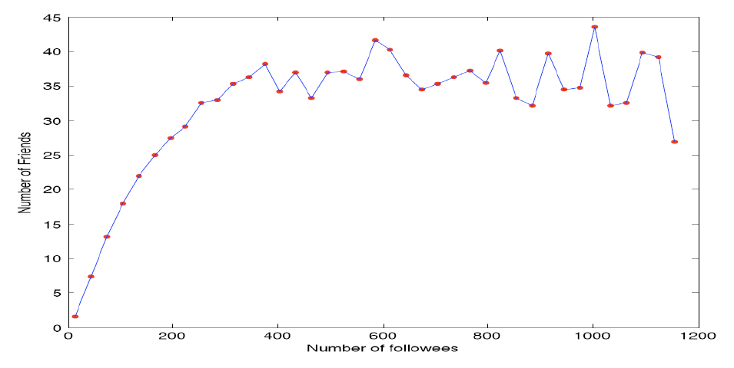
Example: actual friends in Twitter vs people you follow in Twitter
Huberman, B., Romero, D. M., & Wu, F. (2008). Social networks that matter: Twitter under the microscope. First Monday, 14(1).

Slide 27
Weighted networks
In weighted networks, instead of
We have that
Weights may represent different tie strengths

Slide 28
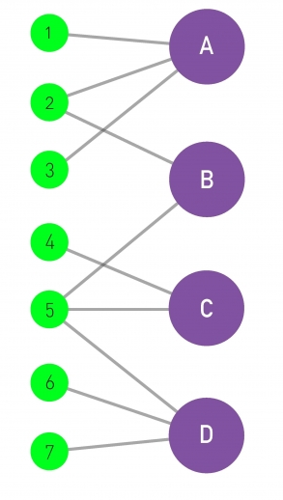
Bipartite networks
A bipartite graph is a graph
G = (V,E) such that

Slide 29
Projecting a bipartite network
?
Left projection:
graph where nodes
are 1, 2, …, 7 and
nodes are connected
if they share a
neighbor
?
Right projection:
graph where nodes
are A, B, …, D and
nodes are connected
if they share a
neighbor

Slide 30
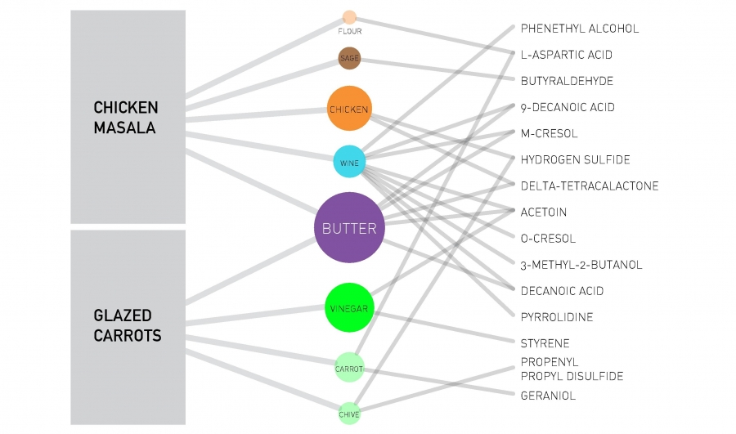
Tripartite network

Slide 31
Clique and Bi-partite clique
A clique is a complete graph:
An n-clique is a complete graph of n nodes
A bi-partite clique is such that
A (n₁, n₂)-clique is a bipartite clique such that

Slide 32
Paths and distances

Slide 33
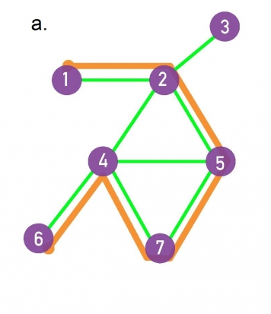
Paths
A path is a sequence of edges from E
The destination of each edge is the origin of the next edge
The length of the path is the number of edges on it
Example: a path marked in orange, having length 5

Slide 34
Connectedness
If a path exists between two nodes i, j:
  those nodes are part of the same connected component
A graph that has only one connected component is called a connected graph

Slide 35
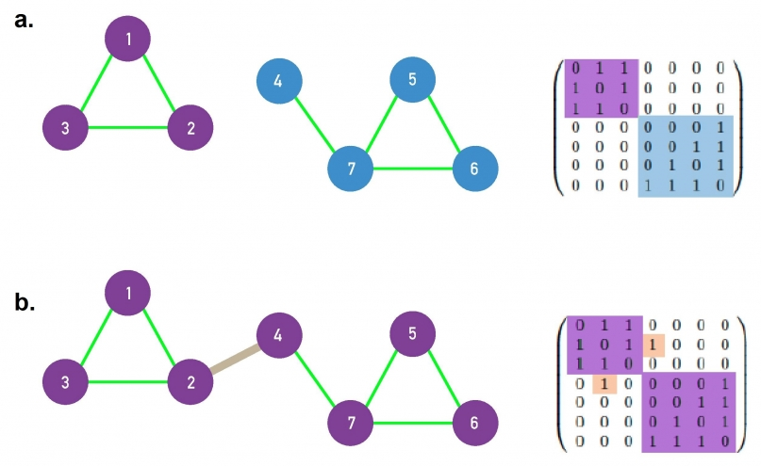
Connected graphs
A disconnected graph has an adjacency matrix that can be arranged in block diagonal form
a. disconnected
b. connected

Slide 36
Distance
If two nodes i, j are in the same connected component:
  the distance between i and j, denoted by d_{ij} is the length of the shortest path between them

Slide 37
Diameter
The diameter of a network is the maximum distance between two nodes on it, d_{max}
The effective diameter (or effective-90% diameter) is a number d such that 90% of the pairs of nodes (i,j) are at a distance smaller than d
The average distance is <d>, and is measured only for nodes that are in the same connected component

Slide 38
Local clustering coefficient
The local clustering coefficient C_{i} is a property of a node i
Let L_{i} represent the number of links among neighbors of node i

Slide 39
Average clustering coefficient
The average clustering coefficient is a property of the entire graph

Slide 40
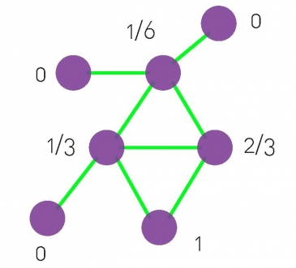
Try it!
What is the local clustering coefficient of each node?
?
?
?
?
?
?
?

Slide 41
Local clustering coefficient of each node

