Slide 1

Random Networks (ER Model)
Social Networks Analysis and Graph Algorithms
Prof. Carlos Castillo — https://chato.cl/teach

Slide 2
Contents
The ER model
Degree distribution under the ER model

Slide 3
Sources
A. L. Barabási (2016). Network Science – Chapter 03
Data-Driven Social Analytics course by Vicenç Gómez and Andreas Kaltenbrunner
URLs cited in the footer of specific slides

Slide 4
Network Models

Slide 5
Network models
Networks of many different types have similar properties:
  Short paths
  Many triangles
  Skewed degree distributions
Where do such properties come from?
How do nodes connect to each other? How are triangles formed?
We will study network models, i.e., sets of instructions to create networks
Source: Menczer, Fortunato, Davis: A First Course on Networks Science. Cambridge, 2020.

Slide 6
Why studying network models?
Our models will be stochastic, i.e., randomized
Running stochastic network models can let us check if they generate networks that look like real ones
Almost invariably, the generated networks will be similar to actual networks in some ways, but different in other ways

Slide 7

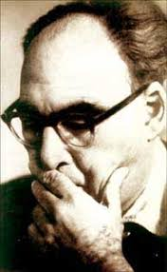
The “Random Network”
Erdös-Rényi (ER) Model
Sounds like “ERDOSH and REGN”
Paul Erdös
(1913-1996)
Alfred Rényi
(1921-1970)

Slide 8
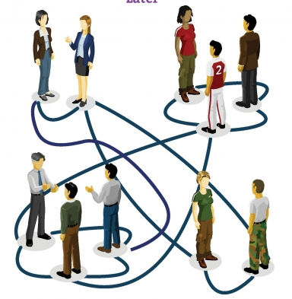
Meeting people at a party
You pick a random person
Talk to that person for a while, if there are good vibes, you are connected
Then pick another person
  And repeat
The result is what we call a random network

Slide 9
Formalization (Erdös-Rényi or ER)
Sounds like “ERDOSH and REGN”
For each pair of nodes in the graph
  Perform a Bernoulli trial with probability p
    “Toss a biased coin with probability p of landing heads”
  If the trial succeeds, connect those nodes
    “If the coin lands heads, connect those nodes”
Repeat for all pairs

Slide 10
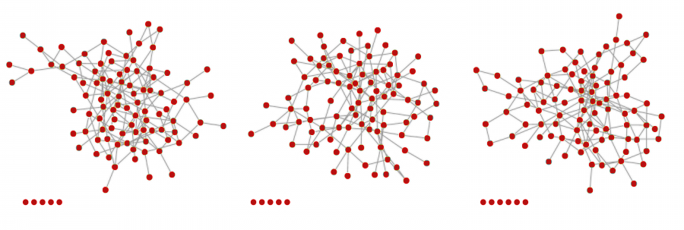
Example
(3 networks, same parameters)
Nodes at the bottom ended up isolated

Slide 11
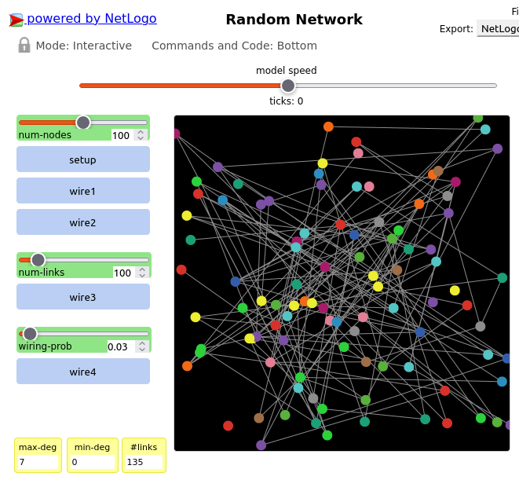

Exercise
Guess formula for 〈L〉
Go to netlogoweb.org/launch and select:
“IABM Textbook / chapter 5 / Random Network”
Execute the “Random Network” program in Netlogo Web
  Select num-nodes N (e.g., 100)
  Click “setup”
  Select wiring-prob p (e.g., 0.03)
  Click “wire4”
  Write down “#links” L somewhere
  Repeat various times
Guess a formula for 〈L〉 as a function of N and p
Pin board: https://upfbarcelona.padlet.org/chato/84a1nj59pkqpxvh3

Slide 12
Answer
Guess formula for 〈L〉

Slide 13
Degree distribution

Slide 14
A key characteristic of a network: its degree distribution
One of the most evident characteristics of a network is its degree distribution
  Is this distribution very skewed? Or every node is close to some average? Is there a “typical” degree?
  Does it look like the degree distribution predicted by a network formation model?
We will spend a fair amount of time studying the degree distribution under various models

Slide 15
The binomial distribution
The distribution of the probability of obtaining x successes in n independent trials, in which each trial has probability of succeeding p

Slide 16
Degree distribution in ER model
Simply a Binomial distribution
Note that the maximum number of “successes” (links) of a node is N-1, hence:

Slide 17
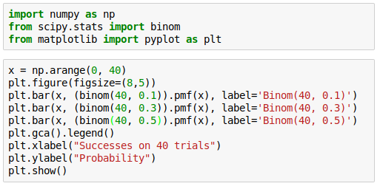
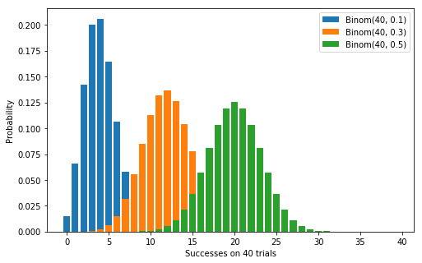

Degree distribution examples
The peak is always at

Slide 18
Expected number of links
Expected number of links
Average degree

Slide 19
Exercise [B. 2016, Ex. 3.11.1]
Expected number of links and average degree
Consider an ER graph with N=3,000 p=10⁻³
  What is the expected number of links 〈L〉?
  What is the average degree 〈k〉?

Slide 20
Answer [B. 2016, Ex. 3.11.1]
Consider an ER graph with N=3,000 p=10⁻³
  What is the expected number of links 〈L〉?

Slide 21
Answer [B. 2016, Ex. 3.11.1]
Consider an ER graph with N=3,000 p=10⁻³
  What is the average degree 〈k〉?

Slide 22
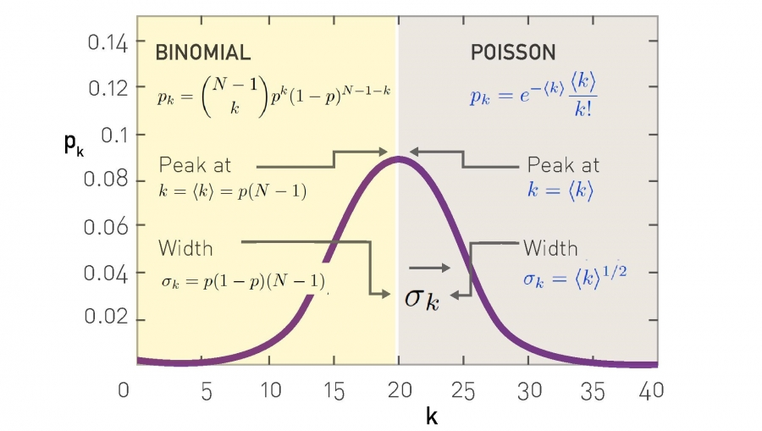
Approximation with a Poisson distribution for

Slide 23
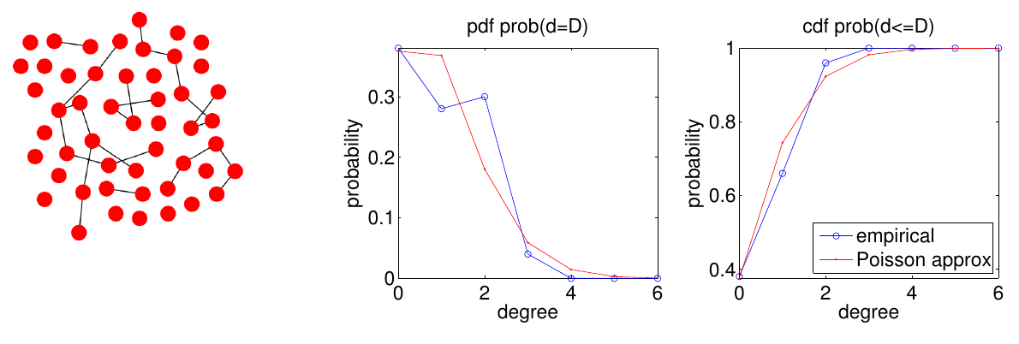
More examples (1/6)
https://www.upf.edu/web/iis/DataDrivenSocialAnalytics

Slide 24
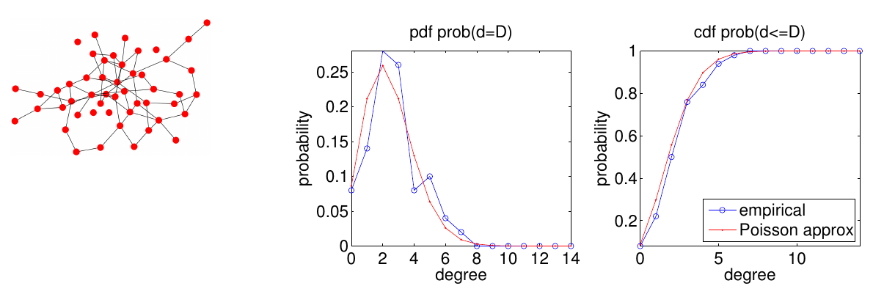
More examples (2/6)
https://www.upf.edu/web/iis/DataDrivenSocialAnalytics

Slide 25
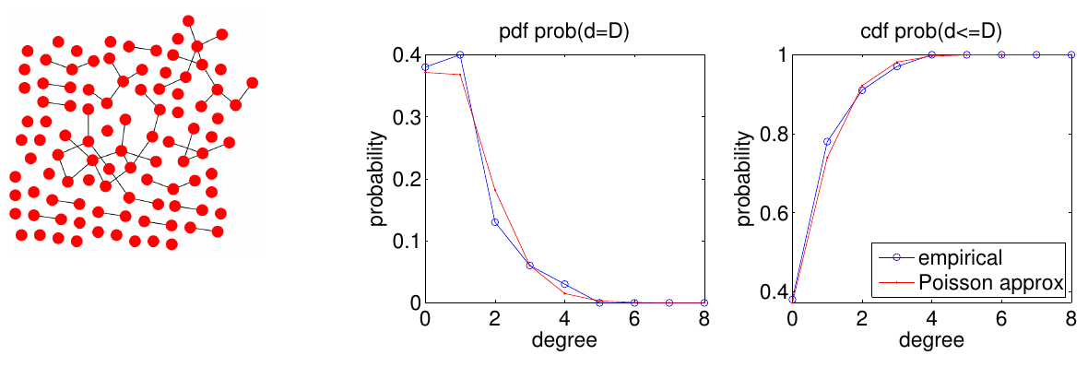
More examples (3/6)
https://www.upf.edu/web/iis/DataDrivenSocialAnalytics

Slide 26
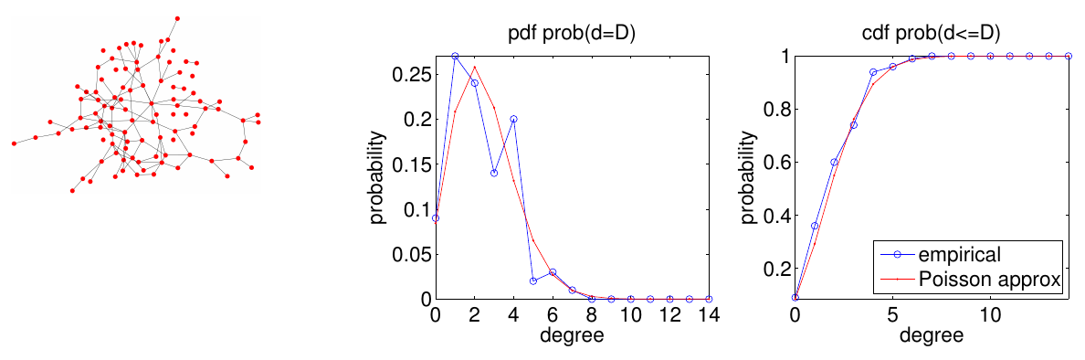
More examples (4/6)
https://www.upf.edu/web/iis/DataDrivenSocialAnalytics

Slide 27
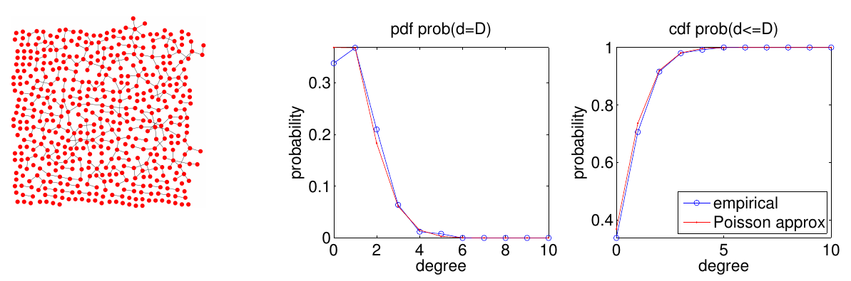
More examples (5/6)
https://www.upf.edu/web/iis/DataDrivenSocialAnalytics

Slide 28
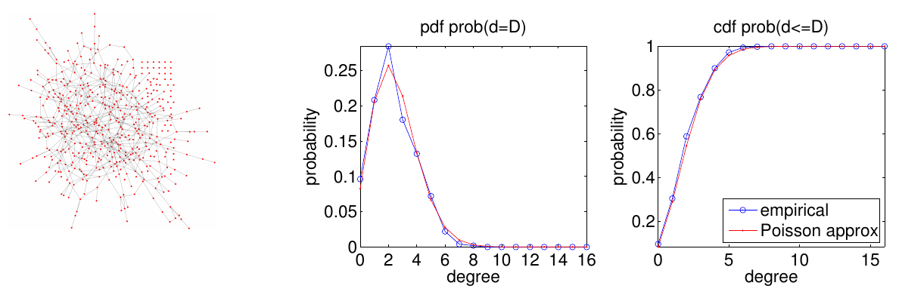
More examples (6/6)
https://www.upf.edu/web/iis/DataDrivenSocialAnalytics

Slide 29
“Back of the envelope” calculations
Suppose N = 7 x 10⁹
Suppose <k> = 1,000
  A person knows the name of approx. 1,000 others
Then on expectation k_{max} = 1,185
<k> ± σ is the range from 968 to 1,032
Is this realistic?

Slide 30

Survey: how many WhatsApp contacts do you have?
https://forms.gle/9xEYhzv2U5NrPQdH8

Slide 31
[Link to spreadsheet with results]

Slide 32
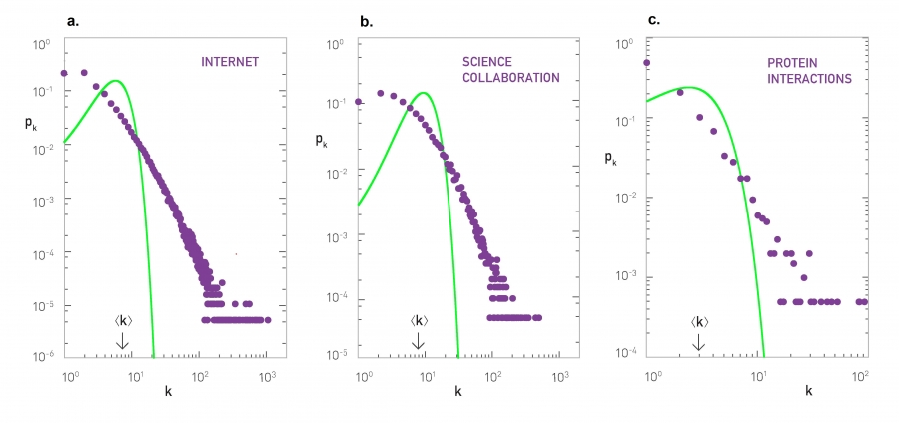
Real networks (green = )

Slide 33
Summary

Slide 34
Things to remember
The ER model
Degree distribution in the ER model

Slide 35
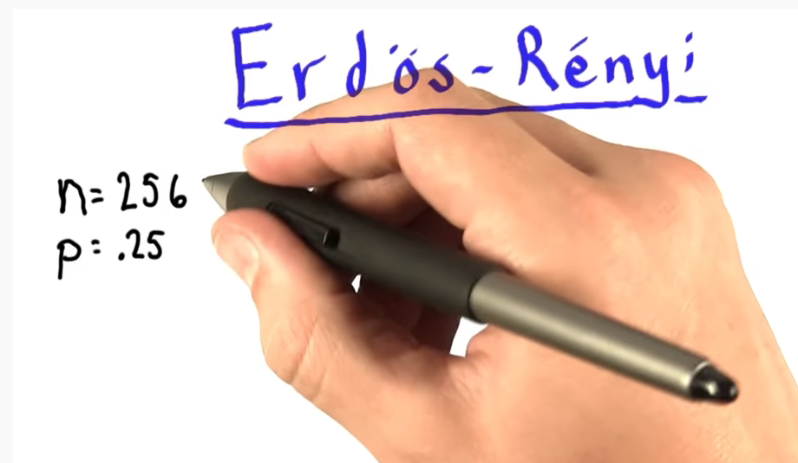
Practice on your own
Indicate the expected number of edges of a network with N=256, p=0.25; then compare your solution with the one on this video:
https://www.youtube.com/watch?v=2DckiyysQy4

