Slide 1

Homophily and assortativity
Introduction to Network Science
Carlos Castillo
Topic 06

Slide 2
Sources
Albert László Barabási: Network Science. Cambridge University Press, 2016. Ch 07
Networks, Crowds, and Markets Ch 03 and 04
Nicola Barbieri’s tutorial on homophily and influence in social networks, 2016
C. Castillo: Link prediction slides 2016

Slide 3
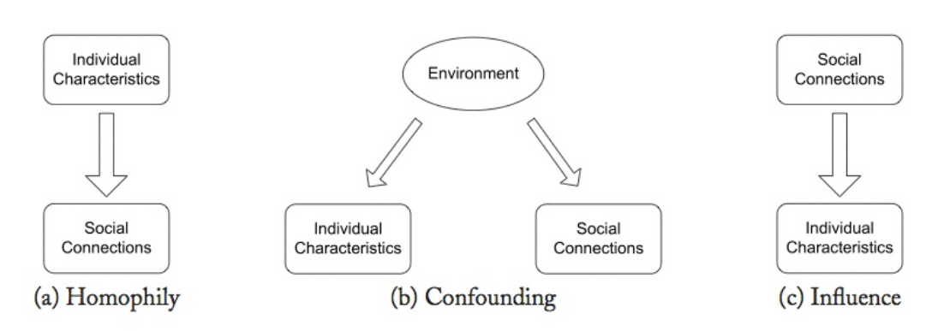
Three models of social correlation

Slide 4
Three models (cont.)
Homophily: tendency of agents to be connected to similar agents
Confounding: correlation between agent actions can be explained by external factors
Influence: agent actions influence the actions of their connections

Slide 5
Think of your own friends
Your friends are not a random sample
  Similar age, affluence, interests, beliefs, … to you
  (most of them)
Long-standing observation
  Plato (“similarity begets friendship”)
  Aristotle (people “love those who are like themselves”)

Slide 6
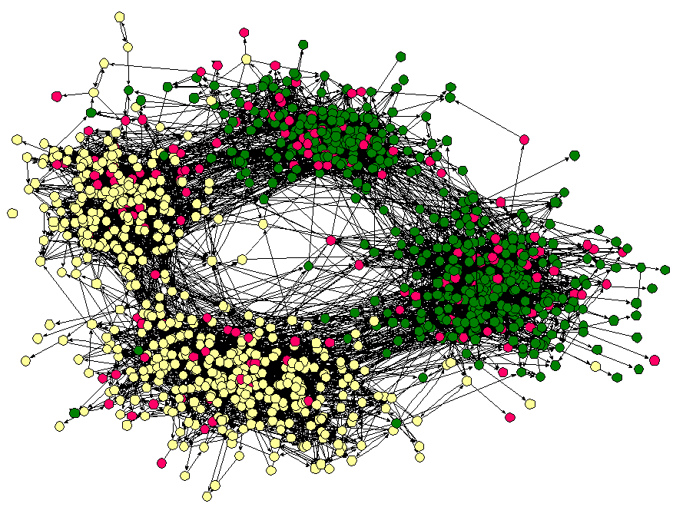
Friendships by race
(Middle school in the US, ca 2001)
Moody, J. (2001). Race, school integration, and friendship segregation in America. American journal of Sociology, 107(3), 679-716.

Slide 7
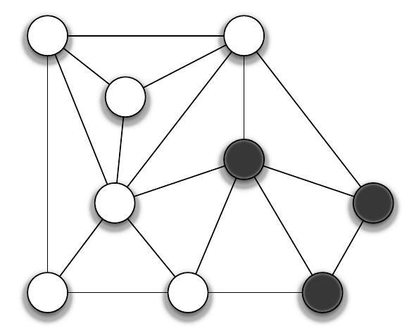
How to measure homophily?
Count homogeneous edges (white-white or black-black)
Count heterogeneous edges (white-black)

Slide 8
There are 5 heterogeneous edges
There are 13 homogeneous edges
There are 18 edges in total

Slide 9
Homophily test
Suppose the probability of being white is
The probability of being black is
What is the probability of:
  A white-white edge
  A black-black edge
  A white-black edge

Slide 10
Homophily test (answer)
Suppose the probability of being white is
The probability of being black is
What is the probability of:
  A white-white edge
  A black-black edge
  A white-black edge

Slide 11
Homophily test (cont.)
How many homogeneous edges do we expect?
Hence, does this graph exhibit homophily?

Slide 12
Homophily test (cont.) (answer)
Probability of being white is
The probability of being black is
Expected number of heterogeneous edges
However we see 5 (< 8), hence we have less heterogeneous edges ⇒ evidence of homophily

Slide 13
Homophily measurement: one-tailed binomial test
Given G=(V,E) with colors assigned at random
  (p|V| white nodes and (1-p)|V| black nodes)
The number of heterogeneous edges follows

Slide 14
In our example
We compute
Hence observing this number of heterogenous edges or less has a probability of more than 10%
Hence homophily in this case is not significant at 0.05

Slide 15
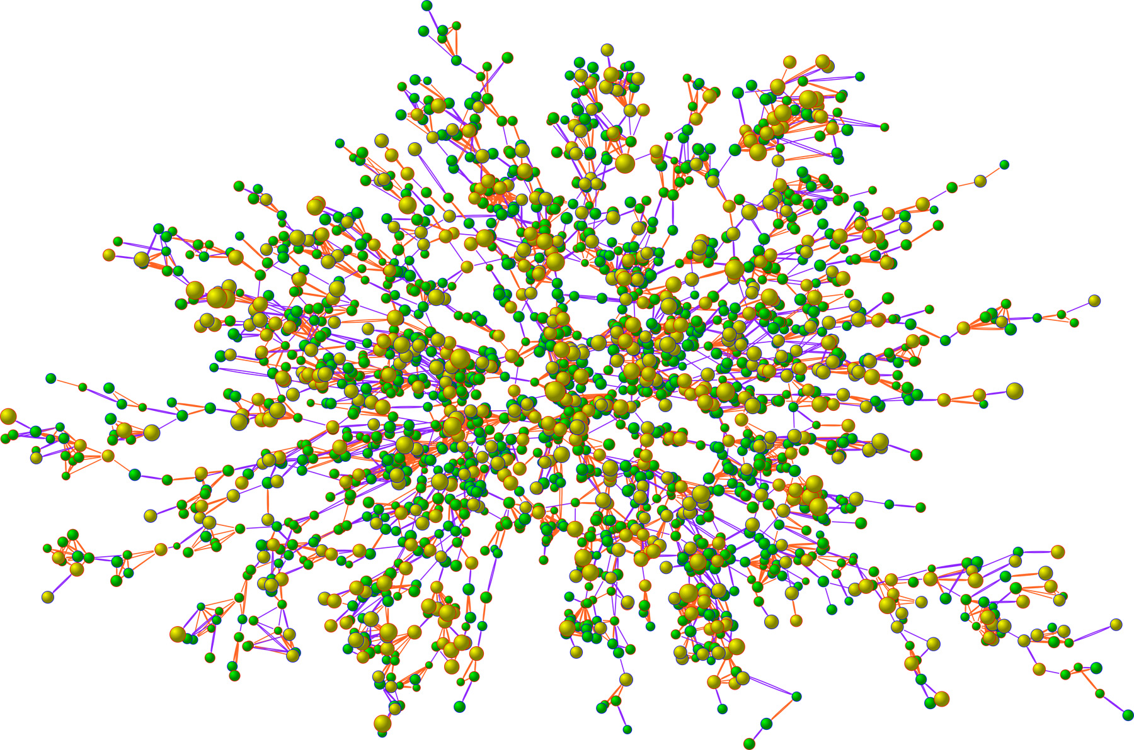
Obesity study (N=2,200)
Size: BMI
Yellow: obese
Christakis, N. A., & Fowler, J. H. (2007). The spread of obesity in a large social network over 32 years. New England journal of medicine, 357(4), 370-379.

Slide 16
Selection and social influence
Selection is the process by which we chose to connect to people based on our characteristics
Social influence is the process by which we transform and are transformed by our connections
What do we see in the obesity study?

Slide 17
Christakis and Fowler show evidence that in their sample:
People indeed connect to other similarly obese or not obese (homophily)
People are affected by external influence to be more or less obese (confounding)
People change the behavior of others (social influence)

Slide 18
Thought experiment
Suppose you are asked to design a program to prevent drug addiction by focusing resources in ensuring well-connected people do not become addicted to drugs
Under which circumstances this program would be more successful? Less successful?

Slide 19
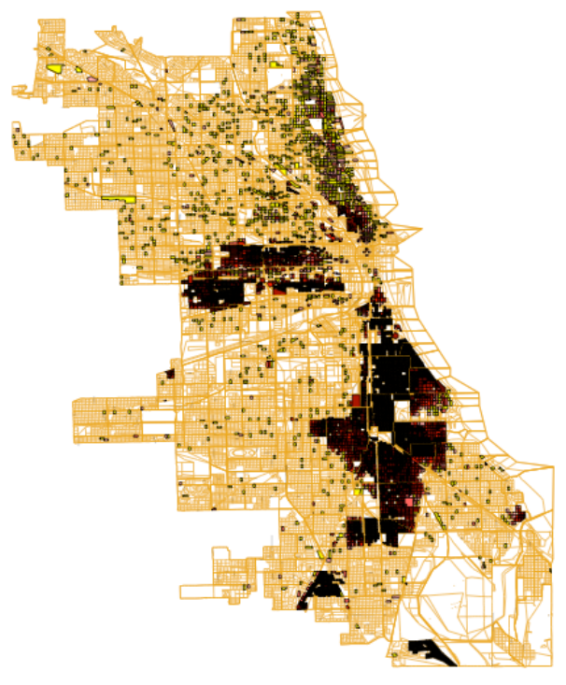
Geographical segregation
In this map of Chicago (US) in 1960, brown/black areas have majority African-American populations
Möbius, M. M., & Rosenblat, T. S. (2001). The process of ghetto formation: evidence from Chicago. Technical Report, Harvard University.

