Slide 1

Spectral clustering
Introduction to Network Science
Carlos Castillo
Topic 15

Slide 2
Sources
Jure Leskovec (2016) Defining the graph laplacian [video]
Evimaria Terzi: Graph cuts / spectral graph partitioning
Daniel A. Spielman (2009): The Laplacian
C. Castillo (2017) Graph partitioning

Slide 3
Graphs are nice, but ...
They describe only local relationships
We would like to understand a global structure
Our objective is transforming a graph into a more familiar object: a cloud of points in R^{k}
R¹

Slide 4
Graphs are nice, but ...
They describe only local relationships
We would like to understand a global structure
Our objective is transforming a graph into a more familiar object: a cloud of points in R^{k}
R¹
Distances should be somehow preserved

Slide 5
What is a graph embedding?
A graph embedding is a mapping from a graph to a vector space
If the vector space is you can think of an embedding as a way of drawing a graph

Slide 6
Try drawing this graph
V = {v1, v2, …, v8}
E = { (v1, v2), (v2, v3), (v3, v4), (v4, v1), (v5, v6), (v6, v7), (v7, v8), (v8, v5), (v1,v5), (v2, v6), (v3, v7), (v4, v8) }
Draw this graph on paper
What constitutes a good drawing?

Slide 7


Example drawings
Look at the 3 neighbors of each corner, they should all be at the same distance
Distances are not preserved well

Slide 8



2D graph embeddings in NetworkX
nx.draw_networkx(g)
nx.draw_spectral(g)

Slide 9
In a good graph embedding ...
Pairs of nodes that are connected to each other should be close
Pairs of nodes that are not connected should be far
Compromises usually need to be made

Slide 10
Random 2D graph projection
Start a BFS from a random node, that has x=1, and nodes visited have ascending x
Start a BFS from another random node, which has y=1, and nodes visited have ascending y
Project node i to position (x_{i}, y_{i})
How do you think this works in practice?

Slide 11
Eigenvectors of adjacency matrix

Slide 12
Adjacency matrix of G=(V,E)
What is Ax? Think of x as a set of labels/values:
Ax is a vector whose i^{th} coordinate contains the sum of the x_{j} who are in-neighbors of i
https://www.youtube.com/watch?v=AR7iFxM-NkA

Slide 13
Properties of adjacency matrix
How many non-zeros are in every row of A?
https://www.youtube.com/watch?v=AR7iFxM-NkA

Slide 14
Understanding the adjacency matrix
What is Ax? Think of x as a set of labels/values:
Ax is a vector whose i^{th} coordinate contains the sum of the x_{j} who are in-neighbors of i
https://www.youtube.com/watch?v=AR7iFxM-NkA

Slide 15
Spectral graph theory
The study of the eigenvalues and eigenvectors of a graph matrix
  Adjacency matrix
  Laplacian matrix (next)
Suppose graph is d-regular,
what is the value of:
What does that imply?

Slide 16
An easy eigenvector of A
Suppose graph is d-regular, i.e. all nodes have degree d:
So [1, 1, …, 1]^{T} is an eigenvector of eigenvalue d

Slide 17
Disconnected graphs
Suppose graph is disconnected (still regular)
Then its adjacency matrix has block structure:
S
S'

Slide 18
Disconnected graphs
Suppose graph is disconnected (still regular)
S
S'

Slide 19
Disconnected graphs
Suppose graph is disconnected (still regular)
S
S'

Slide 20
Disconnected graphs
Suppose graph is disconnected (still regular)
What happens if there are more than 2 connected components?
S
S'

Slide 21
In general
Disconnected graph
Almost disconnected graph
Small “eigengap”

Slide 22
Graph Laplacian

Slide 23
Adjacency matrix
1
5
2
6
3
4

Slide 24
Degree matrix
1
5
2
6
3
4

Slide 25
Laplacian matrix
1
5
2
6
3
4

Slide 26
Laplacian matrix L = D - A
Symmetric
Eigenvalues non-negative and real
Eigenvectors real and orthogonal

Slide 27
Constant vector is eigenvector of L
The constant vector x=[1,1,...,1]^{T} is again an eigenvector, but this time has eigenvalue 0

Slide 28
If the graph is disconnected
If there are two connected components, the same argument as for the adjacency matrix applies, and
In general, the multiplicity of eigenvalue 0 is the number of connected components

Slide 29
x^{T}Lx

Slide 30
Important property of x^{T}Lx
Think of this quantity as the “stress” produced by the assignment of node labels x

Slide 31
x^{T}Lx and graph cuts
Suppose (S, S') is a cut of graph G
Set
1
1
0
1
0

Slide 32
For symmetric matrices
Important fact for symmetric matrices
https://en.wikipedia.org/wiki/Rayleigh_quotient

Slide 33
Second eigenvector
Orthogonal to the first one:
Normal:

Slide 34
What does this mean?
0
Nodes should be placed at both sides of 0 because

Slide 35
Example Graph 1
2
7
1
8
3
6
4
5

Slide 36
Example Graph 1
2
7
1
8
3
6
4
5

Slide 37
Example Graph 1, projected
2
7
1
8
3
6
4
5
-0.383
-0.247
0
0.247
0.383

Slide 38
Example Graph 1, communities
S
S'
2
7
1
8
3
6
4
5
-0.383
-0.247
0
0.247
0.383

Slide 39
Example Graph 2
2
7
1
8
3
6
4
5

Slide 40
Example Graph 3
2
7
1
8
3
6
4
5

Slide 41
Example Graph 3, projected
2
7
1
8
3
6
4
5
-0.364
-0.246
-0.057
0
0.139
0.551
-0.210

Slide 42
Example Graph 3, projected how to partition?
2
8
7
1
3
6
4
5
-0.364
-0.246
-0.057
0
0.139
0.551
-0.210

Slide 43
Example Graph 3, projected
S
S'
2
8
7
1
3
6
4
5
-0.364
-0.246
-0.057
0
0.139
0.551
-0.210

Slide 44

A more complex graph
https://www.youtube.com/watch?v=jpTjj5PmcMM

Slide 45

A graph with 4 “communities”
https://www.youtube.com/watch?v=jpTjj5PmcMM

Slide 46

Other eigenvectors
Second eigenvector
Third eigenvector
Value in third eigenvector
Value in second eigenvector

Slide 47
Other eigenvectors
Second eigenvector
Third eigenvector
Value in third eigenvector
Value in second eigenvector

Slide 48




Interesting application: image segmentation [Shi & Malik 2000]
Transform into grid graph with edge weights proportional to pixel similarity

Slide 49
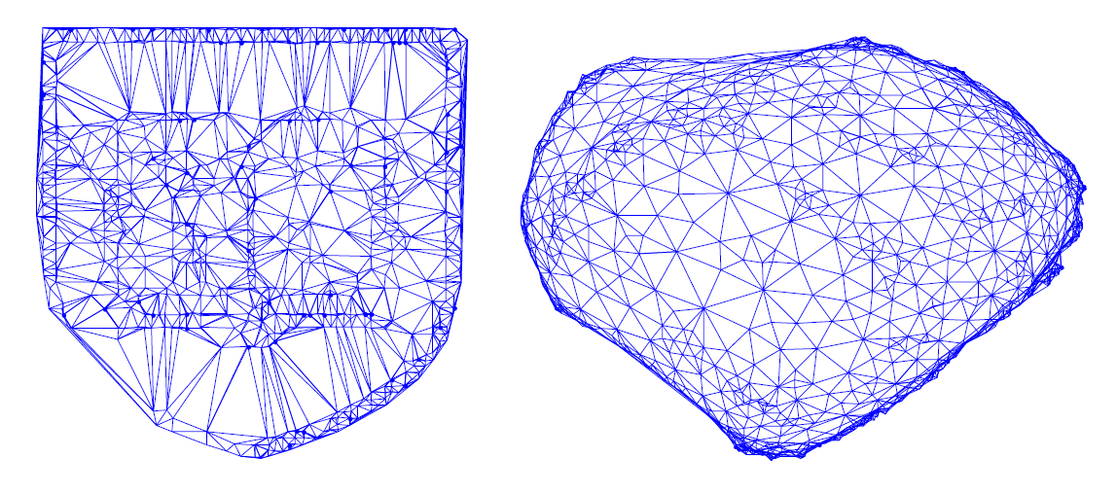
Lots of examples!
http://www.cs.yale.edu/homes/spielman/sgta/SpectTut.pdf

Slide 50
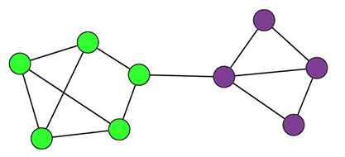
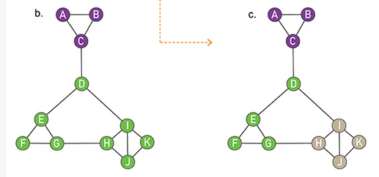
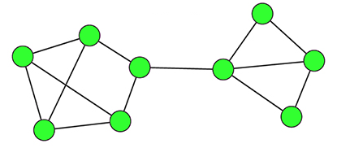
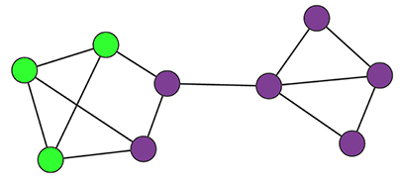
Try it!
Compute the modularity of these partitions

Slide 51
Q=0.36
Q=0.45
Q=0.41
Q=0.22
Q=0.22
Q=0.00

