Slide 1

Degree Distributions in Preferential Attachment
Introduction to Network Science
Carlos Castillo
Topic 12

Slide 2
Contents
Degree distribution under the BA model
Distance distribution under the BA model
Clustering coefficient under the BA model
BA model means Barabási-Albert model (preferential attachment)

Slide 3
Sources
Albert László Barabási (2016) Network Science
  Preferential attachment follows chapter 05
Ravi Srinivasan 2013 Complex Networks Ch 12
Networks, Crowds, and Markets Ch 18
Data-Driven Social Analytics course by Vicenç Gómez and Andreas Kaltenbrunner

Slide 4
Remember the BA model
Network starts with nodes connected arbitrarily as long as their degree is ≥ 1
At every time step we add 1 node
This node will have outlinks
The probability of an existing node of degree to gain one such link is

Slide 5
Degree k_{i}(t) as a function of time
(For large t)

Slide 6
Degree k_{i}(t) … continued
Note: in exams for this course,
you will not be asked to solve
differential equations on your own
(t_{i} is the creation time of node i)

Slide 7


Degree k_{i}(t) … continued
Is the degree growth linear, super-linear, or sub-linear? Intuitively, why?
is called the dynamical exponent

Slide 8
Sub-linear, because exponent ½ < 1

Slide 9
Degree k_{i}(t) … consequences
If t_{i} < t_{j} (node i is older than node j), what do we expect of k_{i} and k_{j}?

Slide 10
Older nodes have a faster degree growth rate

Slide 11
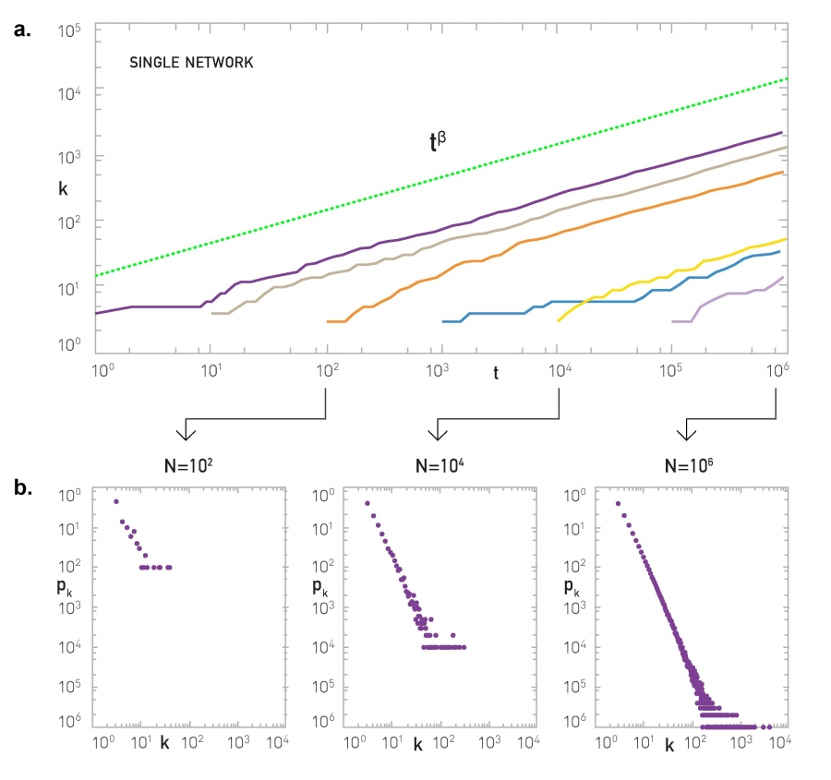
Simulation results
Model
Nodes with t_{i} = 1, 10, 100, 1000, 10000, ...

Slide 12
Degree distribution
Now let’s take the derivative of the CDF to obtain the PDF
Note (2021-10-29): This slide is correct but I’ve to add an explanation of the first line

Slide 13

Degree distribution
Let’s calculate the CDF of the degree distribution

Slide 14
Degree distribution
is called the dynamical exponent
is the power-law exponent
Note that
does not depend on t
hence, it describes a stationary network

Slide 15
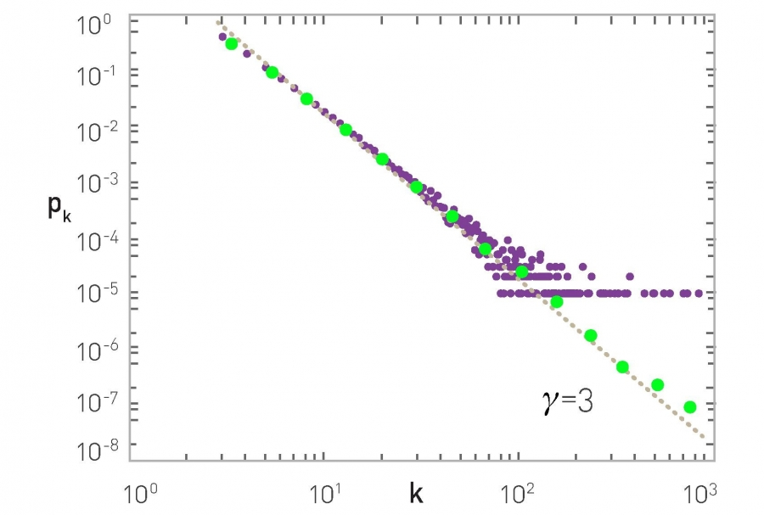
Degree distribution, simulation results
N=100,000 m=3

Slide 16
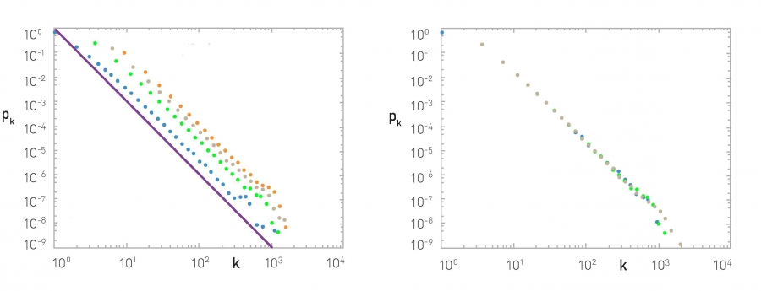
More simulations
N = 100,000; m₀ = m =
1 (blue), 3 (green), 5 (gray), 7 (orange)
Observe γ is independent of m (and m₀)
The slope of the purple line is -3
m₀ = m = 3; N =
50K (blue), 100K (green), 200K (gray)
Observe p_{k} is independent of N

Slide 17
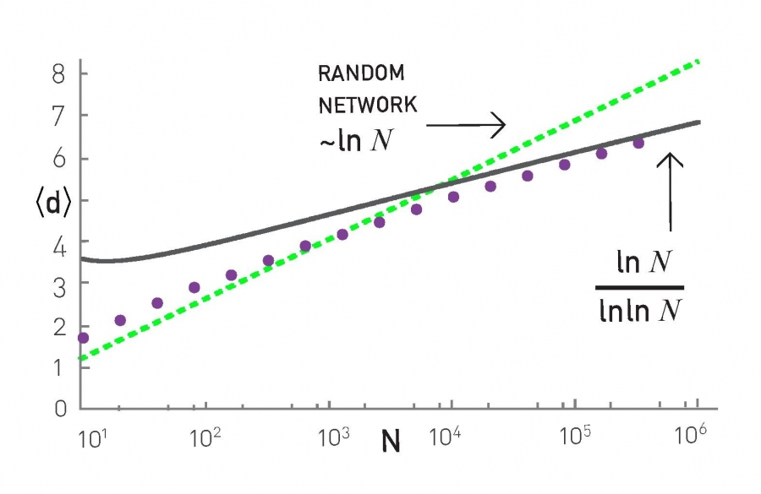
Average distance
Distances grow slower than log N
(Why: scale free network with )

Slide 18
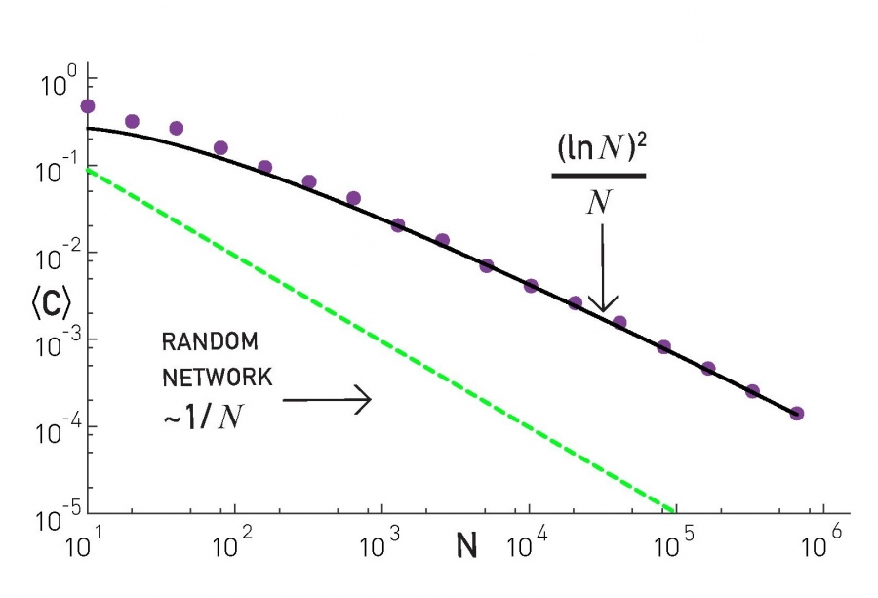
Clustering coefficient
BA networks are locally more clustered than ER networks

Slide 19
Limitations of the BA model
Predicts a fixed exponent of -3
Assumes an undirected network, while many real complex networks are directed
Does not consider node deletions or edge deletions which are common in practice
Considers that all nodes are equal except for their arrival times

Slide 20
Other processes that generate scale-free networks
Link-selection model — step:
  Add one new node v to the network
  Select an existing link (u,w) at random and connect v to either u or w
Copy model ­— step:
  Add one new node v to the network
  Pick a random existing node u
  With probability p link to u
  With probability 1-p link to a neighbor of u

Slide 21
Exercise: the copy model
In the copy model, start at t=1 with one node, and at every step t :
  Add one new node v to the network
  Pick a random existing node u
  If u has no out-links, link to u
  If u has out-links choose one of the following:
    With probability p link to u
    With probability 1-p link to one of the out-neighbors of u chosen at random
Simulate it on paper (directed graph) for 7 nodes with p=0.5
  Make sure you understand the model fully!
What is N(t) and L(t)? What is ?
Answer in Nearpod Draw-ithttps://nearpod.com/student/
Access to be provided during class

Slide 23
Degree distribution in the copy model
Proven in the paper byKumar et al. (FOCS 2000)
“Stochastic models for the web graph” and developed in the advanced materials.
The copy model can generate any exponent between 2 and 3!

Slide 24
Summary

Slide 25
Things to remember
Degree distribution in the BA model
Distances and clustering coefficient in BA
The copy model

Slide 26
Practice on your own
Try to reconstruct the derivations we have done in class
  Try to understand every step
Insert a small change in the model and try to recalculate what we have done

Slide 27
Advanced materials:
Copy model degree
(not included in the exam)

Slide 28
In the copy model, at every step t:
Add one new node v to the network
Pick a random existing node u
With probability p link to u
With probability 1-p link to a neighbor of u
Answer in Nearpod Draw-ithttps://nearpod.com/student/
Access to be provided during class
We will compute but first ...
How many links on average gets node i at time t? In other words, what is:
Hint: it has a term with p and a term with 1-p

Slide 29
The following is proven in
Kumar et al. (FOCS 2000)
“Stochastic models for the web graph” and developed in the advanced materials.

Slide 30
Integrate between ti and t to obtain an expression for
(we drop the “in” superscript just for simplicity during this exercise)
Note that now

Slide 33
Once you have a expression for
Compute
Now write the cumulative distribution function of
And compute its derivative to obtain
It should show exponent

