Slide 1

Link formation mechanisms
Introduction to Network Science
Carlos Castillo
Topic 06

Slide 2
Sources
Albert László Barabási: Network Science. Cambridge University Press, 2016. Ch 07
Networks, Crowds, and Markets Ch 03 and 04
Nicola Barbieri’s tutorial on homophily and influence in social networks, 2016

Slide 3
Link formation is contextual
It is affected by existing links
  e.g., Triadic closure
  It is also affected by content sharing
It is affected by node affinity/similarity
  e.g., Similar characteristics
  e.g., Similar degree

Slide 4
Triadic closure
If two nodes in a network …
  are not connected,
  but have connections in common,
… there is a larger probability that they will form a connection in the future

Slide 5
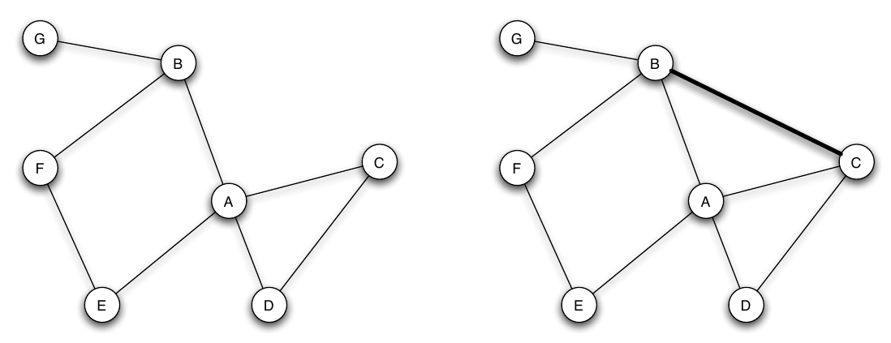
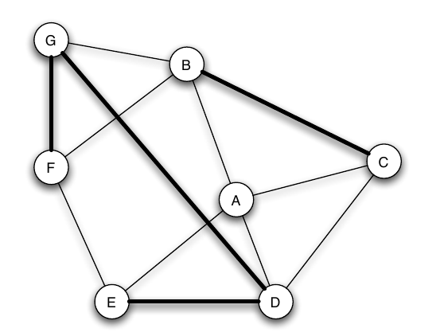
Triadic closure example
Which edges are triadic closures?

Slide 6
Possible mechanisms for triadic closure
Opportunity: A meets B and C often, eventually B and C will meet
Trust: A trusts B, A trusts C, B can trust C
Incentive: if A is friend with B and C, but B and C are not friends, there is tension/stress
  Teenage girls with low clustering coefficient more likely to contemplate suicide
Peter Bearman and James Moody. Suicide and friendships among American adolescents. American Journal of Public Health, 94(1):89–95, 2004.

Slide 7
Possible mechanisms for triadic closure
Opportunity: A meets B and C often, eventually B and C will meet
Trust: A trusts B, A trusts C, B can trust C
Incentive: if A is friend with B and C, but B and C are not friends, there is tension/stress
Triadic closures can happen even if B and C don’t know that they have a friend in common!

Slide 8
Strong/Weak Triadic Closure
Triadic closure can be observed in weighted graphs
If A-B and A-C have a strong connection, then strong triadic closure is violated if B-C have a weak connection or no connection at all

Slide 9
Triadic closure and common neighbors
Let be the number of neighbors in common between nodes i and j
Suppose we take two snapshots:
We want to study the function
How should be with respect to ?

Slide 10
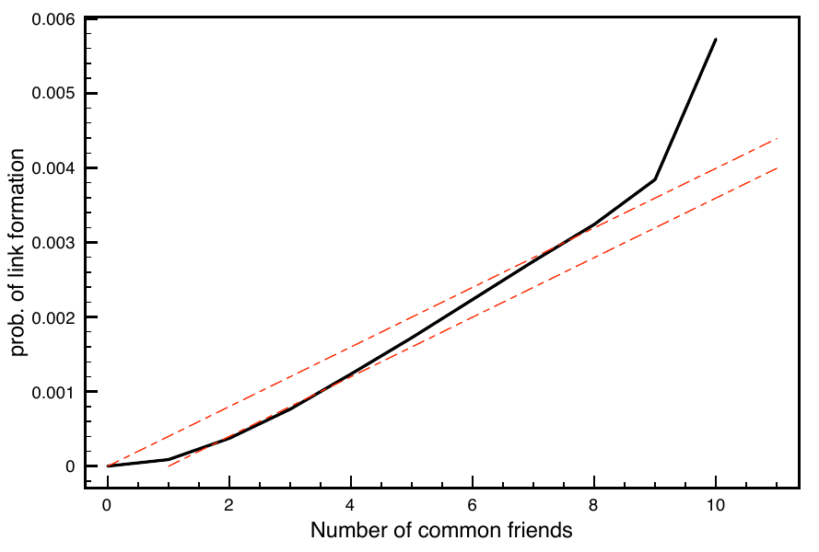
Study in an e-mail dataset
Kossinets, G., & Watts, D. J. (2006). Empirical analysis of an evolving social network. science, 311(5757), 88-90.

Slide 11
Simple model for
Node i is not connected to node j
Between t₀ and t₁ node i sees all the common friends s/he has with node j
Each time there is a small chance p they will introduce node i to j
Write as a function of and

Slide 12
Study in an e-mail dataset
Kossinets, G., & Watts, D. J. (2006). Empirical analysis of an evolving social network. science, 311(5757), 88-90.

Slide 13
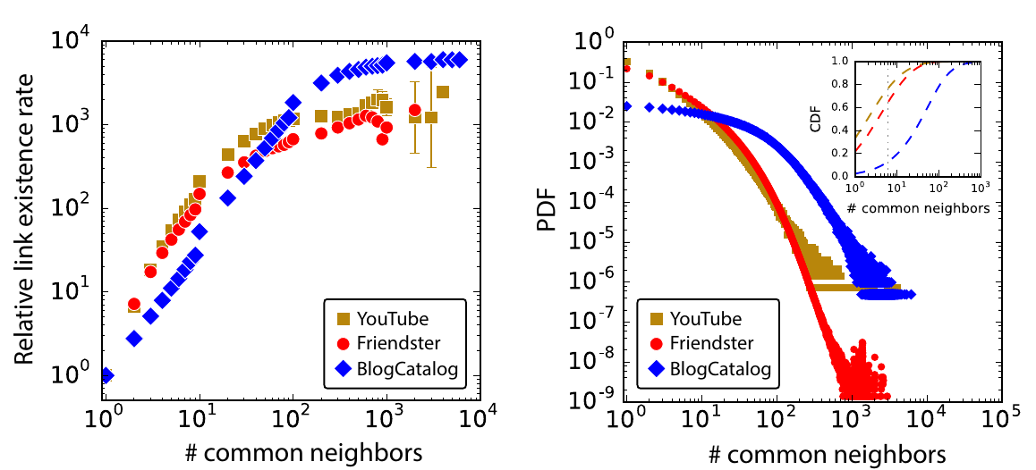
Evidence from other networks
Dong, Y., Johnson, R. A., Xu, J., & Chawla, N. V. (2017, August). Structural diversity and homophily: A study across more than one hundred big networks. In Proc. KDD. ACM.

Slide 14
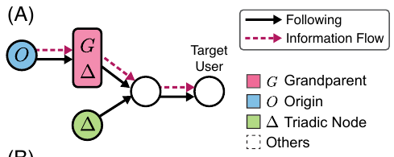
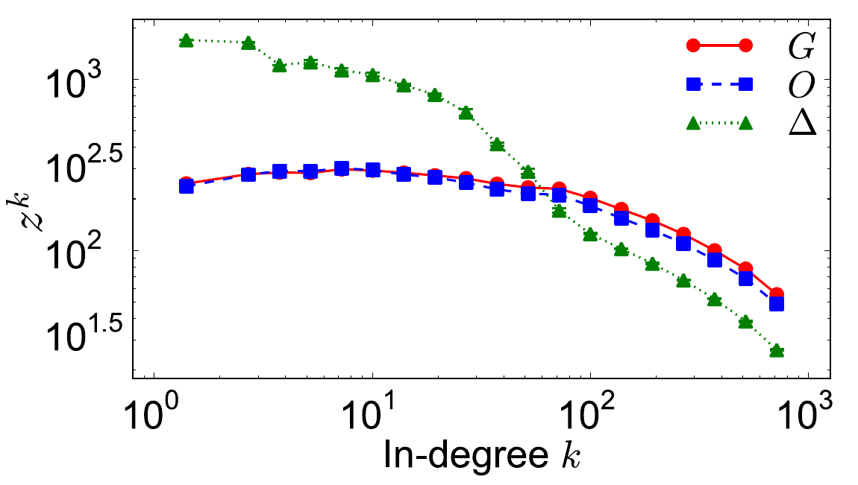
Link probability and content sharing
Triadic closures are affected by content consumption, and are more likely to happen with nodes from which I have received content (posts or re-posts)
Weng, L., Ratkiewicz, J., Perra, N., Gonçalves, B., Castillo, C., Bonchi, F., Flammini, A. (2013). The role of information diffusion in the evolution of social networks. In KDD. ACM.

Slide 15
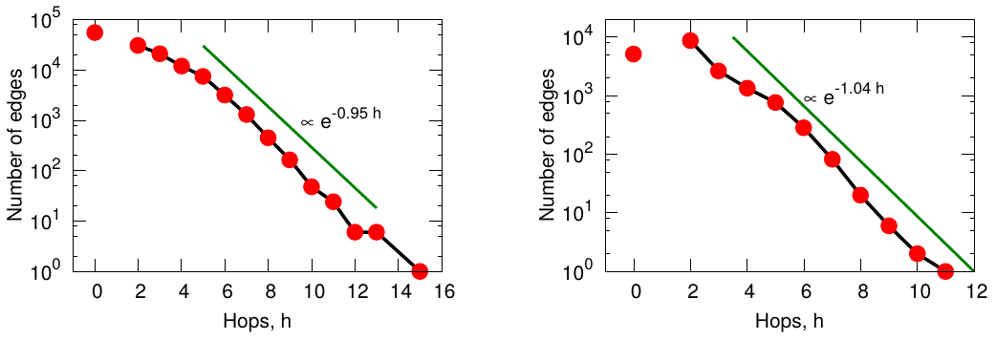
Linking probability and distance
Yahoo! Answers
LinkedIn
Leskovec, J., Backstrom, L., Kumar, R., & Tomkins, A. (2008). Microscopic evolution of social networks. In Proc. KDD

Slide 16
Homophily

Slide 17
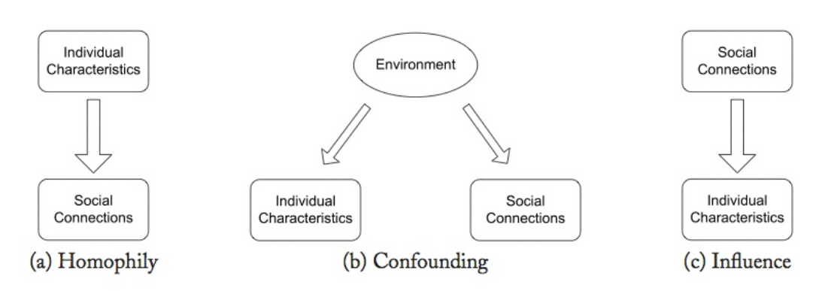
Three models of social correlation

Slide 18
Three models (cont.)
Homophily: tendency of agents to be connected to similar agents
Confounding: correlation between agent actions can be explained by external factors
Influence: agent actions influence the actions of their connections

Slide 19
Think of your own friends
Your friends are not a random sample
  Similar age, affluence, interests, beliefs, … to you
  (most of them)
Long-standing observation
  Plato (“similarity begets friendship”)
  Aristotle (people “love those who are like themselves”)

Slide 20
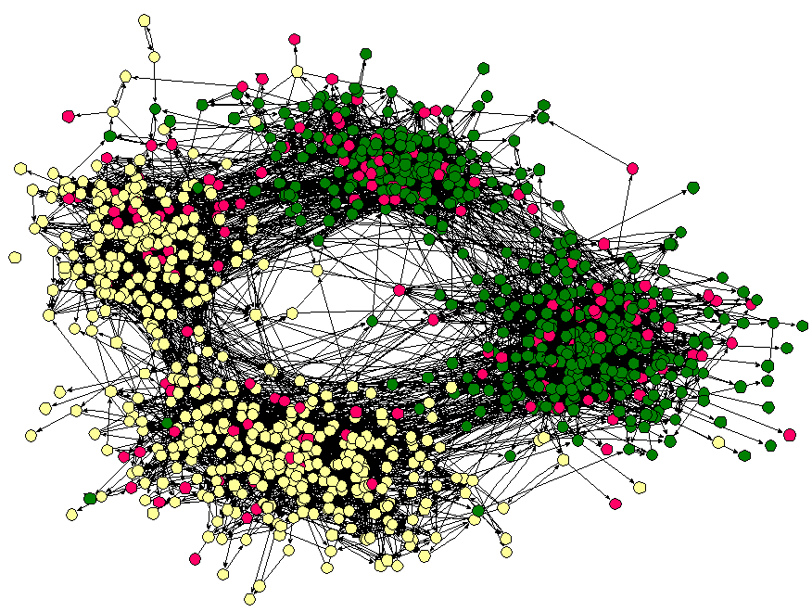
Friendships by race
(Middle school in the US, ca 2001)
Moody, J. (2001). Race, school integration, and friendship segregation in America. American journal of Sociology, 107(3), 679-716.

Slide 21
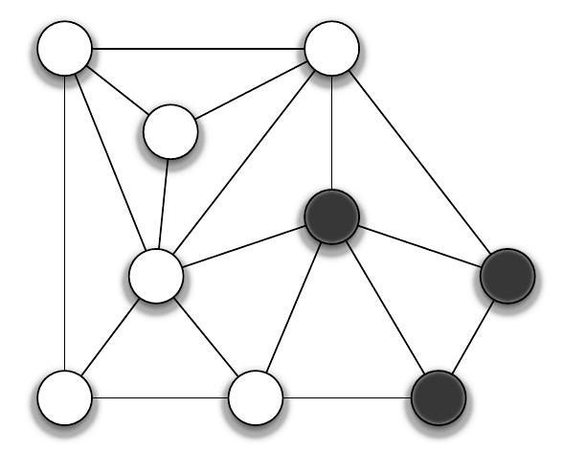
How to measure homophily?
Count homogeneous edges (white-white or black-black)
Count heterogeneous edges (white-black)

Slide 22
There are 5 heterogeneous edges
There are 13 homogeneous edges
There are 18 edges in total

Slide 23
Homophily test
Suppose the probability of being white is
The probability of being black is
What is the probability of:
  A white-white edge
  A black-black edge
  A white-black edge

Slide 24
Homophily test (answer)
Suppose the probability of being white is
The probability of being black is
What is the probability of:
  A white-white edge
  A black-black edge
  A white-black edge

Slide 25
Homophily test (cont.)
How many homogeneous edges do we expect?
Hence, does this graph exhibit homophily?

Slide 26
Homophily test (cont.) (answer)
Probability of being white is
The probability of being black is
Expected number of heterogeneous edges
However we see 5 (< 8), hence we have less heterogeneous edges ⇒ evidence of homophily

Slide 27
Homophily measurement: one-tailed binomial test
Given G=(V,E) with colors assigned at random
  (p|V| white nodes and (1-p)|V| black nodes)
The number of heterogeneous edges follows

Slide 28
In our example
We compute
Hence observing this number of heterogenous edges or less has a probability of more than 10%
Hence homophily in this case is not significant at 0.05

Slide 29
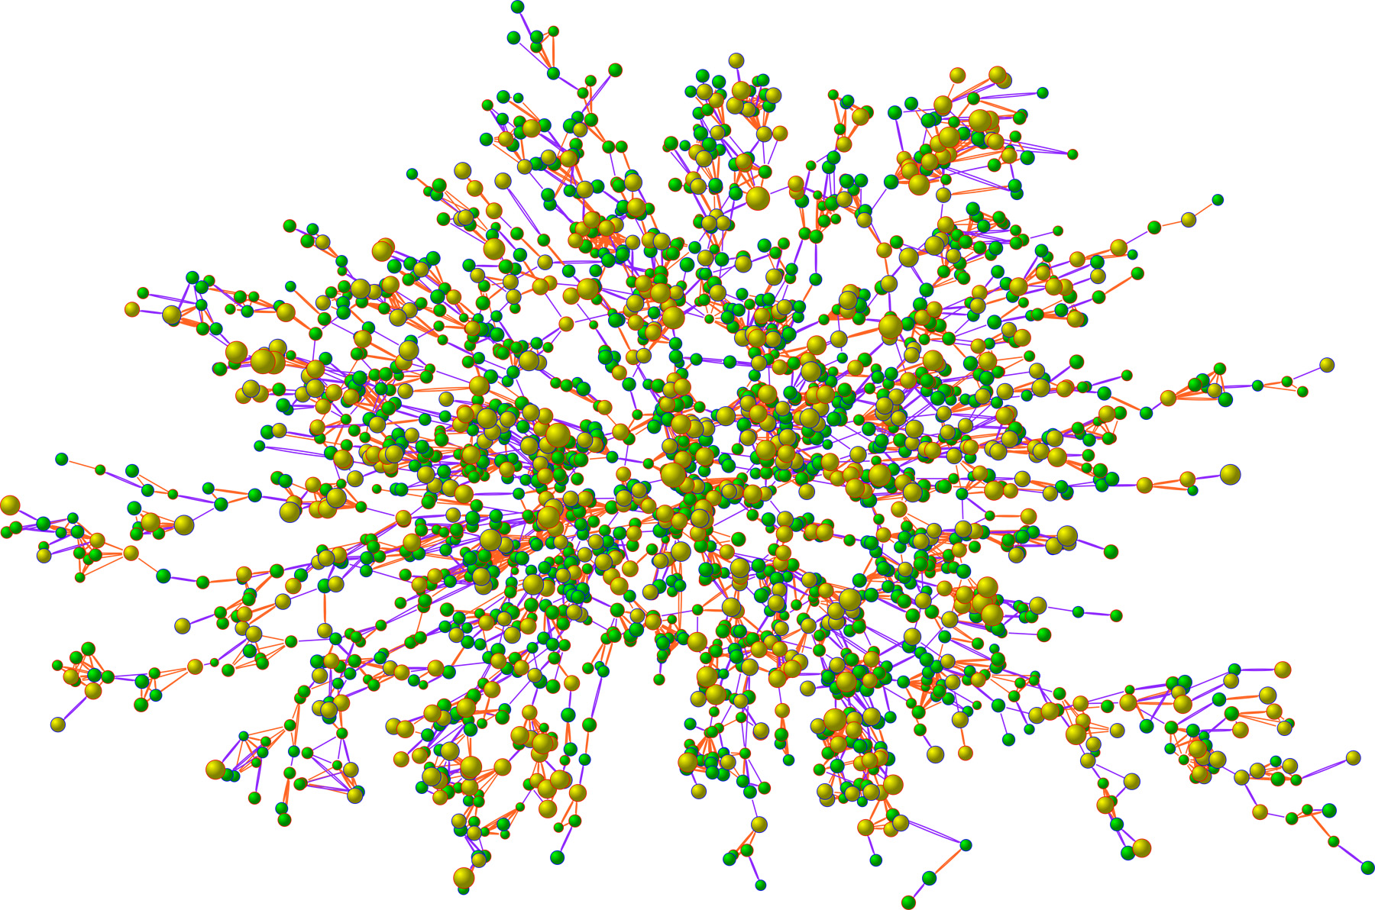
Obesity study (N=2,200)
Size: BMI
Yellow: obese
Christakis, N. A., & Fowler, J. H. (2007). The spread of obesity in a large social network over 32 years. New England journal of medicine, 357(4), 370-379.

Slide 30
Selection and social influence
Selection is the process by which we chose to connect to people based on our characteristics
Social influence is the process by which we transform and are transformed by our connections
What do we see in the obesity study?

Slide 31
Christakis and Fowler show evidence that in their sample:
People indeed connect to other similarly obese or not obese (homophily)
People are affected by external influence to be more or less obese (confounding)
People change the behavior of others (social influence)

Slide 32
Thought experiment
Suppose you are asked to design a program to prevent drug addiction by focusing resources in ensuring well-connected people do not become addicted to drugs
Under which circumstances this program would be more successful? Less successful?

