Slide 1

PageRank
Introduction to Network Science
Carlos Castillo
Topic 08

Slide 2
Sources
Networks, Crowds, and Markets Ch 14
Fei Li's lecture on PageRank
Evimaria Terzi's lecture on link analysis.
C. Castillo: Link-based ranking slides 2016

Slide 3
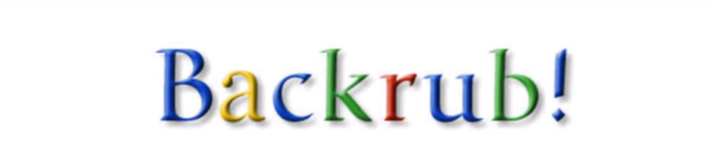
Part of a research project that started in 1995 ...

Slide 4
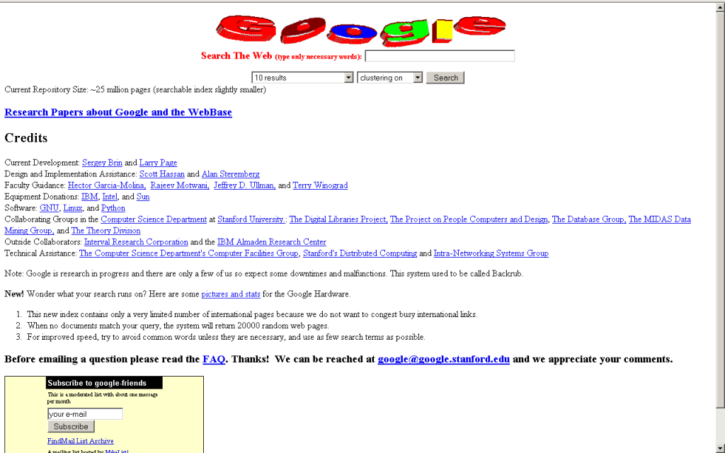

Slide 5
PageRank
The pagerank citation algorithm: bringing order to the web by L Page, S Brin, R Motwani, T Winograd - 7th World Wide Web Conference, 1998 [link].
A very good starting point, but not the end of web ranking!
  Today, PageRank is unlikely to be a top feature

Slide 6
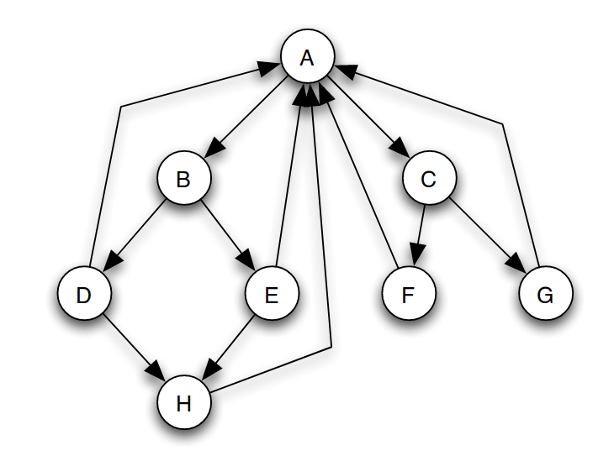
(Simplified) PageRank
All nodes start with score 1/N
Repeat t times:
  Divide equally and “send” its score to out-links
  Add received scores

Slide 7
Execute simplified PageRank:
All nodes start with
score 1/N
Repeat t times:
  Divide equally and “send”
  its score to out-links
  Add received scores
Keep intermediate values in
a table
Try to arrive to equilibrium
values

Slide 8
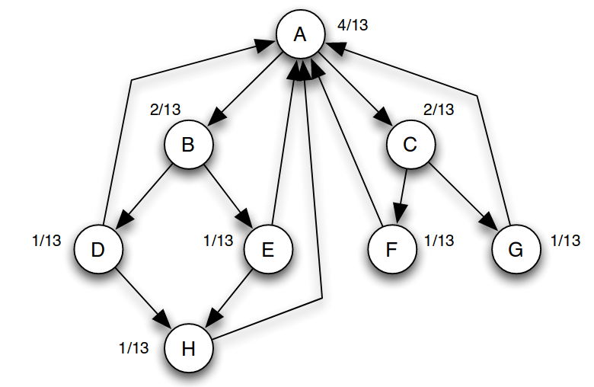
Equilibrium values
Answer: in equilibrium, the score going
into a node is equal to the score going out

Slide 9
Equilibrium values
How can you prove these are
equilibrium values?

Slide 10
(Simplified) PageRank
is the number of out-links of page j
c is a normalization factor to ensure

Slide 11
Running simplified PageRank on a graph
A
Adjacency
matrix
B
C
Row-stochastic adjacency matrix

Slide 12
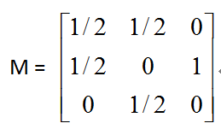
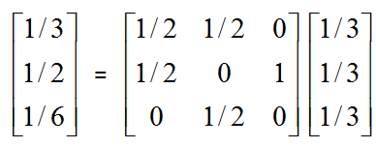
Another example of Simplified PageRank
A
B
C
First iteration of calculation:

Slide 13
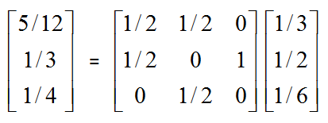
Another example of Simplified PageRank
A
B
C
Second iteration:

Slide 14
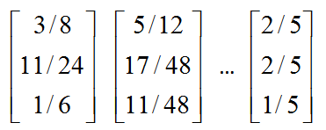
Another example of Simplified PageRank
A
B
C
Following iterations:
Final score

Slide 15
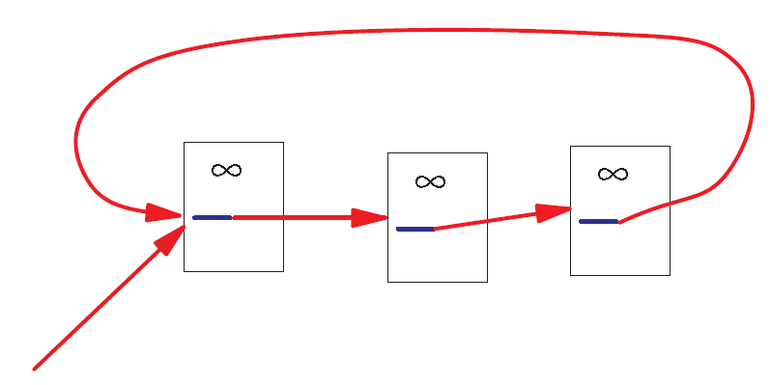
A Problem with Simplified PageRank
A loop:
During each iteration, the loop accumulates score but never distributes score to other pages!

Slide 16
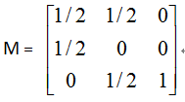
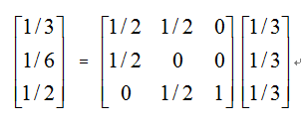
Example of the problem ...
A
B
C
First iteration of calculation:

Slide 17
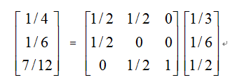
Example of the problem ...
A
B
C
Second iteration:

Slide 18
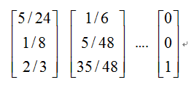
Example of the problem ...
A
B
C
Following iterations:
The winner takes all!

Slide 19
What are we computing?
A is the transposed row-stochastic adjacency matrix
What is p?
How do you call this method to compute p?

Slide 20
What are we computing?
p is an eigenvector of A with eigenvalue 1
This repeated multiplication is
the power method

Slide 21
What are we computing?
This will converge if A is:
  Left-stochastic (each column adds up to one)
  Irreducible (represents a strongly connected graph)
  Aperiodic (does not represent a bipartite graph)

Slide 22
Markov Chain
Discrete process over a set of states
Next state computed from current state only (no memory of older states)
  Higher-order Markov chains can be defined
Stationary distribution of Markov chain is a probability distribution such that p = Ap
Intuitively, p represents “the average time spent” at each node if the process continues forever

Slide 23
Random Walks in Graphs
Random Surfer Model
  The simplified model: the standing probability distribution of a random walk on the graph of the web. simply keeps clicking successive links at random
Modified Random Surfer
  The modified model: the “random surfer” simply keeps clicking successive links at random, but periodically “gets bored” and jumps to a random page based on a distribution R (e.g., uniform)
  This guarantees irreducibility
  Pages without out-links (dangling nodes) are a row of zeros, can be replaced by R, or by a row of 1/N

Slide 24
PageRank
R(i): web pages that “users” jump to when they “get bored”;
Uniform preferences => R(i) = 1/N

Slide 25
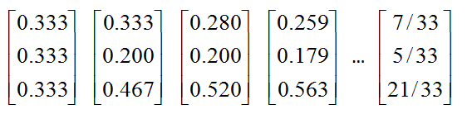
An example of PageRank
A
B
C
Was:

Slide 26

Variant: personalized PageRank
Modify R(i) according to users' tastes
(e.g. user interested in sports vs politics)
http://nlp.stanford.edu/IR-book/html/htmledition/topic-specific-pagerank-1.html

Slide 27
PageRank and internal linking
A website has a maximum amount of Page Rank that is distributed between its pages by internal links [depends on internal links]
The maximum amount of Page Rank in a site increases as the number of pages in the site increases.
By linking poorly, it is possible to fail to reach the site's maximum Page Rank, but it is not possible to exceed it.
http://www.cs.sjsu.edu/faculty/pollett/masters/Semesters/Fall11/tanmayee/Deliverable3.pdf

Slide 28
PageRank Implementation
Suppose there are n pages and m links
Trivial implementation of PageRank requires O(M+N) memory
Streaming implementation requires O(N) memory … how?
”Streaming” means the graph is never held on memory

Slide 29
PageRank streaming implementation
Maintain in memory
Update by reading the graph from disk

Slide 30
Liquid democracy

Slide 31
PageRank as a form of actual voting (liquid democracy)
If α = 1, we can implement liquid democracy
  In liquid democracy, people chose to either vote or to delegate their vote to somebody else
If α < 1, we have a sort of “viscous” democracy where delegation is not total

Slide 32

PageRank as a form of liquid democracy
Boldi, P., Bonchi, F., Castillo, C., & Vigna, S. (2011). Viscous democracy for social networks. Communications of the ACM, 54(6), 129-137.

Slide 33

These two graphs have different alpha (0.2 and 0.9)
Which one is which?

Slide 34
These two graphs have different alpha (0.2 and 0.9)
Which one is which?

Slide 35
Summary

Slide 36
Things to remember
Simplified PageRank
PageRank
Liquid democracy example
Practice on your own by computing with a calculator Simplified PageRank or PageRank on a small graph
You can also write your own code for PageRank

