Slide 1

Epidemics
Introduction to Network Science
Carlos Castillo
Topic 13

Slide 2
Sources
Barabási (2016): Network Science Ch. 10
Easley and Kleinberg (2010): Networks, Crowds, and Markets Ch 21.

Slide 3
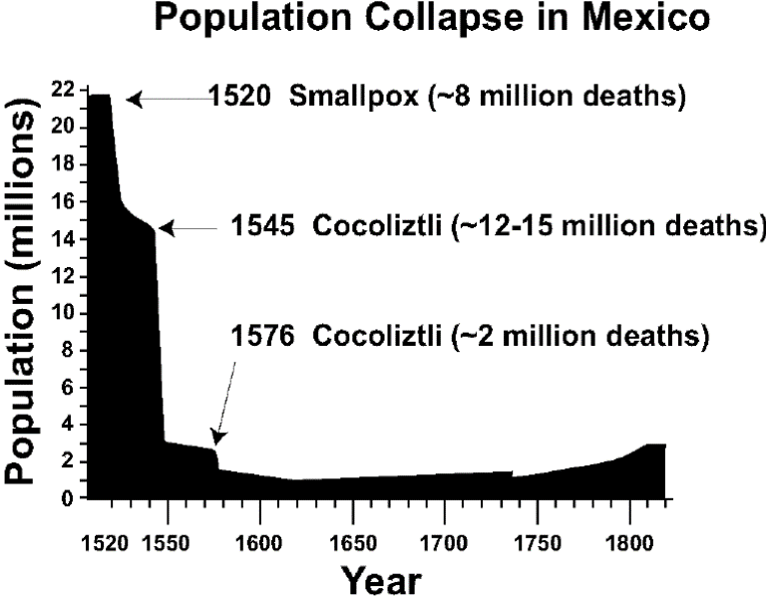
Examples: human epidemics
Influenza, measles, STDs
The “Black Death”
[next slide]
Smallpox and other diseases brought by Europeans to America since early 1500s
https://en.wikipedia.org/wiki/Cocoliztli_Epidemic_of_1545-1548

Slide 4
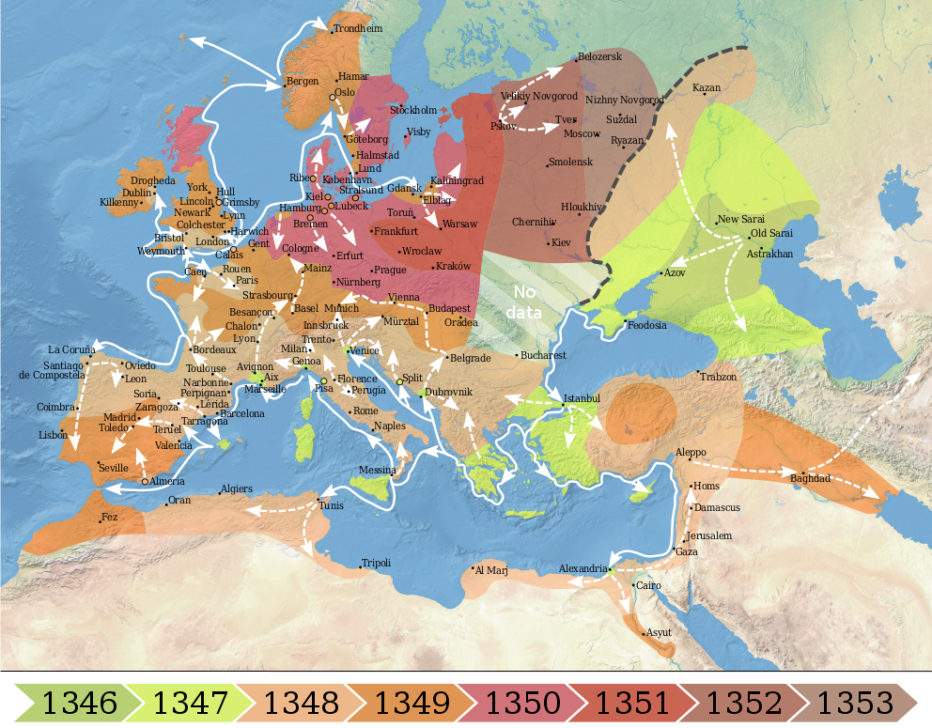
The “Black Death” (Bubonic plague)
1300s
Killed 30%-60% of the total population of Europe
https://commons.wikimedia.org/wiki/File:1346-1353_spread_of_the_Black_Death_in_Europe_map.svg

Slide 5
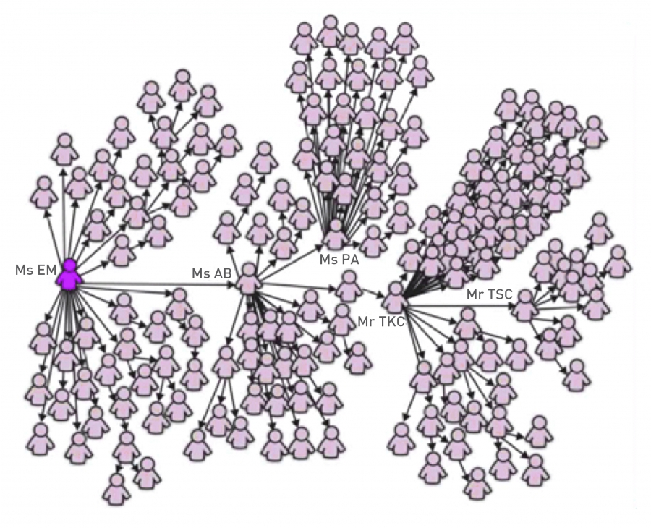
SARS Outbreak (2003)
February 21st: Chinese doctor who have been several treating “atypical pneumonia” cases check-ins into hotel in Hong Kong
  Hospitalized on Feb 22nd
  Died on March 4th
March 1st: “Ms. E. M.” returns to Singapore after visiting Hong Kong
  Graph depicts 144 out of the first 206 SARS patients in Singapore
  Ms. E. M. lived, various of her family members died
https://en.wikipedia.org/wiki/Timeline_of_the_SARS_outbreak

Slide 6
Diffusion of ideas vs diseases
Adopting a new idea, behavior, fashion, product, taste, may also spread from person to person: “social contagion”
There is a certain agency of the receiver
In diffusion of diseases, we assume there is no agency: each contagion is random

Slide 7
Simple model: branching process

Slide 8
Modeling epidemics
There are many factors:
  Contagiousness
  Length of infectious period,
  Severity
  ...
Structure of contacts in a population

Slide 9
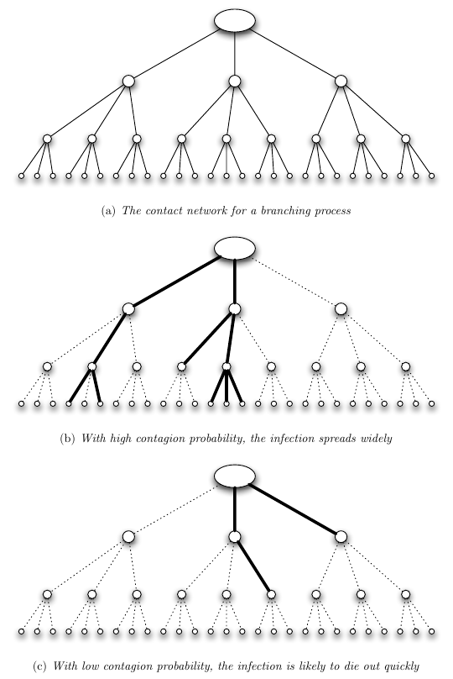
Simple model: branching process
Each person interacts with other k people
Each interaction ends in infection with probability β
Example: k=3

Slide 10
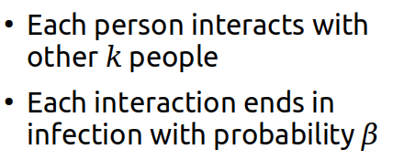
Transmission rate or “Basic reproductive number” R₀
What is the expected number of cases caused by a single individual, R₀?
What do you think happens if R₀ < 1?
What do you think happens if R₀ > 1?

Slide 11
Transmission rate or “Basic reproductive number” R₀
What is the expected number of cases caused by a single individual? R₀ = βk
What do you think happens if R₀ < 1?
  The infection dies out
What do you think happens if R₀ > 1?
  The infection persists
Details: sec. 21.8 of EK’16

Slide 12
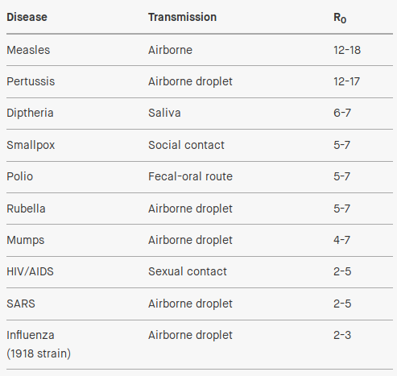
Changing R₀ = βk
Sanitary practices (reduce β)
Quarantine (reduces k)

Slide 13
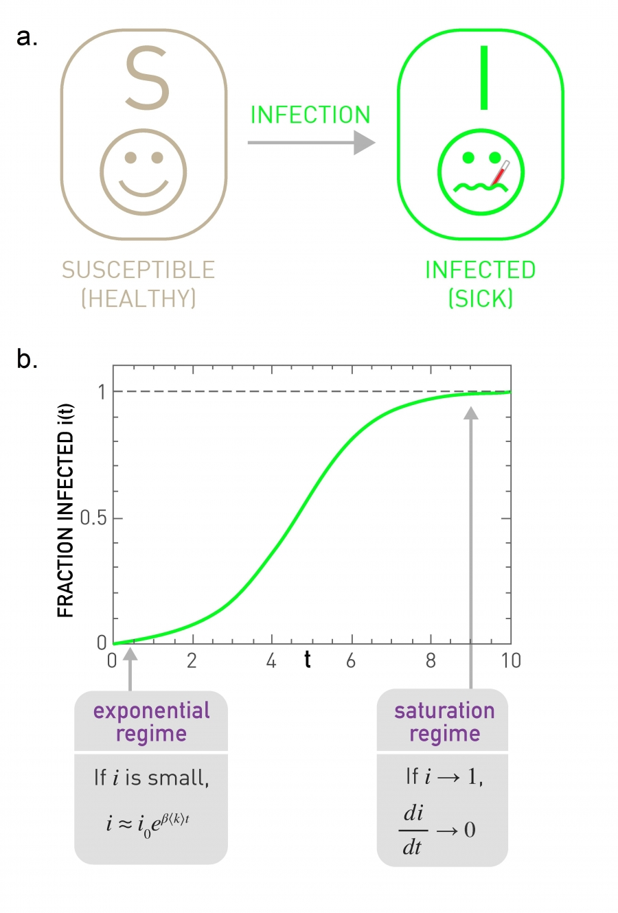
The SI model

Slide 14
The SI model
Susceptible:
  The node can catch the disease
Infected:
  The node has the disease and can spread it
  It will stay sick forever

Slide 15
Notation
Number of susceptible S(t)
  Fraction of susceptible s(t) = S(t) / N
Number of infected I(t)
  Fraction of infected i(t) = I(t) / N
s(t) + i(t) = 1

Slide 16
How many susceptible neighbors a node has?
How many new infections are produced?
(for every infected, iterate through its susceptible neighbors, infect with probability β)
infected
susceptible neighbors
infection probability

Slide 17
Prove that

Slide 18
Infected per period of time

Slide 19
Infected per period of time

Slide 20
Behavior in the limit t → ∞
What is the limit of
when t→∞ ?
Hint: similar to

Slide 21
Infected as a function of time (SI)
Characteristic time
(to infect 1/e ≃ 36% of people):

Slide 22
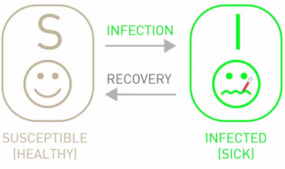
The SIS model

Slide 23
The SIS model
Susceptible:
  The node can catch the disease
Infected:
  The node has the disease and can spread it
  After some time, it recovers … but it becomes susceptible again

Slide 24
Infection dynamics
is the recovery rate, i.e., the probability of becoming susceptible again in an unit of time
C is a constant that depends on i₀

Slide 25
Behavior in the limit t → ∞
What is the limit of
when t→∞ ?
Hint: similar to

Slide 26
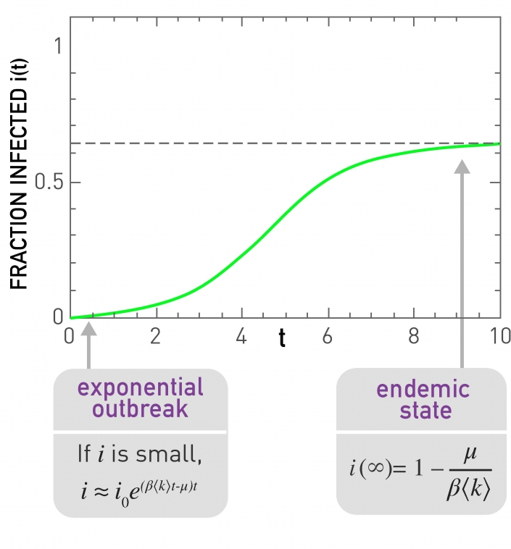
Infected as a function of time
(SIS)
This is in the case

Slide 27
What happens if ?
Remember:

Slide 28
What happens if ?
Remember:
The infection dies out
negative
negative

Slide 29
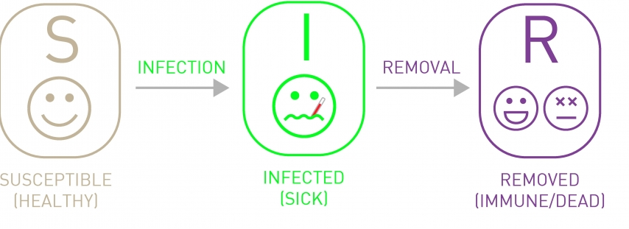
The SIR model

Slide 30
The SIR model
Susceptible:
  The node can catch the disease
Infected:
  The node has the disease and can spread it
Removed:
  The node no longer has the disease, and cannot catch it or propagate it again (could be dead, could be immune)

Slide 31
Infection dynamics in SIR
No closed form solution

Slide 32
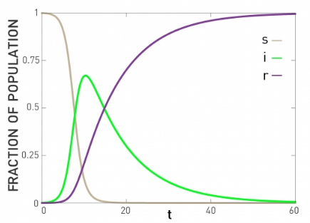
Infection dynamics (SIR)

Slide 33
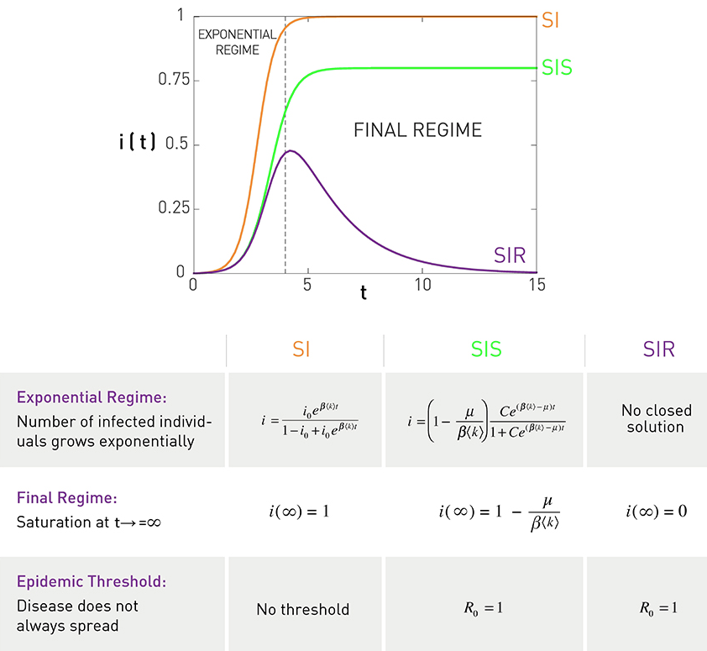
Comparison of i(t)

Slide 34
SI and SIS on a graph

Slide 35
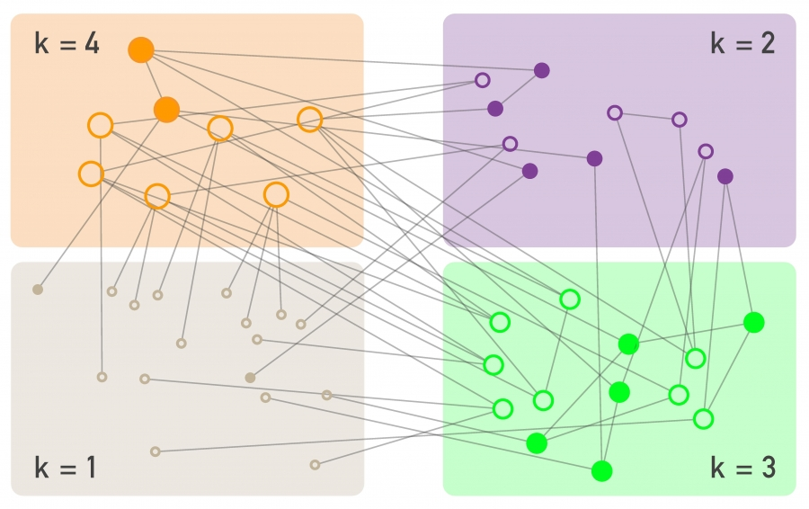
SI dynamics on a graph
Degree block approximation: all nodes with the same degree are jointly analyzed

Slide 36
SI dynamics on a graph
Degree block approximation: all nodes with the same degree are jointly analyzed
Similar to simple SI model, except:
is the fraction of infected neighbors of a susceptible node of degree k
Compare with simple SI model:

Slide 37
SI model on a graph: infected as a function of time
What can you say about ik(t)?
Characteristic time, i.e., the time to infect 1/e ≃ 36% of nodes

Slide 38
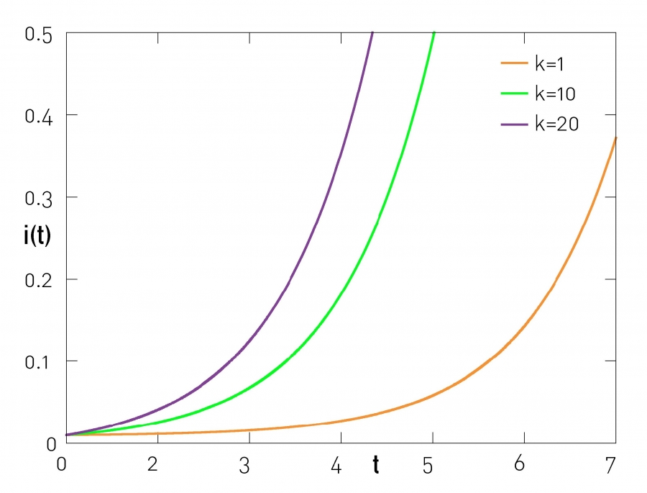
Higher degree nodes are more likely to become infected

Slide 39
Characteristic time
(time to infect 1/e ≃ 36% of nodes)
Random network
Scale-free network with γ ≥ 3
Scale-free network with γ < 3

Slide 40
Characteristic time
(time to infect 1/e ≃ 36% of nodes)
Random network
Scale-free network with γ ≥ 3
Scale-free network with γ < 3

Slide 41
Vanishing characteristic time
If the characteristic time goes to 0
Networks with skewed degree distributions allow infections with the same β to spread faster

Slide 42
SIS dynamics on a graph
Similar to SI dynamics but allowing recovery
If people recover quickly, and the infection dies out … unless

Slide 43
Epidemic threshold
A key quantity is the spreading rate
The critical spreading rate called the epidemic threshold, is such that
Spreading rate larger than epidemic threshold:
  infection becomes endemic
Spreading rate smaller than epidemic threshold:
  Infection dies out

Slide 44
Epidemic threshold
A key quantity is the spreading rate
The critical spreading rate called the epidemic threshold, is such that
Compute the epidemic threshold for an ER graph where

Slide 45
Epidemic threshold in an ER graph
If this holds, the infection becomes endemic
Any less infectious pathogen or one that has faster recovery causes the infection to die out
Epidemic threshold
in ER graph

Slide 46
Epidemic threshold in a scale-free network
Epidemic threshold
in BA graph
In a scale-free network with γ < 3

Slide 47
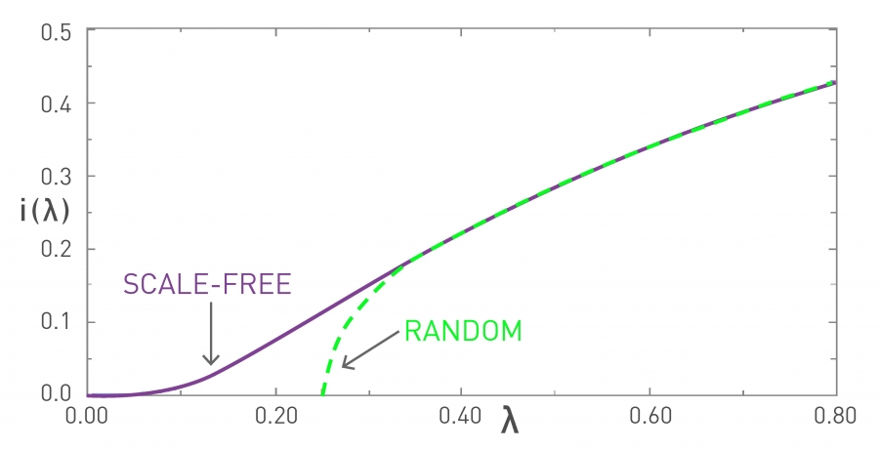
Infected (in the limit) as a function of the epidemic threshold

Slide 48
Two key results for
SI and SIS models on a BA graph
In a large scale-free network with γ < 3
An infection may reach everybody in a very short time:
An infection may become endemic even if it is not very contagious and even if people recover fast:

Slide 49
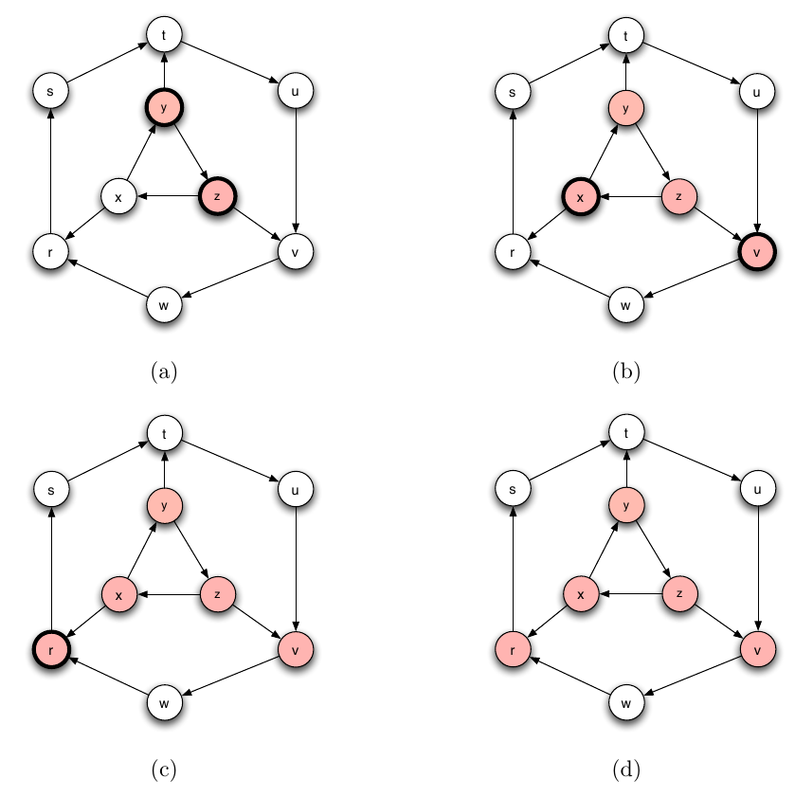
SIR on a graph
In this simulation we assume recovery takes one timestep
Infected nodes have thick borders
Recovered nodes have thin borders

Slide 50
Summary

Slide 51
Things to remember
SI, SIS, SIR models
Which are the states in each process and which are the possible transitions
Equations for number of nodes in each state
Regimes under different parameters
Practice executing by hand and write code if it helps you remember better each process

