Slide 1

Random Networks (ER) Model
Introduction to Network Science
Carlos Castillo
Topic 07

Slide 2
Contents
The ER model
Degree distribution under the ER model

Slide 3
Sources
Albert László Barabási: Network Science. Cambridge University Press, 2016.
  Follows almost section-by-section chapter 03
Data-Driven Social Analytics course by Vicenç Gómez and Andreas Kaltenbrunner
URLs cited in the footer of specific slides

Slide 4
Why studying random networks?
One way of studying complex networks is by running stochastic models of network creation and then see if they generate networks that look like real ones
The “random network” model is one specific stochastic model in which each link is created independently at random

Slide 5
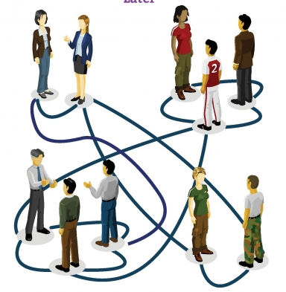
Meeting people at a party
You pick a random person
Talk to that person for a while, if there are good vibes, you are connected
Then pick another person
  And repeat
The result is what we call a random network

Slide 6
Formalization (Erdös-Rényi or ER)
Sounds like “ERDOSH and REGN”
For each pair of nodes in the graph
  Perform a Bernoulli trial with probability p
    “Toss a biased coin with probability p of landing heads”
  If the trial succeeds, connect those nodes
    “If the coin lands heads, connect those nodes”
Repeat for all pairs

Slide 7
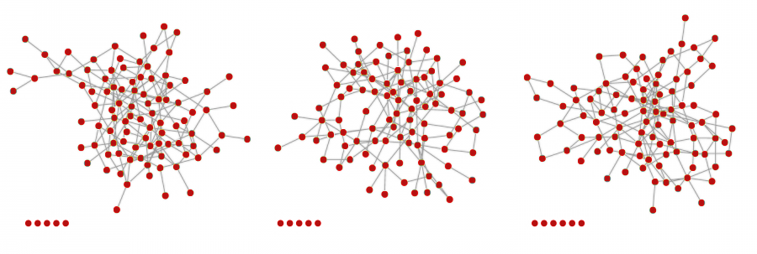
Example
(3 networks, same parameters)
Nodes at the bottom ended up isolated

Slide 8
A key characteristic of a network: its degree distribution
One of the most evident characteristics of a network is its degree distribution
  Is this distribution very skewed? Or every node is close to some average? Is there a “typical” degree?
  Does it look like the degree distribution predicted by a network formation model?
We will spend a fair amount of time studying the degree distribution under various models

Slide 9
The binomial distribution
The distribution of the probability of obtaining x successes in n independent trials, in which each trial has probability of succeeding p

Slide 10
Degree distribution in ER model
Simply a Binomial distribution
Note that the maximum number of “successes” (links) of a node is N-1, hence:

Slide 11
Expected number of links
Expected number of links
Average degree

Slide 12
Exercise [B. 2016, Ex. 3.11.1]
Consider an ER graph with N=3,000 p=10⁻³
  What is the expected number of links <L>?
  What is the average degree <k>?
Answer in Nearpod Poll
https://nearpod.com/student/
Code to be given during class

Slide 13
Sol. Exercise [B. 2016, Ex. 3.11.1]
Consider an ER graph with N=3,000 p=10⁻³
  What is the expected number of links <L>?

Slide 14
Sol. Exercise [B. 2016, Ex. 3.11.1]
Consider an ER graph with N=3,000 p=10⁻³
  What is the average degree <k>?

Slide 15
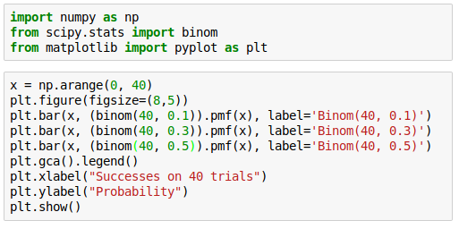
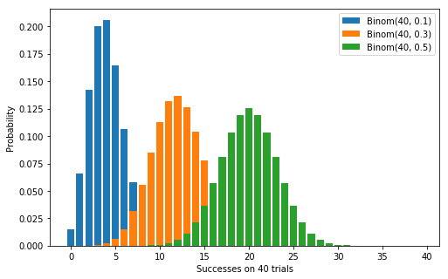

Degree distribution examples
The peak is always at

Slide 16
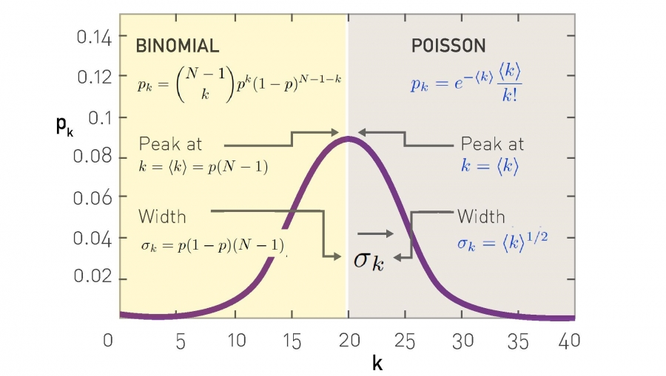
Approximation with a Poisson distribution for

Slide 17
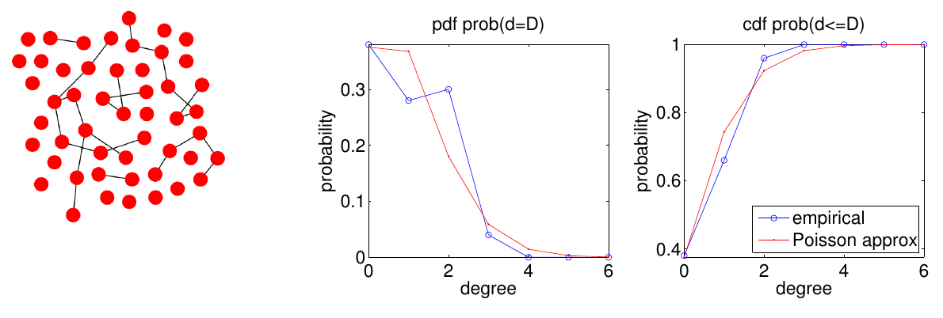
More examples (1/6)
https://www.upf.edu/web/iis/DataDrivenSocialAnalytics

Slide 18
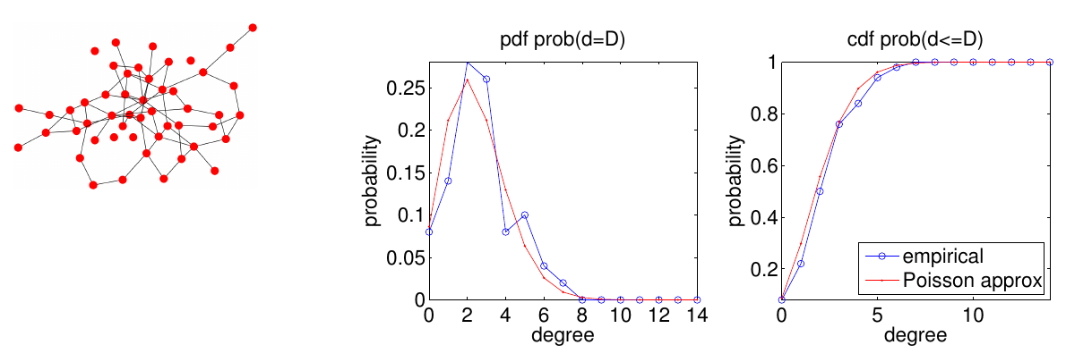
More examples (2/6)
https://www.upf.edu/web/iis/DataDrivenSocialAnalytics

Slide 19
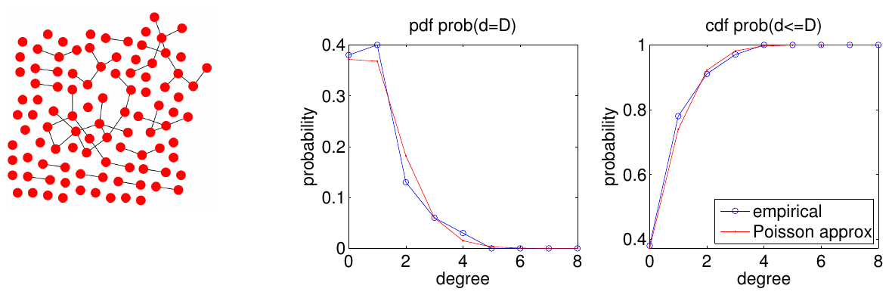
More examples (3/6)
https://www.upf.edu/web/iis/DataDrivenSocialAnalytics

Slide 20
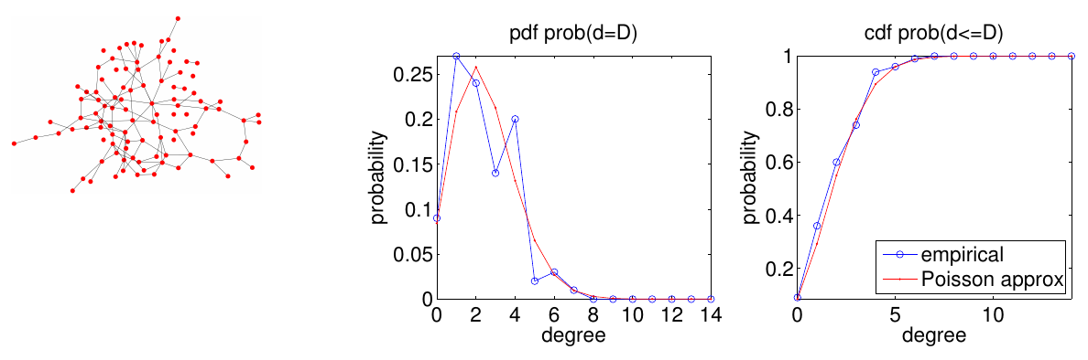
More examples (4/6)
https://www.upf.edu/web/iis/DataDrivenSocialAnalytics

Slide 21
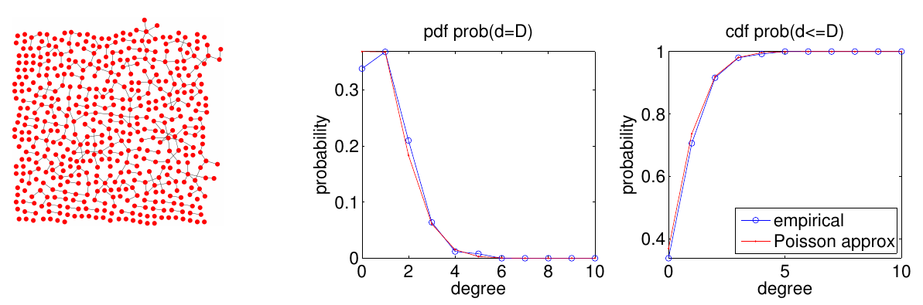
More examples (5/6)
https://www.upf.edu/web/iis/DataDrivenSocialAnalytics

Slide 22
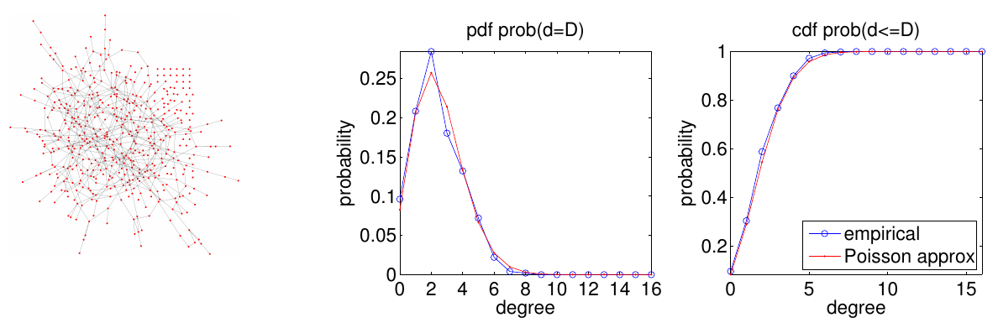
More examples (6/6)
https://www.upf.edu/web/iis/DataDrivenSocialAnalytics

Slide 23
“Back of the envelope” calculations
Suppose N = 7 x 10⁹
Suppose <k> = 1,000
  A person knows the name of approx. 1,000 others
Then on expectation k_{max} = 1,185
<k> ± σ is the range from 968 to 1,032
Is this realistic?

Slide 24
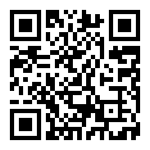
Survey: how many WhatsApp contacts do you have?
https://goo.gl/forms/ovVvdnlWmZgMWdiL2

Slide 25
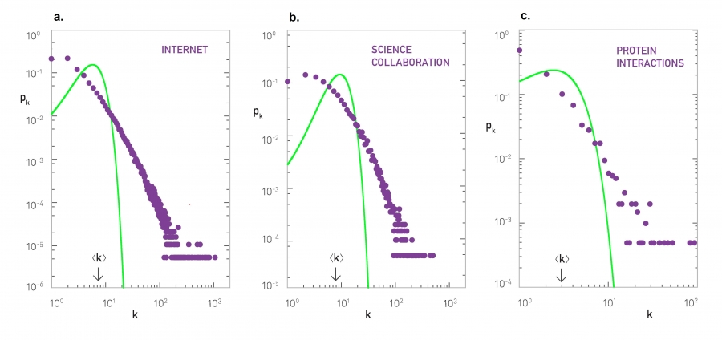
Real networks (green = )

Slide 26
Summary

Slide 27
Things to remember
The ER model
Degree distribution in the ER model

Slide 28
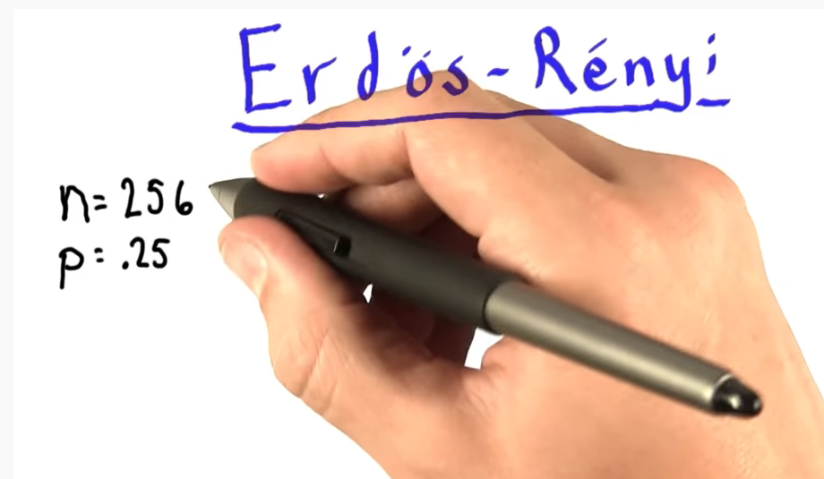
Practice on your own
Write code to create ER networks
Indicate the expected number of edges of a network with N=256, p=0.25; then compare your solution with the one on this video: https://www.youtube.com/watch?v=2DckiyysQy4

