Slide 1

Properties of
Random Networks
Introduction to Network Science
Carlos Castillo
Topic 08

Slide 2
Contents
Connectedness under the ER model
Distances under the ER model
Clustering coefficient under the ER model

Slide 3
Sources
Albert László Barabási: Network Science. Cambridge University Press, 2016.
  Follows almost section-by-section chapter 03
Data-Driven Social Analytics course by Vicenç Gómez and Andreas Kaltenbrunner
URLs cited in the footer of specific slides

Slide 4
Connectivity in ER networks

Slide 5
ER network as <k> increases
When <k> = 0: only singletons
When <k> < 1: disconnected
When <k> > 1: giant connected component
When <k> = N – 1 complete graph
It’s kind of obvious that to have a giant connected it is necessary that <k> = 1, ER proved it’s sufficient in 1959

Slide 6
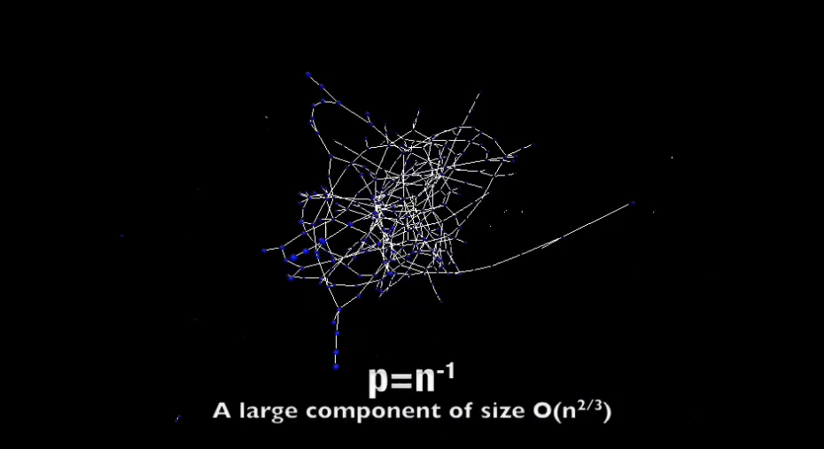
Visualization of increasing p
http://networksciencebook.com/images/ch-03/video-3-2.m4v

Slide 7
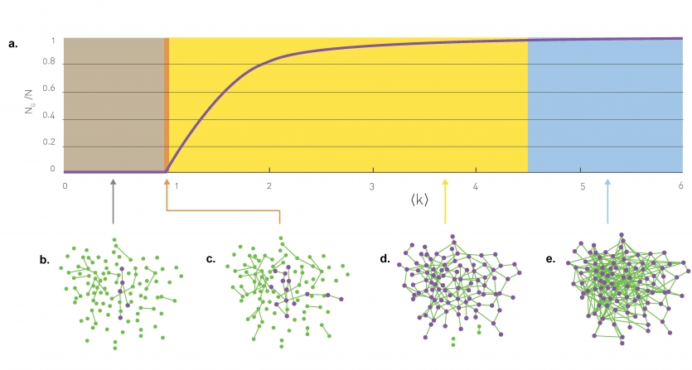
Sub-critical regime:

Slide 8
Critical point:

Slide 9
Supercritical regime:

Slide 10
Connected regime:

Slide 11
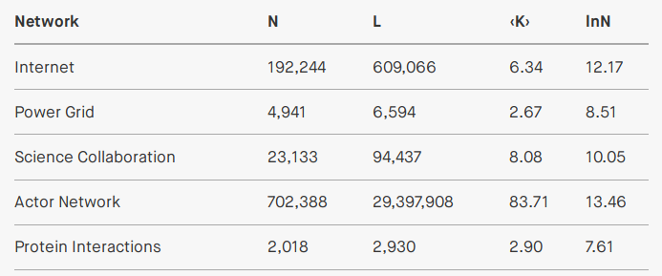
Most real networks are supercritical:

Slide 12
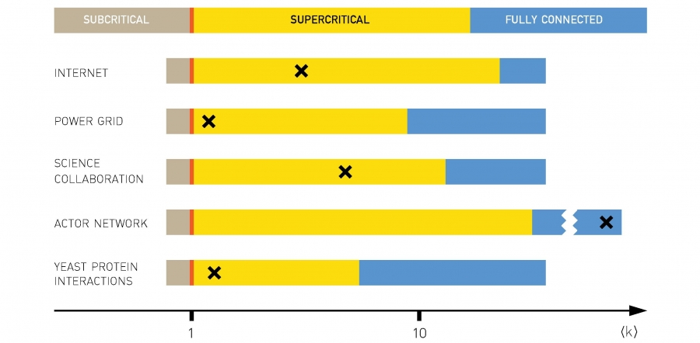
Most real networks are supercritical:

Slide 13
Small-world phenomenon a.k.a. “six degrees of separation”

Slide 14
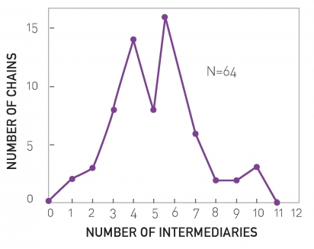
Milgram’s experiment in 1967
Targets: (1) a stock broker in Boston, MA and (2) a student in Sharon, MA
Sources: residents of Wichita and Omaha
Materials: a short summary of the study’s purpose, a photograph, the name, address and information about the target person
Request: to forward the letter to a friend, relative or acquaintance who is most likely to know the target person.
64 of 296 letters reached destination

Slide 15
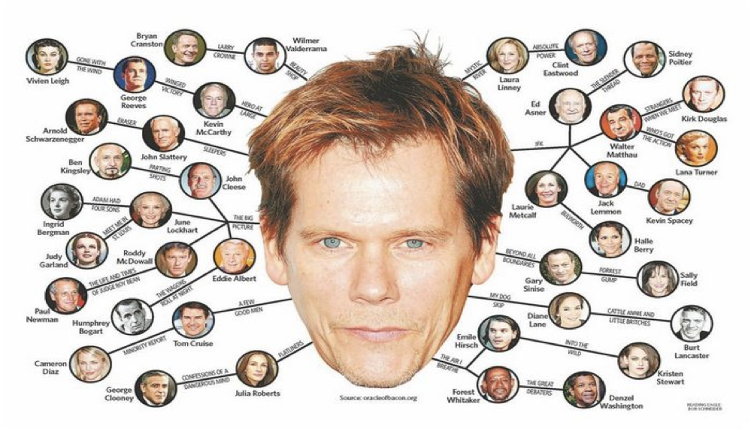

Slide 16
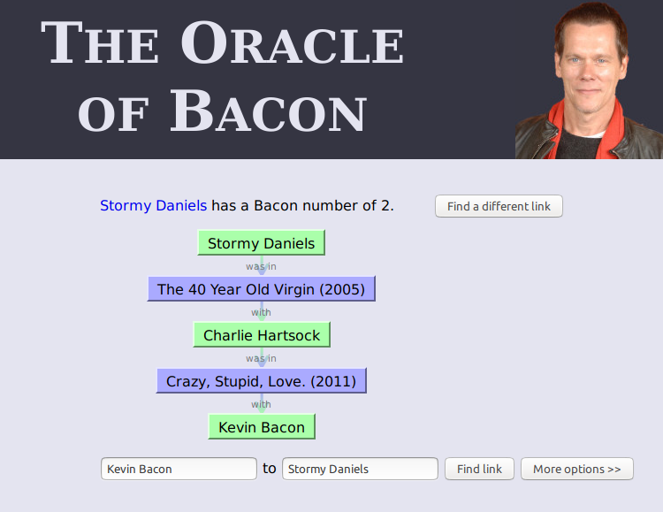
https://oracleofbacon.org/

Slide 17
“Small-world phenomenon”
If you choose any two individuals on Earth, they are connected by a relatively short path of acquaintances
Formally
  The expected distance between two randomly chosen nodes in a network grows much slower than its number of nodes

Slide 18
How many nodes at distance ≤d?
In an ER graph:
  nodes at distance 1
  nodes at distance 2
  …
  nodes at distance d

Slide 19
What is the maximum distance?
Assuming

Slide 20
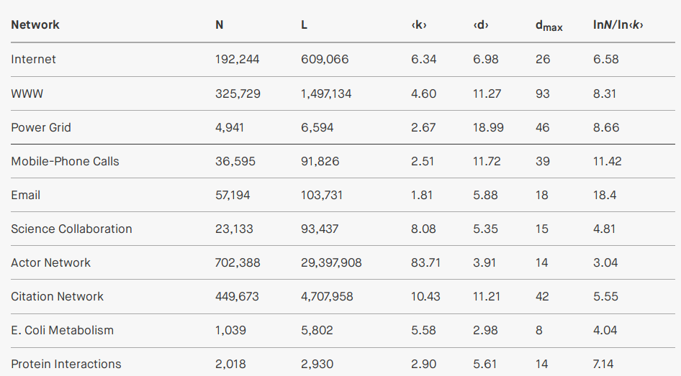
Empirical average and maximum distances

Slide 21
Approximation
Given that d_{max} is dominated by a few long paths, while <d> is averaged over all paths, in general we observe that in an ER graph:

Slide 22
Exercise
Go to https://oracleofbacon.org/ and find a famous actress or actor that has a distance from Kevin Bacon larger than
Write the name of the actress/actor and its distance
Write in Nearpod Collaborate
https://nearpod.com/student/
Code to be given during class

Slide 23
Clustering coefficient or
”a friend of a friend is my friend”

Slide 24
Clustering coefficient C_{i} of node i
Remember
  C_{i} = 0 ⇒ neighbors of i are disconnected
  C_{i} = 1 ⇒ neighbors of i are fully connected

Slide 25
Links between neighbors in ER graphs
The number of nodes that are neighbors of node i is k_{i}
The number of distinct pairs of nodes that are neighbors of i is k_{i}(k_{i}-1)/2
The probability that any of those pairs is connected is p
Then, the expected links L_{i} between neighbors of i are:

Slide 26
Clustering coefficient in ER graphs
Expected links L_{i} between
neighbors of i:
Clustering coefficient

Slide 27
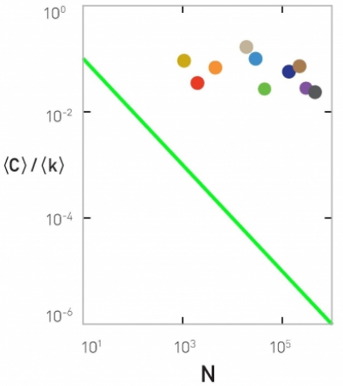
In an ER graph
If <k> is fixed, large networks should have smaller clustering coefficient
We should have that <C>/<k> follows 1/N

Slide 28
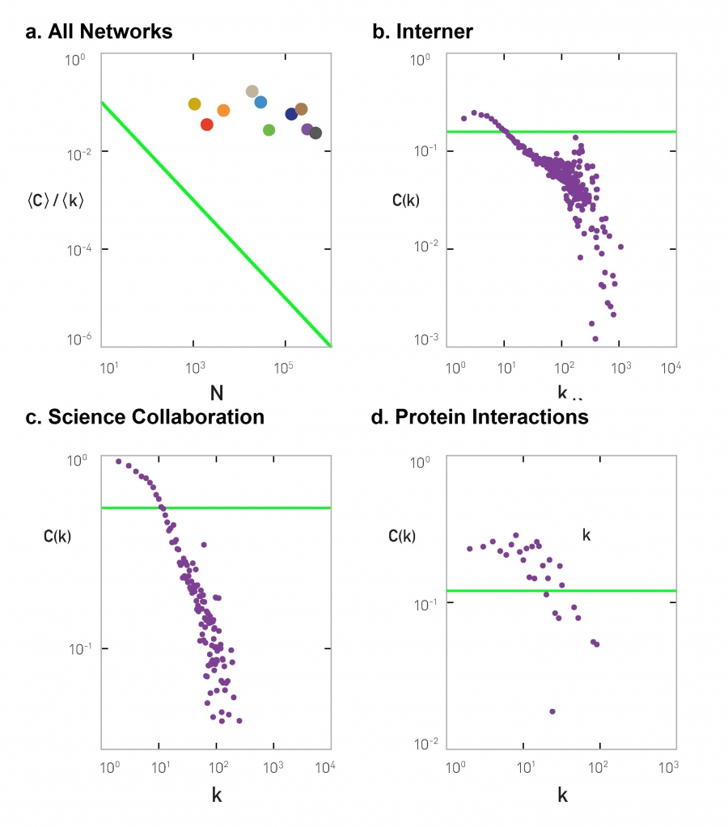
If in an ER graph
Then the clustering coefficient of a node should be independent of the degree
Internet
Science collaborations
Protein interactions

Slide 29
To re-cap ...

Slide 30
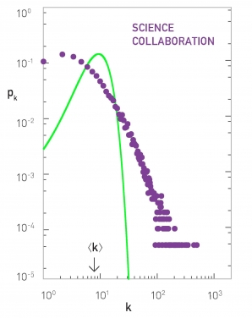
The ER model is a bad model of degree distribution
Predicted
Observed
Many nodes with larger
degree than predicted

Slide 31
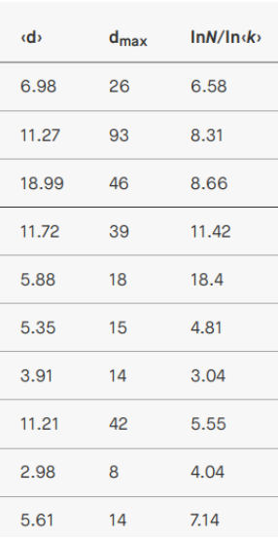
The ER model is a good model of path length
Predicted
Observed

Slide 32
The ER model is a bad model of clustering coefficient
Predicted
Observed
Clustering coefficient decreases
if degree increases

Slide 33
Why do we study the ER model?
Starting point
Simple
Instructional
Historically important, and gained prominence only when large datasets started to become available ⇒ relevant to Data Science!

Slide 34
Exercise [B. 2016, Ex. 3.11.1]
Write in Nearpod Collaborate
https://nearpod.com/student/
Code to be given during class
Consider an ER graph with N=3,000 p=10⁻³
  <k> ≃ 3
  In which regime is the network?
  Suppose we want to increase N until there is only one connected component
  2.1) What is <k> as a function of p and N?
  2.2) What should N be, then? Let’s call that value N^{cr}
  Write the equation and solve by trial and error
  What is <k> if the network has N^{cr} nodes?
  What is the expected distance <d> with N^{cr} nodes?

Slide 35
Sol. Exercise [B. 2016, Ex. 3.11.1]
Consider an ER graph with N=3,000 p=10⁻³
  In which regime is the network?
Given that <k> is between 1 and log(N),
the network is in super-critical regime

Slide 36
Sol. Exercise [B. 2016, Ex. 3.11.1]
Consider an ER graph with N=3,000 p=10⁻³
What should be N^{cr} to have only one component, i.e. how to make ?
This can be solved by trial and error.

Slide 37
Sol. Exercise [B. 2016, Ex. 3.11.1]
Consider an ER graph with N=9,000 p=10⁻³
  Average degree <k>?
  Average distance between nodes <d>?

Slide 38
Summary

Slide 39
Things to remember
The ER model
Degree distribution in the ER model
Distance distribution in the ER model
Connectivity regimes in the ER model

Slide 40
Practice on your own
Take an existing network
  Assume it is an ER network
  Indicate in which regime is the network
  Estimate expected distance
  Compare to actual distances, if available
Write code to create ER networks

