Slide 1

Distances in
Scale-Free Networks
Introduction to Network Science
Carlos Castillo
Topic 10

Slide 2
Contents
Distance distribution of scale-free networks

Slide 3
Sources
Albert László Barabási: Network Science. Cambridge University Press, 2016.
  Follows almost section-by-section chapter 04
URLs cited in the footer of specific slides

Slide 4
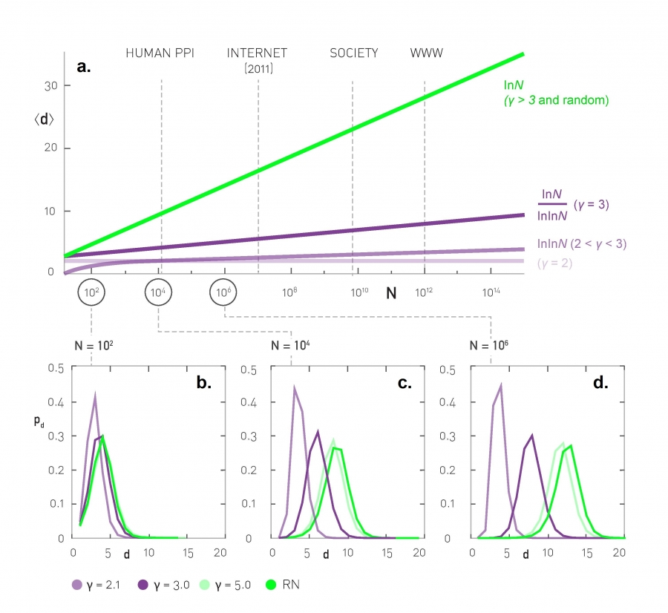
Distance distributions: simulation results
Scale-free networks of increasing size, <k> = 3

Slide 5
Average distance
Depends on Ɣ and N
Same as in ER graphs

Slide 6
Average distance and N

Slide 7
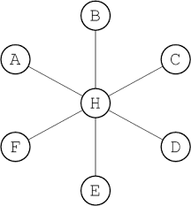
Anomalous regime

Slide 8
Ultra-small world
Average distance follows log(log(N))
Example (humans):

Slide 9
Small world
Average distance follows log(N)
Similar to ER graphs where it followed log(N)/log(<k>)

Slide 10
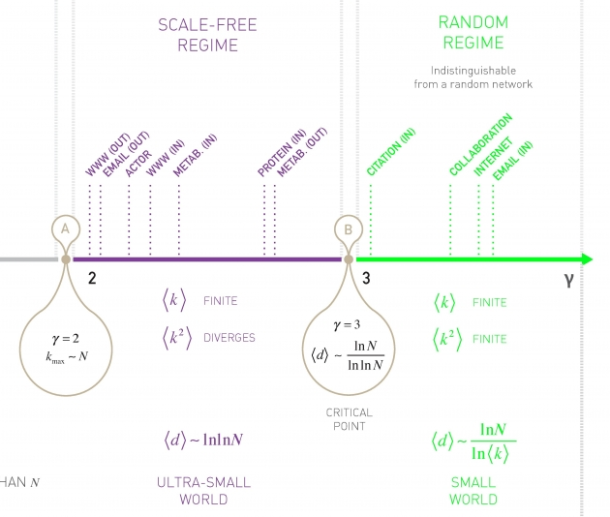
The degree distribution exponent plays an important role

Slide 11
When
In this case it is hard to distinguish this case from an ER graph
In most real complex networks (but not all)

Slide 12
When
Remember
Observing the scale-free properties requires that k_{max} >> k_{min}, e.g. k_{max} = 10 k_{min}
Then if
Hence we won’t find many such networks

Slide 13
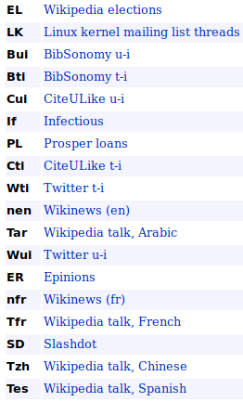
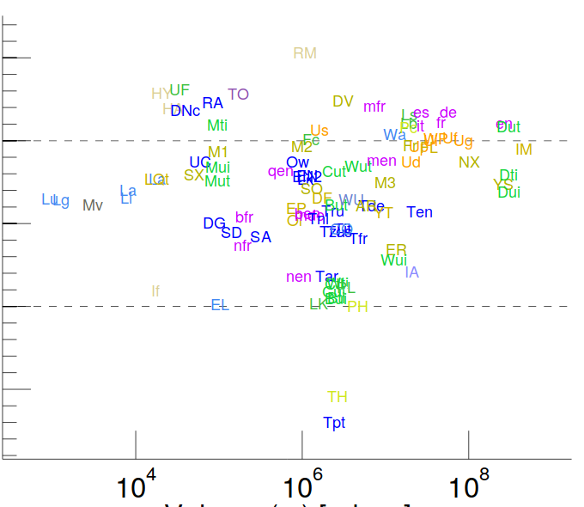
Examples
http://konect.uni-koblenz.de/statistics/prefatt
Etc.

Slide 14
The friendship paradox

Slide 15
The friendship paradox
Take a random person x, what is the expected degree of this person? <k>
Take a random person x, now pick one of x’s neighbors, let’s say y
  What is the expected degree of y?
  It is not <k>

Slide 16
Imagine you’re at a random airport on earth
Is it more likely to be …
  a large airport or a small airport?
If you take a random flight out of it …
  will it go to a large airport or a small airport?

Slide 17
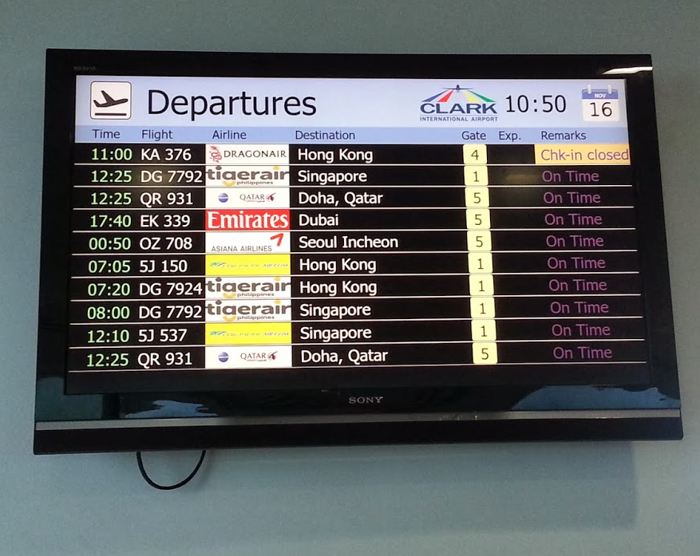
An example of friendship paradox
Pick a random airport on Earth
  Most likely it will be a small airport
However, no matter how small it is, it will have flights to big airports
On average those airports will have much larger degree

Slide 18
Exercise [B. 2016, Ex. 4.10.2]
”Friendship Paradox”
Remember p_{k} is the probability that a node has k “friends”
If we randomly select a link, the probability that a node at any end of the link has k friends is
q_{k} = C k p_{k} where C is a normalization factor
  (a) Find C (the sum of q_{k} must be 1)
Answer in Nearpod Collaboratehttps://nearpod.com/student/
Access to be provided during class

Slide 19
Sol. Exercise [B. 2016, Ex. 4.10.2]
(a) Find normalization C if q_{k} = C k p_{k}
See also https://arxiv.org/abs/1407.4062

Slide 20
Exercise [B. 2016, Ex. 4.10.2]
”Friendship Paradox”
If we randomly select a link, the probability that a node at any end of the link has k friends is
q_{k} = C k p_{k} where C is a normalization factor
q_{k} is also the prob. that a randomly chosen node has a neighbor of degree k
  (b) Find its expectation E[q_{k}] which we will call <k_{F}>
  Remember

Slide 21
Sol. Exercise [B. 2016, Ex. 4.10.2]
(b) Find the average degree of a friend of a node
Note this will diverge if

Slide 22
Exercise [B. 2016, Ex. 4.10.2]
”Friendship Paradox”
(c) Compute the expected number of friends of a neighbor of a randomly chosen node in the case below
(d) compare with the expected number of friends of a randomly chosen node

Slide 23
Sol. Exercise [B. 2016, Ex. 4.10.2]
(c-d) Compute numerically the degree of a random neighbor of a node and degree of a random node, compare
This “paradox” is useful as an immunization strategy!

Slide 24

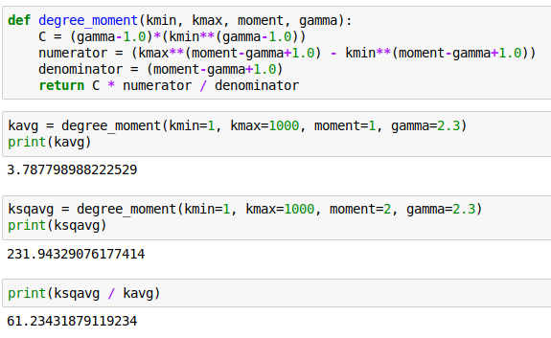
Code

Slide 25
Summary

Slide 26
Things to remember
Regimes of distance and connectivity
The friendship paradox

Slide 27
Practice on your own
Remember the regimes of a graph given <k>
  (It’s useful to know this by heart)
Estimate degree distributions and distance distributions for some graphs
Draw a small graph, and sample from that graph until you’re convinced

