Slide 1

Scale-free networks
Introduction to Network Science
Carlos Castillo
Topic 04

Slide 2
Contents
Characteristics of scale-free networks
Degree distribution of scale-free networks
Distance distribution of scale-free networks

Slide 3
Sources
Albert László Barabási: Network Science. Cambridge University Press, 2016.
  Follows almost section-by-section chapter 04
URLs cited in the footer of specific slides

Slide 4
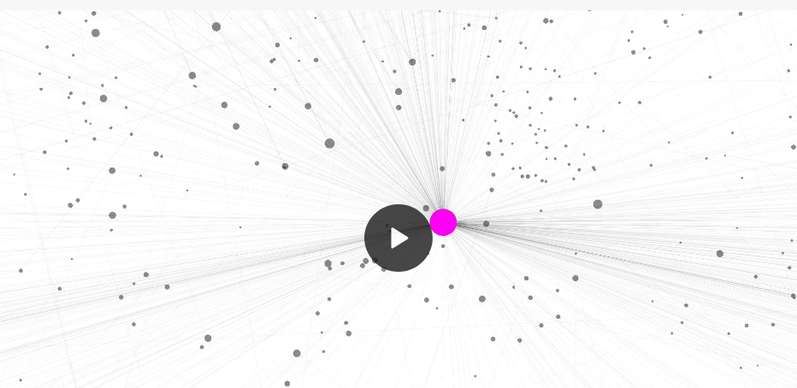
nd.edu in 1998 (N=300K, L=1.5M) nd1998
http://networksciencebook.com/images/ch-04/video-4-1.mov

Slide 5
What the Web Graph has but random networks don’t have
Large “hubs”
  Nodes with a very high degree
  Very unlikely in a random (ER) graph
We have already seen the Poisson distribution is a bad approximation of the degree distribution

Slide 6
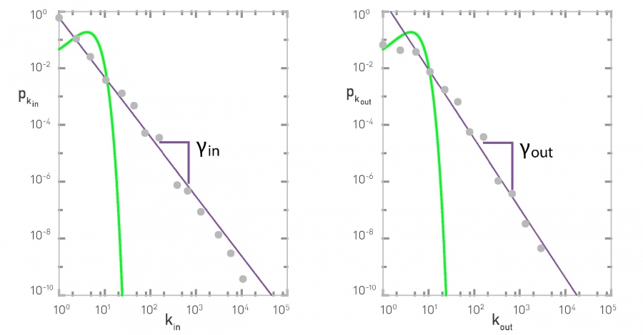
Degree distributions in nd1998

Slide 7
A good approximation of degree in real networks
Straight descending line in log-log plot
Parameter Ɣ is the exponent of the power law
A scale-free network is a network whose degree distribution follows a power law

Slide 8
Parenthesis: 80/20 and Pareto
Vilfredo Pareto in the 19th century noted 80% of money was earned by 20% of people
More recently ...
  80 percent of links on the Web point to only 15 percent of pages;
  80 percent of citations go to only 38 percent of scientists;
  80 percent of links in Hollywood are to 30 percent of actors
A debate that is still open: the wealth of the 1% and the 0.1%

Slide 9
In directed networks ...
Each node has two degrees: k_{in} and k_{out}
In general they may differ, hence
  k_{in} ~ k^{-Ɣin}
  k_{out} ~ k^{-Ɣout}
In nd1998, Ɣ_{in} ≃ 2.1, Ɣ_{out} ≃ 2.4

Slide 10
Formally (discrete)
Riemann’s zeta
This formalism assumes there are no nodes with degree zero

Slide 11
Formally (continuous)
k_{min} is the smaller degree found in the network

Slide 12
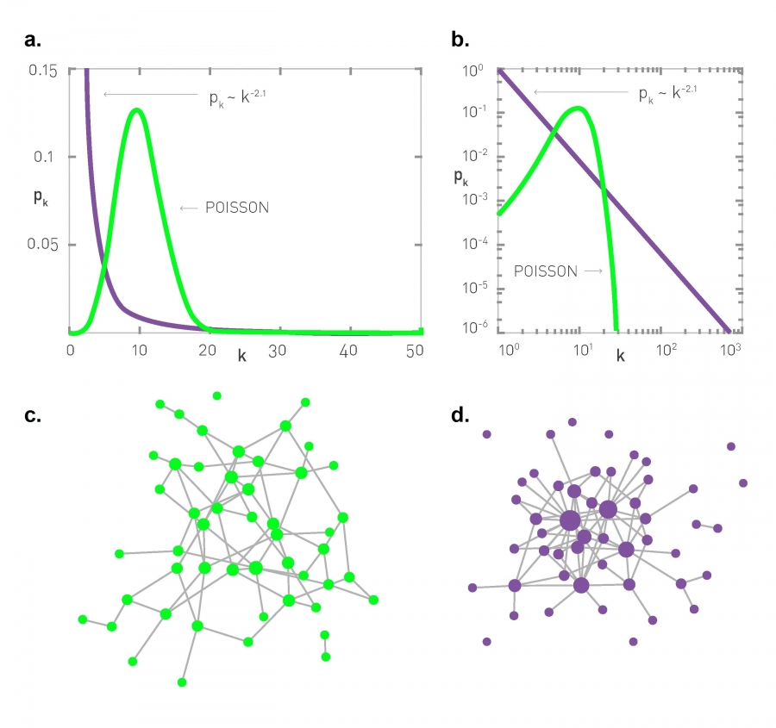
Comparing Poisson to power law

Slide 13
Comparing Poisson to power law

Slide 14
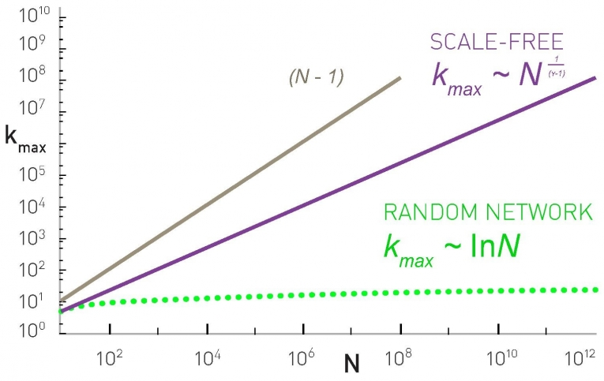
The natural cut-off of the degree
The largest hub cannot have more than N-1 connections

Slide 15
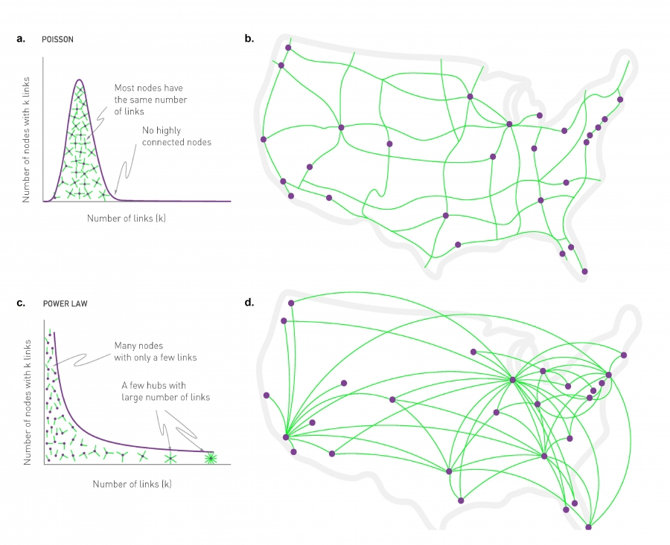
Random vs scale-free networks

Slide 16
What does it mean “scale-free”?
A distribution has a “scale” if values are close to each other, for instance in a random network
Hence, most nodes are in the range
However in scale-free networks ...

Slide 17
What does it mean “scale-free”?
Moments of degree distribution

Slide 18
What does it mean “scale-free”?
In a scale-free network
This diverges as if
Hence there is no “typical” scale

Slide 19
What does it mean “scale-free”?
In a scale-free network
What happens with the variance of the degree for networks with high max degree?

Slide 20
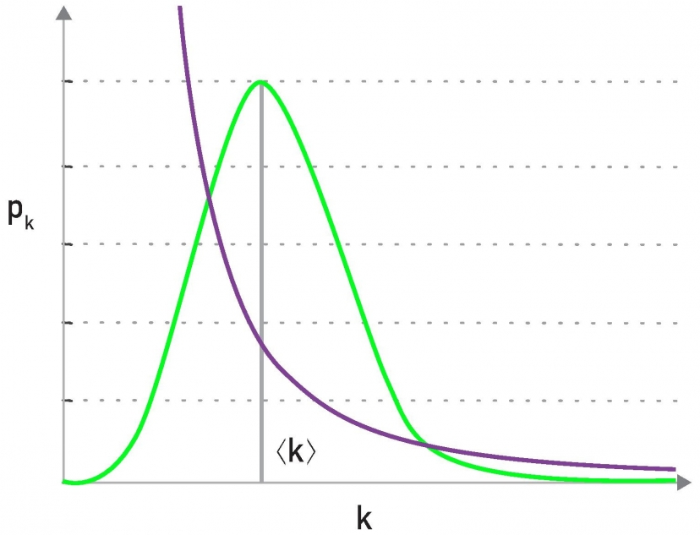
Example: nd1998
In general, the average degree is not very informative in scale-free networks
“Fat tail”, “Heavy tail”, “Long tail”

Slide 21
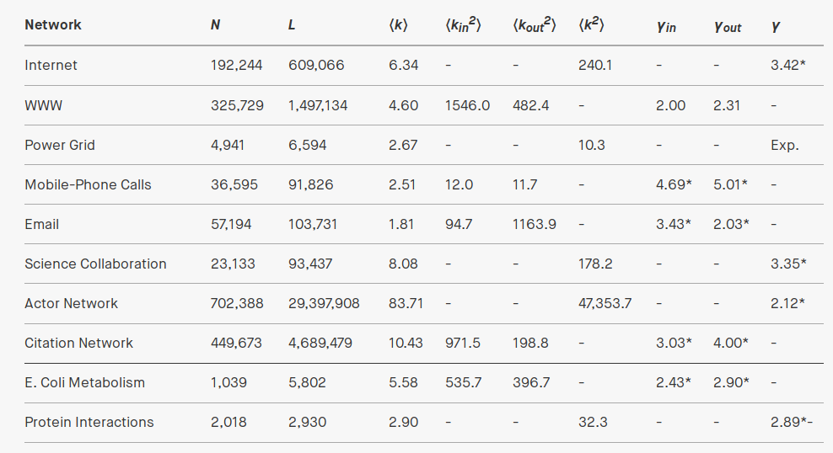
Real network examples

Slide 22
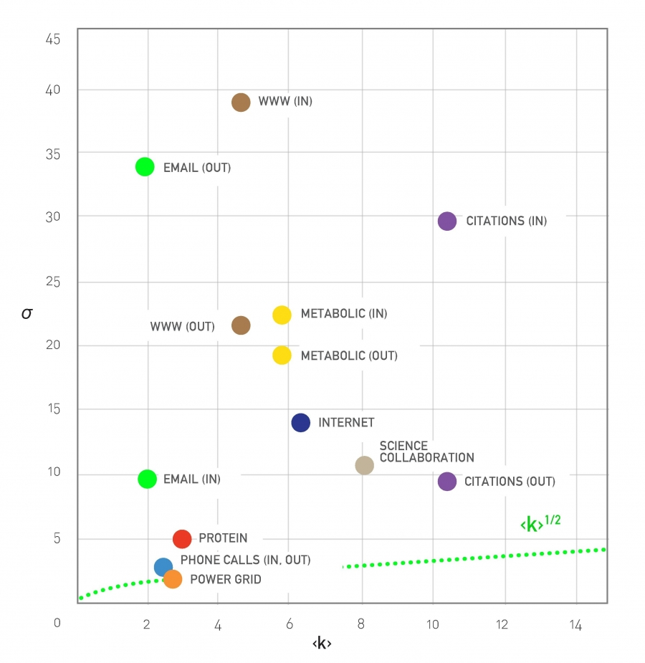
Real network examples

Slide 23
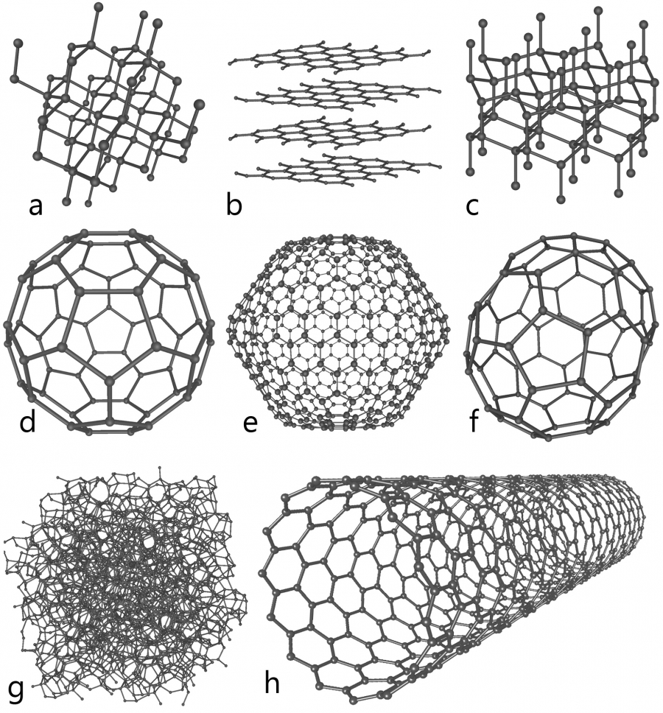
When you don’t observe the scale-free property
In general, when there is a limit to k_{max}
Out-degree in some social networks
Materials networks

Slide 24
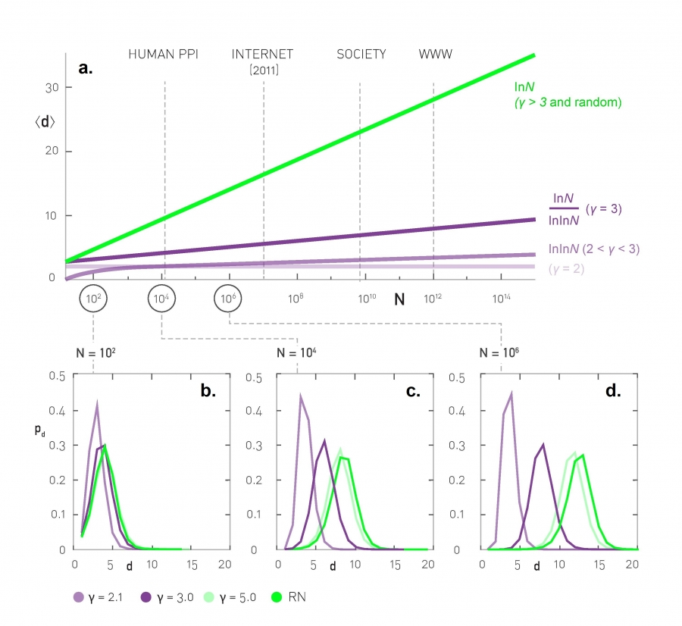
Distance distributions: simulation results
Scale-free networks of increasing size, <k> = 3

Slide 25
Average distance
Depends on Ɣ and N
Same as in ER graphs

Slide 26
Average distance and N

Slide 27
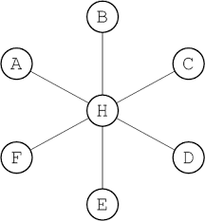
Anomalous regime

Slide 28
Ultra-small world
Average distance follows log(log(N))
Example (humans):

Slide 29
Small world
Average distance follows log(N)
Similar to ER graphs where it followed log(N)/log(<k>)

Slide 30
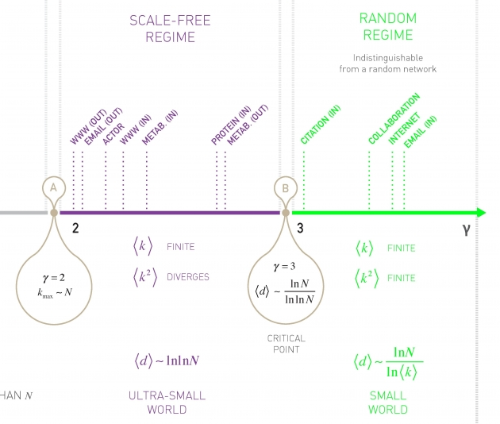
The degree distribution exponent plays an important role

Slide 31
When
In this case it is hard to distinguish the case from an ER graph
In most real complex networks (but not all)

Slide 32
When
Remember
Observing the scale-free properties requires that k_{max} >> k_{min}, e.g. k_{max} = 10 k_{min}
Then if
Hence we won’t find many such networks

Slide 33
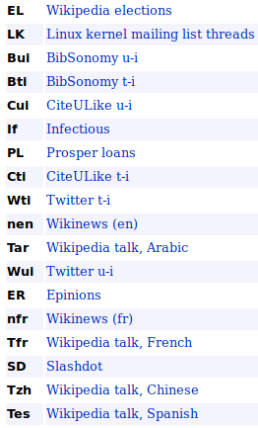
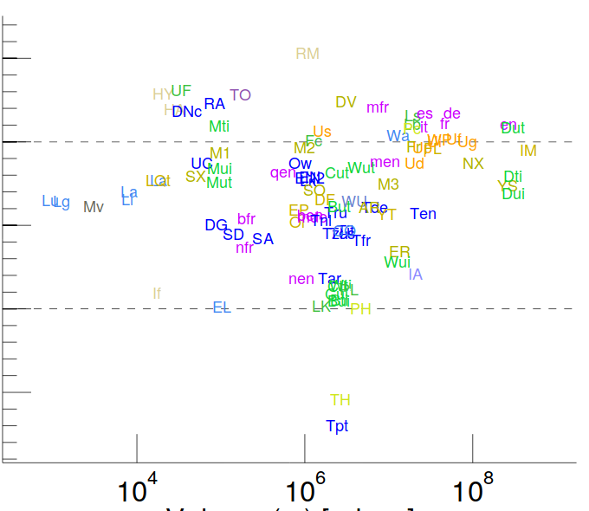
Examples
http://konect.uni-koblenz.de/statistics/prefatt
Etc.

Slide 34
Exercise [B. 2016, Ex. 4.10.2]
”Friendship Paradox”
Remember p_{k} is the probability that a node has k “friends”
If we randomly select a link, the probability that a node at any end of the link has k friends is q_{k} = A k p_{k} where A is a normalization factor
  (a) Find A (the sum of q_{k} must be 1)

Slide 35
Sol. Exercise [B. 2016, Ex. 4.10.2]
(a) Find normalization A if q_{k} = A k p_{k}
See also https://arxiv.org/abs/1407.4062

Slide 36
Exercise [B. 2016, Ex. 4.10.2]
”Friendship Paradox”
If we randomly select a link, the probability that a node at any end of the link has k friends is q_{k} = A k p_{k} where A is a normalization factor
  (b) q_{k} is also the prob. that a randomly chosen node has a neighbor of degree k; find its average

Slide 37
Sol. Exercise [B. 2016, Ex. 4.10.2]
(b) Find the average degree of a friend of a node
Note this will diverge if

Slide 38
Exercise [B. 2016, Ex. 4.10.2]
”Friendship Paradox”
(c-d) Compute the expected number of friends of a neighbor of a randomly chosen node; compare with the expected number of friends of a randomly chosen node when

Slide 39
Sol. Exercise [B. 2016, Ex. 4.10.2]
(c-d) Compute numerically the degree of a random neighbor of a node and degree of a random node, compare
This “paradox” is useful as an immunization strategy!

Slide 40
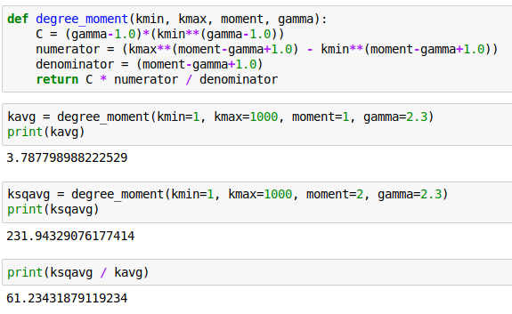
Python code

Slide 41
Practice on your own
Remember the regimes of a graph given <k>
  (It’s useful to know this by heart)
Estimate degree distributions and distance distributions for some graphs
Apply the friendship paradox to some graphs

