Slide 1

Preferential Attachment
Introduction to Network Science
Carlos Castillo
Topic 05

Slide 2
Sources
Albert László Barabási (2016) Network Science
  Preferential attachment follows chapter 05
Ravi Srinivasan 2013 Complex Networks Ch 12
Networks, Crowds, and Markets Ch 18
Data-Driven Social Analytics course by Vicenç Gómez and Andreas Kaltenbrunner

Slide 3
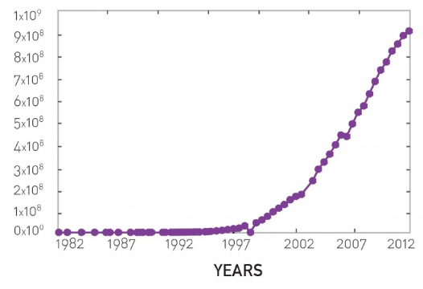
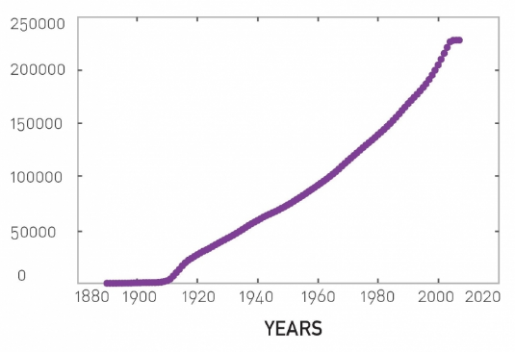
The number of nodes N increases: we need models of network growth
Number of hosts in WWW
Number of movies in IMDB

Slide 4
Preliminary:
Uniform Random Attachment

Slide 5
Growth in an ER network
Two assumptions in ER networks:
  There are N nodes that pre-exist
  Nodes connect at random
Let’s challenge the first assumption

Slide 6
Uniform Attachment
Network starts with m fully-connected nodes
Time starts at t₀=m
At every time step we add 1 node
This node will have m outlinks

Slide 7
Expected degree over time
Probability of obtaining one link:
  Decreases over time
Expected degree of node born at

Slide 8
Compute expected degree over time using a differential equation
(1) Integrate between time i and time t
(2) Use initial condition

Slide 9
Expected degree over time

Slide 10
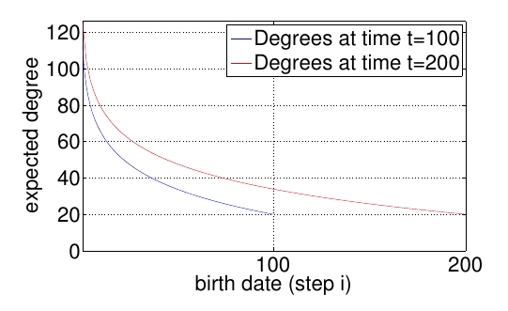
Degree distribution over time is not static
Degree of node born at time

Slide 11
Tail of degree distribution
How many nodes of degree smaller than k are there at time t?
The fraction is
Decreases exponentially with k: it’s vanishingly rare to find high-degree nodes

Slide 12
Preferential Attachment

Slide 13
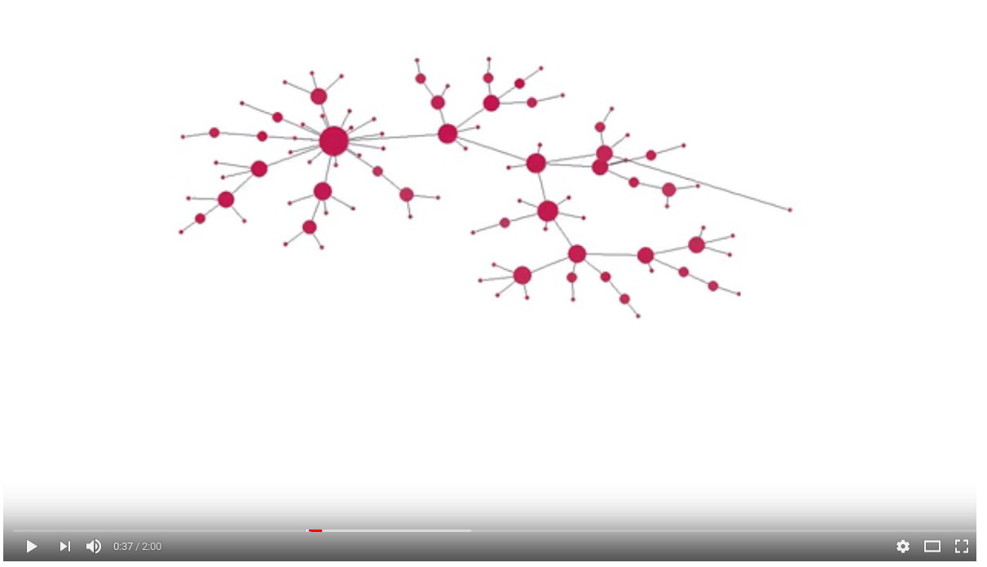
Preferential attachment simulation
https://www.youtube.com/watch?v=4GDqJVtPEGg

Slide 14
We have seen what but not why
Power-law degree distributions are prevalent
  Why?
Two assumptions in ER networks:
  There are N nodes that pre-exist
  Nodes connect at random
Let’s challenge both assumptions

Slide 15
Growth
Suppose there are two web pages on a topic, one with many inlinks the other with few, which one am I most likely to link to?
Which scientific papers are read? Which are cited?
Which actors are more sought after for new movies?

Slide 16


Slide 17
The Barabási-Albert (BA) model
Network starts with nodes
At every time step we add 1 node
This node will have outlinks
The probability of an existing node to gain a link is

Slide 18
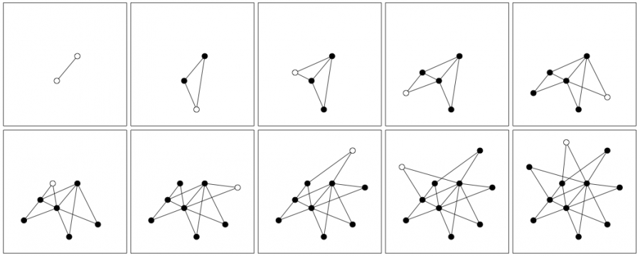
Example (m₀ = 2; m=2)

Slide 19
The Barabási-Albert (BA) model
Network starts with nodes
At every time step we add 1 node
This node will have outlinks
The probability of an existing node to gain a link is
Write the formula for N(t) and L(t)

Slide 20
N(t) and L(t)

Slide 21
Degree k_{i}(t) as a function of time
(All nodes minus the current)
(For large t)

Slide 22
Degree k_{i}(t) … continued
(t_{i} is the creation time of node i)

Slide 23
Degree k_{i}(t) … continued
Is the degree growth linear, super-linear, or sub-linear? Intuitively, why?

Slide 24
Sub-linear, because exponent ½ < 1

Slide 25
Degree k_{i}(t) … consequences
If t_{i} < t_{j} (node i is older than node j), what do we expect of k_{i} and k_{j}?

Slide 26
Older nodes have a faster degree growth rate

Slide 27
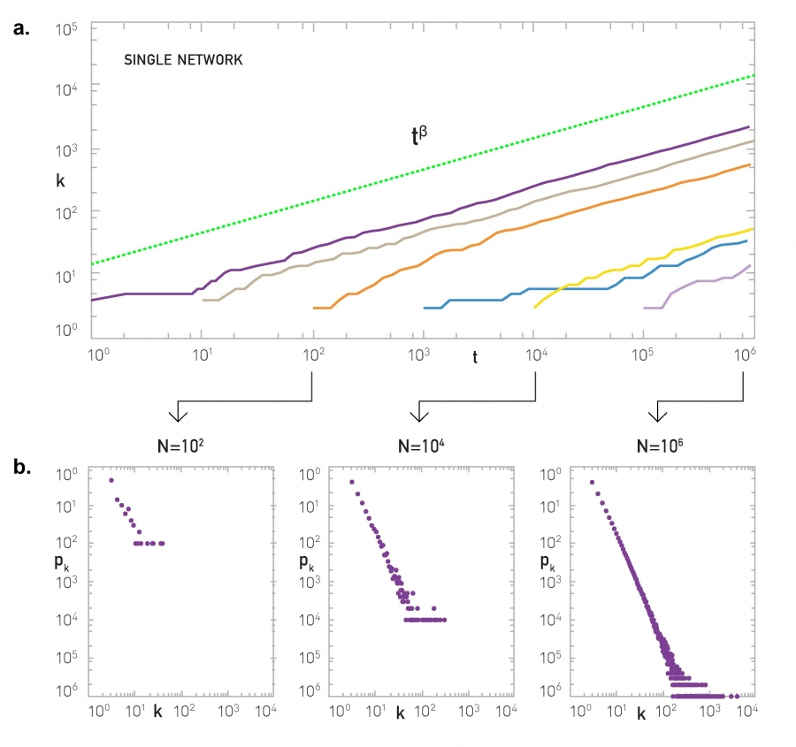
Simulation results
Model
Nodes with t_{i} = 1, 10, 100, 1000, 10000, ...

Slide 28
Degree distribution
Let’s calculate the CDF of the degree distribution

Slide 29
Degree distribution
Now let’s take the derivative of the CDF to obtain the PDF

Slide 30
Degree distribution
is called the dynamical exponent
is the power-law exponent
Note that
does not depend on t
hence, it describes a stationary network

Slide 31
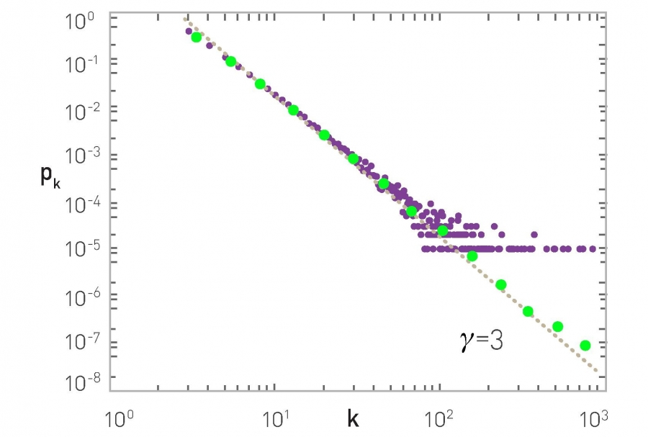
Degree distribution, simulation results
N=100,000 m=3

Slide 32
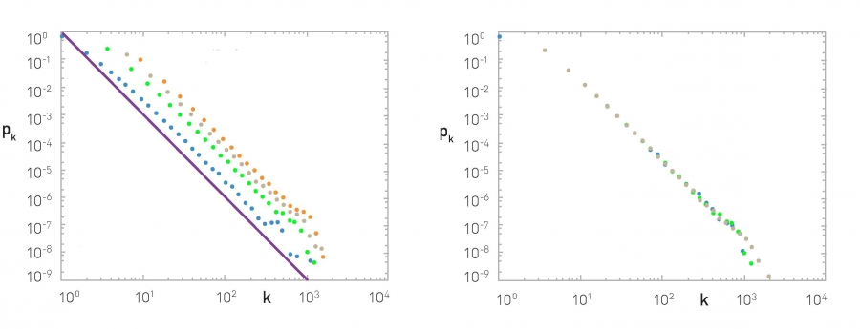
More simulations
N = 100,000; m₀ = m =
1 (blue), 3 (green), 5 (gray), 7 (orange)
Observe γ is independent of m (and m₀)
The slope of the purple line is -3
m₀ = m = 3; N =
50K (blue), 100K (green), 200K (gray)
Observe p_{k} is independent of N

Slide 33
Processes that generate BA networks
Link-selection model (step)
  Add one new node v to the network
  Select an existing link at random and connect v to one of the edges of that existing link
Copy model (step)
  Add one new node v to the network
  Pick a random existing node u
  With probability p link to u
  With probability 1-p link to a neighbor of u

Slide 34
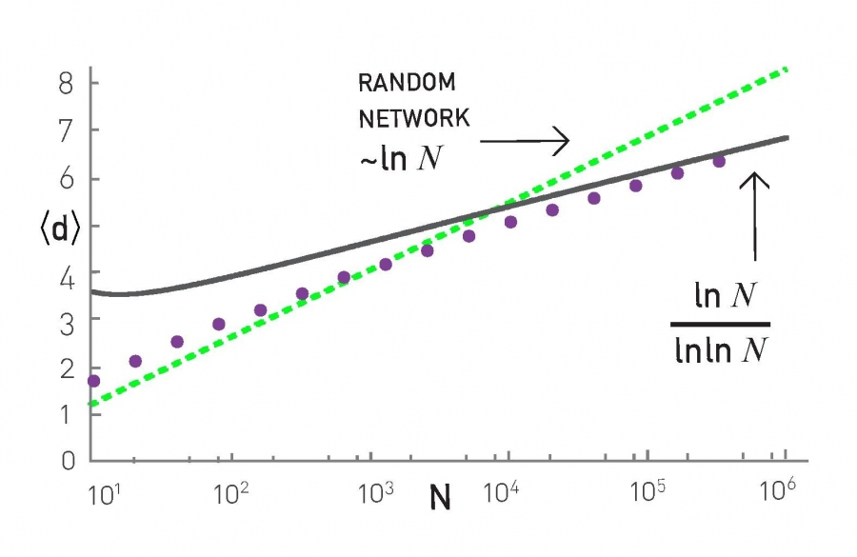
Average distance
Distances grow slower than log N

Slide 35
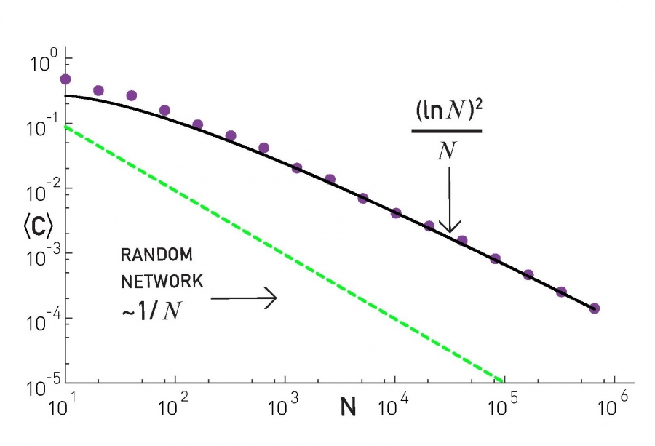
Clustering coefficient
BA networks are locally more clustered than ER networks

Slide 36
Limitations of the BA model
Predicts a fixed exponent of -3
Assumes an undirected network, while many real complex networks are directed
Does not consider node deletions or edge deletions which are common in practice
Considers that all nodes are equal except for their arrival times

Slide 37
Exercise: the copy model
In the copy model, at every step t:
  Add one new node v to the network
  Pick a random existing node u
  With probability p link to u
  With probability 1-p link to a neighbor of u
Simulate it on paper for 5 nodes with p=0.5
  Make sure you understand the model fully!
What is N(t) and L(t)?

Slide 39
In the copy model, at every step t:
Add one new node v to the network
Pick a random existing node u
With probability p link to u
With probability 1-p link to a neighbor of u
What is ?
We will compute
How many links on average gets node i at time t? In other words, what is …
Hint: it has a term with p and a term with 1-p

Slide 41
Rearrange terms in
… to do something similar to what we did for the BA model, then integrate between ti and t to obtain an expression for
Note that now

Slide 44
Once you have a expression for
Compute
Now write the cumulative distribution function of
And compute its derivative to obtain
It should show exponent

