Slide 1

Preferential Attachment
(BA Model)
Introduction to Network Science
Carlos Castillo
Topic 11

Slide 2
Contents
The uniform random attachment model
The BA or preferential attachment model
Degree distribution under the BA model
Distance distribution under the BA model
Clustering coefficient under the BA model

Slide 3
Sources
Albert László Barabási (2016) Network Science
  Preferential attachment follows chapter 05
Ravi Srinivasan 2013 Complex Networks Ch 12
Networks, Crowds, and Markets Ch 18
Data-Driven Social Analytics course by Vicenç Gómez and Andreas Kaltenbrunner

Slide 4
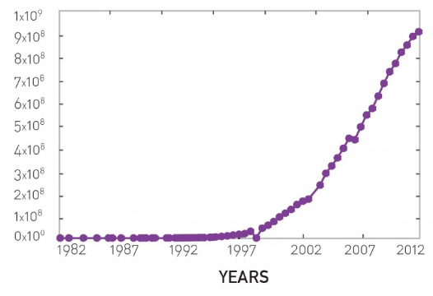
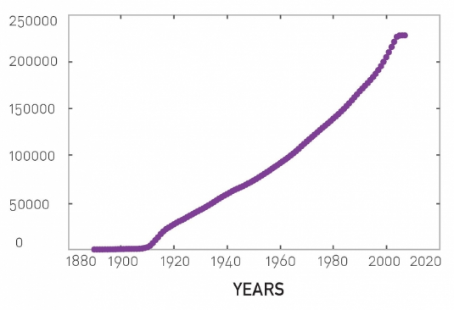
The number of nodes N increases: we need models of network growth
Number of hosts in WWW
Number of movies in IMDB

Slide 5
We have seen what but not why
Power-law degree distributions are prevalent
  Why?
That’s an interesting question … for now we will not answer why but will give a possible answer to how

Slide 6
Preliminary:
Uniform Random Attachment

Slide 7
Growth in an ER network
Two assumptions in ER networks:
  There are N nodes that pre-exist
  Nodes connect at random
Let’s challenge the first assumption

Slide 8
Uniform Attachment
Network starts with m fully-connected nodes
Time starts at t₀=m
At every time step we add 1 node
This node will have m outlinks

Slide 9
Expected degree over time
Probability of obtaining one link:
  Decreases over time
Expected degree of node born at

Slide 10
Tail of degree distribution
How many nodes of degree larger than K are there at time t? (Computation in “Advanced materials” at the end of these slides)
Decreases exponentially with K: it’s vanishingly rare to find high-degree nodes

Slide 11
Preferential Attachment

Slide 12
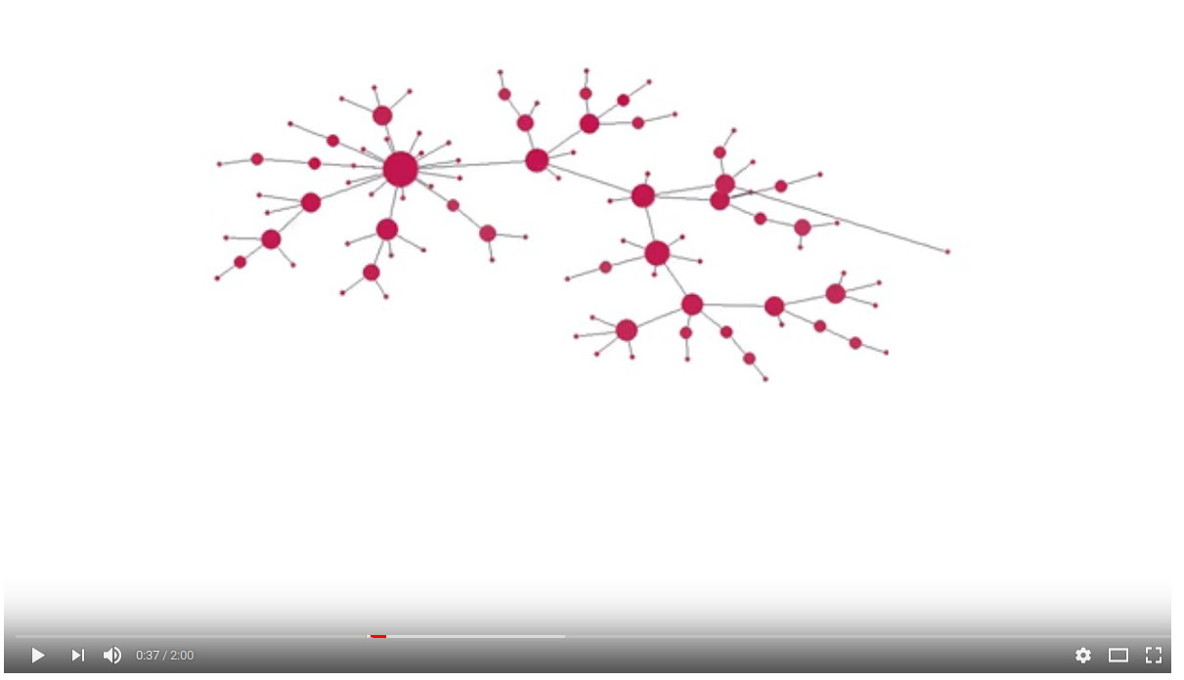
Preferential attachment simulation
https://www.youtube.com/watch?v=4GDqJVtPEGg

Slide 13
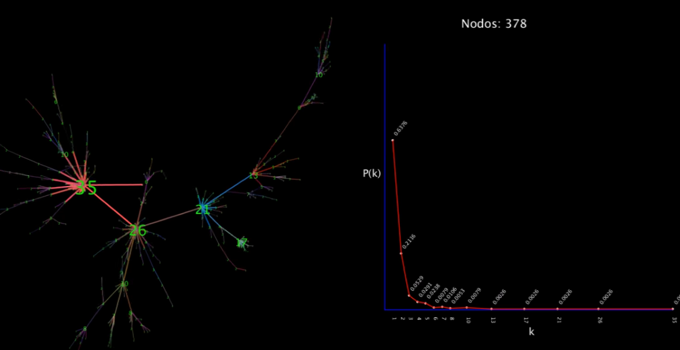
Degree distribution in simulation
https://www.youtube.com/watch?v=5RIQweqPT6A

Slide 14
Growth
Suppose there are two web pages on a topic, one with many inlinks the other with few, which one am I most likely to link to?
Which scientific papers are read?
Which book authors sell more?
Which actors are more sought after?

Slide 15


Slide 16
The Barabási-Albert (BA) model
Network starts with nodes connected arbitrarily as long as their degree is ≥ 1
At every time step we add 1 node
This node will have outlinks
The probability of an existing node of degree to gain one such link is
In an ER network,

Slide 17
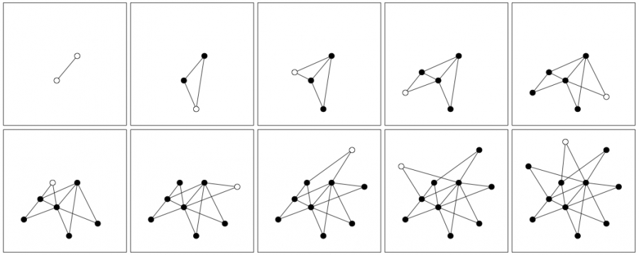
Example (m₀ = 2; m=2)

Slide 18
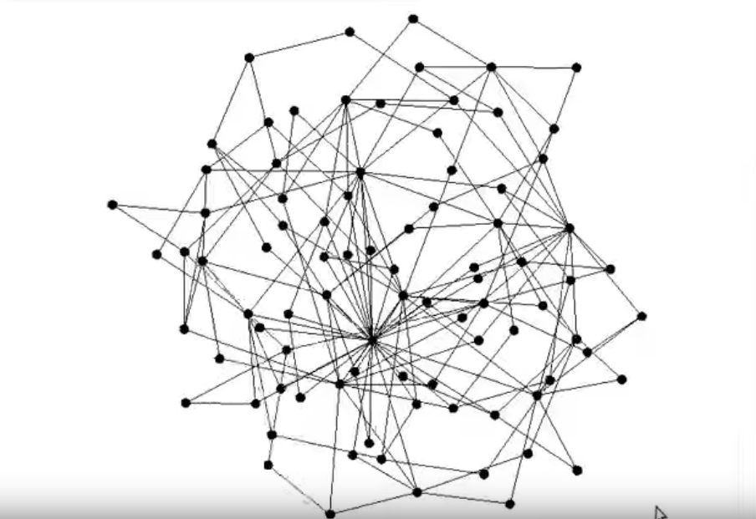
Network growth with m=2
https://www.youtube.com/watch?v=wocaGeNKn7Y

Slide 19
The Barabási-Albert (BA) model
Network starts with nodes connected arbitrarily as long as their degree is ≥ 1
At every time step we add 1 node
This node will have outlinks
The probability of an existing node of degree to gain one such link is
Write the formula for N(t) and L(t): at t=0 the network has m₀ nodes and L(0) links
Answer in Nearpod Collaborate: https://nearpod.com/student/ – Access to be provided during class

Slide 20
N(t) and L(t)

Slide 21
Summary

Slide 22
Things to remember
Preferential attachment
How to create a BA network step by step

Slide 23
Practice on your own
Describe step by step in pseudocode how to create a Barabási-Albert graph with N nodes having m₀ starting nodes and m outlinks per node.
For your pseudocode to be valid, if at any point there is a randomized step, you must indicate what is the probability of each possible outcome.

Slide 24
Advanced materials:
Expected degree under uniform random attachment
(not included in the exam)

Slide 25
Expected degree in uniform random attachment using a differential equation
Obtain ki
(1) Integrate between time i and time t
(2) Use initial condition

Slide 26
Expected degree over time

Slide 27
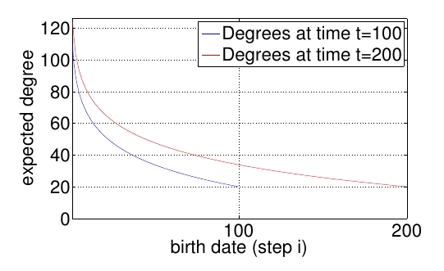
Degree distribution over time is not static
Degree of node born at time

Slide 28
Tail of degree distribution
How many nodes of degree larger than K are there
at time t?
The fraction is
Decreases exponentially with K: it’s vanishingly rare to find high-degree nodes

