Slide 1

Applications of
Network Science
Introduction to Network Science
Carlos Castillo
Topic 03

Slide 2
Sources
Albert László Barabási: Network Science. Cambridge University Press, 2016.
  Chapter 01, Chapter 02
Filippo Menczer, Santo Fortunato, and Clayton A. Davis. A First Course in Network Science. Cambridge University Press, 2020.
  Chapter 00
URLs cited in the footer of specific slides

Slide 3
What could complex networks have in common? Why those regularities could be relevant? How would you find out what they are?

Slide 4
Universality of complex networks
“A key discovery of network science is that the architectures of networks emerging in various domains of science, nature and technology are similar to each other, a consequence of being governed by the same organizing principles.” (Barabási 2016)

Slide 5
Characteristics of network science
Interdisciplinary; indeed we often address problems from disciplines other than CS
Empirical and data-driven; it is based on the observation of networks
Quantitative, mathematical, computational

Slide 6
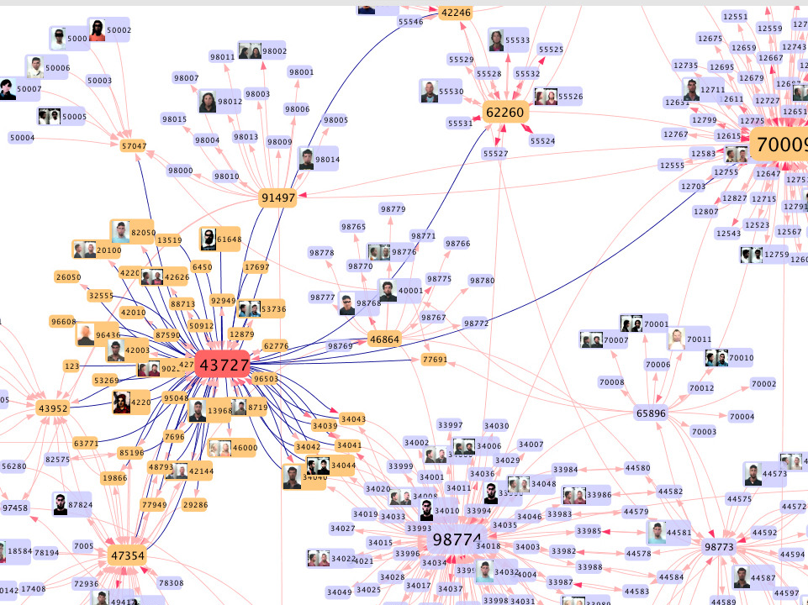
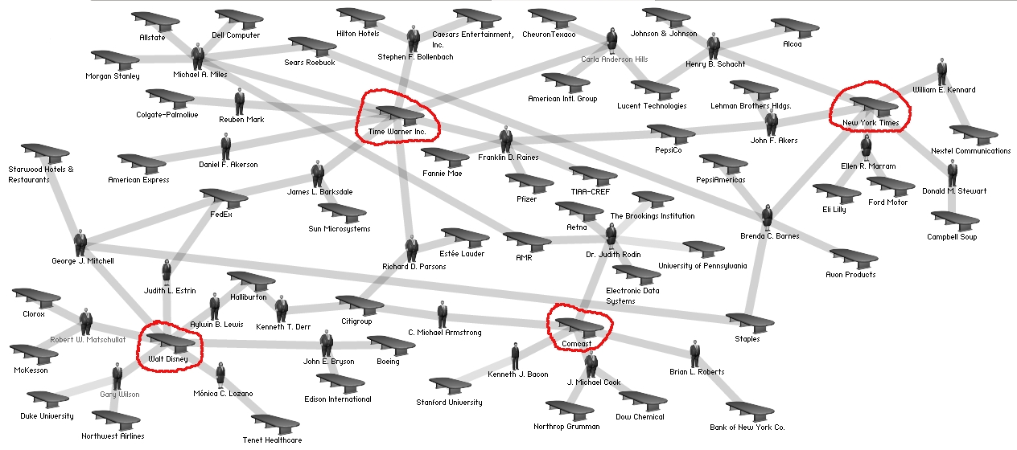
Help fight organized crime and collusion
https://itnews.iu.edu/articles/2014/complex-networks-researcher-at-iu-fighting-crime-with-mobile-phone-data.php
https://en.wikipedia.org/wiki/File:Media_corporation_interlocks_-_2004.jpg

Slide 7
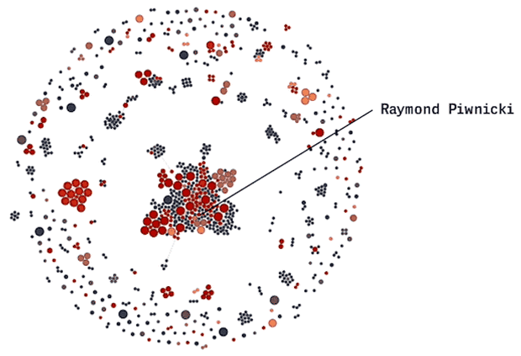
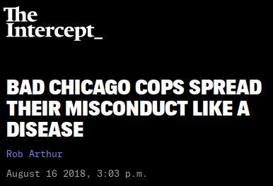
Help fight corruption
https://theintercept.com/2018/08/16/chicago-police-misconduct-social-network/

Slide 8
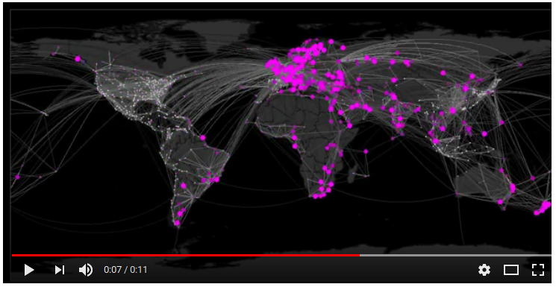
Help to forecast epidemics
https://www.youtube.com/watch?v=mm2u9RKwgsY

Slide 9
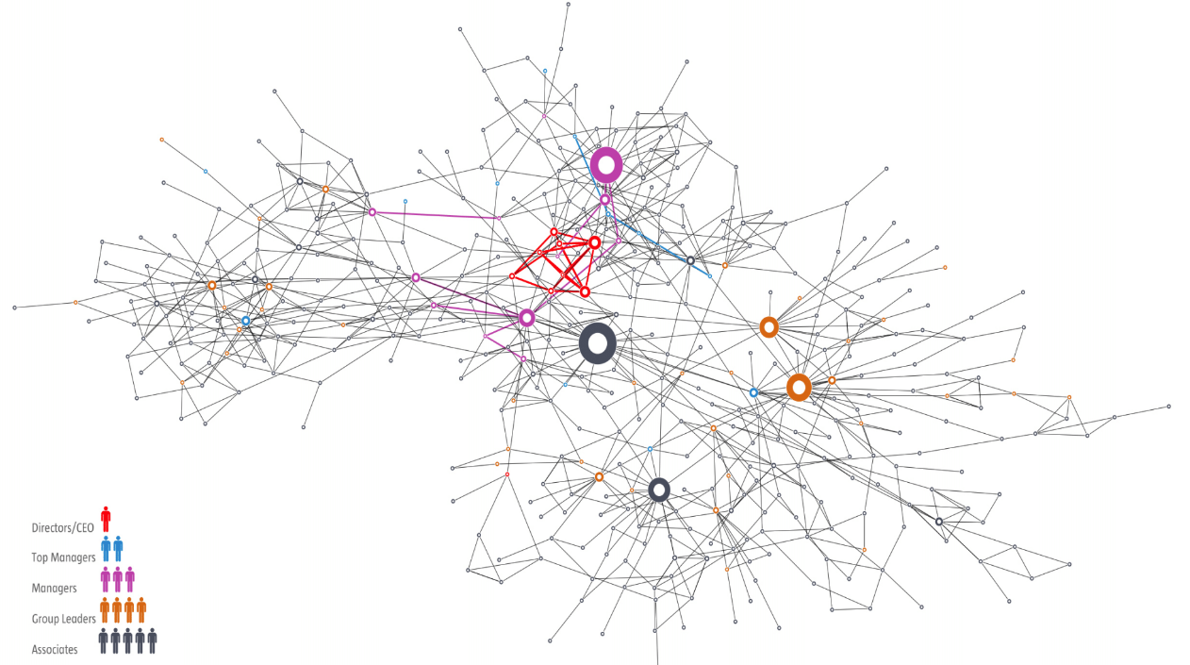
Help understand an organization, a society, or a brain

Slide 10
What can you do with this?
Help fight organized crime and corruption
Help to forecast epidemics
Help to understand an organization, a society, or a brain
Help design new treatments and drugs

Slide 11
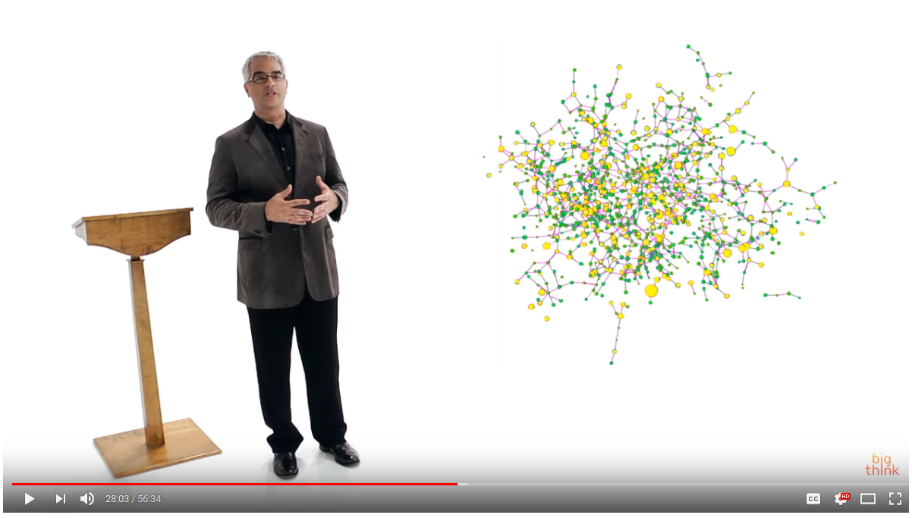
What can you do with this?
Help design new treatments and drugs
...
Highly recommended:
Nicholas Christakis
(one hour lecture)
https://www.youtube.com/watch?v=wadBvDPeE4E

Slide 12
What we will learn
To describe a network in formal terms
To identify it as such and characterize it
To visualize different networks
To operate with networks programmatically
To find important nodes and communities
To make discoveries or help others make them
Much more (to a large extent, it’s up to you!)

Slide 13
How we will learn
Theory sessions:
  Help you understand how to model complex networks
  Help you find important nodes, communities, and track influence
  Do some simple (and not so simple) exercises to check that you understood correctly each concept, and to help you remember
Practice sessions:
  Help you work with complex networks
  Manage and analyze graphs in Python
My focus is on what I think has value for you as a data scientist

Slide 14
Summary

Slide 15
Things to remember
Applications of complex networks analysis

