Slide 1

Graph theory basics
Introduction to Network Science
Carlos Castillo
Topic 04

Slide 2
Contents
Notation for graphs
Degree distributions
Adjacency matrices

Slide 3
Sources
Albert László Barabási: Network Science. Cambridge University Press, 2016.
  Follows almost section-by-section chapter 02
URLs cited in the footer of specific slides

Slide 4

The seven bridges of Königsberg
http://networksciencebook.com/images/ch-02/video-2-1.m4v

Slide 5
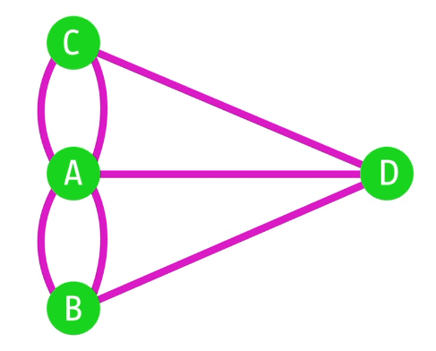
Quick Question
Can one walk across the 7 bridges without crossing the same bridge twice?

Slide 6
Can one walk across the 7 bridges without crossing the same bridge twice?
No
(proven by Euler, 1735)
A graph has an Eulerian circuit iff the graph is connected and all nodes have even degree
A graph has en Eulerian path iff the graph is connected and all nodes have even degree, or only 2 nodes have odd degree

Slide 7
Basic concepts

Slide 8
Notation for a graph
G = (V,E)
  V: nodes or vertices
  E: links or edges
|V| = N size of graph
|E| = L number of links

Slide 9
Typical notation variations
You may find that G is denoted by (N, A), this is typical of directed graphs, means “nodes, arcs”
You may find that
  |V| is denoted by n or N
  |E| is denoted by m, M, or L

Slide 10
Directed vs undirected graphs
In an undirected graph
  E is a symmetric relation
In a directed graph, also known as “digraph”
  E is not a symmetric relation

Slide 11
Example graphs we will use
Network | |V| | |E|
Zachary’s Karate Club (karate.gml) | 34 | 78
Les Misérables (lesmiserables.gml) | 77 | 254
E-mail exchanges (email-eu-core.csv) | 868 | 25K
US companies ownership | 1351 | 6721
Marvel comics (hero-network.csv) | 6K | 167K
https://github.com/chatox/networks-science-course/tree/master/practicum/data

Slide 12
Degree
Node i has degree k_{i}
  This is the number of links incident on this node
  The total number of links L is given by
Average degree

Slide 13
In directed networks
We distinguish in-degree from out-degree
  Incoming and outgoing links, respectively
Degree is the sum of both
Counting total number of links:

Slide 14
Degree distribution
If there are N_{k} nodes with degree k
The degree distribution is given by
The average degree is then

Slide 15
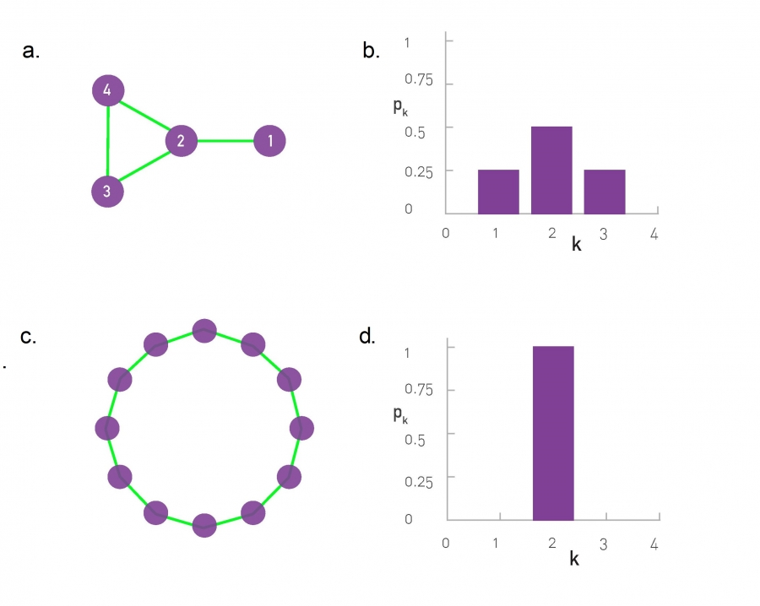
Degree distribution; two toy graphs

Slide 16
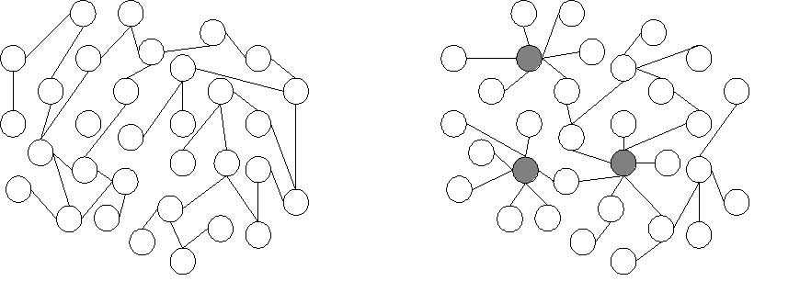
Exercise
Answer in
Google Spreadsheet
Draw the degree distribution of these graphs

Slide 17
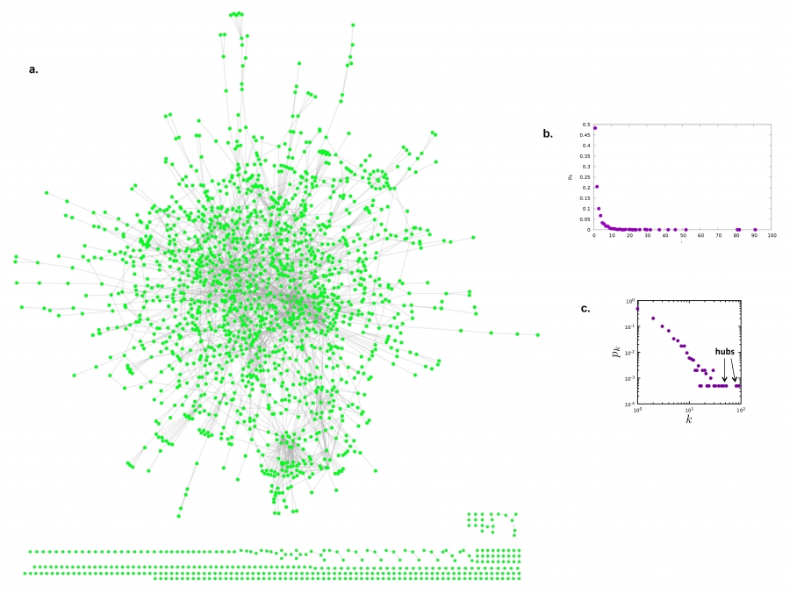
Degree distribution; real graph
Linear
scale
Log-log
scale

Slide 18
Adjacency matrix

Slide 19
What is an adjacency matrix
A is the adjacency matrix of G = (V, E) iff:
  A has |V| rows and |V| columns
  A_{ij} = 1 if (i,j)∈ E
  A_{ij} = 0 if (i,j)∉ E

Slide 20
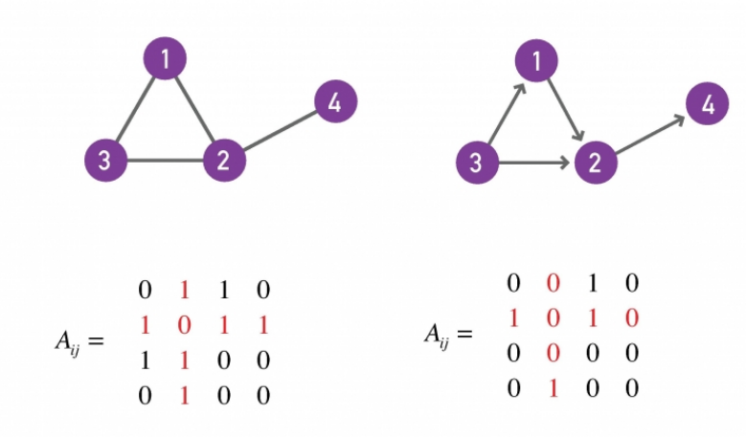
Examples
Undirected graph
Directed graph
0 1 1 0
1 0 1 1
1 1 0 0
0 1 0 0
0 1 0 0
0 0 0 1
1 1 0 0
0 0 0 0

Slide 21
Quick Question
In terms of A, what is the expression for:

Slide 22
Quick Question
In terms of A, what is the expression for:

Slide 23
Some “graphology” ...
G is undirected ⇔ A is symmetric
G has a self-loop
⇔ A has a non-zero element in the diagonal
G is complete ⇔ A_{ij} ≠ 0 (except if i=j)

Slide 24
Summary

Slide 25
Things to remember
Definitions:
  Degree, in-degree, out-degree
Writing the adjacency matrix of a graph and drawing a graph given its adjacency matrix

Slide 26
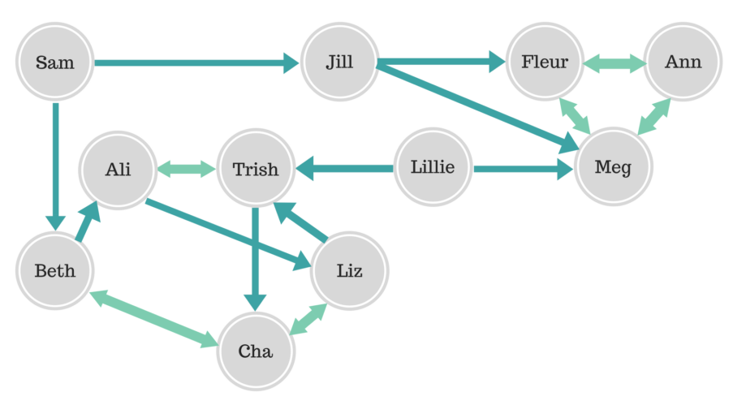
Practice on your own
Draw the indegree, outdegree, degree distribution
Write the adjacency matrix
https://www.6seconds.org/2017/07/03/20125/

