Slide 1

PageRank
Social Networks Analysis and Graph Algorithms
Prof. Carlos Castillo — https://chato.cl/teach

Slide 2
Sources
D. Easley and J. Kleinberg (2010): Networks, Crowds, and Markets – Chapter 14
Fei Li's lecture on PageRank (2011)
Evimaria Terzi's lecture on link analysis (2013)
URLs in the footer of specific slides

Slide 3
The origins of PageRank

Slide 4

Back to the 1990s ...

Slide 5
The early days of the web
March 1989: proposal by Tim Berners-Lee at CERN
Early 1993: NCSA Mosaic graphical browser
Jan 1994: Yahoo! Web directory (manual)
1994: WebCrawler, Lycos (automated, crawlers)
End of 1994: the web has about 10,000 sites
1995-1996: Altavista, Inktomi, and many others ...

Slide 6

Part of a research project that started in 1995 ...

Slide 7


Slide 8

PageRank
[link]
Today, PageRank and its variants are probably part of most ranking systems in linked collections of data
Relevance = links + content + interactions + ...

Slide 9
Simplified PageRank

Slide 10
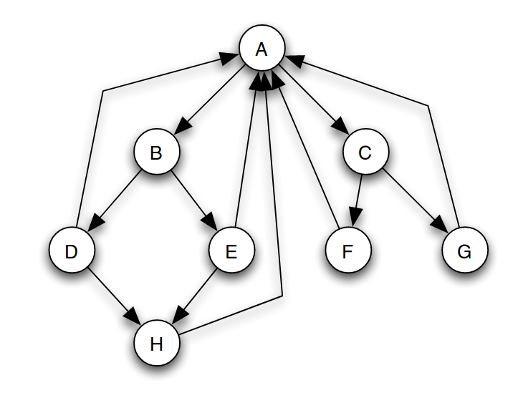
(Simplified) PageRank
All nodes start with score 1/N
Repeat t times:
  Divide equally and “send” its score to out-links
  Add received scores

Slide 11

Exercise
Execute simplified PageRank
All nodes start with score 1/N
Repeat t times:
  Divide equally and “send” the score of each node to out-links
  Add received scores
Keep intermediate values in a table
Try to arrive to equilibrium values
Spreadsheet links: https://upfbarcelona.padlet.org/chato/shyq9m6f2g2dh1bw

Slide 12
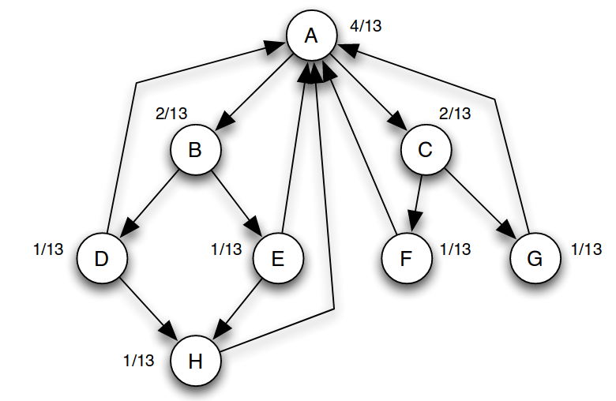
Equilibrium values
How can you prove these are
equilibrium values? (Do it.)

Slide 13
Equilibrium values
Answer: in equilibrium, the score going
into a node is equal to the score going out

Slide 14
(Simplified) PageRank
is the number of out-links of page j
c is a normalization factor to ensure

Slide 15
Running simplified PageRank on a graph
A
Adjacency
matrix
B
C
Row-stochastic adjacency matrix

Slide 16
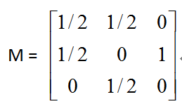
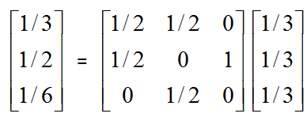
Another example of Simplified PageRank
A
B
C
First iteration of calculation:

Slide 17
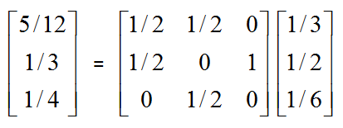
Another example of Simplified PageRank
A
B
C
Second iteration:

Slide 18
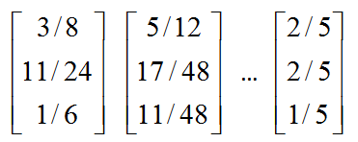
Another example of Simplified PageRank
A
B
C
Following iterations:
Final score

Slide 19
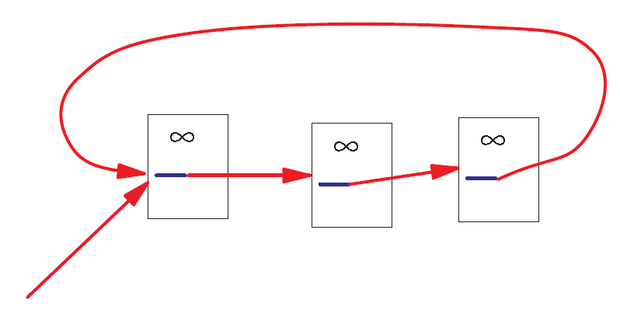
A Problem with Simplified PageRank
A loop:
During each iteration, the loop accumulates score but never distributes score to other pages!

Slide 20
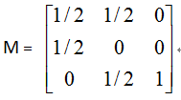
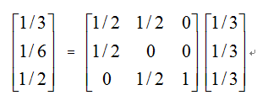
Example of the problem ...
A
B
C
First iteration of calculation:

Slide 21
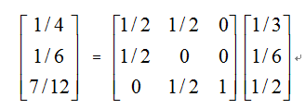
Example of the problem ...
A
B
C
Second iteration:

Slide 22
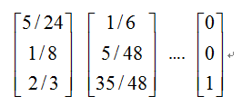
Example of the problem ...
A
B
C
Following iterations:
The winner takes all!

Slide 23
Why is PageRank also refered to as
“Eigen...” centrality

Slide 24
What are we computing?
A is the transposed row-stochastic adjacency matrix
What is p?
How do you call this method to compute p?

Slide 25
What are we computing?
p is an eigenvector of A with eigenvalue 1
This repeated multiplication is the power method

Slide 26
What are we computing?
This will converge if A is:
  Left-stochastic (each column adds up to one)
  Irreducible (represents a strongly connected graph)
  Aperiodic (does not represent a bipartite graph)

Slide 27
“Random walk” interpretation

Slide 28
Markov Chain
Discrete process over a set of states
Next state computed from current state only (no memory of older states)
  Higher-order Markov chains can be defined
Stationary distribution of Markov chain is a probability distribution such that p = Ap
Intuitively, p represents “the average time spent” at each node if the process continues forever

Slide 29

Example Markov Chain: a baby
(think of 1-hour time steps)
0.5
Crying
0.1
0.2
0.4
0.1
0.8
0.1
Eating
Sleeping
0.8
0.0

Slide 30
Random Walks in Graphs
Random Surfer Model → Simplified PageRank
  The simplified model: the standing probability distribution of a random walk on the graph of the web. simply keeps clicking successive links at random
Modified Random Surfer → PageRank
  The modified model: the “random surfer” simply keeps clicking successive links at random, but periodically “gets bored” and jumps to a random page based on a distribution R (e.g., uniform)
  This guarantees irreducibility
  Pages without out-links (dangling nodes) are a row of zeros, can be replaced by R, or by a row of 1/N

Slide 31
PageRank
R(i): web pages that “users” jump to when they “get bored”;
Uniform preferences => R(i) = 1/N

Slide 32
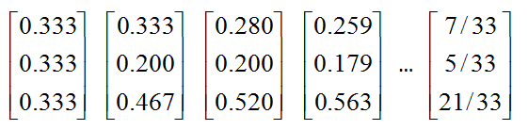
An example of PageRank
A
B
C
Was:

Slide 33
Summary

Slide 34
Things to remember
Simplified PageRank
PageRank

Slide 35
Practice on your own
Consider a directed graph G = (V, E) in which V = {1, 2, . . . , N }
and (i, j) ∈ E ⇐⇒ i ∈ V ∧ j ∈ V ∧ (j = i + 1 ∨ j = i = N )
  1. Indicate the value of Simplified PageRank S(i) for each node i in the graph, justifying your answer.
  2. Indicate the value of PageRank P (i) for each node i in the graph as a function of i and the parameter α.
Tip: write P(1), then write P(2), then write P(3), then write P(i).

