Slide 1

Finding Communities
Social Networks Analysis and Graph Algorithms
Prof. Carlos “ChaTo” Castillo — https://chato.cl/teach

Slide 2
Sources
A. L. Barabási (2016). Network Science – Chapter 09
D. Easly and J. Kleinberg (2010). Networks, Crowds, and Markets – Chapter 03
F. Menczer, S. Fortunato, C. A. Davis (2020). A First Course in Network Science – Chapter 06
URLs cited in the footer of slides

Slide 3
Defining communities

Slide 4
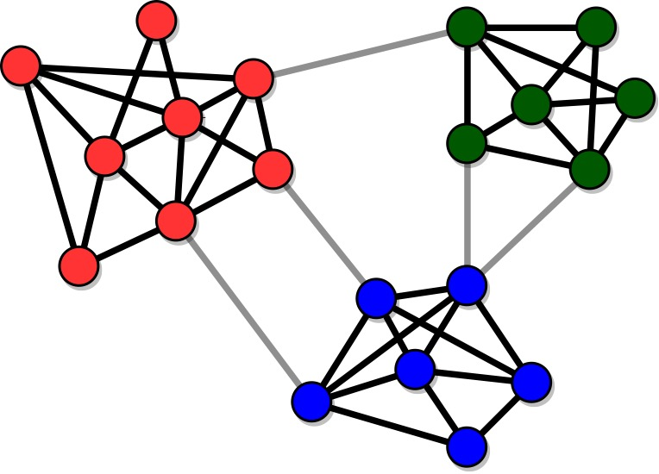
Example with clear community structure
Source: Menczer, Fortunato, Davis: A First Course on Networks Science. Cambridge, 2020.

Slide 5
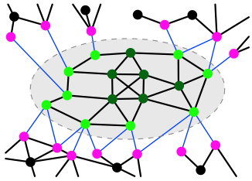
Communities are connected and dense
Given a community C
Internal degree k^{int}(C) considers only nodes inside the community
External degree k^{ext}(C) considers only nodes outside the community
Source: Menczer, Fortunato, Davis: A First Course on Networks Science. Cambridge, 2020.

Slide 6
Strong community
A community C is strong if every node i within the community satisfies:
Is the community of green nodes (dark green and light green) a strong community?
What is the difference between dark green and light green nodes?
Source: Menczer, Fortunato, Davis: A First Course on Networks Science. Cambridge, 2020.

Slide 7
Weak community
A community C is weak if on aggregate nodes satisfy:
All communities satisfying the strong property satisfy the weak one
Source: Menczer, Fortunato, Davis: A First Course on Networks Science. Cambridge, 2020.

Slide 8
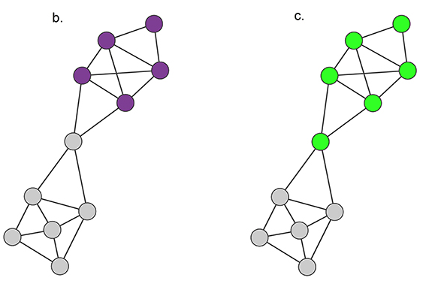
Exercise
Is community A strong, weak, both?
Is community B strong, weak, both?
A community C is strong if, for all nodes i within the community:
A
B
A community C is weak if:

Slide 9
Answer
Community A is a strong community
  (and therefore, also a weak community)
Community B is a weak community

Slide 10
Network bisection

Slide 11
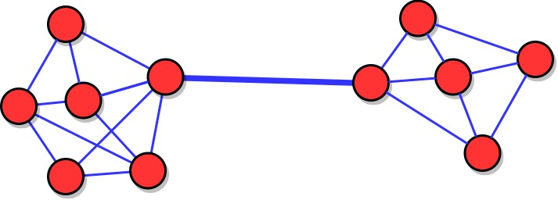
A graph that is easy to bisect
Source: Menczer, Fortunato, Davis: A First Course on Networks Science. Cambridge, 2020.

Slide 12
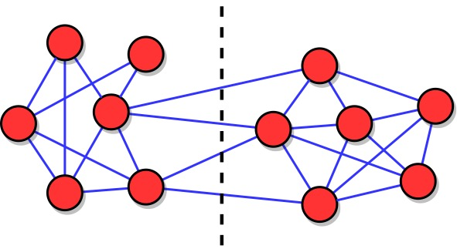
Graph bisection: finding a minimal “cut”
Source: Menczer, Fortunato, Davis: A First Course on Networks Science. Cambridge, 2020.

Slide 13


Simple exercise
Cut size under two partitions
What is the size of the white-red cut?
If node 9 goes to the red component, what is the size of the white-red cut?
Pin board: https://upfbarcelona.padlet.org/chato/4qz0k8ro0zquen1

Slide 14
A divisive method

Slide 15
Hierarchical graph partitioning
Until there are edges in the graph
  Find an edge e that bridges two communities
  Remove edge e

Slide 16
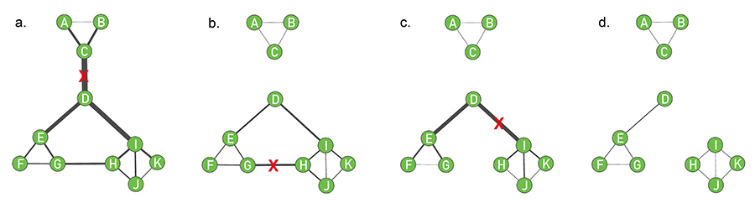
The Girvan-Newman algorithm
Repeat:
  Compute edge betweenness
  Remove edge with larger betweenness

Slide 17
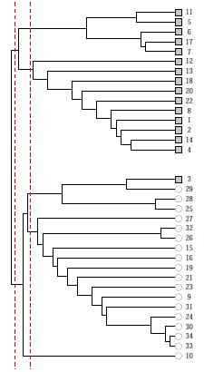
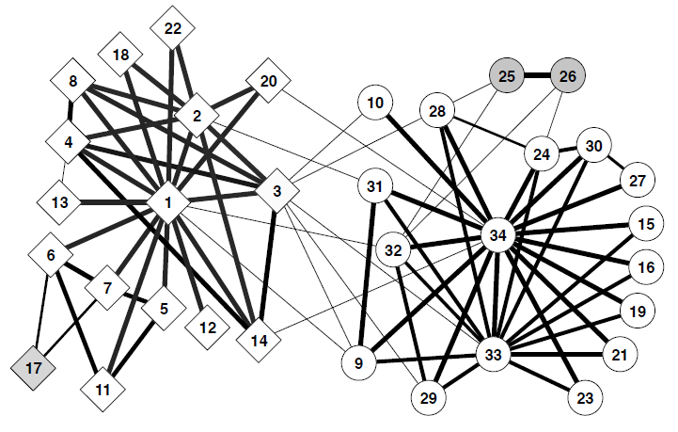
Example: Karate Club
https://slidetodoc.com/online-social-networks-and-media-community-detection-1/

Slide 18
Modularity

Slide 19
Measuring a partition in a graph
Modularity (or one of its variants) is a popular method to determine how good a partition is on a graph
It compares the observed number of internal links in each partition, against the expected number of internal links if those internal links had been placed at random

Slide 20

Modularity of a partition
L = number of links in the network
L_{C} = number of internal links in community C
k_{C} = sum of degree of nodes in C

Slide 21
Modularity of a partition (cont.)
Expression in parenthesis is the difference between observed and expected internal links in community C
L = number of links in the network
L_{C} = number of internal links in community C
k_{C} = sum of degree of nodes in C
k²_{C} /4L = expected number of internal links in community C

Slide 22
Link “stub”
A link “stub” is a connection between a link and a node
There are 2L stubs in a network
There are as many stubs as the sum of the degree of nodes

Slide 23
Modularity of a partition
There are L_{C} internal links in C
Total number of stubs in nodes in C is k_{C}
Total number of stubs in the network is 2L
Probability of chosing two stubs in C: (k_{C}/L)² = k_{C}²/4L²
The expected number of links joining two stubs in C is L(k_{C}²/4L²) = k_{C}²/4L
The observed number is L_{C}

Slide 24
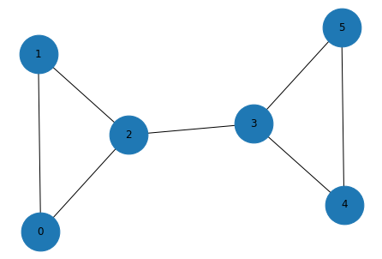
Exercise
What is the modularity of the partition {0, 1, 2}, {3, 4, 5}?
What is the modularity of the partition {0, 1, 2, 3}, {4, 5}?

Slide 25


Answer
import networkx as nx
import networkx.algorithms.community as nx_comm
G = nx.barbell_graph(3, 0)
nx_comm.modularity(G, [{0, 1, 2}, {3, 4, 5}])
0.35714285714285715
nx_comm.modularity(G, [{0, 1, 2, 3}, {4, 5}])
0.12244897959183669

Slide 26
Summary

Slide 27
Things to remember
Strong and weak community
The concept of “cut” in graph bisection
Girvan-Newman’s algorithm
Modularity

Slide 28
Practice on your own
Check the modularity computations in the example on the next slide: (a) optional partitioning into two communities, (b) suboptimal partitioning into two communities, (c) all the nodes in a single community, (d) one community per node
You can check your answers with networkx.algorithms.community.modularity

Slide 29
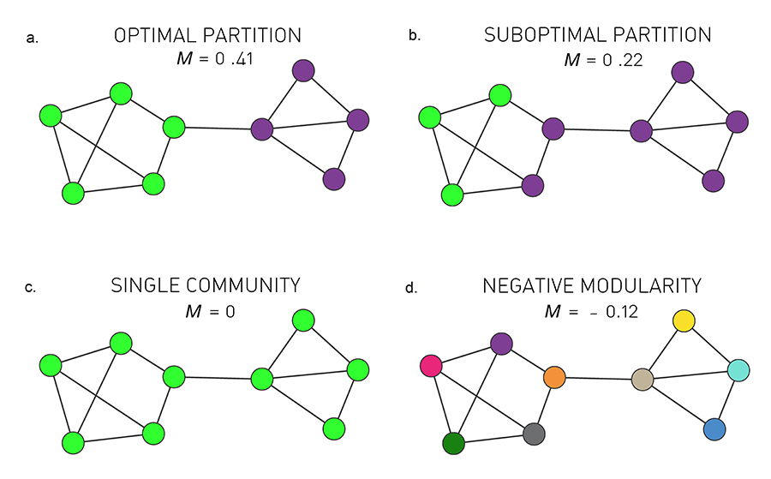
Q = 0.41
Q = 0.22
Q = 0
Q = - 0.12
http://networksciencebook.com/chapter/9#modularity

