Slide 1

Other growth models
Introduction to Network Science
Carlos Castillo
Topic 06

Slide 2
Contents
Good-get-richer
Sub-linear and super-linear
preferential attachment
Aging effects
Advanced materials:
No preference, no growth

Slide 3
Sources
Albert László Barabási: Network Science. Cambridge University Press, 2016.
  Chapters 05 and 06

Slide 4
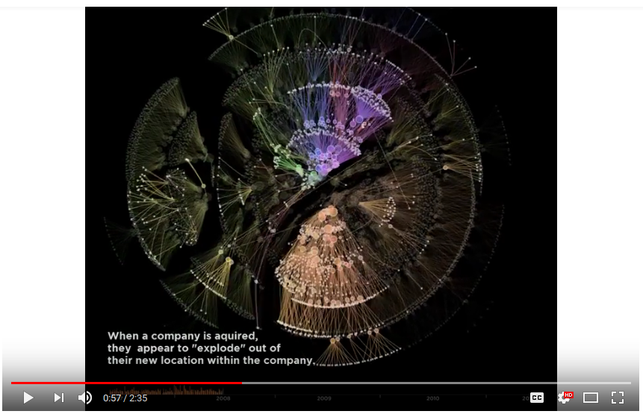
Actual network growth is complex
A snapshot of the Autodesk organizational hierarchy was taken each day between May 2007 and June 2011, a span of 1498 days.
Each day the entire hierarchy of the company is constructed as a tree with each employee represented by a circle, and a line connecting each employee with his or her manager.
Larger circles represent managers with more employees working under them. The tree is then laid out using a force-directed layout algorithm.
From day to day, there are three types of changes that are possible:
Employees join the company
Employees leave the company
Employees change managers
https://www.youtube.com/watch?v=mkJ-Uy5dt5g

Slide 5
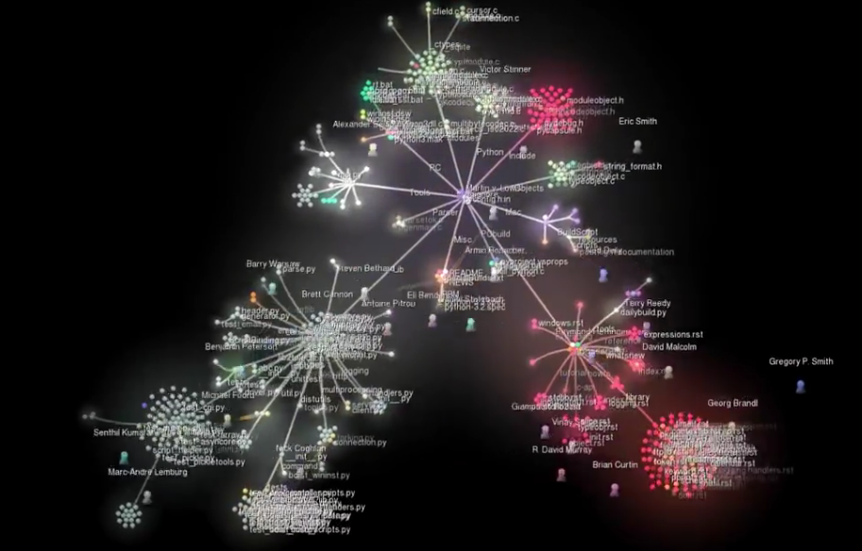
Growth of Python
(Gource visualization)
https://www.youtube.com/watch?v=cNBtDstOTmA

Slide 6
“Good get richer”
(incl. Bianconi-Barabási model)

Slide 7
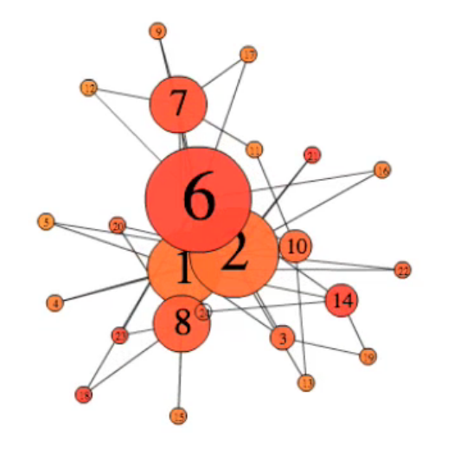
“Good get richer” simulation
(number is attractiveness)
http://networksciencebook.com/images/ch-06/video-6-1.mov

Slide 8
“Good get richer”
A “good get richer” model is one where
  Each node has an “attractiveness” (called “fitness”)
  Preferential attachment is guided by this fitness
The probability of connecting to node i is:

Slide 9
Degree dynamics
With the dynamic exponent
Remember that in linear preferential attachment (for all nodes)

Slide 10
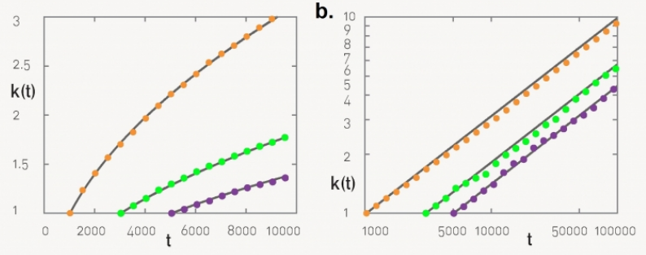
In preferential attachment (BA) a “younger” node cannot overtake an “older” node
Linear plot
Log-log plot

Slide 11
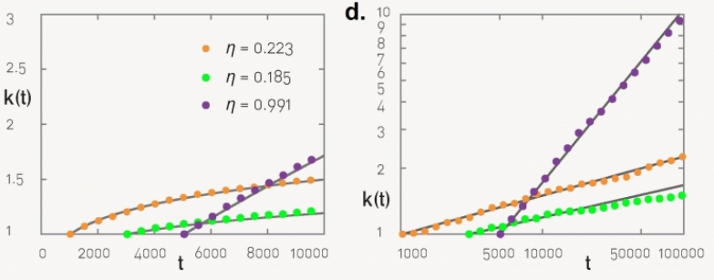
In good-get-richer
(Bianconi-Barabási) this depends on node fitness
Linear plot
Log-log plot

Slide 12
Degree distribution
When is constant this reduces to BA
When is uniformly distributed in [0, 1] this also yields a power law but instead of
we get
Which distribution is more heterogeneous?

Slide 13
Sub-linear and super-linear preferential attachment

Slide 14
Sub-linear and super-linear preferential attachment
The model we have studied so far has linear preferential attachment because
We could imagine cases where
for or
What do you think should happen in each case?

Slide 15
Measuring preferential attachment
We should try to measure
This can be too noisy
  Why?
Instead we will measure
If is constant
If then

Slide 16
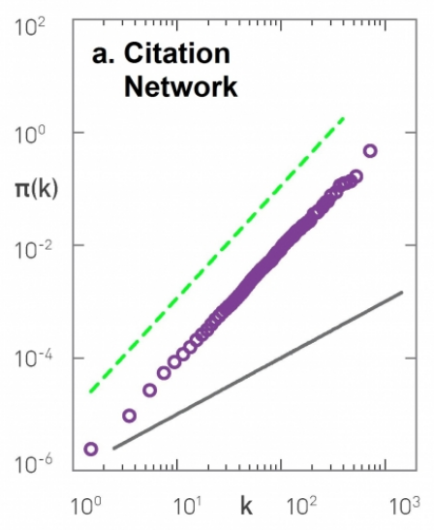
Preferential attachment in a citation network
We observe it follows preferential attachment (with ) in this case

Slide 17
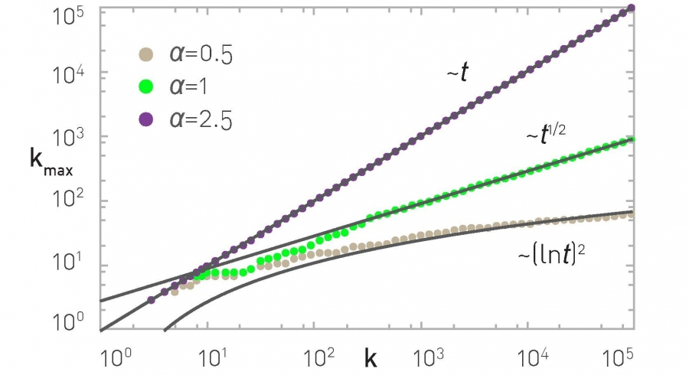
The degree of the largest hub k_{max}

Slide 18
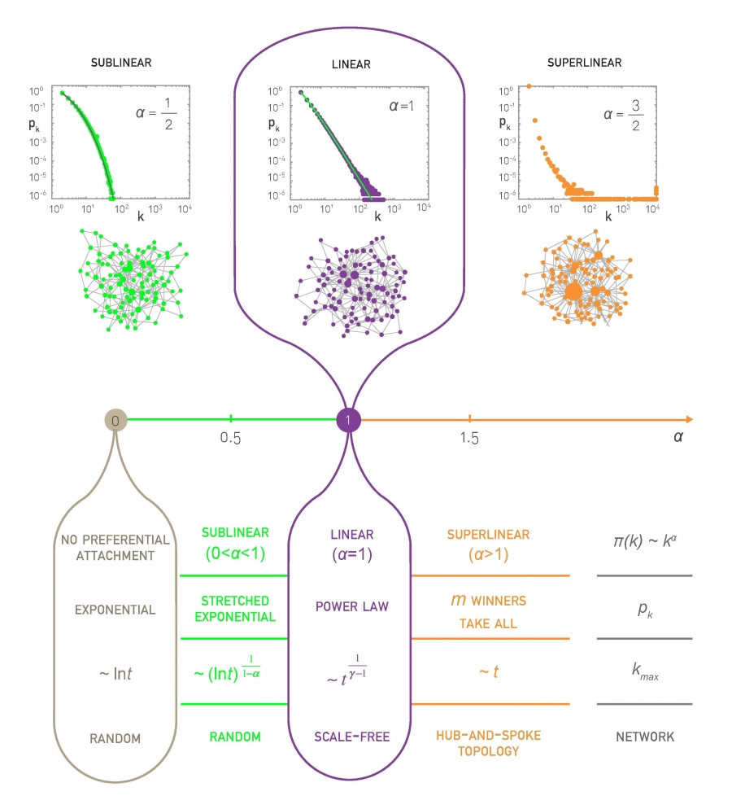

Slide 20
Aging effects

Slide 21

Sick Boy’s unified theory of life from Trainspotting (1996)
In English: https://www.youtube.com/watch?v=pQD-dXfHrvk
In Spanish: https://www.youtube.com/watch?v=cN_WbiuqyQU
English (bad audio) subs in Spanish: https://www.youtube.com/watch?v=4xTWD9GNRFA

Slide 22
Aging effects
Models without fitness but with a negative effect of age
Older nodes accumulate links more slowly
Parameter v is the decay factor
Qualitatively, what would you expect if:

Slide 23
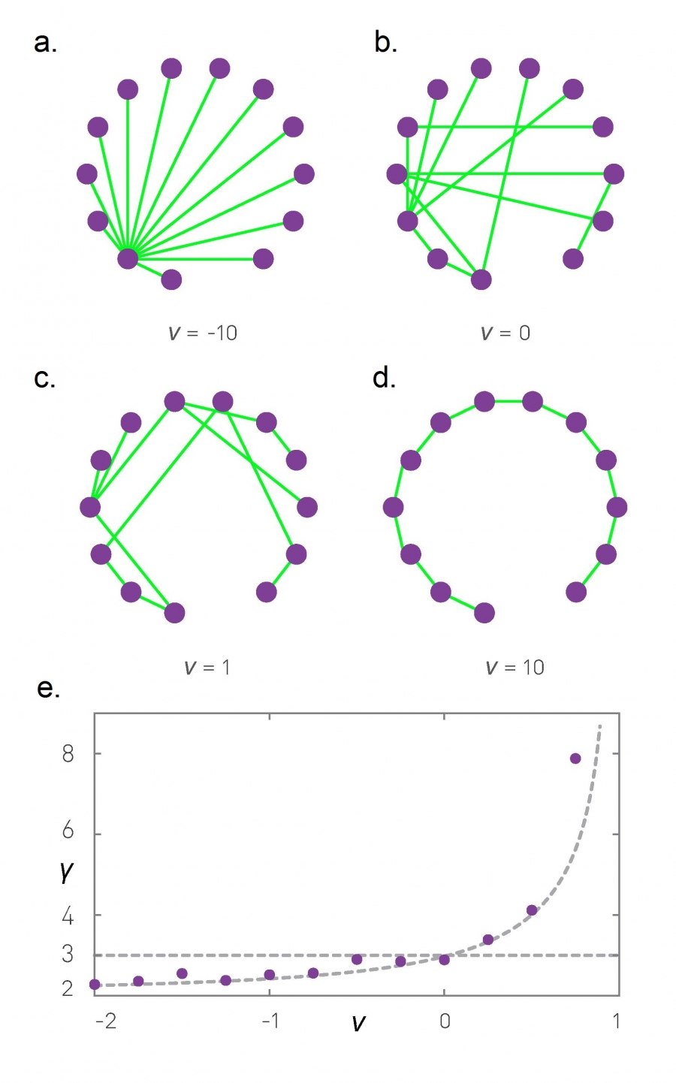
Aging effects
favors older nodes
is simply preferential attachment
means only youngest are linked

Slide 24
Power-law exponent in models with aging (N=10K, m=1)
More heterogeneous
More homogeneous

Slide 25
Advanced materials
(not included in the exam):
(1) No preference (2) No growth

Slide 26
Remember preferential attachment
Start with m₀ nodes
At every time step
  Add one new node u
  Repeat m times
    Pick a node v with probability
    Connect u to v

Slide 27
Two simple variants
No preference
  Nodes receiving inlinks are picked uniformly at random
No growth
  The network starts with N nodes
  No new nodes are created

Slide 28
No preference model
Write the process on paper
Write
Noting that obtain

Slide 30
No preference model (cont.)
Compute assuming large t, t_{i}
Use it to compute
Derive to obtain

Slide 33
Note: in Barabási 2016 section 5.6.1 there is an extra “e” in the solution.
I didn’t get the exact same result but the exponent is what’s important, and it’s the same.

Slide 34
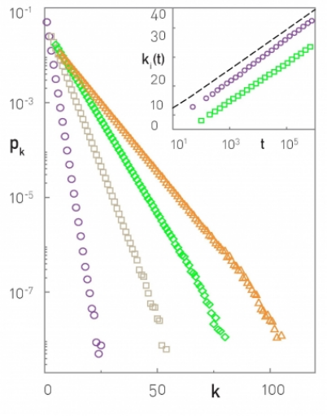
Consequences of the “no preference” model
Two chosen nodes
Degree decays exponentially
No power-law
No large hubs
m=1, m=3, m=5, m=7

Slide 35
No growth model
Write the process on paper
You will need to impose why?
Write
Noting that obtain

Slide 37
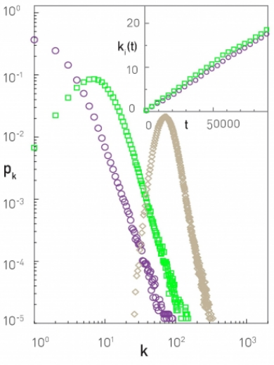
Consequences of the “no growth” model
Two chosen nodes
Degree grows
linearly
Degree distribution is not stationary
N=100K
t=N, t=5N, t=40N

