Slide 1

Models of Influence
Introduction to Network Science
Carlos Castillo
Topic 25

Slide 2
Sources
Easley and Kleinberg (2010): Networks, Crowds, and Markets Ch 19
Carlos Castillo, Wei Chen, Laks V. S. Lakshmanan (2012): Information and Influence Spread in Social Networks, KDD Tutorial.
Carlos Castillo (2017): Social influence slides

Slide 3
What are our observables?
Graph: users, links/ties
Log: user, action, time
User | Action | Time
John | Rates with 5 stars “The Artist” | June 3rd
Peter | Watches “The Artist” | June 5th
Jen | … | …
John
Mary
Peter
Jen

Slide 4
Two main models
Linear threshold model
Independent cascade model

Slide 5



Linear threshold model
Nodes have thresholds
Arcs have weights
Nodes that receive weighted influence equal or above their threshold become active
0.5
0.6
0.2
0.5
0.2
0.8
0.1
0.5
0.3
0.3
0.1
0.2
0.3
0.2
0.4
0.3
0.4
0.3
0.1
0.7
0.1
0.2
0.3
0.2
0.3
0.8
0.2
0.3
0.3
[Kempe, Kleinberg and Tardos, KDD 2003]

Slide 6
Exercise
Add your results to this
Google Spreadsheet
(Sheet: Linear Threshold)
Thick arrows have weight 1.0
Thin arrows have weight 0.5
Execute linear threshold model starting from seed node
0.6
0.4
0.9
0.6
0.4
0.6
1.1
0.4
1.4
0.4
0.4

Slide 7
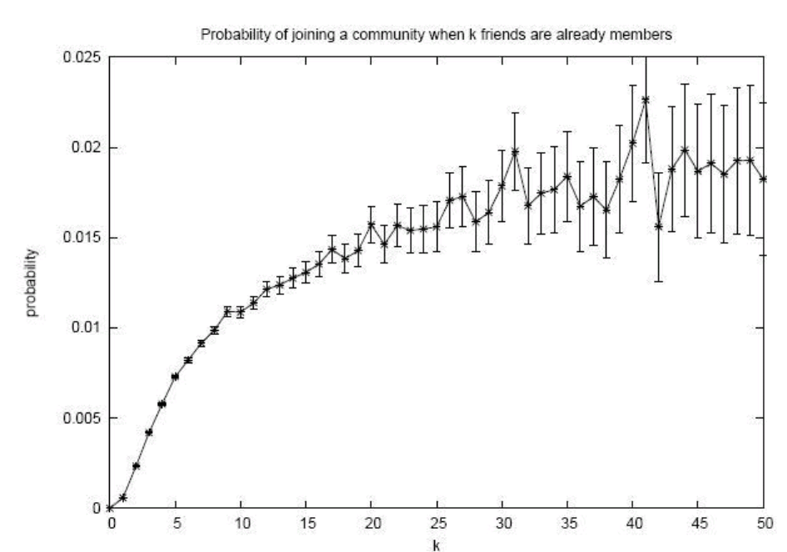
Linear threshold model
Is the linear threshold model compatible with this observation?

Slide 8
Independent cascade model
No thresholds
Each node, when activating, has one chance of activating each of their neighbors
Probability of succeeding represented by arc weights
0.2
0.7
0.2
0.1
0.1
0.1
0.01
0.05
0.3
0.2
0.4
0.1
0.3
0.1
0.1
0.02
0.3
0.04
0.3
0.3
[Kempe, Kleinberg and Tardos, KDD 2003]

Slide 9
Exercise
(you need a coin or 1d4)
Add your results to this
Google Spreadsheet
(Sheet: Independent Cascade)
Thick arrows have probability 0.75
Thin arrows have probability 0.5
Execute independent cascade model starting from seed node

Slide 10
Independent cascade model
Is the independent cascade model compatible with this observation?

Slide 11
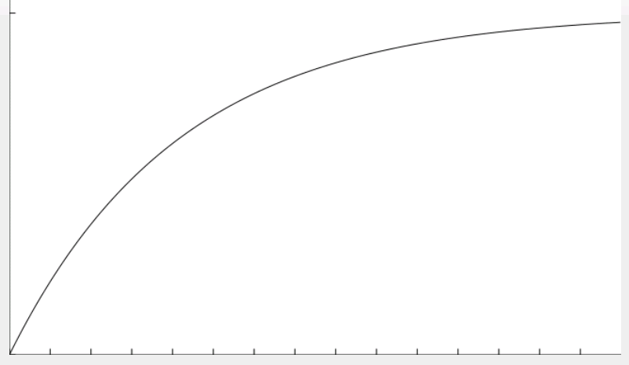
Independent cascade model
Is the independent cascade model compatible with this observation?
Hint:
1 – q^{k} for 0<q<1

Slide 12
What are these models assuming?
(List as many assumptions as you can)
Answer in Nearpod Collaborate
https://nearpod.com/student/
Code to be given during class

Slide 13
Summary

Slide 14
Things to remember
Linear threshold model
Independent cascade model
Practice executing these models in small graphs by hand
Practice writing code implementing them

Slide 15
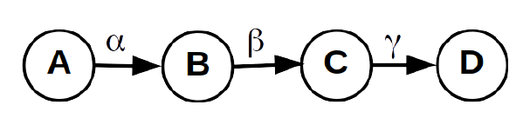
Practice on your own
Consider the graph on the top-right, including the infection probabilities indicated in the edges: α, β and γ. Let X_{i} be the expected number of nodes infected under the Independent Cascade Model for an infection starting at node i, including the node initially infected.
For instance, if an infection starts from node B, the probability that the number of nodes infected is 2 is P (X_{B} = 2) = β · (1 − γ). This is because for the infected to be 2 we need the infection from B to C to succeed and the infection from C to D to fail.
Remember that the expectation of a variable X is E[X] = x · P (X = x), where the summation is done over the possible values x that the variable can take.
1. What is E[X_{C} ] as a function of γ?
2. What is E[X_{A}] as a function of α, β, γ?

Slide 16
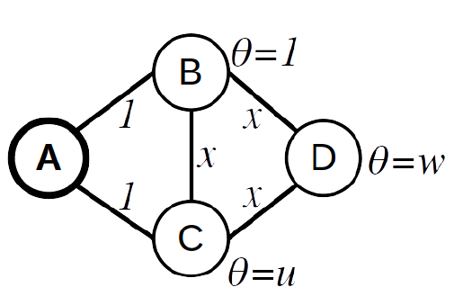
Practice on your own (cont.)
Consider this graph and the Linear Threshold model executed on it, starting from seed node A.
The influence weights are written next to the edges, and the thresholds θ are written next to the nodes.
Indicate what is the range of values of x for node C to be infected, but not node D. Justify briefly your answer.
____≤ x< _____
Justification:

Slide 17
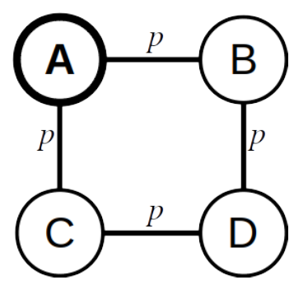
Practice on your own (cont.)
Consider the graph on the right an the Independent Cascade model executed on it, starting from seed node A.
The contagion probability of all edges is p
Indicate what is the probability that at the end of the process:
Only node A is infected:
Only nodes A, B are infected:
Only nodes A, B, C are infected:
Only nodes A, B, D are infected:

