Slide 1

PageRank
Introduction to Network Science
Carlos Castillo
Topic 15

Slide 2
Sources
Networks, Crowds, and Markets Ch 14
Fei Li's lecture on PageRank
Evimaria Terzi's lecture on link analysis.
C. Castillo: Link-based ranking slides 2016

Slide 3
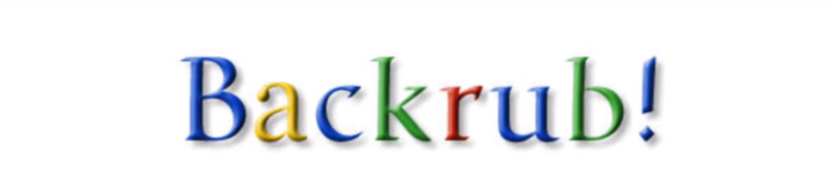
Part of a research project that started in 1995 ...

Slide 4
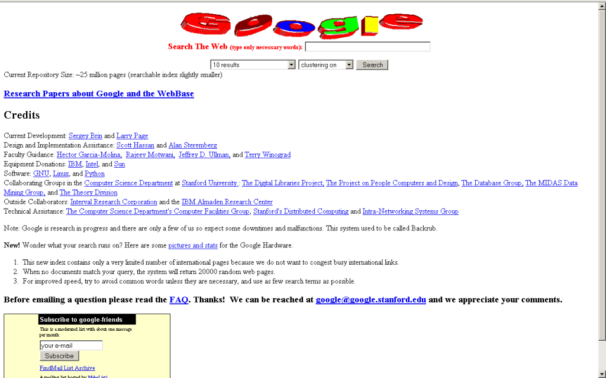

Slide 5
PageRank
The pagerank citation algorithm: bringing order to the web by L Page, S Brin, R Motwani, T Winograd - 7th World Wide Web Conference, 1998 [link].
A very good starting point, but not the end of web ranking!
  Today, PageRank is unlikely to be a top feature

Slide 6
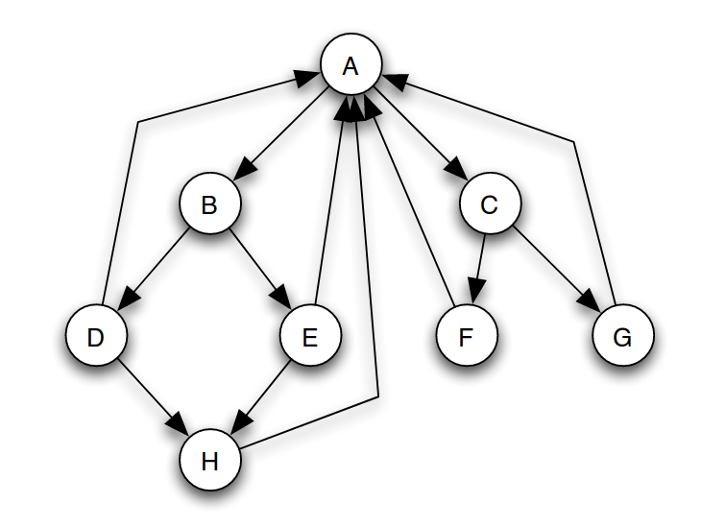
(Simplified) PageRank
All nodes start with score 1/N
Repeat t times:
  Divide equally and “send” its score to out-links
  Add received scores

Slide 7
Execute simplified PageRank:
All nodes start with
score 1/N
Repeat t times:
  Divide equally and “send”
  its score to out-links
  Add received scores
Keep intermediate values in
a table
Try to arrive to equilibrium
values
Answer in Google Spreadsheet

Slide 8
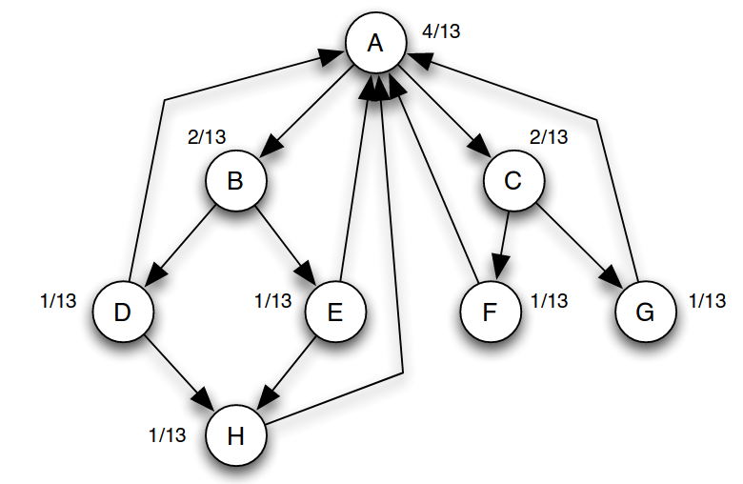
Equilibrium values
How can you prove these are
equilibrium values?

Slide 9
Equilibrium values
Answer: in equilibrium, the score going
into a node is equal to the score going out

Slide 10
(Simplified) PageRank
is the number of out-links of page j
c is a normalization factor to ensure

Slide 11
Running simplified PageRank on a graph
A
Adjacency
matrix
B
C
Row-stochastic adjacency matrix

Slide 12
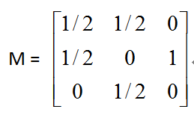
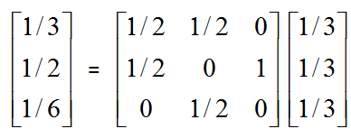
Another example of Simplified PageRank
A
B
C
First iteration of calculation:

Slide 13
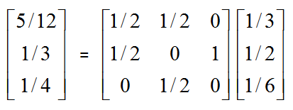
Another example of Simplified PageRank
A
B
C
Second iteration:

Slide 14
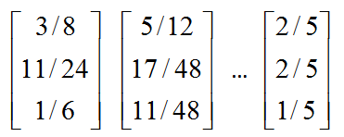
Another example of Simplified PageRank
A
B
C
Following iterations:
Final score

Slide 15
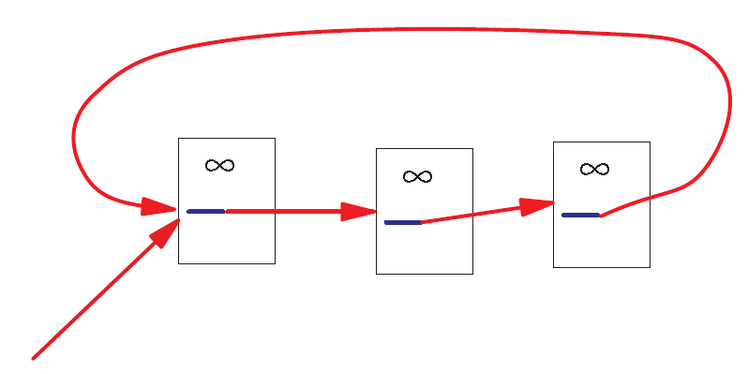
A Problem with Simplified PageRank
A loop:
During each iteration, the loop accumulates score but never distributes score to other pages!

Slide 16
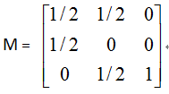
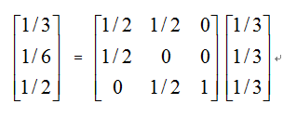
Example of the problem ...
A
B
C
First iteration of calculation:

Slide 17
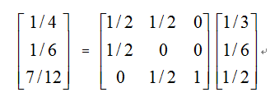
Example of the problem ...
A
B
C
Second iteration:

Slide 18
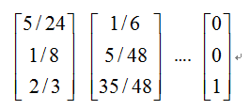
Example of the problem ...
A
B
C
Following iterations:
The winner takes all!

Slide 19
What are we computing?
A is the transposed row-stochastic adjacency matrix
What is p?
How do you call this method to compute p?

Slide 20
What are we computing?
p is an eigenvector of A with eigenvalue 1
This repeated multiplication is
the power method

Slide 21
What are we computing?
This will converge if A is:
  Left-stochastic (each column adds up to one)
  Irreducible (represents a strongly connected graph)
  Aperiodic (does not represent a bipartite graph)

Slide 22
Markov Chain
Discrete process over a set of states
Next state computed from current state only (no memory of older states)
  Higher-order Markov chains can be defined
Stationary distribution of Markov chain is a probability distribution such that p = Ap
Intuitively, p represents “the average time spent” at each node if the process continues forever

Slide 23
Random Walks in Graphs
Random Surfer Model
  The simplified model: the standing probability distribution of a random walk on the graph of the web. simply keeps clicking successive links at random
Modified Random Surfer
  The modified model: the “random surfer” simply keeps clicking successive links at random, but periodically “gets bored” and jumps to a random page based on a distribution R (e.g., uniform)
  This guarantees irreducibility
  Pages without out-links (dangling nodes) are a row of zeros, can be replaced by R, or by a row of 1/N

Slide 24
PageRank
R(i): web pages that “users” jump to when they “get bored”;
Uniform preferences => R(i) = 1/N

Slide 25
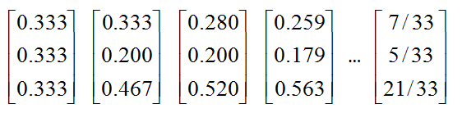
An example of PageRank
A
B
C
Was:

Slide 26
Summary

Slide 27
Things to remember
Simplified PageRank
PageRank

Slide 28
Practice on your own
Consider a directed graph G = (V, E) in which V = {1, 2, . . . , N }
and (i, j) ∈ E ⇐⇒ i ∈ V ∧ j ∈ V ∧ (j = i + 1 ∨ j = i = N )
  1. Indicate the value of Simplified PageRank S(i) for each node i in the graph, justifying your answer.
  2. Indicate the value of PageRank P (i) for each node i in the graph as a function of i and the parameter α.
Tip: write P(1), then write P(2), then write P(3), then write P(i).

