Slide 1

Clustering Coefficient
Introduction to Network Science
Carlos Castillo
Topic 06

Slide 2
Contents
Local clustering coefficient
Global clustering coefficient

Slide 3
Sources
Albert László Barabási: Network Science. Cambridge University Press, 2016.
  Follows almost section-by-section chapter 02
URLs cited in the footer of specific slides

Slide 4
How many links, maximum?
Remember, the maximum number of links between k nodes is

Slide 5

Local clustering coefficient
The local clustering coefficient C_{i} is a property of a node i
Let L_{i} represent the number of links among neighbors of node i

Slide 6
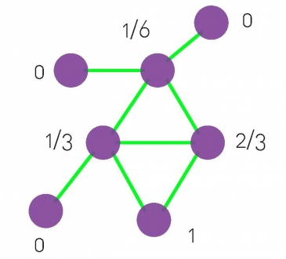
Exercise
What is the local clustering coefficient of each node?
?
?
?
?
?
?
?
Draw in Nearpod Draw-It
https://nearpod.com/student/
Code to be given during class

Slide 7
Local clustering coefficient of each node

Slide 8
Average clustering coefficient
The average clustering coefficient is a property of the entire graph
Sometimes this is called the curvature of a graph

Slide 9
Summary

Slide 10
Things to remember
Local and global clustering coefficient

Slide 11
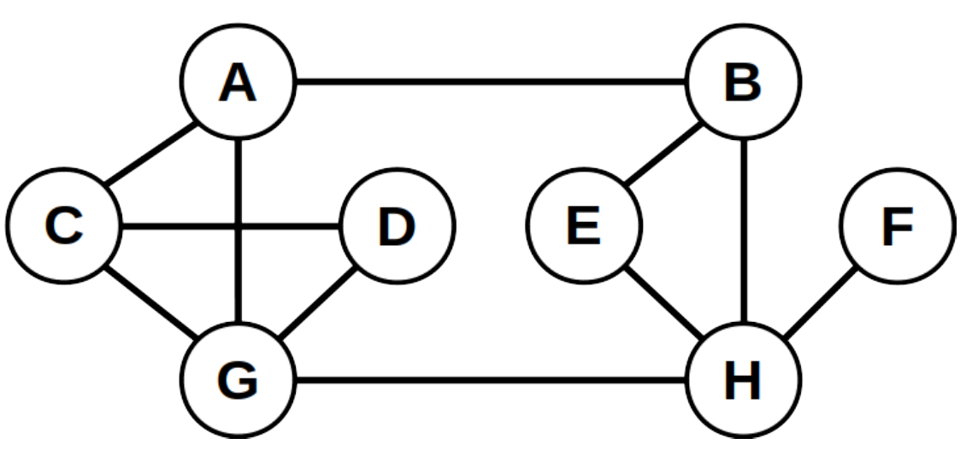
Practice on your own
Calculate local clustering coefficient of each node in this graph

