Slide 1

Scale-Free Networks
Introduction to Network Science
Carlos Castillo
Topic 09

Slide 2
Contents
Characteristics of scale-free networks
Degree distribution of scale-free networks
Distance distribution of scale-free networks

Slide 3
Sources
Albert László Barabási: Network Science. Cambridge University Press, 2016.
  Follows almost section-by-section chapter 04
URLs cited in the footer of specific slides

Slide 4
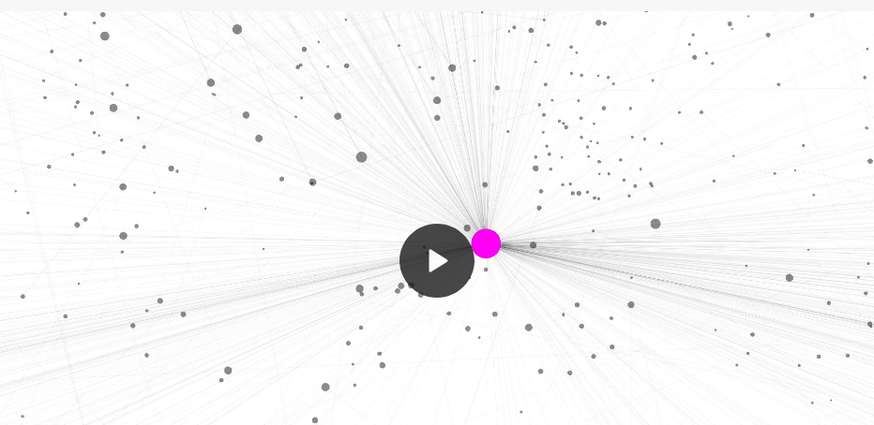
nd.edu in 1998 (N=300K, L=1.5M) nd1998
http://networksciencebook.com/images/ch-04/video-4-1.mov

Slide 5
What the Web Graph has but random networks don’t have
Large “hubs”
  Nodes with a very high degree
  Very unlikely in a random (ER) graph
We have already seen the Poisson distribution is a bad approximation of the observed degree distribution

Slide 6
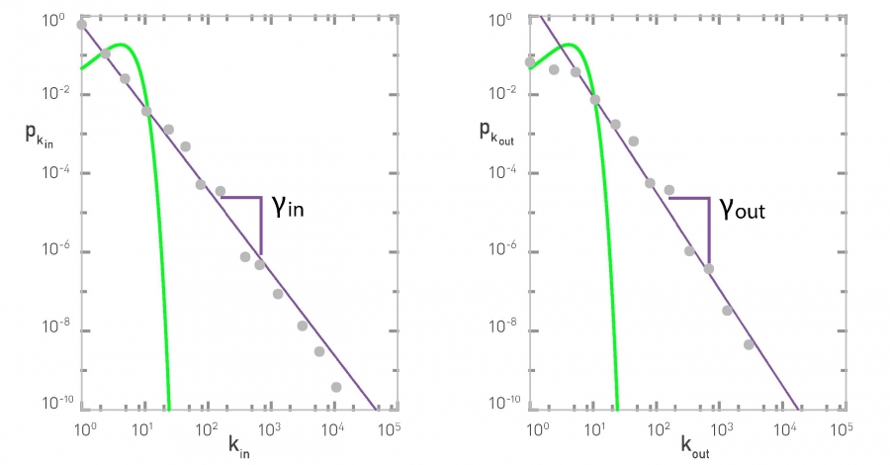
Degree distributions in nd1998
Poisson
Poisson
Power law
Power law

Slide 7
A good approximation of degree in real networks
Straight descending line in log-log plot
Parameter Ɣ is the exponent of the power law
A scale-free network is a network whose degree distribution follows a power law

Slide 8
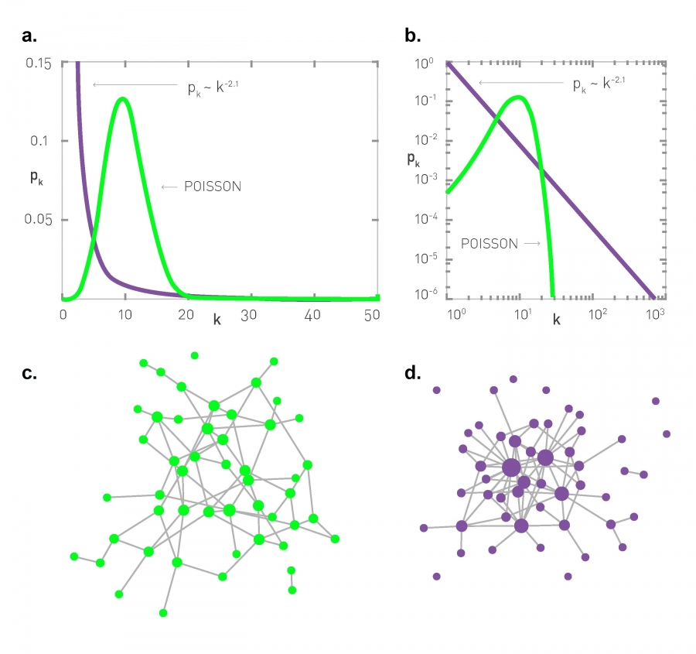
Comparing Poisson to power law
Power law
Poisson
Poisson
Power law

Slide 9
Comparing Poisson to power law

Slide 10
Degree distributions in nd1998
Poisson
Poisson
Power law
Power law
What kind of values of gamma reduce the “long tail” of the power law?

Slide 11
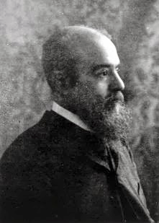
Parenthesis: Pareto
Italian economist Vilfredo Pareto in the
19th century noted 80% of money was
earned by 20% of people
More recently ...
  80 percent of links on the Web point to only 15 percent of pages;
  80 percent of citations go to only 38 percent of scientists;
  80 percent of links in Hollywood are to 30 percent of actors
A debate that is still open: the wealth of the 1% and the 0.1%

Slide 12
In directed networks ...
Each node has two degrees: k_{in} and k_{out}
In general they may differ, hence
  p_{kin} ~ k^{-Ɣin}
  p_{kout} ~ k^{-Ɣout}
In nd1998, Ɣ_{in} ≃ 2.1, Ɣ_{out} ≃ 2.4

Slide 13
Formally (discrete)
Riemann’s zeta
This formalism assumes there are no nodes with degree zero

Slide 14
Formally (continuous approx.)
k_{min} is the smaller degree found in the network

Slide 15
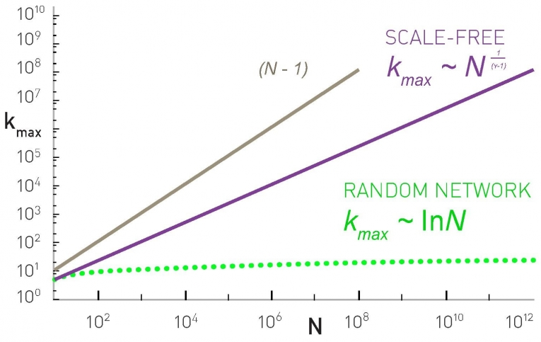
The natural cut-off of the degree
The largest hub cannot have more than N-1 connections

Slide 16
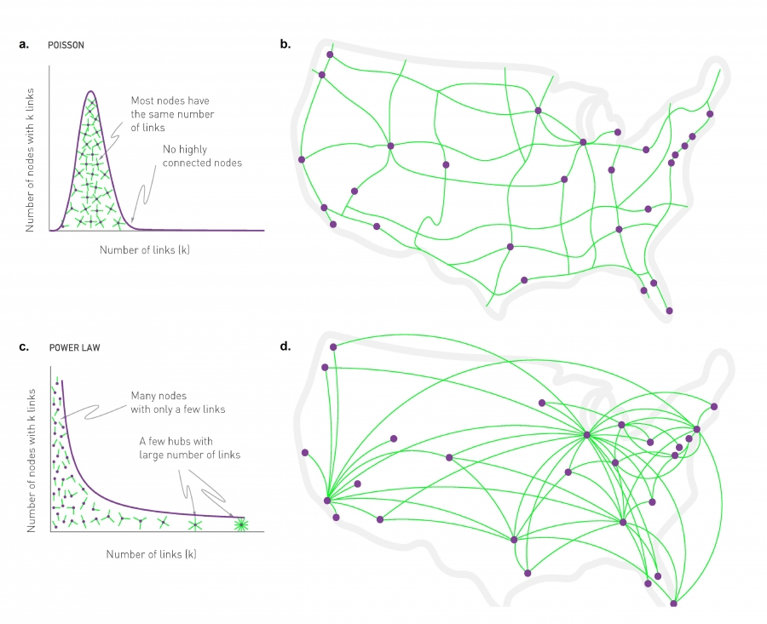
Random vs scale-free networks
Ground transportation
Air transportation

Slide 17
What does it mean “scale-free”?
A distribution has a “scale” if values are close to each other, for instance in a random network
Hence, most nodes are in the range
However in scale-free networks ...

Slide 18
What does it mean “scale-free”?
Moments of degree distribution

Slide 19
What does it mean “scale-free”?
In a scale-free network
This diverges as if
Hence there is no “typical” scale

Slide 20
What does it mean “scale-free”?
In a scale-free network
What happens with the variance of the degree for networks with high max degree?

Slide 21
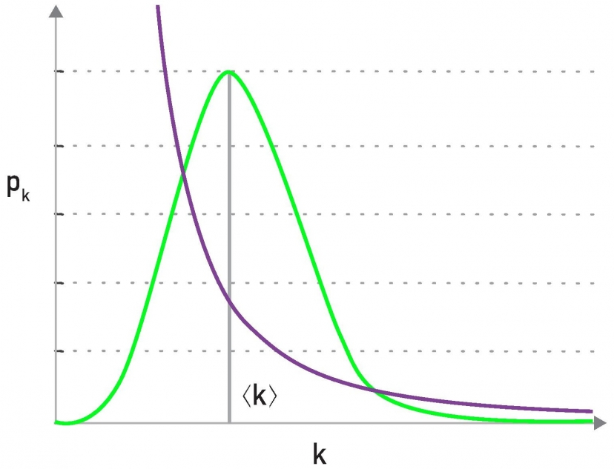
Example: nd1998
In general, the average degree is not very informative in scale-free networks
“Fat tail”, “Heavy tail”, “Long tail”

Slide 22
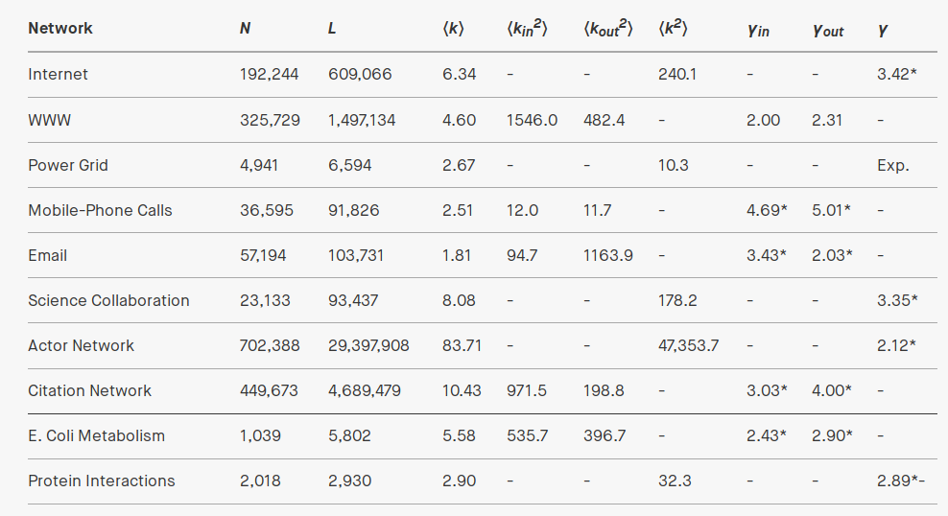
Real network examples

Slide 23
Exercise
Answer in Nearpod Collaboratehttps://nearpod.com/student/
Code to be given during class
In the actor network, N=702,388, Ɣ=2.12
How many actors do we expect to have …
    1 other co-star?
    10 other co-stars?
    100 other co-stars?
For how many co-stars do we still expect to have one actor that has that many co-stars?
https://www.wolframalpha.com/ recognizes x*y, x/y, Zeta(x), x^(-y), etc.

Slide 24
Answer to exercise
In the actor network, N=702388, Ɣ=2.12
How many actors do we expect to have …
    1 other co-star? Approx. 455K
    10 other co-stars? Approx. 3400
    100 other co-stars? Approx. 26
For how many co-stars do we still expect to have one actor that has that many co-stars? Approx. 466
702388 * x^(-2.12) / Zeta(2.12) = 1

Slide 25
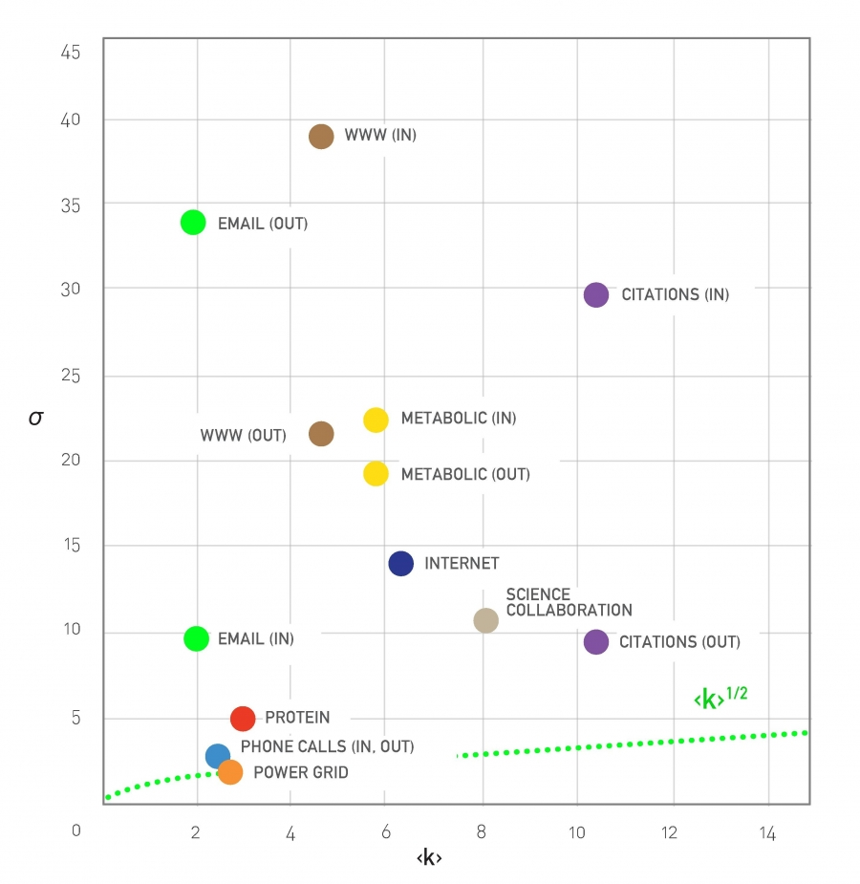
Real network examples

Slide 26
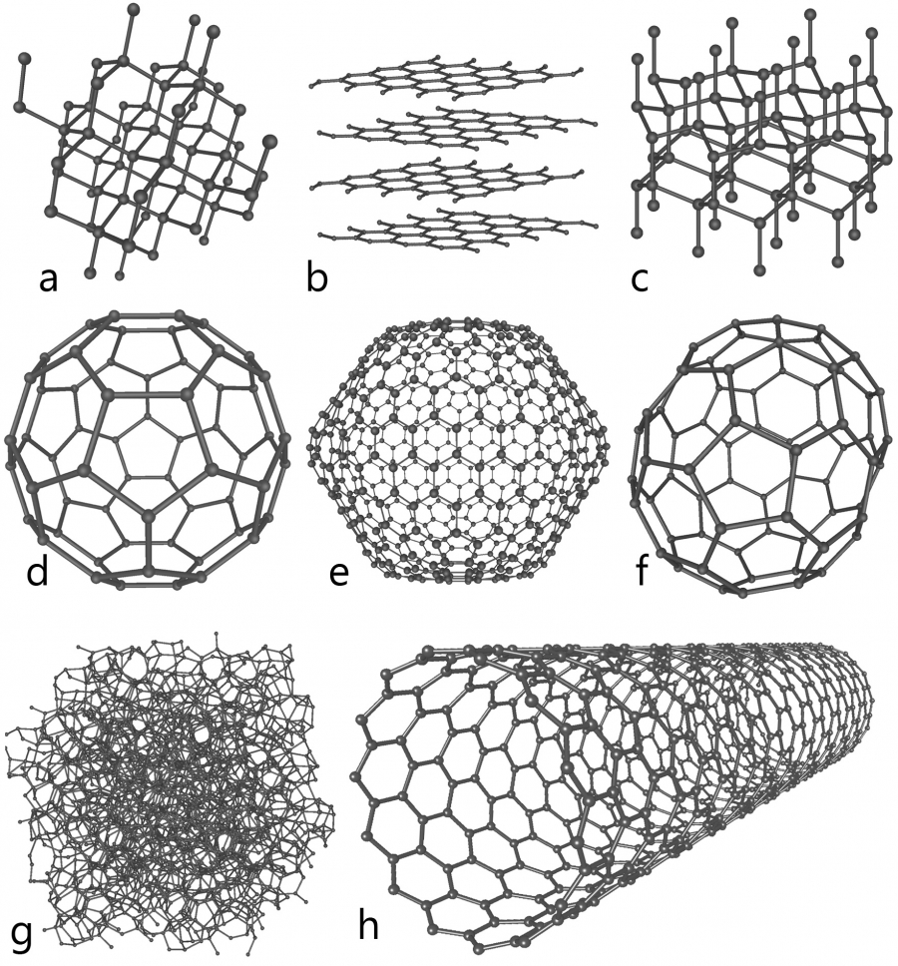
When you don’t observe the scale-free property
In general, when there is a limit to k_{max}
Out-degree in some social networks
Materials networks

Slide 27
Summary

Slide 28
Things to remember
Definition of scale-free
Power law
Formulas for degree distribution
  Discrete formula
  Continuous formula
Formula for kmax

Slide 29
Practice on your own
(Somewhat) difficult, try to solve it ON YOUR OWN
Imagine a connected scale-free graph with 1 million nodes and average degree 5
  If we draw 100 nodes from this graph, how many will have degree 1?
  Remember, if the graph is connected, kmin=1
  If you cannot clear the unknown in a formula, plot it
Solution in next slide (shown only in .odp, not .pdf)

Slide 30
Solution
N=1000000, <k>=5, kmin=1
WolframAlpha:
  plot (x-1) * ((1000000^(1/(x-1)))^(2-x) - 1) / (2-x), x = 2.0 to 3.0
  Intersects 5 at about 2.22, that’s gamma
100 * 1/Zeta(2.2) ≃ 67

