Slide 1

Dense sub-graphs
Introduction to Network Science
Carlos Castillo
Topic 11

Slide 2
Sources
Barabási 2016 Chapter 9
Networks, Crowds, and Markets Ch 3
C. Castillo (2017) Dense Sub-Graphs
Tutorial by A. Beutel, L. Akoglu, C. Faloutsos [Link]
Frieze, Gionis, Tsourakakis: “Algorithmic techniques for modeling and mining large graphs (AMAzING)” [Tutorial]
A survey of algorithms for dense sub-graph discovery [link]

Slide 3
Communities
2 communities [previous topic]
1 community [this topic]
3+ communities [next topic/course]

Slide 4
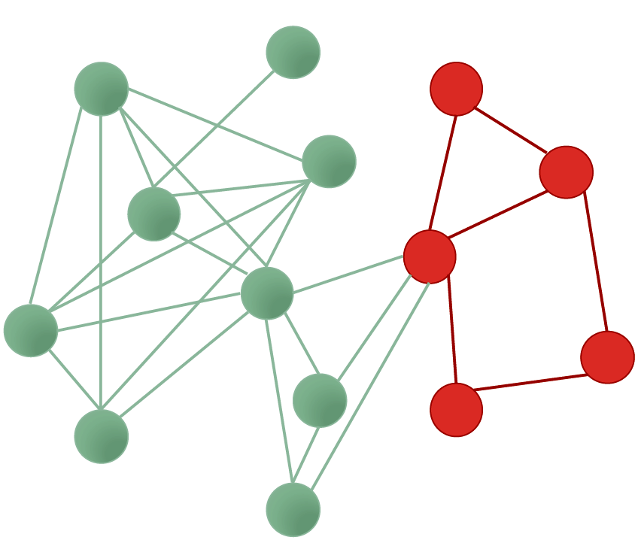
What is a sub-graph?
Subset of nodes, and edges among those nodes

Slide 5
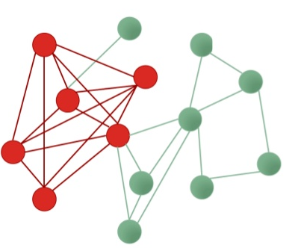
Densest sub-graph
Sub-graph having the maximum density

Slide 6
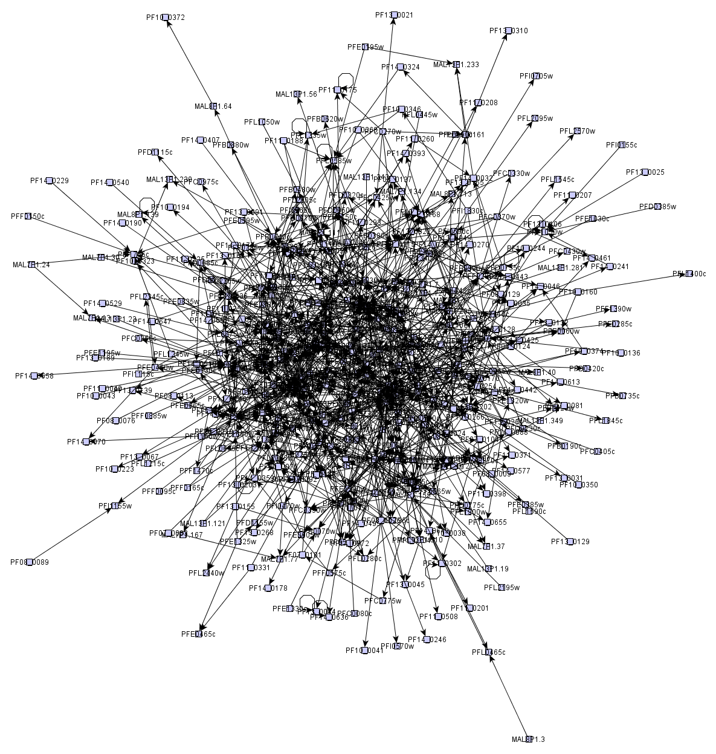
Many graphs look like “hairballs”
Sometimes, at the center these graphs may have an interesting dense sub-graph

Slide 7
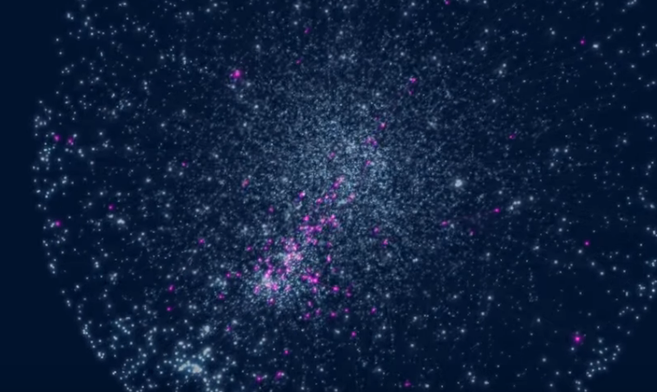
Asthma-related genes
https://www.youtube.com/watch?v=VU_7FHAKMgA

Slide 8
k-core decomposition

Slide 9
k-core decomposition
Remove all nodes having degree 1
  Those are in the 1-core
Remove all nodes having degree 2 in the remaining graph
  Those nodes are in the 2-core
Remove all nodes having degree 3 in the remaining graph
  Those nodes are in the 3-core
Etc.

Slide 10
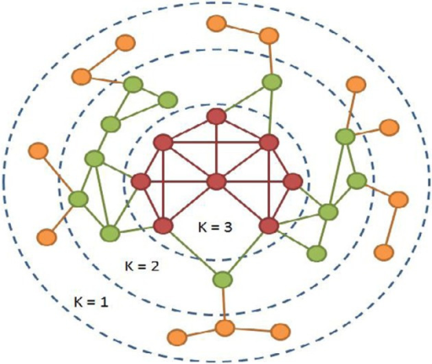
Example
https://openi.nlm.nih.gov/detailedresult.php?img=3368241_fnagi-04-00013-g0001&req=4

Slide 11
Try it!
How many nodes are there in each core of this graph?
http://www.cpt.univ-mrs.fr/~barrat/NHM.pdf

Slide 12
How many nodes are there in each core of this graph?
Core 1:

Slide 13
How many nodes are there in each core of this graph?
Core 1: 3 nodes

Slide 14
How many nodes are there in each core of this graph?
Core 1: 3 nodes

Slide 15
How many nodes are there in each core of this graph?
Core 1: 3 nodes

Slide 16
How many nodes are there in each core of this graph?
Core 1: 3 nodes
Core 2: 3 nodes

Slide 17
How many nodes are there in each core of this graph?
Core 1: 3 nodes
Core 2: 3 nodes

Slide 18
How many nodes are there in each core of this graph?
Core 1: 3 nodes
Core 2: 3 nodes
Core 3: 4 nodes

Slide 19
Density-based methods

Slide 20
Density measures
Density = Average degree =
  Sometimes just
Edge ratio =
What is ?

Slide 21
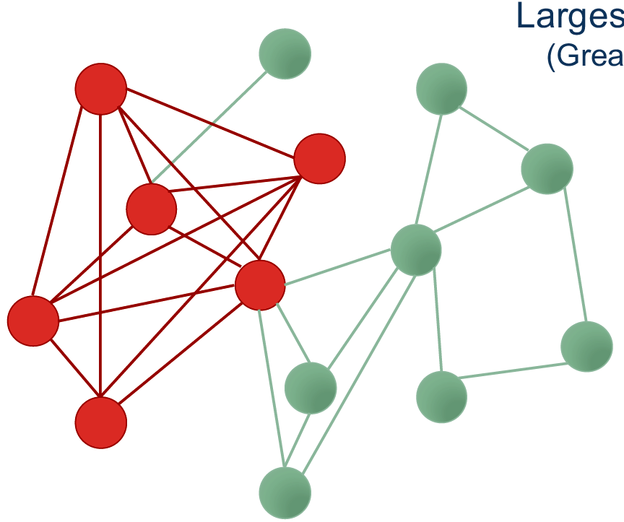
Densest sub-graph

Slide 22
Goldberg’s algorithm
(exact and deterministic)

Slide 23
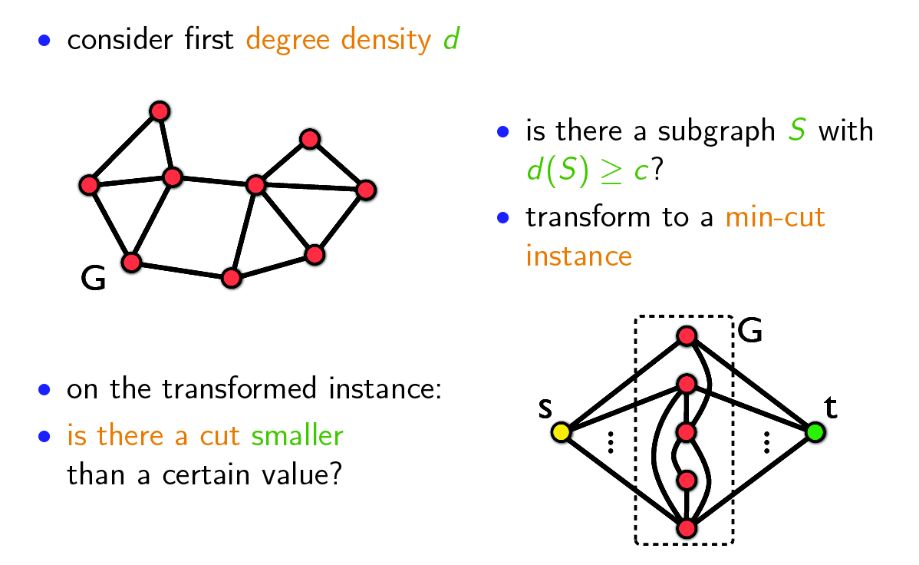
Goldberg's algorithm (1)
Slides on this section from: http://www.math.cmu.edu/~ctsourak/amazing.html

Slide 24
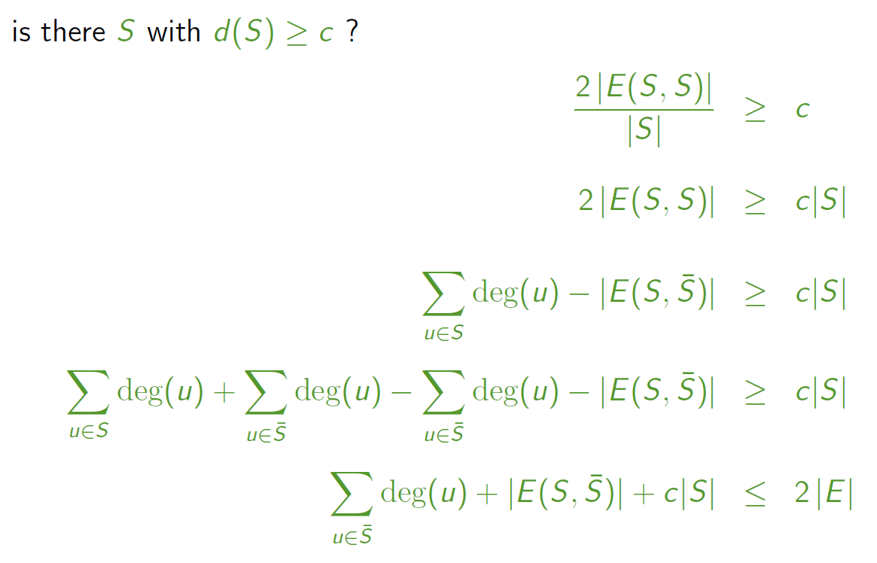
Goldberg's algorithm (2)

Slide 25
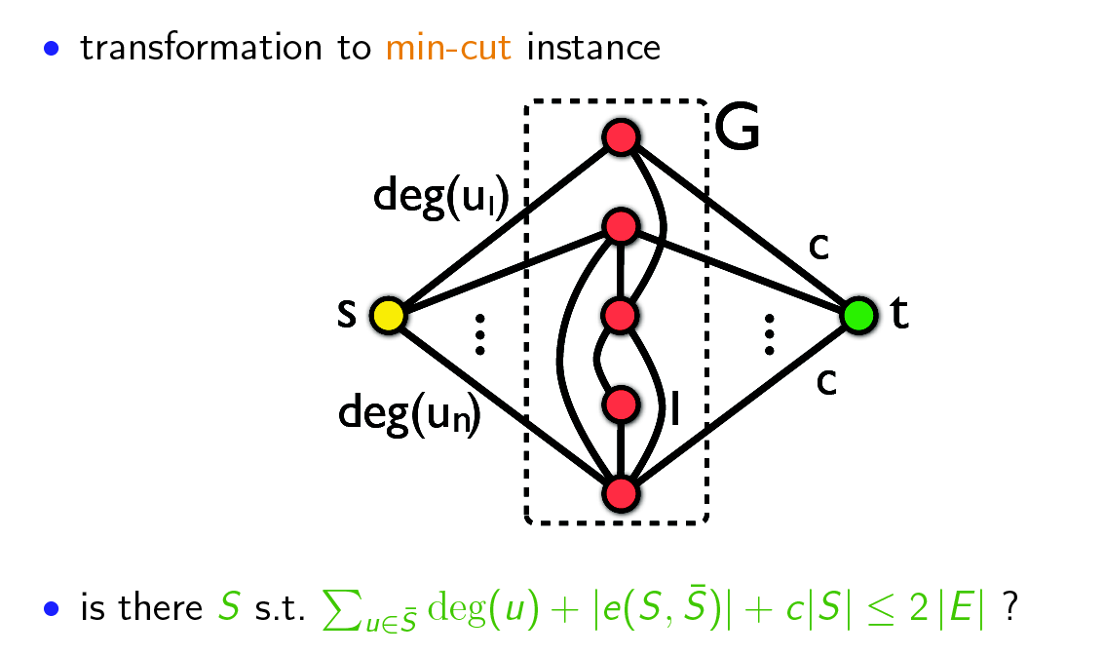
Goldberg's algorithm (3)

Slide 26
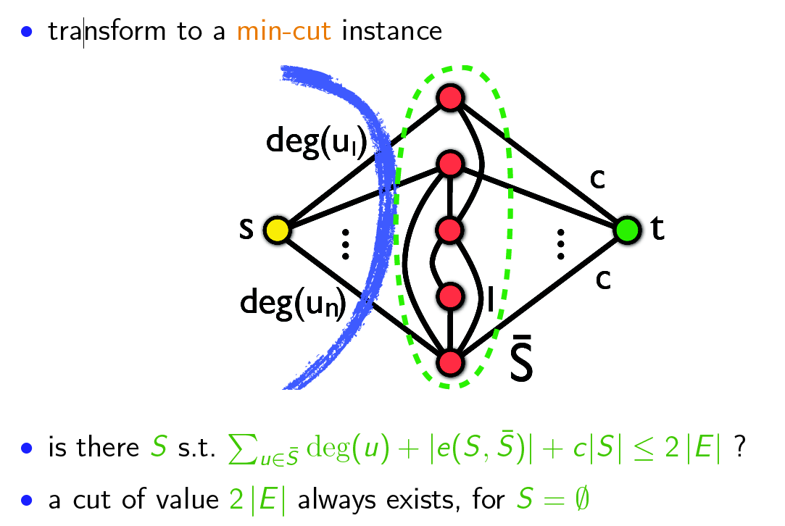
Goldberg's algorithm (4)

Slide 27
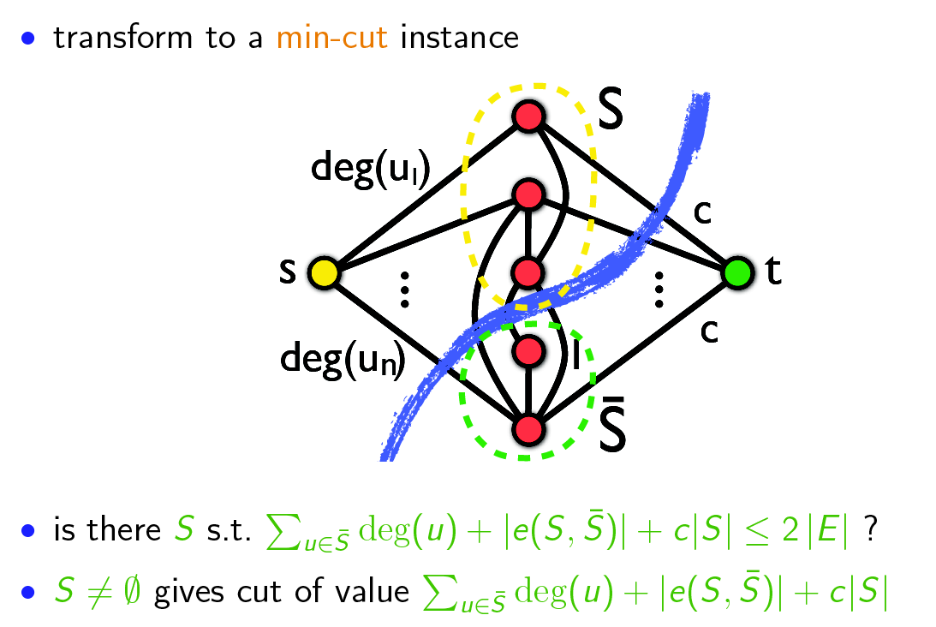
Goldberg's algorithm (5)
If this exists for non-empty S, then S is a sub-graph of density c

Slide 28
Goldberg's algorithm (6)
to find the densest subgraph perform binary search on c
  logarithmic number of min-cut calls
  each min-cut call requires O(|V||E|) time
problem can also be solved with one min-cut call using the parametric max-flow algorithm

Slide 29
Charikar’s algorithm
(approximate and randomized)

Slide 30
Charikar’s algorithm
Charikar, M. (2000). Greedy approximation algorithms for finding dense components in a graph. In APPROX.
Approximate algorithm (by a factor of 2)
  If the optimal density is λ, in the worst case (if you’re very unlucky!) you will get density λ/2

Slide 31
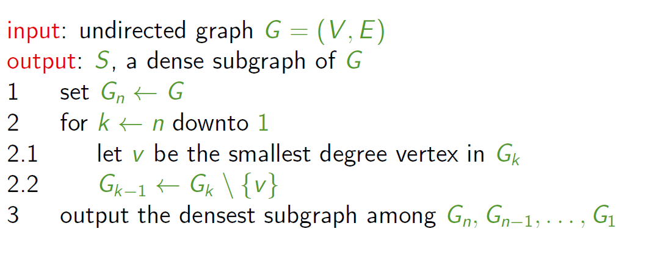
Greedily remove nodes
(break ties randomly)
Compute density as |E|/|V|

Slide 32
Try it!
Density =

Slide 33
Example run
Done!

Slide 34
Example run
15/11=1.36
14/10=1.40
13/9=1.44
12/8=1.50
11/7=1.57
9/6=1.50
8/5=1.60
6/4=1.50
Density =
3/3=1.00
1/2=0.50
0/1=0.00

Slide 35
Example run
15/11=1.36
14/10=1.40
13/9=1.44
12/8=1.50
11/7=1.57
9/6=1.50
8/5=1.60
6/4=1.50
Done!
3/3=1.00
1/2=0.50
0/1=0.00

Slide 36
Advanced materials
(not included in the exam)

Slide 37
Approximation guarantee
S* = optimal sub-graph (highest density)
density(S*) = λ = |e(S*)| / |S*|
For all v in S*, deg(v) >= λ, because
Because of optimality of S*
https://people.cs.umass.edu/~barna/paper/dense-subgraph-full.pdf

Slide 38
Approximation guarantee (cont)
Hence,

Slide 39
Approximation guarantee (cont.)
Now, let's consider when greedy removes the first vertex of the optimal solution
At that point, all the vertices of the remaining subgraph (S) have degree >= λ, because v has degree >= λ
Hence, this subgraph has more than edges, and density more than
Hence this is a 2-approximate algorithm

Slide 40
Summary

Slide 41
Things remember
K-core decomposition algorithm
Goldberg’s algorithm
Charikar’s algorithm
Practice on your own executing these algorithms in small graphs
If useful for you, write code for them

