Slide 1

Homophily and triangles
Social Networks Analysis and Graph Algorithms
Prof. Carlos Castillo — https://chato.cl/teach

Slide 2
Contents
This is all about friends, and friends of friends
Homophily
Clustering coefficient

Slide 3
Sources
A. L. Barabási (2016). Network Science – Chapter 02
F. Menczer, S. Fortunato, C. A. Davis (2020). A First Course in Network Science – Chapter 02
URLs cited in the footer of specific slides

Slide 4
Homophily

Slide 5
Who is a friend? [Homophily]
In social networks, nodes have characteristics that influence their preferences
  Age, gender identity, ethnicity, sexual preference, location, topics of interest, artistic sensitivities, …
People tend to befriend those who are like them: that is called homophily

Slide 6
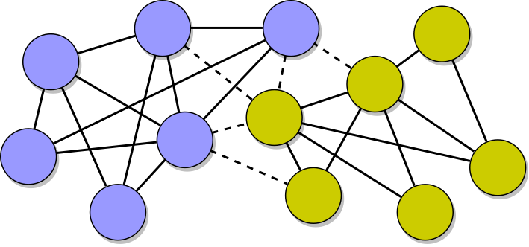
“Birds of a feather flock together”
Source: Menczer, Fortunato, David: A First Course on Networks Science. Cambridge, 2020.

Slide 7
Quantifying homophily
Let G be a graph of N nodes: N_{a} “yellow” and N_{b} “blue”
  N = N_{a} + N_{b}
Let G have L undirected links (including self loops), of which L_{aa} connect yellow to yellow, L_{ab} connect yellow to blue, and L_{bb} connect blue to blue
  L = L_{aa} + L_{ab} + L_{bb} L_{a} = L_{aa} + L_{ab} L_{b} = L_{bb} + L_{ab}

Slide 8
N_{a} = 6, N_{b} = 6, L_{a} = 14, L_{b} = 16, L_{ab} = 5,
Source: Menczer, Fortunato, David: A First Course on Networks Science. Cambridge, 2020.

Slide 9

Expected links across groups
If yellow nodes have L_{a} links placed at random (incl. self loops), how many should go to a blue node?

Slide 10


Quantifying homophily of a group
We compare observed against the expected number of links crossing to the other group
<1 ⇒ homophily 1 ⇒ neutral >1 ⇒ heterophily

Slide 11

N_{a} = 6, N_{b} = 6, L_{a} = 14, L_{b} = 16, L_{ab} = 5,
Yellow nodes are homophilic
Source: Menczer, Fortunato, David: A First Course on Networks Science. Cambridge, 2020.

Slide 12

N_{a} = 6, N_{b} = 6, L_{a} = 14, L_{b} = 16, L_{ab} = 5,
Blue nodes are homophilic
Source: Menczer, Fortunato, David: A First Course on Networks Science. Cambridge, 2020.

Slide 13
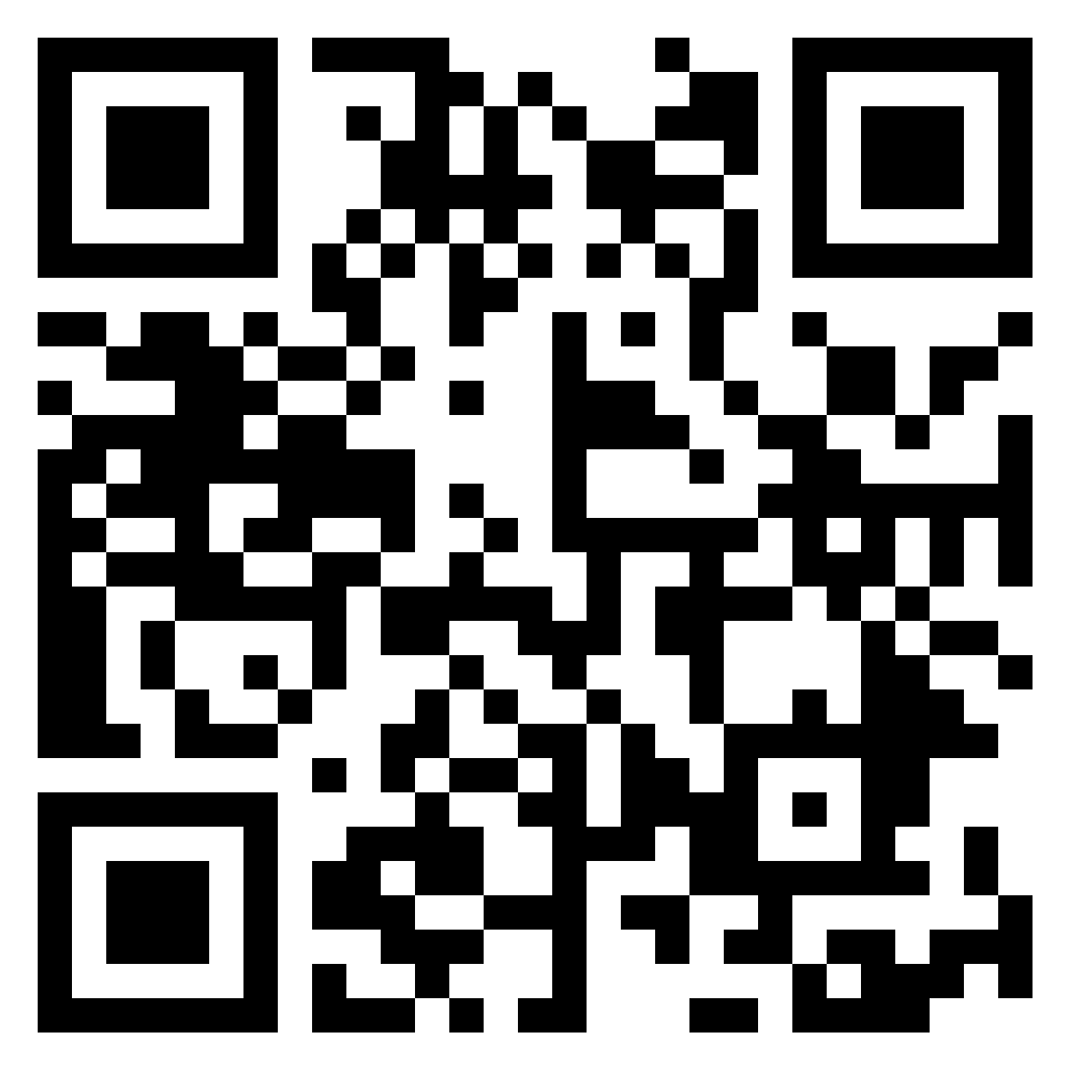
Exercise
Compute homophily of both groups and indicate if each group is homophilic, heterophilic, or neutral
Pin board: https://upfbarcelona.padlet.org/chato/iig2u83qdzk4y7xc

Slide 14


Answer
Yellow nodes are neutral
Blue nodes are heterophilic

Slide 15
Clustering coefficient

Slide 16
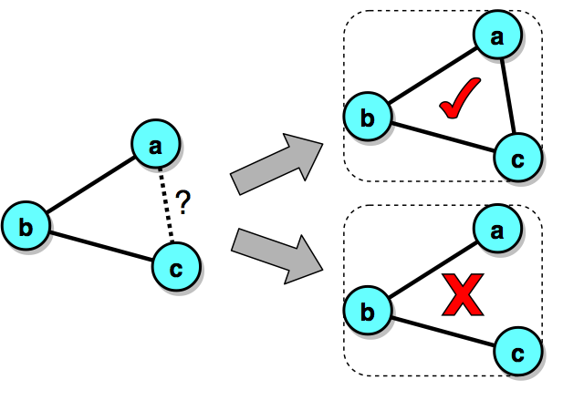
Who is a friend? [Triangle closure]
A prevalent way in which we form friendships is by befriending friends of friends
Source: Menczer, Fortunato, David: A First Course on Networks Science. Cambridge, 2020.

Slide 17
Tendency to form triangles
Other processeses of link formation encourage the closing of “V”s into triangles
  You’re more likely to follow an account u because you see content posted by u and re-posted by an account v that you already follow
Let’s quantify this

Slide 18
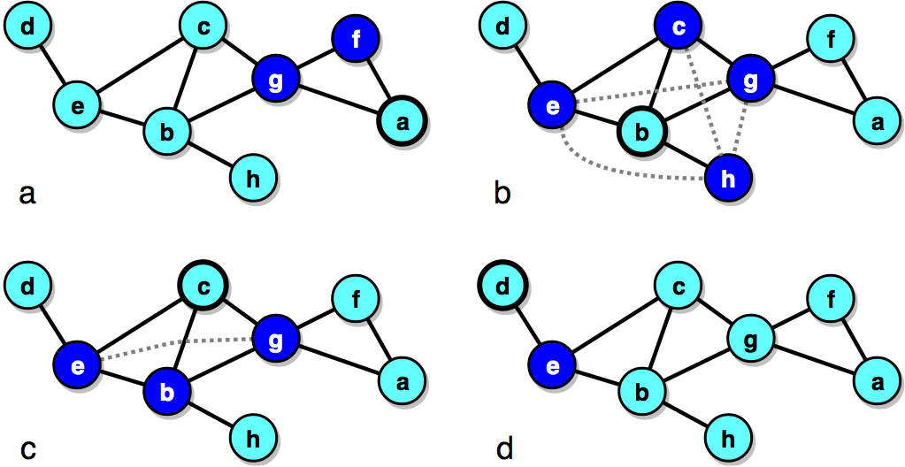
Example 1
Node c has 3 neighbors: a, b, g
They form two triangles out of the possible 3 (the missing one is drawn with a dotted line)
Source: Menczer, Fortunato, David: A First Course on Networks Science. Cambridge, 2020.

Slide 19
Example 2
Node b has 4 neighbors: e, c, g, h
They form two triangles out of the possible 6 (the missing ones are drawn with a dotted line)
Source: Menczer, Fortunato, David: A First Course on Networks Science. Cambridge, 2020.

Slide 20
Remember
The maximum number of links between k nodes is

Slide 21

Local clustering coefficient
The local clustering coefficient C_{i} is a property of a node i
Let L_{i} represent the number of links among neighbors of node i

Slide 22
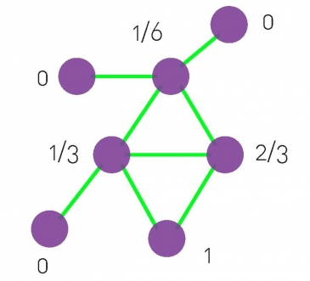
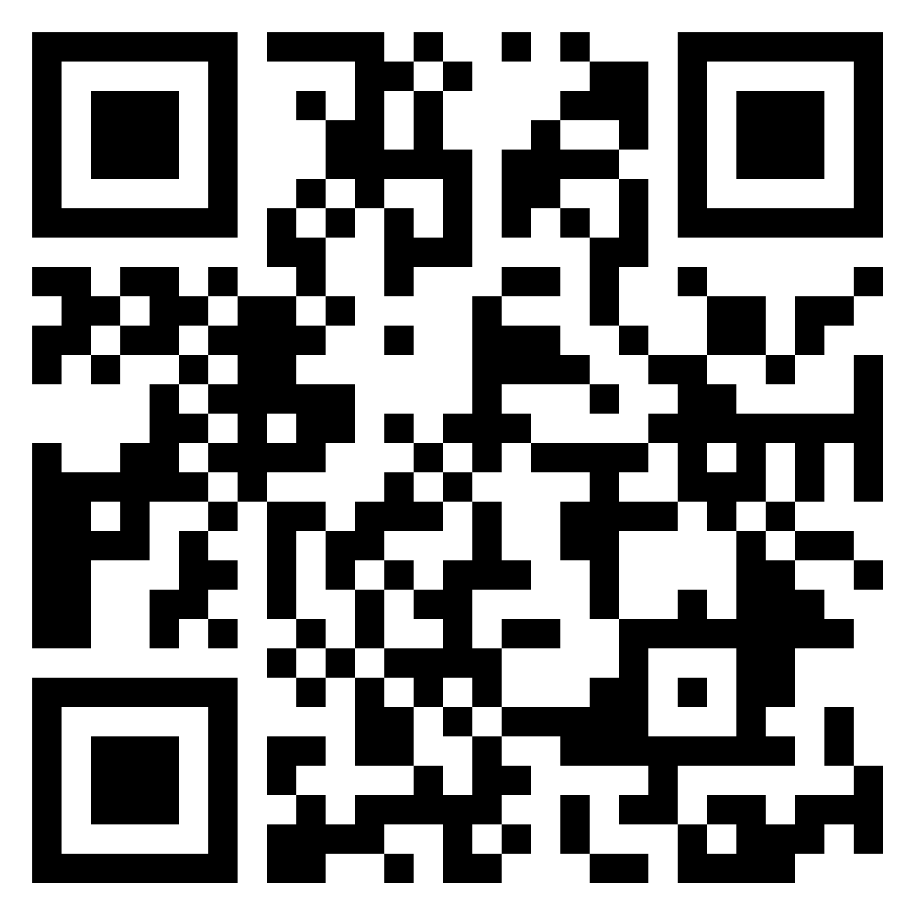
Exercise
What is the local clustering coefficient of each node?
?
a
?
?
b
c
?
d
e
?
f
?
g
?
Pin board: https://upfbarcelona.padlet.org/chato/v0apheshv2l4hbot

Slide 23
Local clustering coefficient of each node

Slide 24
Average clustering coefficient
(“global clustering coefficient”)
The average clustering coefficient is a property of the entire graph
Sometimes this is called the curvature of a graph

Slide 25
Summary

Slide 26
Things to remember
How to quantify if a group is
  Homophilic
  Heterophilic
  Neutral
Local and global clustering coefficient

Slide 27
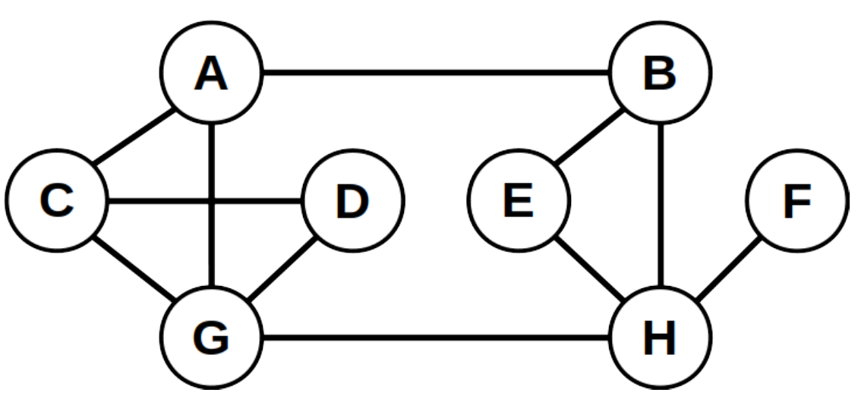
Practice on your own
Determine if the set {C, D, G} is homophilic or heterophilic
Calculate local clustering coefficient of each node in this graph

