Slide 1

Scale-Free Networks
Social Networks Analysis and Graph Algorithms
Prof. Carlos Castillo — https://chato.cl/teach

Slide 2
Contents
Characteristics of scale-free networks
Degree distribution of scale-free networks
Distance distribution of scale-free networks

Slide 3
Sources
A. L. Barabási (2016). Network Science – Chapter 04
URLs cited in the footer of specific slides

Slide 4
Observed degree distributions

Slide 5
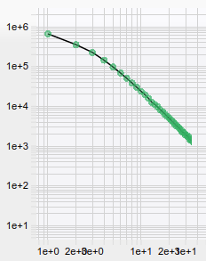
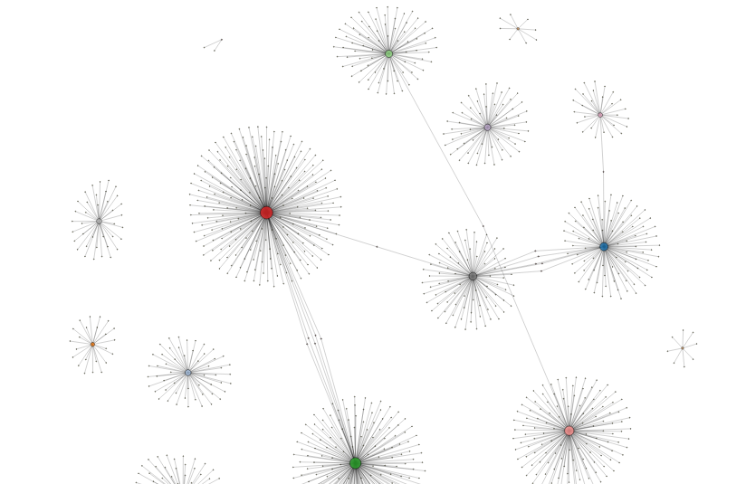
Wikipedia 2009 (N=1.9M, L=4.5M)
https://networkrepository.com/web-wikipedia2009.php

Slide 6
Degree distributions in Web graphs
Web graphs have large “hubs”:
  This is, nodes with very large degree
This does not happen in a random (ER) graph
We have already seen the Poisson distribution is a bad approximation of the observed degree distribution

Slide 7
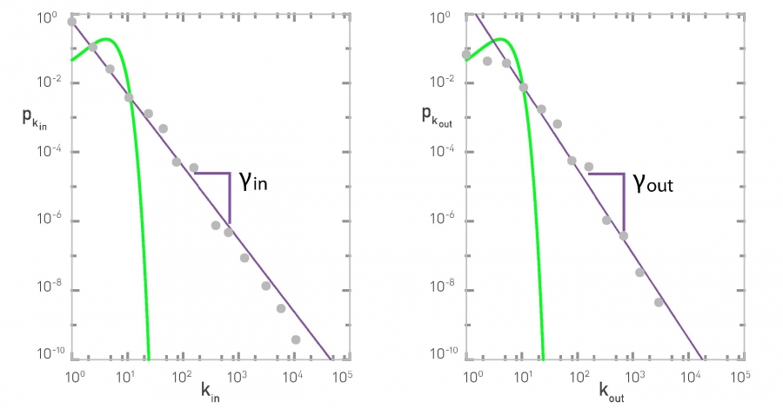
Degree distributions in a web graph [nd.edu]
Poisson
Poisson
Power law
Power law

Slide 8
Modeling degree distributions

Slide 9
Degree distribution in real-world networks
Straight descending line in log-log plot
Parameter Ɣ is the exponent of the power law
A scale-free network is a network whose degree distribution follows a power law
P(k)
Degree k

Slide 10
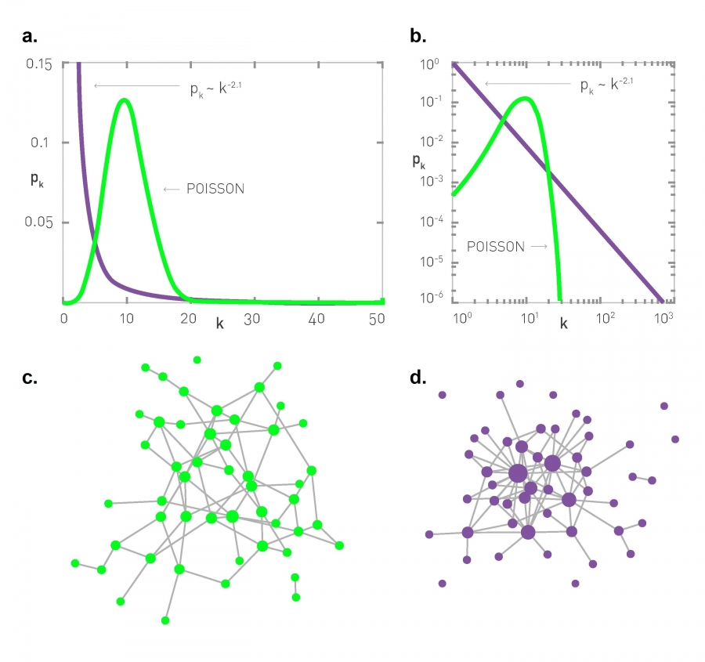
Comparing Poisson to power law
Power law
Poisson
Poisson
Power law

Slide 11
Comparing Poisson to power law

Slide 12
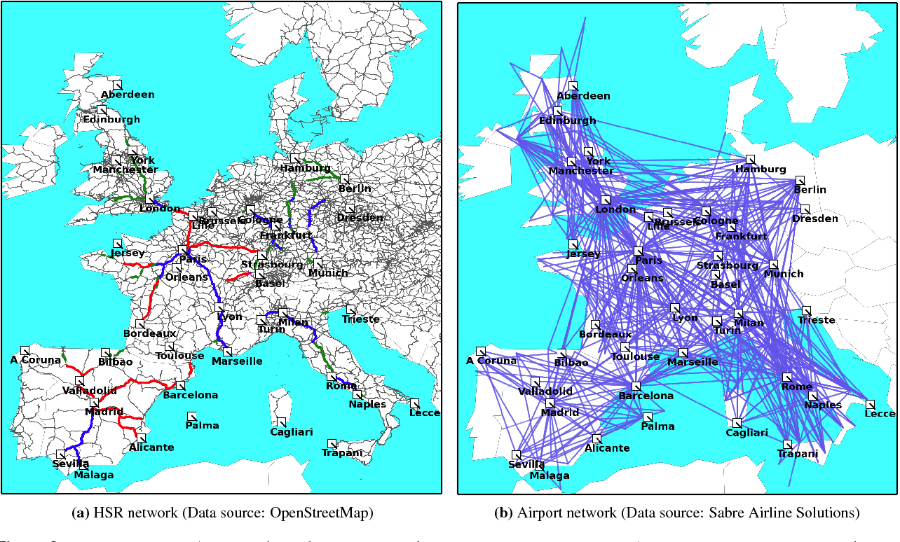
Random vs scale-free networks
High-speed trains
Air transportation

Slide 13
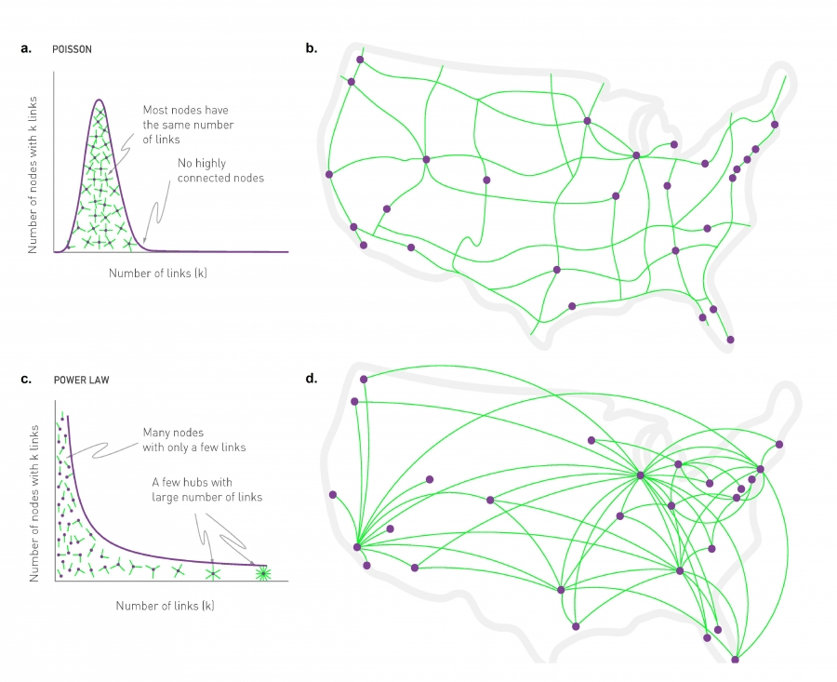
Random vs scale-free networks (cont.)
Ground transportation
Air transportation

Slide 14
Formally (discrete)
Riemann’s zeta
This formalism assumes there are no nodes with degree zero

Slide 15
Formally (continuous approx.)
k_{min} is the smaller degree found in the network

Slide 16
Exercise
In the actor network, N=702,388, Ɣ=2.12
How many actors do we expect to have …
    1 other co-star?
    10 other co-stars?
    100 other co-stars?
For how many co-stars do we still expect to have one actor that has that many co-stars?
https://www.wolframalpha.com/ recognizes x*y, x/y, Zeta(x), x^(-y), etc.

Slide 17
Answer to exercise
In the actor network, N=702388, Ɣ=2.12
How many actors do we expect to have …
    1 other co-star? Approx. 455K
    10 other co-stars? Approx. 3400
    100 other co-stars? Approx. 26
For how many co-stars do we still expect to have one actor that has that many co-stars? Approx. 466
https://www.wolframalpha.com/ recognizes x*y, x/y, Zeta(x), x^(-y), etc.
702388 * 466^(-2.12) / Zeta(2.12) ≃ 1.001

Slide 18
Directed graphs

Slide 19
In directed graphs the exponent might be different for in-degree and out-degree
Poisson
Poisson
Power law
Power law
What kind of values of gamma make the power law “tail” look more like the Poisson “tail”?

Slide 20
In directed networks ...
Each node has two degrees: k_{in} and k_{out}
In general they may differ, hence
  p_{kin} ~ k^{-Ɣin}
  p_{kout} ~ k^{-Ɣout}
In nd1998, Ɣ_{in} ≃ 2.1, Ɣ_{out} ≃ 2.4

Slide 21
Dispersion of the degree distribution

Slide 22
What does it mean “scale-free”?
A distribution has a “scale” if values are close to each other, for instance in a random network
Hence, most nodes are in the range
However in scale-free network with

Slide 23
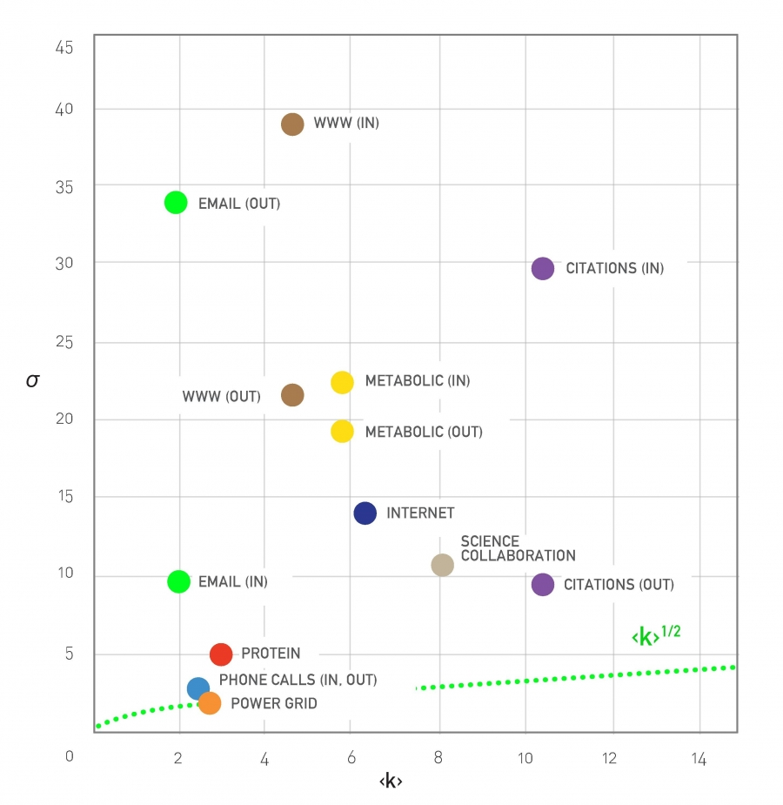
Real network examples

Slide 24
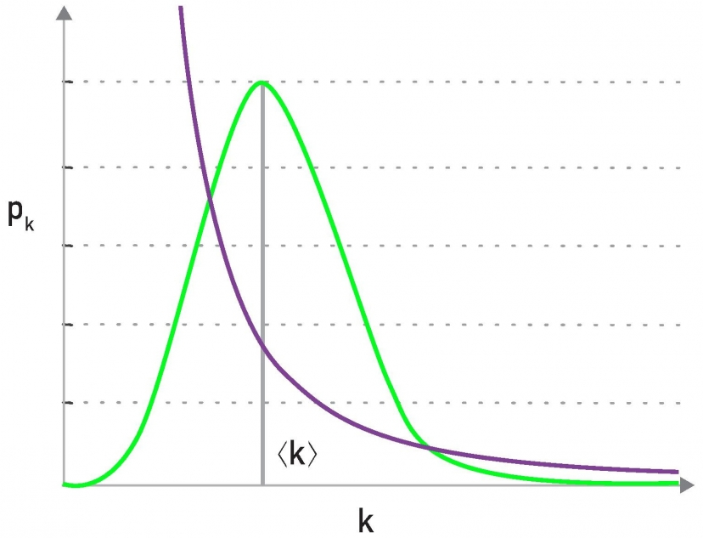
Example: citations to scientific papers
In general, the average degree is not very informative in scale-free networks
“Fat tail”, “Heavy tail”, “Long tail”

Slide 25
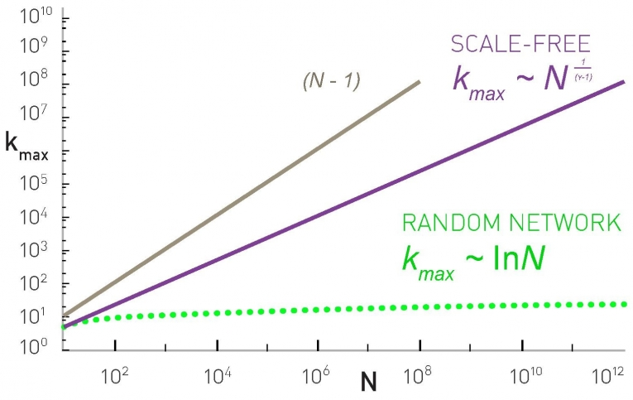
There is a natural cut-off of the degree
The largest hub cannot have more than N-1 connections

Slide 26
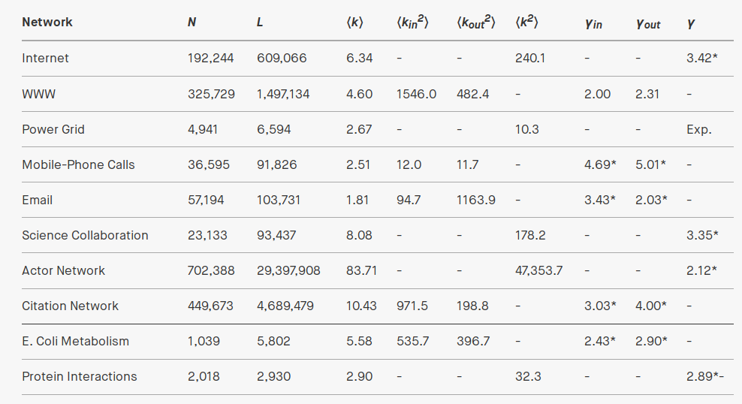
Real network examples

Slide 27
Summary

Slide 28
Things to remember
Definition of scale-free
Power law
Formulas for degree distribution
  Discrete formula
  Continuous formula
Formula for kmax

Slide 29
Practice on your own
(Somewhat) difficult, try to solve it ON YOUR OWN
Imagine a connected scale-free graph with 1 million nodes and average degree 5
  If we draw 100 nodes from this graph, how many will have degree 1?
  Remember, if the graph is connected, kmin=1
  If you cannot clear the unknown in a formula, plot it
Solution in next slide (shown only in .odp, not .pdf)

Slide 30
Solution
N=1000000, <k>=5, kmin=1
WolframAlpha:
  plot (x-1) * ((1000000^(1/(x-1)))^(2-x) - 1) / (2-x), x = 2.0 to 3.0
  Intersects 5 at about 2.22, that’s gamma
100 * 1/Zeta(2.2) ≃ 67

Slide 31

Additional contents
(not included in exams)

Slide 32
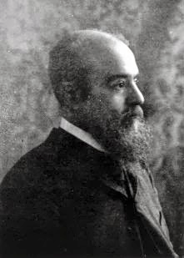
Pareto’s Law
Italian economist Vilfredo Pareto in the
19th century noted 80% of money was
earned by 20% of people
More recently ...
  80 percent of links on the Web point to only 15 percent of pages;
  80 percent of citations go to only 38 percent of scientists;
  80 percent of links in Hollywood are to 30 percent of actors
A debate that is still open: the wealth of the 1% and the 0.1%

Slide 33
Moments of degree distribution
Moments of degree distribution

Slide 34
Moments of degree distribution (cont.)
In a scale-free network
This diverges as if
Hence there is no “typical” scale

Slide 35
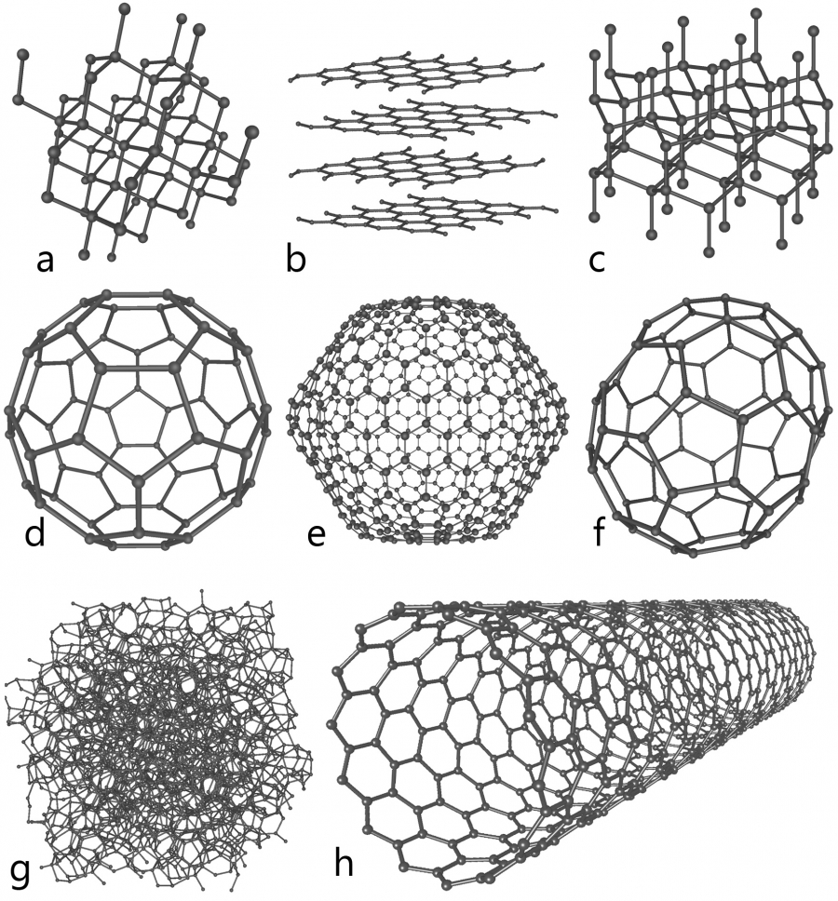
When you do not observe the scale-free property
In general, when there is a limit to k_{max}
Out-degree in some social networks
Materials/crystals

