Slide 1

A personal introduction
Introduction to Network Science
Carlos Castillo
Topic 01

Slide 2
Why network science is important to me

Slide 3
PhD work (2000-2004)
Collecting web pages
Characterizing national web domains
  Chile, Korea, Greece, Spain ...

Slide 4
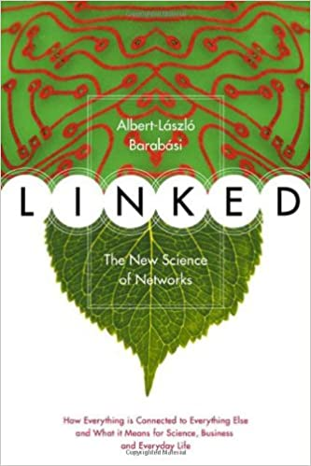
An influential book (to me)
This book came out in 2002 and made me see networks everywhere; it’s an easy read, written for the general public, highly recommended
And Barabási at some point visited my university in Chile!

Slide 5
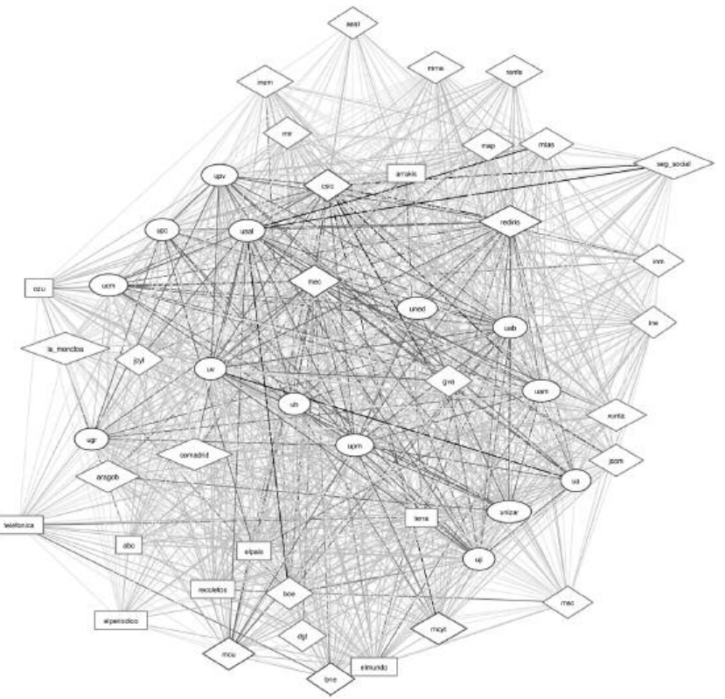
My work on top .es domains (~2006)
usal
“GOV”
la_moncloa
“COM”
ub
“EDU”
http://eprints.rclis.org/9292/1/vol15_1.2.pdf
elmundo

Slide 6
Post-doctoral work (2005-2009)
Web spam pages
  Pages created to deceive search engines
  Attract traffic by stuffing themselves with keywords
  Increase link score of other pages
  Methods evolve all the time, how to catch them?

Slide 7
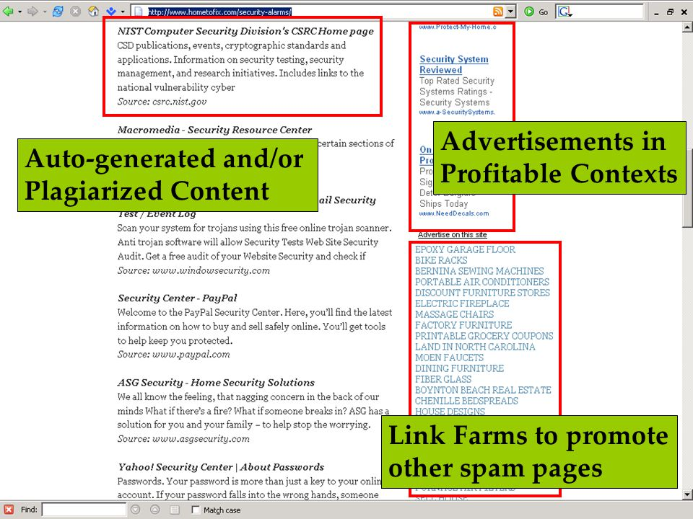
Pranam Kolari’s PhD defense, 2007
https://slideplayer.com/slide/4825954/

Slide 8
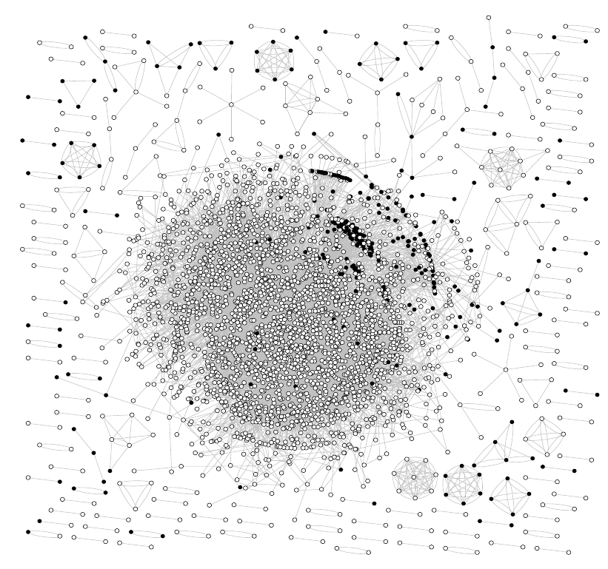
An Eureka! Moment
2006
I used gnuplot to visualize an annotated dataset
Black: spam
They cluster together!
Paper: https://doi.org/10.1145/1277741.1277814

Slide 9
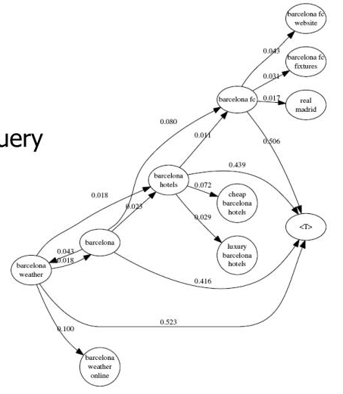
Query flows
2008
We wonder what is the most likely query before or after another query?
How are they connected? This is how we developed query flow graphs

Slide 10
Graphs in my own work
Characterizing national web domains
Finding web spam pages
Suggesting queries to searchers
…
Currently:
  part of a larger toolbox
  skeptical about structural-only conclusions

