Slide 1

Graph partitioning
Introduction to Network Science
Carlos Castillo
Topic 12

Slide 2
Sources
Barabási 2016 Chapter 9
Networks, Crowds, and Markets Ch 3
C. Castillo: Graph partitioning 2017

Slide 3
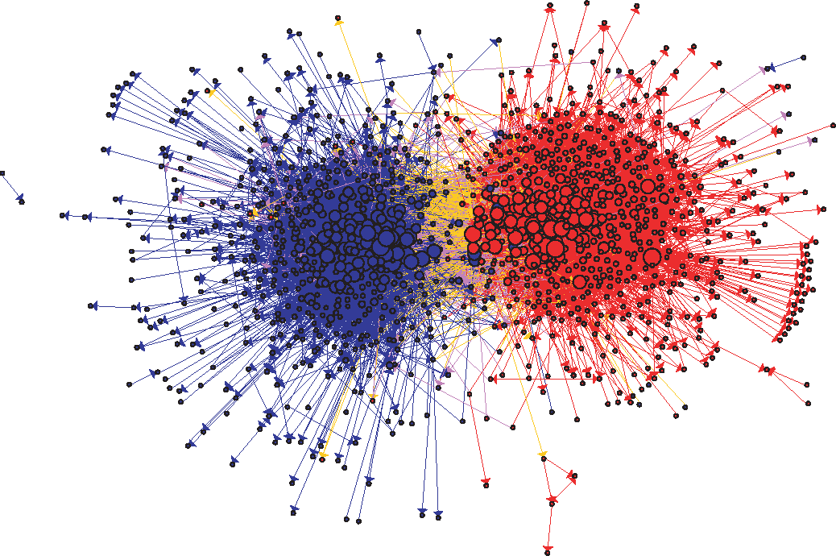
US Political Blogs (2004)
Liberal
Conservative
Adamic, L. A., & Glance, N. (2005, August). The political blogosphere and the 2004 US election: divided they blog. In Proc. LinkKDD (pp. 36-43). ACM.

Slide 4
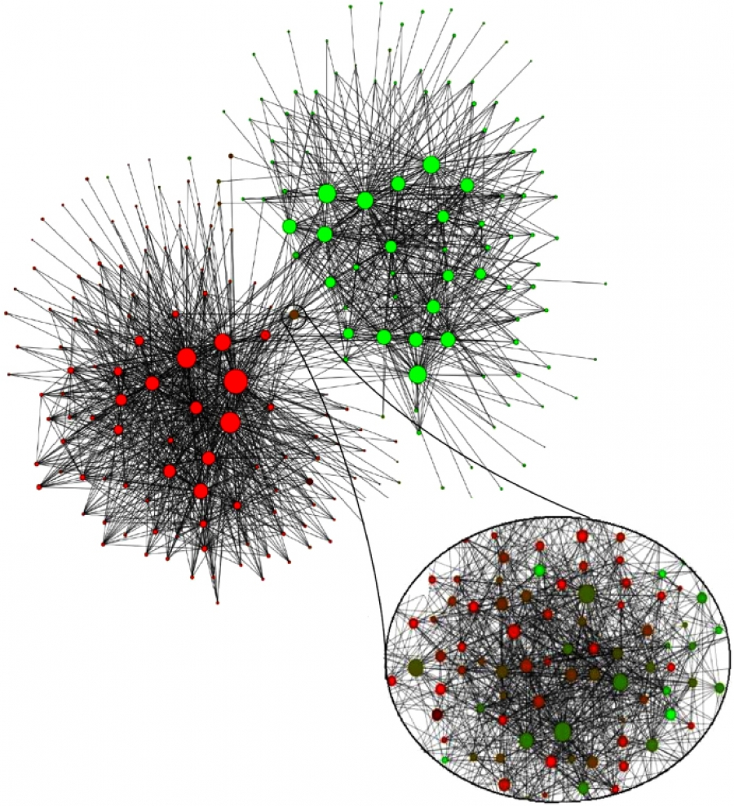
Mobile phone users in Belgium (2008)
Each node is a community of 100 mobile users or more that tend to call each other
Dutch-speaking
French-speaking
V. D. Blondel, J.-L. Guillaume, R. Lambiotte, and E. Lefebvre. Fast unfolding of communities in large networks. J. Stat. Mech., 2008.

Slide 5
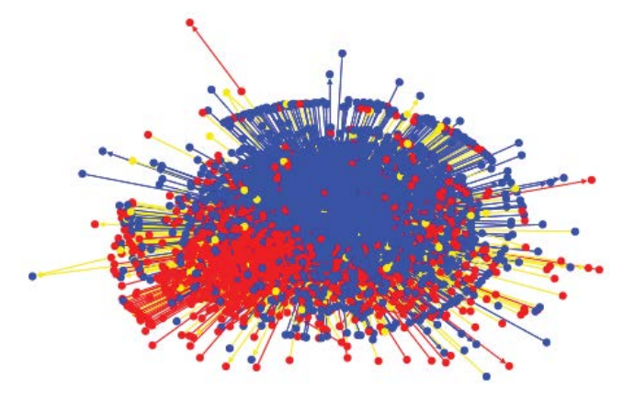
Egyptian Twitter Users (2013)
Islamist
Secularist
Weber, I., Garimella, V. R. K., & Batayneh, A. (2013, August). Secular vs. Islamist polarization in egypt on twitter. In Proc. ASONAM (pp. 290-297). ACM.

Slide 6

Wayne Zachary’s PhD Thesis (1972)
Studied 34 members of a karate club
Found 78 links between members who regularly interacted outside the club
The club splitted in two during the study
1=sensei, 34=president

Slide 7
Splitting into two communities:
Max-flow and Min-cut

Slide 8
Maximum flow: example 1
If edge weights were capacities, what is the maximum flow that can be sent from s to t?
s
t
5 m³/second
1 m³/second
3 m³/second

Slide 9
Maximum flow: example 2
If edge weights were capacities, what is the maximum flow that can be sent from s to t?
1
5
4
s
t
4
2
6

Slide 10
Maximum flow problem
What is the maximum “flow” that can be carried from s to t?
  Think of edge weights as capacities (e.g. m³/s of water)
What is the flow of an edge?
  The amount sent through that edge (an assignment)
What is the net flow of a node?
  The amount exiting the node minus the amount entering the node

Slide 11
Formulating the max flow problem
The flow through each edge should be
Net flow node h = OUT(h) – IN(h)
Node s should have positive flow v
Node t should have negative flow -v
What should be the flow of the other nodes?

Slide 12
Formulating the max flow problem
Let v be a feasible flow
Node s should have positive flow v
Node t should have negative flow -v
What should be the flow of an arbitrary node h?
h

Slide 13
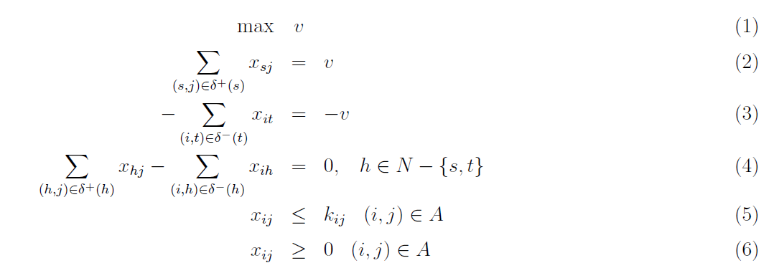
Max flow as a linear program
http://www.dii.unisi.it/~agnetis/mincutENG.pdf

Slide 14
Writing the dual: each constraint will become a variable

Slide 15
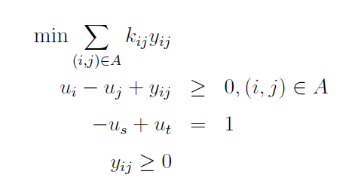
Writing the dual
Remember: the infimum of the solutions of the dual is the supremum of the solutions of primal
Variables u_{i} don't enter the objective, only their difference is in the constraints
We can set them arbitrarily, in particular u_{s} = 0, u_{t} = 1

Slide 16
Dual (after simplification)
What happens with the values of u in every simple path going from s to t ?
u=0
u=?
u=?
u=?
u=1
...

Slide 17
Dual (after simplification)
Given these constraints, the sequence must increase, and can only increase once
u=0
u=0
u=1
u=1
u=1
...

Slide 18
Dual (after simplification)
Every feasible solution represents a cut (S, S')

Slide 19
Dual solutions are cuts
Every feasible solution of the dual has the form of a cut (S, S')
S'
S
u_{s}=0
u_{t}=1

Slide 20
Dual solutions are cuts
Every feasible solution of the dual has the form of a cut (S, S')
u_{s}=0
u_{t}=1
S'
S
u_{s}=0
u_{t}=1
u_{s}=0

Slide 21
Dual solutions are (s-t)-cuts
and remember we're trying to minimize
u_{s}=0
u_{t}=1
S'
S
u_{s}=0
u_{t}=1
u_{s}=0

Slide 22
One more thing about the solution
y_{ij} is a dual variable corresponding to primal constraint
If y_{ij} is non-zero, then the corresponding constraint is tight
What does it mean for the edges in the cut?

Slide 23
One more thing about the solution
y_{ij} is a dual variable corresponding to primal constraint
If y_{ij} is non-zero, then the corresponding constraint is tight
Edges in the cut are saturated (at full capacity)

Slide 24
This is an efficient method
Min-cut and Max-flow are equivalent problems
  Their solutions are also equal: the value of the maximum flow is equivalent to the minimum cut
Think of a chain that breaks at the weakest link
Both can be solved exactly in polynomial time

Slide 25
Randomized algorithm for (s-t)-cuts
Pick an edge at random (u,v)
Merge u and v in new vertex uv
Edges between u and v are removed
Edges pointing to u or v are added as multi-edges to vertex uv
When only s and t remain, the multi-edges are a cut, probably the minimum one

Slide 26
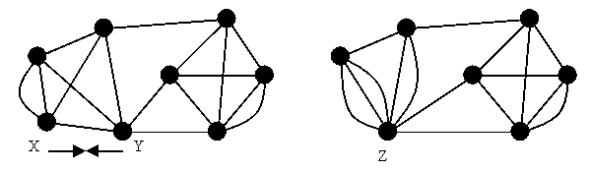
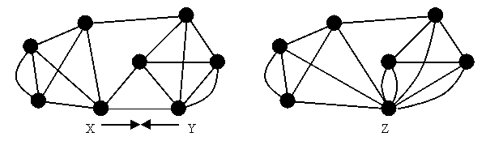
Example merges (“contractions”)
http://www.cs.berkeley.edu/~jfc/cs174lecs/lec18/lec18.html

Slide 27
Try it!
Pick an edge at random (u,v)
Merge u and v in new vertex uv
Edges between u and v are removed
Edges pointing to u or v are added as multi-edges to vertex uv
When only s and t remain, the multi-edges are a cut, probably the minimum one
Run the randomized
algorithm on this graph
a
b
s
t
c
d

Slide 28
Example run
s
t
s
t
s
t
s
t
s
t
s
s
t
t
s
s
t
t
Cut of weight 2 found!

Slide 29
The randomized algorithm might miss the min cut
Multiple runs are required
The probability that this finds the min cut in one run is about 1/log(n), so O(log n) iterations are required to find min cut
Each iteration costs O(n² log n)
O(n² log² n) operations needed to find min cut
Exact algorithm: O(n³ + n² log n); the n³ is because of |V||E| operations required
http://www.cs.berkeley.edu/~jfc/cs174lecs/lec18/lec18.html

Slide 30
Splitting into multiple communities

Slide 31
Community hypotheses
H1. The community structure of a network is uniquely encoded by its links [discoverable]
H2. A community is a locally dense connected subgraph [dense, connected]

Slide 32
Weak < Strong < Clique
Let C be a community with N_{C} nodes
Given a community C,
  Let count links towards C, towards V\C
Clique:
Strong community:
Weak community:

Slide 33
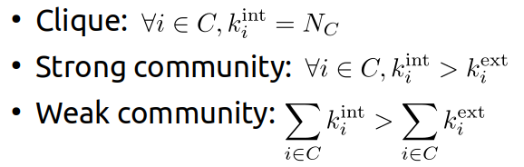
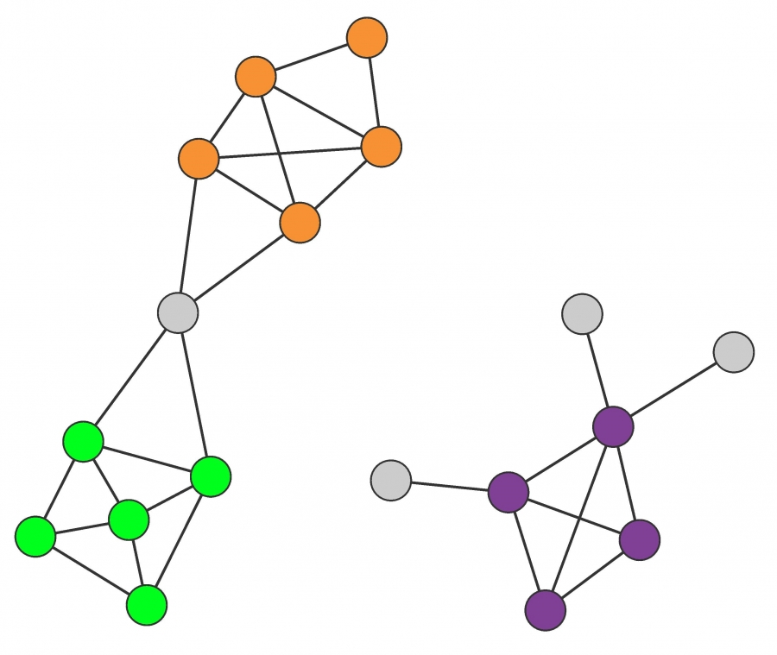
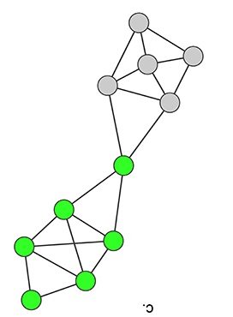
Try it!
Which types of communities are these?
(a)
(d)
(b)
(c)

Slide 34
Solution
Which types of communities are these?
(a)
(a) Strong
(b) Strong
(c) Clique
(d) Weak
(d)
(b)
(c)

Slide 35


How many possible partitions?
With 3 nodes: 5 partitions
With 4 nodes: 15 partitions
http://www-history.mcs.st-andrews.ac.uk/Miscellaneous/StirlingBell/bell.html

Slide 36
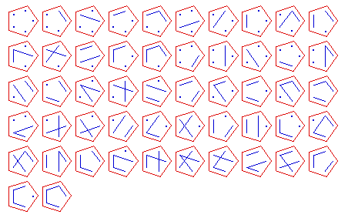
With 5 nodes: 52 partitions
http://www-history.mcs.st-andrews.ac.uk/Miscellaneous/StirlingBell/bell.html

Slide 37
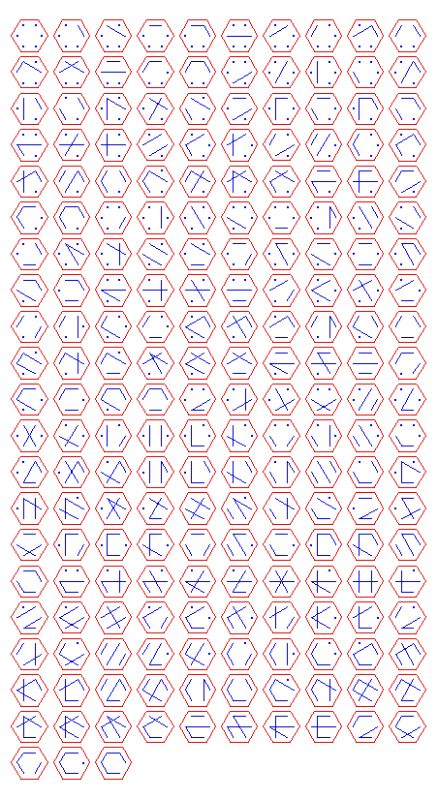
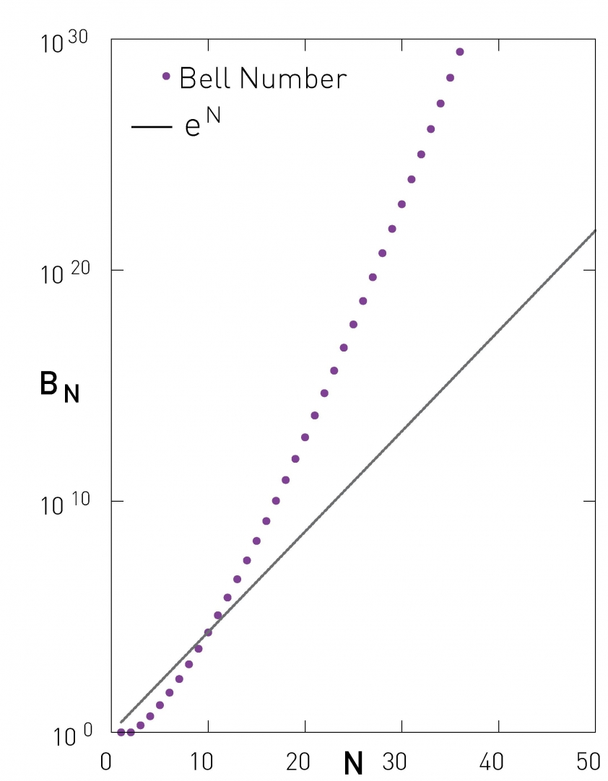
With 6 nodes: 203 partitions
With 7 nodes: 877 partitions
With n nodes: Bell number
http://www-history.mcs.st-andrews.ac.uk/Miscellaneous/StirlingBell/bell.html

Slide 38
Hierarchical algorithms
Recursively:
Merge nodes that are similar (agglomerative)
  — OR —
Split groups that are dissimilar (divisive)

