Slide 1

Network flows
Introduction to Network Science
Carlos Castillo
Topic 20

Slide 2
Sources
Barabási 2016 Chapter 9
Networks, Crowds, and Markets Ch 3
C. Castillo: Graph partitioning 2017

Slide 3
Splitting into two communities:
Max-flow and Min-cut

Slide 4
Maximum flow: example 1
If edge weights were capacities, what is the maximum flow that can be sent from s to t?
s
t
5 m³/second
1 m³/second
3 m³/second

Slide 5
Maximum flow: example 2
If edge weights were capacities, what is the maximum flow that can be sent from s to t?
1
5
4
s
t
4
2
6

Slide 6
Maximum flow problem
What is the maximum “flow” that can be carried from s to t?
  Think of edge weights as capacities (e.g. m³/s of water)
What is the flow of an edge?
  The amount sent through that edge (an assignment)
What is the net flow of a node?
  The amount exiting the node minus the amount entering the node

Slide 7
Formulating the max flow problem
The flow through each edge should be
Net flow at node h:
flow(h) = out_flow(h) - in_flow(h)
Node s has only out_flow, should have positive flow v
Node t has only in_flow, should have negative flow -v
What should be the flow of the other nodes?

Slide 8
Formulating the max flow problem
Let v be a feasible flow
Node s should have positive flow v
Node t should have negative flow -v
What should be the flow of an arbitrary node h?
h

Slide 9
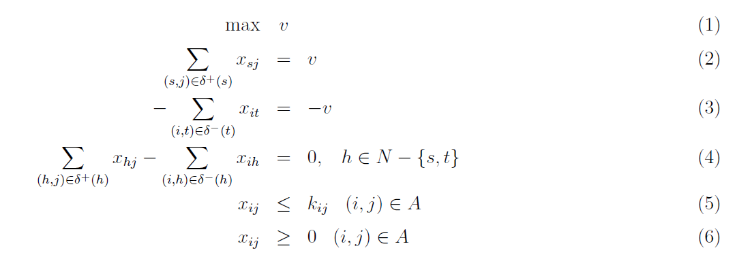
Max flow as a linear program
N: set of nodes, A: set of edges
http://www.dii.unisi.it/~agnetis/mincutENG.pdf

Slide 10
Primal-Dual in Linear Programming
PRIMAL
DUAL

Slide 11
Writing the dual: each constraint will become a variable

Slide 12
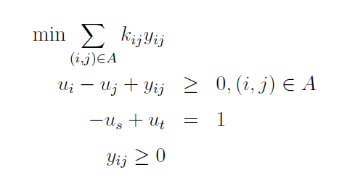
Writing the dual
Remember: the infimum of the solutions of the dual is the supremum of the solutions of primal
(
)
Think of y_{ij} as
0 or 1
Variables u_{i} don't enter the objective, only their difference is in the constraints
We can set them arbitrarily, in particular u_{s} = 0, u_{t} = 1

Slide 13
Dual (after simplification)
What happens with the values of u in every simple path going from s to t ?
u=0
u=?
u=?
u=?
u=1
...

Slide 14
Dual (after simplification)
Given these constraints, the sequence must increase, and can only increase once
u=0
u=0
u=1
u=1
u=1
...

Slide 15
Dual (after simplification)
Every feasible solution represents a cut (S, S')

Slide 16
Exercise
Upload to Nearpod Collaborate
https://nearpod.com/student/
Code to be given during class
a
1
1
Write the primal equations for this graph
  Unknowns: x_{sa}, x_{sc}, x_{ab}, x_{cb}, x_{bt}, v
Write the dual equations for this graph
  Unknowns: u_{a}, u_{b}, u_{c}, y_{sa}, y_{sc}, y_{ab}, y_{cb}, y_{bt}
Guess both solutions,
check that you satisfy
all constraints
3
s
b
t
2
c
1

Slide 17
1
a
1
s
b
3
t
2
c
1

Slide 18
Dual solutions are cuts
Every feasible solution of the dual has the form of a cut (S, S')
S'
S
u_{s}=0
u_{t}=1

Slide 19
Dual solutions are cuts
Every feasible solution of the dual has the form of a cut (S, S')
u_{s}=0
u_{t}=1
S'
S
u_{s}=0
u_{t}=1
u_{s}=0

Slide 20
Dual solutions are (s-t)-cuts
and remember we're trying to minimize
u_{s}=0
u_{t}=1
S'
S
u_{s}=0
u_{t}=1
u_{s}=0

Slide 21
One more thing about the solution
y_{ij} is a dual variable corresponding to primal constraint
If y_{ij} is non-zero, then the corresponding constraint is tight
What does it mean for the edges in the cut?

Slide 22
One more thing about the solution
y_{ij} is a dual variable corresponding to primal constraint
If y_{ij} is non-zero, then the corresponding constraint is tight
Edges in the cut are saturated (at full capacity)

Slide 23
This is an efficient method
Min-cut and Max-flow are equivalent problems
  Their solutions are also equal: the value of the maximum flow is equivalent to the minimum cut
Think of a chain that breaks at the weakest link
Both can be solved exactly in polynomial time

Slide 24
Randomized algorithm for (s-t)-cuts

Slide 25
Randomized algorithm for (s-t)-cuts
Pick an edge at random (u,v)
Merge u and v in new vertex uv
Edges between u and v are removed
Edges pointing to u or v are added as multi-edges to vertex uv
When only s and t remain, the multi-edges are a cut, probably the minimum one

Slide 26
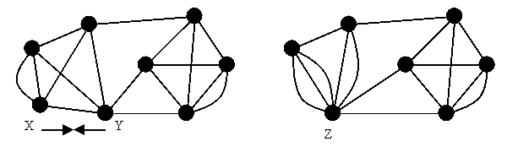
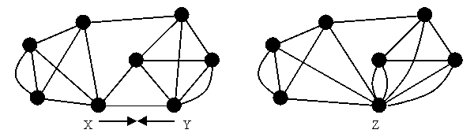
Example merges (“contractions”)
X
Y
XY
Y
Z
YZ
http://www.cs.berkeley.edu/~jfc/cs174lecs/lec18/lec18.html

Slide 27
Exercise
Pick an edge at random (u,v)
Merge u and v in new vertex uv
Edges between u and v are removed
Edges pointing to u or v are added as multi-edges to vertex uv
When only s and t remain, the multi-edges are a cut, probably the minimum one
Run the randomized
algorithm on this graph
a
b
s
t
c
d
Upload to Nearpod Collaborate
https://nearpod.com/student/
Code to be given during class

Slide 28
Example run
s
t
s
t
s
t
s
t
s
t
s
s
t
t
s
s
t
t
Cut of weight 2 found!

Slide 29
The randomized algorithm might miss the min cut
Multiple runs are required
The probability that this finds the min cut in one run is about 1/log(n), so O(log n) iterations are required to find min cut
Each iteration costs O(n² log n)
O(n² log² n) operations needed to find min cut
Exact algorithm: O(n³ + n² log n); the n³ is because of |V||E| operations required
http://www.cs.berkeley.edu/~jfc/cs174lecs/lec18/lec18.html

Slide 30
Summary

Slide 31
Things remember
Minimum s-t cut in a graph = set of edges
The sum of the capacities of those edges is the maximum s-t flow the graph can carry
Solvable in polynomial time
Approximate randomized algorithm exists

Slide 32
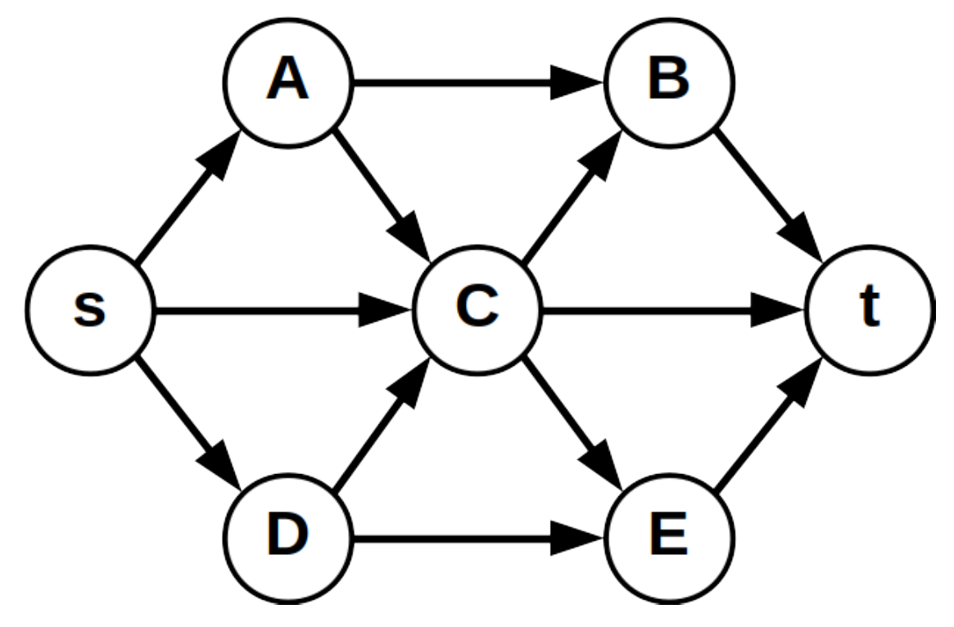
Practice on your own
Consider (s, t)−cuts on the graph on the right, where s is the source node and t is the terminal node. Assume every edge has cost equal to 1.
By visual inspection, what is the minimum cost of an (s, t)−cut in this graph, and what is an example of a cut having that cost?
Run the algorithm for randomized (s, t)-cuts we saw in class, drawing all intermediate graphs, and indicate the cost of the resulting cut.

Slide 33
Practice on your own (cont.)
Create a graph
Write the min-flow, max-cut equations
Find an optimal solution
Run the randomized s-t cut algorithm

