Slide 1

Hubs and Authorities
Social Networks Analysis and Graph Algorithms
Prof. Carlos Castillo — https://chato.cl/teach

Slide 2
Sources
D. Easley and J. Kleinberg (2010): Networks, Crowds, and Markets – Chapter 14
Fei Li's lecture on PageRank (2011)
Evimaria Terzi's lecture on link analysis (2013)
URLs in the footer of specific slides

Slide 3
Motivation: rank search results
Demand
  Information needs are unclear and evolving
Supply
  From scarcity to abundance: “filter failure”

Slide 4
Purpose of Link-Based Ranking
Static (query-independent) ranking
Dynamic (query-dependent) ranking
Applications:
  Search in social networks
  Search on the web

Slide 5
Why computing hubs and authorities?

Slide 6
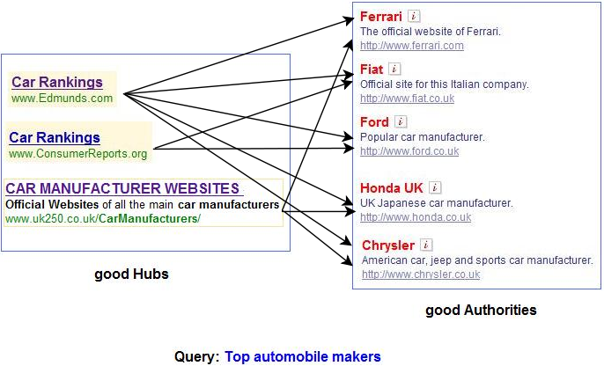
Example 1: “top automobile makers”
http://pi.math.cornell.edu/~mec/Winter2009/RalucaRemus/Lecture4/lecture4.html (2009)

Slide 7
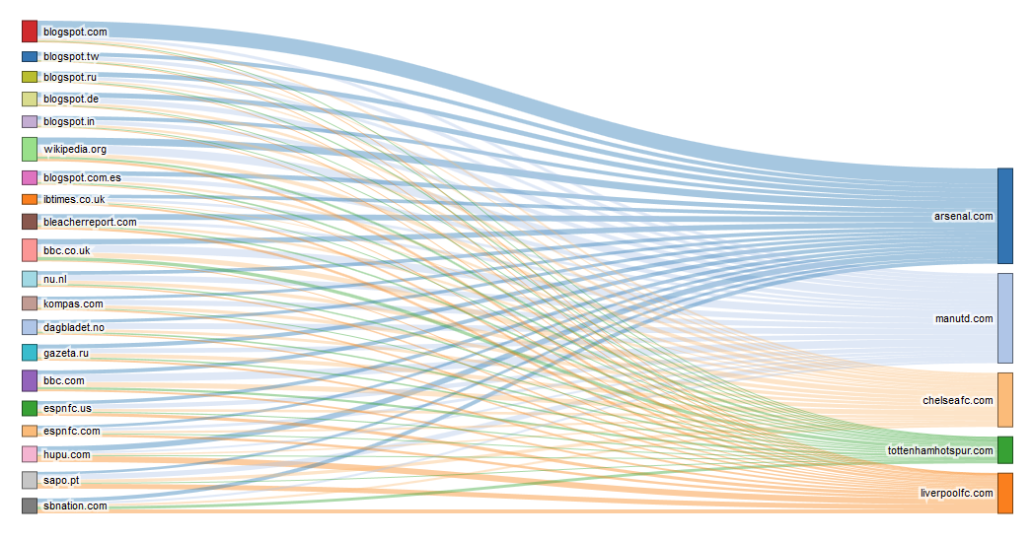
Example 2: UK football teams on the web
https://blog.majestic.com/development/hubs-of-authority-sankey-chart/ (2015)

Slide 8

Example: query “barcelona museum”
CCCB
Picasso
Museum
MNAC
Miró Museum
How would you rank
these pages?
Wax Museum
CaixaForum
Casa Milá

Slide 9
Counting in-links for “barcelona museum”
CCCB
Picasso
Museum
MNAC
Miró Museum
Wax Museum
CaixaForum
Casa Milá

Slide 10

Value of a list of “barcelona museum”
CCCB
Picasso
Museum
MNAC
Miró Museum
Wax Museum
CaixaForum
Casa Milá

Slide 11

Re-weighting votes by list values
CCCB
Picasso
Museum
MNAC
Miró Museum
Wax Museum
CaixaForum
Casa Milá

Slide 12

Normalizing scores
CCCB
Picasso
Museum
MNAC
Miró Museum
Wax Museum
CaixaForum
Casa Milá

Slide 13
The idea behind Hubs and Authorities [Kleinberg 1999]
Highly-recommended items
appear in high-value lists
High-value lists
contain highly-recommended items
Repeated improvement
  Re-calculate scores several times

Slide 14

Limit values
CCCB
Picasso
Museum
MNAC
Miró Museum
Wax Museum
CaixaForum
Casa Milá

Slide 15
This algorithm is called “HITS”
Jon M. Kleinberg. 1999. Authoritative sources in a hyperlinked environment. J. ACM 46, 5 (September 1999), 604-632. [DOI]
Query-dependent algorithm
  Get pages matching the query
  Expand to 1-hop neighborhood
  Find pages with good out-links (“hubs”)
  Find pages with good in-links (“authorities”)

Slide 16

Root set = matches the query

Slide 17

Base set S = root set plus 1-hop neighbors
Base set S is expected to be small and topically focused.

Slide 18
How to compute hubs and authorities

Slide 19
Base graph S of n nodes

Slide 20
Bipartite graph of 2n nodes

Slide 21
Bipartite graph of 2n nodes
0) Initialization:
1) Iteration:
2) Normalization:

Slide 22

Exercise
Ĥ(1) | A(1) | Â(1) | H(2) | Ĥ(2) | A(2) | Â(2)
1 | 0
1 | 3
1 | 1
1 | 1
1 | 1
Complete the table
Which one is the largest hub?
Which the largest authority?
Compare rankings
Rank by indegree = rank by auth?
Rank by outdegree = rank by hub?
Spreadsheet links: https://upfbarcelona.padlet.org/chato/shyq9m6f2g2dh1bw

Slide 23
Ĥ(1) | A(1) | Â(1) | H(2) | Ĥ(2) | A(2) | Â(2)
1 | 0
1 | 3
1 | 1
1 | 1
1 | 1

Slide 24
Ĥ(1) | A(1) | Â(1) | H(2) | Ĥ(2) | A(2) | Â(2)
1 | 0 | 0/S
1 | 3 | 3/S
1 | 1 | 1/S
1 | 1 | 1/S
1 | 1 | 1/S
S = 0 + 3 + 1 + 1 + 1 = 6

Slide 25
Ĥ(1) | A(1) | Â(1) | H(2) | Ĥ(2) | A(2) | Â(2)
1 | 0 | 0
1 | 3 | 1/2 (3/6)
1 | 1 | 1/6
1 | 1 | 1/6
1 | 1 | 1/6

Slide 26
Ĥ(1) | A(1) | Â(1) | H(2) | Ĥ(2) | A(2) | Â(2)
1 | 0 | 0 | 1/2
1 | 3 | 1/2 | 1/6
1 | 1 | 1/6 | 1/2+1/6
1 | 1 | 1/6 | 1/2+1/6
1 | 1 | 1/6 | 0
In this step (A→H) it is as we had inverted the original edges, so they point in the opposite direction (e.g., instead of blue to yellow, now there is yellow to blue)

Slide 27
Ĥ(1) | A(1) | Â(1) | H(2) | Ĥ(2) | A(2) | Â(2)
1 | 0 | 0 | 1/2
1 | 3 | 1/2 | 1/6
1 | 1 | 1/6 | 2/3 (4/6)
1 | 1 | 1/6 | 2/3 (4/6)
1 | 1 | 1/6 | 0

Slide 28
Ĥ(1) | A(1) | Â(1) | H(2) | Ĥ(2) | A(2) | Â(2)
1 | 0 | 0 | 1/2 | (1/2)/S
1 | 3 | 1/2 | 1/6 | (1/6)/S
1 | 1 | 1/6 | 2/3 | (2/3)/S
1 | 1 | 1/6 | 2/3 | (2/3)/S
1 | 1 | 1/6 | 0 | 0/S
S = 1/2+1/6+2/3+2/3+0 = 2

Slide 29
Ĥ(1) | A(1) | Â(1) | H(2) | Ĥ(2) | A(2) | Â(2)
1 | 0 | 0 | 1/2 | 1/4
1 | 3 | 1/2 | 1/6 | 1/12
1 | 1 | 1/6 | 2/3 | 1/3
1 | 1 | 1/6 | 2/3 | 1/3
1 | 1 | 1/6 | 0 | 0

Slide 30
Ĥ(1) | A(1) | Â(1) | H(2) | Ĥ(2) | A(2) | Â(2)
1 | 0 | 0 | 1/2 | 1/4 | 0
1 | 3 | 1/2 | 1/6 | 1/12 | 1/4+ 1/3+ 1/3
1 | 1 | 1/6 | 2/3 | 1/3 | 1/12
1 | 1 | 1/6 | 2/3 | 1/3 | 1/12
1 | 1 | 1/6 | 0 | 0 | 1/3

Slide 31
Ĥ(1) | A(1) | Â(1) | H(2) | Ĥ(2) | A(2) | Â(2)
1 | 0 | 0 | 1/2 | 1/4 | 0
1 | 3 | 1/2 | 1/6 | 1/12 | 11/12
1 | 1 | 1/6 | 2/3 | 1/3 | 1/12
1 | 1 | 1/6 | 2/3 | 1/3 | 1/12
1 | 1 | 1/6 | 0 | 0 | 1/3

Slide 32
Ĥ(1) | A(1) | Â(1) | H(2) | Ĥ(2) | A(2) | Â(2)
1 | 0 | 0 | 1/2 | 1/4 | 0 | 0/S
1 | 3 | 1/2 | 1/6 | 1/12 | 11/12 | (11/12)/S
1 | 1 | 1/6 | 2/3 | 1/3 | 1/12 | (1/12)/S
1 | 1 | 1/6 | 2/3 | 1/3 | 1/3 | (1/3)/S
1 | 1 | 1/6 | 0 | 0 | 1/3 | (1/3)/S
S = 0+11/12+1/12+1/3+1/3
= 20/12 = 5/3

Slide 33
Ĥ(1) | A(1) | Â(1) | H(2) | Ĥ(2) | A(2) | Â(2)
1 | 0 | 0 | 1/2 | 1/4 | 0 | 0
1 | 3 | 1/2 | 1/6 | 1/12 | 11/12 | 11/20
1 | 1 | 1/6 | 2/3 | 1/3 | 1/12 | 1/20
1 | 1 | 1/6 | 2/3 | 1/3 | 1/3 | 1/5
1 | 1 | 1/6 | 0 | 0 | 1/3 | 1/5

Slide 34
Ĥ(1) | A(1) | Â(1) | H(2) | Ĥ(2) | A(2) | Â(2)
1 | 0 | 0 | 1/2 | 1/4 | 0 | 0
1 | 3 | 1/2 | 1/6 | 1/12 | 11/12 | 11/20
1 | 1 | 1/6 | 2/3 | 1/3 | 1/12 | 1/20
1 | 1 | 1/6 | 2/3 | 1/3 | 1/3 | 1/5
1 | 1 | 1/6 | 0 | 0 | 1/3 | 1/5

Slide 35
What are we computing?
Vector a is an eigenvector of A^{T}A
Conversely, vector h is an eigenvector of AA^{T}

Slide 36
Dealing with weighted graphs
(this is an option that does not normalize weights, one can alternatively normalize them)
1) Iteration:
2) Normalization:
i
j

Slide 37
Problem: cliques and quasi-cliques

Slide 38

Problem: tightly-knit communities
Example: a graph made of a (3,3)-clique and a (2,3)-clique
1
1
1
1
1

Slide 39
Problem: tightly-knit communities
Example: a graph made of a (3,3)-clique and a (2,3)-clique
3
3
3
2
2
2

Slide 40
Problem: tightly-knit communities
Example: a graph made of a (3,3)-clique and a (2,3)-clique
3x3
3x3
3x3
3x2
3x2

Slide 41
Problem: tightly-knit communities
Example: a graph made of a (3,3)-clique and a (2,3)-clique
What happens after
n iterations?
Which community
”wins” (i.e., has the
largest sum of scores)?
3x3x3
3x3x3
3x3x3
3x2x2
3x2x2
3x2x2

Slide 42
Problem: tightly-knit communities
HITS favors the largest dense sub-graph
After n iterations:
...
...
...

Slide 43
A different application of hubs and authorities

Slide 44
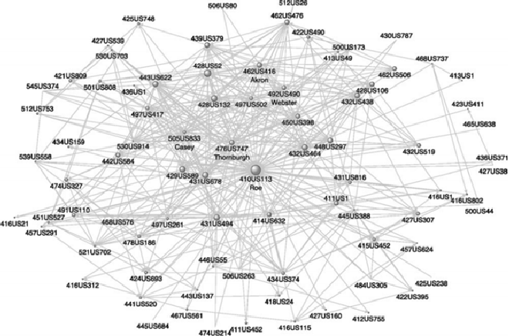
The legal precedent network
Roe v Wade legalized abortion in the US
Many cases reference it as a legal precedent
This is a representation of some of those cases
Carmichael, I., Wudel, J., Kim, M., & Jushchuk, J. (2017). Examining the evolution of legal precedent through citation network analysis. NCL Rev., 96, 227.

Slide 45

Hubs and authorities on the legal precedent network
We can compute authority in this network
Re-compute every year
Different cases acquire authority at different speeds!
(Roe v Wade legalized abortion, Brown v Board of Education declared race-segregated schools unconstitutional)
Authority score
Years after decision
Fowler, J. H., & Jeon, S. (2008). The authority of Supreme Court precedent. Social networks, 30(1), 16-30.

Slide 46
Summary

Slide 47
Things to remember
What is the hubs and authority algorithm
How to execute it step by step
Practice with graphs on your own

Slide 48
Practice on your own
Consider a directed bi-partite graph G = (V_{L} ∪ V_{R} , E) in which V_{L} = {a, b, c, d} and V_{R} = {1, 2, . . . , 120}, and in which all edges go from a node in V_{L} to a node in V_{R} :
  Node a is connected to nodes 1, 2, . . . 120.
  Node b is connected to nodes 1, 2, . . . 60.
  Node c is connected to nodes 1, 2, . . . 30.
  Node d is connected to nodes 1, 2, . . . 15.
Starting with ĥ(1) (i) = 1 for i ∈ {a, b, c, d, 1, 2, . . . , 120}.
  1. Compute a(1)(i) for i ∈ {1, 2, . . . , 120}
  2. Compute â(1)(i) for i ∈ {1, 2, . . . , 120}
  3. Compute h(2) (i) for i ∈ {a, b, c, d}

