Slide 1
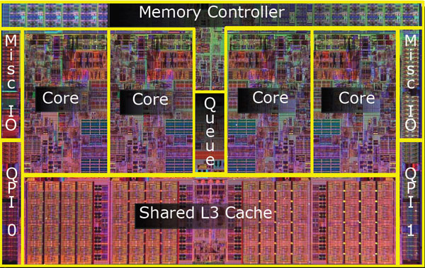
CPEN 411: Computer Architecture Slide Set #10: Introduction to Parallel Processing
Tor Aamodt
aamodt@ece.ubc.ca

Slide 2
Introduction to Slide Set 10
So far in the course we have learned how an individual processor core works. In this slide set start thinking about what happens if we connect multiple cores together.
Here we focus only on introducing the benefits and challenges of having multiple cores.
Next week: Programming GPUs with NVIDIA CUDA

Slide 3
Learning Objectives
By the time we finish talking about this slide set in lectures you should be able to:
Explain the challenges of obtaining performance using parallel processing.

Slide 4
Why (Explicitly) Parallel Computing?
3X
Concern about end of Moore’s Law… Lots of interest in Multiprocessors.

Slide 5
Challenges of Parallel Processing
First challenge is % of program inherently sequential
Suppose we want to obtain an 80X speedup from 100 processors (versus 1 processor). What fraction of original program can be sequential?
10%
5%
1%
<1%

Slide 6
Amdahl’s Law Answers

Slide 7
Challenges of Parallel Processing
Second challenge is long latency to remote memory
Suppose 32 CPU MP, 2GHz, 200 ns remote memory, all local accesses hit memory hierarchy and base CPI is 0.5. (Remote access = 200/0.5 = 400 clock cycles.)
What is performance impact if 0.2% instructions involve remote access?
1.5X
2.0X
2.5X

Slide 8
Solution
CPI = Base CPI + (Remote request rate x Remote request cost)
CPI = 0.5 + 0.2% x 400 = 0.5 + 0.8 = 1.3
If no communication, 1.3/0.5 or 2.6 faster than 0.2% instructions involve remote access

Slide 9
Flynn’s Taxonomy
Flynn classified by data and control streams in 1966
Single Instruction Single Data (SISD) A machine supporting a single thread of execution. | Single Instruction Multiple Data SIMD A computer in which each instruction operates on multiple data elements at once (e.g., think of vectors and matricies)
Multiple Instruction Single Data (MISD) (this combination doesn’t make sense) | Multiple Instruction Multiple Data MIMD A computer in which there are multiple independent threads each operating on their own data.
D
D
D
D
D
I
ALU
I
ALU
ALU
ALU
ALU
D
D
D
I
ALU
I
ALU
I
ALU
Notes:
Reminder, you do need to know the definition in text, the image are just for illustration

Slide 10
SIMD: Operation on Vectors
SIMD architectures operate on “vectors” of data.
Consider the calculation Z = X + Y, where X, Y and Z are vectors:
X = (x₀, x₁, … x_{n-1}) and Y = (y₀, y₁, … y_{n-1})
Z = (x₀ + y₀ , x₁ + y₁ , … , x_{n-1} + y_{n-1} )
SIMD uses vector registers each holding multiple numbers.
Operate on entire vector register at once.

Slide 11
Example: Z = X + Y
MIPS64
DADDIU R4, Rx, 48 ; last address to load
Loop: L.D F0, 0(Rx) ; load X(i)
L.D F1, 0(Ry) ; load Y(i)
ADD.D F2, F1, F0 ; X(i) + Y(i)
S.D F2, 0(Rz) ; store into Z(i)
ADDIU Rx,Rx,#8 ; increment index to X
ADDIU Ry,Ry,#8 ; increment index to Y
ADDIU Rz,Rz,#8 ; increment index to Z
DSUB R20, R4, Rx ; compute bound
BNEZ R20, Loop ; check if done
VMIPS
LV V1,Rx
LV V2,Ry
ADDV.D V3,V1,V2
SV V3,Rz
V1
ADDV.D V3, V1, V2
V2
+
+
+
+
+
+
V3

Slide 12
Multicore Processors
Each P_{i} is a processor like those studied earlier in the course. The boxes labeled “$” are caches.
Multiple processor cores on a single chip.
Processors are connected via an interconnection network (bus, crossbar, ring, mesh).
P
P
1
n
$
$
Inter
connection network
Cache
Memory (DRAM)

Slide 13
How to program?
Easiest: Multiprogramming
Separate single thread applications
Used today for “Cloud Computing”
For some programs: Parallelizing Compiler
Input C/C++/Fortran; Output parallel program
General: Parallel APIs / Languages
APIs: Pthreads, OpenMP, MPI
Languages: CUDA, OpenCL, High Performance Fortran, Erlang, Sisal

Slide 14
POSIX threads (pthreads)
#define N (1024*1024)
double data[N], sum[2];
void *foo() { int i; for(i=0;i<N/2;i++) sum[0] += data[i]; }
void *bar() { int i; for(i=0;i<N/2;i++) sum[1] += data[i+N/2]; }
int main(int argc, char *argv[])
{
pthread_t f, b;
// load data with values here...
pthread_create(&f, NULL, foo, NULL);
pthread_create(&b, NULL, bar, NULL);
pthread_join(f, NULL);
pthread_join(b, NULL);
double total = sum[0]+sum[1];
// do something with total here
return 0;
}
creates a new thread
that starts running
code in foo().
main()
foo()
bar()
Create two new threads. Operating system can schedule them on different cores so they run at same time (concurrently).

Slide 15
thread 0: main()
thread 1: foo()
thread 1: bar()
P
P
1
n
$
$
Inter
connection network
Cache
Memory (DRAM)

Slide 16
One thread per core?
Multiple cores enable multiple threads to run at the same time if we have one thread on each core.
However, with one thread per core, cache misses can cause each core to be idle most of the time.
Would like to “multiplex” more than one thread per core, but an operating system context switch takes far longer than the latency of a cache miss.

Slide 17
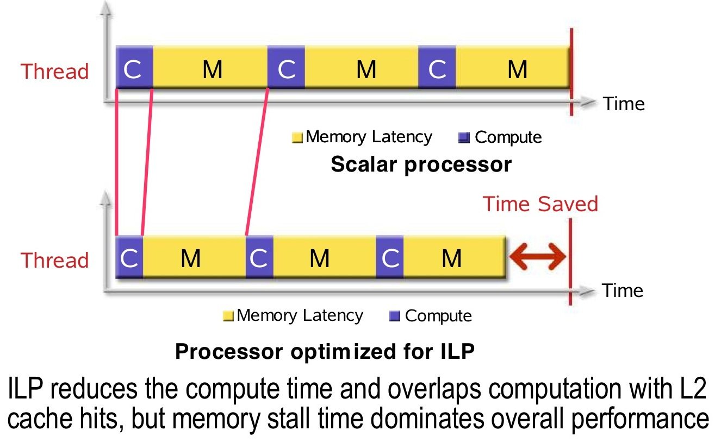
Hardware Idle Due to Memory Latency

Slide 18
Hardware Multithreading?
If operating system is too slow to context switch, can we have hardware do this for us?
Answer: Yes, but there is some area and complexity overhead.

Slide 19
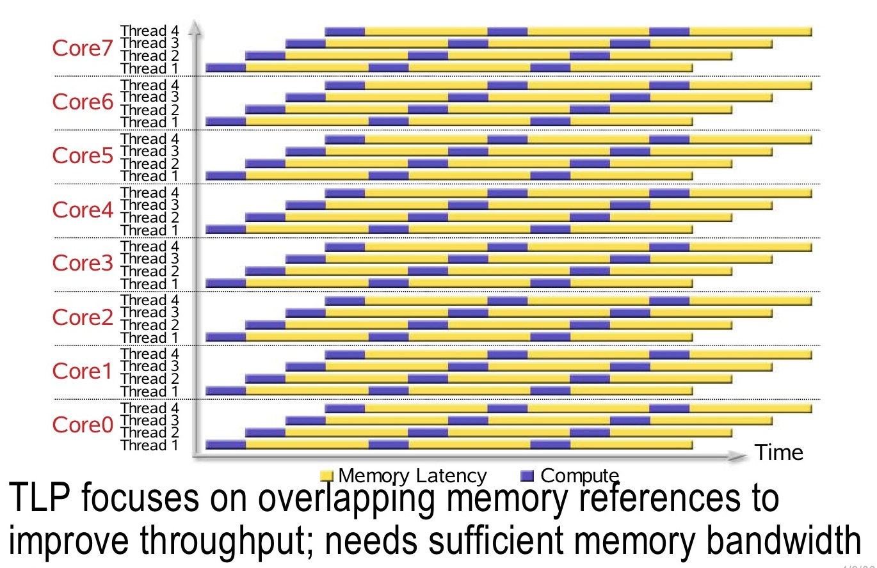
Fine-Grained Multithreading

Slide 20
Parallel Communication Models
Communication occurs by explicitly passing messages among the processors: message-passing
Benefit: Scalable -- systems with 100K processors use this
Drawback: Programmer effort to divide up data among processors and explicitly communicate changes to data.
Communication occurs through a shared address space via load and store instructions: shared memory
Benefit: Less initial work for programmer
Drawback: Not as scalable. Effort to obtain high performance

Slide 21
Shared Memory
We focus on shared memory as this is what you see in today’s microprocessors (e.g., Intel Core i5, i7; and mobile system-on-chips such as Snapdragon).
Communication occurs via memory—from earlier example:
foo() writes sum[0]
bar() writes sum[1]
main() reads sum[0] and sum[1] and adds them.

Slide 22
Two Shared Memory Concepts
Memory Consistency Model
Specifies ordering of updates to different locations that are allowed by hardware
Cache Coherence Protocol
Ensures updates to any single location by one thread become visible to threads on other cores

Slide 23
Intuitive “Memory Model”
P
Reading an address should return the “last value written to that address”
L1
100:67
L2
100:35
Memory
Disk
100:34

Slide 24
Another Silly Analogy
Instructor tells ECE office to change lecture location on SSC (e.g., from MCLD to CHEM), then sends text message to students telling them to check new location on SSC.
Diligent student gets text, immediately checks SSC and sees room is MCLD since ECE office busy and has not yet updated SSC.
Diligent student goes to wrong room!
Instructor sent messages in correct order!
Who is at fault? Solutions?

Slide 25
Memory Consistency Problem
Example:
P1: A = 0; P2: B = 0;
... ...
A = 1; B = 1;
L1: if (B == 0) ... L2: if (A == 0) ...
Possible for both “if” statements L1 & L2 to be true?
What if load is executed before store due to out of order execution?
Memory consistency model specifies rules for ordering of loads and stores accessing different locations and executed in different threads

Slide 26
Caches Critical for Performance
Reduce average latency
Reduce average bandwidth
Data is logically transferred from producer to consumer via memory
store reg --> mem
load reg <-- mem
P
P
P
Many processors can share data efficiently
Problem: What happens when store & load are executed on different processors?

Slide 27
Cache Coherence Problem
P
1
P
2
P
3
u
= ?
u
= ?
3
$
4
$
5
$
u
:5
u
:5
u
= 7
1
I/O devices
u
:5
2
Memory
Processors see different values for u after event 3
With write back caches, value written back to memory depends on order of which cache writes back value first
Unacceptable situation for programmers

Slide 28
Cache Coherence Example
P
1
P
2
P
3
u
= ?
u
= ?
3
$
4
$
5
$
u
:5
u
:5
u
= 7
1
I/O devices
u
:5
2
u = 7
Memory
Must invalidate before step 3

Slide 29
Single Core Performance
Performance depends heavily on memory hierarchy
Managed by hardware
Time spent by a program
Timeprog = Busy + Data Access
Data access time can be reduced by:
Optimizing machine
bigger caches, lower latency...
Optimizing program
temporal and spatial locality
P
1
0
0
D
a
t
a
-
l
o
c
a
l
B
u
s
y
-
u
s
e
f
u
l
7
5
)
s
(
e
m
i
5
0
T
2
5

Slide 30
Multicore Performance
1
0
0
1
0
0
S
y
n
c
h
r
o
n
i
z
a
t
i
o
n
D
a
t
a
-
r
e
m
o
t
e
D
a
t
a
-
l
o
c
a
l
7
5
7
5
B
u
s
y
-
o
v
e
r
h
e
a
d
B
u
s
y
-
u
s
e
f
u
l
)
)
s
s
(
(
e
e
m
5
0
m
5
0
i
i
T
T
2
5
2
5
P
0
P
1
P
2
P
3
(
a
)
S
e
q
u
e
n
t
i
a
l
(
b
)
P
a
r
a
l
l
e
l
w
i
t
h
f
o
u
r
p
r
o
c
e
s
s
o
r
s

