Slide 1
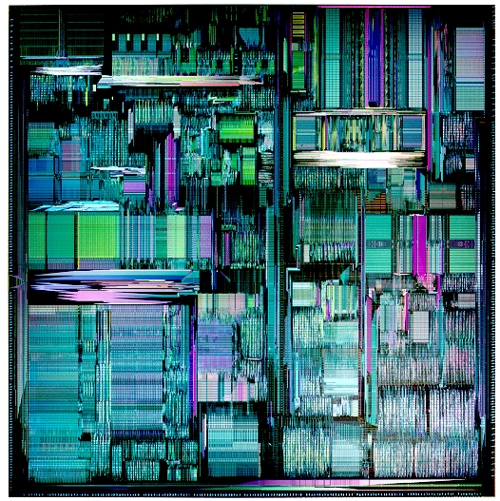
CPEN 411: Computer Architecture Slide Set #13: Tomasulo’s Algorithm (Textbook: 2.1, 2.4, 2.5)
Instructor: Dr. Tor M. Aamodt
aamodt@ece.ubc.ca
Background: Pentium Pro die photo (first x86 with out of order execution)

Slide 2
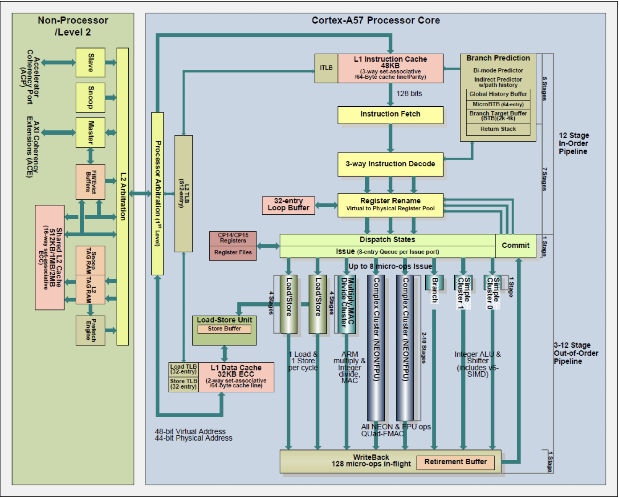

Slide 3
Introduction to Slide Set 13
Once we enable out-of-order execution we have to consider both WAW and WAR hazards. The (out-of-order) scoreboard algorithm handles these hazards by stalling.
Notice that no value is communicated between instructions involved in these WAW or WAR hazards.
In this lecture we will see that it is possible to eliminate the “name dependencies” that require stalling by having the hardware “rename” the locations causing the “name dependencies”.
The specific hardware algorithm we will examine for doing this is called “Tomasulo’s Algorithm”. It is widely used in today’s computers.

Slide 4
Learning Objectives
After we finish going through these slides you will be able to…
Describe Tomasulo’s algorithm in detail.
Explain the key difference between the Scoreboard algorithm and Tomasulo’s algorithm.
Evaluate instruction timing of MIPS assembly code sequences using Tomasulo’s algorithm.

Slide 5
Removing Name Dependencies
Name dependencies result from reusing a register:
LD R1, 0(R2)
DADD R3,R1,R3
DADDUI R2,R2,#8 ; reuse R2
LD R1, 0(R2) ; reuse R1
Adding registers to the hardware we have seen previously will reduce name dependencies but only if software is recompiled to use the additional registers.
It is desirable to be able to add registers to hardware and have hardware use them without requiring recompilation.
If we remove the name dependencies, we don’t encounter WAW or WAR hazards at all (but still have RAW hazards).

Slide 6
Removing Name Dependencies
Basic idea: Introduce new name for each value created
Before:
LD R1, 0(R2)
DADD R3, R1, R3
DADDUI R2, R2,#8
LD R1, 0(R2)
After:
LD T1, 0(R2) ; R1 -> T1
DADD T2, T1, R3 ; R3 -> T2
DADDUI T3, R2, #8 ; R2 -> T3
LD T4, 0(T3) ; R1 -> T4

Slide 7
Observation and Insight
WAW and WAR can only occur for instructions in the pipeline at the same time.
So, we don’t really need infinite # of registers!
One “rename register” per “in flight” instruction
How to implement renaming in hardware?
Distinguish architecture reg. from rename reg.
Associate new name (“rename register”, “physical register”, “reservation station ID”, “tag”) with each inflight instruction updating an arch. reg.
Use table (“rename table”, “register result status”) to map from architecture register → tag (most recent instruction writing this arch. register)
“Recycle” tag after instruction is complete.

Slide 8
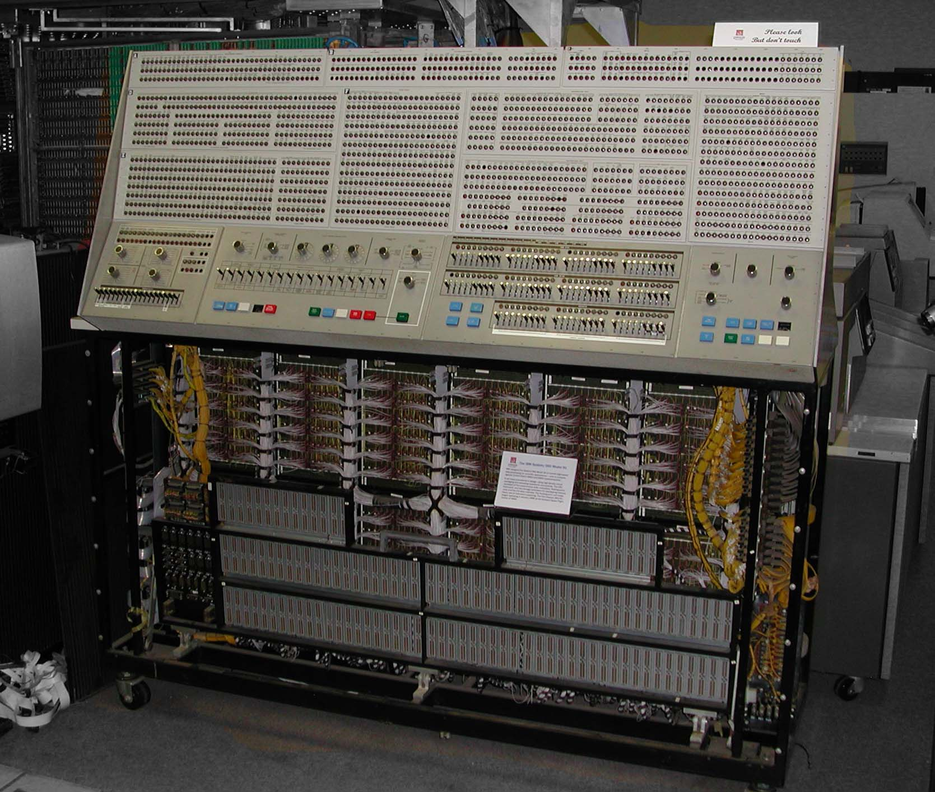

Tomasulo Algorithm: Historical Context
Developed in mid 1960’s for floating-point unit of IBM 360 model 91
IBM 360 model 91 designed for scientific computing (e.g., NASA)
Notion of instruction set compatibility invented for IBM System/360.
4 FP registers
Anticipated FP unit latencies of 6 cycles for multiply, 18 for divide, 2 for addition; 8 cycles to access memory; no cache.

Slide 9
Historical Motivation
Design goal for System/360 model 91:
Sustain CPI as close as possible to 1 on floating-point code
Constraints:
Binary compatibility had to be maintained. Four registers visible to programmer. Code with many WAW hazards since required fewer instructions in 360/91 ISA.
Long floating-point function unit latencies
Separate pipelined floating point adder and multiplier (higher clock frequency)
Today’s Motivation: Above + cache misses + parallelism between branches < 2.
Design tradeoffs Tomasulo considered
Adding busy bits to register file (in-order scoreboard)
Adding “working registers” near function units to improve clock frequency
Additional function units to eliminate structural hazards
Impact of software techniques such as “loop unrolling”
However, Tomasulo ended up with a different design…

Slide 10
Tomasulo Algorithm
Control & buffers distributed with Function Units (FU)
Buffers called reservation stations; contain pending operands
Register numbers in instructions get replaced by “tags” each of which “points to” a reservation station (RS)
Effect of this is to “rename” registers
This “renaming” avoids WAR, WAW hazards which result from reusing the same register name even though no data is passed between the instructions involved.
Renaming allowed more reservation stations than registers
Results sent over a “Common Data Bus” which broadcasts results to all Function Units (Fus), and identifies producer “tag” not the consumer
Load and Stores treated as function units with RSs as well
Tomasulo was working on floating-point hardware unit (similar to example in next few slides). Idea extends to integer instructions as well.

Slide 11
Tomasulo Algorithm
From Mem
FP Op
Queue
FP Registers
Load1
Load2
Load3
Load4
Load5
Load6
Load Buffers
Store
Buffers
Add1
Add2
Add3
Mult1
Mult2
Reservation
Stations
To Mem
FP adders
FP multipliers
Common Data Bus (CDB)‏
Notes:
11
Resolve RAW memory conflict? (address in memory buffers)‏
Integer unit executes in parallel

Slide 12
Three Stages of Tomasulo Algorithm
1. Issue—Get instruction from FP Op Queue
(called “dispatch” in superscalar processors)
If reservation station free (no structural hazard),
(a) lookup source operand registers in “register result status” table while
allocating reservation station.
(b) update “register result status” table entry of destination register with
reservation station (this renames destination register)
2. Execute—Operate on operands
(called “issue” in superscalar processors)
When both operands ready then execute; if not ready, watch Common Data Bus for result
3. Write result—Finish execution
Write on Common Data Bus to all units waiting for result; mark reservation station available
Normal data bus = data + destination address (“go to” bus)
Common data bus = data + source tag (“come from” bus)
64 bits of data + 4 bits of Reservation Station source address (tag)

Slide 13
Tomasulo Algorithm Components
Reservation Station:
Busy: Indicates whether reservation station is busy
Op: Operation to perform in FU (e.g., “add” or “subtract”)‏
Vj, Vk: Value of Source operands
Qj, Qk: Tags: Identify reservation station producing Vj, Vk
When Qj=0 (no tag), Vj holds valid data
When Qk=0 (no tag), Vk holds valid data
Address: Used to hold effective address for memory (initially set to
immediate offset)‏
Register File (each register has):
Qi—Indicates which reservation station will write register, if such a
reservation station exists. Blank if no pending instructions write register.
Notes:
13
What you might have thought
1. 4 stages of instruction executino
2.Status of FU: Normal things to keep track of (RAW & structura for busyl):
Fi from instruction format of the mahine (Fi is dest)‏
Add unit can Add or Sub
Rj, Rk - status of registers (Yes means ready)‏
Qj,Qk - If a no in Rj, Rk, means waiting for a FU to write result; Qj, Qk means wihch FU waiting for it
3.Status of register result (WAW &WAR)s:
which FU is going to write into registers
Scoreboard on 6600 = size of FU
6.7, 6.8, 6.9, 6.12, 6.13, 6.16, 6.17
FU latencies: Add 2, Mult 10, Div 40 clocks

Slide 14
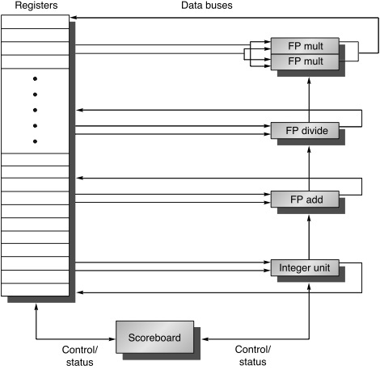
Tomasulo vs. Scoreboard
From Mem
FP Op
Queue
FP Registers
Load1
Load2
Load3
Load4
Load5
Load6
Load Buffers
Store
Buffers
Add1
Add2
Add3
Mult1
Mult2
Reservation
Stations
To Mem
FP adders
FP multipliers
Common Data Bus (CDB)‏
Tomasulo:
Decentralized Control
Reservation Stations/Renaming
Scoreboard:
Centralized Control
WAR, WAW hazards
Notes:
14
Resolve RAW memory conflict? (address in memory buffers)‏
Integer unit executes in parallel

Slide 15
Original code:
LD R1, 0(R2)
DADD R3,R1,R3
DADDUI R2,R2,#8
LD R1, 0(R2)
Rewrite using T1, T2, etc… for each new value:
LD T1, 0(R2) ; R1 renamed to T1
DADD T2,T1,R3 ; R3 renamed to T2
DADDUI T3,R2,#8 ; R2 renamed to T3
LD T4, 0(T3) ; R1 renamed to T4

Slide 16
Tomasulo Algorithm, Renaming Implemented
“Register result status” aka “register alias table” (RAT)
Program:
ADD.D F1,F2,F1
MUL.D F2,F1,F4
FP Op
Queue
FP Registers
F1
F2
F3
F4
- R[F1]
- R[F2]
- R[F3]
- R[F4]
MUL.D F2,F1,F4
ADD.D F1,F2,F1
Add1
Add2
Add3
Mul1
Mul2
Reservation
Stations
FP adders
FP multipliers
Common Data Bus (CDB)‏
Cycle 1
Notes:
16

Slide 17
Tomasulo Algorithm, Renaming Implemented
Program:
ADD.D F1,F2,F1
MUL.D F2,F1,F4
FP Op
Queue
FP Registers
F1
F2
F3
F4
- R[F1]
- R[F2]
- R[F3]
- R[F4]
MUL.D F2,F1,F4
Add1
Add2
Add3
ADD.D - R[F2], - R[F1]
Mul1
Mul2
Reservation
Stations
FP adders
FP multipliers
Common Data Bus (CDB)‏
Cycle 2a: ADD.D reads R[F2] & R[F1] values from FP Registers
Notes:
17

Slide 18
Tomasulo Algorithm, Renaming Implemented
Program:
ADD.D F1,F2,F1
MUL.D F2,F1,F4
FP Op
Queue
FP Registers
F1
F2
F3
F4
ADD1
-
- R[F2]
- R[F3]
- R[F4]
MUL.D F2,F1,F4
Add1
Add2
Add3
ADD.D - R[F2], - R[F1]
Mul1
Mul2
Reservation
Stations
FP adders
FP multipliers
Common Data Bus (CDB)‏
Cycle 2b: F1 “renamed” to “ADD1” (in “register result status”)
Notes:
18

Slide 19
Tomasulo Algorithm, Renaming Implemented
Program:
ADD.D F1,F2,F3
MUL.D F2,F1,F4
FP Op
Queue
FP Registers
F1
F2
F3
F4
Add1
-
- R[F2]
- R[F3]
- R[F4]
Add1
Add2
Add3
ADD.D - R[F2], - R[F3]
Mul1
Mul2
MUL.D Add1 - - R[F4]
Reservation
Stations
FP adders
FP multipliers
Common Data Bus (CDB)‏
Cycle 3a: MUL.D gets tag “Add1” instead of value “R[F1]”
Notes:
19

Slide 20
Tomasulo Algorithm, Renaming Implemented
Program:
ADD.D F1,F2,F3
MUL.D F2,F1,F4
FP Op
Queue
FP Registers
F1
F2
F3
F4
Add1
-
-
- R[F3]
- R[F4]
Mul1
Add1
Add2
Add3
ADD.D - R[F2], - R[F3]
Mul1
Mul2
MUL.D Add1 - - R[F4]
Reservation
Stations
FP adders
FP multipliers
Common Data Bus (CDB)‏
Cycle 3b: F2 renamed to “Mul1”
Notes:
20

Slide 21
Tomasulo Algorithm, Renaming Implemented
Program:
ADD.D F1,F2,F3
MUL.D F2,F1,F4
FP Op
Queue
FP Registers
F1
F2
F3
F4
X
-
- R[F3]
- R[F4]
Mul1
Add1
Add2
Add3
ADD.D - R[F2], - R[F3]
Mul1
Mul2
MUL.D - X - R[F4]
Reservation
Stations
FP adders
FP multipliers
ADD1, X
Common Data Bus (CDB)‏
Cycle 4: result value “X” and name “ADD1” broadcast on CDB
Notes:
21

Slide 22
Assumptions for example
Execution Latency:
2 clocks for floating point add, subtract;
10 clocks for floating point multiply
40 clocks for floating point divide
Load/Store: 2 cycles
1st cycle effective address
2nd cycle access memory
Pipelined function units (start one operation per cycle)
3 floating-point add/subtract reservation stations
2 floating-point multiple reservation stations
Read value into reservation station same cycle as writeback of value to register file (even if the reservation station was “allocated” the same cycle); however, if that means all operands ready, still have to wait until following cycle to “begin execution”

Slide 23
Tomasulo Example Cycle 1
Instruction stream
3 Load/Buffers
3 FP Adder R.S.
2 FP Mult R.S.
FU count
down
Clock cycle counter

Slide 24
Tomasulo Example Cycle 2
Note: Hardware allows multiple loads to be overlapped

Slide 25
Tomasulo Example Cycle 3
Shorthand for
contents of
register F4
Note: registers names are removed (“renamed”) in Reservation Stations
MUL.D issued; Load1 completing - what is waiting for it?

Slide 26
Tomasulo Example Cycle 4
Shorthand for
contents of
memory at
address A1,
where A1 is
effective addr.
of first load
(34+R2)
Issue SUB.D; Load2 completing; what is waiting for Load2?

Slide 27
Tomasulo Example Cycle 5
Load2 writes to CDB; Timer starts down for Add1, Mult1 (they “begin execution” following cycle -- clock cycle 6)

Slide 28
Tomasulo Example Cycle 6
Yes ADD.D M(A2) Add1
Add2
Issue ADD.D here despite name dependency on F6?

Slide 29
Tomasulo Example Cycle 7
Add1 (SUB.D) completing; what is waiting for it?

Slide 30
Tomasulo Example Cycle 8

Slide 31
Tomasulo Example Cycle 9

Slide 32
Tomasulo Example Cycle 10
Add2 (ADD.D) completing; what is waiting for it?

Slide 33
Tomasulo Example Cycle 11
Write result of ADD.D here?

Slide 34
Tomasulo Example Cycle 12

Slide 35
Tomasulo Example Cycle 13

Slide 36
Tomasulo Example Cycle 14

Slide 37
Tomasulo Example Cycle 15
Mult1 (MUL.D) completing; what is waiting for it?

Slide 38
Tomasulo Example Cycle 16
Just waiting for Mult2 (DIVD) to complete

Slide 39
Faster than light computation (skip a couple of cycles)

Slide 40
Tomasulo Example Cycle 55

Slide 41
Tomasulo Example Cycle 56
Mult2 (DIVD) is completing; what is waiting for it?

Slide 42
Tomasulo Example Cycle 57
Once again: In-order issue, out-of-order execution and out-of-order completion.

Slide 43
Tomasulo Drawbacks
Complexity
delays of 360/91, MIPS 10000, Alpha 21264, IBM PPC 620 (in CA:AQA 2/e, but not in silicon!)
Many associative comparisons (CDB) at high speed
Performance limited by Common Data Bus
Each CDB must go to multiple functional units ⇒high capacitance, high wiring density
Number of functional units that can complete per cycle limited to one!
Multiple CDBs ⇒ more FU logic for parallel assoc. stores
Non-precise interrupts!
We will see how to solve this problem later

