Slide 1
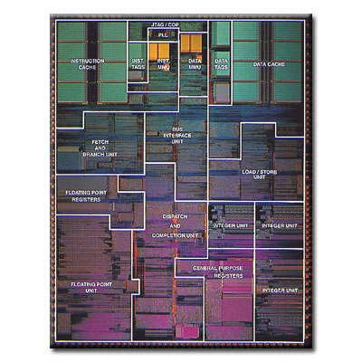
CPEN 411: Computer Architecture Slide Set #14: Reorder Buffer, Exceptions, Multiple Instruction Issue
Tor Aamodt
aamodt@ece.ubc.ca
Background: PowerPC 604, one of the first microprocessors with a reorder buffer

Slide 2
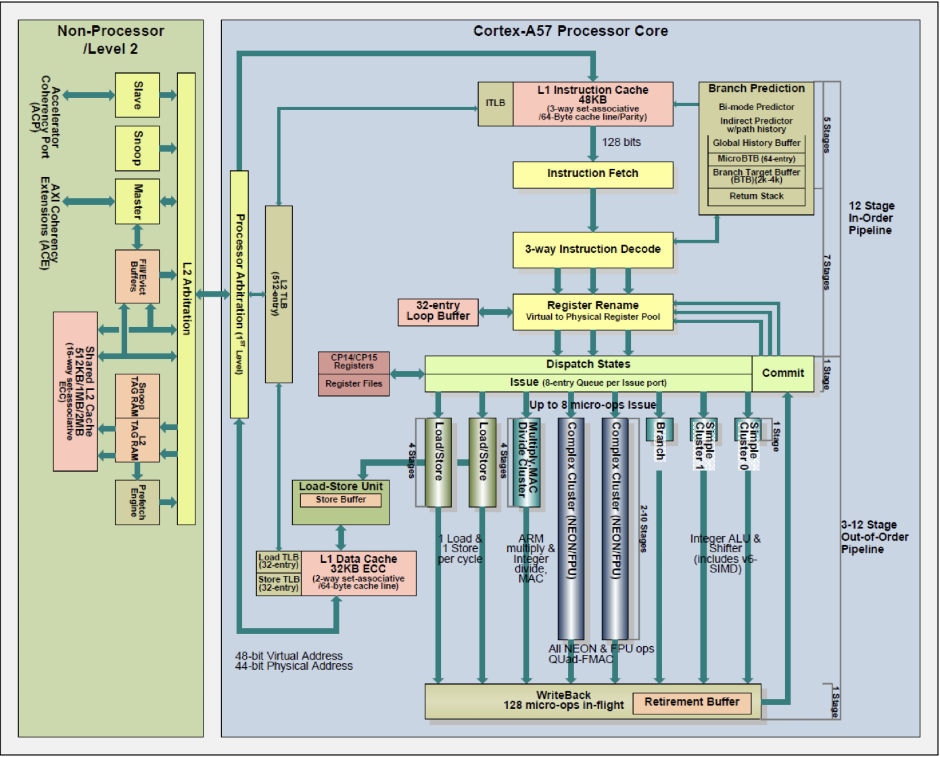

Slide 3
Introduction to Slide Set 14
Out-of-order execution with Tomasulo’s algorithm allows an instruction to execute when its source operands are available. Branch prediction enables us to fetch and decode instructions after a branch before that branch is “resolved”.
To increase performance (reduce CPI) we would like to start executing the instructions fetched and decoded following the predicted branch *before* that branch is resolved. However, we have a problem: out-of-order execution (e.g., using Tomasulo’s algorithm) allows an instruction to update the register file before the branch is “resolved”.
An elegant solution is a hardware structure known as the “re-order buffer”. One reason for calling it an “elegant solution” is it also enables “virtual memory” by supporting an execution model known as “precise exceptions”.

Slide 4
Learning Objectives
After we finish this set of slides you should be able to:
Explain the motivation for using a reorder buffer and how a reorder buffer operates.
Define multiple instruction issue and explain the motivation for using it.
List two approaches to achieving multiple instruction issue
Evaluate the timing of a processor using multiple issue and Tomasulo’s algorithm.
Evaluate the timing of a processor using multiple issue, Tomasulo’s algorithm and a reorder buffer.
Define what an exception is and list several categories of exceptions.
Explain what is meant by a precise exception.
Explain how the reorder buffer supports precise exceptions.

Slide 5
Speculative Execution
DIVD R3,R1,R2 ; F:1, D:2, I:3, X:4, W:104
BEQZ R3,Label ; F:2, D:3, I:4, X:105 (“not taken”)
DSUB R4,R4,R3 branch predicted “taken” on cycle 2
Label: DMUL R4,R4,R2 ; F:3, D:4, I:5, X:6, W:?
DADD R4,R4,R1
Goal: Support execution of instructions fetched following a branch prediction before we know if the prediction is correct. Above: Want to execute and broadcast result of DMUL “speculatively” long before branch resolved on cycle 105.
Problem: Such instructions should not update register file because branch might have been predicted incorrectly. Above: cannot let DMUL write to register file until control hazard resolved.

Slide 6
The Reorder Buffer (ROB)
An elegant solution to this problem is a hardware structure known as a “Reorder Buffer” (ROB).
The reorder buffer is used to divide the “writeback” step into two separate steps: “instruction completion” and “instruction commit”.
An instruction enters “instruction completion” when it finishes execution.
Instruction broadcasts result on the CDB so dependent instructions can begin execution.
However, register file not updated yet.
Instead, the result is “buffered” in the reorder buffer to be written into the register file later.
An instruction enters “instruction commit” when it is the oldest instruction that has completed (and is free from “exceptions”).
Writes results to register file

Slide 7
The Reorder Buffer (ROB)
Pipeline stages: fetch, decode, issue, execute, complete, commit
Reorder
Buffer
Inst.
Queue
Commit
Regs
Issue
Res Stations
Res Stations
execute
Adder
Multiplier
Complete

Slide 8
The Reorder Buffer (ROB)
The Reorder Buffer (ROB) maintains a “window” of dynamic instructions currently in the pipeline.
The instructions are stored in “first-in first-out” order. That is, the order originally specified by the programmer). Entry allocated in ROB during issue at same time as a reservation station is allocated.
Each ROB entry contains the instruction’s PC, destination register number, destination register value, and an execution status flag.
To make it easier to update the ROB after an instruction executes and to enable easy lookup of results buffered in the ROB but not yet written to the register file we use the ROB entry of the instruction as the tag for renaming instead of reservation station ID.

Slide 9
Tomasulo With Reorder Buffer
Dest
Value
Program Counter
Done?
Intr.
Queue
ROB7
ROB6
ROB5
ROB4
ROB3
ROB2
ROB1
Newest
Reorder Buffer
Cycle 3a
DIV issues: allocate ROB
and reservation station
entries, copy R1 and R2
values into reservation
station, and …
Oldest
R3
PC=0x00(DIV R3,R1,R2)
N
R4
R3
R2
R1
6
0
7
14
RAT+Registers
Dest
Dest
1 DIVD 14, 7
Reservation
Stations
adder
multipliers
branch
multipliers
Notes:
Resolve RAW memory conflict? (address in memory buffers)
Integer unit executes in parallel

Slide 10
Tomasulo With Reorder Buffer
Dest
Value
Program Counter
Done?
Intr.
Queue
ROB7
ROB6
ROB5
ROB4
ROB3
ROB2
ROB1
Newest
Reorder Buffer
Cycle 3b
... and updates
register alias table (RAT)
since will update R3
if/when DIV commits
Oldest
R3
PC=0x00(DIV R3,R1,R2)
N
R4
R3
R2
R1
6
0
7
14
ROB1
RAT+Registers
Dest
Dest
1 DIVD 14, 7
Reservation
Stations
adder
multipliers
branch
multipliers
Notes:
Resolve RAW memory conflict? (address in memory buffers)
Integer unit executes in parallel

Slide 11
Tomasulo With Reorder Buffer
Done?
Intr.
Queue
ROB7
ROB6
ROB5
ROB4
ROB3
ROB2
ROB1
Newest
Reorder Buffer
Cycle 4
BEQZ issued, allocates
ROB and Reservation
Station entries
-
-
PC=0x04(BEQZ R3,Label)
N
Oldest
R3
PC=0x00(DIV R3,R1,R2)
N
R4
R3
R2
R1
6
0
7
14
ROB1
RAT+Registers
Dest
Dest
1 DIVD 14, 7
BEQZ ROB1,Loop
Reservation
Stations
adder
multipliers
branch
multipliers
Notes:
Resolve RAW memory conflict? (address in memory buffers)
Integer unit executes in parallel

Slide 12
Tomasulo With Reorder Buffer
Done?
Intr.
Queue
ROB7
ROB6
ROB5
ROB4
ROB3
ROB2
ROB1
Newest
Reorder Buffer
Cycle 5a
DMUL issues: allocate ROB
and reservation station
entries, check RAT, copy
register values into
reservation station, and …
R4
PC=0x0C(DMUL R4,R4,R2)
N
-
-
PC=0x04(BEQZ R3,Label)
N
Oldest
R3
PC=0x00(DIV R3,R1,R2)
N
R4
R3
R2
R1
6
0
7
14
ROB1
RAT+Registers
Dest
Dest
1 DIVD 14, 7
BEQZ ROB1,Loop
3 DMUL 6, 7
Reservation
Stations
adder
multipliers
branch
multipliers
Notes:
Resolve RAW memory conflict? (address in memory buffers)
Integer unit executes in parallel

Slide 13
Tomasulo With Reorder Buffer
Done?
Intr.
Queue
ROB7
ROB6
ROB5
ROB4
ROB3
ROB2
ROB1
Newest
Reorder Buffer
Cycle 5b:
… and updates register
alias table (RAT) since
DMUL should write R4 (if
it commits)
R4
PC=0x0C(DMUL R4,R4,R2)
N
-
-
PC=0x04(BEQZ R3,Label)
N
Oldest
R3
PC=0x00(DIV R3,R1,R2)
N
R4
R3
R2
R1
ROB3
6
0
7
14
ROB1
RAT+Registers
Dest
Dest
1 DIVD 14, 7
BEQZ ROB1,Loop
3 DMUL 6, 7
Reservation
Stations
adder
multipliers
branch
multipliers
Notes:
Resolve RAW memory conflict? (address in memory buffers)
Integer unit executes in parallel

Slide 14
Tomasulo With Reorder Buffer
Done?
Intr.
Queue
ROB7
ROB6
ROB5
ROB4
ROB3
ROB2
ROB1
Newest
Reorder Buffer
R4
PC=0x10(DADD R4,R4,R1)
N
R4
PC=0x0C(DMUL R4,R4,R2)
N
Cycle 6b:
DADD issues, allocates
ROB and Reservation
Station entries, copy R1
value (14) into reservation
station, …
-
-
PC=0x04(BEQZ R3,Loop)
N
Oldest
R3
PC=0x00(DIV R3,R1,R2)
N
R4
R3
R2
R1
ROB3
6
0
7
14
ROB1
Dest
Dest
4 DADD ROB3 , 14
1 DIVD 14, 7
BEQZ ROB1,Loop
3 DMUL 6, 7
Reservation
Stations
adder
multipliers
branch
multipliers
Notes:
Resolve RAW memory conflict? (address in memory buffers)
Integer unit executes in parallel

Slide 15
Tomasulo With Reorder Buffer
Done?
Intr.
Queue
ROB7
ROB6
ROB5
ROB4
ROB3
ROB2
ROB1
Newest
Reorder Buffer
R4
PC=0x10(DADD R4,R4,R1)
N
R4
PC=0x0C(DMUL R4,R4,R2)
N
Cycle 6b:
… and updates
RAT entry for R4 since
DADD will write to R4
-
-
PC=0x04(BEQZ R3,Loop)
N
Oldest
R3
PC=0x00(DIV R3,R1,R2)
N
R4
R3
R2
R1
ROB4
6
0
7
14
ROB1
Dest
Dest
4 DADD ROB3 , 14
1 DIVD 14, 7
BEQZ ROB1,Loop
3 DMUL 6, 7
Reservation
Stations
adder
multipliers
branch
multipliers
Notes:
Resolve RAW memory conflict? (address in memory buffers)
Integer unit executes in parallel

Slide 16
Tomasulo With Reorder Buffer
Done?
Intr.
Queue
ROB7
ROB6
ROB5
ROB4
ROB3
ROB2
ROB1
Newest
Reorder Buffer
R4
PC=0x10(DADD R4,R4,R1)
N
R4 42
PC=0x0C(DMUL R4,R4,R2)
Y
Cycle 16:
DMUL writes to CDB,
DADD and ROB get
value, but register file
not updated
-
-
PC=0x04(BEQZ R3,Loop)
N
Oldest
R3
PC=0x00(DIV R3,R1,R2)
N
R4
R3
R2
R1
ROB4
6
0
7
14
ROB1
Dest
Dest
4 DADD 42, 14
1 DIVD 14, 7
BEQZ ROB1,Loop
3 DMUL 6, 7
Reservation
Stations
adder
multipliers
branch
multipliers
ROB3, 42
Notes:
Resolve RAW memory conflict? (address in memory buffers)
Integer unit executes in parallel

Slide 17
Tomasulo With Reorder Buffer
Done?
Intr.
Queue
ROB7
ROB6
ROB5
ROB4
ROB3
ROB2
ROB1
Newest
Reorder Buffer
R4 56
PC=0x10(DADD R4,R4,R1)
Y
R4 42
PC=0x0C(DMUL R4,R4,R2)
Y
Cycle 17:
DADD writes to CDB,
ROB gets value, but
register file not updated
-
N
Oldest
-
PC=0x04(BEQZ R3,Loop)
N
R3
PC=0x00(DIV R3,R1,R2)
N
R4
R3
R2
R1
ROB4
6
0
7
14
ROB1
Dest
Dest
4 DADD 42, 14
1 DIVD 14, 7
BEQZ ROB1,Loop
Reservation
Stations
adder
multipliers
branch
multipliers
ROB4, 56
Notes:
Resolve RAW memory conflict? (address in memory buffers)
Integer unit executes in parallel

Slide 18
Tomasulo With Reorder Buffer
Done?
Intr.
Queue
ROB7
ROB6
ROB5
ROB4
ROB3
ROB2
ROB1
Newest
Reorder Buffer
R4 56
PC=0x10(DADD R4,R4,R1)
Y
R4 42
PC=0x0C(DMUL R4,R4,R2)
Y
-
N
Oldest
Cycle 105:
DIVD writes to CDB, ROB, BEQZ updated
-
PC=0x04(BEQZ R3,Loop)
N
R3
2
PC=0x00(DIV R3,R1,R2)
N
R4
R3
R2
R1
ROB4
6
0
7
14
ROB1
Dest
Dest
1 DIVD 14, 7
BEQZ 2,Loop
Reservation
Stations
adder
multipliers
branch
multipliers
ROB1, 2
Notes:
Resolve RAW memory conflict? (address in memory buffers)
Integer unit executes in parallel

Slide 19
Tomasulo With Reorder Buffer
Done?
Intr.
Queue
ROB7
ROB6
ROB5
ROB4
ROB3
ROB2
ROB1
Newest
Reorder Buffer
R4 56
PC=0x10(DADD R4,R4,R1)
Y
R4 42
PC=0x0C(DMUL R4,R4,R2)
Y
Cycle 106a:
Register R3 updated
(ROB1 released).
-
-
PC=0x04(BEQZ R3,Loop)
N
Oldest
R3 2
PC=0x00(DIV R3,R1,R2)
Y
R4
R3
R2
R1
ROB4
6
2
7
14
ROB1
Dest
Dest
BEQZ 2,Loop
Reservation
Stations
adder
multipliers
branch
multipliers
Notes:
Resolve RAW memory conflict? (address in memory buffers)
Integer unit executes in parallel

Slide 20
Tomasulo With Reorder Buffer
Done?
Intr.
Queue
ROB7
ROB6
ROB5
ROB4
ROB3
ROB2
ROB1
Newest
Reorder Buffer
R4 56
PC=0x10(DADD R4,R4,R1)
Y
R4 42
PC=0x0C(DMUL R4,R4,R2)
Y
Cycle 106b:
BEQZ executes, detects misprediction,
starts flush of ROB
-
-
PC=0x04(BEQZ R3,Loop)
N
Oldest
R4
R3
R2
R1
ROB4
6
2
7
14
flush
Dest
Dest
BEQZ 2,Loop
Reservation
Stations
adder
multipliers
branch
multipliers
Notes:
Resolve RAW memory conflict? (address in memory buffers)
Integer unit executes in parallel

Slide 21
Tomasulo With Reorder Buffer
Done?
Intr.
Queue
ROB7
ROB6
ROB5
ROB4
ROB3
ROB2
ROB1
Newest
Reorder Buffer
R4 56
PC=0x10(DADD R4,R4,R1)
Y
Cycle 107:
ROB flushed (may take more than one cycle), RAT reset, “front end” of pipeline fetches correct next instruction
R4 42
PC=0x0C(DMUL R4,R4,R2)
Y
-
-
PC=0x04(BEQZ R3,Loop)
N
Oldest
R4
R3
R2
R1
ROB4
6
2
7
14
flush
Dest
Dest
BEQZ 2,Loop
Reservation
Stations
adder
multipliers
branch
multipliers
Notes:
Resolve RAW memory conflict? (address in memory buffers)
Integer unit executes in parallel

Slide 22
Tomasulo With Reorder Buffer
Done?
Intr.
Queue
ROB7
ROB6
ROB5
ROB4
ROB3
ROB2
ROB1
Newest
Reorder Buffer
Cycle 109a:
DSUB issues: allocate ROB and reservation station entries, copy R4 and R2 values into reservation station, and …
R4
PC=0x08(DSUB R4,R4,R3)
N
-
-
PC=0x04(BEQZ R3,Loop)
N
Oldest
R4
R3
R2
R1
6
2
7
14
Dest
Dest
4 DSUB 6, 2
BEQZ 2,Loop
Reservation
Stations
adder
multipliers
branch
multipliers
Notes:
Resolve RAW memory conflict? (address in memory buffers)
Integer unit executes in parallel

Slide 23
Tomasulo With Reorder Buffer
Done?
Intr.
Queue
ROB7
ROB6
ROB5
ROB4
ROB3
ROB2
ROB1
Newest
Reorder Buffer
Cycle 109b:
… updates RAT
R4
PC=0x08(DSUB R4,R4,R3)
N
-
-
PC=0x04(BEQZ R3,Loop)
N
Oldest
R4
R3
R2
R1
ROB3
6
2
7
14
Dest
Dest
4 DSUB 6, 2
BEQZ 2,Loop
Reservation
Stations
adder
multipliers
branch
multipliers
Notes:
Resolve RAW memory conflict? (address in memory buffers)
Integer unit executes in parallel

Slide 24
Exceptions
So far, we have considered how to design hardware to support higher performance execution of a program, but we assumed we can always execute an instruction.
What happens if an instruction cannot complete or the program needs to ask the operating system to do something?
If there is a bug, the program might tell the hardware to do something that is impossible. For example, divide by zero, or read/write the wrong location in memory. Another reason an instruction might not be able to complete is related to virtual memory.
We call these “special cases” exceptions.
The hardware detects exceptions and has a special program run that either handles the exception, or passes control to the operating system. The OS may handle the exception or end the program.

Slide 25
Exceptions
Exceptions are also sometimes referred to “interrupts”, or “faults”. We’ll just call them all “exceptions”.
Generally they require transfer of control to the operating system (OS) or other software “handler” routine.
Causes:
I/O device request
Invoking an OS service from a user program
Page fault
Memory protection violation
FP arithmetic anomaly
Integer arithmetic overflow
etc...

Slide 26
Categories of Exceptions
Synchronous versus Asynchronous
Async: external device or hardware failure.
User requested versus coerced
user requested => handle after instruction
User maskable versus user nonmaskable
e.g., overflow can be masked (ignored) by user.
Within versus between instructions
within => hard
Resume versus terminate
terminate => easier
Most challenging, but very important =>
required for supporting “virtual memory”
(which we will talk about later).

Slide 27
Exceptions in an In-order Pipeline
Upon detection of exception:
Force first instruction of an exception handler upon next IF
Turn off control signals for all instructions after and including “faulting instruction” (i.e., convert them to “nops” / “squash” them)
After exception handling routine gets control, save PC of faulting instruction (or N+1 PCs if delayed branch with N delay slots)

Slide 28
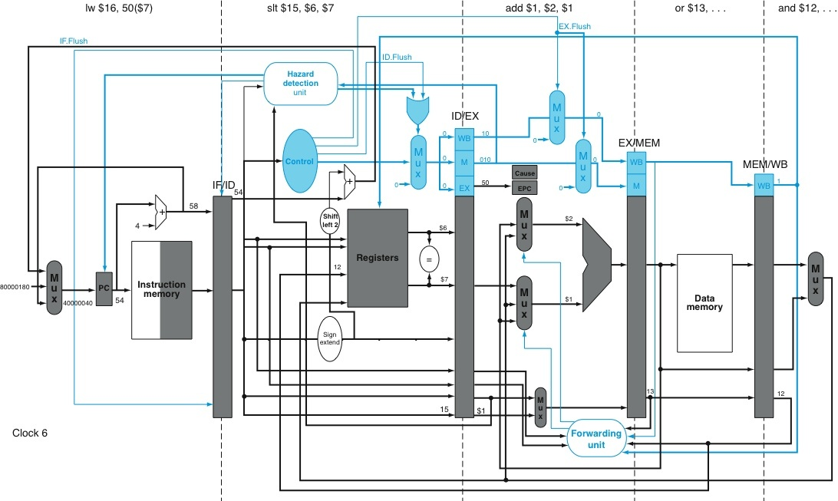
Exception Handling Support

Slide 29
Exception Handling Support
add instruction causes overflow!
add instruction causes overflow!
save PC of instruction causing fault, plus cause of fault
save PC of instruction causing fault, plus cause of fault
exception handler address
exception handler address
“nop”/“squash” injection signals
“nop”/“squash” injection signals

Slide 30
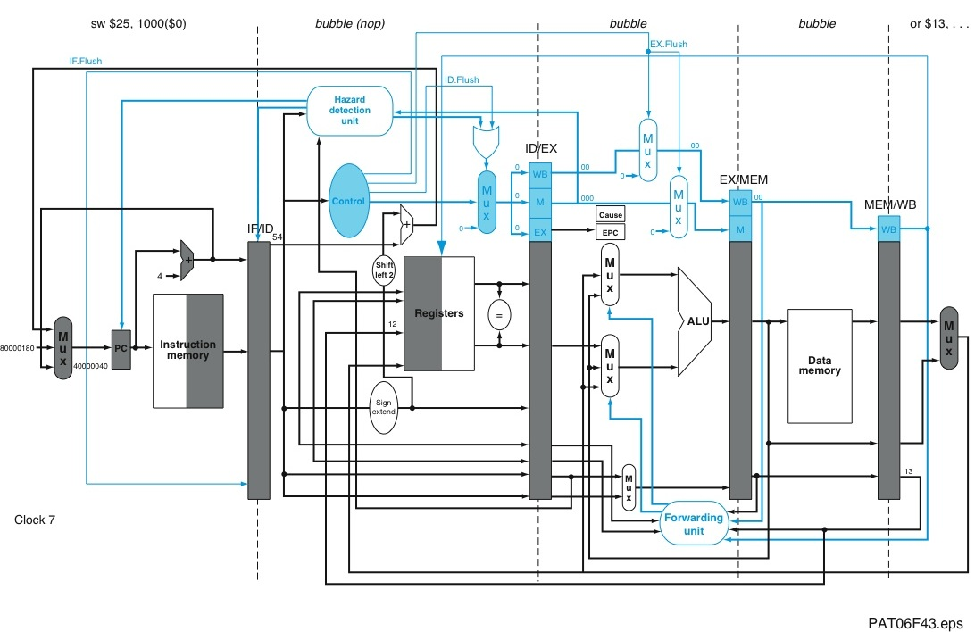
Exception Handling Support
First instruction of handler

Slide 31
After exception handled...
RFE instruction restarts pipeline (MIPS)

Slide 32
Precise Exceptions
If hardware guarantees that ALL instructions before faulting instruction have updated programmer visible state (i.e., R1...R31, memory) and NONE after (and including) faulting instruction have updated programmer visible state, then pipeline is said to support precise exceptions.
IF
Has not updated “programmer visible state”
div
Has updated “programmer visible state”
WB

Slide 33
Precise Exceptions?
Both Scoreboard and Tomasulo have:
In-order issue, out-of-order execution, out-of-order completion
Out-of-order completion means that interrupts are not precise
Need way to “resynchronize” execution with instruction stream
Easiest way is with reorder buffer
18

Slide 34
Memory Dependencies
Done?
FP Op
Queue
--
M[10]
S.D F2,0(R3)
Y
ROB7
ROB6
ROB5
ROB4
ROB3
ROB2
ROB1
Newest
F0
<val4>
ADD.D F0,F2,F3
Y
F3
M[10]
L.D F3,0(R3)
Y
Reorder Buffer
--
BNE F1,<…>
N
F1
<val3>
DIV.D F1,F2,F0
Y
What about memory
hazards???
Oldest
F3
F2
F1
F0
Registers
<val2>
Write
Memory
<val1>
Dest
Dest
Read
Memory
)
Dest
Reservation
Stations
FP adders
FP multipliers
Notes:
Resolve RAW memory conflict? (address in memory buffers)
Integer unit executes in parallel

Slide 35
Memory Disambiguation
Example: SD R5,0(R2) LD R6,0(R3)
If LD wants to read from a different location than the SD wants to write to, it is safe for the LD to read memory *before* the SD writes memory?
Is this useful? Yes! Turns out to be very useful in out-of-order processors (e.g., Core i7 tries to do this).
When can LD read memory? Naïve answer is that we are not allowed to start load until we know that address 0(R2) ≠ 0(R3). More details next slide.
More sophisticated answer (Andreas Moshovos, University of Toronto): “Predict” whether or not they are dependent (called “dependence prediction”) and use reorder buffer to fixup if we are wrong. We won’t talk more about this (I do talk about it in EECE 527).

Slide 36
Hardware Support for Memory Disambiguation
Add “store queue” to keep track of all outstanding stores to memory, in program order.
Keep track of address (when becomes available) and value (when becomes available)
FIFO ordering: retire stores from this buffer in program order
When issuing a load, record current head of store queue (know which stores are ahead of you).
When have address for load, check store queue:
If any store prior to load is waiting for its address, stall load.
If load address matches earlier store address (associative lookup), then we have a memory-induced RAW hazard:
store value available ⇒ return value
store value not available ⇒ return ROB number of source
Otherwise, send out request to memory
Stores modify memory during commit, which is “in order”, and this prevents WAR/WAW hazards through memory.

Slide 37
Limits to Performance
Pipeline CPI = Ideal CPI
+ Structural stalls
+ Data hazard stalls
+ Control hazard stalls
Have looked at how to remove/reduce stalls: pipelining, forwarding, out-of-order execution, branch prediction, speculative execution.
Can we reduce “Ideal CPI”?
Ideal CPI limited by rate at which instructions issued: 1 per cycle.
Modern microprocessors can achieve CPI < 1 by issuing more than one instruction per cycle.
We will start to speak about average instructions per cycle (IPC)
IPC = (1/CPI)

Slide 38
Multiple Instruction Issue
We will just call it “multiple issue”
Two types of multiple issue processor
Superscalar
Dynamic issue - varying number of instructions per cycle.
Statically or dynamically scheduled execution order
i.e., in order, out of order w/ or w/o speculative execution
VLIW (very long instruction word)
Static issue - fixed number of instructions per cycle.
Statically scheduled execution

Slide 39
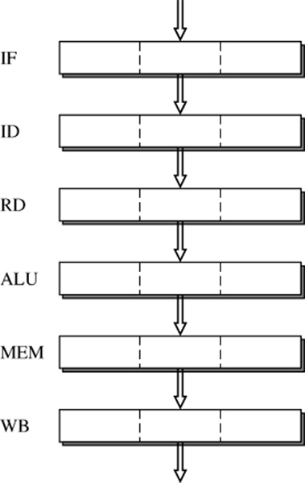
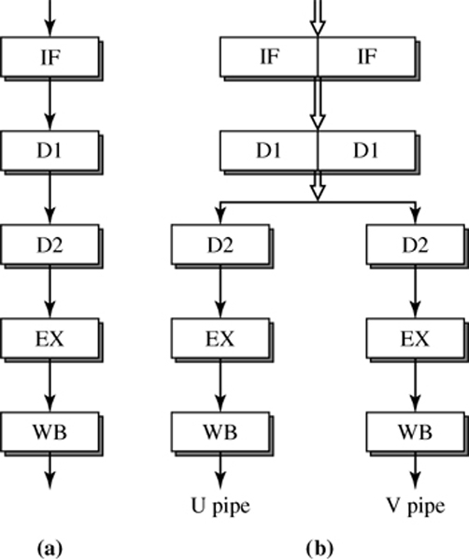
Inorder Superscalar Pipeline
3-wide Superscalar 486 Pentium
(2-wide superscalar)

Slide 40
Statically Scheduled Superscalar
Issue up to N instructions per cycle (where N is the “issue width” of the processor).
Issue: Check each instruction for hazards with earlier instructions in program order issued this cycle, as well as against all earlier instructions still in execution.
tgt
src1
src1
Program order
tgt
src1
src1
tgt
src1
src1
Above: Comparisons to avoid RAW, WAR, and WAW hazards
in a 3-wide in-order superscalar.

Slide 41
2-Issue In-order Superscalar
Clock Number
1
2
3
4
5
6
7
8
integer instruction
IF
ID
EX
MEM
WB
FP instruction
IF
ID
EX
EX
EX
WB
integer instruction
IF
ID
EX
MEM
WB
FP instruction
IF
ID
EX
EX
EX
WB
integer instruction
IF
ID
EX
MEM
WB
FP instruction
IF
ID
EX
EX
EX
WB
Issue restriction: At most one Integer and one Floating Point operation can issue per cycle (this organization was used in the HP 7100 processor).
Challenge maintaining peak throughput: Next 3 instructions cannot use result of load; branch delay 4-5 instructions (if resolve in execute).

Slide 42
Very Long Instruction Word (VLIW)
In a superscalar processor, we need to check for dependencies between instructions before they can be issued in parallel.
Each time we fetch and decode the same group of instructions we will find the same dependencies (through registers).
Why not let the compiler search for these dependencies and groups of instructions that are known to be independent? This is how a VLIW processor works
Drawbacks:
Need to explicitly encode “no ops” for units that do not have an operation.
Hard to predict which memory access instructions miss in cache
Need to use profile feedback to find “hot traces” in program to extract instruction level parallelism
Memory dependencies hard to determine in compiler
Inst N: ADD.D F1,F1,F4 NOP L.D F7, 0(R1) DSUBI R2,R2,#1 NOP
Inst N+1: ADD.D F1,F1,F7 MUL.D F4,F5,F6 NOP DSUBI R2,R2,#1 BEQZ R2, Loop

Slide 43
Multiple Issue w/ Dynamic Scheduling
Use extension of Tomasulo’s algorithm.
Benefits:
Overcome data hazards
Overcome issue restrictions
Key challenge: for each instruction in issue packet, in program order
Assign reservation station and update pipeline control tables
Two approaches to overcome this challenge:
Run this step at higher clock frequency (i.e., do in half a clock cycle for 2-wide superscalar)
Add logic to perform operation on multiple (e.g., 2) instructions at once.

Slide 44
Tomasulo Organization (with two-wide issue)
From Mem
FP Op
Queue
FP Registers
Load1
Load2
Load3
Load4
Load5
Load6
Load Buffers
2x / cycle
Store
Buffers
Add1
Add2
Add3
Mult1
Mult2
Reservation
Stations
To Mem
FP adders
FP multipliers
Common Data Bus 1‏
Common Data Bus 2‏
44
Notes:
44
Resolve RAW memory conflict? (address in memory buffers)‏
Integer unit executes in parallel

Slide 45
Example
Loop: L.D F0,0(R1) ; F0-array element
ADD.D F4,F0,F2 ; add scalar in F2
S.D F4,0(F1) ; store result
DADDIU R1,R1,#-8 ; decrement pointer 8 bytes (per DW)
BNE R1,R2,Loop ; branch R1 != R2
Assumptions:
2-wide issue
Infinite number of reservation stations
Perfect branch prediction (let’s do three iterations of loop); separate branch unit.
Issue instruction from target of taken branch 1 cycle after branch (due to fetch restrictions)
One Integer Unit (handles load/store effective address calculation)
Separate FP Function Unit for each type of FP operation
Issue and Write Results take one cycle
Latencies: One cycle for integer ALU; two cycles for loads; three cycles for FP adds
Two CDBs
Load/Store effective address calculation “decoupled” from memory access (e.g., compute effective address as soon as possible, even if data to store to memory is not available)
NO Reorder Buffer

Slide 46
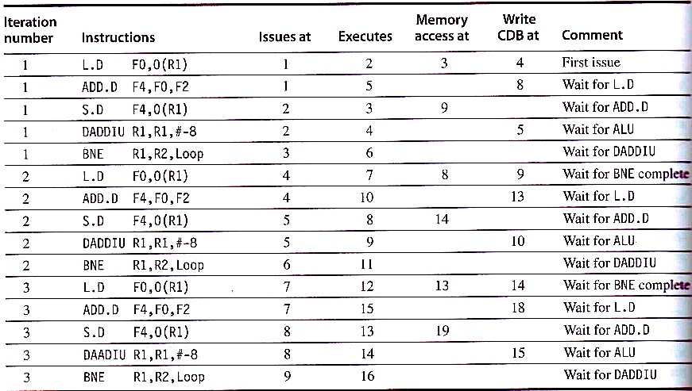
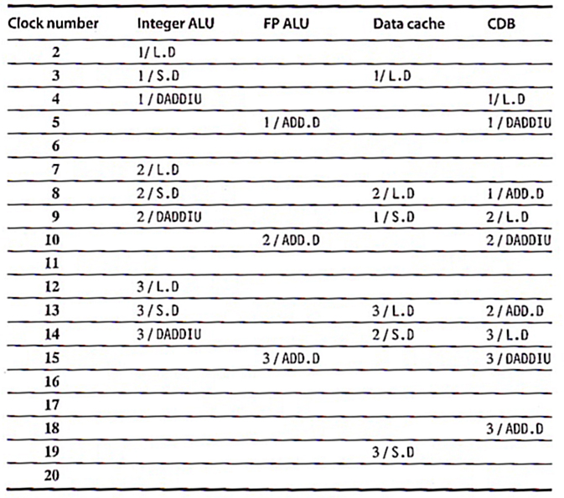
Example: 2-issue w/ Tomasulo
Mark relevant dependencies (true deps)
Each clock cycle: Start from oldest instruction, working toward younger instructions and attempt to apply scheduling algorithm + assumptions
Fetch Issue 15 instructions/9 cycles = 1.67 IPC
Execution Completion rate = 15 inst./16 cycles = 0.94 IPC (much less than 2)

Slide 47
Modified Example (extra Int ALU)
Loop: L.D F0,0(R1) ; F0-array element
ADD.D F4,F0,F2 ; add scalar in F2
S.D F4,0(F1) ; store result
DADDIU R1,R1,#-8 ; decrement pointer 8 bytes (per DW)
BNE R1,R2,Loop ; branch R1 != R2
Changed Assumptions:
…
Address Adder & Integer Unit
…

Slide 48
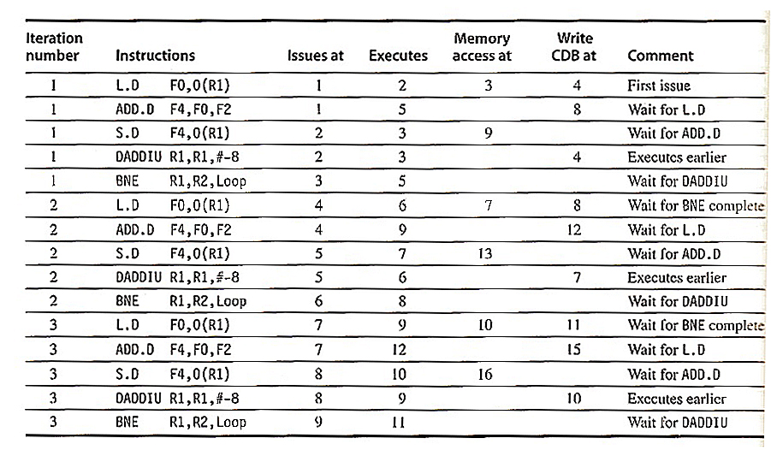
Modified Example, cont’d...
Execution completion rate: 3 cycles less (3/S.D vs 1/L.D: 16-4+1 = 13 vs. 16 cycles before) IPC = 15/13 = 1.15 (vs. 0.94)
Performance limited by waiting for branch to resolve.

Slide 49
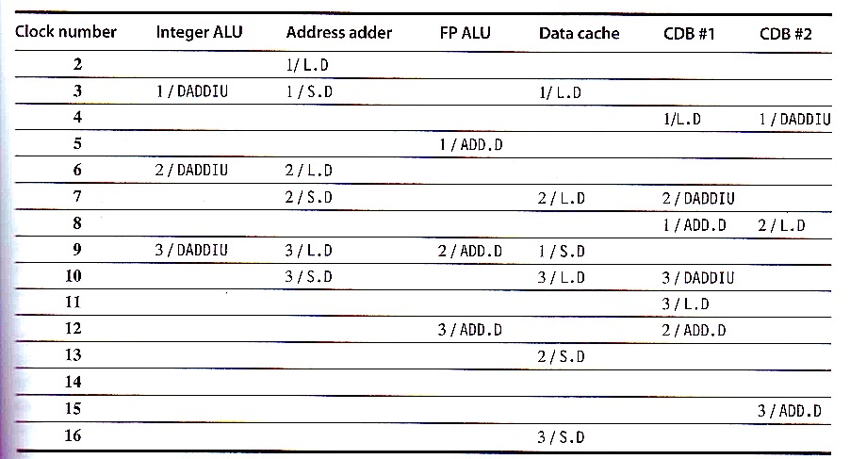
Modified Example, cont’d...
Execution completion rate: 3 cycles less (3/S.D vs 1/L.D: 16-4+1 = 13 vs. 16 cycles before) IPC = 15/13 = 1.15 (vs. 0.94)
Performance limited by waiting for branch to resolve.

Slide 50
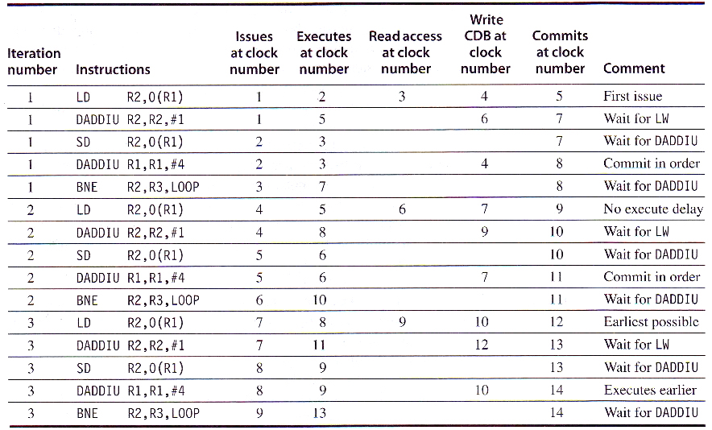
Example of Multiple Issue, Tomasulo & Reorder Buffer
#8
#8
#8
Mark true dependencies
Each clock cycle: Start from oldest instruction, working toward younger instructions and attempt to apply <whichever OoO> algorithm rules
Commit rate: 15 instructions in 14-5+1 = 10 cycle
Speculative execution helped use commit 1.5 instructions per cycle

Slide 51
Summary of Slide Set 14
In this slide set, we learned about the following:
Support for precise exceptions and speculative execution
with a single mechanism: The reorder buffer.
Multiple issue lowers the “ideal CPI” to below 1.
Two forms of multiple issue: Superscalar, VLIW
We now know how a single processor “core” works. In the next slide set we will talk about software approaches to instruction scheduling, take a look at the Pentium 4 processor, and talk about the limits of instruction level parallelism.
After this we will shift focus to multicore processors. Note that while the current focus is on increasing the number of cores per chip, extracting greater levels of instruction level parallelism will remain important due to Amdahl’s Law.

