Slide 1

LOAD / STORE PROCESSING
CPEN 411

Slide 2
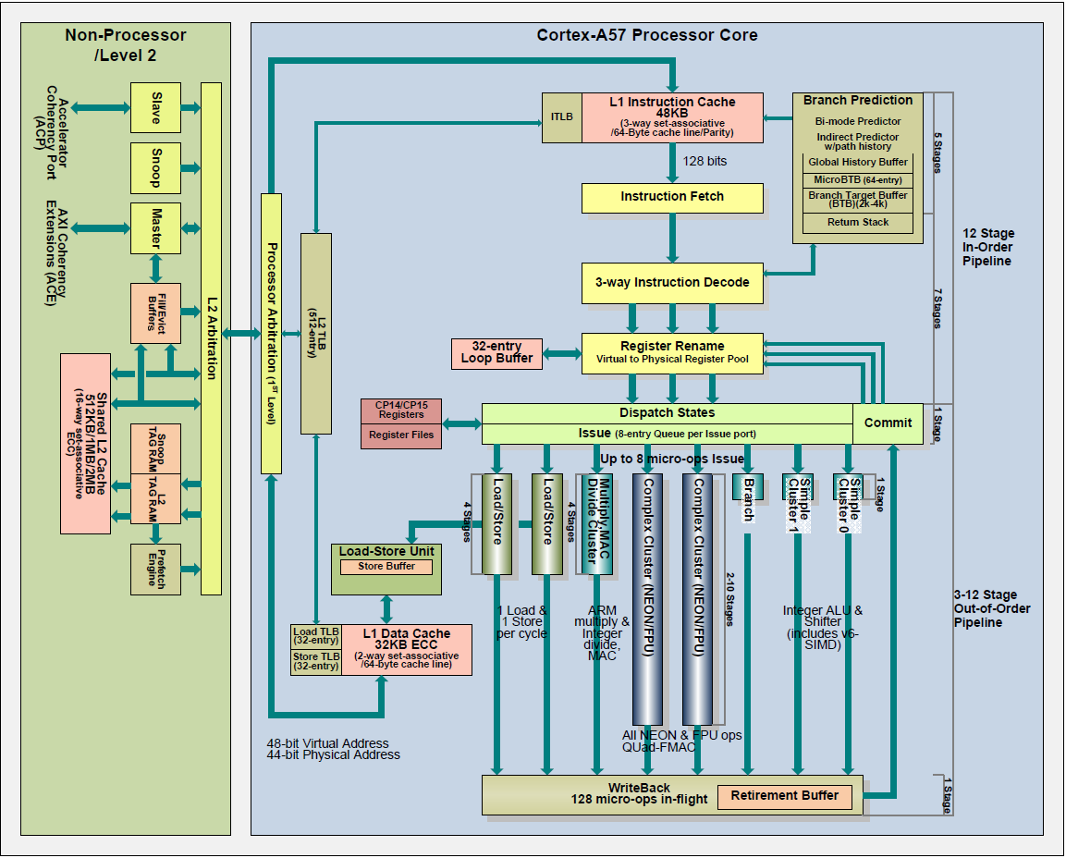

memory
data flow

Slide 3


Slide 4


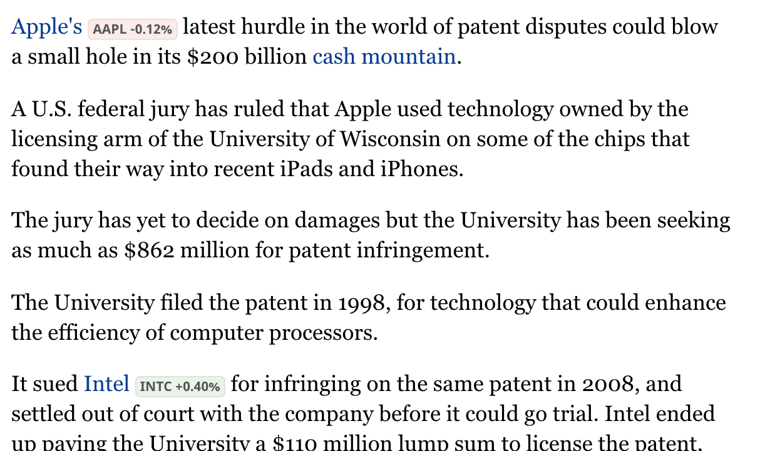
(Apple won on appeal, Sept 28, 2018)

Slide 5
Learning objectives
explain when loads can be reordered wrt stores
motivate, describe, and emulate the store buffer
motivate and explain the load-store queue (LSQ)
explain the need for memory dependency prediction

Slide 6
Load bypassing
sw r2, 0(r9)
lw r2, 0(r8)
addi r4, r2, #0xf00
loads are on the critical path, stores are (usually) not
would like to use cache bandwidth for loads and send stores to the cache when free (~20% better performance)

Slide 7
Store buffer
IDEA: delay stores until bandwidth available
queue stores in a store buffer
allow loads to bypass
mark as non-committed if store still in ROB
mark as committed if store retired from ROB

Slide 8
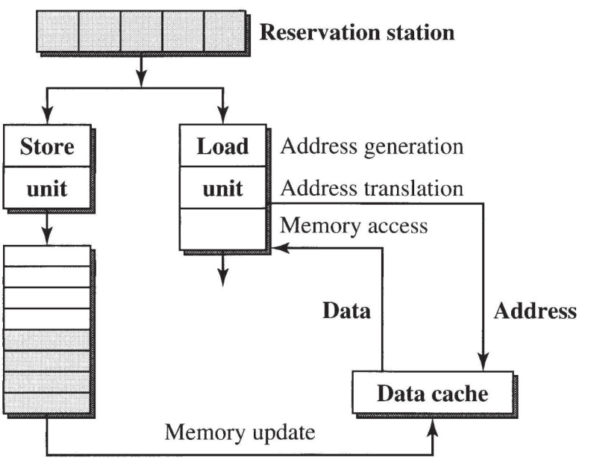
addr
not yet
committed
data
committed
D$ write
problem: we have no way to check for dependencies

Slide 9
Load bypassing, revisited
sw r2, 0(r9)
lw r2, 0(r8)
addi r4, r2, #0xf00
loads can bypass stores only if their results do not depend on previous stores*
*more on memory access ordering later

Slide 10
addr
not yet
committed
data
committed
D$ write

Slide 11
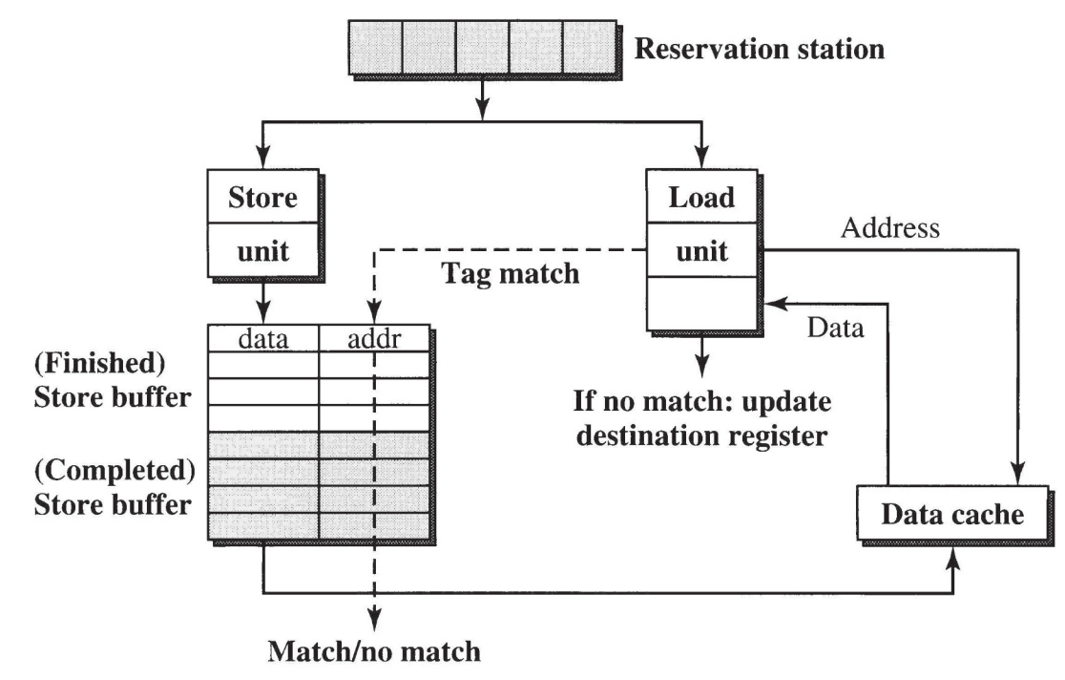
addr
not yet
committed
data
committed
D$ write

Slide 12
Load bypassing so far
store executed in a store buffer
if load address matches in the store buffer, stall
is stalling always necessary?
what if store value already available?
forward!

Slide 13
Load forwarding
sw r4, 0(r9)
lw r2, 0(r8)
addi r4, r2, #0xf00
on RAW dependency: if store value known, there is no need to stall
value can be forwarded directly to waiting load (additional ~5% performance)

Slide 14
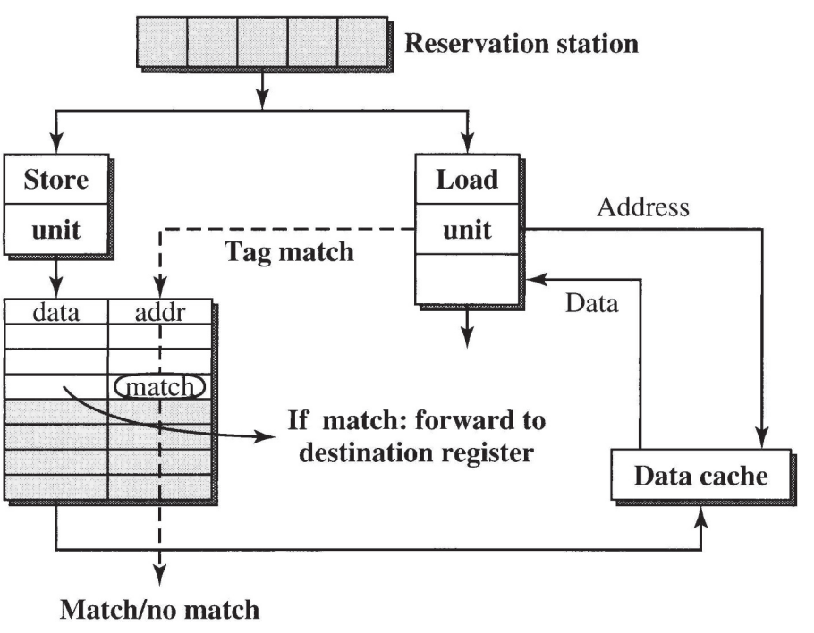
addr
not yet
committed
data
committed
D$ write

Slide 15
When can dependencies be resolved?
problem: must wait until addresses resolved to determine if there is a dependency
IDEA: speculate no dependency, cancel if wrong
as stores complete, cancel mis-executed code
better alterative: memory dependency prediction (this is where Apple and Intel got in trouble)

Slide 16
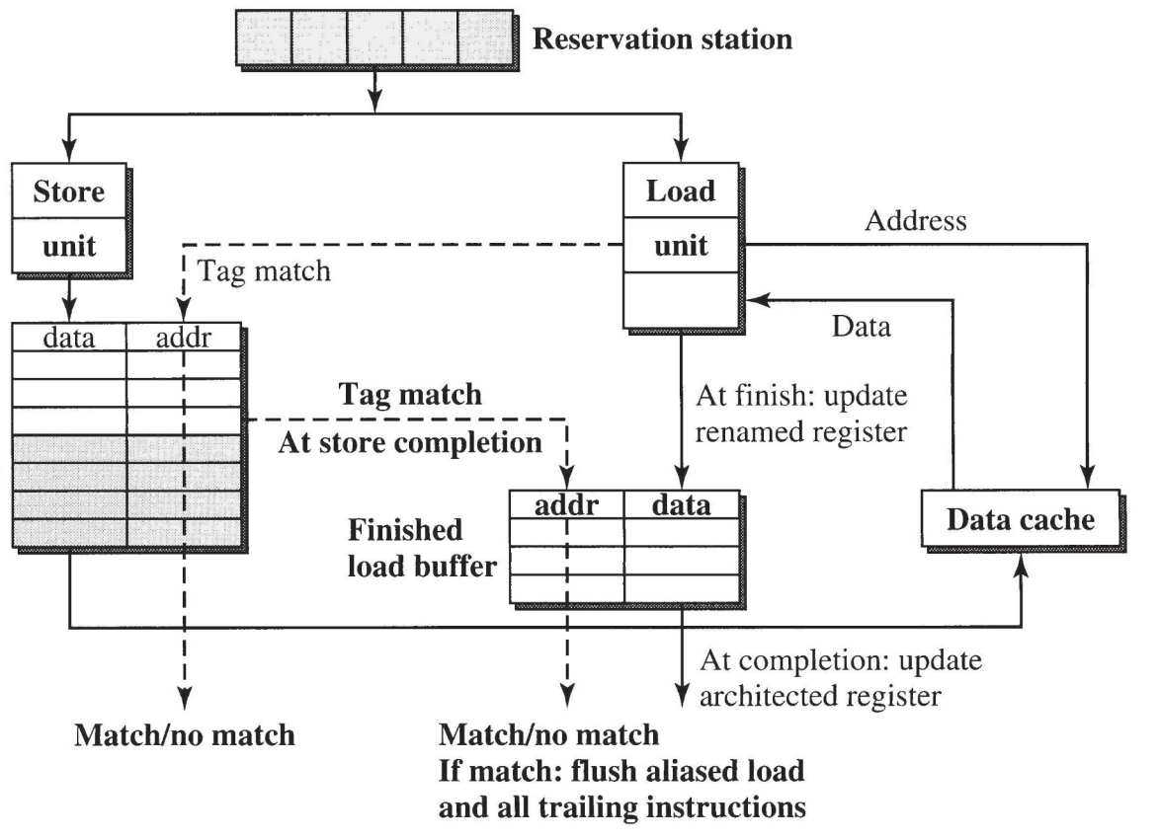
addr
data
not yet
committed
committed
not yet
committed
D$ write

Slide 17
More memory data flow ideas
observation: load address can often be predicted
e.g., cache prefetchers do this pretty well
this way load can be sent to the D$ even earlier
cancel if prediction incorrect
observation: load value often the same as last time
predict load value directly before accessing D$
instrs dependent on load value can proceed speculatively
cancel if D$ returns a different value

Slide 18
Summary
would like to delay stores to save BW for loads
store buffer keeps in-flight and committed stores
load bypassing w/ the store buffer
load forwarding from the store buffer
speculative loads using the load-store queue
memory dependency prediction

