Slide 1
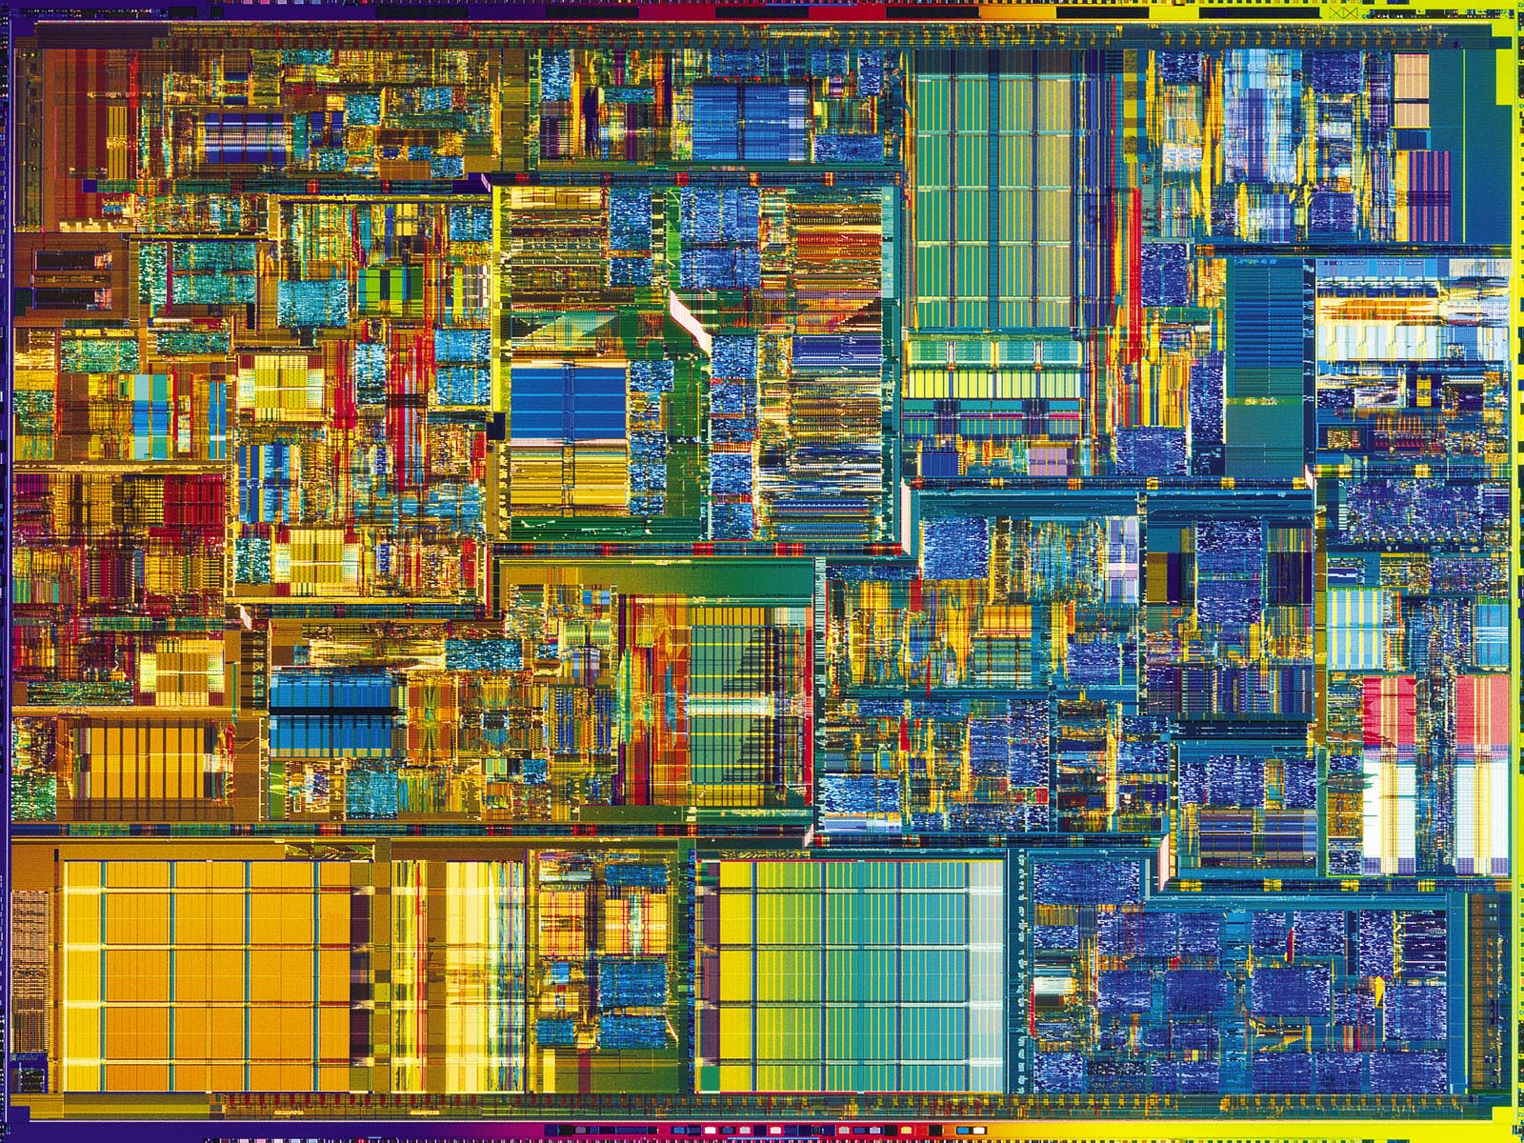
CPEN 411: Computer Architecture Slide Set #16: Branch Prediction
Tor Aamodt
aamodt@ece.ubc.ca
Background: Pentium 4 die photo (uses advanced branch prediction mechanisms)

Slide 2
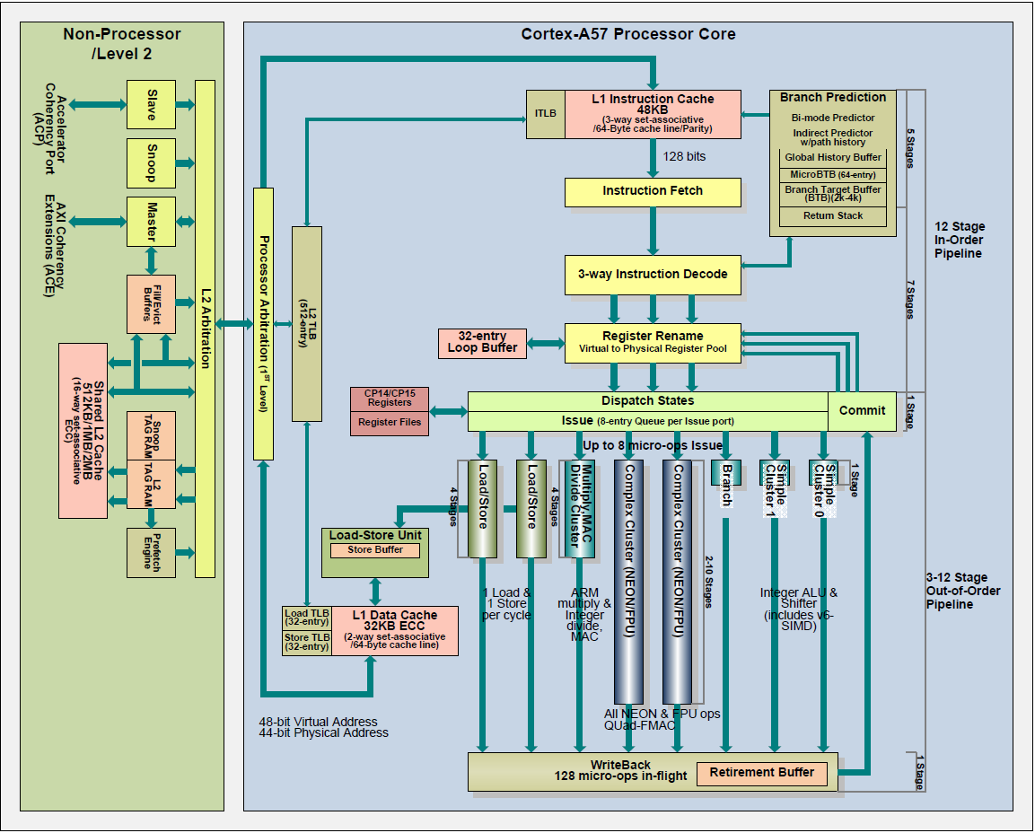





instruction
flow
register
data flow
intercore
comms
memory
data flow

Slide 3

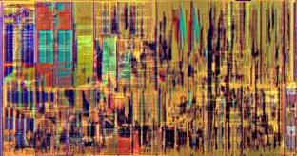
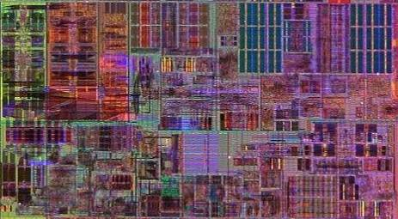
Intel Core i7
Execution Units
L1 Data Cache
L2 Cache & Interrupt Servicing
Memory Ordering & Execution
Paging
Out-of-Order Scheduling & Retirement
Instruction Decode & Microcode
Branch Prediction
Instruction Fetch & L1 Cache
Highlighted above: Significant investment of silicon area to “predict branches”.

Slide 4
Introduction to Slide Set 16
In the past couple of slide sets we considered how to execute instructions “out-of-order”.
The key to out-of-order execution (with Tomasulo’s algorithm) is finding instructions which do not have true data dependencies.
Did not talk about how to handle branches: Branches limit number of instructions we can consider for dynamic scheduling.
In this slide set, we explore mechanisms for predicting the “outcome” of a branch long before executing the branch.
Requires a way to “recover” when the prediction is incorrect (our prediction techniques will be incorrect sometimes). Note, we already learned how to “recover” after incorrect predictions when using Tomasulo’s algorithm by using a reorder buffer.

Slide 5
Learning Objectives
After we finish this set of slides you should be able to:
Describe the motivation for and purpose of a branch predictor and branch target buffer.
Explain why it is possible to predict branch outcomes with relatively good accuracy.
Describe three types of branch predictor and evaluate their operation in detail.

Slide 6
Control Dependence (H&P 2.1)‏
Intuition: An instruction X is control dependent on a branch B if whether instruction X executes is determined by the outcome of branch B.
if( p1 ) {
S1; // S1 (statement 1) control dependent on p1
}
if (p2) {
S2; // S2 control dependent on p2, not c.d. on p1
}
Control dependencies lead to control hazards. Earlier, we saw three approaches to dealing with control hazards: (1) wait for the branch to execute, (2) “predict not taken” (3) delayed branches,. In this slide set, we extend the “predict not taken” approach.

Slide 7
Control Hazards
Predict-not-taken. Expanded pipeline view, showing flushed instructions (assuming branch “resolved in execute”):
Clock Cycle
Taken Branch
1
2
3
4
5
6
7
8
BEQZ R1, Label
IF
ID
EX
MEM
WB
branch +1 (PC+4)
IF
ID
EX
MEM
WB
branch + 2 (PC+8)
IF
ID
EX
MEM
WB
branch target (Label)
IF
ID
EX
MEM
WB
branch target. + 1
IF
ID
EX
MEM
branch target. + 2
IF
ID
EX
Clock cycle 1: IF stage predicts “branch+1” is the next instruction to fetch.
Clock cycle 3: EX stage resolves branch, instructions in ID (“branch+1”) and IF (“branch+2”) turned into “no-ops”… they are “flushed”, correct next instruction (“branch target”) fetched on clock cycle 4.

Slide 8
Branch Prediction Impact (5-stage pipeline) – Resolved in EX
Correct Prediction
Clock Number
1
2
3
4
5
6
7
8
taken branch
IF
ID
EX
MEM
WB
branch target
IF
ID
EX
MEM
WB
branch target. + 1
IF
ID
EX
MEM
WB
branch target. + 2
IF
ID
EX
MEM
WB
Incorrect Prediction
Clock Number
1
2
3
4
5
6
7
8
taken branch
IF
ID
EX
MEM
WB
predicted next inst.
IF
ID
nop
nop
nop
predicted next inst.+1
IF
nop
nop
nop
nop
actual next inst.
IF
ID
EX
MEM
WB

Slide 9
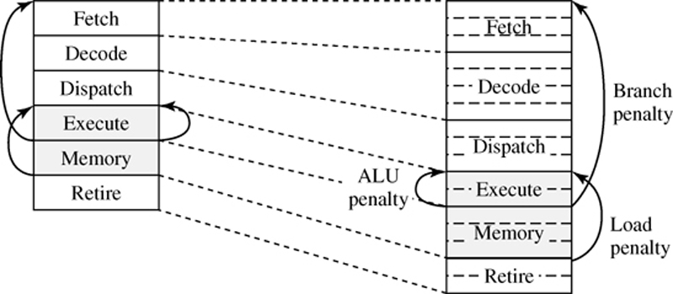
Effect of Deeper Pipelining
“typical” modern pipeline
(superpipelined stages)
“textbook” pipeline
Large Penalty !!!
Waiting for branch to be executed incurs large penalty (related to number of pipeline stages between fetch and execute). If we correctly predict branch outcome, this penalty is “hidden”.
If branch prediction is wrong, we still pay the large penalty. Thus, important to build predictors that mispredict rarely.

Slide 10
Branch Instructions: Two Problems
Problem 1: Is branch taken? (“direction”)
Hardware to predict this: “Branch Predictor”
We will look at several designs
Problem 2: If taken, what is target PC?
Hardware to predict this: “Branch Target Buffer”
We will look at one design that works fairly well.

Slide 11
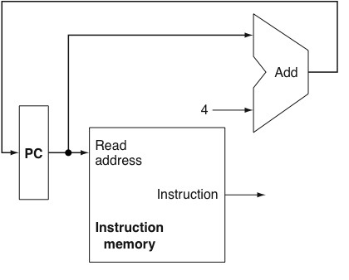
Branches Predicted in Fetch Stage
Quick Review: How are instructions fetched?
Recall, from Slide Set 8:
Next PC
Two new hardware
structures:
1. Branch Target Buffer
2. Branch Predictor
Our focus:
What is the motivation?
What do they do?
How do we use them?
How do we design them?
PC
Branch- Target Buffer
1
1
Adder (+4)
0
Branch- Predictor
hit?
taken?
taken?
Instr Mem
Branch Instruction
Fetch stage (IF)
Decode stage (ID)…
“Next PC” based upon *prediction* of branch outcome.

Slide 12
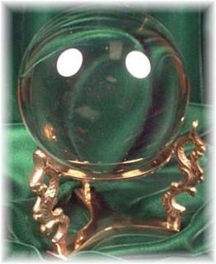
Predicting the future...
Method #1
Crystal ball!!
Method #2
Study history since “history repeats itself”.
This works amazingly well in computer architecture
Past branch “behaviour” => excellent predictor of future branch “behaviour”.
(doesn’t work)

Slide 13
Example Prediction Problem
Loop: ...
...
DSUBI R1,R1,#1
BNEZ R1,Loop ; taken 9 times, not taken once
Observations: For this code, last branch outcome (taken,
not taken) a good (but not perfect) predictor of next branch
outcome. This turns out to be true for many branches.

Slide 14
design hardware to use observation?

Slide 15
1-Bit Branch Predictor
Row 00₂
1
PC of branch
0
Output (“0”) is previous actual outcome of branch:
“1” => last time this branch was “taken” (T)
“0” => last time, this branch was “not taken” (NT)
Row 01₂
Row 10₂
0
01…100
000000011
00
Row 11₂
0
Use “n” lower order bits to select row from table.
Choose “n” for good CPI/area trade-off (good “!/$”)
Row 2^{n}-1
2^{n} x 1 bit table
Notes:
1. How might we remember the last branch outcome? Answer: table with one bit per branch.
2. What does each bit in the table mean? Answer: last correct outcome.
3. What is a good way for hardware to identify individual branches? Answer: address of branch.
4. How might we use the instruction address to pick one of the entries in our table? Answer use some bits as an index.
5. Which bits should we use? Answer: n-bits where table size is 2^n, but discard lower 2 bits since instructions are 32-bits long and aligned in memory.
6. How do we pick the number of entries in our table? Answer: CPI – cycle time - area tradeoff.

Slide 16
Operation of 1-bit Branch Predictor
Step 1: Making a Prediction:
Take n-bits of “PC” and use it to select a row in table. If entry in that row is “1”, prediction is “taken” and if entry is “0”, prediction is “not taken”.
PC here is address of the branch instruction itself.
Step 2: Updating Predictor
When we know the correct outcome of the branch update the entry in the table to be “1” if the actual outcome was “taken”, and to “0” if the actual outcome was “not taken”

Slide 17
Aside: Hash Tables
Some of you might have learned about “hash tables” in one of your programming courses. You might note that the hardware used for branch prediction does something similar. (If you don’t remember, don’t worry about it.)

Slide 18
Example, cont’d
Loop: ...
...
DSUBI R1,R1,#1
BNEZ R1,Loop

Slide 19
1-bit Branch Predictor
Problem: A branch that is almost always taken (not-taken) will mispredict twice each time branch is not-taken (taken).
time (loop iteration)
Actual outcome: TTTTTTTTTNTTTTTTTTTNTTTT
Predicted outcome:
?
TTTTTTTTTNTTT
T
Mispredicts last loop iteration
TTTTTTTT
N
Again when see loop again‏

Slide 20
ideas to get rid of mispredictions?

Slide 21
2-bit Branch Predictor
T
Transitions determined by
actual outcome of branch
T= “Taken”/ NT=“not taken”
T
T
11
Current state provides
prediction:
T= “Taken”/ NT=“not taken”
NT
T
State encoding uses
two bits (encoding
is arbitrary)
NT
01
T
10
Observations:
Repeating T stays in ‘11’ state
Repeating NT stays in ‘00’ state
Two-in-a-row to change prediction
(T,NT) won’t change prediction
(NT,T) won’t change prediction
NT
T
NT
00
NT
NT

Slide 22
2-bit “Saturating Counter” Predictor
T
2-bit counter that is incremented
after a taken branch, and
decrement after a not-taken branch.
Prediction is simply most significant bit.
T
11
T
NT
T
10
T
NT
NT
01
T
NT
NT
00
NT

Slide 23
2-Bit Predictor
T
prediction based
upon current state.
T
11
Row 00₂
0 0
T
NT
1 0
T
10
Row 01₂
T
NT
01
NT
next state
depends upon
current state and
actual outcome.
PC of branch
Row 10₂
1 1
T
NT
NT
00
Row 11₂
01…100
000000001
00
NT
Contents of each row specify state in state machine. Make prediction based upon current state. E.g., if in state “10”, saturating counter state machine says predict “taken”.
When actual branch outcome known, update entry in table. E.g.,
if actual outcome taken new state in row is “11”
Row 2^{n}-1
Size of table (in bits) =
2^{n} x 2 (n=# of PC bits used)

Slide 24
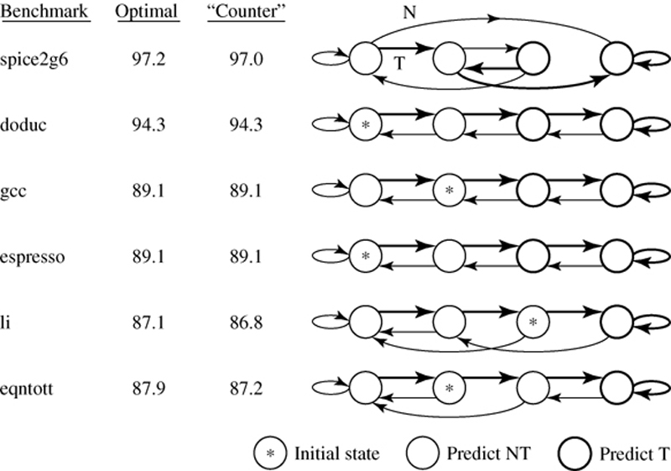
Other 2-bit predictors (there are 1000’s of possible 2-bit state machines...)
Study: Ravi Nair, IBM, 1992
Saturating 2-bit counter is close to “optimal” among all 2-bit
state machines (though we will see better predictors).

Slide 25
Loop: ...
...
DSUBI R1,R1,#1
BNEZ R1,Loop
Assume branch is “taken” 9 times in a row then not taken (i.e., loop iterates 10 times before exiting).

Slide 26
3-bit “Saturating Counter” Predictor
Can increase to N-bits
(but diminishing returns
as N grows)
NT
T
T
100
NT
011
NT
T
NT
T
101
NT
010
NT
T
NT
T
110
NT
001
NT
NT
T
T
111
NT
000
T
NT

Slide 27
Branch Prediction “FAQ”
Important: Branch predictor only makes predictions. Correct predictions NOT necessary for correct program execution. Correct predictions improve performance. Hardware must check if predictions were correct when branch is executed. If wrong, “throw out” instructions following branch and start fetching again.
Branch predictor used to reduce CPI (increase performance)
There is a trade off between predictor size (silicon area), and the accuracy of the predictor.
Significant innovation in branch predictor design 1985-2005.
Typically around 95% correct prediction rate on real programs with sophisticated predictor designs (1-bit predictor: ~70-80%)
Further improvements? Example: Going from 96% to 99% accuracy (factor of 4 fewer mispredictions) might uncover roughly twice as much instruction level parallelism in a typical program.

Slide 28
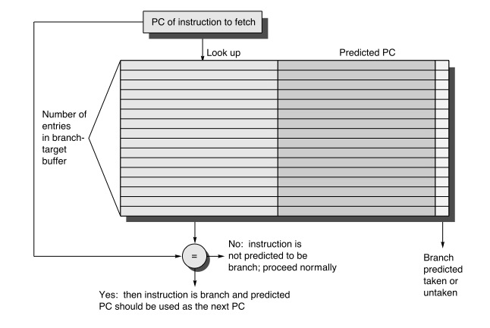
Branch Target Buffer (BTB)
“tags”
“targets”
Predicted (target) PC of
branch or jump instruction
Many ways to perform “look up” operation
Simplest is to use m bits of PC to select a single row to compare left hand side address against entire PC (this is called a “direct mapped” cache structure)
BTB is a form of cache

Slide 29
Putting it all together: BP + BTB
0
PC
Branch- Target Buffer
1
1
1
Adder (+4)
0
We had Adder and Inst. Mem blocks already
branch
misprediction?
(from EX)
Branch- Predictor
hit?
taken?
Instr Mem
Instruction
correct PC
(from EX)
Instruction fetch stage (IF)
decode stage (ID)…
Prediction from BP used to select new PC value
Not shown: Inputs to BTB and BP for training.

Slide 30

The curious case of function calls
for (;;) {
...
print(...);
...
print(...);
...
print(...);
...
}
print(...) {
...
return;
}
problem:
return address
depends on where
print was called from

Slide 31
Return address stack
Special case for function call / return
HW can distinguish these from other jumps (how?)
jal / jalr / jr r31 in MIPS, call / ret in x86, ...
ret addr
ret addr
when we see a call:
push addr on stack
when we see a return:
pop addr from stack

Slide 32
BTB Terminology
In some designs, the BTB is combined with the branch predictor. Often the combined hardware is also called a BTB (even though it corresponds to a BTB and a branch predictor).
This is not true in all designs
Some use “branch predictor” to mean BTB + branch predictor
H&P uses BTB to mean BTB + branch predictor
On 411 quiz/exam: BTB means only the part of the hardware that predicts the branch target, not whether the branch is taken.

Slide 33
Another Branch Prediction Example…
C code
if (d==0) // b1
d=1;
if (d==1) { // b2
…
}
MIPS64 Assembly
000000₂ BNEZ R1,L1 ; branch b1 (d!=0)
000100₂ DADDI R1,R0,#1 ; d=1
001000₂ L1: DADDI R3,R1,#-1 ; R3 = d - 1
001100₂ BNEZ R3,L2 ; branch b2 (d!=1)
...
100100₂ L2:
instruction addresses (binary)
consider initial values for d = 0, 1, 2:
g
initial value of d
d==0?
b1
value of d before b2
d==1?
b2
0
yes
N
1
yes
N
1
no
T
1
yes
N
2
no
T
2
no
T

Slide 34
Example, cont’d...
First, let’s consider behavior of the simple 1-bit predictor from slide 14 (all table entries initialized to “not taken”) if d alternates from 2 to 0: d = 2, 0, 2, 0, ...
from previous slide
across: behavior as code executes a single time
d=?
b1 prediction
b1 action
new b1 prediction
b2 prediction
b2 action
new b2 prediction
2
N
T
T
N
T
T
0
T
N
N
T
N
N
2
N
T
T
N
T
T
0
T
N
N
T
N
N
down: successive passes through the example code
Always mispredicts!

Slide 35
Another Example…
C code
if (d==0) // b1
d=1;
if (d==1) { // b2
…
}
MIPS64 Assembly
000000₂ BNEZ R1,L1 ; branch b1 (d!=0)
000100₂ DADDI R1,R0,#1 ; d=1
001000₂ L1: DADDI R3,R1,#-1 ; R3 = d - 1
001100₂ BNEZ R3,L2 ; branch b2 (d!=1)
...
100100₂ L2:
instruction addresses (binary)
consider initial values for d = 0, 1, 2:
g
initial value of d
d==0?
b1
value of d before b2
d==1?
b2
0
yes
N
1
yes
N
1
no
T
1
yes
N
2
no
T
2
no
T
Note: branch b2 correlated with branch b1 (if b1 is T, likely b2 is T)

Slide 36
Why Are Branch Outcomes Correlated? Answer: Affector Branches
x=0;
if( someCondition ) { /* branch A */
x=3;
}
if( someOtherCondition ) { /* branch B */
y += 19;
}
if( x <= 0 ) { /* branch C */
doSomething();
}

Slide 37
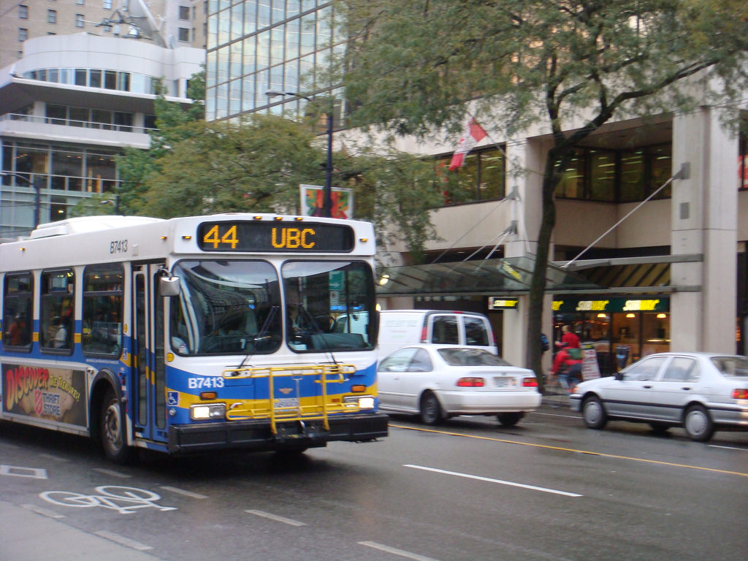
A (Silly) Analogy…
Which bus route should you take to school tomorrow?
Goal is to get to school fastest.
Make prediction based upon:
Static information (shortest bus route in km?)
History: Most times, route T was faster than route N.
Better prediction if consider additional “context”: Route N better than route T on rainy days, but worse on sunny days. Ask friend how roads were this morning?

Slide 38
(Silly) Correlating Branch Predictor Analogy…
Problem: You want to predict which bus to take to school.
You have a feeling that the best route to take seems to depend on the weather. It rains 50% of the time and is sunny 50% of the time.
You don’t yet know it, but “route T” is usually faster than “route N” on sunny days, but is often slower than “route N” on rainy days. Perhaps there are lots of accidents on route T when it rains. You don’t care why the bus is slow, you just want to make it to class on time. Besides, you’re too busy studying while on the bus to notice why it is faster or slower.
How are you ever going to notice you should predict N on rainy days, and T on sunny days?
Solution: Keep two tables: One you record what happens on rainy days, other you record what happens on sunny days.

Slide 39
1-Bit Branch Predictor with1-Bit of Correlation:
Row 00₂
T
N
PC
Row 01₂
Row 10₂
N
N
00…000
000000010
00
Row 11₂
if (d!=0) goto L1
d=1;
L1: if (d!=1) goto L2
...
L2:
...
Row 2^{n}-1
no
yes
Was prior branch “taken”?
Use prior branch outcomes to select which table to use. Prior branch outcome is like “checking weather” before deciding which bus to. After actual branch outcome is known, update entry used to make prediction with actual branch outcome information.

Slide 40
1-Bit Predictor with 1-Bit of Correlation:
pass 1: d=2
(predicting b1)
b1
NT

NT
Row 00₂
PC
Row 01₂
Row 10₂
NT
NT
if (d!=0) goto L1;//b1
d=1;
L1: if (d!=1) goto L2;//b2
...
L2:
...
00…000
000000000
00
Row 11₂
Row 2^{n}-1
no
yes
Was most recent branch taken? (assume we start with
answer = “no” for first branch)
1-bit of “branch history” used to correlate prediction for current branch with outcome of last branch.

Slide 41
1-Bit Predictor with 1-Bit of Correlation:
pass 1: d=2,
(after executing b1,
before executing b2)
Update table after
actual outcome of
b1 is known
b1
T
NT
Row 00₂
PC
Row 01₂
Row 10₂
NT
NT
if (d!=0) goto L1;//b1
d=1;
L1: if (d!=1) goto L2;//b2
...
L2:
...
00…000
000000000
00
Row 11₂
Row 2^{n}-1
no
yes
Was most recent branch taken? (assume we start with
answer = “no” for first branch)
1-bit of “branch history” used to correlate prediction for current branch with outcome of last branch.

Slide 42
1-Bit Predictor with 1-Bit of Correlation:
pass 1: d=2
(predicting b2)
Row 00₂
T
NT
Row 01₂
b2
Row 10₂
NT
NT

if (d!=0) goto L1;//b1
d=1;
L1: if (d!=1) goto L2;//b2
...
L2:
...
PC
Row 11₂
00…000
000000010
00
Row 2^{n}-1
no
yes
Was most recent branch taken? “Yes” because b1 was taken.
1-bit of “branch history” used to correlate prediction for current branch with outcome of last branch.

Slide 43
1-Bit Predictor with 1-Bit of Correlation:
pass 1: d=2
(updating predictor
for b2)
Row 00₂
T
NT
Row 01₂
b2
Row 10₂
NT
T
if (d!=0) goto L1;//b1
d=1;
L1: if (d!=1) goto L2;//b2
...
L2:
...
PC
Row 11₂
00…000
000000010
00
no
yes
Was most recent branch taken? “Yes” because b1 was taken.
1-bit of “branch history” used to correlate prediction for current branch with outcome of last branch.

Slide 44
Example, cont’d...
Consider behavior of a 1-bit predictor with one bit of correlation history... if d alternates from 2 to 0: d = 2, 0, 2, 0, ...
from slide 29
across: behavior as code executes a single time
d=?
b1 prediction
b1 action
new b1 prediction
b2 prediction
b2 action
new b2 prediction
2
N/N
T
T/N
N/N
T
N/T
0
T/N
N
T/N
N/T
N
N/T
2
T/N
T
T/N
N/T
T
N/T
0
T/N
N
T/N
N/T
N
N/T
down: successive passes through the example code
6 out of 8 = 75% correct predictions

Slide 45
2-bit Predictor with 1-bit of Correlation
Useful to build a predictor that uses both correlation and hysteresis.
1 0
1 1
T
0 1
1 0
T
11
PC
0 0
0 0
T
NT
T
10
T
NT
NT
01
n bits
T
NT
NT
00
NT
no
yes
most recent
branch taken?
2 x 2^{n} x 2 bit table

Slide 46
Affector Branches, reconsidered…
x=0;
if( someCondition ) { /* branch A */
x=3;
}
if( someOtherCondition ) { /* branch B */
y += 19;
}
if( x <= 0 ) { /* branch C */
doSomething();
}

Slide 47
Correlating against Multiple Branches
In the last slide we saw that the outcome of branch C depended in some way upon the outcome of branch A but not Branch B.
Instead of tracking the outcome of only the last branch and using that to choose between two tables, we will track the outcome of last N branch outcomes and use that to choose between 2^{N} tables.
We track the outcome of the last N branches using an N-bit shift register.

Slide 48
Quick Review: Shift Register
Each cycle, shift contents of this register by one bit:
In Q1 Q2 Q3 Q4
cycle 0 1 0 0 0 0
cycle 1 0 1 0 0 0
cycle 2 1 0 1 0 0
cycle 3 1 1 0 1 0
cycle 4 0 1 1 0 1
cycle 5 0 0 1 1 0

Slide 49
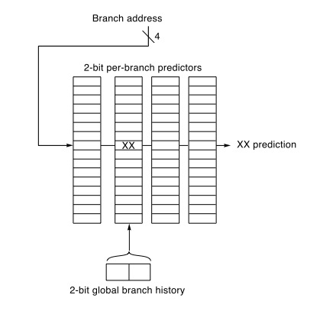
Increase “History Length” - gselect branch predictor (e.g., correlate against last 2 branches)
T
Real code example from SPEC89
benchmark “eqnott”:
T
11
T
T
10
NT
T
NT
01
NT
if( aa==2 )
aa=0;
if( bb==2 )
bb=0;
if( aa!=bb ) {
T
NT
00
NT
NT
goal: want better
prediction for
this branch
Global branch history = shift register (recall from 353) “Shift in” branch outcomes of earlier branches.

Slide 50
Track outcome of 3-branches
T
100
T
NT
011
NT
T
101
T
NT
010
NT
NT
T
NT
T
110
NT
001
NT
T
111
T
NT
000
NT
T
NT
Which is “correct” one to use?

Slide 51
gshare branch predictor
more history, exponentially more tables
tradeoff between # tables vs # branches tracked
but long history required for useful correlation
PC
1 1
1 0
GBHR
0 0
pattern history table (PHT)
bitwise XOR
what are the tradeoffs?

Slide 52
Remembering history
BHR
branch history register
BHR
last branch outcome
PHR
path history register
PHR 0
xor
last branch target PC
what are the tradeoffs?

Slide 53
Kinds of branches
unconditional vs conditional — beqz vs j
direct (target known statically) — j LABEL
for-loop end (j)
simple function call (jal)
indirect — j [r5]
function return (target known @ runtime)
function pointer (when is target known?)
virtual method call (runtime-type-dependent)

Slide 54
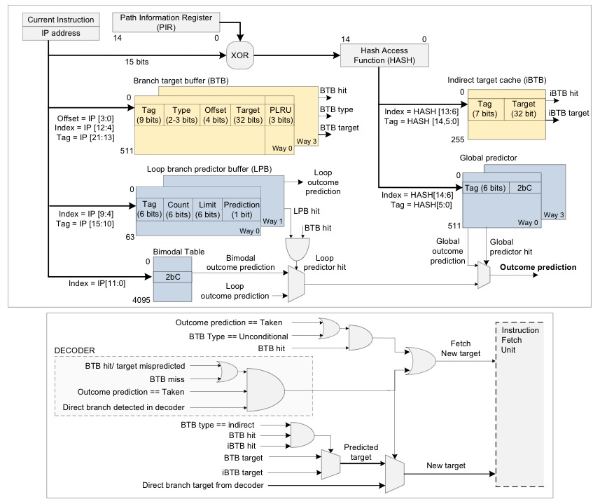
Pentium M Branch Predictor
Intel/AMD tend not to disclose many details about their branch predictors
It is possible to infer structure of branch predictor using “microbenchmarks”.
The figure is from a recent academic paper. The authors determined this structure by running microbenchmarks on the Pentium M and using VTune.
Vladimir Uzelac, Aleksandar Milenkovic: Experiment flows and microbenchmarks for
reverse engineering of branch predictor structures. ISPASS 2009: 207-217

Slide 55
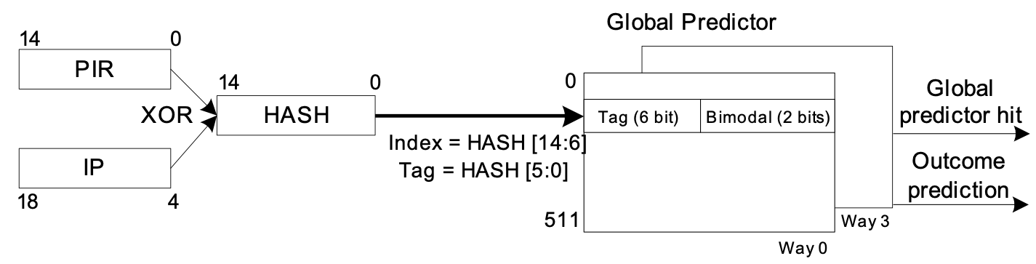
Global (T/NT) predictor
is this gselect or gshare?

Slide 56
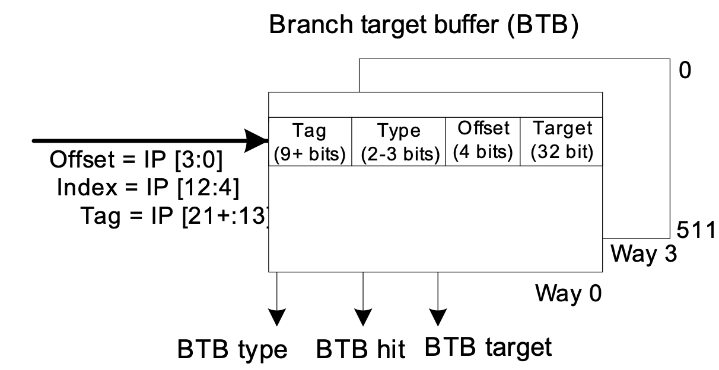
BTB organization

Slide 57
Predicting counted loops
long for-loops: best-case for 2-bit bimodal BP?
can we predict loops perfectly?
what would we have to learn?
recognize it’s a counted loop
find out max value
track current value

Slide 58
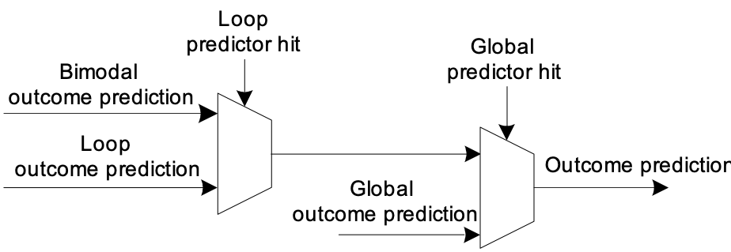
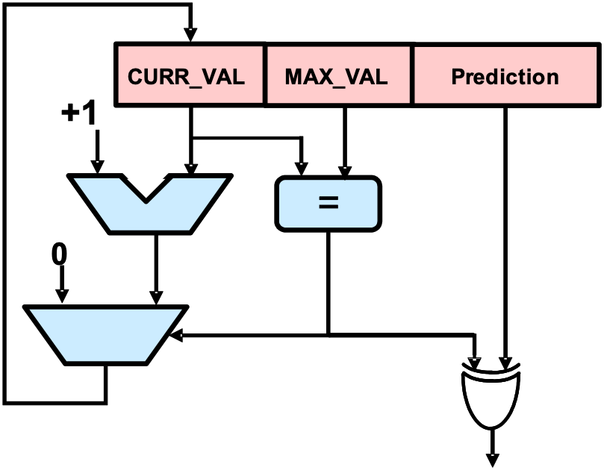
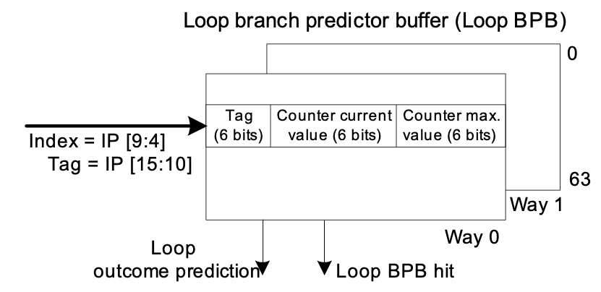
Loop Predictor

Slide 59
Indirect branches
e.g., virtual function call (inheritance)
person::greet(name):
say(“Hello”);
say(name);
animal *a;
...
a->greet(“Whisky”);
cow::greet(name):
say(“moo.”);
say(“mooooooooooo!”);

Slide 60
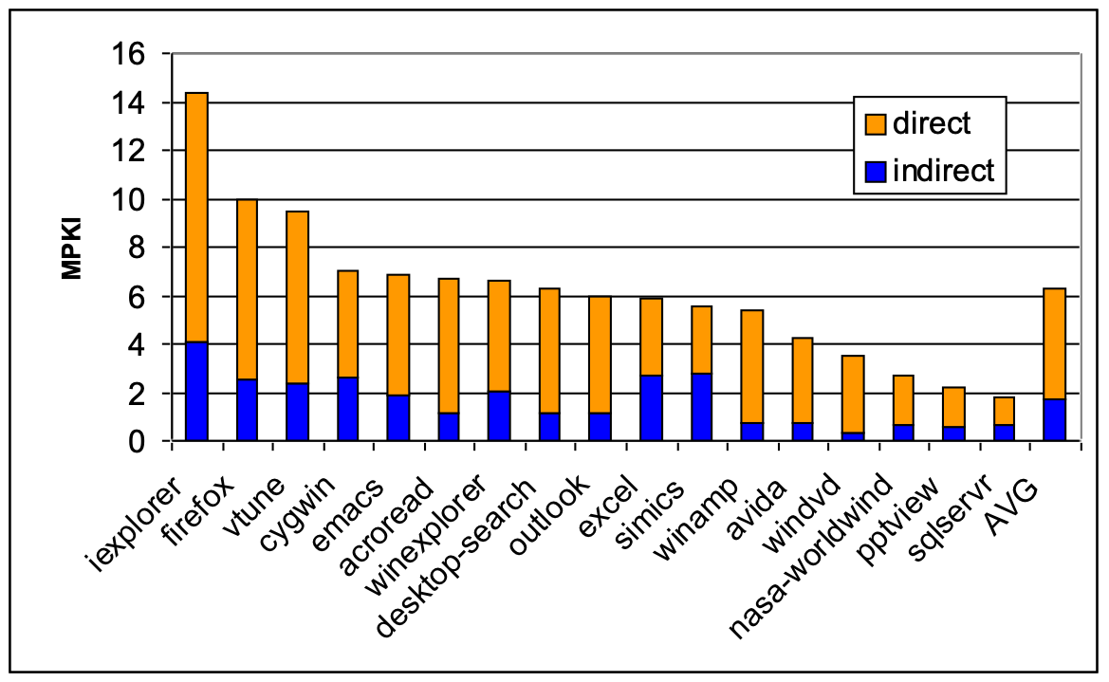
Predicting indirect branch target(s)
how to predict?
observation: often context is enough
(plot: Kim et al)

Slide 61
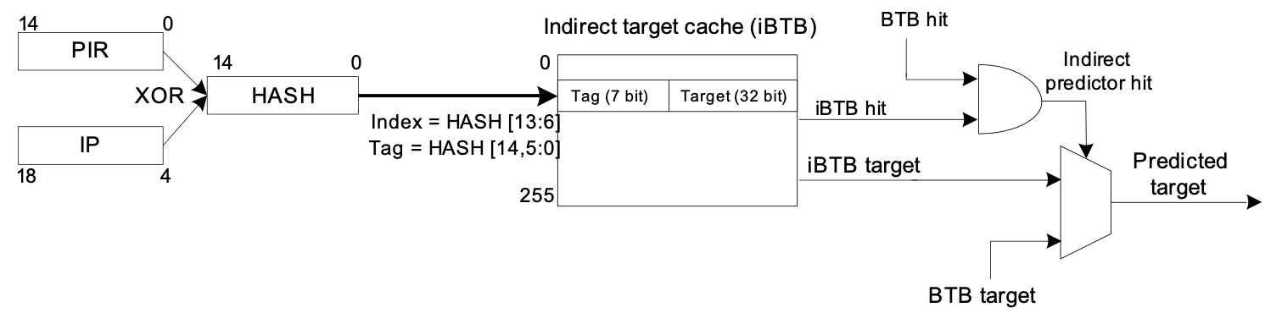
Indirect BTB
how is iBTB different from BTB?

Slide 62
More predictor ideas
several predictors + majority vote
several predictors + tournament predictor
train ML model (e.g., perceptron) instead of FSM
track path history instead of branch history
variable history length (maybe compiler chooses)
keep local history (BHT), alloy w/ GBHR
guess if predictor correct, invert if not
dataflow predictor (track affector branches)
what else can we predict?

Slide 63
Summary of Slide Set 16
Branch prediction is motivated by need to keep pipeline filled with instructions. This is especially important for processors that use out-of-order execution and deep pipelines. It motivates significant investment of silicon area.
A 1-bit predictor uses the last outcome of a branch to predict the next outcome.
A 2-bit predictor uses a state machine. The current state indicates the prediction. The outcome determines the next state.
A correlating branch predictor uses information about other branch outcomes when making a prediction about the current branch.

