Slide 1

CPEN 411: Computer Architecture Slide Set #4: Instruction Set Architecture Design
Instructor: Tor Aamodt

Slide 2
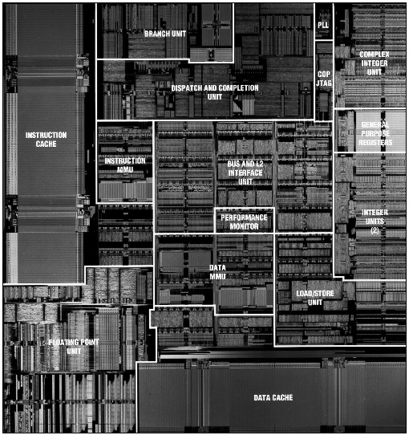
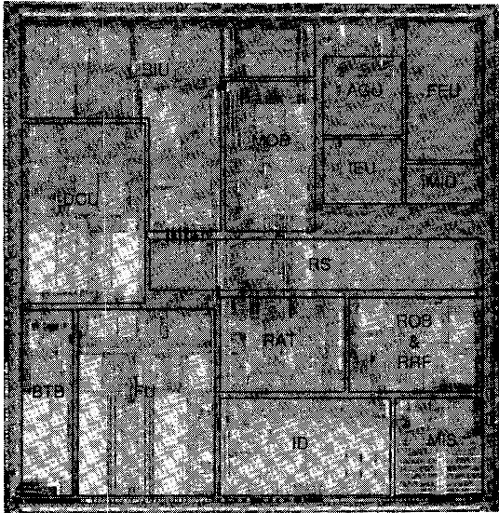
The RISC vs. CISC Debate
PowerPC 620 - “RISC” ISA
PentiumPro - “CISC” ISA
(w/ “RISC implementation”)
RISC = Reduced Instruction Set Computer
CISC = Complex Instruction Set Computer
Red portion on Pentium Pro represents overhead of supporting CISC (about 5% area increase)
Notes:
This might have raised manufacture cost of Pentium Pro as much as 15% assuming defect density of 1.5/cm^2, pentium pro chip area of 197 mm^2, and wafer cost of $1500 for a 200mm dia wafer...

Slide 3
Instruction Set Architecture (ISA)
The low-level software interface to the computer
Language the computer understands
Must translate any programming language into this language
Examples: ARM, x86, PowerPC, MIPS, SPARC, …
ISA is the set of features “visible to programmer”
software
instruction set
hardware

Slide 4
Levels of Representation
temp = v[k];
v[k] = v[k+1];
v[k+1] = temp;
High Level Language Program
Compiler
LW R15,0(R2)
LW R16,4(R2)
SW R16,0(R2)
SW R15,4(R2)
Assembly Language Program
Assembler
1000 1100 0110 0010 0000 0000 0000 0000
1000 1100 1111 0010 0000 0000 0000 0100
1010 1100 1111 0010 0000 0000 0000 0000
1010 1100 0110 0010 0000 0000 0000 0100
Machine Language Program
Machine Interpretation
Control Signal Specification
ALUOP[0:3] ← InstrReg[9:12] & MASK
°
°

Slide 5
Elements of an ISA
Set of machine-recognized data types
bytes, words, integers, floating point, strings, . . .
Operations performed on those data types
Add, sub, mul, div, xor, move, ….
Programmable storage
Registers, program counter, memory
Methods of identifying and obtaining data referenced by instructions (addressing modes)
Addressing modes: Literal, register, absolute, relative, reg + offset, …
Endianness, alignment restrictions
Format (encoding) of the instructions
Op code, operand fields, …
Current Logical State
of the Machine
Next Logical State
of the Machine

Slide 6
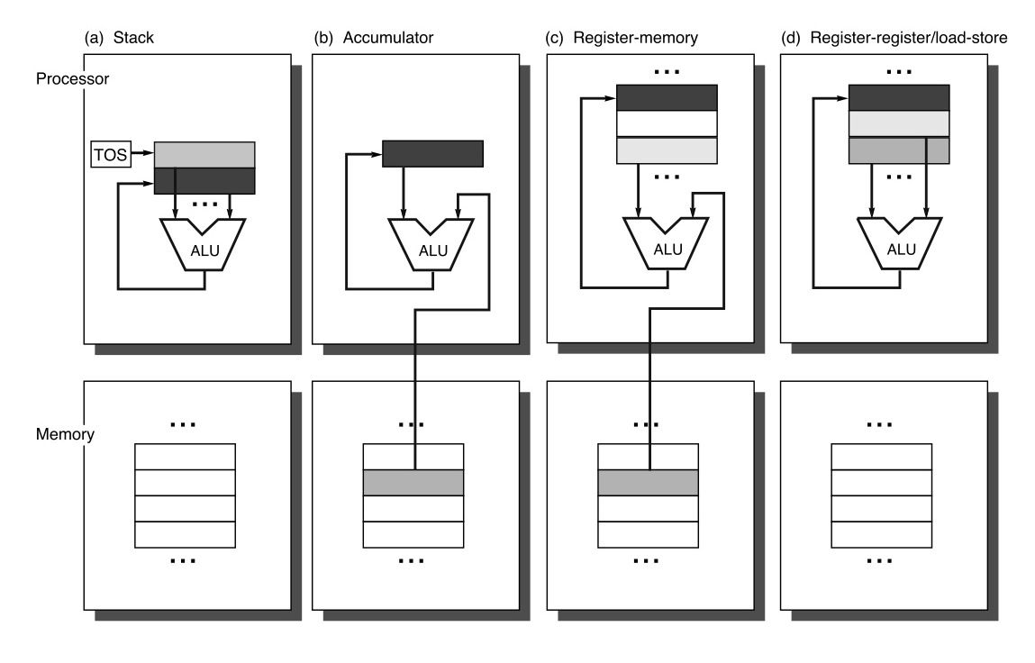
Four ISA Classes
Notes:
First distinction among different ISAs: Type of internal storage.
Stack, Accumulator, or Register.
Stack used for x86 floating point instructions, Java byte code.
Accumulator: Very popular in digital signal processors.
Register Memory: 68000
Register-Register/Load-Store: MIPS, PowerPC, SPARC.
What are the tradeoffs?
Stack / Accumulator can use “implicit operands” => can improve code density. Important when memory is relatively expensive.
Other benefits of implicit operands? What about implementation? May require less area per bit of memory. May be faster (clock frequency).
Stack Drawbacks: Cannot access operands “hidden” on stack => compiler may need to generate longer instruction sequences.
Accumulator Drawbacks: Code generation is complicated. One operand is not equivalent to the other (it gets overwritten).
Benefits of Registers: Fast access to temporary variables => reduce traffic between memory and processor.

Slide 7
Four ISA Classes
How to compute “C = A + B”:
Stack
Push A
Push B
Add
Pop C
Accumulator
Load A
Add B
Store C
Reg/Mem
Load R1,A
Add R3,R1,B
Store R3,C
Reg/Reg
Load R1,A
Load R2,B
Add R3,R1,R2
Store R3,C

Slide 8
Question
Assume A, B, and C reside in memory. Assume opcodes are 8-bits. Memory addresses are 64-bits, and register addresses are 6-bits (64 registers)
For each class of ISA, how many addresses or names appear in each instruction for the code to compute C = A + B, and what is the total code size?

Slide 9
Four ISA Classes
Stack
Push A
Push B
Add
Pop C
Accumulator
Load A
Add B
Store C
Reg/Mem
Load R1,A
Add R3,R1,B
Store R3,C
Reg/Reg
Load R1,A
Load R2,B
Add R3,R1,R2
Store R3,C
Stack 3 addresses, total bits = 4*8+3*64 = 224 bits
Accumulator 3 addresses, total bits = 3*(8+64) = 216 bits
Reg/Mem 3 addresses+4 regs, total bits = 3*64+4*6+3*8 = 240 bits
Reg/Reg 3 addresses+6 regs, total bits = 3*64+6*6+4*8 = 260 bits

Slide 10
Trade-Offs
Stack
extra code / memory bandwidth
hard to “reorder” instructions
+ good code density
Accumulator
difficult for compiler
extra code / memory bandwidth
+ good code density
Register-Memory
# of registers may be limited
operands not equivalent
+ good code density
Register-Register
- poor code density (more instructions to do same thing)
+ easy to pipeline
+ easy for compiler to generate efficient code

Slide 11
Addressing Modes
Recall Notation:
“Regs” is array of N-bit registers
(for MIPS64, 32x64-bit registers)
Regs[x] is the 64-bit quantity in register “x”
“Mem” is array of bytes
Mem[x] is “m” bytes starting at address “x”
“m” will be implied by usage
Terminology:
“Effective Address” = actual memory address calculated by instruction (just before accessing memory).

Slide 12
Addressing Modes
Mode Example Meaning
Register Add R4,R3 Regs[R4] <- Regs[R4] + Regs[R3]
Immediate Add R4,#3 Regs[R4] <- Regs[R4] + 3
Displacement Add R4,100(R1) Regs[R4] <- Regs[R4] + Mem[ 100 + Regs[R1] ]
Register Indirect Add R4,(R1) Regs[R4] <- Regs[R4] + Mem[Reg[R1]]
Indexed Add R3,(R1+R2) Regs[R3] <- Regs[R3] + Mem[Regs[R1]+Regs[R2]]

Slide 13
Addressing Modes
Mode
Direct Add R1,(1001) Regs[R1] <- Regs[R1] + Mem[1001]
Memory Indirect Add R1,@(R3) Regs[R1] <- Regs[R1] + Mem[Mem[Regs[R3]]]
Autoincrement Add R1,(R2)+ Regs[R1] <- Regs[R1]+Mem[Regs[R2]] Regs[R2] <- Regs[R2] + d
Autodecrement Add R1,-(R2) Regs[R2] <- Regs[R2] - d Regs[R1] <- Regs[R1]+Mem[Regs[R2]]
Scaled Add R1,100(R2)[R3] Regs[R1] <- Regs[R1] + Mem[100+Regs[R2]+Regs[R3]*d]

Slide 14
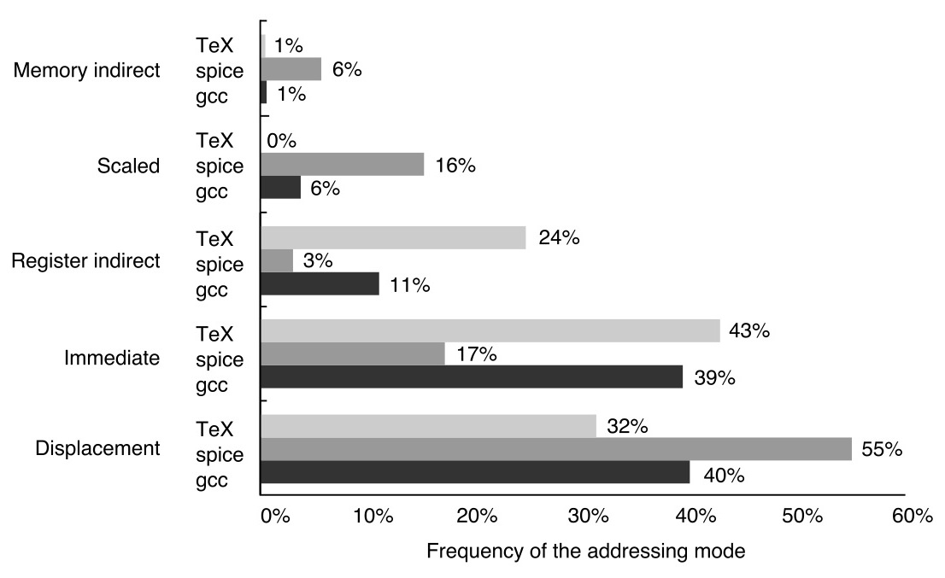
Addressing Modes
Lesson: ‘fancy’ addressing modes not used much by compiler
simple addressing modes used most often

Slide 15
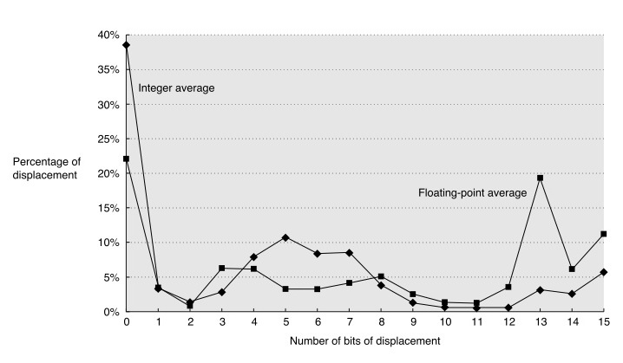
Displacement Mode
How many bits should be used to encode displacement?
What are the tradeoffs?

Slide 16
Example: How Many Bits?
Imagine a RISC instruction set that supports a 24-bit displacement field and that initially Regs[R1]=0x40. We have a program with the following instruction:
LD R2, 0x10002(R1) ; Eff. Addr. = 0x10002+0x40=0x10042
NOTE: The value 0x10002 requires at least 17 bits to represent.
We can implement the same operation using a16-bit displacement by using multiple instructions. For example, using MIPS64 (which has a 16-bit displacement field):
LUI R3,#1 ; Regs[R3] = 0x10000
DADD R4,R3,R1 ; Regs[R4] = 0x10000+0x40=0x10040
LD R2,2(R4) ; Eff. Addr = 0x10040+0x2=0x10042

Slide 17
Typical ISA Operations
There are several basic types of operations that are found
in most instruction sets. These are listed below.
Data Movement
Load (from memory)
Store (to memory)
memory-to-memory move
register-to-register move
input (from I/O device)
output (to I/O device)
push, pop (to/from stack)
Arithmetic
integer (binary + decimal) or FP
Add, Subtract, Multiply, Divide
Shift
shift left/right, rotate left/right
Logical
not, and, or, set, clear
Control (Jump/Branch)
unconditional, conditional
Subroutine Linkage
call, return
Interrupt
trap, return
Synchronization
test & set (atomic read-modify-write)

Slide 18
Top 10 IA-32 Instructions
Rank
Instruction
Integer Average (Percent total executed)
1
load
22%
2
conditional branch
20%
3
compare
16%
4
store
12%
5
add
8%
6
and
6%
7
sub
5%
8
move register-register
4%
9
call
1%
10
return
1%
Total
96%
Simple instructions dominate instruction frequency

Slide 19
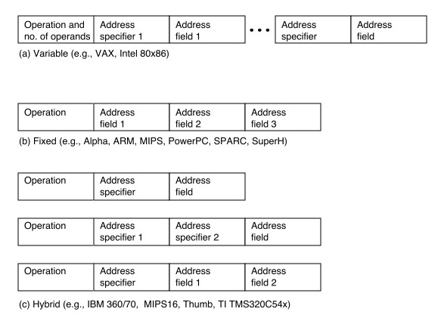
Encoding an ISA
Once we decide which instructions we want, we need to specify the instruction in 1’s and 0’s so that digital logic gates can implement it. This is known as “encoding” the instruction set.
One important question is whether instructions are all encoded with the same number of bits. The options are “variable” encoding (each instruction can be a different size); “fixed” encoding (all instruction same), or a “hybrid” (where there may be a limited number of instruction sizes).
Choice influenced by competing forces:
desire to have large # of registers + addressing modes
code density
ease of decoding

Slide 20
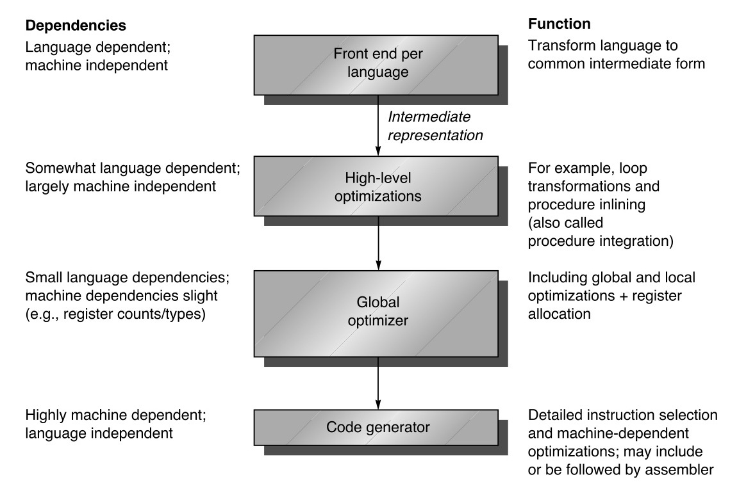
Optimizing Compilers (e.g., “gcc -O3”)
An optimizing compiler transforms code to make your software run faster. One important transformation is to allocate variables to registers. The number of registers impacts the effectiveness of optimizing compilers.
Register allocation works best with >= 16 registers.
Orthogonal ISA features => compiler easier to write.

Slide 21
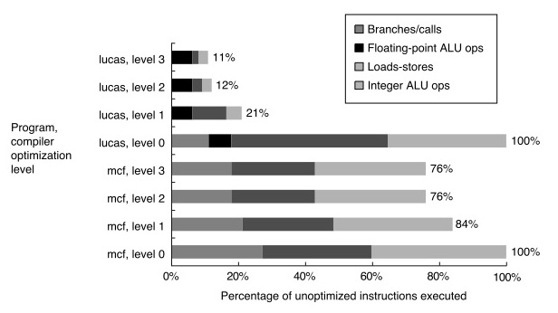
Impact of Compiler Optimization
An important pitfall to avoid is optimizing a hardware design using software
benchmarks that have not been optimized by an optimizing compiler. The
data below shows how some characteristics of a program likely to be of
importance to an ISA designer can change dramatically before/after using
an optimizing compiler.

Slide 22
Putting it all together: Desirable ISA Properties...
Local Storage
general purpose registers (load-store architecture)
at least 16 registers
Addressing Modes
Displacement (12-16 bits)
Immediate (8-16 bits)
Register Indirect
Aligned memory accesses
Type and Size of Operands
- 8-, 16-, 32-, and 64-bit integers, 64-bit FP
Minimalist instruction set: Simple operations used most frequently in practice (load, store, add, sub, move, shift, …)

Slide 23
Desirable ISA Properties, Cont’d
PC-relative branches with compare equal, not-equal, less-than
Support function calls (PC-relative, indirect), returns
Fixed instruction encoding for performance, variable encoding for code density.
Provide at least 16 general-purpose registers.
Addressing modes apply to all data transfer instructions.

