Slide 1
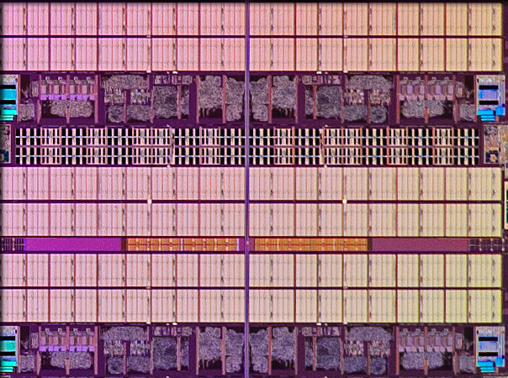
CPEN 411: Computer Architecture Slide Set 6: Caches and Prefetching
Prof. Tor Aamodt
[Background: Portion of Intel Core i7-5960X Extreme Edition 20 MB L3 Cache;
Source: https://www.anandtech.com/show/8426/the-intel-haswell-e-cpu-review-core-i7-5960x-i7-5930k-i7-5820k-tested]
Notes:
1

Slide 2
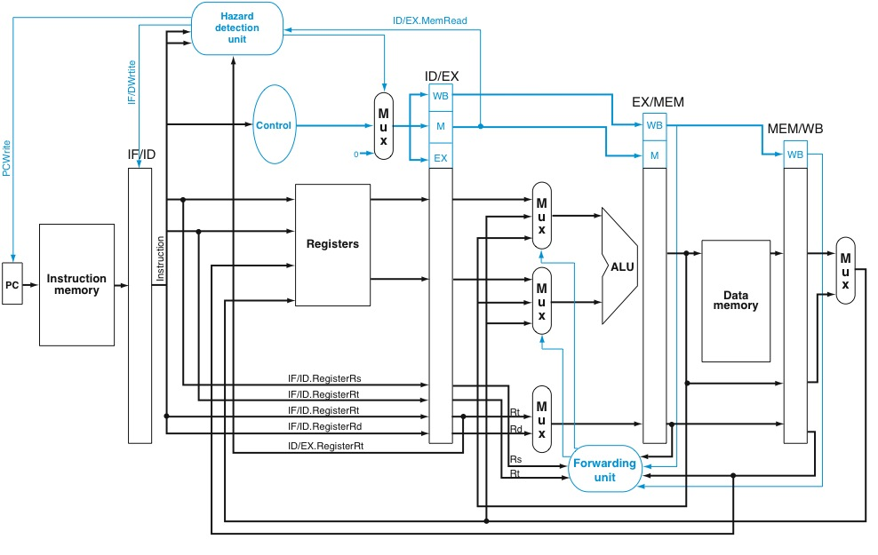
How to Design “Memory” Blocks?

Slide 3
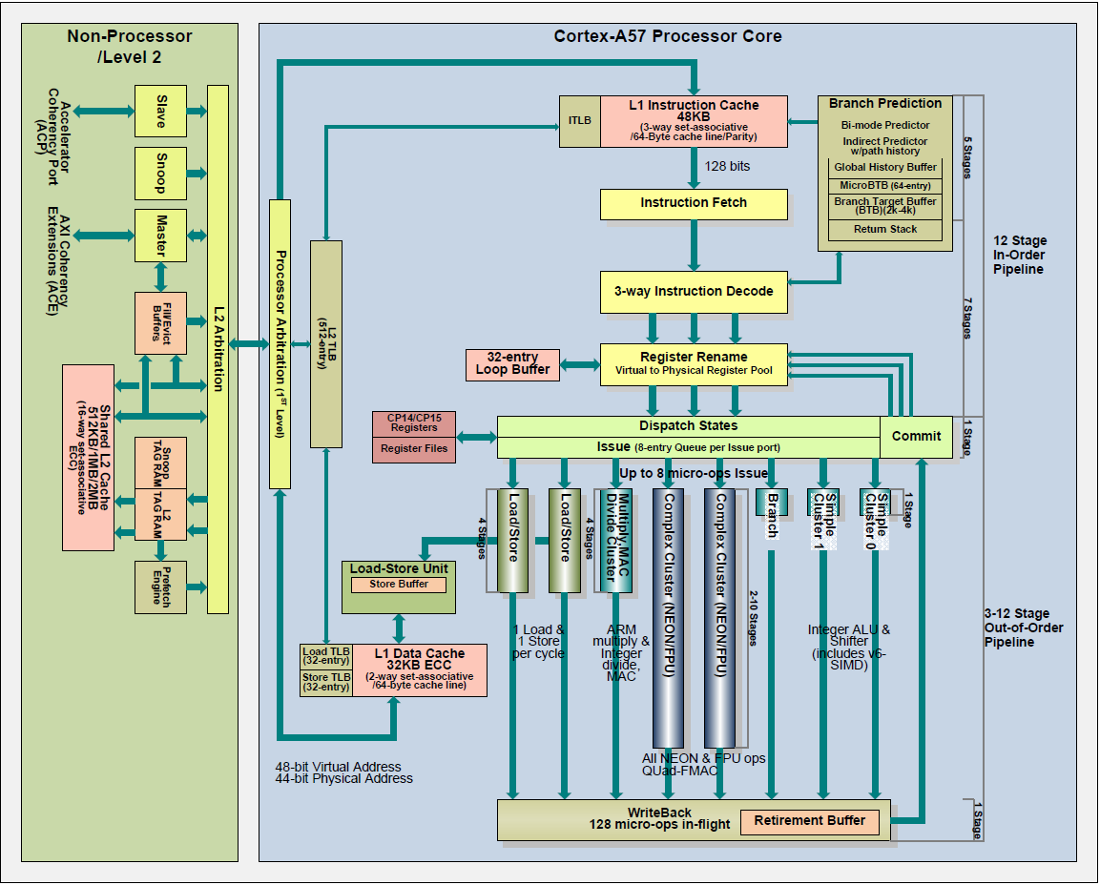



Slide 4
Fundamental Problem
Faster memory is smaller.
How can we design a fast computer that can use large memory?

Slide 5
The Memory Wall
CPU-DRAM Gap
1980: no cache in µproc; 1995 2-level cache on chip (1989 first Intel µproc with a cache on chip)
1000
µProc
60%/yr.
CPU
“Moore’s Law”
100
Processor-Memory
Performance Gap: (grows 50% / year)
Performance
10
DRAM
7%/yr.
DRAM
1
1989
1980
1990
1981
1982
1983
1984
1985
1986
1987
1988
1991
1992
1993
1994
1995
1996
1997
1998
1999
2000
Notes:
Y-axis is performance
X-axis is time
Latency
Cliché:
Not e that x86 didn’t have cache on chip until 1989

Slide 6
Solution: Memory Hierarchy
Regs
Faster
L1-Cache
L2-Cache
Memory
Bigger
Disk, Tape, etc.

Slide 7
What do real programs do?
Consider “SAXPY” loop:
void saxpy( float a, float *X, float *Y, unsigned N )
{
for( i=0; i < N; i++ )
Y[i] = a*X[i] + Y[i];
}
Two observations:
1. Read then write Y[i] (temporal locality)
2. Read X[0], then X[1], then X[2] (spatial locality)

Slide 8
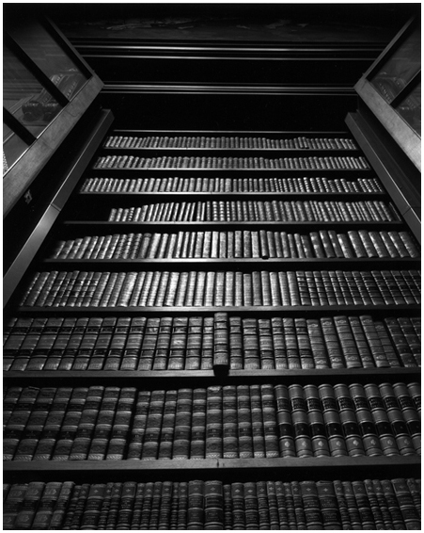


A Silly Locality Analogy
Fast RAM: Is book I want in backpack?
Slow RAM: Is book in UBC library?
Disk: inter-library loan (or chapters.ca)
Temporal Locality (analogy):
If use book once, likely to
use it again soon.
Spatial Locality (analogy):
If last time went to library
borrowed book on “mystery
novels” next time likely get
another book from same
section.

Slide 9
Temporal Locality
Temporal Locality: After accessing single location once the program accesses it again.
Example: Y[i] = a*X[i] + Y[i];
1: FLDS S3,[R1] ; read X[i]
2: FMULS S5,S3,S4 ; a*X[i]
3: FLDS S6,[R2] ; read Y[i]
4: FADDS S7,S5,S6 ; a*X[i]+Y[i]
5: FSTS S7,[R2] ; write Y[i]
line 3: read Y[i]
line 5: write Y[i] (note: same location)

Slide 10
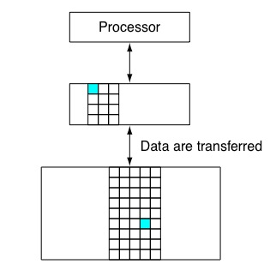
Exploiting Temporal Locality
Idea: When accessing location (address) make copy of data in small fast memory. If there is temporal locality program will (likely) try to access the same data again soon.
Small fast memory
Y[0]
Large slow memory

Slide 11
How is data transferred?
Option 1: Software moves data
Small fast RAM called a “scratchpad” memory
Used by recent GPUs
Typically, the programmer must decide when to move data between slow big memory and fast small memory. Add extra code to move data.
Benefits: Programmer can optimize what to put in fast memory and when.
Drawbacks: More work for programmer
Option 2: Hardware managed cache
Most CPUs take this approach. Our focus.

Slide 12
Hardware managed cache design
We will have hardware automatically copy data to “cache” when program accesses the location holding that data.
Problem: Need mechanism for hardware to find data next time program accesses it.
Solution: Save address (“tag”) in cache along with copy of the data at that address.

Slide 13
Example
Show cache contents when executing following code on “fully associative” data cache with two 4 byte blocks.
FLDS S3,[R2] ; read Y[i]
FADDS S4,S2,S3 ; a*X[i]+Y[i]
FSTS S4,[R2] ; write Y[i]
Initially: Regs[R2]=0x8, Regs[S2]=78.2, memory state:
Address | Memory contents | Description
0x0000000c | C4 7A 00 00 | Y[3] = -1000.0
0x00000008 | 40 2D F8 54 | Y[2] = 2.718282
0x00000004 | 40 49 0F DB | Y[1] = 3.141593
0x00000000 | 42 28 00 00 | Y[0] = 42.0

Slide 14
Example, continued…
valid? | modified? |  | tag | data
0 | 0 |  | 0x00000000 | 00 00 00 00
0 | 0 |  | 0x00000000 | 00 00 00 00
cache holding two 4-byte “blocks”
Each row in cache contains four fields:
“data” holds copy of memory data
“tag” indicates address associated with data
“modified” indicates if data in cache was written to since copying from memory
“valid” indicates the row contains valid information.

Slide 15
Example, continued
Executing:
FLDS S3,[R2] ; read Y[i]
Step 1: compute effective address of memory access R2 = 0x00000008
Step 2: Check if block containing contents of memory
at address 0x00000008 is present in cache:
Answer = no (“cache miss”). (If yes, “cache hit”)
valid? | modified? |  | tag | data
0 | 0 |  | 0x00000000 | 00 00 00 00
0 | 0 |  | 0x00000000 | 00 00 00 00

Slide 16
Example, continued
Executing:
FLDS S3,[R2] ; read Y[i]
Step 3: Copy data into cache (use block with “valid=0”)
valid? | modified? | tag | data
0 | 0 | 0x00000000 | 00 00 00 00
0 | 0 | 0x00000000 | 00 00 00 00
valid? | modified? | tag | data
1 | 0 | 0x00000008 | 40 2D F8 F4
0 | 0 | 0x00000000 | 00 00 00 00
Address | Memory contents | Description
0x0000000c | C4 7A 00 00 | Y[3] = -1000.0
0x00000008 | 40 2D F8 54 | Y[2] = 2.718282
0x00000004 | 40 49 0F DB | Y[1] = 3.141593
0x00000000 | 42 28 00 00 | Y[0] = 42.0

Slide 17
Example, continued
Cache after executing
FADDS S4,S2,S3; Regs[F4]=80.918 (0x42A1D629)
FSTS S4,[R2]; write Y[i]
valid? | modified? | tag | data
1 | 1 | 0x00000008 | 42 A1 D6 29
0 | 0 | 0x00000000 | 00 00 00 00
valid? | modified? | tag | data
1 | 0 | 0x00000008 | 40 2D F8 F4
0 | 0 | 0x00000000 | 00 00 00 00
Address | Memory contents | Description
0x0000000c | C4 7A 00 00 | Y[3] = -1000.0
0x00000008 | 40 2D F8 54 | Y[2] = 2.718282
0x00000004 | 40 49 0F DB | Y[1] = 3.141593
0x00000000 | 42 28 00 00 | Y[0] = 42.0

Slide 18
Question
Consider the following series of memory references (byte addresses, in decimal): 2, 3, 2, 8, 10, and 2.
Assume fully associative cache with 8 one-byte blocks that are initially empty (valid=0), label each reference in the list as a hit or a miss, report the total number of hits and show the final contents of the cache.
Ignore “modified” and “data” fields.

Slide 19
Solution
2 m, 3 m, 2 h, 8 m, 10 m, 2 h
Valid | Tag
0 | -
0 | -
0 | -
0 | -
0 | -
0 | -
0 | -
0 | -
Valid | Tag
1 | 2
1 | 3
1 | 8
1 | 10
0 | -
0 | -
0 | -
0 | -
Valid | Tag
1 | 2
0 | -
0 | -
0 | -
0 | -
0 | -
0 | -
0 | -
Valid | Tag
1 | 2
1 | 3
0 | -
0 | -
0 | -
0 | -
0 | -
0 | -
Valid | Tag
1 | 2
1 | 3
1 | 8
0 | -
0 | -
0 | -
0 | -
0 | -

Slide 20
Problem with this design
Where do we put data if cache is full?
Return to this question after considering spatial locality.

Slide 21
Spatial Locality
Definition: After accessing a location program accesses nearby location.
Example:
Y[2] = a*X[2] + Y[2];
Y[3] = a*X[3] + Y[3];
Program reads Y[2], then Y[3].

Slide 22
Exploiting Spatial Locality
When program accesses Y[2] transfer both Y[2] and Y[3].
In general, transfer a “block” of data (or instructions) at a time. Block size
typically 32 to 128 bytes.
In figure at left have a block containing Y[2] and Y[3] but more typical 64 byte block can hold sixteen 4-byte values.
Y[2], Y[3]

Slide 23
Cache Blocks (Cache Lines)
Want to move nearby data at same time to exploit spatial locality. Divide up memory into blocks that are power of two multiples of word size. Block starts at address aligned to block size (whole number multiple of block size).
memory
address
memory
contents
0xfffffff8 | 00 00 00 00 00 00 00 00
0xfffffff0 | 00 00 00 00 00 00 00 00
… | …
0x00000010 | 01 00 70 95 42 3C E7 98
0x00000008 | C4 7A 00 00 40 2D F8 54
0x00000000 | 40 49 0F DB 42 28 00 00
8 byte block. First byte at 0x00000008 contains “54”. Last byte at 0x0000000f contains “C4” (“little endian” byte order).
Copy entire block at once.

Slide 24
Modified Cache Design
Increase data field size to hold block of size 8 bytes. Now cache can exploit both spatial and temporal locality.
valid? | modified? | tag | data
0 | 0 | 0x00000000 | 00 00 00 00 00 00 00 00
0 | 0 | 0x00000000 | 00 00 00 00 00 00 00 00

Slide 25
Block Size Impact on Tag
Blocks start at address aligned to block size.
This means lower log₂(block size) bits of block address are always zero.
Would be a waste of transistors if we explicitly store these zero values.

Slide 26
Question
For a fully associative cache with 16 byte blocks what is the tag in hex for a block with starting address 0x00008020?

Slide 27
Example, revisited (FLDS F3, [R2])
Regs[R2] = 0x00000008 implies tag=0x0000001 -- why?
In binary 0x00000008 = 0000 … 000000001000
Drop least significant 3 bits since using 8 byte blocks
Cache after executing
FLDS F3 [R2] ; read Y[i]
valid? | modified? | tag | data
0 | 0 | 0x00000000 | 00 00 00 00 00 00 00 00
0 | 0 | 0x00000000 | 00 00 00 00 00 00 00 00
valid? | modified? | tag | data
1 | 0 | 0x00000001 | C4 7A 00 00 40 2D F8 54
0 | 0 | 0x00000000 | 00 00 00 00 00 00 00 00
copy 8 byte block to cache
memory
address
memory
contents
4 byte value written to Regs[F3] by FLDS is 0x402DF854
0x00000010 | 01 00 70 95 42 3C E7 98
0x00000008 | C4 7A 00 00 40 2D F8 54
0x00000000 | 40 49 0F DB 42 28 00 00

Slide 28
Multiple words in block
For the SAXPY loop 8 byte block contains two elements – e.g., Y[2] and Y[3]:
How to find specific data (e.g., Y[2] or Y[3]) accessed by load/store instruction?
valid? | modified? | tag | data
1 | 0 | 0x00000001 | C4 7A 00 00 40 2D F8 54
Y[2]
Y[3]

Slide 29
Solution: Block Offset
Recall, block starts at address aligned to log₂(block size) and data stored within block in same order as in memory.
So, we can compute location of word in block by using lower log₂(block size) bits of address of word.

Slide 30
Solution: Block Offset
Example block offset calculation (8 byte block)
address (hex) address (binary)
0x00000008 = 0000 … 000000001000
0x0000000C = 0000 … 000000001100
valid? | modified? | tag | data
1 | 0 | 0x00000001 | C4 7A 00 00 40 2D F8 54
Block Offset = 0
Block Offset = 4

Slide 31
Question
For a cache with 16 byte blocks what is the block offset for a 4 byte float stored in memory at starting address 0x00008028?

Slide 32
Example, revisited
Regs[R2] = 0x8 => Tag=0x1, Block Offset=0
Cache after executing
FADDS S4,S2,S3 ; Regs[S4] = 0x42A1D629
FSTS S4,[R2] ; write Y[i]
valid? | modified? | tag | data
1 | 1 | 0x00000001 | C4 7A 00 00 42 A1 D6 29
0 | 0 | 0x00000000 | 00 00 00 00 00 00 00 00
valid? | modified? | tag | data
1 | 0 | 0x00000001 | C4 7A 00 00 40 2D F8 54
0 | 0 | 0x00000000 | 00 00 00 00 00 00 00 00

Slide 33
What if cache is full?
So far we assumed we “fill” blocks into cache starting at first available (“invalid”) row and when accessing cache do parallel search for tag match in all rows (“fully associative”)
If cache full (no blocks are “invalid”), need to make space for new block by “evicting” a “valid” block from cache.

Slide 34
Which block gets evicted?
Which is best block to evict? Recall we want to keep useful data in cache. So, we need to consider locality.
Provably optimal (Bélády): evict block that will be accessed again furthest in future.
Problem: Hardware does not know future. Need prediction mechanism.

Slide 35
How to predict?
Goal: Want to predict which block will be accessed furthest in future.
Observation: For many programs, the longer a block has not been accessed, the less likely it is that we will access it soon.
Can quantify this using “reuse distance”.

Slide 36
Reuse Distance (Definition)
Consider sequence of memory accesses to blocks A, B, C, D, and E:
ABBCBCCDBBEDBBBA
Between two accesses to block A made 14 accesses to four unique blocks (B, C, D, E)
Reuse distance for A is four.

Slide 37
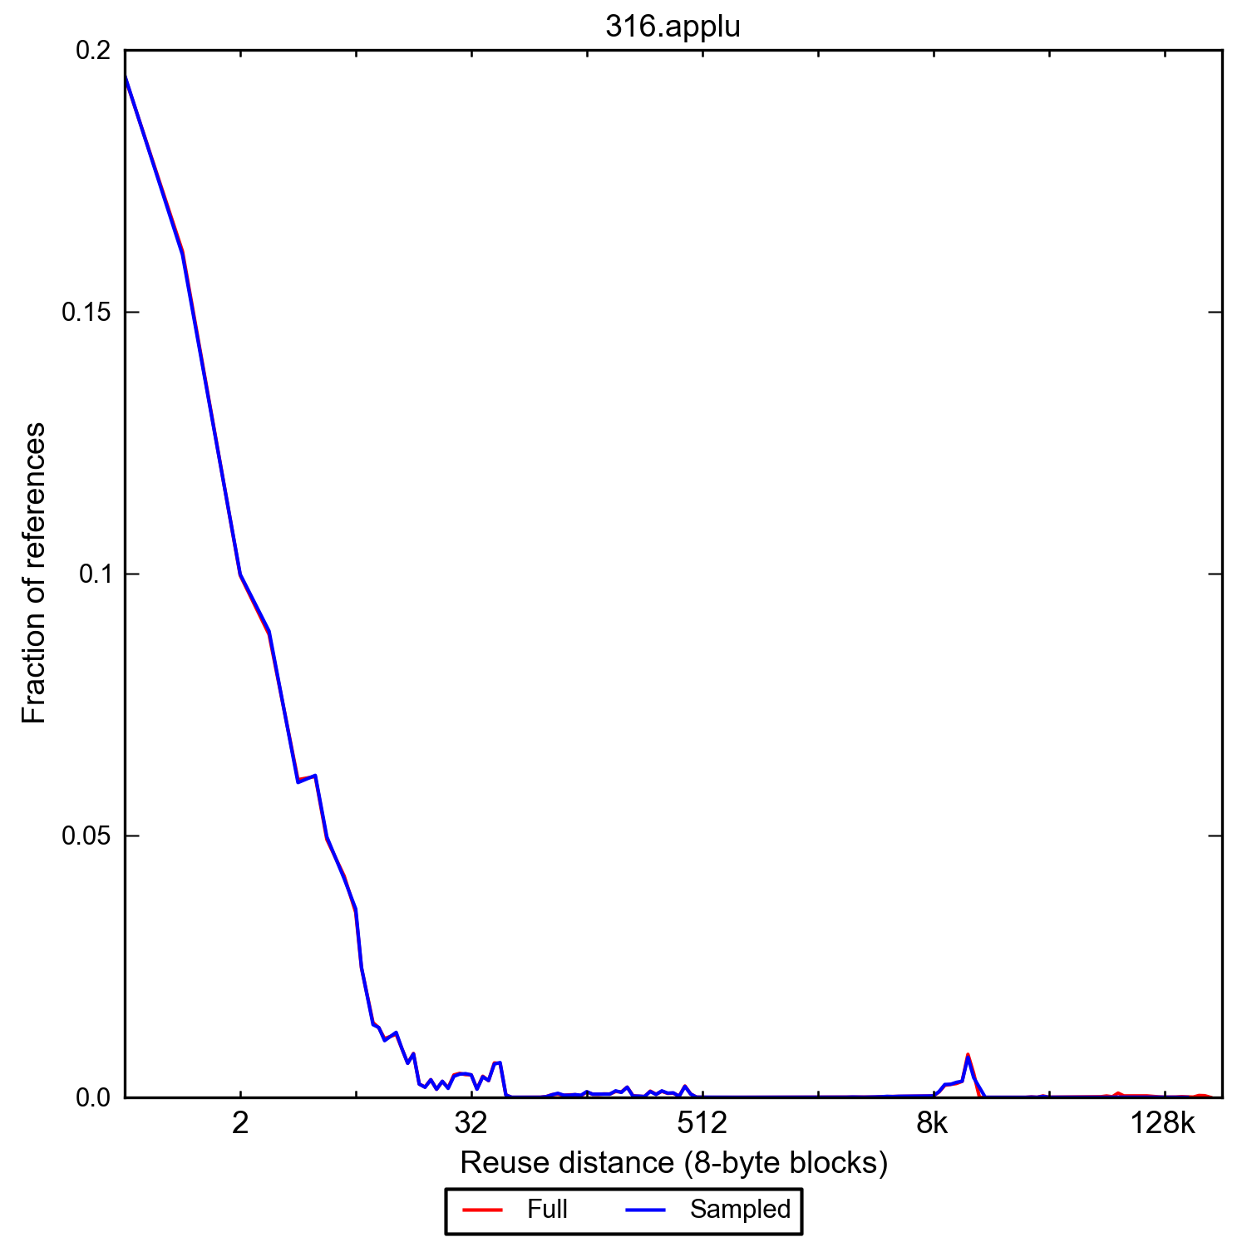
Reuse distance measurement
typically, recently used data accessed most frequently

Slide 38
Replacement Policy (RP)
algorithm used to decide which block to evict
some ideas for choosing replacement victim:
random (works better than you would expect) ←
least frequently used
least recently used ←
what do we need to keep track of?
LFU?
LRU?

Slide 39
Random Replacement
select victim uniformly at random
pros: don’t need to remember anything!
but how well does it work?
consider, e.g., accesses AAAABAAAACAAAAD... = (AAAAx)^{n}
lowest possible miss rate?
miss rate if we always evict A?
w/ 32-entry fully associative cache & random RP?
1/5 + 1/5×1/32 ≈ 0.23

Slide 40
Natural Selection Analogy

Slide 41
Least Recently Used (LRU)
naïve: timestamp per cache block (cons?)
two-way set associative: one LRU bit
if last touched left way, LRU bit ← 0
if last touched right way, LRU bit ← 1
if bit 0, replace right, else left
>2 ways: many choices for pseudo-LRU (pLRU)
MRU bit per block, clear all when all set
rereference prediction value (RRPV) per block, set to max @ insert or hit, decrement over time

Slide 42
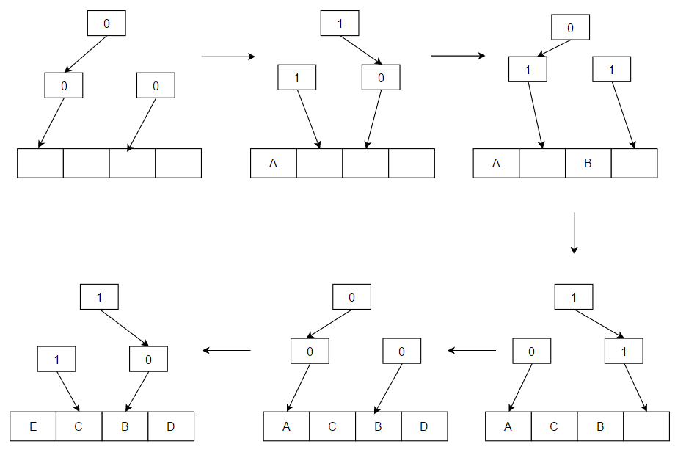
Tree-based Pseudo LRU
N-1 bits for N blocks: 0=>go left, 1=>go right. Flip bits while traversing to find block to evict.
https://en.wikipedia.org/wiki/Pseudo-LRU

Slide 43
Question
Assume fully associative cache with 8 one-byte blocks. Consider the following series of memory references (byte addresses, in decimal): 2, 3, 2, 8, 10, and 2. After this sequence has been observed, what is the tag of the least recently used block?

Slide 44
Fully Associative Implementation
4-bit tag comparison hardware
=

Slide 45
Problem with Fully Associative
Comparing all tags in parallel is expensive (time, area and energy).
Can avoid multiple tag comparisons if block can only be stored in single row in cache. This is called “direct mapped”. Then, only one tag needs to be checked.
Also makes replacement decision easy (only one choice of what to evict).

Slide 46
Direct Mapped Cache
Given start address of block need way for hardware to select single row of cache to place block in.
Start of block is aligned so least significant log₂(block size) bits in address are zero. Use hash on remaining address bits to compute an index used to select row.
Typically, use next log₂(number of rows) least significant bits of block start address as hash function: index = block address % num. rows

Slide 47
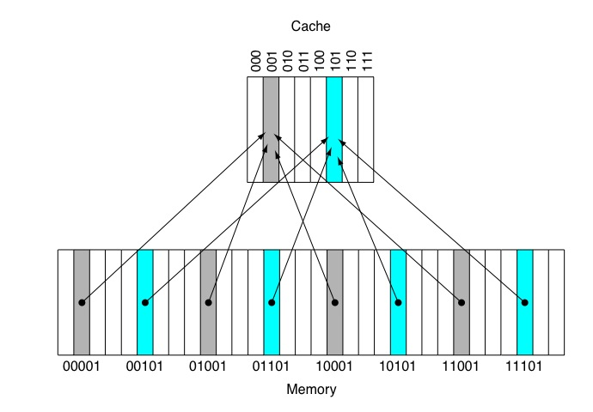
Direct Mapped Cache
“Block Address” is starting address of block with log₂(block size) least significant bits truncated (removed).
Address:
Index = (Block Address) modulo (Number of Rows)
Address:
Block Address Block Offset
Tag Index Block Offset

Slide 48
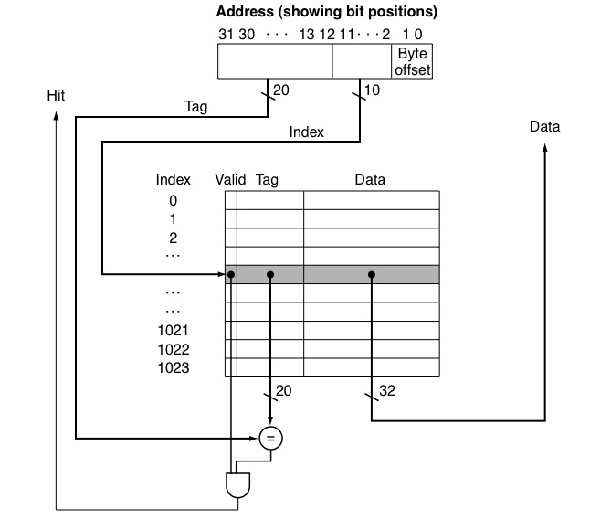
Direct Mapped Cache
LDR R1, [R2, #8]
4-byte blocks, so block offset is 2-bits.
1024 rows so use log₂(1024)=10-bits of address to select row. These bits are called “index”.

Slide 49
Problem: Conflict Misses
Some “rows” (blocks) in direct mapped cache used more than others.
Data that index to these blocks may get evicted before reused even though there was enough space in cache to keep them.
Would like to have flexibility of fully associative without cost of parallel comparison of all tags in cache.

Slide 50
Set Associative Cache
Index selects row containing set of blocks.
Search tags of all blocks in this set in parallel.

Slide 51
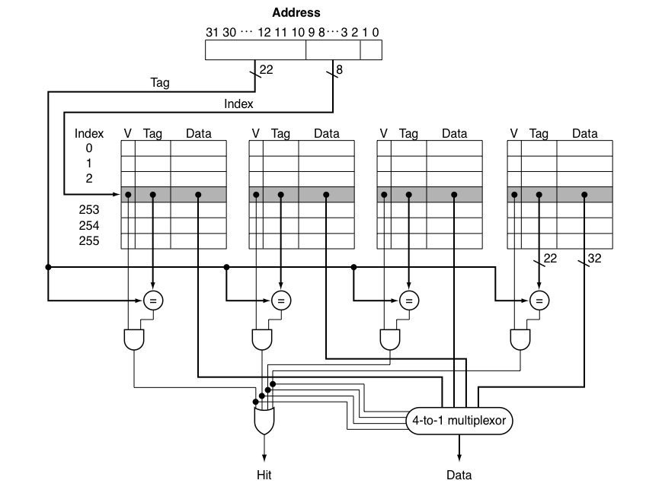
Set Associative Cache

Slide 52
Question
Consider the following series of memory references (byte addresses, in decimal): 2, 3, 2, 8, 10, and 2. Assuming first a direct mapped cache with one byte blocks and total capacity of 8 bytes, then a two-way set associative cache with 2-byte blocks and total size of 16 bytes that are initially empty. Label each reference in the list as a hit or a miss and show the final contents of the cache.

Slide 53
Solution
2 m, 3 m, 2 h, 8 m, 10 m, 2 m
2 m, 3 h, 2 h, 8 m, 10 m, 2 h
Cache set | Address
000
001
010
011
100
101
110
111
8
Cache Set | Address
00 | { - , - }
01 | { - , - }
10 | { - , - }
11 | { - , - }
10
[8,9]
2
2
2
3
[2,3]
[10,11]
[2,3]
[2,3]
Direct-mapped cache 2-way set associative
1 byte blocks 2 byte blocks
8 bytes total 16 bytes total

Slide 54
Victim cache
lots of associativity good but expensive
some sets need more associativity
idea: small fully associative cache that stores recently evicted lines
on evict, place in victim $
on hit in V$, bring to normal $
managed with e.g., LRU like normal $
effectively extra associativity for some lines
CPU
L1 $
v$

Slide 55
What happens on a write? Cache Writing Policies
Write-through
Store to both cache and memory on every write
Slow writes
Conservative: memory always holds valid data
Simple cache
Write-back
Store to cache only
Fast writes
On write, mark data block in cache as dirty
Need extra memory bit for each cache line (dirty bit)
Memory may hold invalid/stale data (must fix!)
More complex cache
Text: COD ARM Edition §5.3

Slide 56
Writes that hit in the cache
write-through
write-back
write-evict
sw R1, 0(R2)
sw R1, 0(R2)
sw R1, 0(R2)
main memory
main memory
main memory
data valid
data invalid
data valid

Slide 57
Write Misses (how are they handled by hardware?)
Writes can miss in cache… leads to a hardware design choice (the design choice options are answers to question “how do we deal with write miss”). Two choices are:
Write-allocate
First, read cache block from memory into cache
Second, proceed with write
No write-allocate
Write to memory directly
Memory access is slow, CPU must wait
Improve performance using “write buffers” (see later)
Most common design choices:
Writeback cache uses write-allocate
Write-through cache uses no write-allocate (keep it simple)
Text: COD ARM Edition §5.3

Slide 58
Writes that miss in the cache
write-allocate
write-no-allocate
sw R1, 0(R2)
sw R1, 0(R2)
aside:
proposals exist
to bypass cache
for some reads
(why and how?)
main memory
main memory

Slide 59
Two points about reads and writes
consider load access to cache: when can this cause a memory write?
consider store access to cache: when can this cause a memory read?

Slide 60
Counter-Intuitive Case 1: Load instruction may cause Writes
Write-back cache problems
Over time, many cache blocks marked “dirty”
Eventually, must write dirty data back to memory
Usually, when cache block is evicted
(Also, if cache is “flushed” for OS context switch)
Called a “writeback” event
Load may cause writes
Load instruction miss, may evict a dirty cache block
Write first: (old) dirty cache block writes to memory
Read second: (new) memory block loaded into cache
…but CPU is waiting for read result to do Load…
Many CPUs do the “read first”
Holds dirty cache block in special “write buffer” during read
Text: COD ARM Edition §5.3

Slide 61
Counter-Intuitive Case 2: Store instruction may cause Reads
Writes can miss in the cache!
Store may cause Reads
Writeback cache with write-allocate policy
Store misses in cache
CPU performs READ from memory, puts data in cache
CPU performs write in cache, marks block dirty
It can be even more complex
When store misses in cache above
Must evict existing cache block
If marked dirty, must first write back the cache block to memory
CPU performs read from memory
CPU performs write in cache
Text: COD ARM Edition §5.3

Slide 62
Write Buffers for Write-Through Caches
Cache
Lower Level Memory
Processor
Write Buffer
Holds data awaiting write-through to
lower level memory
Q. Why a write buffer ?
A. So CPU doesn’t stall
Q. Why a buffer, why not just one register ?
A. Bursts of writes are
common.
Q. Are Read After Write (RAW) hazards an issue for write buffer?
A. Yes! Drain buffer before next read, or send read after 1st checking write buffers.
Text: COD ARM Edition §5.3

Slide 63
Evictions in a cache hierarchy
inclusive
exclusive
non-inclusive
in L1 ==> in LLC
(inv L1 on LLC evict)
in L1 ==> not in LLC
(L1 evict spills to LLC)
in L1 ==> ? in LLC
(silent LLC evict)
evict
fill
fill
fill
evict
main memory
main memory
main memory

Slide 64
CPU
32 KB, 8-way
(private)
32 KB, 8-way
(private)
L1 I$
L1 D$
256 KB, 4-way
(private)
L2 $
12 cycles
D$ and I$ usually separated at L1 — why?
different effect of misses on performance
for data load stalls, can maybe cover latency by OoO
but instruction load stalls are deadly (why?)
different access patterns (how?)
avoids friendly fire where data accesses evict our program’s instructions
8 MB, 16-way
(shared)
L3 $
42 cycles
16 GB+
42 cycles + 51ns ≈ 246 cycles
off-chip DRAM
Intel i7-6700 (Skylake) Q3 2015

Slide 65
Performance / Multilevel Caches
Impact of caches on performance?
Reduce “Miss Penalty” by adding second-level of caching:
CPU
CPU
1 cycle
1 cycle
L1 $
L1 $
10 cycles
200 cycles
L2 $
200 cycles
Memory
Memory

Slide 66
Example Problem
How much faster is a processor with both L1 and L2 caches versus a processor with only an L1 cache?
Assume the following:
CPI is 1.0 when all memory references hit in the L1 cache.
All instruction references hit in L1 instruction cache.
Loads and stores comprise 30% of instructions.
L1 data cache hit rate is 80%
L2 data cache hit rate is 40% and a L2 cache hit takes 10 cycles.
Main memory takes 200 cycles to access.

Slide 67




Solution
$$Speedup with L2= \frac{Performance with L2}{Performance without L2}$$
$$= \frac{Execution Time without L2}{Execution Time with L2}$$
$$= \frac{{IC}_{without L2}× {CPI}_{without L2}×{cycle time}_{without L2}}{{IC}_{with L2}× {CPI}_{with L2}×{cycle time}_{with L2}}$$
(Adding L2 cache does not impact instruction count or cycle time)
$$Speedup with L2= \frac{{CPI}_{without L2}}{{CPI}_{with L2}}$$

Slide 68
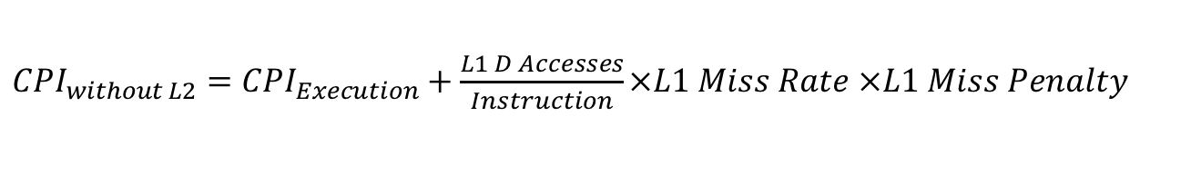

Solution, Continued…
$$Speedup with L2= \frac{{CPI}_{without L2}}{{CPI}_{with L2}}$$
${CPI}_{without L2}=$ ${CPI}_{Execution}+\frac{L1 D Accesses}{Instruction}×L1 Miss Rate ×L1 Miss Penalty$
$=$ $1.0+0.3×(1−0. 8)×200$
$=$ $13$

Slide 69
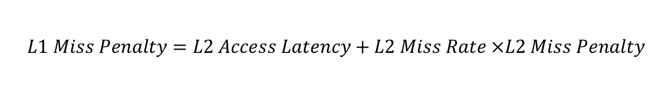
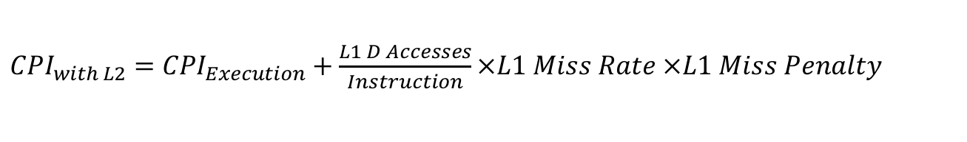
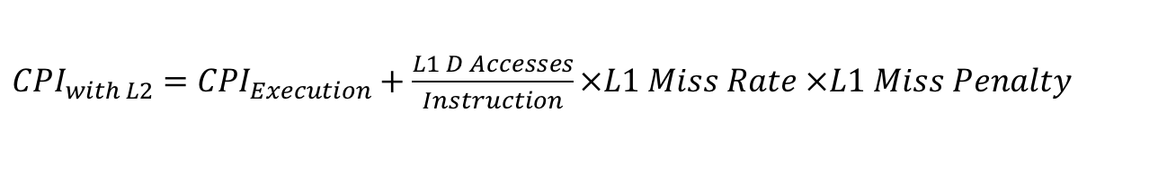
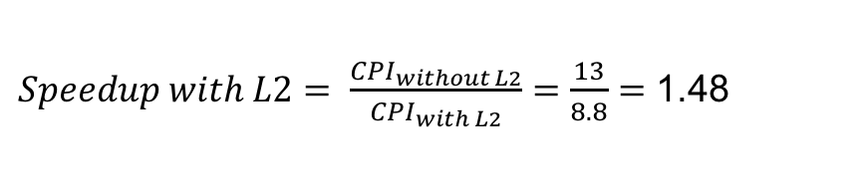
Solution, Continued…
${CPI}_{with L2}=$ ${CPI}_{Execution}+\frac{L1 D Accesses}{Instruction}×L1 Miss Rate ×L1 Miss Penalty$
$$L1 Miss Penalty=L2 Access Latency+L2 Miss Rate ×L2 Miss Penalty$$
$=$ $10+(1−0. 4)×200$
$=$ $13$0
${CPI}_{with L2}=$ ${CPI}_{Execution}+\frac{L1 D Accesses}{Instruction}×L1 Miss Rate ×L1 Miss Penalty$
$=$ $1.0+0.3×(1−0. 8)×130$
$=$ $8.8$
$Speedup with L2= \frac{{CPI}_{without L2}}{{CPI}_{with L2}}=\frac{13}{8.8}=$ 1.48

Slide 70
Lockup-free caches
problem: only one outstanding cache miss
but this may take 100s of cycles
idea: MSHRs (miss status handling registers)
block address and offset
dst tag (or reg) for a load, value for a store
CPU continues executing (even memops if 2+ MSHRs)
broadcast value on CDB after miss serviced
can merge multiple requests to same address (must be careful about order, though)

Slide 71
Question
fully assoc. cache, eight 16-byte blocks, empty
4 MSHRs, all empty
memory accesses very long (100s of cycles)
load sequence w/ the following byte addresses: 0, 8, 16, 4, 12, 20, 24, 32, 128, 96, 64
which access will stall b/c all MSHRs full?
MSHR allocs

Slide 72
Prefetching
problem: predictable access pattern e.g., x[0], x[8], x[16], x[24], ...
w/ 64-bit vals, 64-byte blocks: cold misses
but we know pattern in advance, so prefetch
especially useful for instructions (why?)
prefetch tradeoffs
effective only if accurate and timely
if not, wastes valuable memory bandwidth
real prefetchers turn off if ineffective

Slide 73
Stream buffer
IDEA: buffer sequential access stream
maybe several buffers for multiple streams
if hit in stream buffer, move to $, prefetch next
what is the problem w/ this?
L1$

Slide 74
Stride prefetcher
observation: accesses may not be adjacent
multiple access streams w/ different strides
IDEA: track prev addr, stride, correctness
if predictions confirmed, keep prefetching
incorrect
PC
tag
prev_addr
stride
state
init
steady
correct
correct
incorrect
(update
stride)
correct
correct
trans
no-pred
incorrect
(update stride)
incorrect
(update stride)

Slide 75
Stride prefetcher example (one PC)
A stride prefetcher has an FSM and is initialized as shown below
The observed access sequence is
4, 8, 12, 16, 10, 20, 30, 40
How many will be prefetched? How many are correct/incorrect?
prev stride state prefetch
0 0 init —
4 4 trans —
incorrect
8 4 steady 12
init
steady
12 4 steady 16
correct
correct
16 4 steady 20
incorrect
(update
stride)
correct
10 4 init —
20 10 trans —
correct
trans
no-pred
30 10 steady 40
incorrect
(update stride)
incorrect
(update stride)

