Slide 1
CPEN 411: Computer Architecture Virtual Memory

Slide 2
Learning Objectives
define and motivate virtual memory
describe how page tables implement VM
perform virtual → physical address translation
motivate and emulate the TLB
explain/address VM–cache interaction issues

Slide 3
Virtual memory
problem: OS wants to multitask (time-multiplex)
but all programs assume address space starts at 0
enough physical RAM to run one program but not enough to fit all of them at once
solution: separate address space per program
each program has separate address space ID (ASID)
program executes using virtual addresses (VA)
CPU + OS translate to physical addresses (PA)
{ASID 42, VA 0xdeadbeef} ≠ {ASID 17, VA 0xdeadbeef} (they will map to different physical addresses)

Slide 4
Multiple Programs Using Memory
Word
OS starts, reserves some memory
browser starts, wants memory
Word starts, wants memory
open webpage, browser allocs memory
open doc, Word allocs memory
open webpage, browser allocs more
user edits doc, Word allocs more
total more than physical memory
Web
Main
Mem
Word
Web
Word
Web
OS

Slide 5
Fragmentation
“writer’s block,” user exits Word (sorry ENGL 112)
start game, needs lots of RAM
and it wants contiguous addrs
can’t move the browser (has pointers to green memory)
Word
Web
Main
Mem
Word
Web
Word
Web
OS

Slide 6
Paged virtual memory
program view of memory
main memory, actually
V
i
r
t
u
a
l
a
d
d
r
e
s
s
e
s
P
h
y
s
i
c
a
l
a
d
d
r
e
s
s
e
s
A
d
d
r
e
s
s
t
r
a
n
s
l
a
t
i
o
n
pages
equal
size
pages
fragmented:
non-contiguous (holes), out-of-order, some on disk (that CPEN 411 sim...)
nice contiguous address space, can always alloc more
D
i
s
k
a
d
d
r
e
s
s
e
s

Slide 7
Address Translation
V
i
r
t
u
a
l
a
d
d
r
e
s
s
3
1
3
0
2
9
2
8
2
7
1
5
1
4
1
3
1
2
1
1
1
0
9
8
3
2
1
0
V
i
r
t
u
a
l
p
a
g
e
n
u
m
b
e
r
P
a
g
e
o
f
f
s
e
t
T
r
a
n
s
l
a
t
i
o
n
2
9
2
8
2
7
1
5
1
4
1
3
1
2
1
1
1
0
9
8
3
2
1
0
P
h
y
s
i
c
a
l
p
a
g
e
n
u
m
b
e
r
P
a
g
e
o
f
f
s
e
t
P
h
y
s
i
c
a
l
a
d
d
r
e
s
s

Slide 8
Page Table
program view
main memory view
Virtual Addresses
Physical Addresses
Address Translation
civ
civ
pages
civ
civ
civ
civ
civ
civ
civ
Page Table
D
i
s
k
a
d
d
r
e
s
s
e
s

Slide 9
Page Table Translation Structure
page table register
virtual address
3
1
3
0
2
9
2
8
2
7
1
5
1
4
1
3
1
2
1
1
1
0
9
8
3
2
1
0
register
in CPU
per process:
changes
on OS
context
switch
2
7
virtual page number
page offset
2
0
1
2
physical page number
valid?
page table
if 0 then page is on disk
1
8
2
9
2
8
2
7
1
5
1
4
1
3
1
2
1
1
1
0
9
8
3
2
1
0
physical page number
page offset
physical address

Slide 10
Where to put the page table?
option 1: on-chip near the CPU (like the L1$)
pros: very fast access
cons: 1 M entries >> any reasonable L1$
option 2: off-chip in main memory
pros: might actually fit
cons: access very slow (but must be done up to 2× per instr)
cons: per-process tables still lots of memory

Slide 11
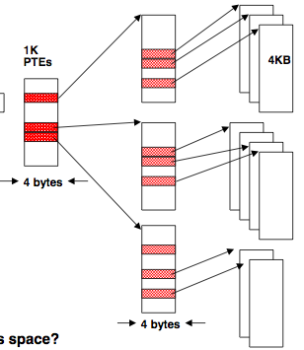
Efficient Page Table Storage
observation: each process needs own page table
100s–1000s processes could easily be active
observation: page tables are sparse
few programs use the entire address space
solution: multi-level PTs
top-level table in RAM
next-level either in RAM or paged out to disk
31
22
21
12
11
0
P1 index
P2 index
page offset
32 bit virtual address

Slide 12
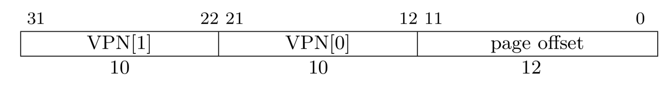
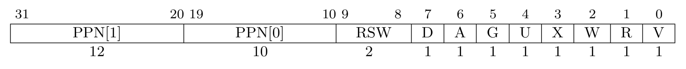
So what’s in a PTE?
RISCV-32, Sv32 mode:
dirty
global
writeable
valid
reserved
accessed
usermode
readable
executable
XWR=0 → pointer to next level PT
RISCV-64, Sv39 and Sv48:

Slide 13
Translation-related exceptions
page fault
page is accessible, but it’s sitting on disk
this is not a program error!
resume instruction execution once page in RAM
segmentation fault / general protection fault
page is not user-accessible
page is R/O but tried to write/exec
program terminated (unless caught)
Meltdown avoided this by misspeculating

Slide 14
Faster page table access
okies, so page table stays in main memory
problem: access still. way. too. slow.
Q: how to speed up page table access?
cache it!
we’ll call this the translation cache
translation lookaside buffer (TLB)

Slide 15
TLB: Translation Lookaside Buffer
virtual page number
physical page number
TLB: a $ for the PT
V
tag
1
Physical Memory
1
1
1
0
1
Physical Page Number or Disk Address
V
1
1
Disk
1
1
0
1
1
page table
0
1
1
0
1

Slide 16
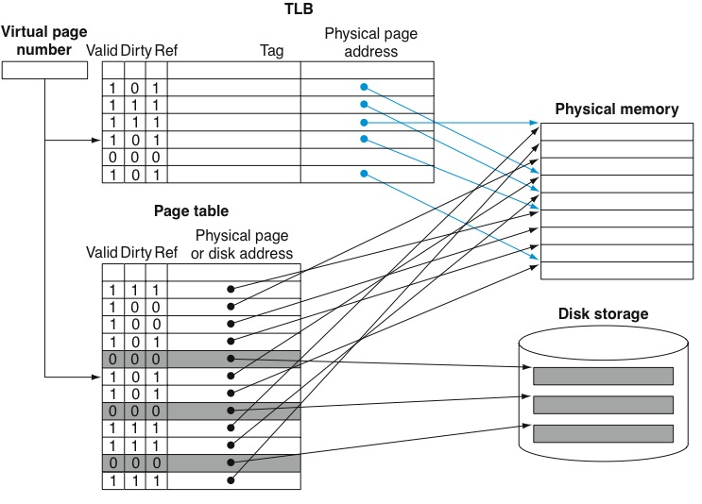
Writes and evictions
+ permission bits (read-only, execute), sharing info, etc.

Slide 17
I$ access w/ address translation
V
i
r
t
u
a
l
a
d
d
r
e
s
s
3
1
3
0
2
9
1
5
1
4
1
3
1
2
1
1
1
0
9
8
3
2
1
0
V
i
r
t
u
a
l
p
a
g
e
n
u
m
b
e
r
P
a
g
e
o
f
f
s
e
t
2
0
1
2
V
a
l
i
d
D
i
r
t
y
T
a
g
P
h
y
s
i
c
a
l
p
a
g
e
n
u
m
b
e
r
1. ITLB lookup
T
L
B
T
L
B
h
i
t
2
0
2. translate VA to PA
P
h
y
s
i
c
a
l
p
a
g
e
n
u
m
b
e
r
P
a
g
e
o
f
f
s
e
t
P
h
y
s
i
c
a
l
a
d
d
r
e
s
s
t
a
g
P
h
y
s
i
c
a
l
a
d
d
r
e
s
s
B
y
t
e
C
a
c
h
e
i
n
d
e
x
o
f
f
s
e
t
1
6
1
4
2
3. access I$
V
a
l
i
d
T
a
g
D
a
t
a
Q: how many cycles?
C
a
c
h
e
3
2
C
a
c
h
e
h
i
t
D
a
t
a

Slide 18
When to do address translation?
CPU
CPU
CPU
VA
VA
VA
TLB
VA
tags
$
PA
tags
$
TLB
PA
VA
PA
$
TLB
L2 $
PA
PA
MEM
MEM
MEM
overlap $ access
with VA translation
physically
addressed
cache
virtually
addressed
cache

Slide 19
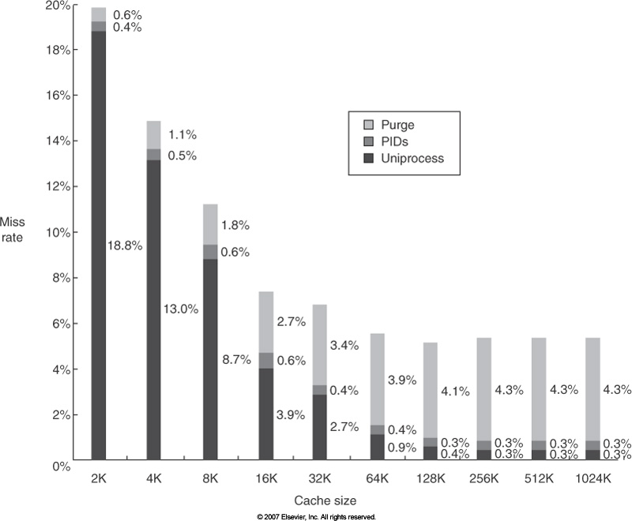
Virtually addressed L1 caches
...what must happen on a context switch?
misses because of flushing VA L1 caches

Slide 20
Virtually addressed L1 caches
okies, so use {ASID, VA} to address L1 D$?
what if a memory region is shared among different processes (and so diff. ASIDs)?
problem: same page in D$ multiple times
what if we want to write to one of them?

Slide 21
Overlapping TLB & L1 D$ accessses
Virtual Page Number | Page Offset
 | Index | Byte Select
Virtual
Cache Tags
Valid
Cache Data
TLB
Cache Block
Cache Block
Physical
cache tag
=
hit?
data out

Slide 22
Virtually addr’d, physically tagged $
problem: some address bits change (VA→PA)
but we need those bits to index the cache!
possible solutions
bigger page sizes (8 KB in this case)
more associativity (2-way set-associative here)
OS guarantees VA[13] == PA[13] (harder if many bits)
bite the bullet and deal w/ the synonym problem
7
6
$ idx
offs
bit changed by VA→PA
but needed to index D$
20
12
virt page #
offset

Slide 23
Synonym problem: example
64 KB direct-mapped $, 16-byte blocks
block offset: addr[3:0]
cache index: addr[15:4]
4 KB pages
page offset: addr[11:0]
16 synonym locations for each PA
4 virtual bits used to index $: addr[15:12]:
process 1 VA 0x0000 000 0 -> PA 0xFF000000
process 2 VA 0x0000 F00 0 -> PA 0xFF000000
process 1 index = 0x000 (tag = 0xFF000)
process 2 index = 0xF00 (tag = 0xFF000)
what if process 1 writes, process 2 reads?

Slide 24
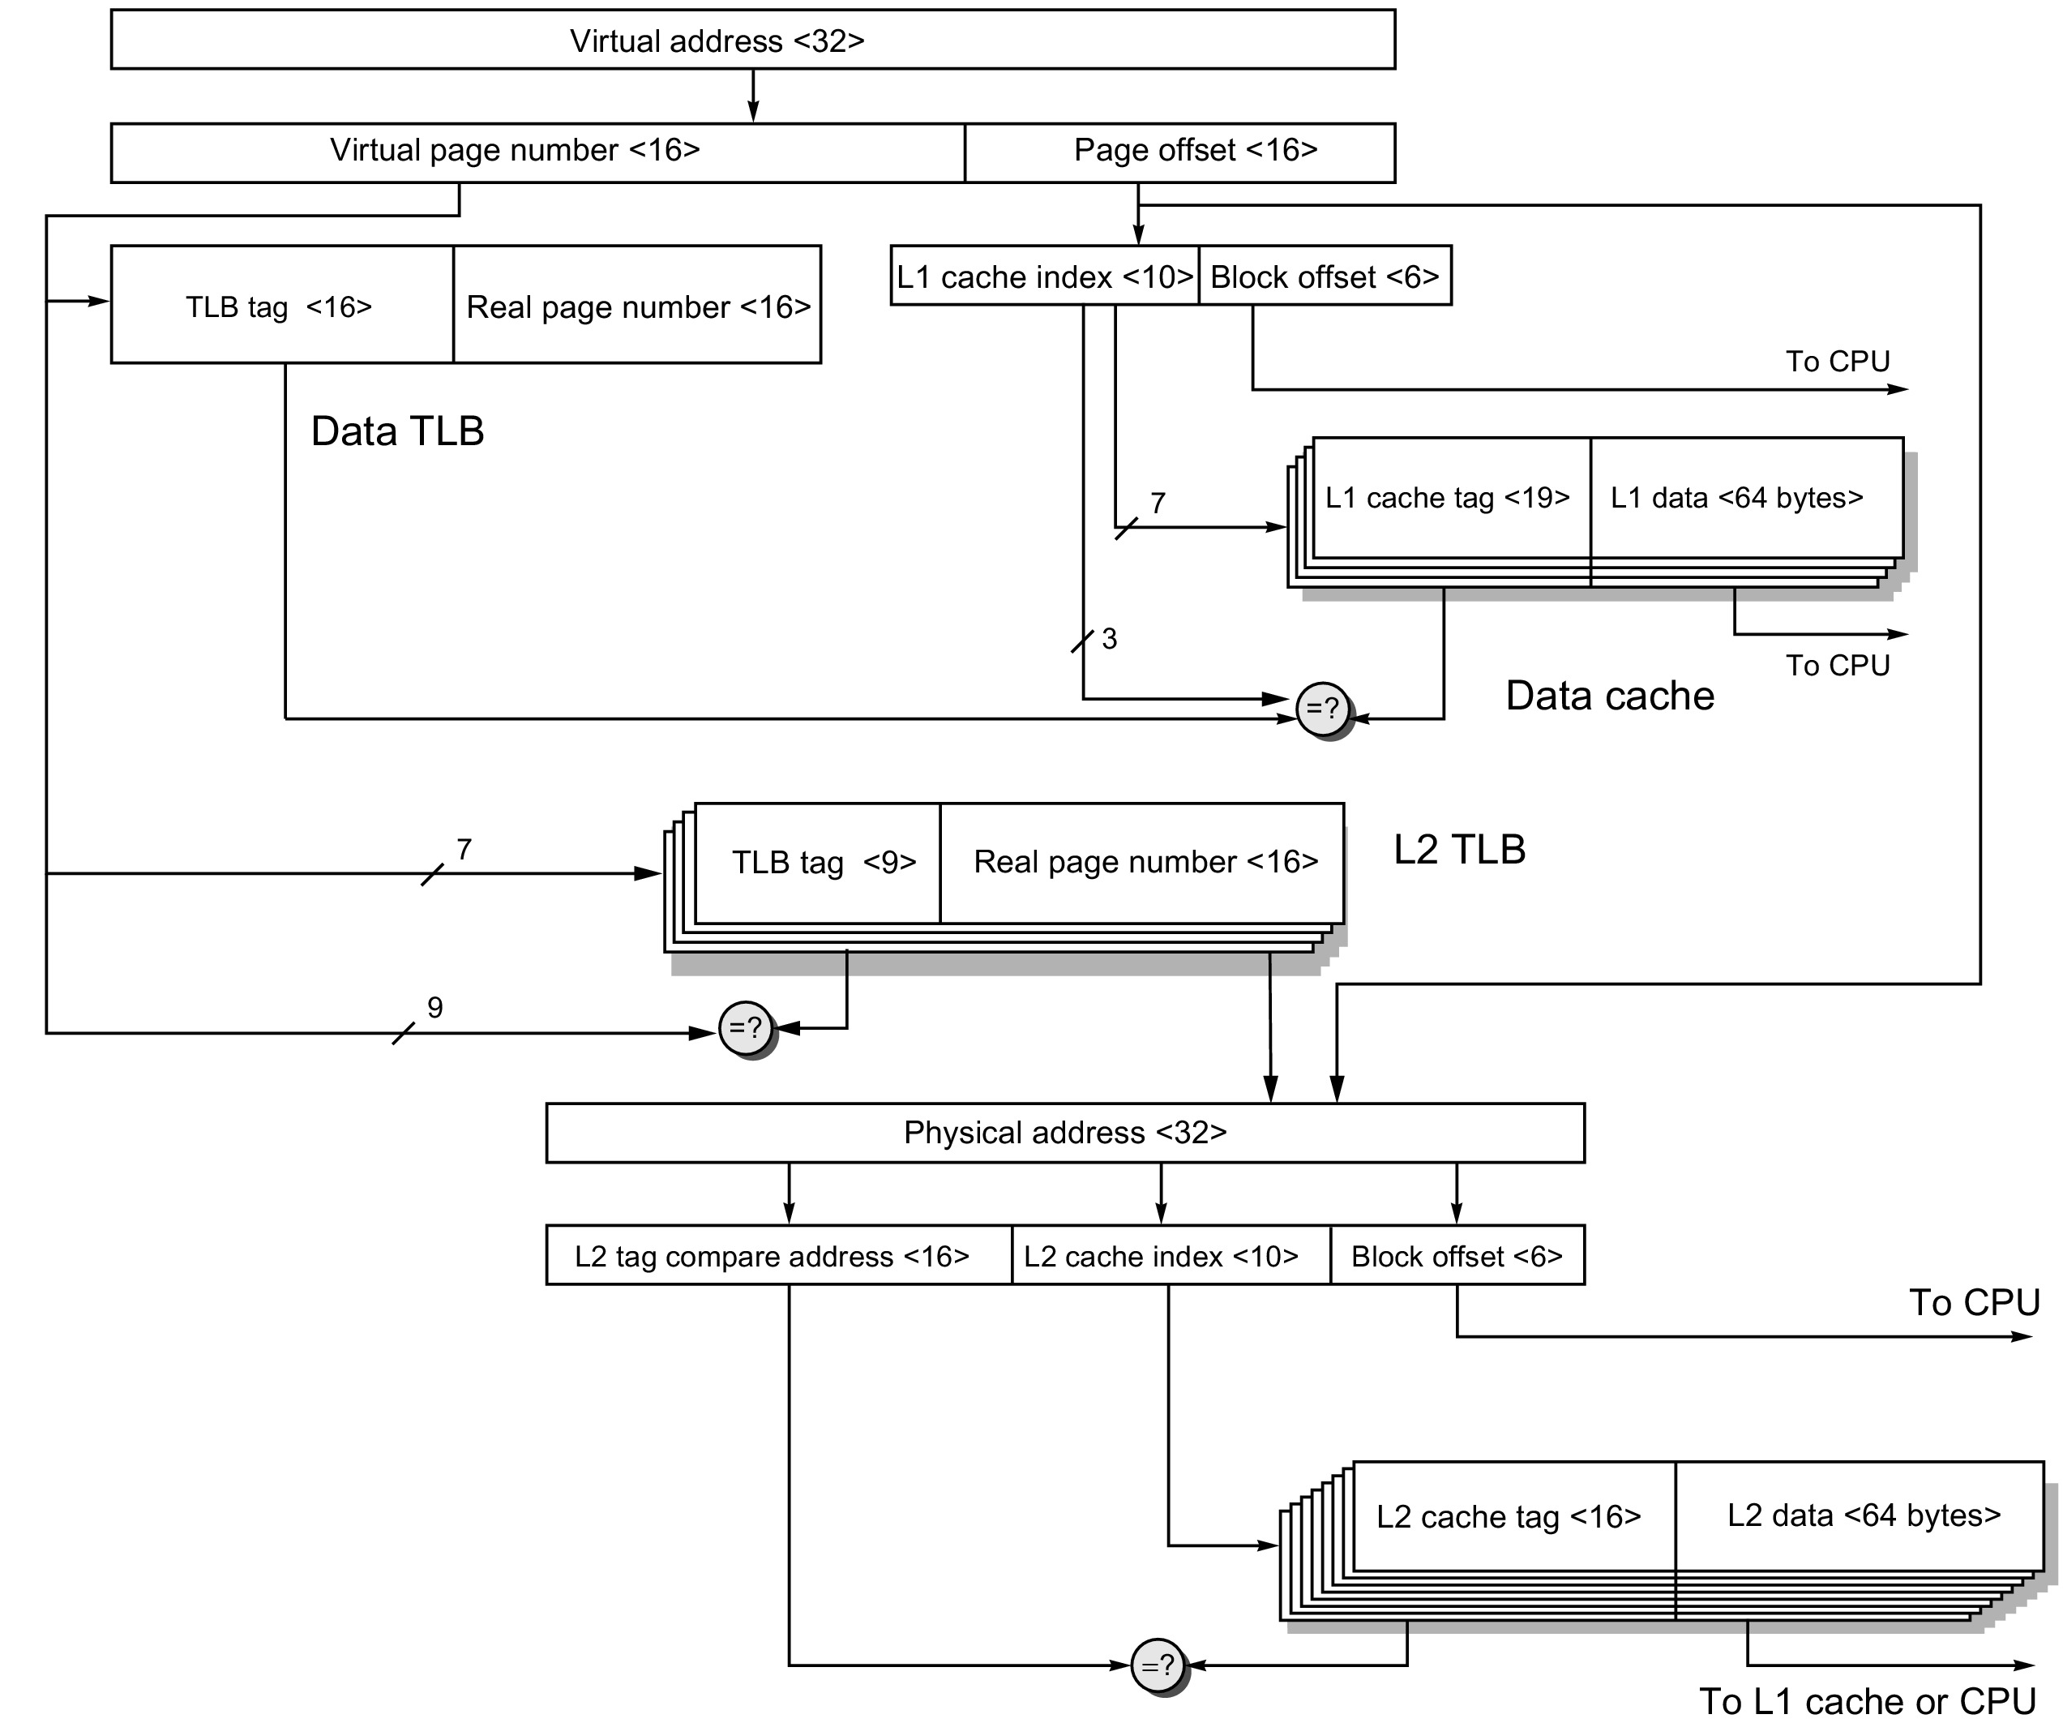
ARM Cortex A53
(data path)

Slide 25
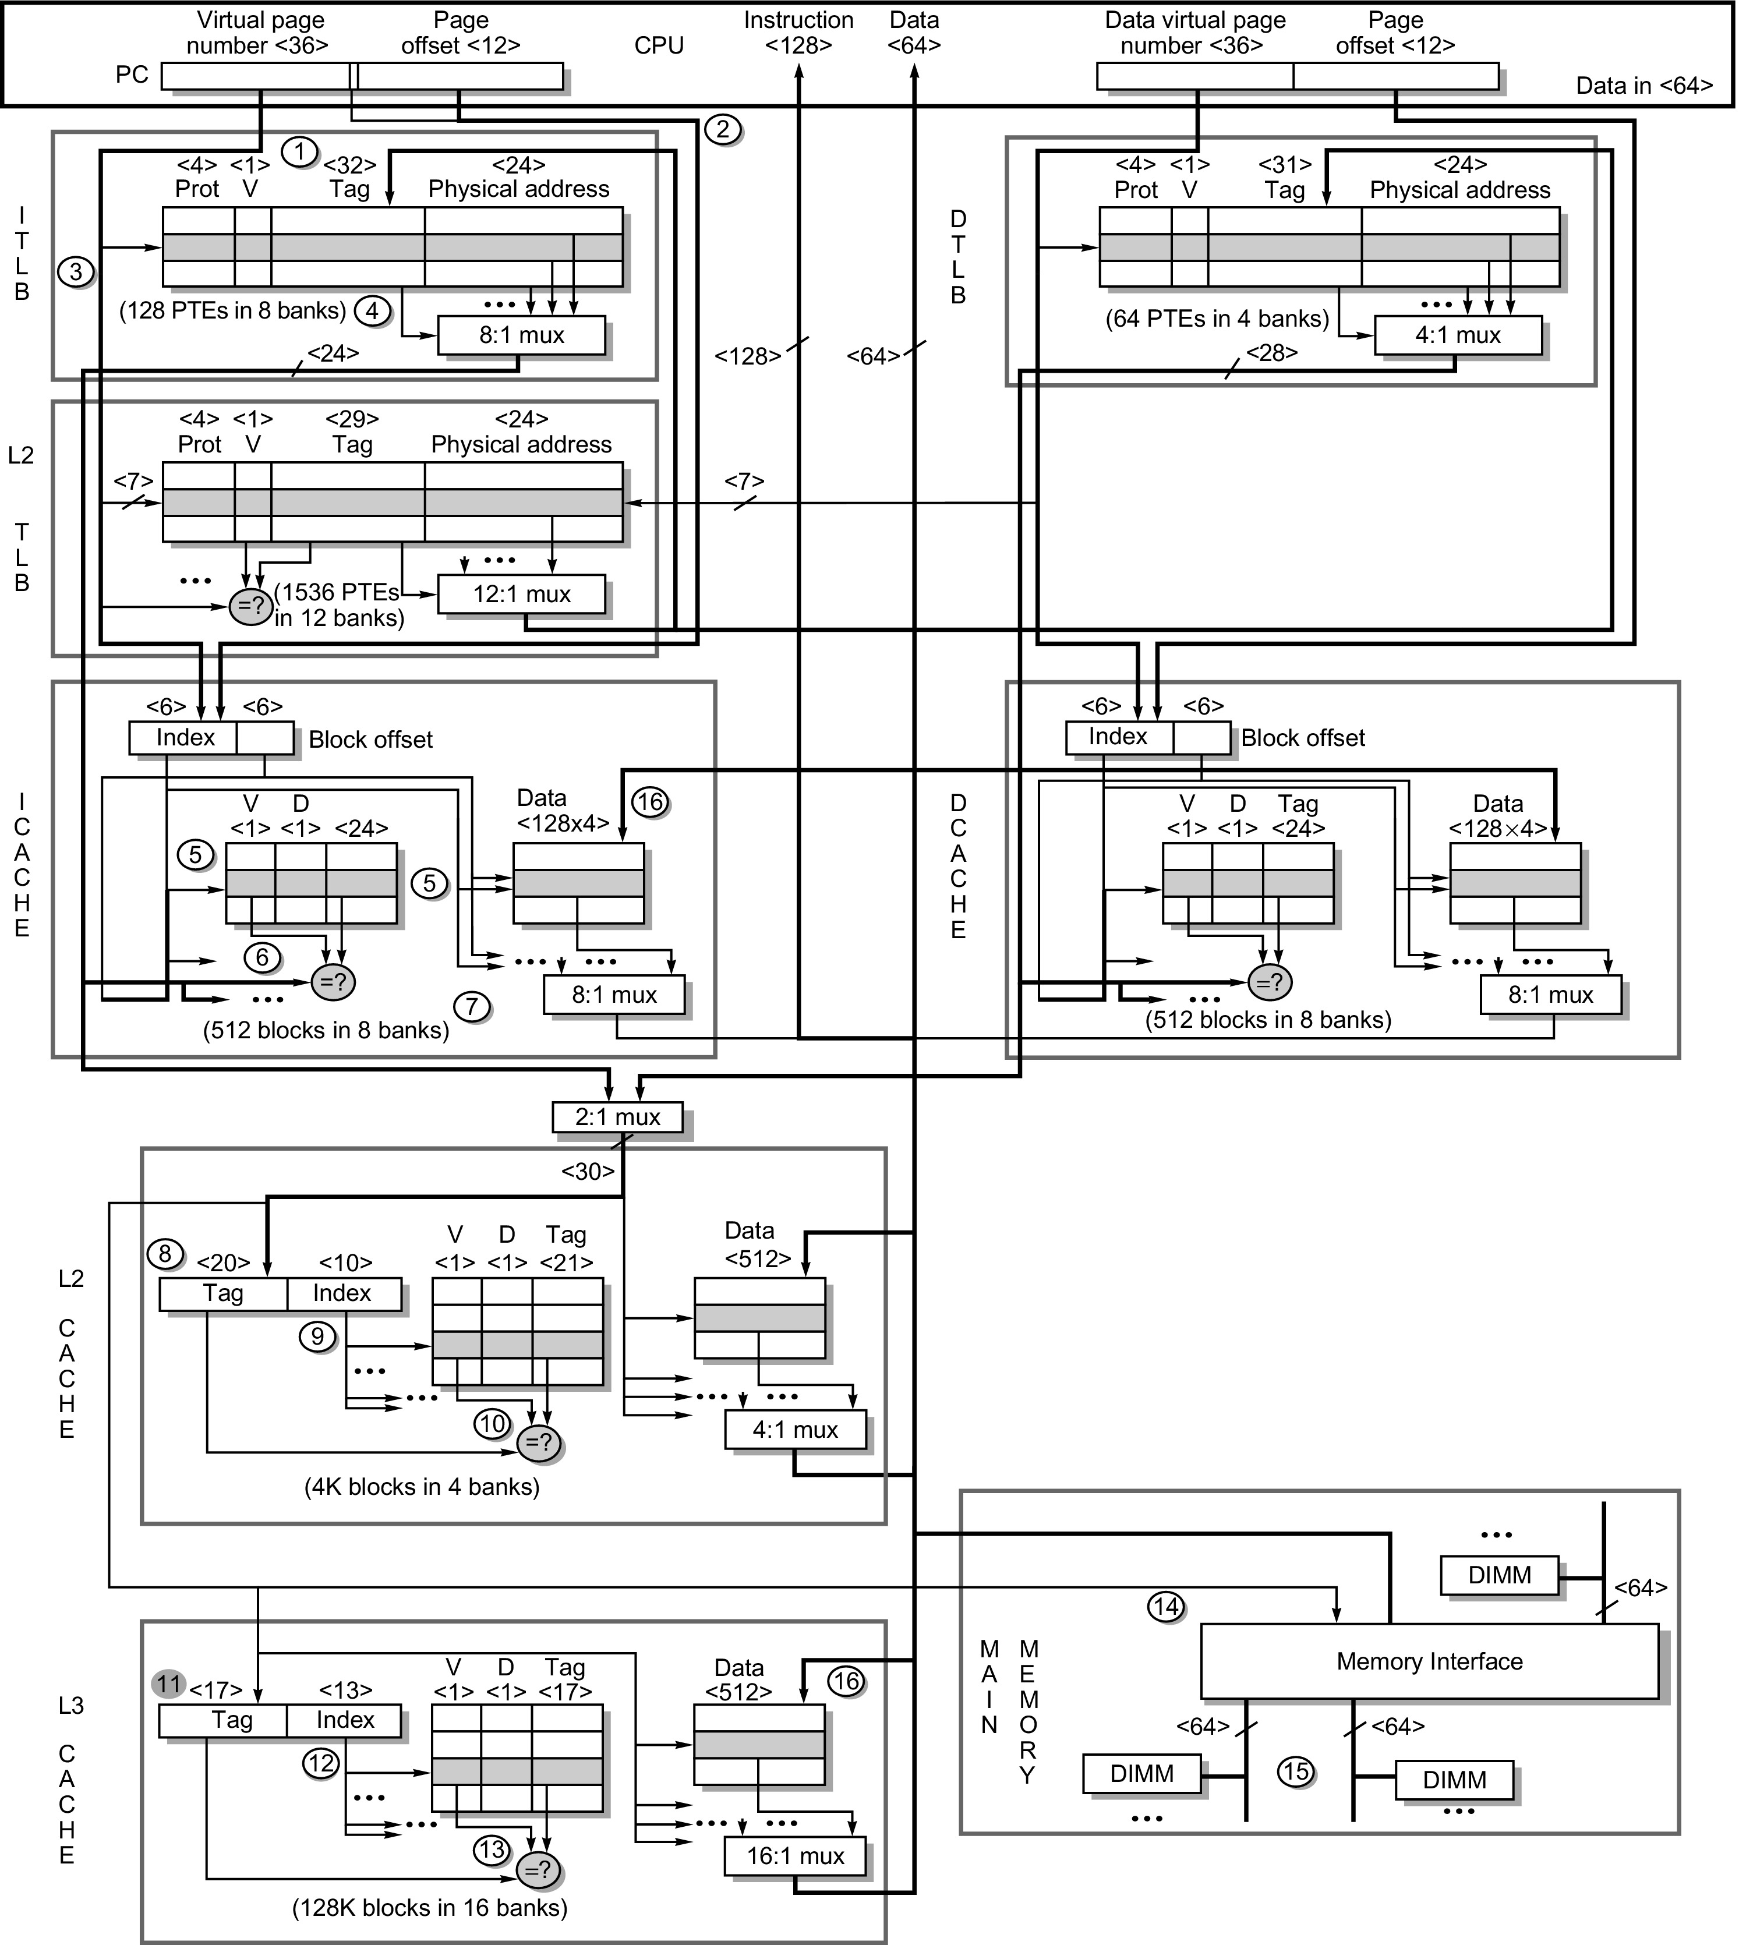
Intel Core i7
(everything)

Slide 26
Updating PTEs
when updating PTEs, what needs to be done?
synchronize PTE writes w/ addr translation HW
flush any translation caches (TLBs)
in multicores, also remote TLBs (TLB shootdown)
implementation options?
instruction in fault handler, e.g., sfence.vma
detect write to PT in HW, trigger TLB shootdown

Slide 27
Summary
Why virtual addressing?
Page tables and VA→PA translation
TLB = a cache for the page table
Virtually addressed, physically tagged cache
The synonym problem

