Slide 1
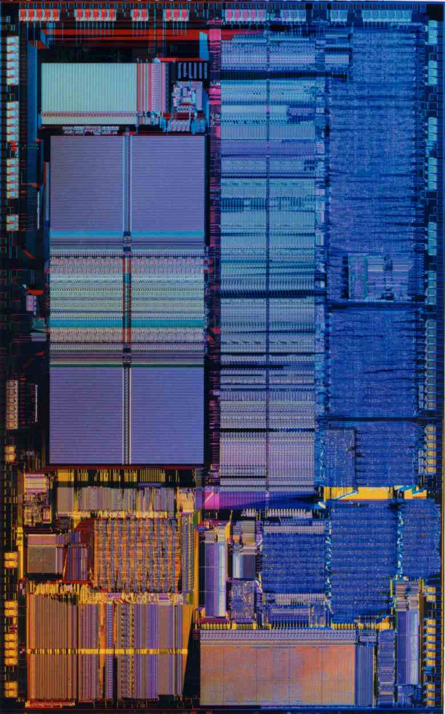
CPEN 411: Computer Architecture Slide Set #8: Pipelining
Instructor: Tor Aamodt
Slide background: Die photo of the Intel 486 (first pipelined x86 processor)
Notes:
The background of this slide is a die photo of the Intel 486 – the first pipelined x86 microprocessor.

Slide 2
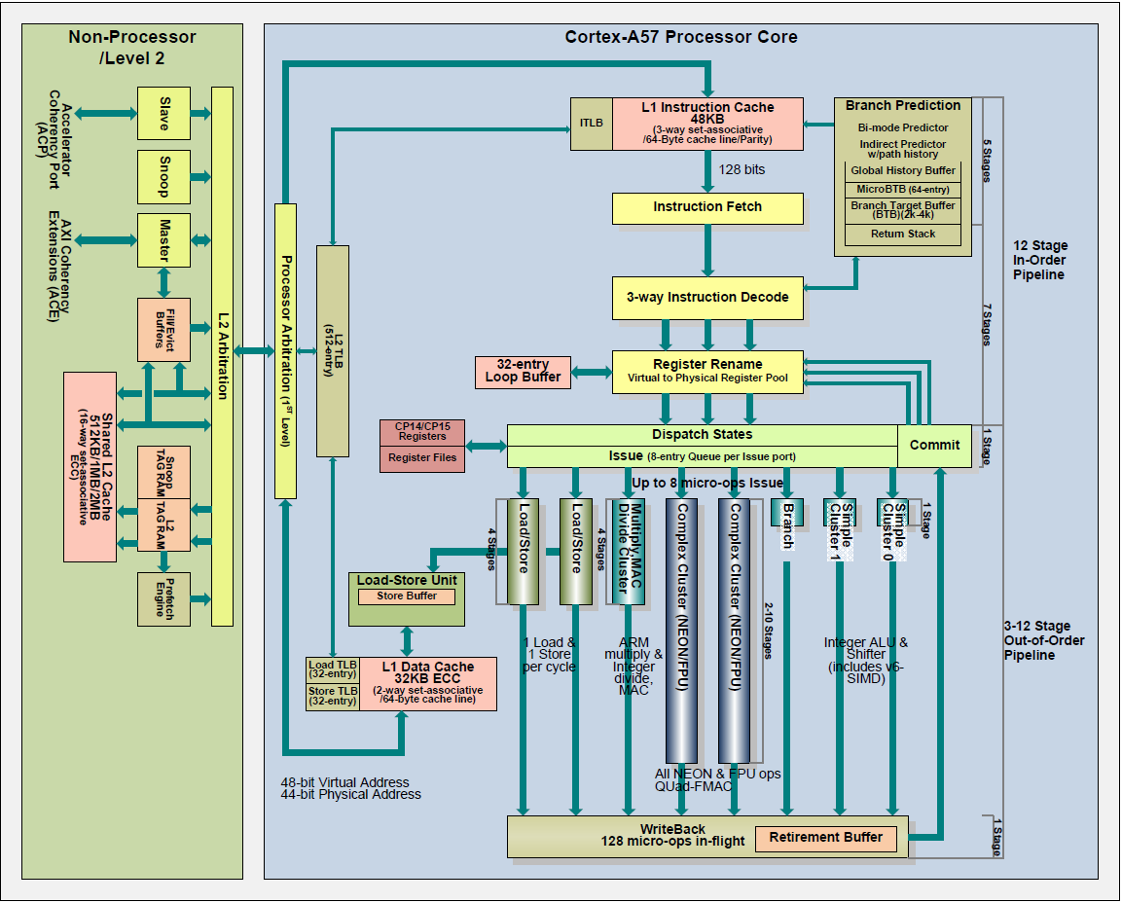

pipelined
execution

Slide 3
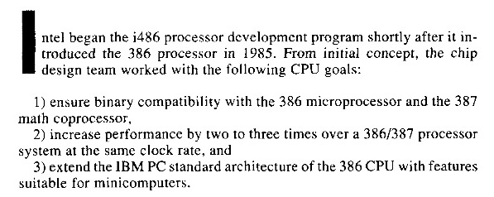
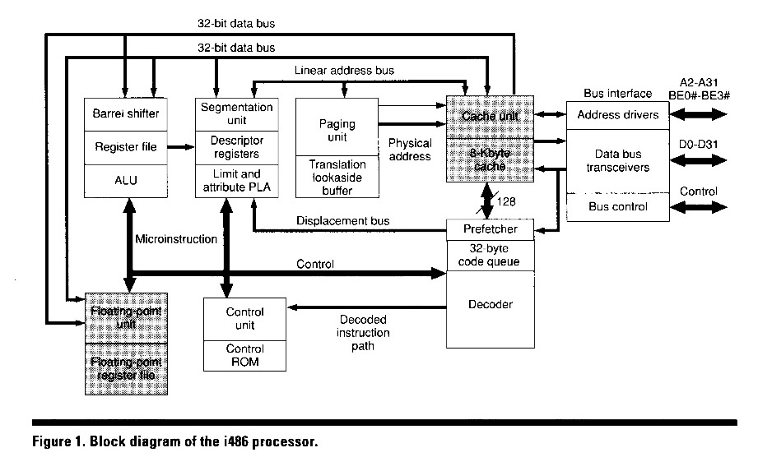
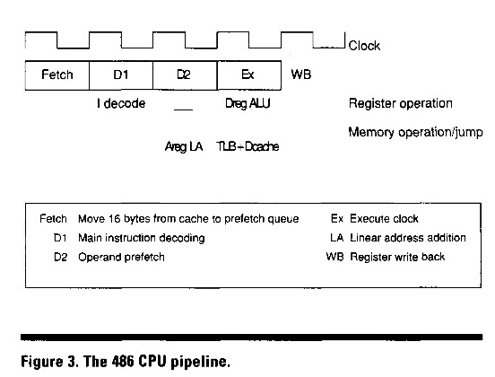
Intel 486
John H. Crawford, “The i486 CPU: Executing Instructions in One Clock Cycle”, IEEE Micro, Feb. 1990

Slide 4
Learning Objectives
Define pipelining and explain it using a simple analogy
Describe arithmetic pipelines and the limitations of pipelining
Explain the simple five stage pipeline
Describe pipelined control signals and explain their purpose
Explain hazards
Describe the approaches used to overcome hazards
Explain the implementation logic of the five-stage pipeline

Slide 5
A Simple RISC Implementation
Instruction fetch (IF)
Send PC to memory and fetch the current instruction from memory. Update the PC to next sequential PC by adding 4
Instruction Decode/Register fetch (ID)
decode instruction (what does it do?)
read source registers
compute branch target and condition
Execute/effective address (EX)
memory reference: ALU computes effective address from base register and offset.
register-register ALU instruction: ALU performs operation
register-immediate ALU instruction: ALU performs operation

Slide 6
A Simple RISC Implementation
Memory access (MEM)
load: read memory @ effective address
store: write value from register to effective address
Write-back cycle (WB)
Register-Register/Register Immediate/Load: Write the result into the register file.

Slide 7
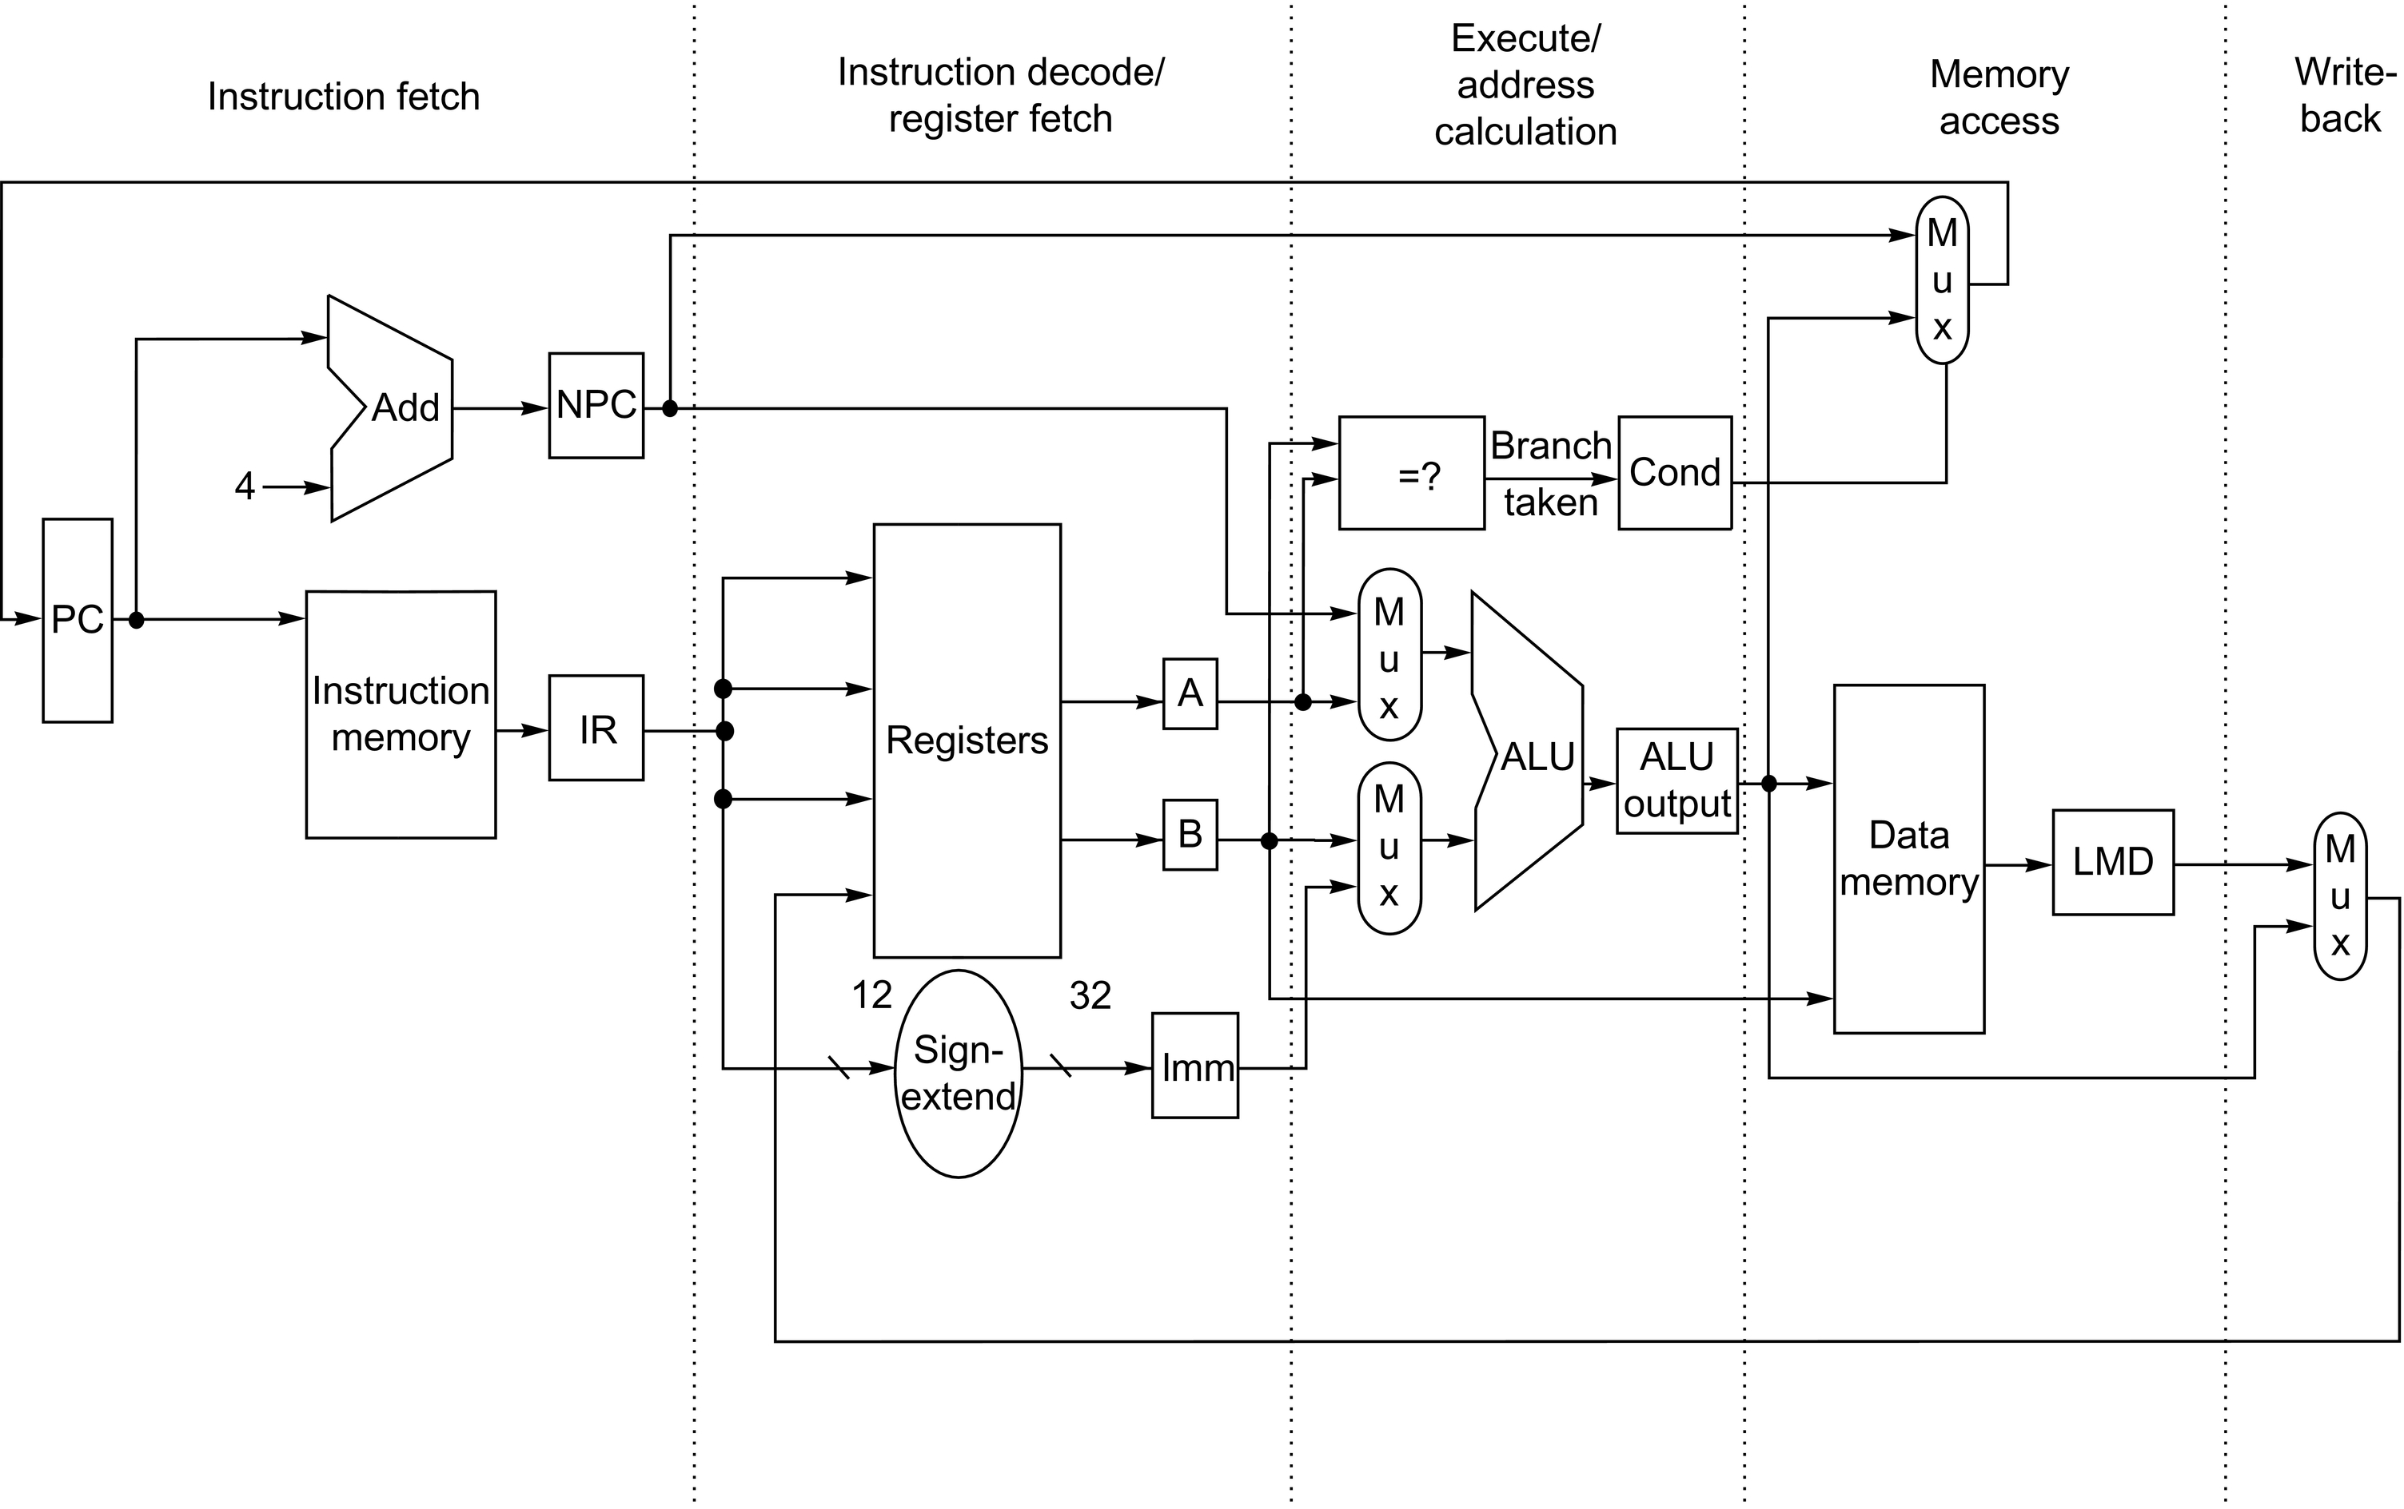

Slide 8
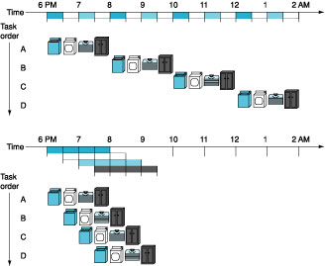
Pipelining: Analogy
Early in Time
Later in Time
1st task
Last task
Simultaneous activity
From 7:30 to 8:00 pm

Slide 9
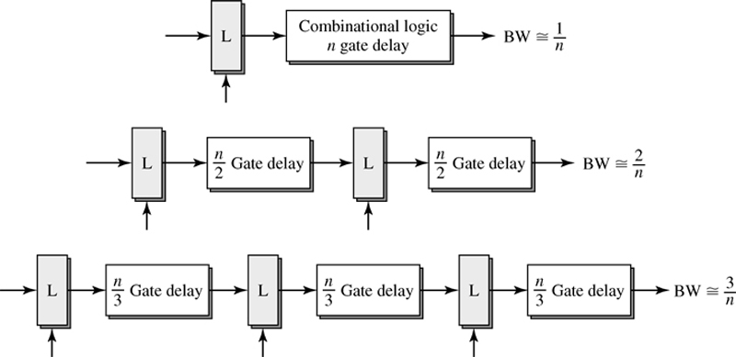
Pipelining Combination Logic
Figure 2.1: Shen & Lipasti
increases bandwidth at the cost of latency

Slide 10
Pipelining: what would we like?
Uniform Subcomputations
Goal: Each stage has same delay
Achieve by balancing pipeline stages
Identical Computations
Goal: Each computation uses same number of stages
Independent Computations
Goal: start new computation each cycle

Slide 11
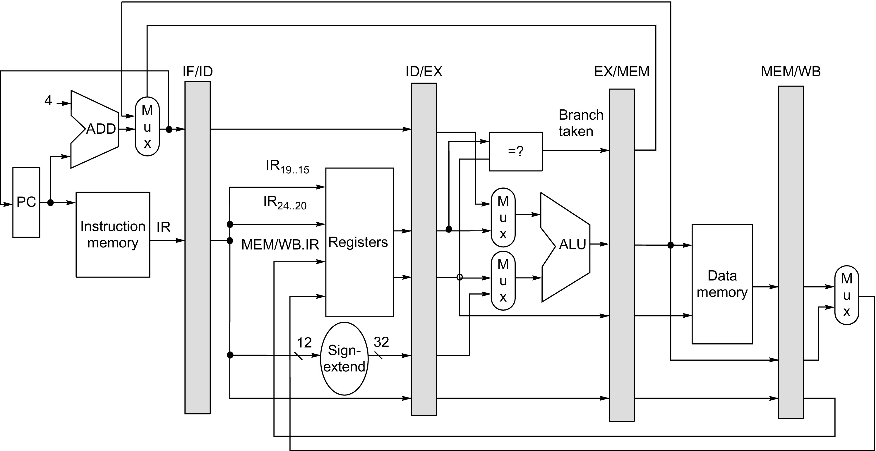
key: not exposed to the programmer

Slide 12
Instruction Pipelining Example
Let’s look at how a single instruction flows through a 5-stage pipeline:
lw x1, 100(x2)

Slide 13
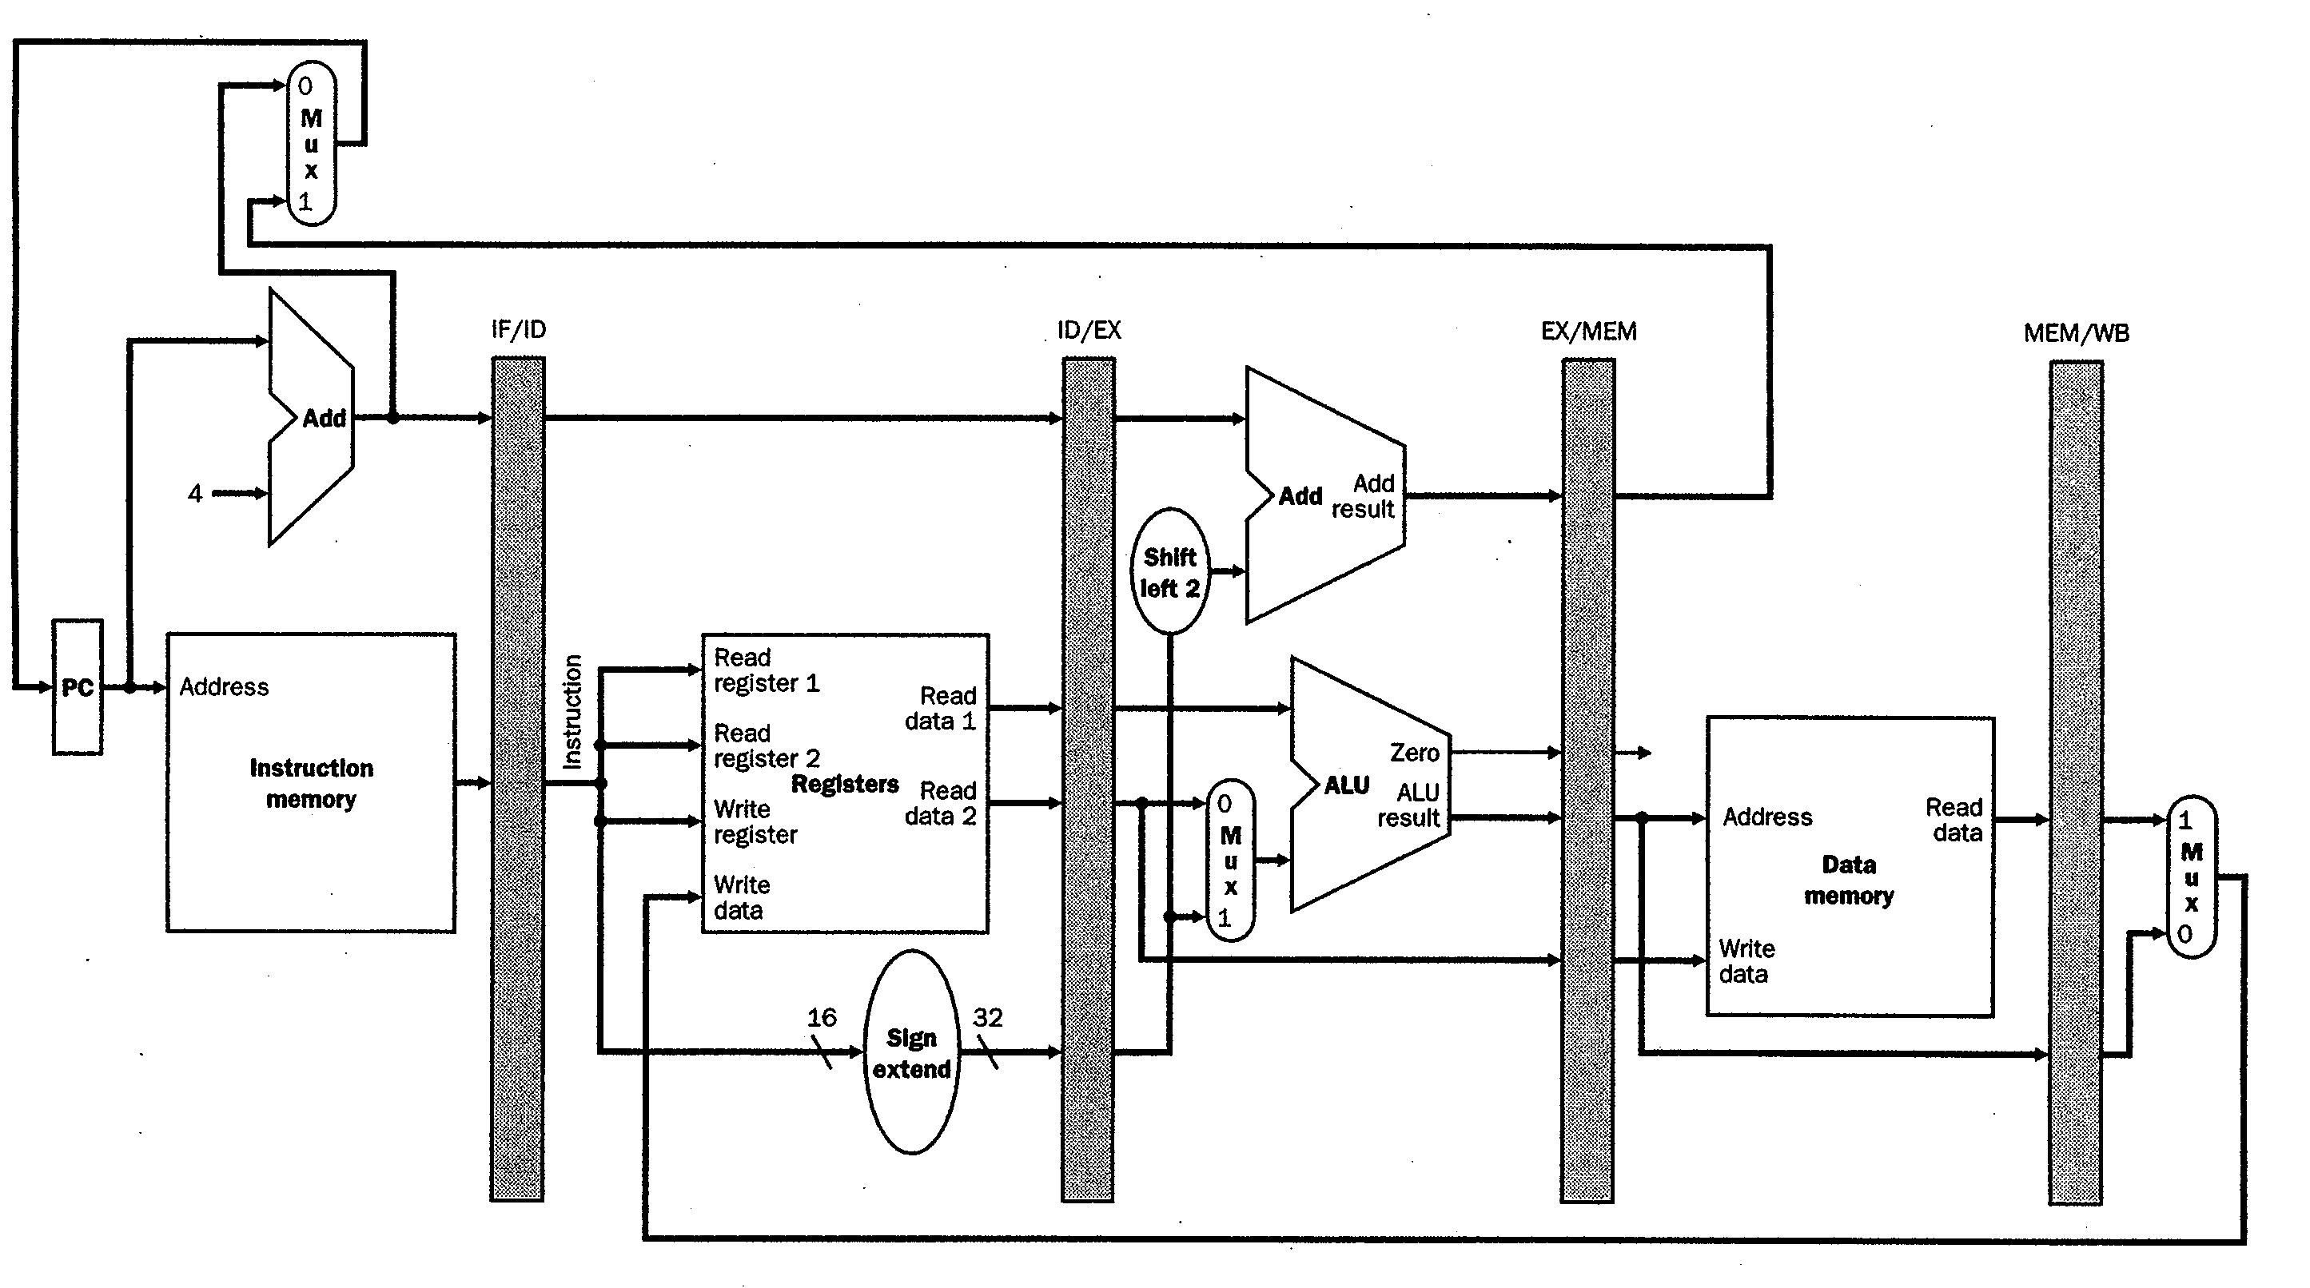
Pipelined “lw x1, 100(x2)”
Add registers between stages of execution
Pipeline Register Stores bits encoding the instruction “lw x1,100(x2)”
Send PC, fetch
“LW” instruction

Slide 14
Pipelined “lw x1, 100(x2)”
Pipeline Register Stores Reg[rs], Reg[rt], SgnExt(100)

Slide 15
Pipelined “lw x1, 100(x2)”
Pipeline Register Stores ALU outputs

Slide 16
Pipelined “lw x1, 100(x2)”
Pipeline Register Stores Output of Data Memory

Slide 17


Pipelined “lw x1, 100(x2)”
Register File Stores Data Memory output to x1
=> RegisterFile acts like final pipeline register

Slide 18
Question
Something was wrong in the last example – did you see it? Not something missing. Something just wrong.
Load writes to destination register of instruction in IF/ID stage and doing so is wrong.
Why?
Look at source of “Write Register” in previous slide.
Write to destination register of instruction that comes 3 instructions later:
lw x1,100(x2) ; instruction in MEM/WB
addu x3,x4,x5 ; instruction in EX/MEM
subu x6,x7,x8 ; instruction in ID/EX
addu x10,x11,x12 ; instruction in IF/ID
So, which register gets written to? => x10 (i.e., not x1)
Let’s fix this...

Slide 19
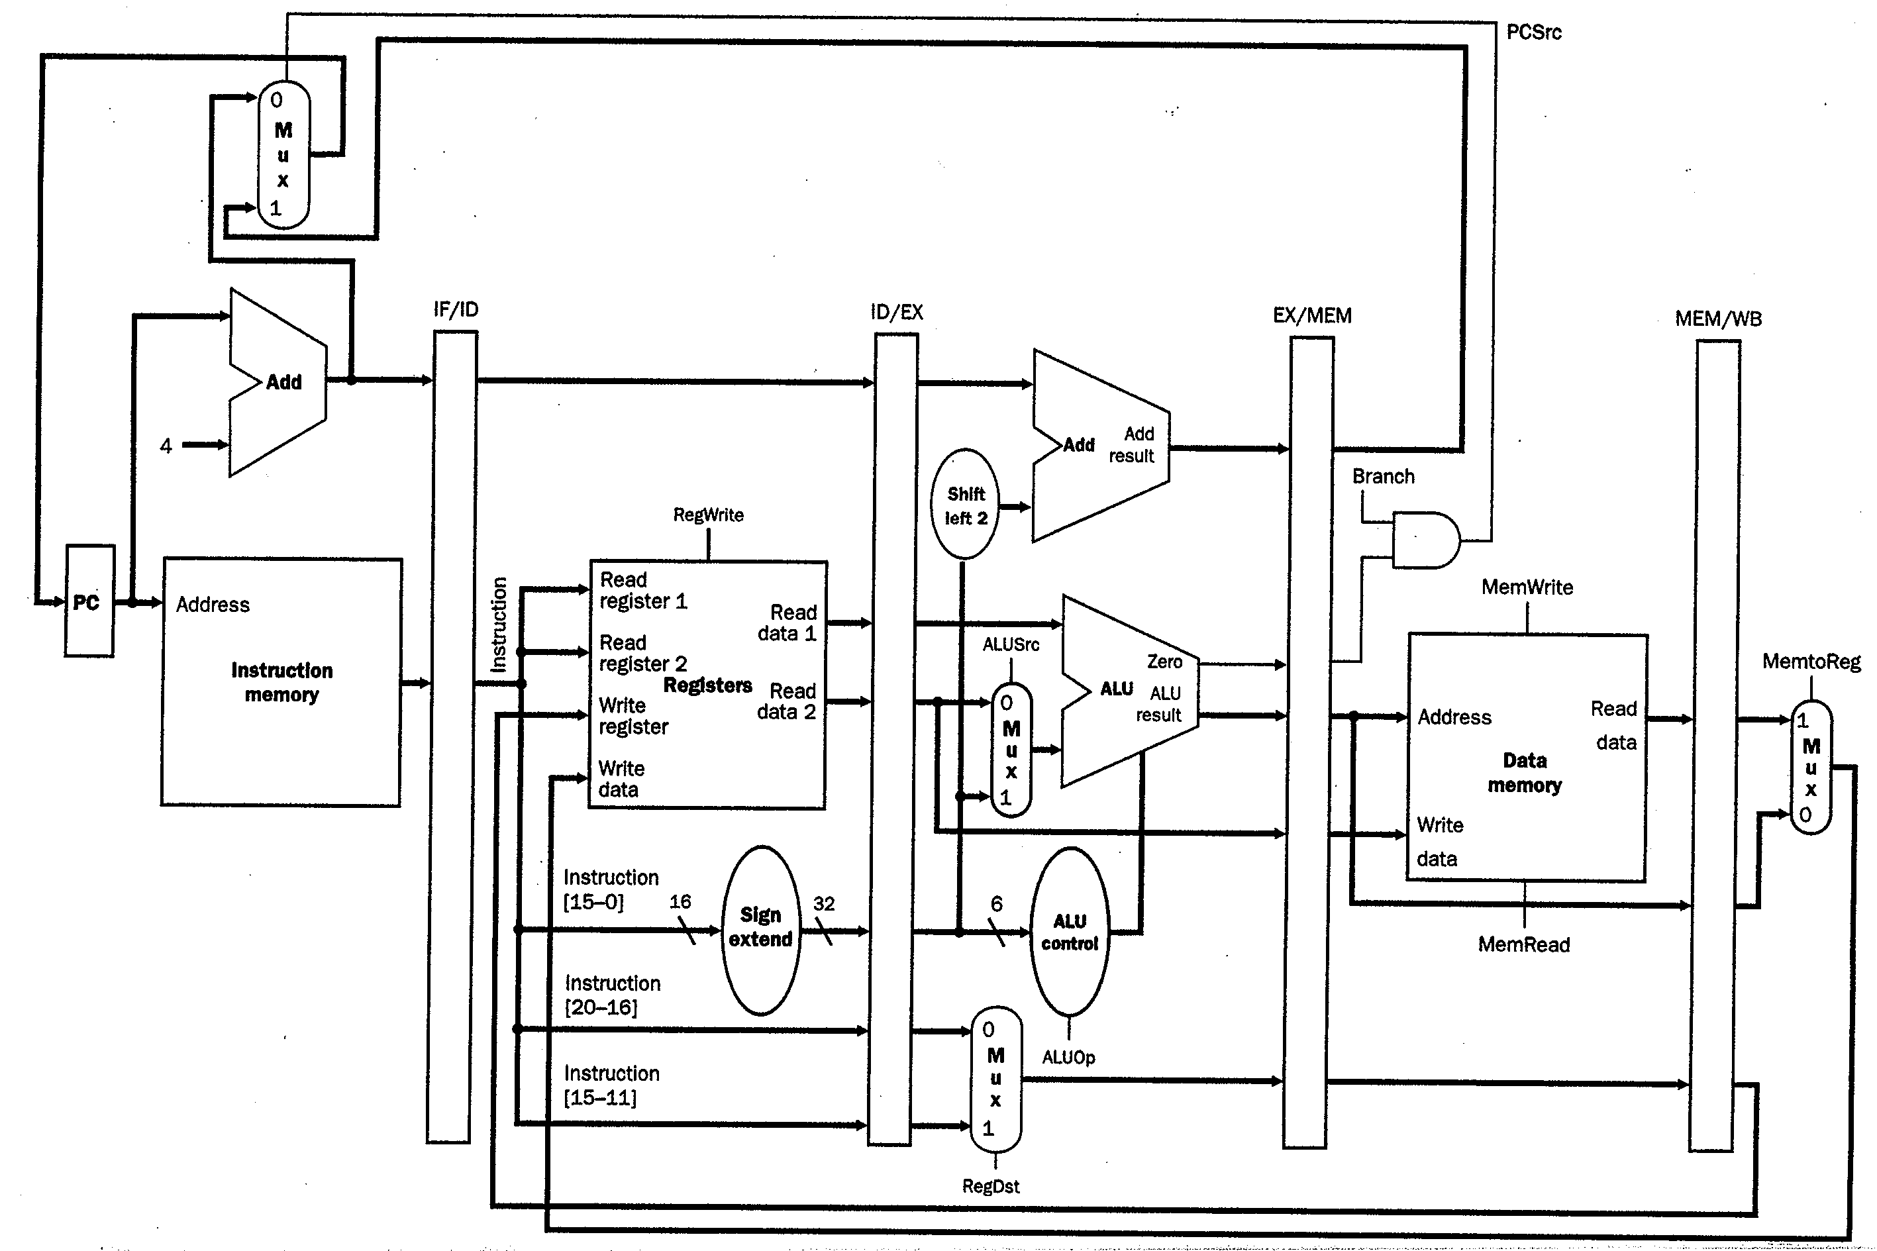
Pipeline Control Signals
lw x1,100(x2)
lw x1,100(x2)
lw x1,100(x2)
lw x1,100(x2)

Slide 20
Recap
pipelining as parallelism
break task into independent pieces
overlap different pieces from different instrs
control signals semantically tied to instructions
next: analysis and hazards

Slide 21
Pipelining and ISA
Uniform Subcomputations
Memory addressing modes <=> Disparity of speed between processor and memory.
Identical Computations
RISC: reducing complexity makes each instruction use roughly same number of stages.
Independent Computations
Reg-Reg (“Load-Store”) : Makes it easier to identify dependencies (versus Reg-Mem).

Slide 22
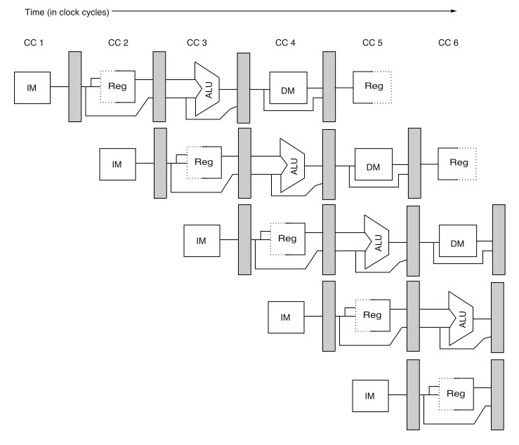
Analysis of Instruction Pipelining
Step 1: Imagine hardware is replicated for each instruction…
Early in Time
Later in Time
1st Inst.
Last Instruction

Slide 23
Step 2: Abstraction
 | Clock Number
 | 1 | 2 | 3 | 4 | 5 | 6 | 7 | 8 | 9
Instruction i | IF | ID | EX | MEM | WB
Instruction i+1 |  | IF | ID | EX | MEM | WB
Instruction i+2 |  |  | IF | ID | EX | MEM | WB
Instruction i+3 |  |  |  | IF | ID | EX | MEM | WB
Instruction i+4 |  |  |  |  | IF | ID | EX | MEM | WB
ID,…,WB = “instruction decode,” …, “write back” (slide 5-6)
Above example:
As # instructions increases CPI approaches 1.0 (ideal, can’t be faster)
In reality, instructions may have “dependencies”, hardware may have “hazards” that increase CPI above 1.0

Slide 24
Pipelining introduces potential “hazards”
 | Clock Number
 | 1 | 2 | 3 | 4 | 5 | 6 | 7 | 8 | 9
DADD x1,x2,x3 | IF | ID | EX | MEM | WB
DSUB x4,x1,x5 |  | IF | ID | EX | MEM | WB
AND x6,x1,x7 |  |  | IF | ID | EX | MEM | WB
OR x8,x1,x9 |  |  |  | IF | ID | EX | MEM | WB
XOR x10,x1,x11 |  |  |  |  | IF | ID | EX | MEM | WB
How do instructions after DADD get the correct value for x1?

Slide 25
Pipeline Hazards
Types
structural Hazards
data Hazards
control Hazards
Analysis
causes?
solutions?
tradeoffs (impact on performance)?

Slide 26
Structural Hazards
Caused by resource conflicts
Two or more instructions want to use the same hardware at the same time
Two ways to resolve structural hazards:
Solution 1: Stall
wait until earlier instruction is finished using resource… + / –?
Solution 2: Replicate hardware
Often we can eliminate need for stalling by replicating hardware or building hardware capable of servicing multiple instructions at the same time.

Slide 27
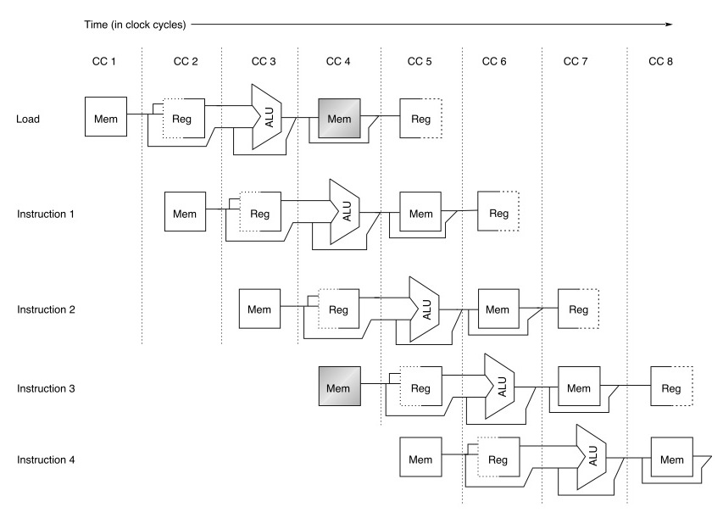
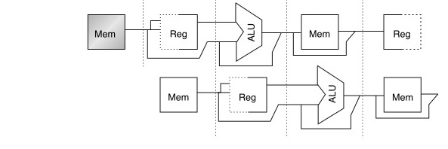
Structural Hazard Example
What if data and instructions are placed in same memory (at different locations)?
stall

Slide 28
Example Question...
Which processor is faster (& by how much?)
Assume:
40% of instructions are data memory references.
Ignoring structural hazard CPI = 1.0
Processor with structural hazard has clock rate that is 1.05 times faster than processor w/o.

Slide 29
Solution...
=> processor without hazard is 1.3x faster than processor w/ hazard even though clock frequency of processor with hazard is 5% faster.

Slide 30
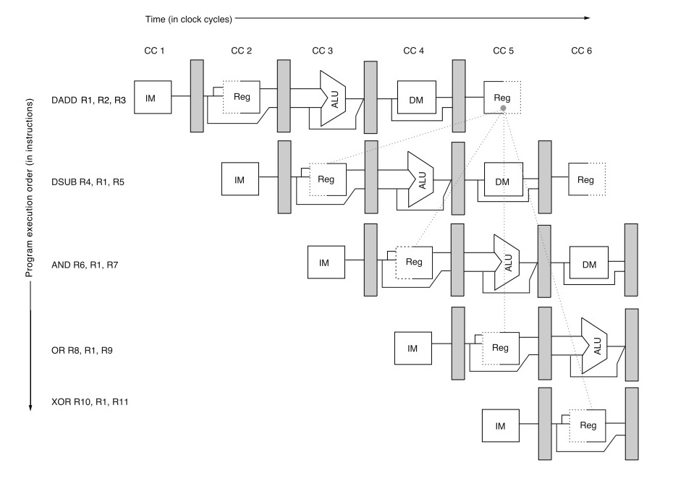
Problem: Data Hazards
“RAW hazards”
(read after write
hazard)
Note data dependencies
Red/dotted: Impossible to send information “back in time”.
Green/solid: Can potentially send information to other part of pipeline in same cycle or to a later cycle… requires hardware support and consideration of what can happen in a single clock cycle.

Slide 31

Forwarding
Note: forwarding always occurs within a single clock cycle.

Slide 32
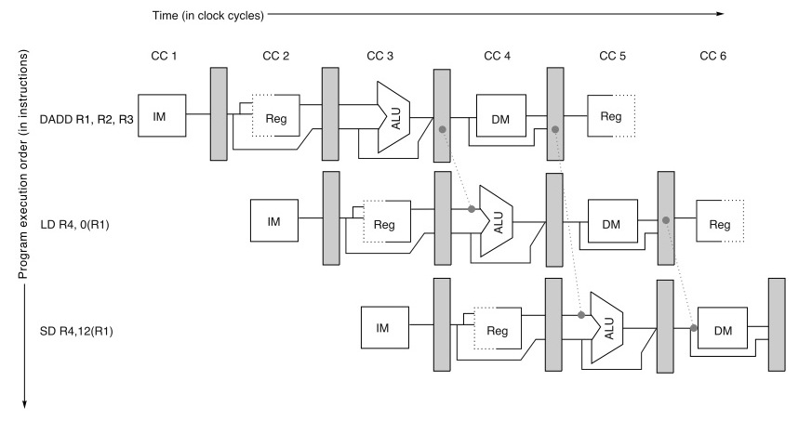
Forwarding Example #2
Questions:
1. How do we know a forwarding path is helpful?
2. How do we control the forwarding path?

Slide 33
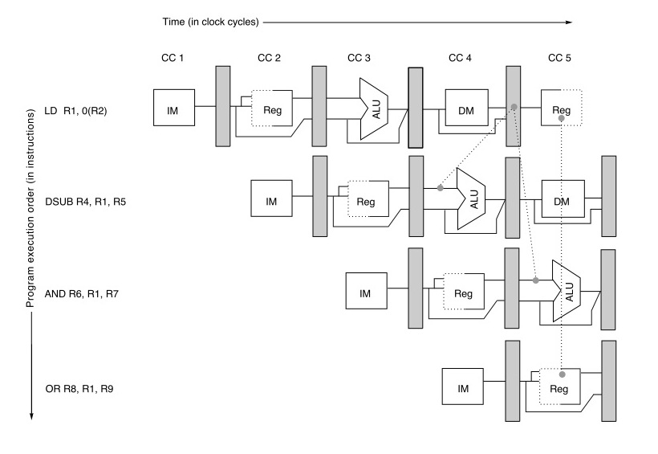
Unavoidable Stalls
Can’t do this. Why?
Forwarding cannot
eliminate stall for this
data hazard

Slide 34
Control Hazards
Branch may or may not change program counter (PC).
Therefore, which instruction should follow a branch depends upon the result of executing the branch instruction.
Result of branch typically known by end of EX (or ID).

Slide 35
Option 1: Stall
First, let’s define some terminology:
BNEZ x1, Label ; branch instruction
DADD x1,x2,x3 ; branch successor for “not taken” branch
LD x1,0(x2)
…
Label: DSUB x1,x2,x3 ; branch successor for “taken” branch

Slide 36
Option 1: Stall
 | Clock Number
 | 1 | 2 | 3 | 4 | 5 | 6 | 7 | 8
branch instruction | F | D | X | M | W
branch successor |  |  |  | F | D | X | M | W
branch succ. + 1 |  |  |  |  | F | D | X | M
branch succ. + 2 |  |  |  |  |  | F | D | X
Decode branch and
stall fetch on cycle 2
Fetch successor on cycle 4.
(cannot do this on cycle 3)
“Resolve branch” during cycle 3.
(hardware determines successor
at end of cycle 3)

Slide 37
Option 2: Predict “Not Taken”
Many “forward” branches are “weakly biased” meaning they are taken and not-taken roughly the same number of times.
This means that about half the time, if we had just guessed that the branch was not taken, we would have been right.
What happens if we are wrong? If we are wrong, we need a way to correct our mistake.

Slide 38
BNEZ x1, Label ; branch instruction
DADD x1,x2,x3 ; branch instruction + 1
LD x1,0(x2) ; branch instruction + 2
…
Label: DSUB x1,x2,x3 ; branch target

Slide 39
Predict “Not Taken” (correct prediction)
 | Clock Number
 | 1 | 2 | 3 | 4 | 5 | 6 | 7 | 8
Not taken branch | F | D | X | M | W
branch instr. + 1 |  | F | D | X | M | W
branch instr. + 2 |  |  | F | D | X | M | W
branch instr. + 3 |  |  |  | F | D | X | M | W
“Resolve branch” during cycle 3.
Hardware determines successor
at end of cycle 3. In this case, the prediction turns out to be correct since the branch was not taken. We did not know this until end of cycle 3.
On cycle 2, hardware
predicts next instruction
is “branch instr. + 1”

Slide 40




Predict “Not Taken” (incorrect/wrong prediction)
 | Clock Number
 | 1 | 2 | 3 | 4 | 5 | 6 | 7 | 8
TAKEN branch | F | D | X | M | W
branch instr. +1 |  | F | D | X | M | W
branch instr. +2 |  |  | F | D | X | M | W
branch target |  |  |  | F | D | X | M | W
Next cycle (clock cycle 4), fix incorrect prediction.
Two things happen:
Squash incorrectly fetched instructions (turn into “no ops” or “bubbles”)
Start fetching correct instruction
Resolve branch
on cycle 3. Find out prediction was wrong.

Slide 41
Option #3: Delayed Branches
Delayed branch = branch that does not change control flow until after next N instructions (typically N=1).
Below, assume branch is resolved in decode stage rather than execute stage.
 | Clock Number
 | 1 | 2 | 3 | 4 | 5 | 6 | 7 | 8
TAKEN branch | F | D | X | M | W
Branch instr. + 1 |  | F | D | X | M | W
Branch target |  |  | F | D | X | M | W
Branch target + 1 |  |  |  | F | D | X | M | W
(Delayed branches were motivated by 5-stage pipeline... “negative benefit” due to impl. complexity in modern microarchitectures)

Slide 42
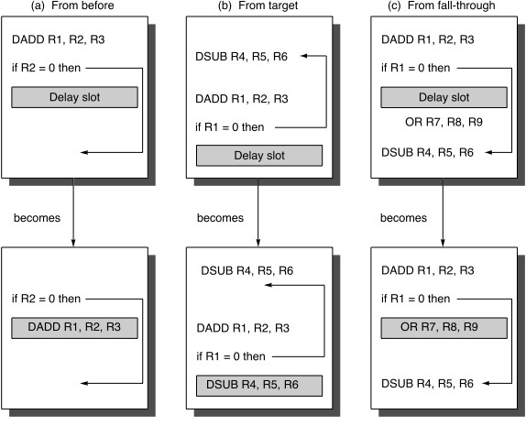
Strategies for filling delay slot

Slide 43
Control Hazards Summary
Arise from the pipelining of branches (and other instructions, like jumps, that change the PC).
Three mechanisms to deal with them:
Stop fetching until branch is resolved
flush instruction after branch and fetch correct one
Predict the outcome of the branch
only flush if we were wrong
simplest approach: “predict not taken” we will look at better ways later.
Delayed branch
require the compiler (or assembly programmer) to “fill delay slot”

Slide 44
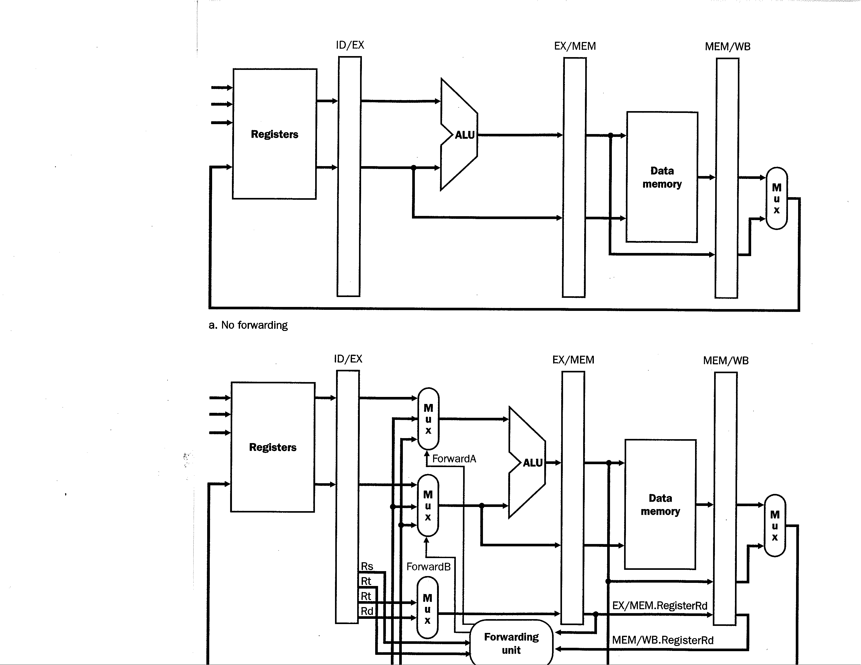
Implementing Forwarding
The figure below shows a basic pipelined processor (focusing on data flow) but with no forwarding

Slide 45
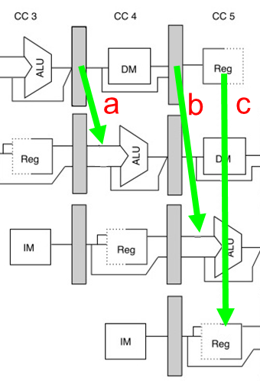
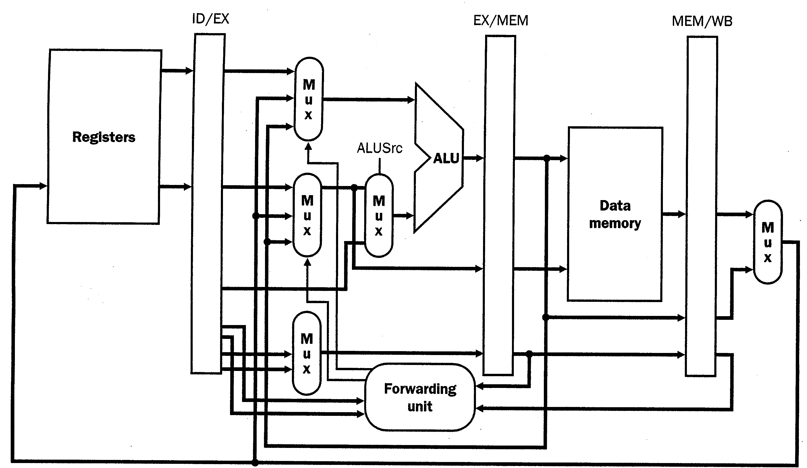
Implementing Forwarding
SgnExt(Imm16)
Rs
Rt
Rt
Rd
a
b
Forwarding paths often begin at output of pipeline register
(values forwarded at beginning of clock cycle)

Slide 46
Forwarding Example
DADD x1,x2,x3
Regs[x2]
Regs[x3]
Rs = 2
Rt = 3
Rt = 3
Rd = 1

Slide 47
Forwarding Example
DSUB x4,x1,x5
DADD x1,x2,x3
Regs[x1]
Regs[x2]
Regs[x5]
Regs[x3]
Rs = 1
2
Rt = 5
3
Rd = 1
Rt = 5
3
Rd = 4
1

Slide 48
Forwarding Example
AND x6,x7,x1
DSUB x4,x1,x5
DADD x1,x2,x3
Rs = 1
1
Rt = 7
5
4
1
Rt = 7
5
Rd = 6
4
1
1
5
Above: Forwarding unit compares the destination register specifier of DADD
instruction in EX/MEM to both source register specifiers of DSUB instruction
in ID/EX. Finds a match (Rs == Rd == 1), and thus enables forwarding mux.
Notes:
Some questions one might ask at this point:
1. What are all the possible combinations of instructions we need to consider? For example, what if DADD x1,x2,x3 were LD x1,0(x3)??
2. What other forwarding paths are required to reduce or minimize stalling due to RAW hazards for the classic 5-stage MIPS pipeline
3. How would you go about deciding where to put forwarding paths in a new design?

Slide 49
Forwarding Example
OR x8,x1,x9
AND x6,x7,x1
DSUB x4,x1,x5
DADD x1,...
Rs = 1
7
Rt = 9
1
6
4
1
Rt = 9
1
Rd = 8
6
4
7
1
1

Slide 50
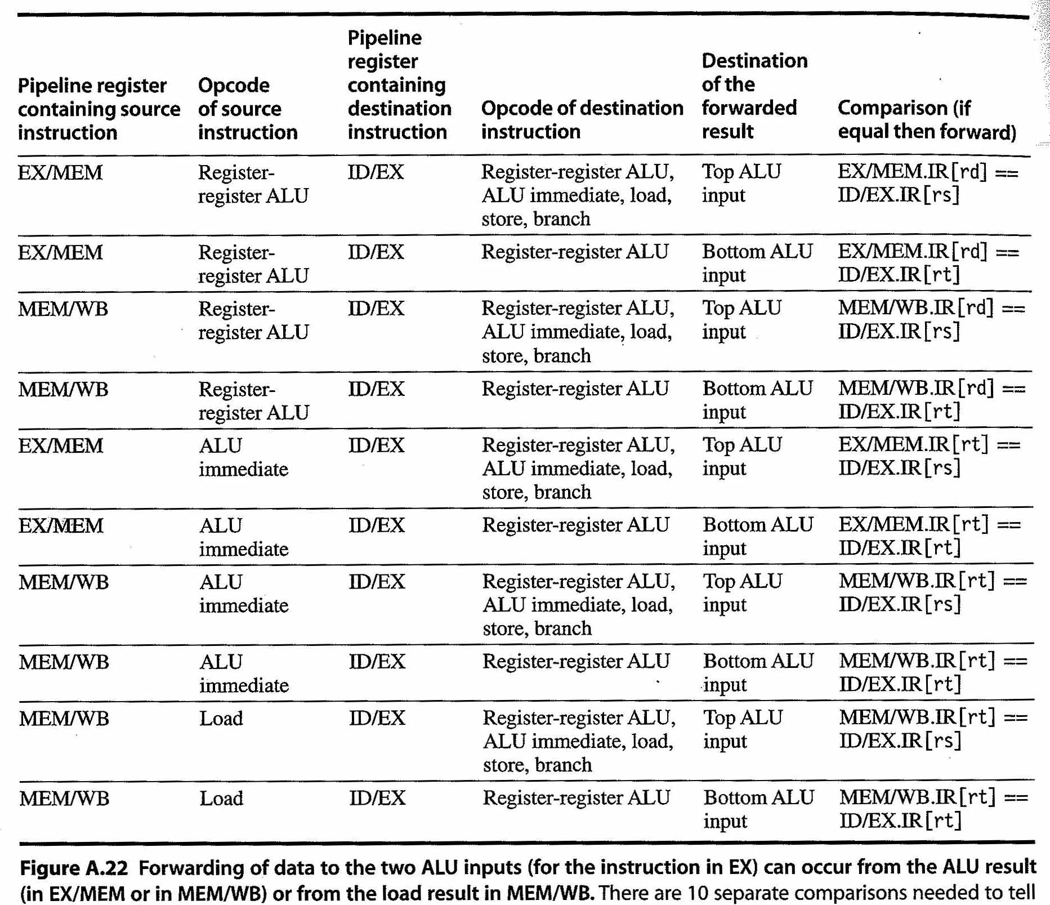
Forwarding Unit Logic
Let’s briefly consider the forwarding unit in a bit more detail.
This unit needs to check for data hazards between instructions in different stages of the pipeline and enable the forwarding muxes.
Fig A-22 in the textbook (partially shown below) lists all the combinations a hardware designer would need to consider for controlling multiplexers for “a” and “b”.

Slide 51
Where do Forwarding Paths go?
PC
To fully reduce or eliminate need for stalling: Add forwarding paths starting from “producer” stages (and later stages) to earlier “consumer” stages.
IF/ID
ID forwarding paths
(used if branches resolved in decode)
ID/EX
EX/MEM
ALU
forwarding
paths
MEM forwarding paths
MEM/WB
Example: “All forwarding paths required to reduce or eliminate stalls” if branches are resolved in decode

Slide 52
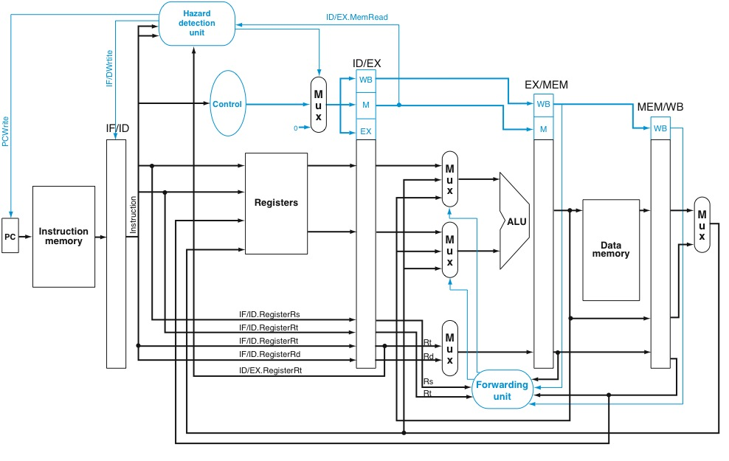
Stall Hardware: Hazard Detection Unit
NOP

Slide 53
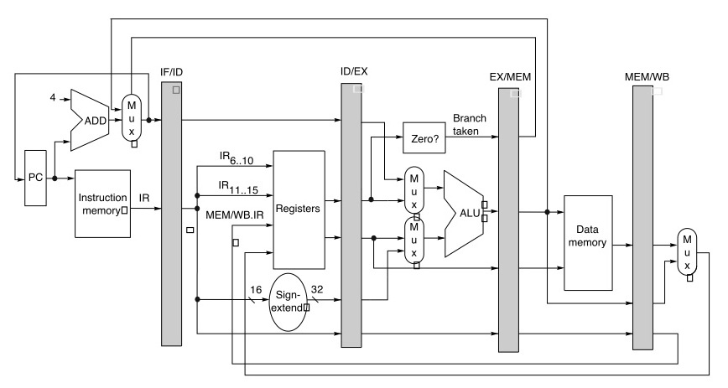
Resolving a Branch in Execute (EX)
EX
Check branch condition and compute target in execute stage. Update PC with correct target by end of cycle that branch enters execute stage. Fetch correct target following cycle.

Slide 54
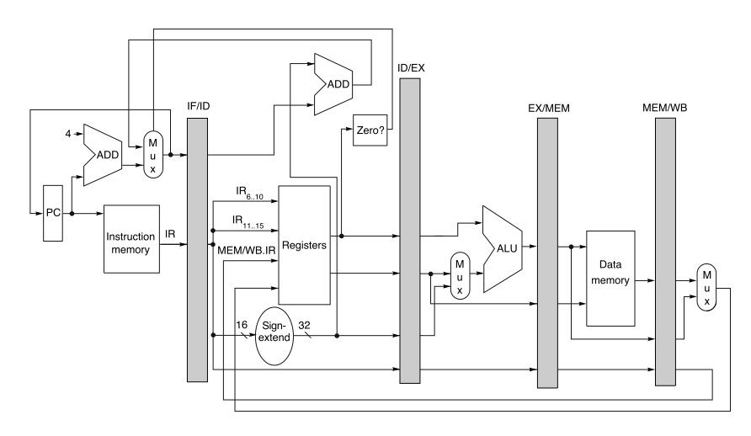
Resolving a Branch in Decode (ID)
ID
Check branch condition and compute target in decode stage. Update PC with correct target by end of cycle that branch enters decode stage. Fetch correct target following cycle.

Slide 55
Summary
pipelining
parallelism at sub-instruction level
hazards
structural
data
control
forwarding
paths and control

Slide 56
Summary of This Slide Set
In this slide set we learned about how to translate an instruction set architecture into a simple processor implementation.
Then, we saw how the performance of this implementation could be made faster by pipelining instruction execution.
We talked about the challenges of pipelining instruction execution, namely the three pipelining idealisms and hazards.
We also discussed ways to mitigate the effect of hazards.
In the next slide set, we are going to look at how pipelining is implemented in more detail. This will provide intuition that enables you to quickly and accurately analyze the performance characteristics of software executed on pipelined processors.

